Slide 1
Computer Networks II User Datagram Protocol
Amitangshu Pal
Computer Science and Engineering
IIT Kanpur

Slide 2
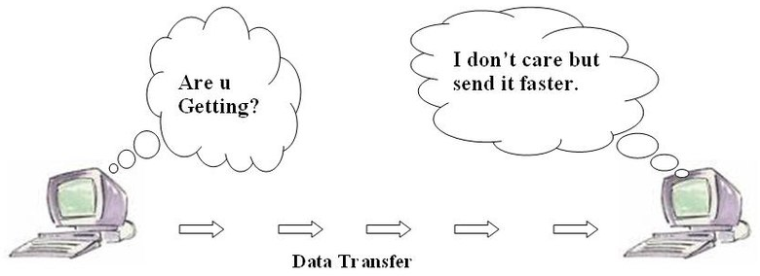
UDP: User Datagram Protocol
“No frills,” “bare bones” Internet transport protocol
“Best effort” service, UDP segments may be:
Lost, duplicated
Delivered out-of-order to app
Src: https://commons.wikimedia.org/wiki/File:Fig2_UDPwork.jpg
Connectionless:
No handshaking between UDP sender, receiver
Each UDP segment handled independently of others

Slide 3
UDP: User Datagram Protocol
Why is there a UDP?
UDP use:
Streaming multimedia apps (loss tolerant, rate sensitive)
DNS
DHCP
HTTP/3
If reliable transfer needed over UDP (e.g., HTTP/3):
Add needed reliability at application layer
Add congestion control at application layer
No connection establishment (which can add RTT delay)
Simple: no connection state at sender, receiver
Small header size
No congestion control
UDP can blast away as fast as desired!

Slide 4
UDP Segment Header
32 bits
Checksum covers UDP segment + IP pseudoheader
Optional in IPv4, compulsory in IPv6
ver
head.
len
type of
service
length
16-bit identifier
flgs
fragment
offset
time to
live
upper
layer
header
checksum
32 bits
32 bits
source IP address
source port #
dest port #
ver
pri
flow label
destination IP address
length
checksum
payload len
next hdr
hop limit
source address
(128 bits)
options (if any)
application
data
(payload)
length, in bytes of UDP segment, including header
destination address
(128 bits)
payload data
(variable length,
typically a TCP
or UDP segment)
data to/from application layer
payload (data)
UDP segment format
IPv6 datagram format
IPv4 datagram format
Info: https://www.packetmania.net/en/2021/12/26/IPv4-IPv6-checksum/

Slide 5
UDP Checksum
Suppose a segment consists of these bits:
1 1 1 0 0 1 1 0 0 1 1 0 0 1 1 0
1 1 0 1 0 1 0 1 0 1 0 1 0 1 0 1
1 1 1 0 0 1 1 0 0 1 1 0 0 1 1 0
1 1 1 0 0 1 1 0 0 1 1 0 0 1 1 0
1 1 0 1 0 1 0 1 0 1 0 1 0 1 0 1
1 1 0 1 0 1 0 1 0 1 0 1 0 1 0 1
wraparound
1 1 0 1 1 1 0 1 1 1 0 1 1 1 0 1 1
1 1 0 1 1 1 0 1 1 1 0 1 1 1 0 1 1
sum
1 0 1 1 1 0 1 1 1 0 1 1 1 1 0 0
1 0 1 1 1 0 1 1 1 0 1 1 1 1 0 0
checksum
0 1 0 0 0 1 0 0 0 1 0 0 0 0 1 1
0 1 0 0 0 1 0 0 0 1 0 0 0 0 1 1
sum
1 1 1 1 1 1 1 1 1 1 1 1 1 1 1 1
Transmitted bits:
1 1 1 0 0 1 1 0 0 1 1 0 0 1 1 0
1 1 0 1 0 1 0 1 0 1 0 1 0 1 0 1
0 1 0 0 0 1 0 0 0 1 0 0 0 0 1 1

Slide 6
UDP checksum
Goal: Detect errors (i.e., flipped bits) in transmitted segment
Sender:
Treat contents of UDP segment (including UDP header fields and IP addresses) as sequence of 16-bit integers
Checksum: addition (one’s complement sum) of segment content
Checksum value put into UDP checksum field
Receiver:
Compute the addition of the segment contents including the checksum
Check if computed sum equals to all 1’s:
Not all 1’s - error detected
All 1’s - no error detected. But maybe errors nonetheless?

Slide 7
UDP Checksum
Suppose a segment consists of these bits:
1 1 1 0 0 1 1 0 0 1 1 0 0 1 1 0
1 1 0 1 0 1 0 1 0 1 0 1 0 1 0 1
0 1
1 1 1 0 0 1 1 0 0 1 1 0 0 1 1 0
1 1 1 0 0 1 1 0 0 1 1 0 0 1 1 0
1 0
1 1 0 1 0 1 0 1 0 1 0 1 0 1 0 1
1 1 0 1 0 1 0 1 0 1 0 1 0 1 0 1
wraparound
1 1 0 1 1 1 0 1 1 1 0 1 1 1 0 1 1
1 1 0 1 1 1 0 1 1 1 0 1 1 1 0 1 1
sum
1 0 1 1 1 0 1 1 1 0 1 1 1 1 0 0
1 0 1 1 1 0 1 1 1 0 1 1 1 1 0 0
checksum
0 1 0 0 0 1 0 0 0 1 0 0 0 0 1 1
0 1 0 0 0 1 0 0 0 1 0 0 0 0 1 1
sum
1 1 1 1 1 1 1 1 1 1 1 1 1 1 1 1
Even though numbers have changed (bit flips), no change in checksum!

Slide 8
Summary: UDP
“No frills” protocol:
Segments may be lost, delivered out of order
Best effort service: “send and hope for the best”
UDP has its plusses:
No setup/handshaking needed (no RTT incurred)
Helps with reliability (checksum)
Build additional functionality on top of UDP in application layer (e.g., HTTP/3)

