Slide 1
Computer Networks TCP Connection Management
Amitangshu Pal
Computer Science and Engineering
IIT Kanpur

Slide 2
TCP Segment Structure
32 bits
Source port #
Dest port #
segment seq #: counting bytes of data into bytestream (not segments!)
ACK: seq # of next expected byte; A bit: this is an ACK
Sequence number
Acknowledgement number
length (of TCP header)
head
len
not
used
A
receive window
flow control: # bytes receiver willing to accept
C
P
S
E
R
F
U
Internet checksum
checksum
Urg data pointer
C, E: congestion notification
options (variable length)
TCP options
Application data
(variable length)
data sent by application into TCP socket
RST, SYN, FIN: connection management

Slide 3

TCP Connection Management
Before exchanging data, sender/receiver “handshake”:
Agree to establish connection (each knowing the other willing to establish connection)
Agree on connection parameters (e.g., starting seq #s)
application
application
connection state: ESTAB
connection variables:
seq # client-to-server
server-to-client
rcvBuffer size
at server,client
connection state: ESTAB
connection Variables:
seq # client-to-server
server-to-client
rcvBuffer size
at server,client
network
network
Notes:
The other TCP topic we’ll want to consider here is that of “connection management”
The TCP sender and reciver have a number of pieces of shared state that they must establish before actually communication
FIRST theym ust both agree that they WANT to communicate with each other
Secondly there are connection parameters – the initial sequence number and the initial receiver-advertised bufferspace that they’ll want to agree on
This is done via a so-called handshake protocol – the client reaching our to the server, and the server answering back.
And before diving into the TCP handshake protocol, let’s first consider the problem of handshaking, of establishing shared state.

Slide 4


Agreeing to Establish a Connection
2-way handshake:
Will 2-way handshake always work in network?
Variable delays
Retransmitted messages (e.g. req_conn(x)) due to message loss
Message reordering
Let’s talk
OK
ESTAB
ESTAB
choose x
req_conn(x)
acc_conn(x)
ESTAB
ESTAB
Notes:
Here’s an example of a two way handshake. Alice reaches out to Bob and say’s “let’s talk” and Bob says OK, and they start their conversation
For a network protocol, the equivalent protocol would be a client sending a “request connection” message saying ”let’s talk, the initial sequence number is x”
And the server would respond with a message ”I accept your connect x”
And the question we want to ask ourselves is <talk through>
Will this work? Let’s look at a few scenarios…

Slide 5


2-way Handshake Scenarios
choose x
req_conn(x)
choose x
req_conn(x)
ESTAB
choose x
req_conn(x)
ESTAB
retransmit
req_conn(x)
acc_conn(x)
ESTAB
retransmit
req_conn(x)
acc_conn(x)
acc_conn(x)
ESTAB
ESTAB
data(x+1)
accept
data(x+1)
ESTAB
data(x+1)
req_conn(x)
retransmit
data(x+1)
accept
data(x+1)
connection
x completes
ACK(x+1)
connection
x completes
server
forgets x
client terminates
server
forgets x
client terminates
connection
x completes
req_conn(x)
ESTAB
No problem!
ESTAB
data(x+1)
accept
data(x+1)
acc_conn(x)
Problem: half open connection! (no client)
Problem: dup data
accepted!

Slide 6
TCP 3-way Handshake
Client state
Server state
LISTEN
choose init seq num, x
send TCP SYN msg
SYNSENT
SYNbit=1, Seq=x
x and y are chosen randomly
choose init seq num, y
send TCP SYNACK
msg, acking SYN
SYN RCVD
SYNbit=1, Seq=y
ACKbit=1; ACKnum=x+1
received SYNACK(x)
indicates server is live;
send ACK for SYNACK;
this segment may contain
client-to-server data
ESTAB
ACKbit=1, ACKnum=y+1
received ACK(y)
indicates client is live
ESTAB
Notes:
TCP’s three way handshake, that operates as follows
Let’s say the client and server both create a TCP socket as we learned about in Chapter 2 and enter the LISTEN state
The client then connects to the server sending a SYN message with a sequence number x (SYN Message is an TCP Segment with SYN but set in the header – you might want to go back and review the TCP segment format!)
The server is waiting for a connection, and receives the SYN message enters the SYN received state (NOT the established state and sends a SYN ACK message back.
Finally the client sends an ACK message to the server, and when the server receiver this enters the ESTABLished state. This is when the application process would see the return from the wait on the socket accept() call

Slide 7
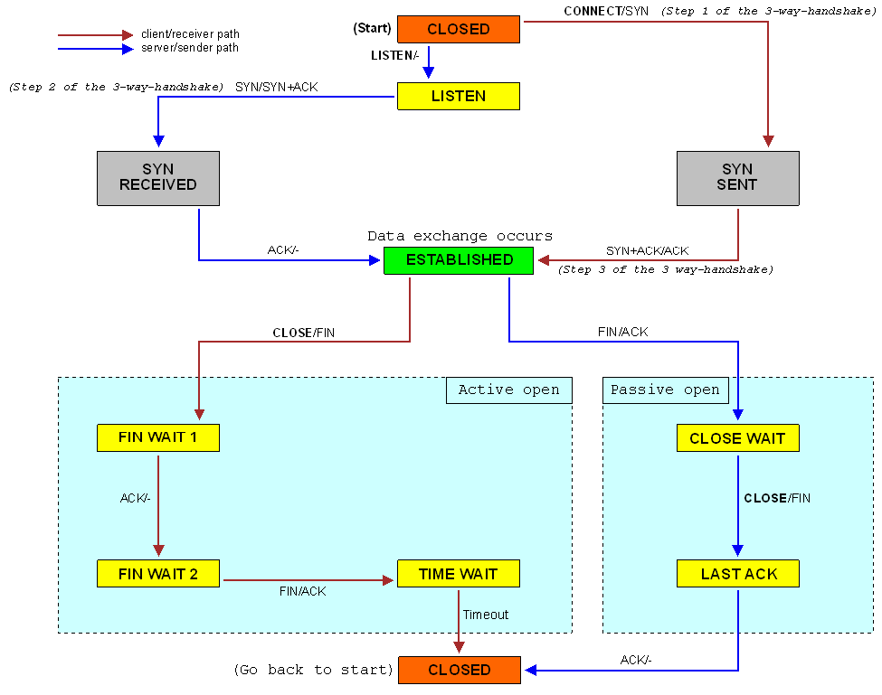
TCP State Diagram
Client state
Server state
LISTEN
SYNSENT
SYNbit=1, Seq=x
SYN RCVD
SYNbit=1, Seq=y
ACKbit=1; ACKnum=x+1
ESTAB
ACKbit=1, ACKnum=y+1
ESTAB
Src: https://en.wikipedia.org/wiki/File:Tcp_state_diagram.png
Notes:
All good things must come to an end, and that’s true for a TCP connection as well.
And of course there’s a protocol for one side to gracefully close of a TCP connection using a FIN message, to which the other side sends a FINACK message and waits around a bit to respond to any retransmitted FIN messages before timing out.

Slide 8
TCP 3-way Handshake
RST: Abort connection
Receiver is confused
Unexpected sequence number
Port number or IP address do not match with any ongoing sockets
choose x
req_conn(x)
choose x
SYN,Seq=x
ESTAB
SYN
RCVD
retransmit
req_conn(x)
acc_conn(x)
retransmit
SYN
SYNACK,
Seq=y,ACK=x+1
ESTAB
ESTAB
ACK, ACK=y+1
req_conn(x)
ESTAB
connection
x completes
connection
x completes
client terminates
server
forgets x
client terminates
server
forgets x
SYN,Seq=x
How it will solve the “half-open connection” problem?
ESTAB
SYN
RCVD
acc_conn(x)
SYNACK,
Seq=z,ACK=x+1
🤔
RST,ACK=z+1

Slide 9
TCP 3-way Handshake
RST: Abort connection
Receiver is confused
Unexpected sequence number
Port number or IP address do not match with any ongoing sockets
choose x
req_conn(x)
choose x
SYN,Seq=x
ESTAB
SYN
RCVD
retransmit
req_conn(x)
acc_conn(x)
retransmit
req_conn(x)
SYNACK,
Seq=y,ACK=x+1
ESTAB
data(x+1)
ESTAB
ACK,Seq=x+1,
ACK=y+1,DATA
ESTAB
accept
data(x+1)
accept
data(x+1)
retransmit
data(x+1)
retransmit
data(x+1)
connection
x completes
connection
x completes
client terminates
server
forgets x
client terminates
server
forgets x
req_conn(x)
SYN,Seq=x
How it will solve the “duplicate data accept” problem?
ESTAB
ACK,Seq=x+1,
ACK=y+1,DATA
SYN
RCVD
data(x+1)
accept
data(x+1)
🤔
SYNACK,
Seq=z,ACK=x+1
🤔
RST,ACK=z+1

Slide 10
Initial Sequence Number
Initial sequence numbers are chosen randomly
Why not 0?
Segments of different connections can get mixed up
Security issues when sequence numbers are predictable
choose x
choose x
SYN,Seq=x
SYN,Seq=x
SYN
RCVD
ESTAB
SYNACK,
Seq=y,ACK=x+1
retransmit
SYN
SYNACK,
Seq=y,ACK=x+1
retransmit
req_conn(x)
ESTAB
ESTAB
ACK,Seq=x+1,
ACK=y+1,DATA
ESTAB
ACK,
Seq=x+1.ACK=y+1
accept
data(x+1)
retransmit
data(x+1)
connection
x completes
connection
x completes
client terminates
server
forgets x
client terminates
server
forgets x
SYN,Seq=x
SYN,Seq=x
ACK,Seq=x+1,
ACK=y+1.DATA
SYN
RCVD
ESTAB
SYNACK,
Seq=z,ACK=x+1
🤔
🤔
SYNACK,
Seq=z,ACK=x+1
RST,ACK=z+1
🤔
RST,ACK=z+1

Slide 11
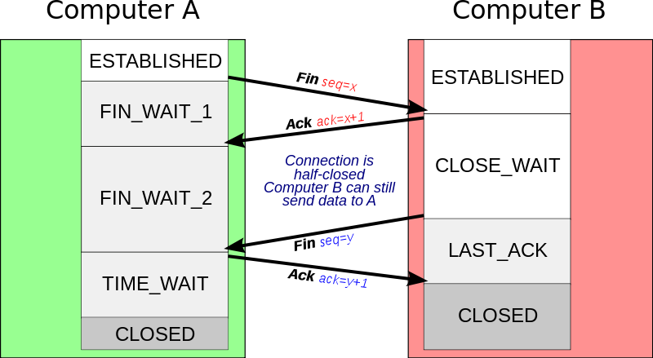
Closing a TCP Connection
Client, server each close their side of connection
Send TCP segment with FIN bit = 1
Respond to received FIN with ACK
On receiving FIN, ACK can be combined with own FIN
All resources on the client side (including port number) are released
Src: https://commons.wikimedia.org/wiki/File:Tcp_close.svg
Notes:
All good things must come to an end, and that’s true for a TCP connection as well.
And of course there’s a protocol for one side to gracefully close of a TCP connection using a FIN message, to which the other side sends a FINACK message and waits around a bit to respond to any retransmitted FIN messages before timing out.

Slide 12
Closing a TCP Connection
Symmetric connection termination
Both side should release separately
B may have some data to transmit
TIME_WAIT varies from 30 secs - 2 mins
Typically equal to 2 x Max time an IP datagram might live in the Internet
Final ACK may be lost
B may retransmit the FIN
A can resend final ACK in case it is lost
The second FIN may get delayed
Another pair of processes may open the connection (with same port numbers)
The delayed FIN may initiate an unwanted termination
Case-1:
Case-2:
Src: https://commons.wikimedia.org/wiki/File:Tcp_close.svg
Notes:
All good things must come to an end, and that’s true for a TCP connection as well.
And of course there’s a protocol for one side to gracefully close of a TCP connection using a FIN message, to which the other side sends a FINACK message and waits around a bit to respond to any retransmitted FIN messages before timing out.

Slide 13
TCP State Diagram
Src: https://commons.wikimedia.org/wiki/File:Tcp_close.svg
Src: https://en.wikipedia.org/wiki/File:Tcp_state_diagram.png
Notes:
All good things must come to an end, and that’s true for a TCP connection as well.
And of course there’s a protocol for one side to gracefully close of a TCP connection using a FIN message, to which the other side sends a FINACK message and waits around a bit to respond to any retransmitted FIN messages before timing out.

Slide 14
Summary
TCP connection management:
Connection setup → 3-way handshake
Connection termination → Symmetric release

