Slide 1
Computer Networks II Socket Programming
Amitangshu Pal
Computer Science and Engineering
IIT Kanpur

Slide 2

Socket programming
Goal: learn how to build client/server applications that communicate using sockets
Socket: door between application process and end-end-transport protocol
application
socket
application
controlled by
app developer
process
process
transport
transport
network
network
controlled
by OS
link
Internet
link
physical
physical

Slide 3
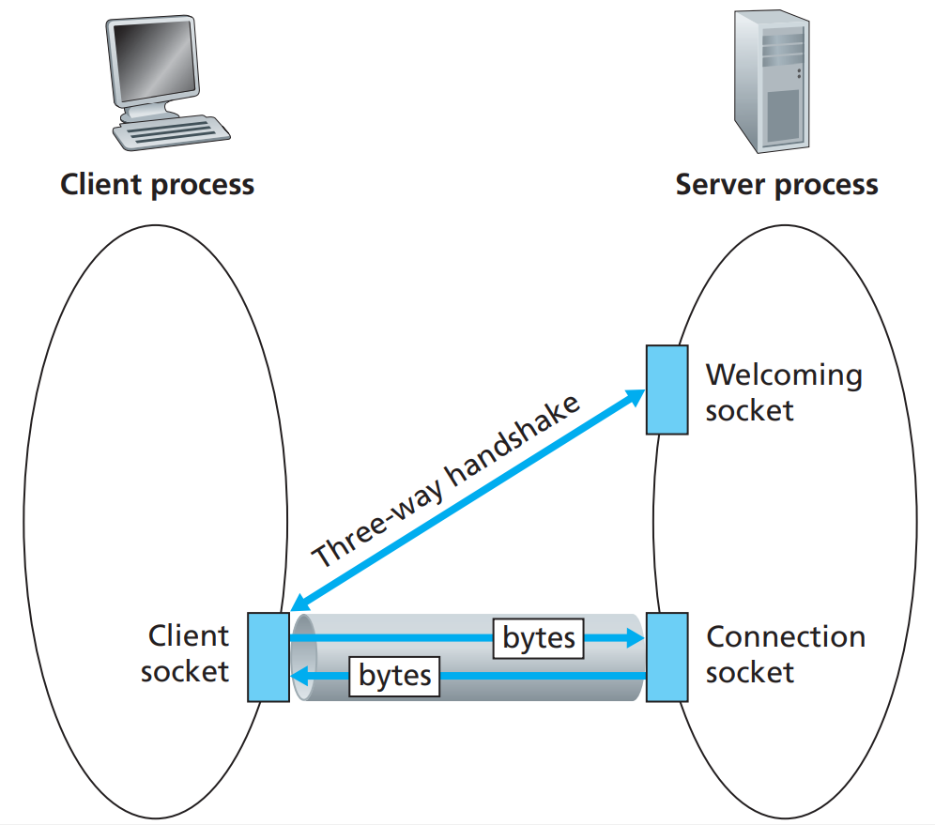
Client/server socket interaction: TCP

Slide 4
Client/server socket interaction: TCP
server (running on hostid)
client
create socket,
port=x, for incoming request:
serverSocket = socket()
wait for incoming
connection request
TCP
connection setup
create socket,
connect to hostid, port=x
connectionSocket =
serverSocket.accept()
clientSocket = socket()
send request using
clientSocket
read request from
connectionSocket
write reply to
connectionSocket
read reply from
clientSocket
close
connectionSocket
close
clientSocket

Slide 5
Client/server socket interaction: UDP
server (running on serverIP)
client
create socket:
create socket, port= x:
clientSocket =
socket(AF_INET,SOCK_DGRAM)
serverSocket =
socket(AF_INET,SOCK_DGRAM)
Create datagram with server IP and
port=x; send datagram via clientSocket
read datagram from
serverSocket
write reply to
serverSocket
specifying client address,
port number
read datagram from
clientSocket
close
clientSocket

