Slide 1
Computer Networks TCP Congestion and Flow Control
Amitangshu Pal
Computer Science and Engineering
IIT Kanpur

Slide 2
TCP Congestion Control

Slide 3
Challenges of Congestion Control
End-end congestion control:
Routers have input/output queue
These queues get filled up → leads to congestion
TCP: prevent such congestion
What the sender can do?
Tune the sending rate → window size
switch
fabric

Slide 4

Challenges of Congestion Control
End-end congestion control:
no explicit feedback from network
congestion inferred from observed loss, delay
ACKs
Data
Data
ACKs
approach taken by TCP

Slide 5
TCP congestion control: details
sender sequence number space
TCP sending behavior:
roughly: send cwnd bytes, wait RTT for ACKS, then send more bytes
cwnd
last byte
ACKed
TCP rate
cwnd
sent, but not-yet ACKed
(“in-flight”)
available but not used
~
bytes/sec
~
RTT
last byte sent
TCP sender limits transmission:
cwnd is dynamically adjusted in response to observed network congestion (implementing TCP congestion control)
<
cwnd
LastByteSent- LastByteAcked

Slide 6
TCP congestion control: AIMD
approach: senders can increase sending rate until packet loss (congestion) occurs, then decrease sending rate on loss event
Additive Increase
Multiplicative Decrease
increase sending rate by 1 maximum segment size every RTT until loss detected
cut sending rate in half at each loss event
AIMD sawtooth
behavior: probing
for bandwidth
TCP sender Sending rate
time

Slide 7
TCP slow start
Host A
Host B
when connection begins, increase rate exponentially until first loss event:
initially cwnd = 1 MSS
double cwnd every RTT
done by incrementing cwnd for every ACK received
one segment
RTT
two segments
four segments
summary: initial rate is slow, but ramps up exponentially fast
time

Slide 8

TCP Tahoe: Slow start followed by additive increase
X

Slide 9
TCP Tahoe: Slow start followed by additive increase
.
new ACK
new ACK
cwnd = cwnd + MSS (MSS/cwnd)
transmit new segment(s), as allowed
cwnd = cwnd+MSS
transmit new segment(s), as allowed
L
cwnd = 1 MSS
ssthresh = 64 KB
slow
start
cwnd > ssthresh
L
congestion
avoidance
Timeout or 3 Duplicate ACK
ssthresh = cwnd/2
cwnd = 1 MSS
retransmit missing segment
timeout
ssthresh = cwnd/2
cwnd = 1 MSS
retransmit missing segment

Slide 10
TCP Reno: TCP Tahoe + Fast recovery
.
duplicate ACK
new ACK
dupACKcount++
new ACK
cwnd = cwnd + MSS (MSS/cwnd)
dupACKcount = 0
transmit new segment(s), as allowed
cwnd = cwnd+MSS
dupACKcount = 0
transmit new segment(s), as allowed
L
cwnd = 1 MSS
ssthresh = 64 KB
dupACKcount = 0
slow
start
cwnd > ssthresh
L
congestion
avoidance
timeout
ssthresh = cwnd/2
cwnd = 1 MSS
dupACKcount = 0
retransmit missing segment
duplicate ACK
timeout
dupACKcount++
ssthresh = cwnd/2
cwnd = 1 MSS
dupACKcount = 0
retransmit missing segment
timeout
ssthresh = cwnd/2
cwnd = 1
dupACKcount = 0
retransmit missing segment
New ACK
dupACKcount == 3
cwnd = ssthresh
dupACKcount = 0
dupACKcount == 3
ssthresh= cwnd/2
cwnd = ssthresh + 3
retransmit missing segment
ssthresh= cwnd/2
cwnd = ssthresh + 3
retransmit missing segment
fast
recovery
duplicate ACK
cwnd = cwnd + MSS
transmit new segment(s), as allowed

Slide 11
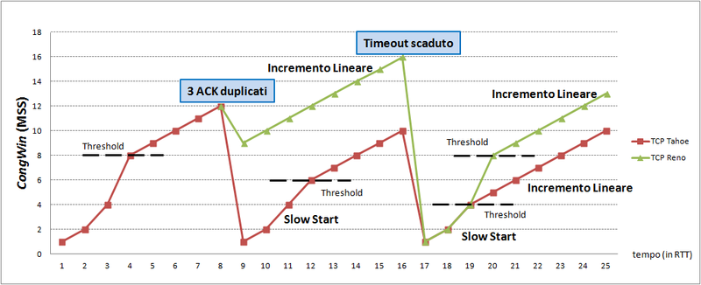
TCP Reno vs TCP Tahoe
Src: https://commons.wikimedia.org/wiki/File:CongWin_in_TCP_Tahoe_e_Reno.png

Slide 12
TCP throughput
Avg. TCP throughput as function of window size, RTT?
ignore slow start, assume always data to send
W: window size (measured in bytes) where loss occurs
avg. window size (# in-flight bytes) is ¾ W
avg. throughput is 3/4W per RTT
avg TCP throughput =
3
W
4
RTT
bytes/sec
W
W/2

Slide 13
Other Variants

Slide 14
TCP CUBIC
Is there a better way than AIMD to “probe” for usable bandwidth?
Insight/intuition:
W_{max}: sending rate at which congestion loss was detected
congestion state of bottleneck link probably (?) hasn’t changed much
after cutting rate/window in half on loss, initially ramp to to W_{max} faster, but then approach W_{max} more slowly
W_{max}
classic TCP
TCP CUBIC - higher throughput in this example
W_{max}/2

Slide 15
TCP CUBIC
Is there a better way than AIMD to “probe” for usable bandwidth?
Insight/intuition:
W_{max}: sending rate at which congestion loss was detected
congestion state of bottleneck link probably (?) hasn’t changed much
after cutting rate/window in half on loss, initially ramp to to W_{max} faster, but then approach W_{max} more slowly
TCP CUBIC default in Linux, most popular TCP for popular Web servers
W_{max}
TCP Reno
TCP CUBIC
TCP
sending
rate
time
t₀
t₁
t₂
t₃
t₄

Slide 16
Explicit congestion notification (ECN)
TCP deployments often implement network-assisted congestion control:
two bits in IP header (ToS field) marked by network router to indicate congestion
policy to determine marking chosen by network operator
congestion indication carried to destination
destination sets ECE bit on ACK segment to notify sender of congestion
involves both IP (IP header ECN bit marking) and TCP (TCP header C,E bit marking)
source
TCP ACK segment
destination
application
TCP
network
link
physical
ECE=1
application
TCP
network
link
physical
ECN=10
ECN=11
IP datagram

Slide 17
Explicit congestion notification (ECN)
32 bits
“type” of service:
diffserv (0:5)
ECN (6:7)
32 bits
ver
head.
len
type of
service
length
Source port #
Dest port #
16-bit identifier
flgs
fragment
offset
Sequence number
time to
live
upper
layer
header
checksum
Acknowledgement number
C, E:
congestion notification
head
len
not
used
A
receive window
C
P
E
S
U
R
F
source IP address
checksum
Urg data pointer
destination IP address
options (variable length)
options (if any)
payload data
(variable length,
typically a TCP
or UDP segment)
Application data
(variable length)

Slide 18
DCTCP: Two Key Ideas
React in proportion to the extent of congestion, not its presence.
Reduces variance in sending rates, lowering queuing requirements.
Mark based on instantaneous queue length.
Fast feedback to better deal with bursts.
ECN Marks | TCP | DCTCP
1 0 1 1 1 1 0 1 1 1 | Cut window by 50% | Cut window by 40%
0 0 0 0 0 0 0 0 0 1 | Cut window by 50% | Cut window by 5%
K
Mark

Slide 19
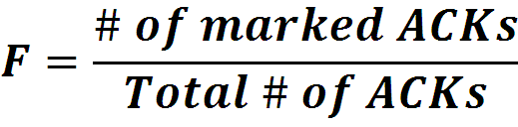

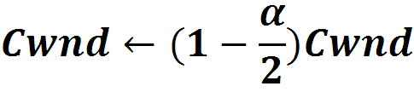
Data Center TCP Algorithm
Switch side:
Mark packets when Queue Length > K
K
Don’t
Mark
Mark
Sender side:
Maintain running average of fraction of packets marked (α).
In each RTT:
Adaptive window decreases:
Notes:
very simple marking mechanism
not all the tunings other aqms have
on the source side, the source is tryign to estimate the fraction of packets getting marked
using the obs that there is a stream of ecn marks coming back – more info in the stream than in any single bit
trying to maintain smooth rate variations to operate well even when using shallow buffers, and only a few flows (no stat mux)
F over the last RTT. In TCP there is always a way to get the next RTT from the window size. Comes from the self-clocking of TCP.
Only changing the decrease. Simplest version – makes a lot of sense. So generic could apply it to any algorithm – CTCP, CUBIC – how to cut its window leaving increase part to what it already does. Have to be careful here.

Slide 20
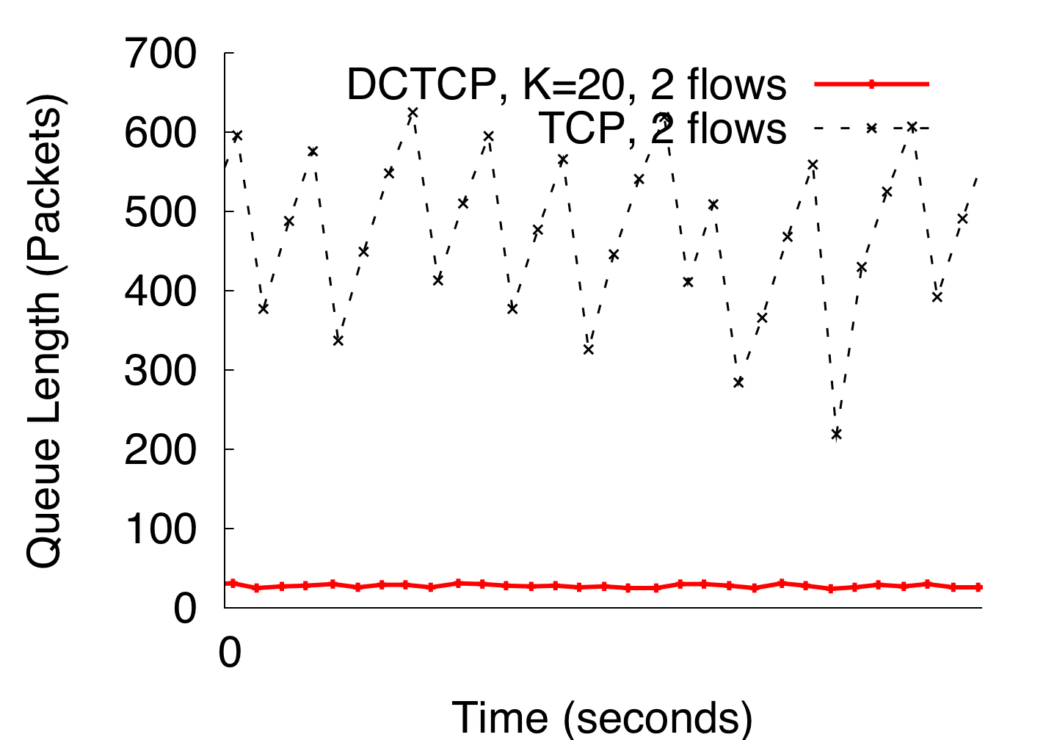
DCTCP in Action
(Kbytes)
Setup: Win 7, Broadcom 1Gbps Switch
Scenario: 2 long-lived flows, K = 30KB
Notes:
Not ns2.

Slide 21
RTO Calculation

Slide 22
TCP round trip time, timeout
Q: how to set TCP timeout value?
longer than RTT, but RTT varies!
too short: premature timeout, unnecessary retransmissions
too long: slow reaction to segment loss
Q: how to estimate RTT?
SampleRTT:measured time from segment transmission until ACK receipt
ignore retransmissions
SampleRTT will vary, want estimated RTT “smoother”
average several recent measurements, not just current SampleRTT

Slide 23
TCP round trip time, timeout
EstimatedRTT = (1- α)*EstimatedRTT + α*SampleRTT
exponential weighted moving average (EWMA)
influence of past sample decreases exponentially fast
typical value: α = 0.125
RTT: gaia.cs.umass.edu to fantasia.eurecom.fr
RTT (milliseconds)
sampleRTT
EstimatedRTT
time (seconds)
Notes:
This is how TCP re-computes the estimated RTT each time a new SampleRTT is taken.
The process is knows as an exponeitally weighted moving average, shown by the equation here.
<say it>
Where alpha reflects the influence of the most recent measurements on the estimated RTT; a typical value of alpha used in implementaitons is .125
The graph at the bottom show measured RTTs beween a host in the Massachusetts and a host in France, as well as the estimated, “smoothed” RTT

Slide 24

TCP round trip time, timeout
DevRTT: EWMA of SampleRTT deviation from EstimatedRTT:
DevRTT = (1-β)*DevRTT + β*|SampleRTT-EstimatedRTT|
(typically, β = 0.25)
timeout interval: EstimatedRTT plus “safety margin”
large variation in EstimatedRTT: want a larger safety margin
TimeoutInterval = EstimatedRTT + 4*DevRTT
estimated RTT
“safety margin”
More reading: http://research.protocollabs.com/captcp/doc-socket-statistic-module.html
Notes:
Given this value of the estimated RTT, TCP computes the timeout interval to be the estimated RTT plus a “safety margin”
And the intuition is that if we are seeing a large variation in SAMPLERTT – the RTT estimates are fluctuating a lot - then we’ll want a larger savety margin
So TCP computes the Timeout interval to be the Estimated RTT plus 4 times a measure of deviation in the RTT.
The deviation in the RTT is computed as the eWMA of the difference between the most recently measured SampleRTT from the Estimated RTT

Slide 25
TCP Fairness

Slide 26
TCP fairness
Fairness goal: if K TCP sessions share same bottleneck link of bandwidth R, each should have average rate of R/K
TCP connection 1
bottleneck
router
capacity R
TCP connection 2

Slide 27
Is TCP Fair?
Example: two competing TCP sessions:
additive increase gives slope of 1, as throughout increases
multiplicative decrease decreases throughput proportionally
R
equal bandwidth share
Is TCP fair?
A: Yes, under idealized assumptions:
same RTT
fixed number of sessions only in congestion avoidance
loss: decrease window by factor of 2
congestion avoidance: additive increase
Connection 2 throughput
loss: decrease window by factor of 2
congestion avoidance: additive increase
Connection 1 throughput
R

Slide 28
TCP Flow Control

Slide 29
TCP flow control
application
process
Q: What happens if network layer delivers data faster than application layer removes data from socket buffers?
Application removing data from TCP socket buffers
TCP socket
receiver buffers
flow control
TCP
code
receiver controls sender, so sender won’t overflow receiver’s buffer by transmitting too much, too fast
IP
code
from sender
receiver protocol stack
Notes:
(Presuming an intro)
Before diving into the details of TCP flow control, let’s first get the general context and motivate the need for flow control.
This diagram show a typical transport-layer implementation
A segment is brought up the protocol stack to the transport layer, and the segment’s payload is removed from the segment and written INTO socket buffers.
How does data get taken OUT of socket buffers? By applications performing socket reads, as we learned in Chapter 2.
And so the question is “What happens if network layer delivers data faster than an application-layer process removes data from socket buffers?”
Let’s watch a video of what happens when things arrive way too fast to fast to be processed.
<video>. (I love that video). Another human analogy showing the need for flow control is the saying – to use some English slang - “no one can drink from a firehose”
Flow control is a mechanism to the calamity of a receiver being over-run by a sender that is sending too fast – it allows the RECEIVER to explictly control the SENDER so sender won’t overflow receiver’s buffer by transmitting too much, too fast

Slide 30
TCP flow control
TCP receiver “advertises” free buffer space in rwnd field in TCP header
RcvBuffer size set via socket options (typical default is 4096 bytes)
many operating systems autoadjust RcvBuffer
sender limits amount of unACKed (“in-flight”) data to received rwnd
guarantees receive buffer will not overflow
to application process
RcvBuffer
buffered data
rwnd
free buffer space
TCP segment payloads
TCP receiver-side buffering
Notes:
Here’s how TCP implement flow control. The basic idea is simple – the receiver informs the sender how much free buffer space there is, and the sender is limited to send no more than this amount of data. That the value o RWND in the diagram to the right.
This information is carried from the receiver to the sender in the “receiver advertised window” (do a PIP of header) in the TCP header, and the value will change as the amount of free buffer space fluctuates over time.

Slide 31
TCP flow control
flow control: # bytes receiver willing to accept
TCP receiver “advertises” free buffer space in rwnd field in TCP header
RcvBuffer size set via socket options (typical default is 4096 bytes)
many operating systems autoadjust RcvBuffer
sender limits amount of unACKed (“in-flight”) data to received rwnd
guarantees receive buffer will not overflow
receive window
TCP segment format
Notes:
Here’s how TCP implement flow control. The basic idea is simple – the receiver informs the sender how much free buffer space there is, and the sender is limited to send no more than this amount of data. That the value o RWND in the diagram to the right.
This information is carried from the receiver to the sender in the “receiver advertised window” (do a PIP of header) in the TCP header, and the value will change as the amount of free buffer space fluctuates over time.

