Slide 1
Computer Networks
Application Layer
Amitangshu Pal
Computer Science and Engineering
IIT Kanpur

Slide 2

















Creating a network app
application
transport
network
data link
physical
write programs that:
run on (different) end systems
communicate over network
e.g., web server software communicates with browser software
no need to write software for network-core devices
network-core devices do not run user applications
applications on end systems allows for rapid app development, propagation
application
transport
network
data link
physical
application
transport
network
data link
physical

Slide 3
Application architectures
possible structure of applications:
client-server
peer-to-peer (P2P)

Slide 4
Client-server architecture
server:
always-on host
permanent IP address
data centers for scaling
clients:
communicate with server
may be intermittently connected
may have dynamic IP addresses
do not communicate directly with each other
client/server

Slide 5
P2P architecture
peer-peer
no always-on server
arbitrary end systems directly communicate
peers request service from other peers, provide service in return to other peers
  self scalability – new peers bring new service capacity, as well as new service demands
peers are intermittently connected and change IP addresses
  complex management

Slide 6
Internet apps: types and requirements
application
file transfer
e-mail
Web documents
real-time audio/video
stored audio/video
interactive games
text messaging
data loss
no loss
no loss
no loss
loss-tolerant
loss-tolerant
loss-tolerant
no loss
throughput
elastic
elastic
elastic
audio: 5kbps-1Mbps
video:10kbps-5Mbps
same as above
few kbps up
elastic
time sensitive
no
no
no
yes, 100’s msec
yes, few secs
yes, 100’s msec
yes and no

Slide 7
Internet apps: application, transport protocols
application
layer protocol
SMTP [RFC 2821]
Telnet [RFC 854]
HTTP [RFC 2616]
FTP [RFC 959]
HTTP (e.g., YouTube),
RTP [RFC 1889]
SIP, RTP, proprietary
(e.g., Skype)
underlying
transport protocol
TCP
TCP
TCP
TCP
TCP or UDP
TCP or UDP
application
e-mail
remote terminal access
Web
file transfer
streaming multimedia
Internet telephony

Slide 8
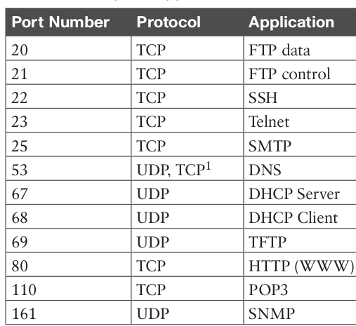
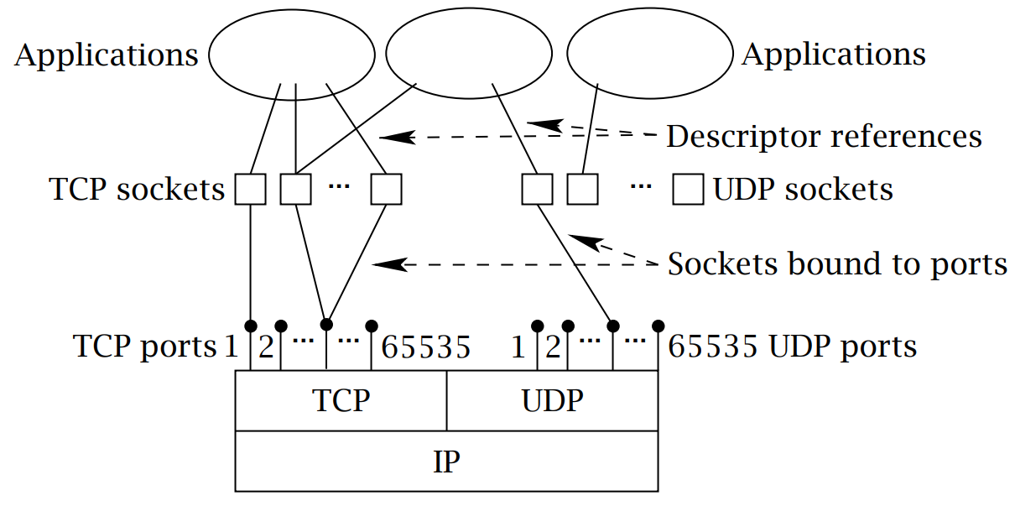
Internet apps: common port numbers
Src: https://linuxwheel.com/chapter-5-fundamentals-of-tcp-ip-transport-and-application/

Slide 9
DNS

Slide 10
DNS: domain name system
Domain Name System:
distributed database implemented in hierarchy of many name servers
application-layer protocol: hosts, name servers communicate to resolve names (address/name translation)
Host Aliasing:
Many names may map to same IP address
Internet hosts, routers:
  IP address (32 bit) - used for addressing datagrams
  “name”, e.g., www.yahoo.com - used by humans
DNS services
hostname to IP address translation

Slide 11
DNS: a distributed, hierarchical database
Root DNS Servers
Root
…
…
.com DNS servers
.org DNS servers
.edu DNS servers
Top Level Domain
…
…
…
…
yahoo.com
DNS servers
amazon.com
DNS servers
pbs.org
DNS servers
nyu.edu
DNS servers
umass.edu
DNS servers
Authoritative
client wants IP for www.amazon.com:
client queries root server to find com DNS server
client queries .com DNS server to get amazon.com DNS server
client queries amazon.com DNS server to get IP address for www.amazon.com

Slide 12
DNS: root name servers
contacted by local name server that can not resolve name
root name server:
  contacts authoritative name server if name mapping not known
  gets mapping
  returns mapping to local name server
  ICANN (Internet Corporation for Assigned Names and Numbers) manages root DNS domain

Slide 13

DNS: root name servers
13 logical root name “servers” worldwide
each “server” replicated many times
c. Cogent, Herndon, VA (5 other sites)
d. U Maryland College Park, MD
h. ARL Aberdeen, MD
j. Verisign, Dulles VA (69 other sites )
k. RIPE London (17 other sites)
i. Netnod, Stockholm (37 other sites)
e. NASA Mt View, CA
f. Internet Software C.
Palo Alto, CA (and 48 other sites)
m. WIDE Tokyo
(5 other sites)
a. Verisign, Los Angeles CA
(5 other sites)
b. USC-ISI Marina del Rey, CA
l. ICANN Los Angeles, CA
(41 other sites)
g. US DoD Columbus, OH (5 other sites)

Slide 14

TLD, authoritative servers
top-level domain (TLD) servers:
  responsible for com, org, net, edu, aero, jobs, museums, and all top-level country domains, e.g.: uk, fr, ca, jp
  Network Solutions maintains servers for .com TLD
  Educause for .edu TLD
authoritative DNS servers:
  organization’s own DNS server(s), providing authoritative hostname to IP mappings for organization’s named hosts
  can be maintained by organization or service provider

Slide 15
Local DNS name server
does not strictly belong to hierarchy
each ISP (residential ISP, company, university) has one
  also called “default name server”
when host makes DNS query, query is sent to its local DNS server
  has local cache of recent name-to-address translation pairs (but may be out of date!)
  acts as proxy, forwards query into hierarchy

Slide 16

DNS name resolution example
root DNS server
2
3
TLD DNS server
iterated query:
contacted server replies with name of server to contact
“I don’t know this name, but ask this server”
4
5
local DNS server
7
6
1
8
authoritative DNS server
requesting host

Slide 17
DNS name
resolution example
root DNS server
2
3
7
recursive query:
puts burden of name resolution on contacted name server
heavy load at upper levels of hierarchy?
6
TLD DNS
server
local DNS server
5
4
1
8
authoritative DNS server
requesting host

Slide 18
DNS: caching, updating records
once (any) name server learns mapping, it caches mapping
  cache entries timeout (disappear) after some time (TTL)
  TLD servers typically cached in local name servers
    thus root name servers not often visited

Slide 19
DNS: distributed database storing resource records (RR)
RR format: (name, value, type, ttl)
type=A
  name is hostname
  value is IP address
type=CNAME
  name is alias name for some “canonical” (the real) name
  www.ibm.com is really servereast.backup2.ibm.com
  value is canonical name
type=NS
  name is domain (e.g., foo.com)
  value is hostname of authoritative name server for this domain
type=MX
  value is name of SMTP mail server associated with name

Slide 20
DNS query and reply messages, both have same format:
2 bytes
2 bytes
message header:
identification: 16 bit # for query, reply to query uses same #
flags:
  query or reply
  recursion desired
  recursion available
  reply is authoritative
identification
flags
# questions
# answer RRs
# authority RRs
# additional RRs
questions (variable # of questions)
answers (variable # of RRs)
authority (variable # of RRs)
additional info (variable # of RRs)

Slide 21
DNS query and reply messages, both have same format:
2 bytes
2 bytes
identification
flags
# questions
# answer RRs
# authority RRs
# additional RRs
name, type fields for a query
questions (variable # of questions)
RRs in response to query
answers (variable # of RRs)
records for authoritative servers
authority (variable # of RRs)
additional “ helpful” info that may be used
additional info (variable # of RRs)

Slide 22
Web and HTTP

Slide 23
Web and HTTP
First, a review…
web page consists of objects
object can be HTML file, JPEG image, Java applet, audio file,…
web page consists of base HTML-file which includes several referenced objects
each object is addressable by a URL, e.g.,
http://en.Wikipedia.ord/somePage/pic.gif
Protocol
Server
Page on server

Slide 24

HTTP overview
HTTP: hypertext transfer protocol
Web’s application layer protocol
client/server model
  client: browser that requests, receives, (using HTTP protocol) and “displays” Web objects
  server: Web server sends (using HTTP protocol) objects in response to requests
HTTP request
PC running
Firefox browser
HTTP response
HTTP request
server
running
Apache Web
server
HTTP response
iPhone running
Safari browser

Slide 25
HTTP overview
uses TCP:
Client resolves server to IP address (DNS)
client initiates TCP connection (creates socket) to server, port 80
server accepts TCP connection from client
HTTP messages (application-layer protocol messages) exchanged between browser (HTTP client) and Web server (HTTP server)
TCP connection closed
HTTP is “stateless”
server maintains no information about past client requests

Slide 26
HTTP request message
two types of HTTP messages: request, response
carriage return character
request line (GET, POST,
HEAD commands)
line-feed character
GET /index.html HTTP/1.1\r\n
Host: www-net.cs.umass.edu\r\n
User-Agent: Mozilla/5.0 (Macintosh; Intel Mac OS X 10.15; rv:80.0) Gecko/20100101 Firefox/80.0 \r\n
Accept: text/html,application/xhtml+xml\r\n
Accept-Language: en-us,en;q=0.5\r\n
Accept-Encoding: gzip,deflate\r\n
Connection: keep-alive\r\n
\r\n
header
lines
carriage return, line feed at start of line indicates end of header lines

Slide 27
HTTP response message
status line (protocol
status code status phrase)
HTTP/1.1 200 OK
Date: Tue, 08 Sep 2020 00:53:20 GMT
Server: Apache/2.4.6 (CentOS) OpenSSL/1.0.2k-fips PHP/7.4.9 mod_perl/2.0.11 Perl/v5.16.3
Last-Modified: Tue, 01 Mar 2016 18:57:50 GMT
ETag: "a5b-52d015789ee9e"
Accept-Ranges: bytes
Content-Length: 2651
Content-Type: text/html; charset=UTF-8
\r\n
data data data data data ...
header
lines
data, e.g., requested
HTML file

Slide 28
HTTP response status codes
status code appears in 1st line in server-to-client response message.
some sample codes:
200 OK
  request succeeded, requested object later in this message
301 Moved Permanently
  requested object moved, new location specified later in this message (in Location: field)
400 Bad Request
  request msg not understood by server
404 Not Found
  requested document not found on this server
505 HTTP Version Not Supported

Slide 29
Non-persistent HTTP (HTTP 1.0)
non-persistent HTTP
at most one object sent over TCP connection
  connection then closed
downloading multiple objects required multiple connections
non-persistent HTTP issues:
requires 2 RTTs per object
OS overhead for each TCP connection
browsers often open parallel TCP connections to fetch referenced objects

Slide 30
Non-persistent HTTP (HTTP 1.0): response time
HTTP response time:
one RTT to initiate TCP connection
one RTT for HTTP request and first few bytes of HTTP response to return
file transmission time
non-persistent HTTP response time =
  2RTT+ file transmission time
initiate TCP
connection
RTT
request
file
RTT
time to
transmit
file
file
received
time
time

Slide 31
Persistent HTTP (HTTP 1.1)
persistent HTTP:
server leaves connection open after sending response
subsequent HTTP messages between same client/server sent over open connection
client sends requests as soon as it encounters a referenced object
persistent HTTP
multiple objects can be sent over single TCP connection between client, server

Slide 32
HTTP with (a) multiple connections and sequential requests. (b) A persistent connection and sequential requests.
(c) A persistent connection and pipelined requests.

Slide 33
HTTP/2
Key goal: decreased delay in multi-object HTTP requests
HTTP1.1: introduced multiple, pipelined GETs over single TCP connection
server responds in-order (FCFS: first-come-first-served scheduling) to GET requests
with FCFS, small object may have to wait for transmission (head-of-line (HOL) blocking) behind large object(s)
loss recovery (retransmitting lost TCP segments) stalls object transmission
Notes:
t’

Slide 34
HTTP/2
Key goal: decreased delay in multi-object HTTP requests
HTTP/2: [RFC 7540, 2015] increased flexibility at server in sending objects to client:
methods, status codes, most header fields unchanged from HTTP 1.1
transmission order of requested objects based on client-specified object priority (not necessarily FCFS)
divide objects into frames, schedule frames to mitigate HOL blocking
Notes:
t’

Slide 35
HTTP/2: mitigating HOL blocking
HTTP 1.1: client requests 1 large object (e.g., video file) and 3 smaller objects
server
GET O₄
GET O₃
GET O₂
GET O₁
object data requested
client
O₁
O₂
O₁
O₃
O₂
O₃
O₄
O₄
objects delivered in order requested: O₂, O₃, O₄ wait behind O₁
Notes:
t’

Slide 36
HTTP/2: mitigating HOL blocking
HTTP/2: objects divided into frames, frame transmission interleaved
server
GET O₄
GET O₃
GET O₂
GET O₁
object data requested
client
O₂
O₄
O₃
O₁
O₂
O₃
O₄
O₁
O₂, O₃, O₄ delivered quickly, O₁ slightly delayed
Notes:
shortest job first: decreased average delay!

Slide 37
User-server state: cookies
many Web sites use cookies
four components:
  1) cookie header line of HTTP response message
  2) cookie header line in next HTTP request message
  3) cookie file kept on user’s host, managed by user’s browser
  4) back-end database at Web site
example:
An user visits specific e-commerce site for first time
when initial HTTP requests arrives at site, site creates:
  unique ID
  entry in backend database for ID

Slide 38
User-server state: cookies
client
server
ebay 8734
usual http request msg
Amazon server
creates ID
1678 for user
cookie file
usual http response
set-cookie: 1678
backend
database
create
entry
ebay 8734
amazon 1678
usual http request msg
cookie: 1678
cookie-
specific
action
access
usual http response msg
one week later:
access
ebay 8734
amazon 1678
usual http request msg
cookie: 1678
cookie-
specific
action
usual http response msg

Slide 39
Cookies (continued)
what cookies can be used for:
authorization
shopping carts
recommendations
user session state (Web e-mail)

Slide 40
Web Caches

Slide 41
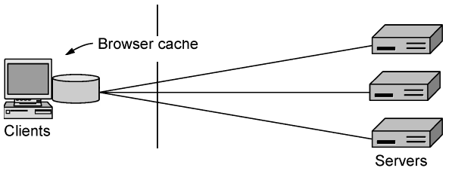
Web caching (Browser cache)
User often revisit same pages
goal: satisfy client request without involving origin server
why Web caching?
reduce response time for client request
reduce traffic on an institution’s access link

Slide 42
Conditional GET
client
server
Goal: don’t send object if cache has up-to-date cached version
cache: specify date of cached copy in HTTP request
  If-modified-since: <date>
server: response contains no object if cached copy is up-to-date:
  HTTP/1.0 304 Not Modified
HTTP request msg
If-modified-since: <date>
object
not
modified
before
<date>
HTTP response
HTTP/1.0
304 Not Modified
HTTP request msg
If-modified-since: <date>
object
modified
after
<date>
HTTP response
HTTP/1.0 200 OK
<data>

Slide 43

Web caching (Web Proxies)
assumptions:
avg object size: 100K bits
avg request rate from browsers to origin servers:15/sec
avg data rate to browsers: 1.50 Mbps
RTT from institutional router to any origin server: 2 sec
access link rate: 1.54 Mbps
consequences:
LAN utilization: 15%
access link utilization = 99%
total delay = Internet delay + access delay + LAN delay
= 2 sec + minutes + usecs
origin
servers
public
Internet
1.54 Mbps
access link
institutional
network
1 Gbps LAN

Slide 44
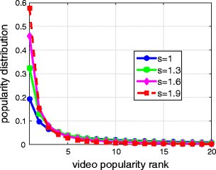
Internet content popularity
Src: https://www.researchgate.net/publication/299518874_Fast-Start_Video_Delivery_in_Future_Internet_Architectures_with_Intra-domain_Caching/figures?lo=1

Slide 45
Internet content popularity
Zipf distribution (a) On a linear scale. (b) On a log-log scale.

Slide 46
Web caching (Web Proxies)
Calculating access link utilization, delay with cache:
suppose cache hit rate is 0.4
  40% requests satisfied at cache, 60% requests satisfied at origin
origin
servers
public
Internet
access link utilization:
  60% of requests use access link
data rate to browsers over access link
= 0.6*1.50 Mbps = .9 Mbps
  utilization = 0.9/1.54 = .58
1.54 Mbps
access link
institutional
network
1 Gbps LAN
total delay
  = 0.6 * (delay from origin servers) +0.4 * (delay when satisfied at cache)
  = 0.6 (2.01) + 0.4 (~msecs) = ~ 1.2 secs
local web
cache

Slide 47
Web caches (proxy server)
A proxy cache between Web browsers and Web servers.

Slide 48
Electronic Mail

Slide 49
Electronic mail
user
agent
mail
server
user
agent
SMTP protocol between mail servers to send email messages
  client: sending mail server
  “server”: receiving mail server
SMTP
mail
server
user
agent
SMTP
SMTP
user
agent
mail
server
user
agent
user
agent

Slide 50
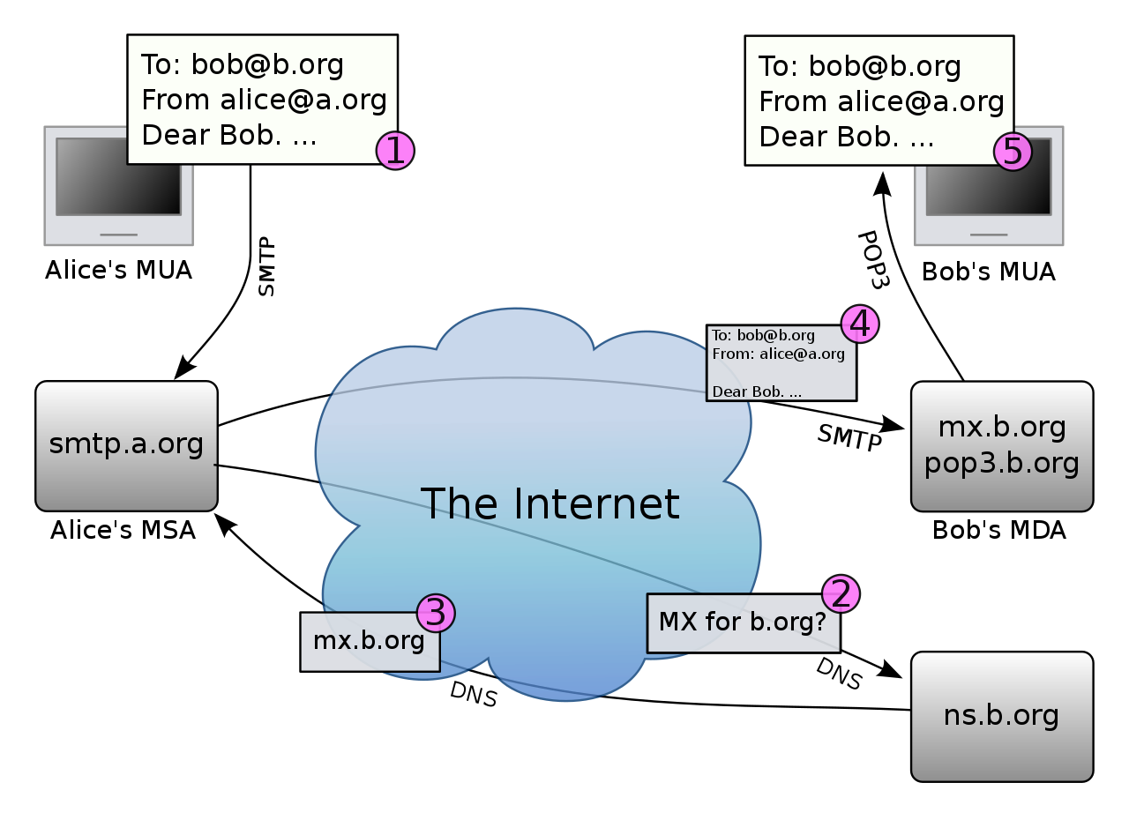
Mail access protocols
SMTP: delivery/storage to receiver’s server
Mail access protocol: retrieval from server
  POP: Post Office Protocol [RFC 1939]: authorization, download
  IMAP: Internet Mail Access Protocol [RFC 1730]: more features, including manipulation of stored messages on server
  HTTP: gmail, Hotmail, Yahoo! Mail, etc.
Src: https://en.wikipedia.org/wiki/Open_mail_relay#/media/File:Email.svg

