Slide 1
Computer Networks Transmission Media (Unguided) and Antennas
Amitangshu Pal
Computer Science and Engineering
IIT Kanpur

Slide 2
Antennas
Electrical conductors used to radiate or collect electromagnetic energy
Transmission antenna: Electrical energy → converted to electromagnetic energy → radiated into the surrounding
Reception antenna: Electromagnetic energy → converted to electrical energy → fed to the receiver

Slide 3
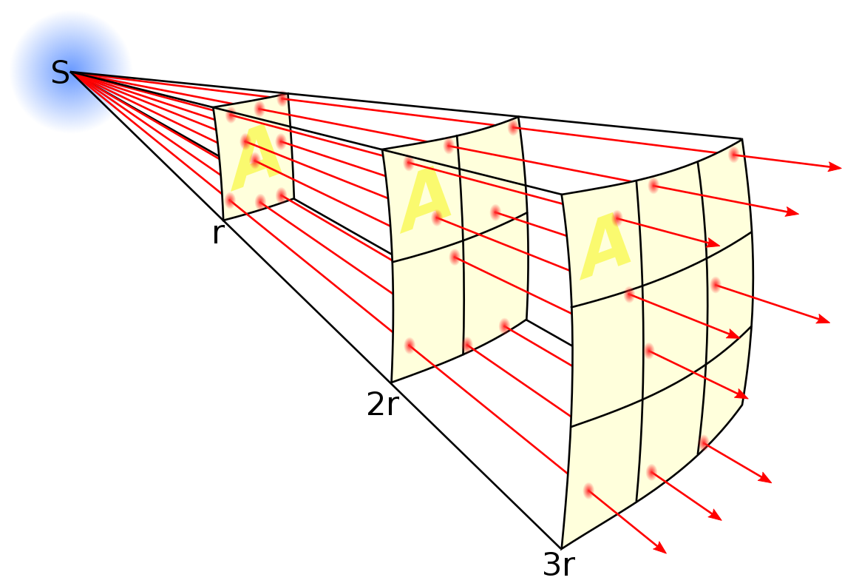
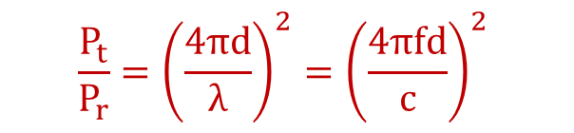
Isotropic Antennas
Isotropic antenna:
A point in space that radiates power in all directions equally with a spherical radiation pattern
$$\frac{P_{t}}{P_{r}}={\left(\frac{4πd}{λ}\right)}^{2}={\left(\frac{4πfd}{c}\right)}^{2}$$
Src: https://en.wikipedia.org/wiki/Free-space_path_loss

Slide 4
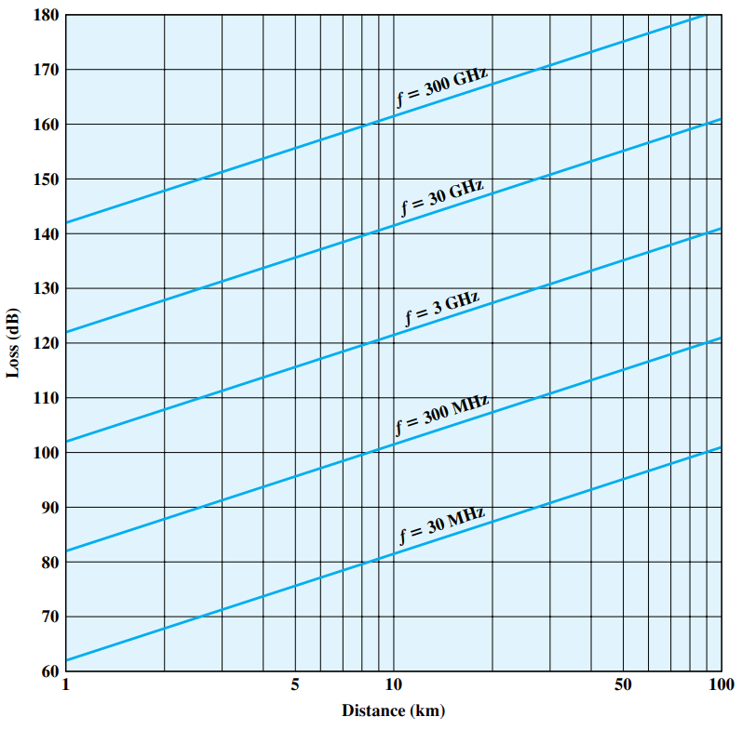
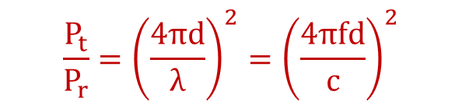
Isotropic Antennas
$$\frac{P_{t}}{P_{r}}={\left(\frac{4πd}{λ}\right)}^{2}={\left(\frac{4πfd}{c}\right)}^{2}$$

Slide 5
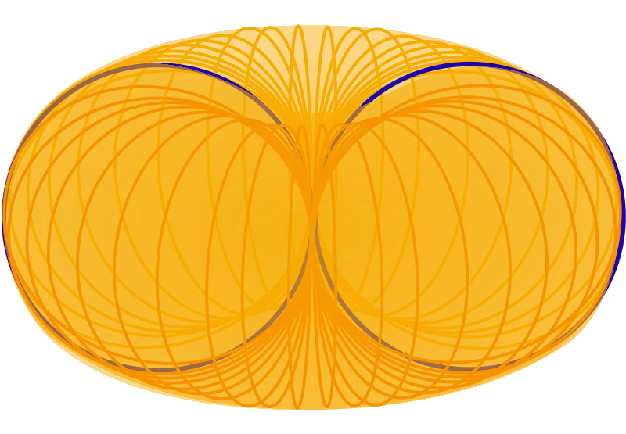
Omni-directional Antennas
Omni-directional antenna: power propagates uniformly in all directions in a plane
Cell phones, FM radios, walkie-talkies etc.
Src: https://commons.wikimedia.org/wiki/File:Elem-doub-rad-pat-pers.svg

Slide 6
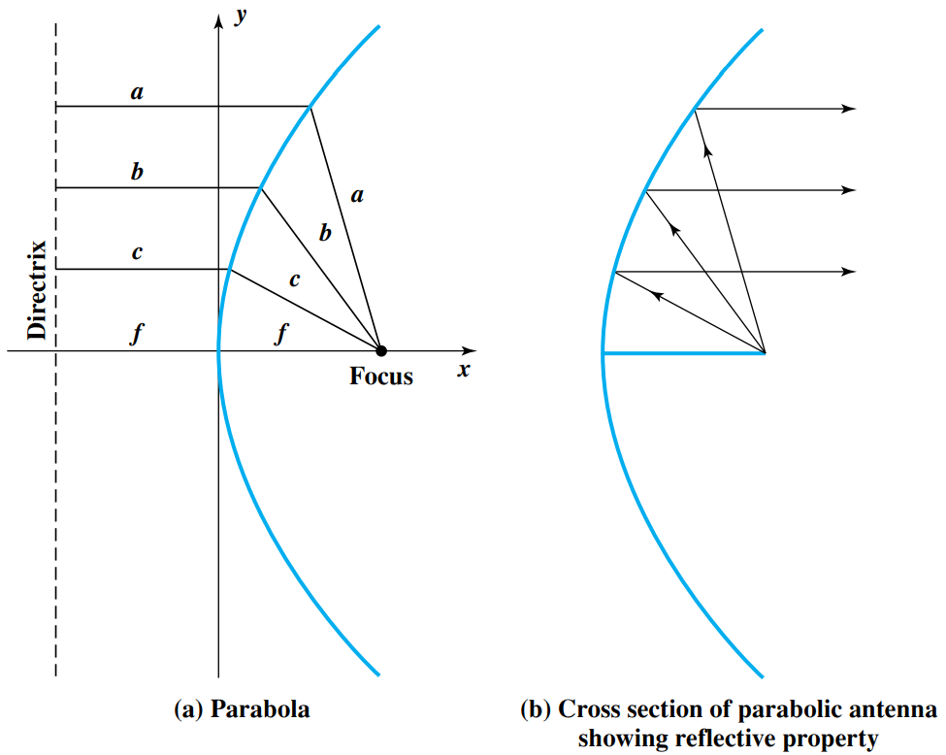
Directional Antennas
Directional antenna: Parabolic reflective antenna

Slide 7
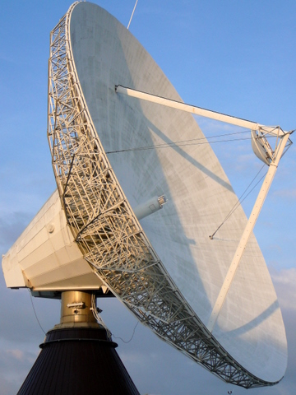
Antennas
Directional antenna: Parabolic reflective antenna
Satellite communications, radio telescopes etc.
Src:https://commons.wikimedia.org/wiki/File:Antenna_03.JPG

Slide 8
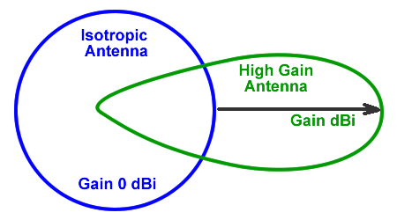
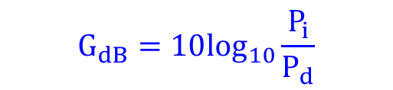
Antenna Gain
Antenna gain:
Measure of directionality
Defined as the power output in a particular direction, compared to that produced in any direction by a perfect isotropic antenna (dBi)
http://www.cisco.com/en/US/prod/collateral/wireless/ps7183/ps469/product_data_sheet09186a008008883b.html
Radiated power of isotropic antenna
$$G_{dB}=10\log_{10}\frac{P_{i}}{P_{d}}$$
Radiated power of directional antenna
Src: https://www.ahsystems.com/articles/Understanding-antenna-gain-beamwidth-directivity.php

Slide 9
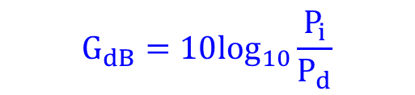
Antenna Gain
Consider a directional antenna with a gain of 6 dB over a reference antenna and that radiates 700 W. How much power must the reference antenna radiates to provide the same signal power in the preferred direction?
$$G_{dB}=10\log_{10}\frac{P_{i}}{P_{d}}$$
Src: https://www.ahsystems.com/articles/Understanding-antenna-gain-beamwidth-directivity.php

Slide 10


Antenna Gain
Antenna gain:
Relates to the effective area of the antenna
Effective area of an antenna is related to its physical size and its shape
Effective area of an ideal isotropic antenna is $\frac{λ^{2}}{4π}$, with a power gain = 1
$G=\frac{4πA_{e}}{λ^{2}}$ = $\frac{4πf^{2}A_{e}}{c^{2}}$

Slide 11

Antenna Gain
Antenna gain:
Relates to the effective area of the antenna
Effective area of an antenna is related to its physical size and its shape
Effective area of an parabolic antenna with a face area of A is $0.56A$, with a power gain of $\frac{7A}{λ^{2}}$
$G=\frac{4πA_{e}}{λ^{2}}$ = $\frac{4πf^{2}A_{e}}{c^{2}}$

Slide 12

Antenna Gain
For a parabolic reflective antenna with a diameter of 2 m, operating at 12 GHz, what is the effective area and the antenna gain?
$G=\frac{4πA_{e}}{λ^{2}}$ = $\frac{4πf^{2}A_{e}}{c^{2}}$

Slide 13

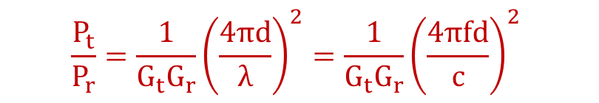
Free Space Path Loss
Free space path loss:
$G_{t}$: Transmit antenna gain
$G_{r}$: Receiver antenna gain
Receiver antenna provides an aperture with an effective area for receiving a fraction of the transmitted power
$$\frac{P_{t}}{P_{r}}={\frac{1}{G_{t}G_{r}}\left(\frac{4πd}{λ}\right)}^{2}={\frac{1}{G_{t}G_{r}}\left(\frac{4πfd}{c}\right)}^{2}$$

Slide 14
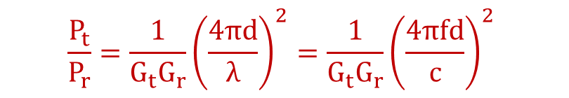
Free Space Path Loss
Assume that a ground station is transmitting a signal of 250 W to a satellite at 4 GHz (earth to satellite distance is 35863 km). The antenna gains are 44 dB and 48 dB. What is the received power?
$$\frac{P_{t}}{P_{r}}={\frac{1}{G_{t}G_{r}}\left(\frac{4πd}{λ}\right)}^{2}={\frac{1}{G_{t}G_{r}}\left(\frac{4πfd}{c}\right)}^{2}$$

Slide 15
Summary
Wireless transmission medium:
Isotropic, omnidirectional and directional antenna
Free space path loss
Antenna gain

