Slide 1
Computer Networks Signal Encoding Techniques (Digital to Digital)
Amitangshu Pal
Computer Science and Engineering
IIT Kanpur

Slide 2
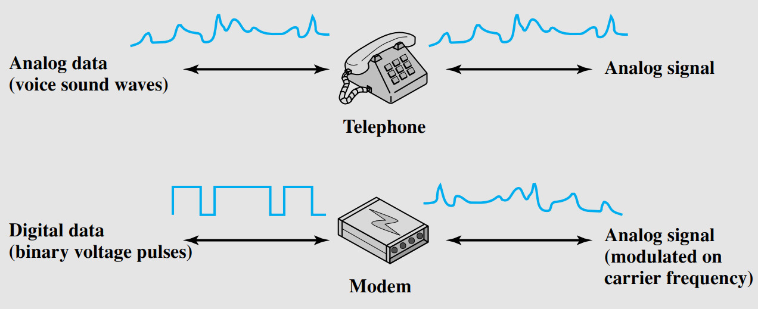
Analog Signal

Slide 3

Analog Signal
central office
telephone
network
DSL
modem
splitter
DSLAM
ISP
voice, data transmitted
at different frequencies over
dedicated line to central office
DSL access
multiplexer

Slide 4
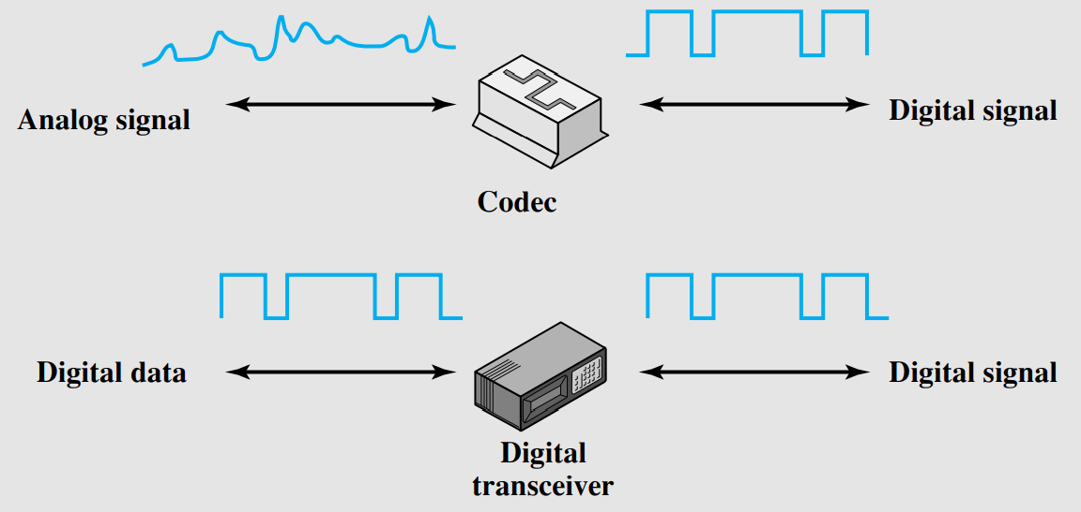
Digital Signal

Slide 5
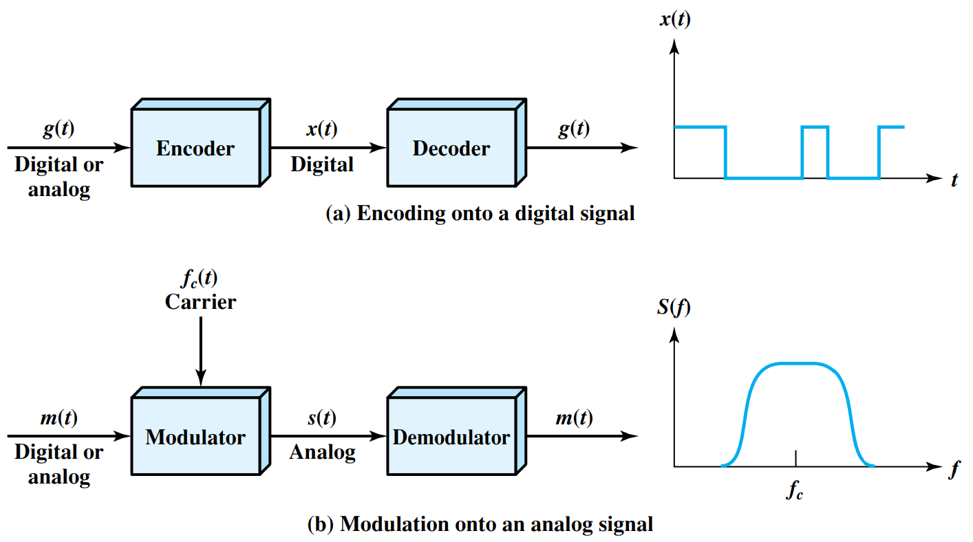
Signal Encoding Techniques
Notes:
Let me first give a brief introduction of WOBAN architecture and the motivation of using WOBAN as an access technology. There are two main types of popular access networks. 1. Optical access networks where from CO optical fibers are pulled to ONUs located at every homes, premises or offices, which basically work as gateways for Internet access to the users. The popular access technology of this access networks is PON. The advantage of this access is that it provides high bandwidth and fast Internet service. The limitation is that it needs fiber to penetrate in each and every premises which make this scheme very costly. Also there is a limitation of maximum fiber length.
Another popular access networks is wireless access. Popular technology of this type are WiFi and WiMAX. The advantage of these access technology is that this is flexible and cost effective scheme. But the limitation is that when the hop of hops increase a lot, real time multi-media traffic suffers a lot.
Let me first give a brief introduction of WOBAN architecture and the motivation of using WOBAN as an access technology. There are two main types of popular access networks. First is the optical access such as passive optical networks (PON), which provides fast Internet service because of high bandwidth. But it requires fiber to be penetrated from central office to all residential complex, offices and premises which make the scheme highly costly. Another popular access technology is wireless access, which is flexible and cost-efficient, but does not function well when the number of hops increases.

Slide 6
Digital Data → Digital Signals

Slide 7
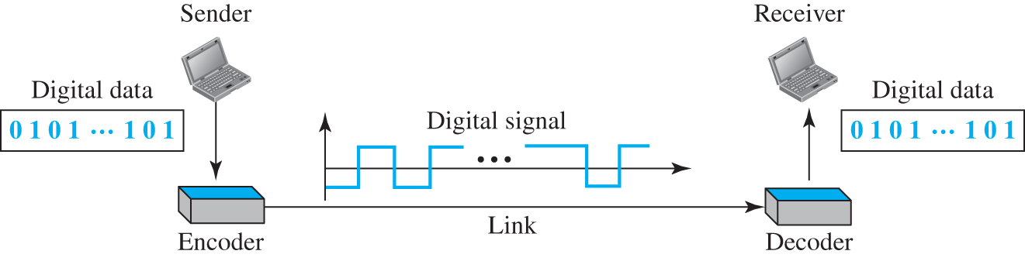
Digital Data → Digital Signals
Notes:
Let me first give a brief introduction of WOBAN architecture and the motivation of using WOBAN as an access technology. There are two main types of popular access networks. 1. Optical access networks where from CO optical fibers are pulled to ONUs located at every homes, premises or offices, which basically work as gateways for Internet access to the users. The popular access technology of this access networks is PON. The advantage of this access is that it provides high bandwidth and fast Internet service. The limitation is that it needs fiber to penetrate in each and every premises which make this scheme very costly. Also there is a limitation of maximum fiber length.
Another popular access networks is wireless access. Popular technology of this type are WiFi and WiMAX. The advantage of these access technology is that this is flexible and cost effective scheme. But the limitation is that when the hop of hops increase a lot, real time multi-media traffic suffers a lot.
Let me first give a brief introduction of WOBAN architecture and the motivation of using WOBAN as an access technology. There are two main types of popular access networks. First is the optical access such as passive optical networks (PON), which provides fast Internet service because of high bandwidth. But it requires fiber to be penetrated from central office to all residential complex, offices and premises which make the scheme highly costly. Another popular access technology is wireless access, which is flexible and cost-efficient, but does not function well when the number of hops increases.

Slide 8
Evaluation Criterias of Encoding Techniques
Signal spectrum, DC component and bandwidth
No DC component is desirable
Encoding with less bandwidth is preferable
Clocking
Transmitted signal can be used by the receiver for synchronizing
Error detection
Encoding scheme can have some inbuilt error detection mechanism
Notes:
Let me first give a brief introduction of WOBAN architecture and the motivation of using WOBAN as an access technology. There are two main types of popular access networks. 1. Optical access networks where from CO optical fibers are pulled to ONUs located at every homes, premises or offices, which basically work as gateways for Internet access to the users. The popular access technology of this access networks is PON. The advantage of this access is that it provides high bandwidth and fast Internet service. The limitation is that it needs fiber to penetrate in each and every premises which make this scheme very costly. Also there is a limitation of maximum fiber length.
Another popular access networks is wireless access. Popular technology of this type are WiFi and WiMAX. The advantage of these access technology is that this is flexible and cost effective scheme. But the limitation is that when the hop of hops increase a lot, real time multi-media traffic suffers a lot.
Let me first give a brief introduction of WOBAN architecture and the motivation of using WOBAN as an access technology. There are two main types of popular access networks. First is the optical access such as passive optical networks (PON), which provides fast Internet service because of high bandwidth. But it requires fiber to be penetrated from central office to all residential complex, offices and premises which make the scheme highly costly. Another popular access technology is wireless access, which is flexible and cost-efficient, but does not function well when the number of hops increases.

Slide 9
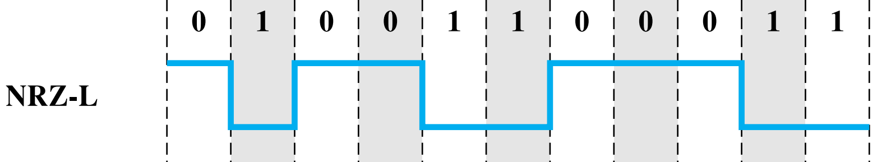

NRZ-L
$$PSD(f)=\text{A}\text{2}\text{T}\text{b}\text{sinc}\text{2}\text{(}π\text{fT}\text{b}\text{)}$$
0 = High level
1 = Low level
Problems:
Lack of clock recovery during long string of 0 or 1s 🙁
Has d.c. component 🙁
Notes:
Let me first give a brief introduction of WOBAN architecture and the motivation of using WOBAN as an access technology. There are two main types of popular access networks. 1. Optical access networks where from CO optical fibers are pulled to ONUs located at every homes, premises or offices, which basically work as gateways for Internet access to the users. The popular access technology of this access networks is PON. The advantage of this access is that it provides high bandwidth and fast Internet service. The limitation is that it needs fiber to penetrate in each and every premises which make this scheme very costly. Also there is a limitation of maximum fiber length.
Another popular access networks is wireless access. Popular technology of this type are WiFi and WiMAX. The advantage of these access technology is that this is flexible and cost effective scheme. But the limitation is that when the hop of hops increase a lot, real time multi-media traffic suffers a lot.
Let me first give a brief introduction of WOBAN architecture and the motivation of using WOBAN as an access technology. There are two main types of popular access networks. First is the optical access such as passive optical networks (PON), which provides fast Internet service because of high bandwidth. But it requires fiber to be penetrated from central office to all residential complex, offices and premises which make the scheme highly costly. Another popular access technology is wireless access, which is flexible and cost-efficient, but does not function well when the number of hops increases.

Slide 10
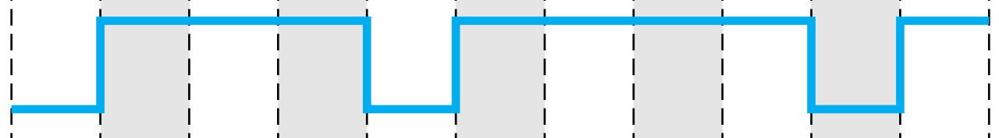
NRZ-I
$$PSD(f)=\text{A}\text{2}\text{T}\text{b}\text{sinc}\text{2}\text{(}π\text{fT}\text{b}\text{)}$$
1 = change of signal level (on-off or off-on) 0 = no change of signal level
Fixes clocking problem for long string of 1 bits 🙂
Problems:
Lack of clock recovery during long string of 0 bits 🙁
Has d.c. component 🙁
Notes:
Let me first give a brief introduction of WOBAN architecture and the motivation of using WOBAN as an access technology. There are two main types of popular access networks. 1. Optical access networks where from CO optical fibers are pulled to ONUs located at every homes, premises or offices, which basically work as gateways for Internet access to the users. The popular access technology of this access networks is PON. The advantage of this access is that it provides high bandwidth and fast Internet service. The limitation is that it needs fiber to penetrate in each and every premises which make this scheme very costly. Also there is a limitation of maximum fiber length.
Another popular access networks is wireless access. Popular technology of this type are WiFi and WiMAX. The advantage of these access technology is that this is flexible and cost effective scheme. But the limitation is that when the hop of hops increase a lot, real time multi-media traffic suffers a lot.
Let me first give a brief introduction of WOBAN architecture and the motivation of using WOBAN as an access technology. There are two main types of popular access networks. First is the optical access such as passive optical networks (PON), which provides fast Internet service because of high bandwidth. But it requires fiber to be penetrated from central office to all residential complex, offices and premises which make the scheme highly costly. Another popular access technology is wireless access, which is flexible and cost-efficient, but does not function well when the number of hops increases.

Slide 11
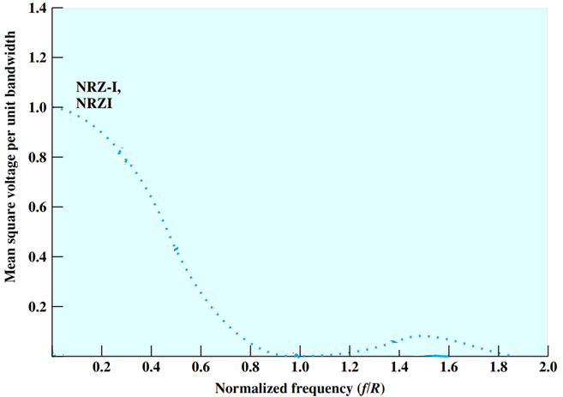

Performance of Encoding Schemes
$$PSD(f)=\text{A}\text{2}\text{T}\text{b}\text{sinc}\text{2}\text{(}π\text{fT}\text{b}\text{)}$$
Notes:
Let me first give a brief introduction of WOBAN architecture and the motivation of using WOBAN as an access technology. There are two main types of popular access networks. 1. Optical access networks where from CO optical fibers are pulled to ONUs located at every homes, premises or offices, which basically work as gateways for Internet access to the users. The popular access technology of this access networks is PON. The advantage of this access is that it provides high bandwidth and fast Internet service. The limitation is that it needs fiber to penetrate in each and every premises which make this scheme very costly. Also there is a limitation of maximum fiber length.
Another popular access networks is wireless access. Popular technology of this type are WiFi and WiMAX. The advantage of these access technology is that this is flexible and cost effective scheme. But the limitation is that when the hop of hops increase a lot, real time multi-media traffic suffers a lot.
Let me first give a brief introduction of WOBAN architecture and the motivation of using WOBAN as an access technology. There are two main types of popular access networks. First is the optical access such as passive optical networks (PON), which provides fast Internet service because of high bandwidth. But it requires fiber to be penetrated from central office to all residential complex, offices and premises which make the scheme highly costly. Another popular access technology is wireless access, which is flexible and cost-efficient, but does not function well when the number of hops increases.

Slide 12

Bipolar-AMI
$$PSD(f)=\text{A}\text{2}\text{T}\text{b}\text{sinc}\text{2}\text{(}π\text{fT}\text{b}\text{)}\text{sin}\text{2}\text{(}π\text{fT}\text{b}\text{)}$$
Uses 3 signal levels: +V, 0, -V
0 = no signal (0 voltage) 1 = alternating +V and -V
No d.c. component (alternating +V and -V) 🙂
Can detect some bit errors (consecutive +V or -V) 🙂
Problems:
Loss of synchronization during long string of 0 bits 🙁
Inefficient bandwidth usage: 3 signal levels is used to represent 2 bits 🙁
Notes:
Let me first give a brief introduction of WOBAN architecture and the motivation of using WOBAN as an access technology. There are two main types of popular access networks. 1. Optical access networks where from CO optical fibers are pulled to ONUs located at every homes, premises or offices, which basically work as gateways for Internet access to the users. The popular access technology of this access networks is PON. The advantage of this access is that it provides high bandwidth and fast Internet service. The limitation is that it needs fiber to penetrate in each and every premises which make this scheme very costly. Also there is a limitation of maximum fiber length.
Another popular access networks is wireless access. Popular technology of this type are WiFi and WiMAX. The advantage of these access technology is that this is flexible and cost effective scheme. But the limitation is that when the hop of hops increase a lot, real time multi-media traffic suffers a lot.
Let me first give a brief introduction of WOBAN architecture and the motivation of using WOBAN as an access technology. There are two main types of popular access networks. First is the optical access such as passive optical networks (PON), which provides fast Internet service because of high bandwidth. But it requires fiber to be penetrated from central office to all residential complex, offices and premises which make the scheme highly costly. Another popular access technology is wireless access, which is flexible and cost-efficient, but does not function well when the number of hops increases.

Slide 13
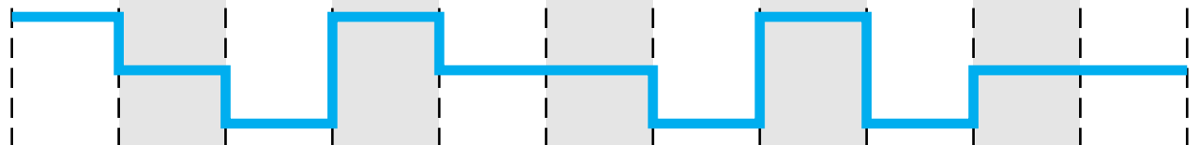
Pseudoternary
$$PSD(f)=\text{A}\text{2}\text{T}\text{b}\text{sinc}\text{2}\text{(}π\text{fT}\text{b}\text{)}\text{sin}\text{2}\text{(}π\text{fT}\text{b}\text{)}$$
Same as Bipolar-AMI except reverses signaling:
1 = no signal (0 voltage) 0 = alternating +V and -V
Notes:
Let me first give a brief introduction of WOBAN architecture and the motivation of using WOBAN as an access technology. There are two main types of popular access networks. 1. Optical access networks where from CO optical fibers are pulled to ONUs located at every homes, premises or offices, which basically work as gateways for Internet access to the users. The popular access technology of this access networks is PON. The advantage of this access is that it provides high bandwidth and fast Internet service. The limitation is that it needs fiber to penetrate in each and every premises which make this scheme very costly. Also there is a limitation of maximum fiber length.
Another popular access networks is wireless access. Popular technology of this type are WiFi and WiMAX. The advantage of these access technology is that this is flexible and cost effective scheme. But the limitation is that when the hop of hops increase a lot, real time multi-media traffic suffers a lot.
Let me first give a brief introduction of WOBAN architecture and the motivation of using WOBAN as an access technology. There are two main types of popular access networks. First is the optical access such as passive optical networks (PON), which provides fast Internet service because of high bandwidth. But it requires fiber to be penetrated from central office to all residential complex, offices and premises which make the scheme highly costly. Another popular access technology is wireless access, which is flexible and cost-efficient, but does not function well when the number of hops increases.

Slide 14
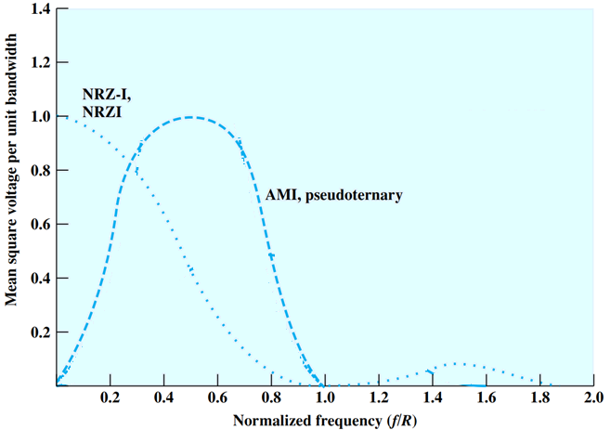
Performance of Encoding Schemes
$$PSD(f)=\text{A}\text{2}\text{T}\text{b}\text{sinc}\text{2}\text{(}π\text{fT}\text{b}\text{)}\text{sin}\text{2}\text{(}π\text{fT}\text{b}\text{)}$$
Notes:
Let me first give a brief introduction of WOBAN architecture and the motivation of using WOBAN as an access technology. There are two main types of popular access networks. 1. Optical access networks where from CO optical fibers are pulled to ONUs located at every homes, premises or offices, which basically work as gateways for Internet access to the users. The popular access technology of this access networks is PON. The advantage of this access is that it provides high bandwidth and fast Internet service. The limitation is that it needs fiber to penetrate in each and every premises which make this scheme very costly. Also there is a limitation of maximum fiber length.
Another popular access networks is wireless access. Popular technology of this type are WiFi and WiMAX. The advantage of these access technology is that this is flexible and cost effective scheme. But the limitation is that when the hop of hops increase a lot, real time multi-media traffic suffers a lot.
Let me first give a brief introduction of WOBAN architecture and the motivation of using WOBAN as an access technology. There are two main types of popular access networks. First is the optical access such as passive optical networks (PON), which provides fast Internet service because of high bandwidth. But it requires fiber to be penetrated from central office to all residential complex, offices and premises which make the scheme highly costly. Another popular access technology is wireless access, which is flexible and cost-efficient, but does not function well when the number of hops increases.

Slide 15

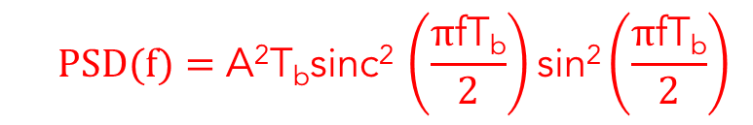
Manchester Encoding
Always transition in middle of bit period: 0 = high-to-low transition 1 = low-to-high transition
Transition at beginning of bit period when necessary
Good clock recovery, error detection capability, no d.c. component 🙂
Bandwidth requirement is higher 🙁
$$PSD(f)=\text{A}\text{2}\text{T}\text{b}\text{sinc}\text{2 }\left(\frac{π\text{fT}\text{b}}{2}\right)\text{s}\text{in}\text{2}\left(\frac{π\text{fT}\text{b}}{2}\right)$$
Notes:
Let me first give a brief introduction of WOBAN architecture and the motivation of using WOBAN as an access technology. There are two main types of popular access networks. 1. Optical access networks where from CO optical fibers are pulled to ONUs located at every homes, premises or offices, which basically work as gateways for Internet access to the users. The popular access technology of this access networks is PON. The advantage of this access is that it provides high bandwidth and fast Internet service. The limitation is that it needs fiber to penetrate in each and every premises which make this scheme very costly. Also there is a limitation of maximum fiber length.
Another popular access networks is wireless access. Popular technology of this type are WiFi and WiMAX. The advantage of these access technology is that this is flexible and cost effective scheme. But the limitation is that when the hop of hops increase a lot, real time multi-media traffic suffers a lot.
Let me first give a brief introduction of WOBAN architecture and the motivation of using WOBAN as an access technology. There are two main types of popular access networks. First is the optical access such as passive optical networks (PON), which provides fast Internet service because of high bandwidth. But it requires fiber to be penetrated from central office to all residential complex, offices and premises which make the scheme highly costly. Another popular access technology is wireless access, which is flexible and cost-efficient, but does not function well when the number of hops increases.

Slide 16


Differential Manchester Encoding
$$PSD(f)=\text{A}\text{2}\text{T}\text{b}\text{sinc}\text{2 }\left(\frac{π\text{fT}\text{b}}{2}\right)\text{s}\text{in}\text{2}\left(\frac{π\text{fT}\text{b}}{2}\right)$$
0 = transition at beginning of bit period (low-to-high or high-to-low, depending on previous output level) 1 = no transition at beginning of bit period
Similar properties as Manchester encoding
Bandwidth requirement is higher 🙁
Notes:
Let me first give a brief introduction of WOBAN architecture and the motivation of using WOBAN as an access technology. There are two main types of popular access networks. 1. Optical access networks where from CO optical fibers are pulled to ONUs located at every homes, premises or offices, which basically work as gateways for Internet access to the users. The popular access technology of this access networks is PON. The advantage of this access is that it provides high bandwidth and fast Internet service. The limitation is that it needs fiber to penetrate in each and every premises which make this scheme very costly. Also there is a limitation of maximum fiber length.
Another popular access networks is wireless access. Popular technology of this type are WiFi and WiMAX. The advantage of these access technology is that this is flexible and cost effective scheme. But the limitation is that when the hop of hops increase a lot, real time multi-media traffic suffers a lot.
Let me first give a brief introduction of WOBAN architecture and the motivation of using WOBAN as an access technology. There are two main types of popular access networks. First is the optical access such as passive optical networks (PON), which provides fast Internet service because of high bandwidth. But it requires fiber to be penetrated from central office to all residential complex, offices and premises which make the scheme highly costly. Another popular access technology is wireless access, which is flexible and cost-efficient, but does not function well when the number of hops increases.

Slide 17
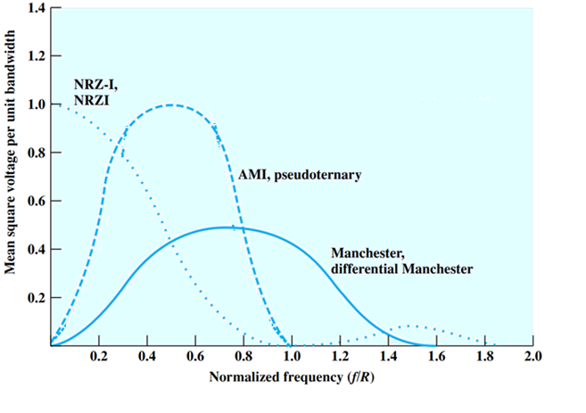
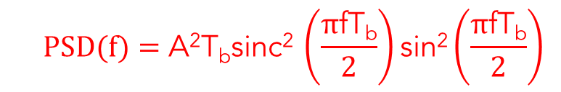
Performance of Encoding Schemes
$$PSD(f)=\text{A}\text{2}\text{T}\text{b}\text{sinc}\text{2 }\left(\frac{π\text{fT}\text{b}}{2}\right)\text{s}\text{in}\text{2}\left(\frac{π\text{fT}\text{b}}{2}\right)$$
Notes:
Let me first give a brief introduction of WOBAN architecture and the motivation of using WOBAN as an access technology. There are two main types of popular access networks. 1. Optical access networks where from CO optical fibers are pulled to ONUs located at every homes, premises or offices, which basically work as gateways for Internet access to the users. The popular access technology of this access networks is PON. The advantage of this access is that it provides high bandwidth and fast Internet service. The limitation is that it needs fiber to penetrate in each and every premises which make this scheme very costly. Also there is a limitation of maximum fiber length.
Another popular access networks is wireless access. Popular technology of this type are WiFi and WiMAX. The advantage of these access technology is that this is flexible and cost effective scheme. But the limitation is that when the hop of hops increase a lot, real time multi-media traffic suffers a lot.
Let me first give a brief introduction of WOBAN architecture and the motivation of using WOBAN as an access technology. There are two main types of popular access networks. First is the optical access such as passive optical networks (PON), which provides fast Internet service because of high bandwidth. But it requires fiber to be penetrated from central office to all residential complex, offices and premises which make the scheme highly costly. Another popular access technology is wireless access, which is flexible and cost-efficient, but does not function well when the number of hops increases.

Slide 18
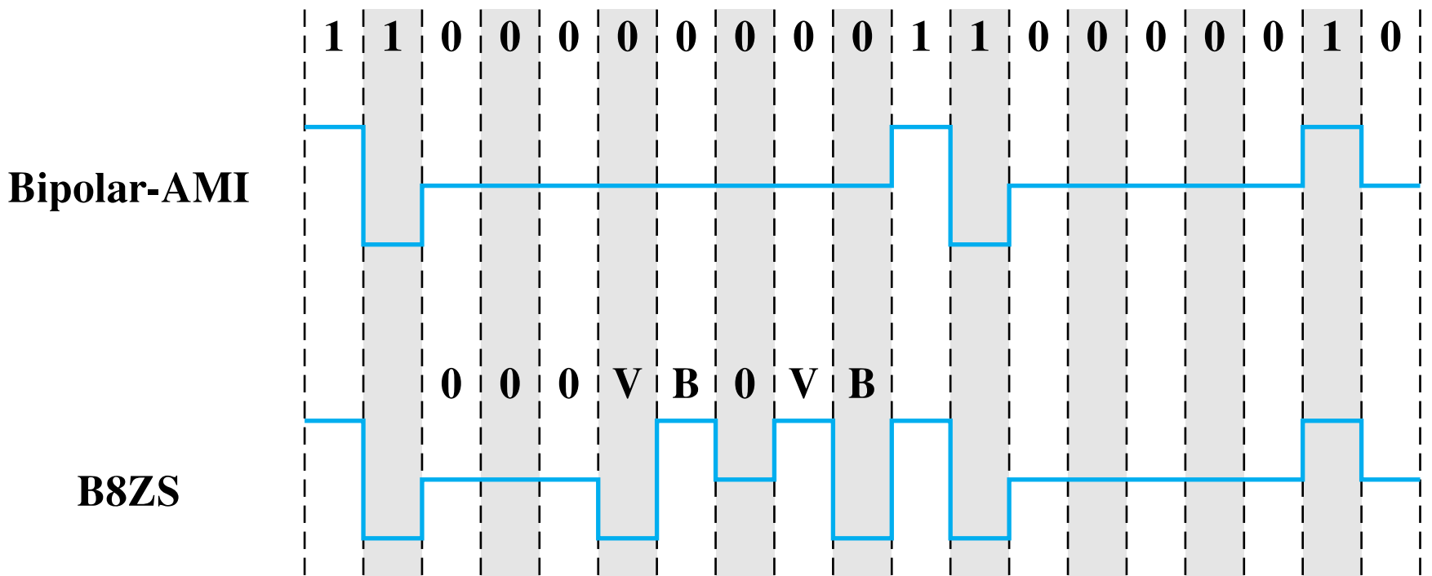
B8ZS
Based on Bipolar-AMI
8 consecutive 0s are encoded as:
If the last voltage pulse preceding this octet was + → encode as 000+-0-+
If the last voltage pulse preceding this octet was - → encode as 000-+0+-
Notes:
Let me first give a brief introduction of WOBAN architecture and the motivation of using WOBAN as an access technology. There are two main types of popular access networks. 1. Optical access networks where from CO optical fibers are pulled to ONUs located at every homes, premises or offices, which basically work as gateways for Internet access to the users. The popular access technology of this access networks is PON. The advantage of this access is that it provides high bandwidth and fast Internet service. The limitation is that it needs fiber to penetrate in each and every premises which make this scheme very costly. Also there is a limitation of maximum fiber length.
Another popular access networks is wireless access. Popular technology of this type are WiFi and WiMAX. The advantage of these access technology is that this is flexible and cost effective scheme. But the limitation is that when the hop of hops increase a lot, real time multi-media traffic suffers a lot.
Let me first give a brief introduction of WOBAN architecture and the motivation of using WOBAN as an access technology. There are two main types of popular access networks. First is the optical access such as passive optical networks (PON), which provides fast Internet service because of high bandwidth. But it requires fiber to be penetrated from central office to all residential complex, offices and premises which make the scheme highly costly. Another popular access technology is wireless access, which is flexible and cost-efficient, but does not function well when the number of hops increases.

Slide 19
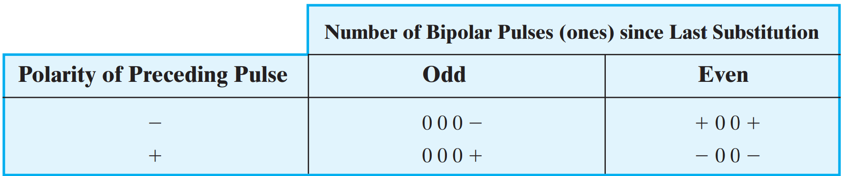
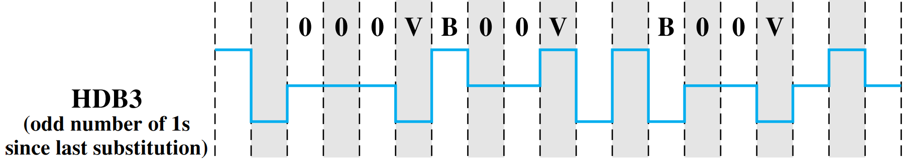
HDB3
Based on Bipolar-AMI
Notes:
Let me first give a brief introduction of WOBAN architecture and the motivation of using WOBAN as an access technology. There are two main types of popular access networks. 1. Optical access networks where from CO optical fibers are pulled to ONUs located at every homes, premises or offices, which basically work as gateways for Internet access to the users. The popular access technology of this access networks is PON. The advantage of this access is that it provides high bandwidth and fast Internet service. The limitation is that it needs fiber to penetrate in each and every premises which make this scheme very costly. Also there is a limitation of maximum fiber length.
Another popular access networks is wireless access. Popular technology of this type are WiFi and WiMAX. The advantage of these access technology is that this is flexible and cost effective scheme. But the limitation is that when the hop of hops increase a lot, real time multi-media traffic suffers a lot.
Let me first give a brief introduction of WOBAN architecture and the motivation of using WOBAN as an access technology. There are two main types of popular access networks. First is the optical access such as passive optical networks (PON), which provides fast Internet service because of high bandwidth. But it requires fiber to be penetrated from central office to all residential complex, offices and premises which make the scheme highly costly. Another popular access technology is wireless access, which is flexible and cost-efficient, but does not function well when the number of hops increases.

Slide 20
Advantages B8ZS and HDB3
No d.c. component 🙂
Fixes clocking problem for long string of both 0 and1s 🙂
Error detection capability 🙂
Notes:
Let me first give a brief introduction of WOBAN architecture and the motivation of using WOBAN as an access technology. There are two main types of popular access networks. 1. Optical access networks where from CO optical fibers are pulled to ONUs located at every homes, premises or offices, which basically work as gateways for Internet access to the users. The popular access technology of this access networks is PON. The advantage of this access is that it provides high bandwidth and fast Internet service. The limitation is that it needs fiber to penetrate in each and every premises which make this scheme very costly. Also there is a limitation of maximum fiber length.
Another popular access networks is wireless access. Popular technology of this type are WiFi and WiMAX. The advantage of these access technology is that this is flexible and cost effective scheme. But the limitation is that when the hop of hops increase a lot, real time multi-media traffic suffers a lot.
Let me first give a brief introduction of WOBAN architecture and the motivation of using WOBAN as an access technology. There are two main types of popular access networks. First is the optical access such as passive optical networks (PON), which provides fast Internet service because of high bandwidth. But it requires fiber to be penetrated from central office to all residential complex, offices and premises which make the scheme highly costly. Another popular access technology is wireless access, which is flexible and cost-efficient, but does not function well when the number of hops increases.

Slide 21
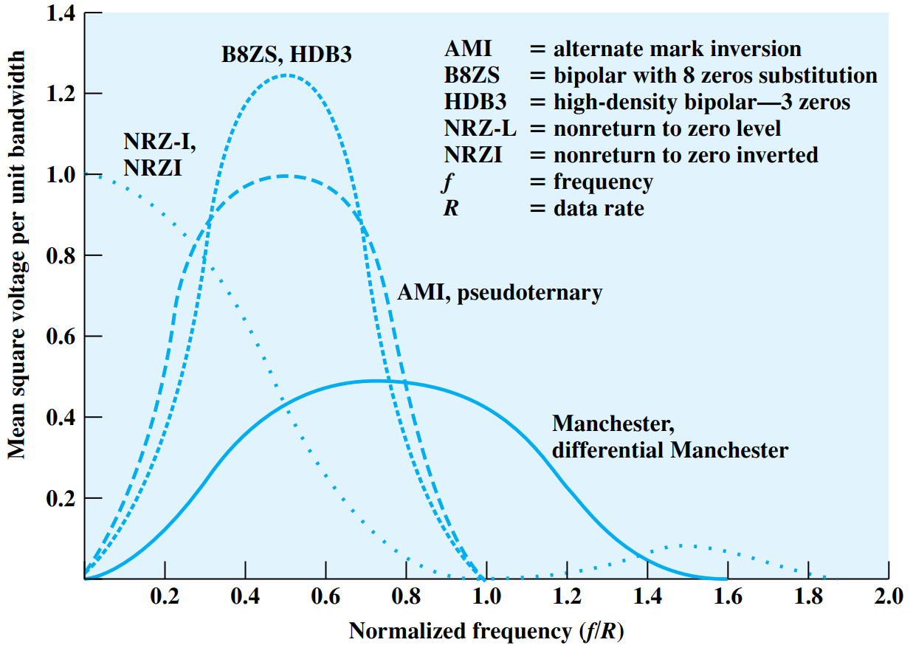
Comparison of Encoding Schemes
Notes:
Let me first give a brief introduction of WOBAN architecture and the motivation of using WOBAN as an access technology. There are two main types of popular access networks. 1. Optical access networks where from CO optical fibers are pulled to ONUs located at every homes, premises or offices, which basically work as gateways for Internet access to the users. The popular access technology of this access networks is PON. The advantage of this access is that it provides high bandwidth and fast Internet service. The limitation is that it needs fiber to penetrate in each and every premises which make this scheme very costly. Also there is a limitation of maximum fiber length.
Another popular access networks is wireless access. Popular technology of this type are WiFi and WiMAX. The advantage of these access technology is that this is flexible and cost effective scheme. But the limitation is that when the hop of hops increase a lot, real time multi-media traffic suffers a lot.
Let me first give a brief introduction of WOBAN architecture and the motivation of using WOBAN as an access technology. There are two main types of popular access networks. First is the optical access such as passive optical networks (PON), which provides fast Internet service because of high bandwidth. But it requires fiber to be penetrated from central office to all residential complex, offices and premises which make the scheme highly costly. Another popular access technology is wireless access, which is flexible and cost-efficient, but does not function well when the number of hops increases.

Slide 22
Unipolar vs Polar Encoding
Polar
One logic state represented by positive voltage and the other by negative voltage
Unipolar
All signal elements have the same sign
Notes:
Let me first give a brief introduction of WOBAN architecture and the motivation of using WOBAN as an access technology. There are two main types of popular access networks. 1. Optical access networks where from CO optical fibers are pulled to ONUs located at every homes, premises or offices, which basically work as gateways for Internet access to the users. The popular access technology of this access networks is PON. The advantage of this access is that it provides high bandwidth and fast Internet service. The limitation is that it needs fiber to penetrate in each and every premises which make this scheme very costly. Also there is a limitation of maximum fiber length.
Another popular access networks is wireless access. Popular technology of this type are WiFi and WiMAX. The advantage of these access technology is that this is flexible and cost effective scheme. But the limitation is that when the hop of hops increase a lot, real time multi-media traffic suffers a lot.
Let me first give a brief introduction of WOBAN architecture and the motivation of using WOBAN as an access technology. There are two main types of popular access networks. First is the optical access such as passive optical networks (PON), which provides fast Internet service because of high bandwidth. But it requires fiber to be penetrated from central office to all residential complex, offices and premises which make the scheme highly costly. Another popular access technology is wireless access, which is flexible and cost-efficient, but does not function well when the number of hops increases.

Slide 23
Summary
Signal encoding techniques (Digital data → Digital signals):
Different encoding techniques discussed
NRZ-L and NRZ-I
Bipolar-AMI and Pseudoternary
Manchester and Differential Manchester
B8ZS and HDB3
Comparison of the encoding schemes

