Slide 1
Computer Networks I Signal Encoding Techniques (Analog to Digital)
Amitangshu Pal
Computer Science and Engineering
IIT Kanpur

Slide 2
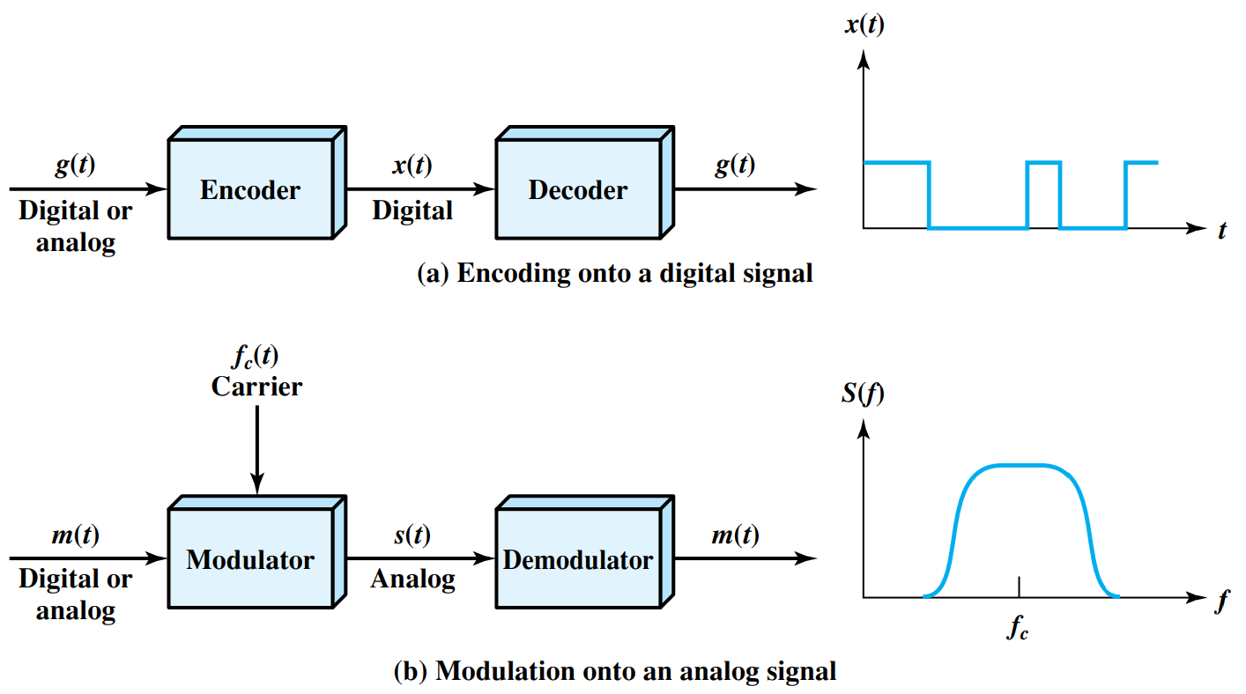
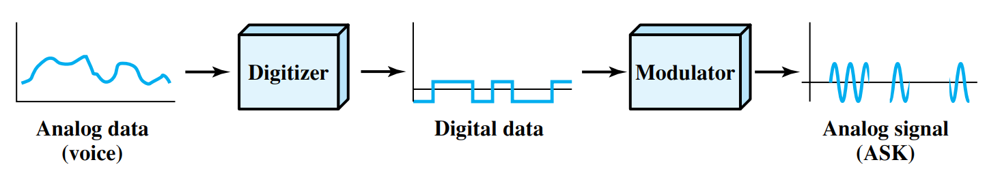
Digitizing Analog Data
Once analog data is converted to digital data:
The digital data can be encoded into digital signals
The digital data can be modulated into an analog signal
Two principle techniques:
Pulse Code Modulation (PCM)
Delta Modulation (DM)
Notes:
Let me first give a brief introduction of WOBAN architecture and the motivation of using WOBAN as an access technology. There are two main types of popular access networks. 1. Optical access networks where from CO optical fibers are pulled to ONUs located at every homes, premises or offices, which basically work as gateways for Internet access to the users. The popular access technology of this access networks is PON. The advantage of this access is that it provides high bandwidth and fast Internet service. The limitation is that it needs fiber to penetrate in each and every premises which make this scheme very costly. Also there is a limitation of maximum fiber length.
Another popular access networks is wireless access. Popular technology of this type are WiFi and WiMAX. The advantage of these access technology is that this is flexible and cost effective scheme. But the limitation is that when the hop of hops increase a lot, real time multi-media traffic suffers a lot.
Let me first give a brief introduction of WOBAN architecture and the motivation of using WOBAN as an access technology. There are two main types of popular access networks. First is the optical access such as passive optical networks (PON), which provides fast Internet service because of high bandwidth. But it requires fiber to be penetrated from central office to all residential complex, offices and premises which make the scheme highly costly. Another popular access technology is wireless access, which is flexible and cost-efficient, but does not function well when the number of hops increases.

Slide 3

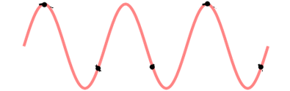
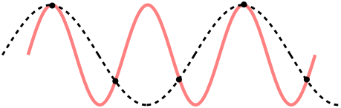
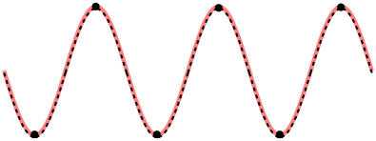
Nyquist Sampling Theorem
Src: https://commons.wikimedia.org/wiki/File:CPT-sound-nyquist-thereom-raw.svg
Src: https://commons.wikimedia.org/wiki/File:CPT-sound-nyquist-thereom-1.5percycle.svg
Src: https://commons.wikimedia.org/wiki/File:CPT-sound-nyquist-thereom-1.5percycle.svg
Src: https://commons.wikimedia.org/wiki/File:CPT-sound-nyquist-thereom-2percycle.svg
Notes:
Let me first give a brief introduction of WOBAN architecture and the motivation of using WOBAN as an access technology. There are two main types of popular access networks. 1. Optical access networks where from CO optical fibers are pulled to ONUs located at every homes, premises or offices, which basically work as gateways for Internet access to the users. The popular access technology of this access networks is PON. The advantage of this access is that it provides high bandwidth and fast Internet service. The limitation is that it needs fiber to penetrate in each and every premises which make this scheme very costly. Also there is a limitation of maximum fiber length.
Another popular access networks is wireless access. Popular technology of this type are WiFi and WiMAX. The advantage of these access technology is that this is flexible and cost effective scheme. But the limitation is that when the hop of hops increase a lot, real time multi-media traffic suffers a lot.
Let me first give a brief introduction of WOBAN architecture and the motivation of using WOBAN as an access technology. There are two main types of popular access networks. First is the optical access such as passive optical networks (PON), which provides fast Internet service because of high bandwidth. But it requires fiber to be penetrated from central office to all residential complex, offices and premises which make the scheme highly costly. Another popular access technology is wireless access, which is flexible and cost-efficient, but does not function well when the number of hops increases.

Slide 4
Nyquist Sampling Theorem
Sampling theorem: If a continuous time signal is sampled, then it can be reconstructed from the samples, if the sampling rate must be at least 2 times the highest frequency contained in the signal
Src: https://commons.wikimedia.org/wiki/File:CPT-sound-nyquist-thereom-1.5percycle.svg
Src: https://commons.wikimedia.org/wiki/File:CPT-sound-nyquist-thereom-2percycle.svg
Notes:
Let me first give a brief introduction of WOBAN architecture and the motivation of using WOBAN as an access technology. There are two main types of popular access networks. 1. Optical access networks where from CO optical fibers are pulled to ONUs located at every homes, premises or offices, which basically work as gateways for Internet access to the users. The popular access technology of this access networks is PON. The advantage of this access is that it provides high bandwidth and fast Internet service. The limitation is that it needs fiber to penetrate in each and every premises which make this scheme very costly. Also there is a limitation of maximum fiber length.
Another popular access networks is wireless access. Popular technology of this type are WiFi and WiMAX. The advantage of these access technology is that this is flexible and cost effective scheme. But the limitation is that when the hop of hops increase a lot, real time multi-media traffic suffers a lot.
Let me first give a brief introduction of WOBAN architecture and the motivation of using WOBAN as an access technology. There are two main types of popular access networks. First is the optical access such as passive optical networks (PON), which provides fast Internet service because of high bandwidth. But it requires fiber to be penetrated from central office to all residential complex, offices and premises which make the scheme highly costly. Another popular access technology is wireless access, which is flexible and cost-efficient, but does not function well when the number of hops increases.

Slide 5
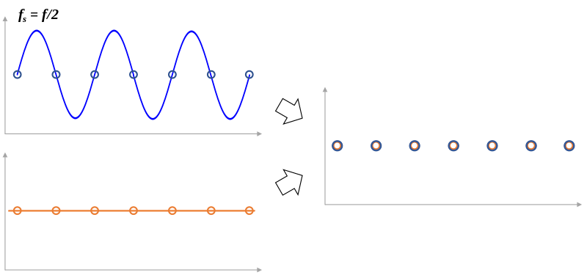
Is it sufficient to keep fs = 2f_{max}?
Src: https://commons.wikimedia.org/wiki/File:Sampling_theorem_limit.svg
Notes:
Let me first give a brief introduction of WOBAN architecture and the motivation of using WOBAN as an access technology. There are two main types of popular access networks. 1. Optical access networks where from CO optical fibers are pulled to ONUs located at every homes, premises or offices, which basically work as gateways for Internet access to the users. The popular access technology of this access networks is PON. The advantage of this access is that it provides high bandwidth and fast Internet service. The limitation is that it needs fiber to penetrate in each and every premises which make this scheme very costly. Also there is a limitation of maximum fiber length.
Another popular access networks is wireless access. Popular technology of this type are WiFi and WiMAX. The advantage of these access technology is that this is flexible and cost effective scheme. But the limitation is that when the hop of hops increase a lot, real time multi-media traffic suffers a lot.
Let me first give a brief introduction of WOBAN architecture and the motivation of using WOBAN as an access technology. There are two main types of popular access networks. First is the optical access such as passive optical networks (PON), which provides fast Internet service because of high bandwidth. But it requires fiber to be penetrated from central office to all residential complex, offices and premises which make the scheme highly costly. Another popular access technology is wireless access, which is flexible and cost-efficient, but does not function well when the number of hops increases.

Slide 6
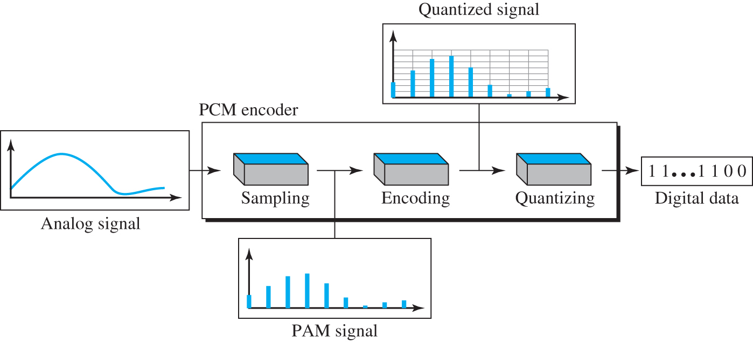
Pulse Code Modulation Block Diagram
Notes:
Let me first give a brief introduction of WOBAN architecture and the motivation of using WOBAN as an access technology. There are two main types of popular access networks. 1. Optical access networks where from CO optical fibers are pulled to ONUs located at every homes, premises or offices, which basically work as gateways for Internet access to the users. The popular access technology of this access networks is PON. The advantage of this access is that it provides high bandwidth and fast Internet service. The limitation is that it needs fiber to penetrate in each and every premises which make this scheme very costly. Also there is a limitation of maximum fiber length.
Another popular access networks is wireless access. Popular technology of this type are WiFi and WiMAX. The advantage of these access technology is that this is flexible and cost effective scheme. But the limitation is that when the hop of hops increase a lot, real time multi-media traffic suffers a lot.
Let me first give a brief introduction of WOBAN architecture and the motivation of using WOBAN as an access technology. There are two main types of popular access networks. First is the optical access such as passive optical networks (PON), which provides fast Internet service because of high bandwidth. But it requires fiber to be penetrated from central office to all residential complex, offices and premises which make the scheme highly costly. Another popular access technology is wireless access, which is flexible and cost-efficient, but does not function well when the number of hops increases.

Slide 7
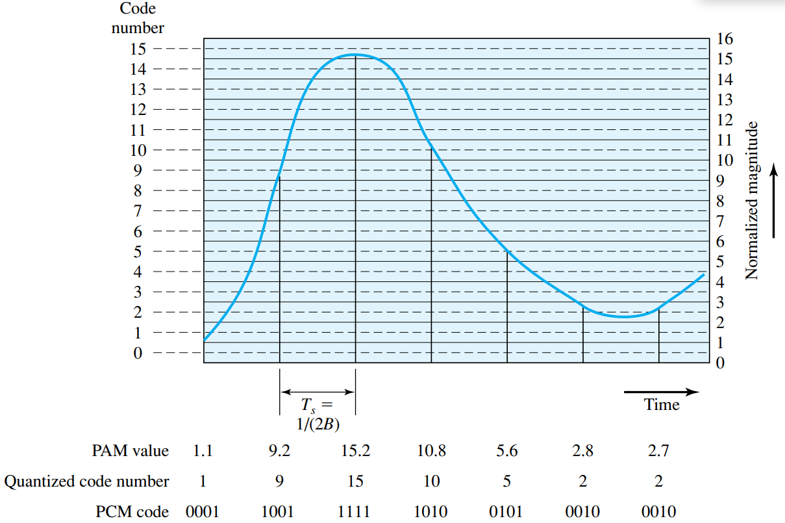
Pulse Code Modulation
Notes:
Let me first give a brief introduction of WOBAN architecture and the motivation of using WOBAN as an access technology. There are two main types of popular access networks. 1. Optical access networks where from CO optical fibers are pulled to ONUs located at every homes, premises or offices, which basically work as gateways for Internet access to the users. The popular access technology of this access networks is PON. The advantage of this access is that it provides high bandwidth and fast Internet service. The limitation is that it needs fiber to penetrate in each and every premises which make this scheme very costly. Also there is a limitation of maximum fiber length.
Another popular access networks is wireless access. Popular technology of this type are WiFi and WiMAX. The advantage of these access technology is that this is flexible and cost effective scheme. But the limitation is that when the hop of hops increase a lot, real time multi-media traffic suffers a lot.
Let me first give a brief introduction of WOBAN architecture and the motivation of using WOBAN as an access technology. There are two main types of popular access networks. First is the optical access such as passive optical networks (PON), which provides fast Internet service because of high bandwidth. But it requires fiber to be penetrated from central office to all residential complex, offices and premises which make the scheme highly costly. Another popular access technology is wireless access, which is flexible and cost-efficient, but does not function well when the number of hops increases.

Slide 8
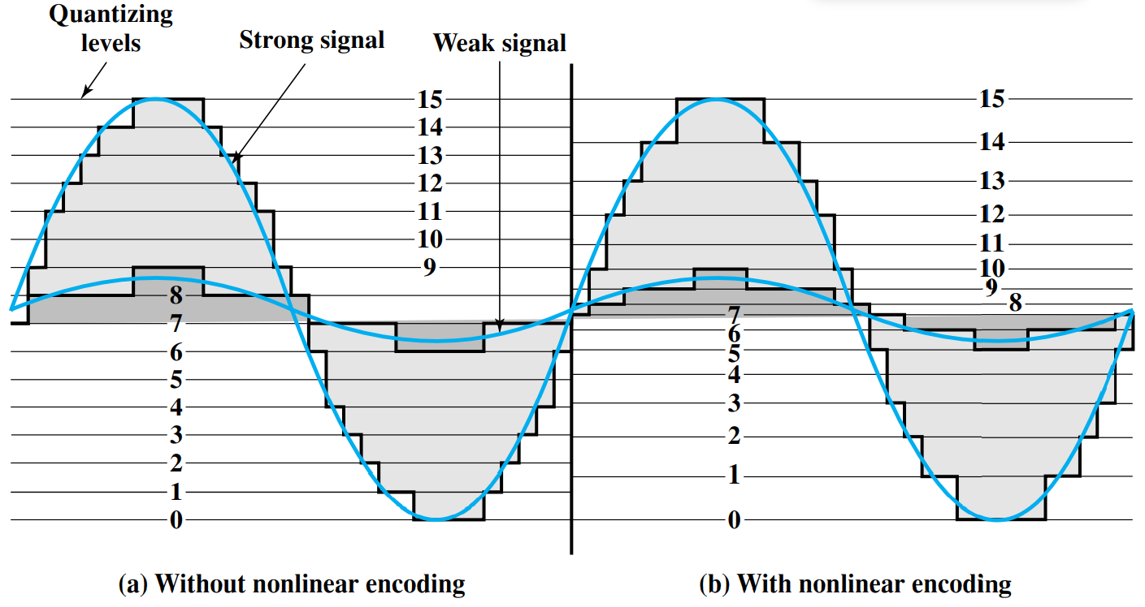
Nonlinear Coding
Notes:
Let me first give a brief introduction of WOBAN architecture and the motivation of using WOBAN as an access technology. There are two main types of popular access networks. 1. Optical access networks where from CO optical fibers are pulled to ONUs located at every homes, premises or offices, which basically work as gateways for Internet access to the users. The popular access technology of this access networks is PON. The advantage of this access is that it provides high bandwidth and fast Internet service. The limitation is that it needs fiber to penetrate in each and every premises which make this scheme very costly. Also there is a limitation of maximum fiber length.
Another popular access networks is wireless access. Popular technology of this type are WiFi and WiMAX. The advantage of these access technology is that this is flexible and cost effective scheme. But the limitation is that when the hop of hops increase a lot, real time multi-media traffic suffers a lot.
Let me first give a brief introduction of WOBAN architecture and the motivation of using WOBAN as an access technology. There are two main types of popular access networks. First is the optical access such as passive optical networks (PON), which provides fast Internet service because of high bandwidth. But it requires fiber to be penetrated from central office to all residential complex, offices and premises which make the scheme highly costly. Another popular access technology is wireless access, which is flexible and cost-efficient, but does not function well when the number of hops increases.

Slide 9
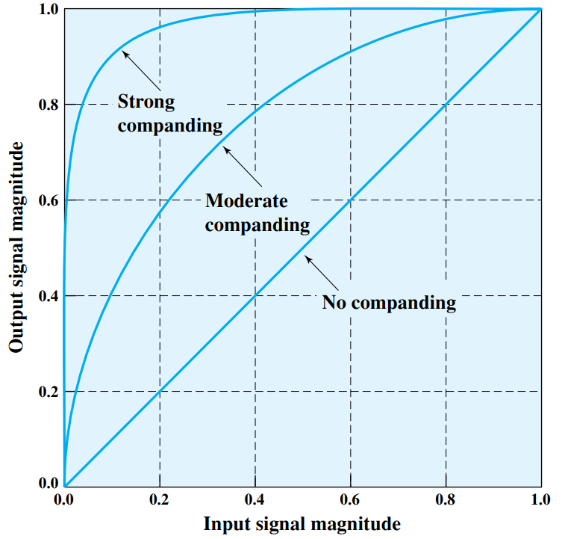
Companding
Notes:
Let me first give a brief introduction of WOBAN architecture and the motivation of using WOBAN as an access technology. There are two main types of popular access networks. 1. Optical access networks where from CO optical fibers are pulled to ONUs located at every homes, premises or offices, which basically work as gateways for Internet access to the users. The popular access technology of this access networks is PON. The advantage of this access is that it provides high bandwidth and fast Internet service. The limitation is that it needs fiber to penetrate in each and every premises which make this scheme very costly. Also there is a limitation of maximum fiber length.
Another popular access networks is wireless access. Popular technology of this type are WiFi and WiMAX. The advantage of these access technology is that this is flexible and cost effective scheme. But the limitation is that when the hop of hops increase a lot, real time multi-media traffic suffers a lot.
Let me first give a brief introduction of WOBAN architecture and the motivation of using WOBAN as an access technology. There are two main types of popular access networks. First is the optical access such as passive optical networks (PON), which provides fast Internet service because of high bandwidth. But it requires fiber to be penetrated from central office to all residential complex, offices and premises which make the scheme highly costly. Another popular access technology is wireless access, which is flexible and cost-efficient, but does not function well when the number of hops increases.

Slide 10
Pulse Code Modulation
A voice signal occupies a bandwidth of 4 KHz (assume that this is the maximum frequency). Now good voice reproduction via PCM can be achieved with 128 quantization levels. Then what will be the minimum data rate for the PCM encoded digital data?
128 quantization levels → 7 bit coding
The maximum frequency is 4khz → the sampling rate is atleast 8000 samples/sec
Therefore, the datarate will be atleast 8000 x 7 = 56kbps
Notes:
Let me first give a brief introduction of WOBAN architecture and the motivation of using WOBAN as an access technology. There are two main types of popular access networks. 1. Optical access networks where from CO optical fibers are pulled to ONUs located at every homes, premises or offices, which basically work as gateways for Internet access to the users. The popular access technology of this access networks is PON. The advantage of this access is that it provides high bandwidth and fast Internet service. The limitation is that it needs fiber to penetrate in each and every premises which make this scheme very costly. Also there is a limitation of maximum fiber length.
Another popular access networks is wireless access. Popular technology of this type are WiFi and WiMAX. The advantage of these access technology is that this is flexible and cost effective scheme. But the limitation is that when the hop of hops increase a lot, real time multi-media traffic suffers a lot.
Let me first give a brief introduction of WOBAN architecture and the motivation of using WOBAN as an access technology. There are two main types of popular access networks. First is the optical access such as passive optical networks (PON), which provides fast Internet service because of high bandwidth. But it requires fiber to be penetrated from central office to all residential complex, offices and premises which make the scheme highly costly. Another popular access technology is wireless access, which is flexible and cost-efficient, but does not function well when the number of hops increases.

Slide 11
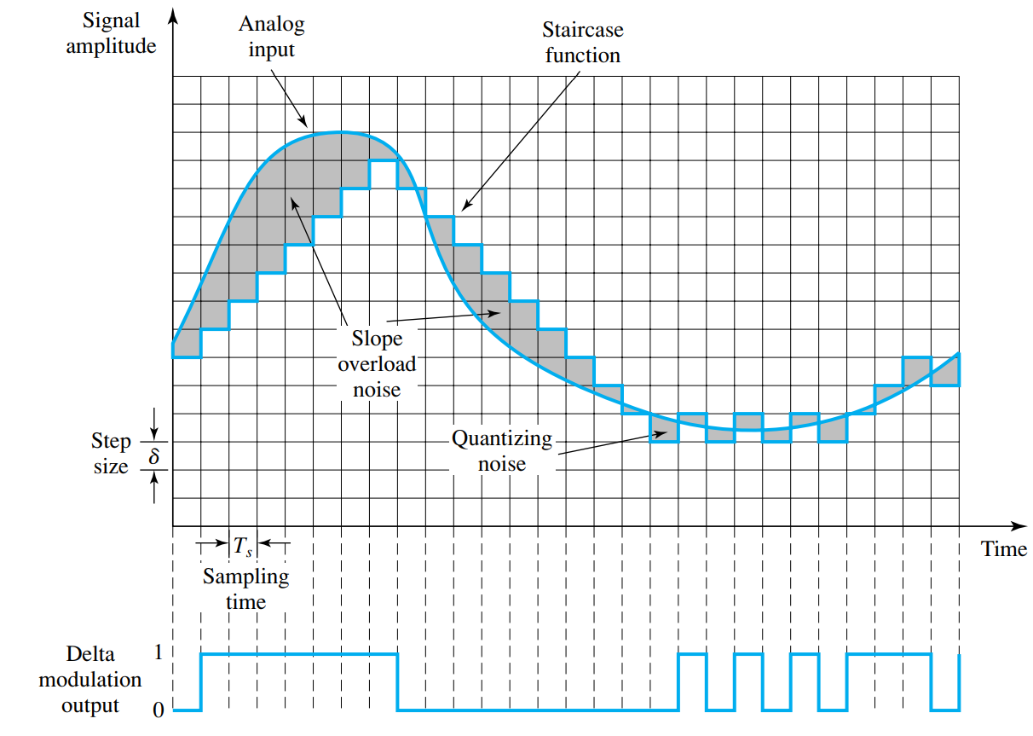
Delta Modulation
Notes:
Let me first give a brief introduction of WOBAN architecture and the motivation of using WOBAN as an access technology. There are two main types of popular access networks. 1. Optical access networks where from CO optical fibers are pulled to ONUs located at every homes, premises or offices, which basically work as gateways for Internet access to the users. The popular access technology of this access networks is PON. The advantage of this access is that it provides high bandwidth and fast Internet service. The limitation is that it needs fiber to penetrate in each and every premises which make this scheme very costly. Also there is a limitation of maximum fiber length.
Another popular access networks is wireless access. Popular technology of this type are WiFi and WiMAX. The advantage of these access technology is that this is flexible and cost effective scheme. But the limitation is that when the hop of hops increase a lot, real time multi-media traffic suffers a lot.
Let me first give a brief introduction of WOBAN architecture and the motivation of using WOBAN as an access technology. There are two main types of popular access networks. First is the optical access such as passive optical networks (PON), which provides fast Internet service because of high bandwidth. But it requires fiber to be penetrated from central office to all residential complex, offices and premises which make the scheme highly costly. Another popular access technology is wireless access, which is flexible and cost-efficient, but does not function well when the number of hops increases.

Slide 12
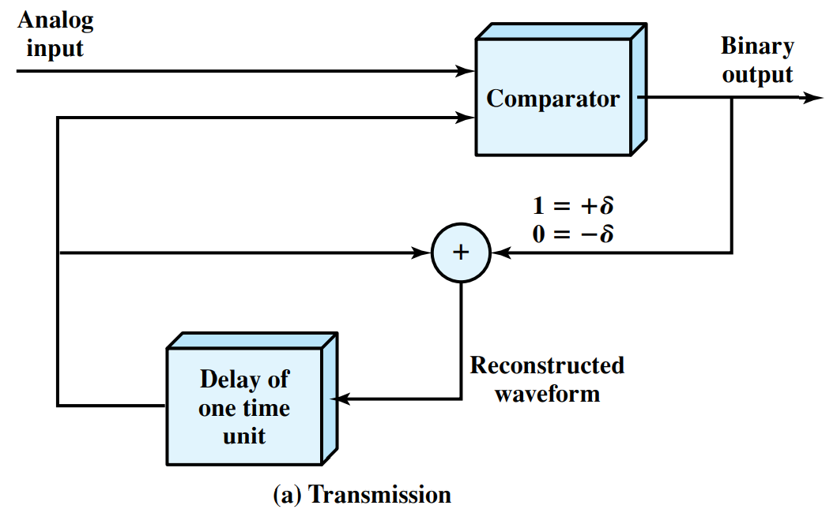
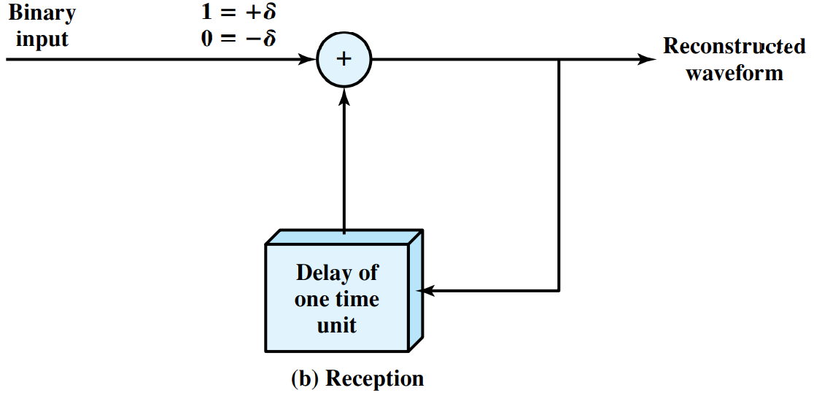
Delta Modulation Operation
Notes:
Let me first give a brief introduction of WOBAN architecture and the motivation of using WOBAN as an access technology. There are two main types of popular access networks. 1. Optical access networks where from CO optical fibers are pulled to ONUs located at every homes, premises or offices, which basically work as gateways for Internet access to the users. The popular access technology of this access networks is PON. The advantage of this access is that it provides high bandwidth and fast Internet service. The limitation is that it needs fiber to penetrate in each and every premises which make this scheme very costly. Also there is a limitation of maximum fiber length.
Another popular access networks is wireless access. Popular technology of this type are WiFi and WiMAX. The advantage of these access technology is that this is flexible and cost effective scheme. But the limitation is that when the hop of hops increase a lot, real time multi-media traffic suffers a lot.
Let me first give a brief introduction of WOBAN architecture and the motivation of using WOBAN as an access technology. There are two main types of popular access networks. First is the optical access such as passive optical networks (PON), which provides fast Internet service because of high bandwidth. But it requires fiber to be penetrated from central office to all residential complex, offices and premises which make the scheme highly costly. Another popular access technology is wireless access, which is flexible and cost-efficient, but does not function well when the number of hops increases.

Slide 13
PCM versus Delta Modulation
DM has simplicity compared to PCM
DM requires lower transmission bandwidth
DM has poorer SNR as compared to PCM
Notes:
Let me first give a brief introduction of WOBAN architecture and the motivation of using WOBAN as an access technology. There are two main types of popular access networks. 1. Optical access networks where from CO optical fibers are pulled to ONUs located at every homes, premises or offices, which basically work as gateways for Internet access to the users. The popular access technology of this access networks is PON. The advantage of this access is that it provides high bandwidth and fast Internet service. The limitation is that it needs fiber to penetrate in each and every premises which make this scheme very costly. Also there is a limitation of maximum fiber length.
Another popular access networks is wireless access. Popular technology of this type are WiFi and WiMAX. The advantage of these access technology is that this is flexible and cost effective scheme. But the limitation is that when the hop of hops increase a lot, real time multi-media traffic suffers a lot.
Let me first give a brief introduction of WOBAN architecture and the motivation of using WOBAN as an access technology. There are two main types of popular access networks. First is the optical access such as passive optical networks (PON), which provides fast Internet service because of high bandwidth. But it requires fiber to be penetrated from central office to all residential complex, offices and premises which make the scheme highly costly. Another popular access technology is wireless access, which is flexible and cost-efficient, but does not function well when the number of hops increases.

Slide 14
Summary
Signal encoding techniques (Analog data → Digital signals):
Nyquist Sampling Theorem
Pulse Code Modulation
Delta Modulation
Comparison of Pulse Code Modulation and Delta Modulation

