Slide 1
Computer Networks I Signal Modulation Techniques (Digital to Analog)
Amitangshu Pal
Computer Science and Engineering
IIT Kanpur

Slide 2
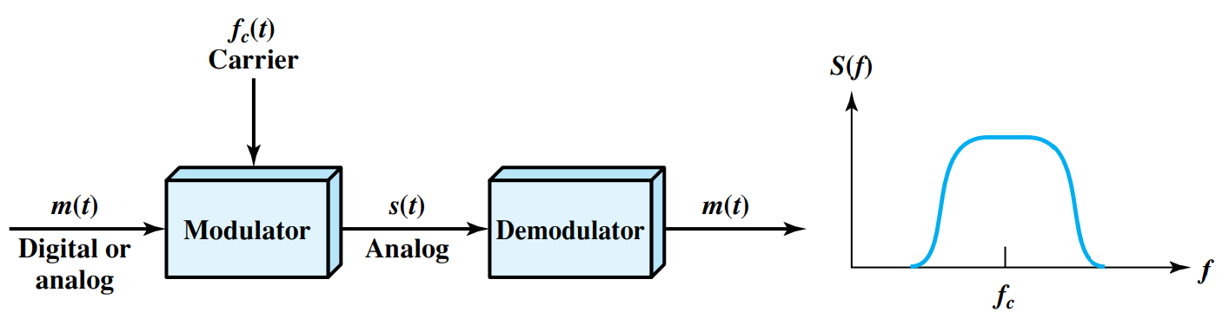
Modulation Basics
Notes:
Let me first give a brief introduction of WOBAN architecture and the motivation of using WOBAN as an access technology. There are two main types of popular access networks. 1. Optical access networks where from CO optical fibers are pulled to ONUs located at every homes, premises or offices, which basically work as gateways for Internet access to the users. The popular access technology of this access networks is PON. The advantage of this access is that it provides high bandwidth and fast Internet service. The limitation is that it needs fiber to penetrate in each and every premises which make this scheme very costly. Also there is a limitation of maximum fiber length.
Another popular access networks is wireless access. Popular technology of this type are WiFi and WiMAX. The advantage of these access technology is that this is flexible and cost effective scheme. But the limitation is that when the hop of hops increase a lot, real time multi-media traffic suffers a lot.
Let me first give a brief introduction of WOBAN architecture and the motivation of using WOBAN as an access technology. There are two main types of popular access networks. First is the optical access such as passive optical networks (PON), which provides fast Internet service because of high bandwidth. But it requires fiber to be penetrated from central office to all residential complex, offices and premises which make the scheme highly costly. Another popular access technology is wireless access, which is flexible and cost-efficient, but does not function well when the number of hops increases.

Slide 3
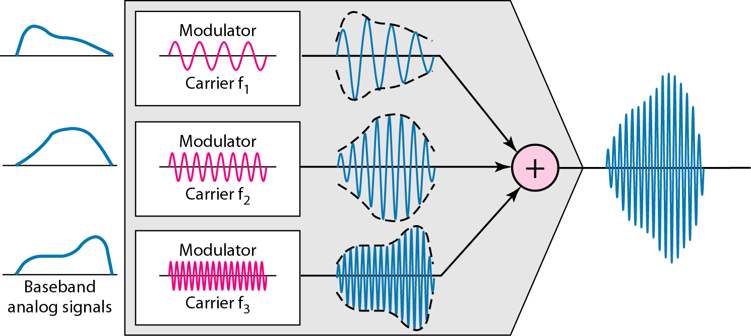
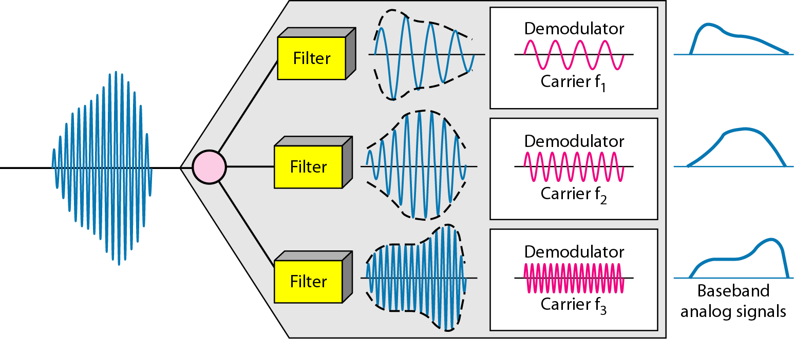

Frequency reuse and multiplexing
Multiple stations can simultaneously transmit at different frequencies
Reducing antenna length
Antenna length $∝λ$
Why Modulation?

Slide 4

Digital Data → Analog Signals
Three principle techniques:
Amplitude shift keying (ASK)
Frequency shift keying (FSK)
Phase shift keying (PSK)
$$s\left(t\right)=A\sin{(2πft+ϕ)}$$
Notes:
Let me first give a brief introduction of WOBAN architecture and the motivation of using WOBAN as an access technology. There are two main types of popular access networks. 1. Optical access networks where from CO optical fibers are pulled to ONUs located at every homes, premises or offices, which basically work as gateways for Internet access to the users. The popular access technology of this access networks is PON. The advantage of this access is that it provides high bandwidth and fast Internet service. The limitation is that it needs fiber to penetrate in each and every premises which make this scheme very costly. Also there is a limitation of maximum fiber length.
Another popular access networks is wireless access. Popular technology of this type are WiFi and WiMAX. The advantage of these access technology is that this is flexible and cost effective scheme. But the limitation is that when the hop of hops increase a lot, real time multi-media traffic suffers a lot.
Let me first give a brief introduction of WOBAN architecture and the motivation of using WOBAN as an access technology. There are two main types of popular access networks. First is the optical access such as passive optical networks (PON), which provides fast Internet service because of high bandwidth. But it requires fiber to be penetrated from central office to all residential complex, offices and premises which make the scheme highly costly. Another popular access technology is wireless access, which is flexible and cost-efficient, but does not function well when the number of hops increases.

Slide 5
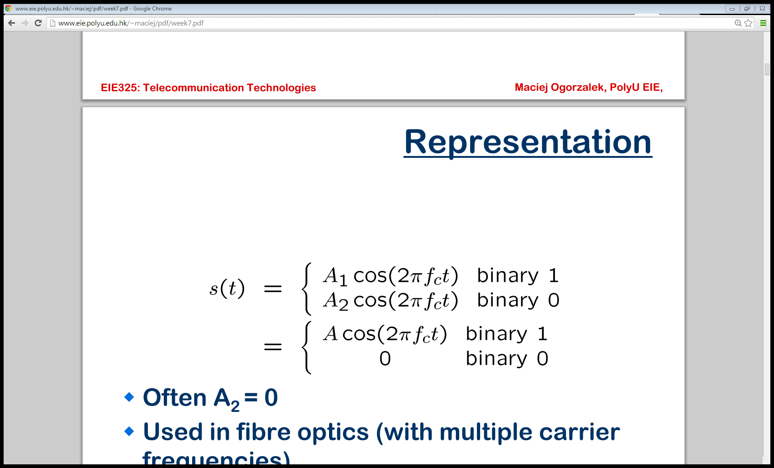
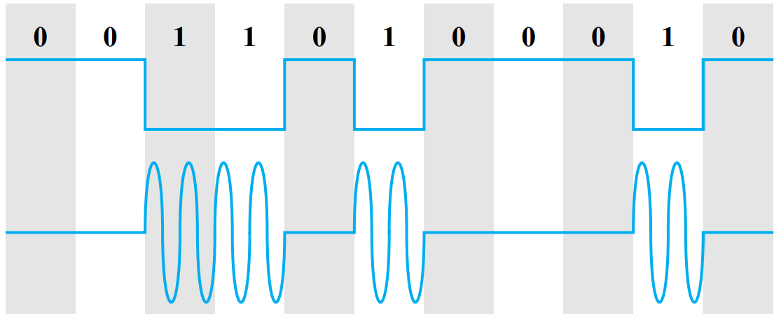
Amplitude Shift Keying
Encode 0/1 by different carrier amplitudes
Usually have one amplitude zero
Notes:
Let me first give a brief introduction of WOBAN architecture and the motivation of using WOBAN as an access technology. There are two main types of popular access networks. 1. Optical access networks where from CO optical fibers are pulled to ONUs located at every homes, premises or offices, which basically work as gateways for Internet access to the users. The popular access technology of this access networks is PON. The advantage of this access is that it provides high bandwidth and fast Internet service. The limitation is that it needs fiber to penetrate in each and every premises which make this scheme very costly. Also there is a limitation of maximum fiber length.
Another popular access networks is wireless access. Popular technology of this type are WiFi and WiMAX. The advantage of these access technology is that this is flexible and cost effective scheme. But the limitation is that when the hop of hops increase a lot, real time multi-media traffic suffers a lot.
Let me first give a brief introduction of WOBAN architecture and the motivation of using WOBAN as an access technology. There are two main types of popular access networks. First is the optical access such as passive optical networks (PON), which provides fast Internet service because of high bandwidth. But it requires fiber to be penetrated from central office to all residential complex, offices and premises which make the scheme highly costly. Another popular access technology is wireless access, which is flexible and cost-efficient, but does not function well when the number of hops increases.

Slide 6
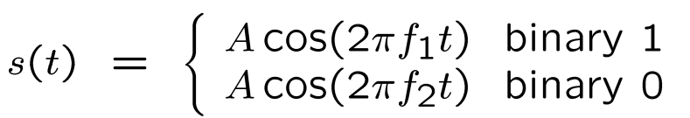
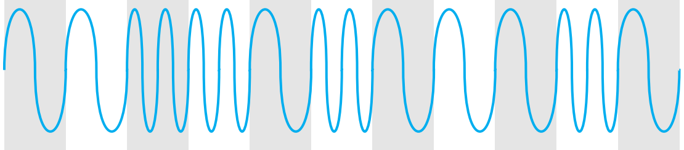
Frequency Shift Keying
Most common is binary FSK (BFSK)
Two binary values represented by two different frequencies
Notes:
Let me first give a brief introduction of WOBAN architecture and the motivation of using WOBAN as an access technology. There are two main types of popular access networks. 1. Optical access networks where from CO optical fibers are pulled to ONUs located at every homes, premises or offices, which basically work as gateways for Internet access to the users. The popular access technology of this access networks is PON. The advantage of this access is that it provides high bandwidth and fast Internet service. The limitation is that it needs fiber to penetrate in each and every premises which make this scheme very costly. Also there is a limitation of maximum fiber length.
Another popular access networks is wireless access. Popular technology of this type are WiFi and WiMAX. The advantage of these access technology is that this is flexible and cost effective scheme. But the limitation is that when the hop of hops increase a lot, real time multi-media traffic suffers a lot.
Let me first give a brief introduction of WOBAN architecture and the motivation of using WOBAN as an access technology. There are two main types of popular access networks. First is the optical access such as passive optical networks (PON), which provides fast Internet service because of high bandwidth. But it requires fiber to be penetrated from central office to all residential complex, offices and premises which make the scheme highly costly. Another popular access technology is wireless access, which is flexible and cost-efficient, but does not function well when the number of hops increases.

Slide 7
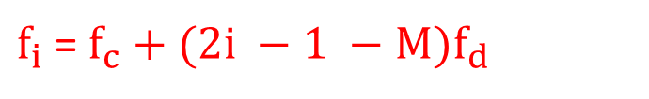
Frequency Shift Keying
Most common is binary FSK (BFSK)
Two binary values represented by two different frequencies
MFSK:
$f_{i}$ = $f_{c}+(2i −1 −M)f_{d}$
Notes:
Let me first give a brief introduction of WOBAN architecture and the motivation of using WOBAN as an access technology. There are two main types of popular access networks. 1. Optical access networks where from CO optical fibers are pulled to ONUs located at every homes, premises or offices, which basically work as gateways for Internet access to the users. The popular access technology of this access networks is PON. The advantage of this access is that it provides high bandwidth and fast Internet service. The limitation is that it needs fiber to penetrate in each and every premises which make this scheme very costly. Also there is a limitation of maximum fiber length.
Another popular access networks is wireless access. Popular technology of this type are WiFi and WiMAX. The advantage of these access technology is that this is flexible and cost effective scheme. But the limitation is that when the hop of hops increase a lot, real time multi-media traffic suffers a lot.
Let me first give a brief introduction of WOBAN architecture and the motivation of using WOBAN as an access technology. There are two main types of popular access networks. First is the optical access such as passive optical networks (PON), which provides fast Internet service because of high bandwidth. But it requires fiber to be penetrated from central office to all residential complex, offices and premises which make the scheme highly costly. Another popular access technology is wireless access, which is flexible and cost-efficient, but does not function well when the number of hops increases.

Slide 8
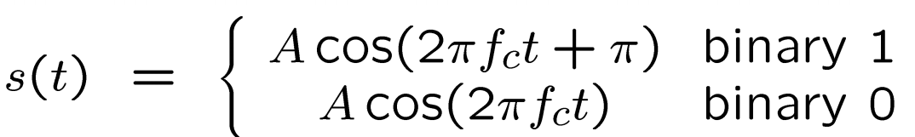
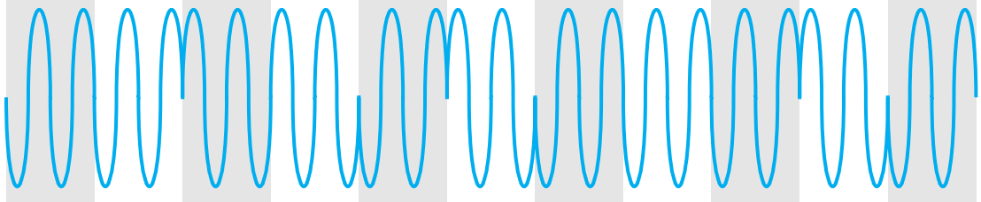
Phase Shift Keying
Phase of carrier signal is shifted to represent data
Binary PSK
Two phases represent two binary digits
Notes:
Let me first give a brief introduction of WOBAN architecture and the motivation of using WOBAN as an access technology. There are two main types of popular access networks. 1. Optical access networks where from CO optical fibers are pulled to ONUs located at every homes, premises or offices, which basically work as gateways for Internet access to the users. The popular access technology of this access networks is PON. The advantage of this access is that it provides high bandwidth and fast Internet service. The limitation is that it needs fiber to penetrate in each and every premises which make this scheme very costly. Also there is a limitation of maximum fiber length.
Another popular access networks is wireless access. Popular technology of this type are WiFi and WiMAX. The advantage of these access technology is that this is flexible and cost effective scheme. But the limitation is that when the hop of hops increase a lot, real time multi-media traffic suffers a lot.
Let me first give a brief introduction of WOBAN architecture and the motivation of using WOBAN as an access technology. There are two main types of popular access networks. First is the optical access such as passive optical networks (PON), which provides fast Internet service because of high bandwidth. But it requires fiber to be penetrated from central office to all residential complex, offices and premises which make the scheme highly costly. Another popular access technology is wireless access, which is flexible and cost-efficient, but does not function well when the number of hops increases.

Slide 9
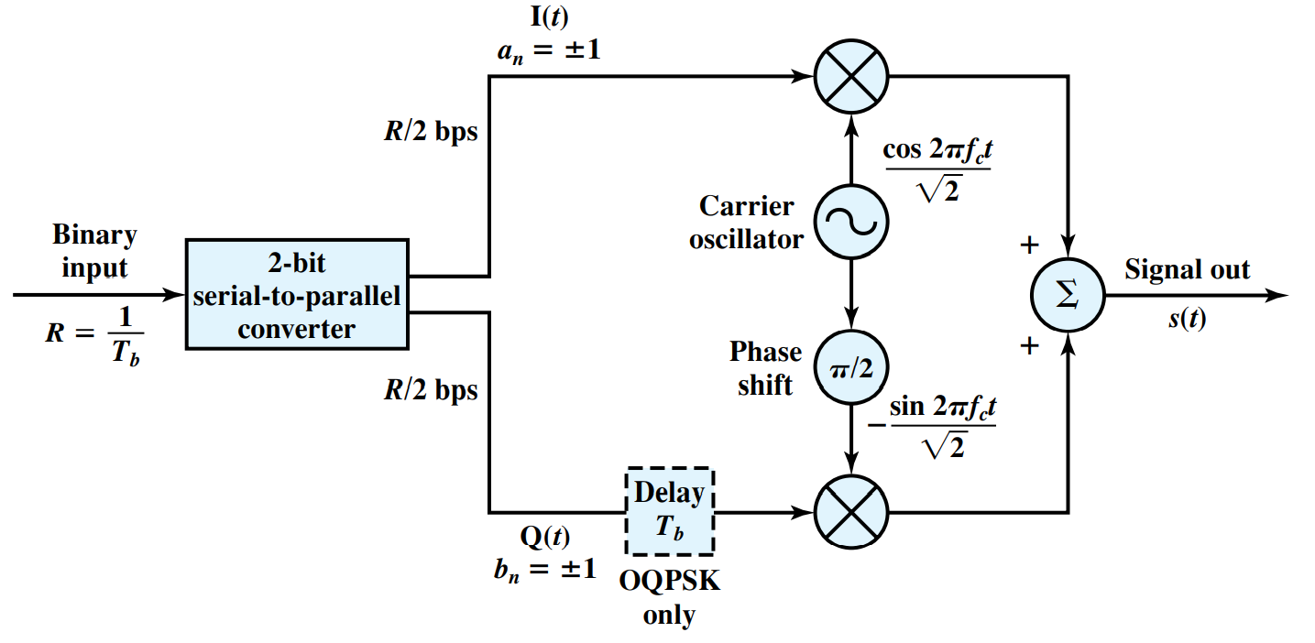
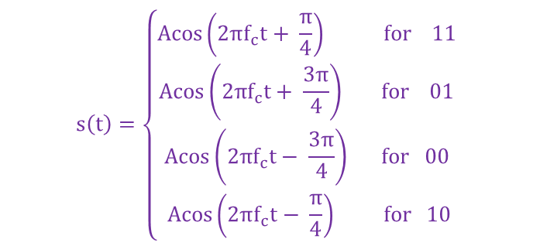

Quadrature Phase Shift Keying
$$s\left(t\right)=\left\{\begin{aligned}Acos\left(2πf_{c}t+ \frac{π}{4}\right) for 11 \\ Acos\left(2πf_{c}t+ \frac{3π}{4}\right) for 01 \\ Acos\left(2πf_{c}t− \frac{3π}{4}\right) for 00 \\ Acos\left(2πf_{c}t− \frac{π}{4}\right) for 10\end{aligned}\right.$$
$$s\left(t\right)=\frac{1}{\sqrt{2}}I\left(t\right)cos2πf_{c}t −\frac{1}{\sqrt{2}}Q\left(t\right)sin2πf_{c}t$$
Notes:
Let me first give a brief introduction of WOBAN architecture and the motivation of using WOBAN as an access technology. There are two main types of popular access networks. 1. Optical access networks where from CO optical fibers are pulled to ONUs located at every homes, premises or offices, which basically work as gateways for Internet access to the users. The popular access technology of this access networks is PON. The advantage of this access is that it provides high bandwidth and fast Internet service. The limitation is that it needs fiber to penetrate in each and every premises which make this scheme very costly. Also there is a limitation of maximum fiber length.
Another popular access networks is wireless access. Popular technology of this type are WiFi and WiMAX. The advantage of these access technology is that this is flexible and cost effective scheme. But the limitation is that when the hop of hops increase a lot, real time multi-media traffic suffers a lot.
Let me first give a brief introduction of WOBAN architecture and the motivation of using WOBAN as an access technology. There are two main types of popular access networks. First is the optical access such as passive optical networks (PON), which provides fast Internet service because of high bandwidth. But it requires fiber to be penetrated from central office to all residential complex, offices and premises which make the scheme highly costly. Another popular access technology is wireless access, which is flexible and cost-efficient, but does not function well when the number of hops increases.

Slide 10
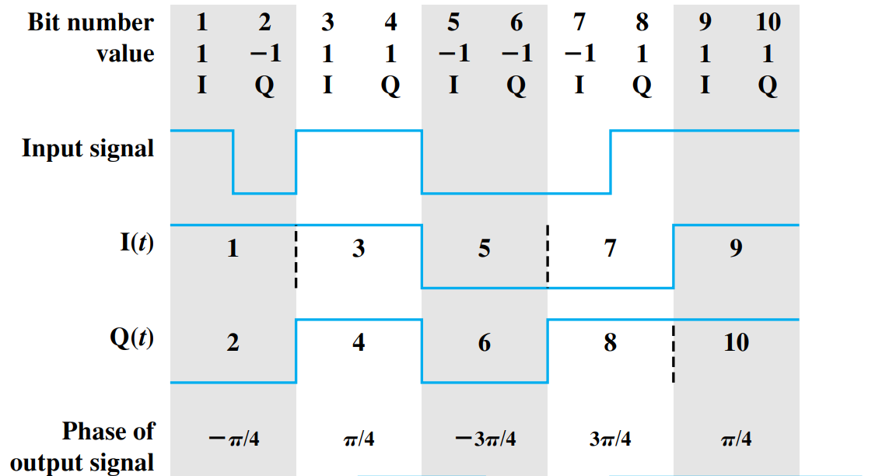
Quadrature Phase Shift Keying
Notes:
Let me first give a brief introduction of WOBAN architecture and the motivation of using WOBAN as an access technology. There are two main types of popular access networks. 1. Optical access networks where from CO optical fibers are pulled to ONUs located at every homes, premises or offices, which basically work as gateways for Internet access to the users. The popular access technology of this access networks is PON. The advantage of this access is that it provides high bandwidth and fast Internet service. The limitation is that it needs fiber to penetrate in each and every premises which make this scheme very costly. Also there is a limitation of maximum fiber length.
Another popular access networks is wireless access. Popular technology of this type are WiFi and WiMAX. The advantage of these access technology is that this is flexible and cost effective scheme. But the limitation is that when the hop of hops increase a lot, real time multi-media traffic suffers a lot.
Let me first give a brief introduction of WOBAN architecture and the motivation of using WOBAN as an access technology. There are two main types of popular access networks. First is the optical access such as passive optical networks (PON), which provides fast Internet service because of high bandwidth. But it requires fiber to be penetrated from central office to all residential complex, offices and premises which make the scheme highly costly. Another popular access technology is wireless access, which is flexible and cost-efficient, but does not function well when the number of hops increases.

Slide 11
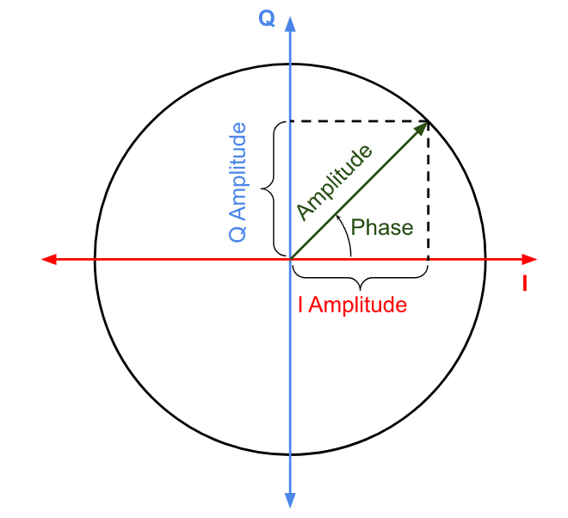
Constellation Diagram
Representation of a digital modulated signal as a two-dimensional scatter diagram
Src: https://commons.wikimedia.org/wiki/File:IQ_phasor_diagram.svg
Notes:
Let me first give a brief introduction of WOBAN architecture and the motivation of using WOBAN as an access technology. There are two main types of popular access networks. 1. Optical access networks where from CO optical fibers are pulled to ONUs located at every homes, premises or offices, which basically work as gateways for Internet access to the users. The popular access technology of this access networks is PON. The advantage of this access is that it provides high bandwidth and fast Internet service. The limitation is that it needs fiber to penetrate in each and every premises which make this scheme very costly. Also there is a limitation of maximum fiber length.
Another popular access networks is wireless access. Popular technology of this type are WiFi and WiMAX. The advantage of these access technology is that this is flexible and cost effective scheme. But the limitation is that when the hop of hops increase a lot, real time multi-media traffic suffers a lot.
Let me first give a brief introduction of WOBAN architecture and the motivation of using WOBAN as an access technology. There are two main types of popular access networks. First is the optical access such as passive optical networks (PON), which provides fast Internet service because of high bandwidth. But it requires fiber to be penetrated from central office to all residential complex, offices and premises which make the scheme highly costly. Another popular access technology is wireless access, which is flexible and cost-efficient, but does not function well when the number of hops increases.

Slide 12
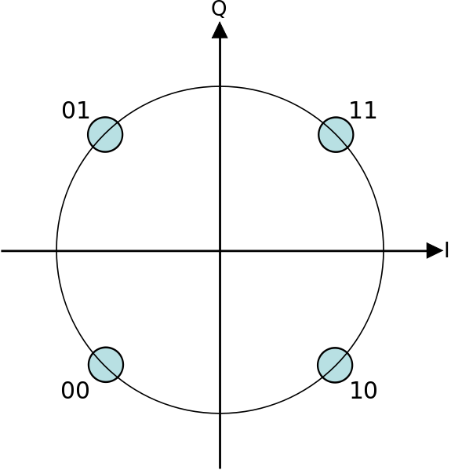
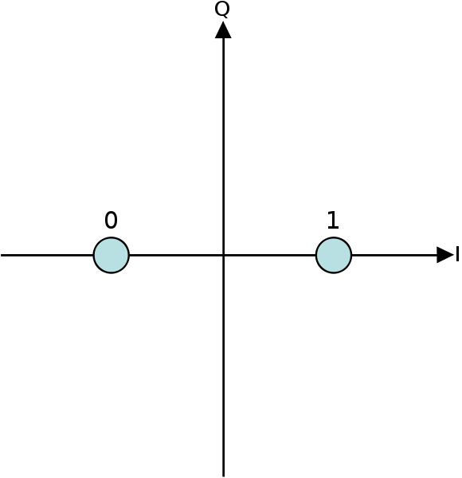
Constellation Diagram
QPSK
BPSK
Src:https://commons.wikimedia.org/wiki/File:BPSK_Gray_Coded.svg
Src:https://commons.wikimedia.org/wiki/File:QPSK_Gray_Coded.svg
Notes:
Let me first give a brief introduction of WOBAN architecture and the motivation of using WOBAN as an access technology. There are two main types of popular access networks. 1. Optical access networks where from CO optical fibers are pulled to ONUs located at every homes, premises or offices, which basically work as gateways for Internet access to the users. The popular access technology of this access networks is PON. The advantage of this access is that it provides high bandwidth and fast Internet service. The limitation is that it needs fiber to penetrate in each and every premises which make this scheme very costly. Also there is a limitation of maximum fiber length.
Another popular access networks is wireless access. Popular technology of this type are WiFi and WiMAX. The advantage of these access technology is that this is flexible and cost effective scheme. But the limitation is that when the hop of hops increase a lot, real time multi-media traffic suffers a lot.
Let me first give a brief introduction of WOBAN architecture and the motivation of using WOBAN as an access technology. There are two main types of popular access networks. First is the optical access such as passive optical networks (PON), which provides fast Internet service because of high bandwidth. But it requires fiber to be penetrated from central office to all residential complex, offices and premises which make the scheme highly costly. Another popular access technology is wireless access, which is flexible and cost-efficient, but does not function well when the number of hops increases.

Slide 13
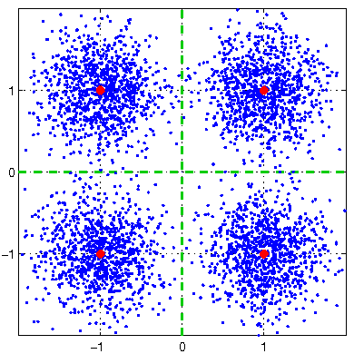
Constellation Diagram
QPSK
Src:https://commons.wikimedia.org/wiki/File:QPSK_Gray_Coded.svg
Src:https://commons.wikimedia.org/wiki/File:4qam_constellation_noisy_sigma025.png
Notes:
Let me first give a brief introduction of WOBAN architecture and the motivation of using WOBAN as an access technology. There are two main types of popular access networks. 1. Optical access networks where from CO optical fibers are pulled to ONUs located at every homes, premises or offices, which basically work as gateways for Internet access to the users. The popular access technology of this access networks is PON. The advantage of this access is that it provides high bandwidth and fast Internet service. The limitation is that it needs fiber to penetrate in each and every premises which make this scheme very costly. Also there is a limitation of maximum fiber length.
Another popular access networks is wireless access. Popular technology of this type are WiFi and WiMAX. The advantage of these access technology is that this is flexible and cost effective scheme. But the limitation is that when the hop of hops increase a lot, real time multi-media traffic suffers a lot.
Let me first give a brief introduction of WOBAN architecture and the motivation of using WOBAN as an access technology. There are two main types of popular access networks. First is the optical access such as passive optical networks (PON), which provides fast Internet service because of high bandwidth. But it requires fiber to be penetrated from central office to all residential complex, offices and premises which make the scheme highly costly. Another popular access technology is wireless access, which is flexible and cost-efficient, but does not function well when the number of hops increases.

Slide 14
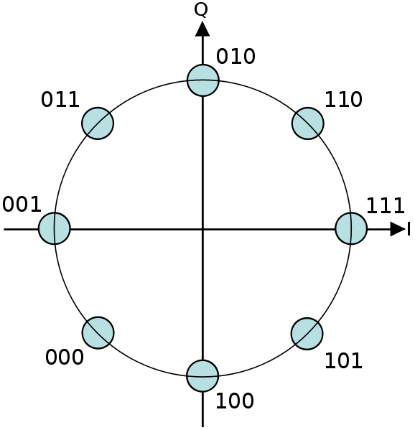
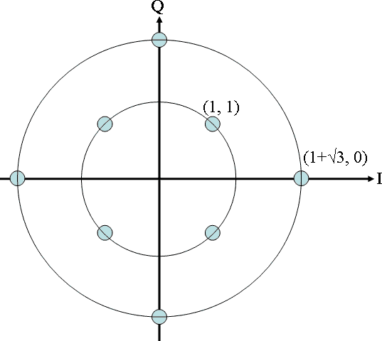
Constellation Diagram
8-PSK
8-QAM
Src:https://commons.wikimedia.org/wiki/File:8PSK_Gray_Coded.svg
Src:https://commons.wikimedia.org/wiki/File:Circular_8QAM.png
Notes:
Let me first give a brief introduction of WOBAN architecture and the motivation of using WOBAN as an access technology. There are two main types of popular access networks. 1. Optical access networks where from CO optical fibers are pulled to ONUs located at every homes, premises or offices, which basically work as gateways for Internet access to the users. The popular access technology of this access networks is PON. The advantage of this access is that it provides high bandwidth and fast Internet service. The limitation is that it needs fiber to penetrate in each and every premises which make this scheme very costly. Also there is a limitation of maximum fiber length.
Another popular access networks is wireless access. Popular technology of this type are WiFi and WiMAX. The advantage of these access technology is that this is flexible and cost effective scheme. But the limitation is that when the hop of hops increase a lot, real time multi-media traffic suffers a lot.
Let me first give a brief introduction of WOBAN architecture and the motivation of using WOBAN as an access technology. There are two main types of popular access networks. First is the optical access such as passive optical networks (PON), which provides fast Internet service because of high bandwidth. But it requires fiber to be penetrated from central office to all residential complex, offices and premises which make the scheme highly costly. Another popular access technology is wireless access, which is flexible and cost-efficient, but does not function well when the number of hops increases.

Slide 15
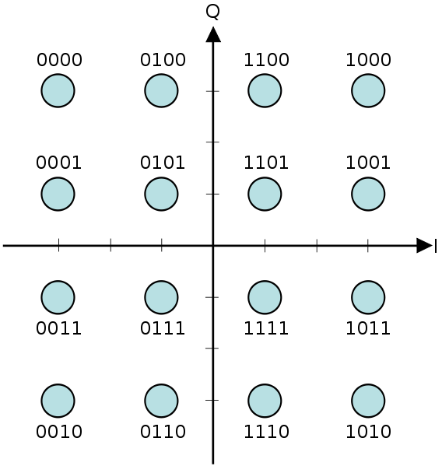
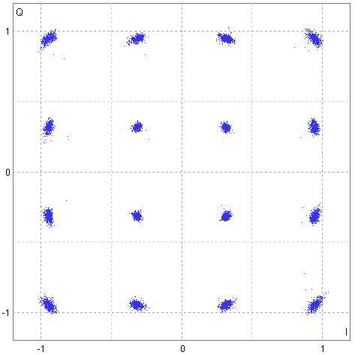
Quadrature Amplitude Modulation
16-QAM
Src:https://commons.wikimedia.org/wiki/File:16QAM_Gray_Coded.svg
Src:https://commons.wikimedia.org/wiki/File:FDD_16-QAM.png
Notes:
Let me first give a brief introduction of WOBAN architecture and the motivation of using WOBAN as an access technology. There are two main types of popular access networks. 1. Optical access networks where from CO optical fibers are pulled to ONUs located at every homes, premises or offices, which basically work as gateways for Internet access to the users. The popular access technology of this access networks is PON. The advantage of this access is that it provides high bandwidth and fast Internet service. The limitation is that it needs fiber to penetrate in each and every premises which make this scheme very costly. Also there is a limitation of maximum fiber length.
Another popular access networks is wireless access. Popular technology of this type are WiFi and WiMAX. The advantage of these access technology is that this is flexible and cost effective scheme. But the limitation is that when the hop of hops increase a lot, real time multi-media traffic suffers a lot.
Let me first give a brief introduction of WOBAN architecture and the motivation of using WOBAN as an access technology. There are two main types of popular access networks. First is the optical access such as passive optical networks (PON), which provides fast Internet service because of high bandwidth. But it requires fiber to be penetrated from central office to all residential complex, offices and premises which make the scheme highly costly. Another popular access technology is wireless access, which is flexible and cost-efficient, but does not function well when the number of hops increases.

Slide 16
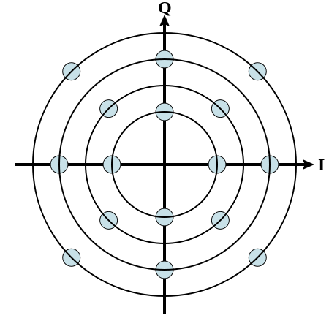
Quadrature Amplitude Modulation
16-QAM
Src:https://commons.wikimedia.org/wiki/File:16QAM_Gray_Coded.svg
Src:https://commons.wikimedia.org/wiki/File:Circular_16QAM.svg
Notes:
Let me first give a brief introduction of WOBAN architecture and the motivation of using WOBAN as an access technology. There are two main types of popular access networks. 1. Optical access networks where from CO optical fibers are pulled to ONUs located at every homes, premises or offices, which basically work as gateways for Internet access to the users. The popular access technology of this access networks is PON. The advantage of this access is that it provides high bandwidth and fast Internet service. The limitation is that it needs fiber to penetrate in each and every premises which make this scheme very costly. Also there is a limitation of maximum fiber length.
Another popular access networks is wireless access. Popular technology of this type are WiFi and WiMAX. The advantage of these access technology is that this is flexible and cost effective scheme. But the limitation is that when the hop of hops increase a lot, real time multi-media traffic suffers a lot.
Let me first give a brief introduction of WOBAN architecture and the motivation of using WOBAN as an access technology. There are two main types of popular access networks. First is the optical access such as passive optical networks (PON), which provides fast Internet service because of high bandwidth. But it requires fiber to be penetrated from central office to all residential complex, offices and premises which make the scheme highly costly. Another popular access technology is wireless access, which is flexible and cost-efficient, but does not function well when the number of hops increases.

Slide 17
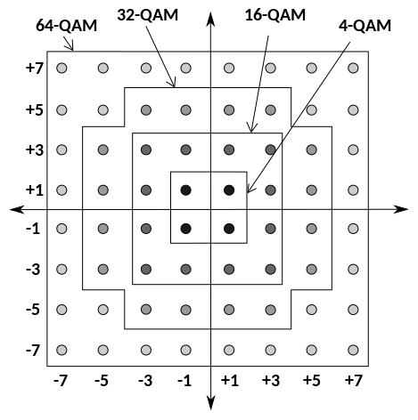
Quadrature Amplitude Modulation
Src:https://commons.wikimedia.org/wiki/File:Rectangular_constellation_for_QAM.svg
Notes:
Let me first give a brief introduction of WOBAN architecture and the motivation of using WOBAN as an access technology. There are two main types of popular access networks. 1. Optical access networks where from CO optical fibers are pulled to ONUs located at every homes, premises or offices, which basically work as gateways for Internet access to the users. The popular access technology of this access networks is PON. The advantage of this access is that it provides high bandwidth and fast Internet service. The limitation is that it needs fiber to penetrate in each and every premises which make this scheme very costly. Also there is a limitation of maximum fiber length.
Another popular access networks is wireless access. Popular technology of this type are WiFi and WiMAX. The advantage of these access technology is that this is flexible and cost effective scheme. But the limitation is that when the hop of hops increase a lot, real time multi-media traffic suffers a lot.
Let me first give a brief introduction of WOBAN architecture and the motivation of using WOBAN as an access technology. There are two main types of popular access networks. First is the optical access such as passive optical networks (PON), which provides fast Internet service because of high bandwidth. But it requires fiber to be penetrated from central office to all residential complex, offices and premises which make the scheme highly costly. Another popular access technology is wireless access, which is flexible and cost-efficient, but does not function well when the number of hops increases.

Slide 18
Bit and Baud Rate Comparison
Modulation | Bits/Baud | Baud rate | Bit Rate
ASK, FSK, 2-PSK | 1 | N | N
4-PSK, 4-QAM | 2 | N | 2N
8-PSK, 8-QAM | 3 | N | 3N
16-QAM | 4 | N | 4N
32-QAM | 5 | N | 5N
64-QAM | 6 | N | 6N
128-QAM | 7 | N | 7N
256-QAM | 8 | N | 8N
Notes:
Let me first give a brief introduction of WOBAN architecture and the motivation of using WOBAN as an access technology. There are two main types of popular access networks. 1. Optical access networks where from CO optical fibers are pulled to ONUs located at every homes, premises or offices, which basically work as gateways for Internet access to the users. The popular access technology of this access networks is PON. The advantage of this access is that it provides high bandwidth and fast Internet service. The limitation is that it needs fiber to penetrate in each and every premises which make this scheme very costly. Also there is a limitation of maximum fiber length.
Another popular access networks is wireless access. Popular technology of this type are WiFi and WiMAX. The advantage of these access technology is that this is flexible and cost effective scheme. But the limitation is that when the hop of hops increase a lot, real time multi-media traffic suffers a lot.
Let me first give a brief introduction of WOBAN architecture and the motivation of using WOBAN as an access technology. There are two main types of popular access networks. First is the optical access such as passive optical networks (PON), which provides fast Internet service because of high bandwidth. But it requires fiber to be penetrated from central office to all residential complex, offices and premises which make the scheme highly costly. Another popular access technology is wireless access, which is flexible and cost-efficient, but does not function well when the number of hops increases.

Slide 19
Summary
Modulation techniques (Digital data → Analog signals):
Different modulation techniques discussed
Amplitude Shift Keying
Frequency Shift Keying
Phase Shift Keying
Constellation diagram
Quadrature Amplitude Modulation

