Slide 1
Computer Networks I Signal Modulation Techniques (Analog to Analog)
Amitangshu Pal
Computer Science and Engineering
IIT Kanpur

Slide 2
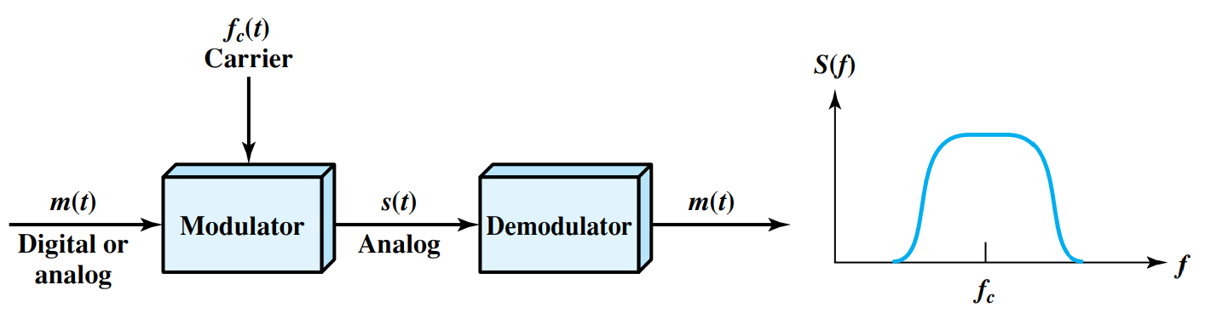
Analog Data → Analog Signals
Two principle techniques:
Amplitude modulation
Angle modulation
Frequency modulation
Phase modulation
Notes:
Let me first give a brief introduction of WOBAN architecture and the motivation of using WOBAN as an access technology. There are two main types of popular access networks. 1. Optical access networks where from CO optical fibers are pulled to ONUs located at every homes, premises or offices, which basically work as gateways for Internet access to the users. The popular access technology of this access networks is PON. The advantage of this access is that it provides high bandwidth and fast Internet service. The limitation is that it needs fiber to penetrate in each and every premises which make this scheme very costly. Also there is a limitation of maximum fiber length.
Another popular access networks is wireless access. Popular technology of this type are WiFi and WiMAX. The advantage of these access technology is that this is flexible and cost effective scheme. But the limitation is that when the hop of hops increase a lot, real time multi-media traffic suffers a lot.
Let me first give a brief introduction of WOBAN architecture and the motivation of using WOBAN as an access technology. There are two main types of popular access networks. First is the optical access such as passive optical networks (PON), which provides fast Internet service because of high bandwidth. But it requires fiber to be penetrated from central office to all residential complex, offices and premises which make the scheme highly costly. Another popular access technology is wireless access, which is flexible and cost-efficient, but does not function well when the number of hops increases.

Slide 3
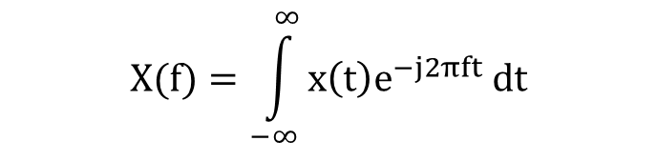
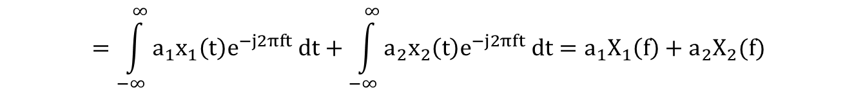
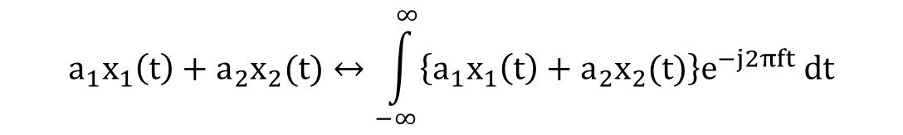
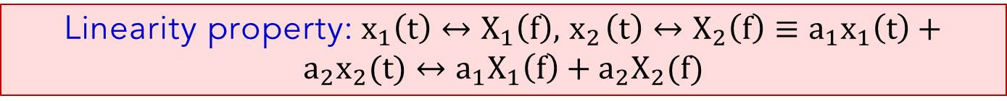
Time Domain ⇔ Frequency Domain
$$X(f)=\int_{−∞}^{∞}{x\left(t\right)e^{−j2πft} dt}$$
Linearity property:$x_{1}\left(t\right)↔X_{1}\left(f\right),{ x}_{2}\left(t\right)↔X_{2}\left(f\right)≡a_{1}x_{1}\left(t\right)+a_{2}x_{2}(t)↔a_{1}X_{1}\left(f\right)+a_{2}X_{2}(f)$
$$a_{1}x_{1}\left(t\right)+a_{2}x_{2}(t)↔\int_{−∞}^{∞}{\left\{a_{1}x_{1}\left(t\right)+a_{2}x_{2}(t)\right\}e^{−j2πft} dt}$$
$$=\int_{−∞}^{∞}{a_{1}x_{1}\left(t\right)e^{−j2πft} dt+\int_{−∞}^{∞}{a_{2}x_{2}\left(t\right)e^{−j2πft} dt=a_{1}X_{1}\left(f\right)+a_{2}X_{2}(f) }}$$

Slide 4
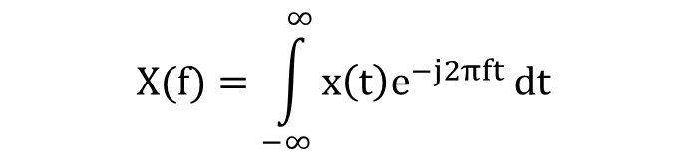
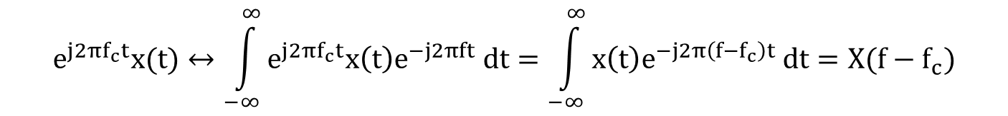
Time Domain ⇔ Frequency Domain
$$X(f)=\int_{−∞}^{∞}{x\left(t\right)e^{−j2πft} dt}$$
Frequency shifting property: $x\left(t\right)↔X\left(f\right) ≡e^{j2πf_{c}t}x\left(t\right)↔X(f−f_{c})$
$$e^{j2πf_{c}t}x(t)↔\int_{−∞}^{∞}{e^{j2πf_{c}t}x\left(t\right)e^{−j2πft} dt=\int_{−∞}^{∞}{x\left(t\right)e^{−j2π\left(f−f_{c}\right)t} dt=X(f−f_{c})}}$$

Slide 5
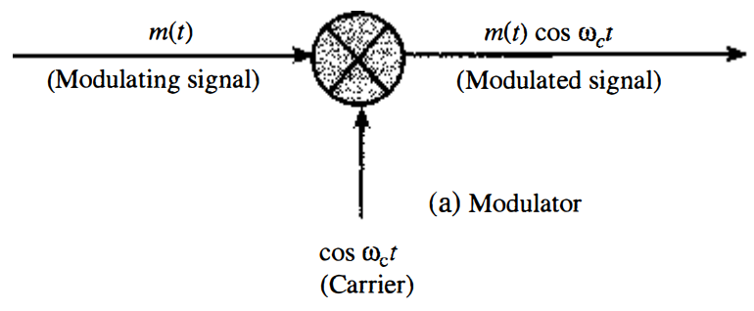
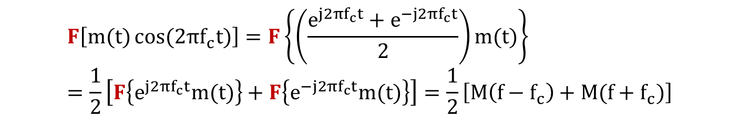
DSB-SC Modulation
Transmitted signal: $m(t)\cos{(2πf_{c}t)}$
$$F\left[m(t)\cos{(2πf_{c}t)}\right]=F\left\{\left(\frac{e^{j2πf_{c}t}+e^{−j2πf_{c}t}}{2}\right)m(t)\right\}=\frac{1}{2}\left[F\left\{e^{j2πf_{c}t}m(t)\right\}+F\left\{e^{−j2πf_{c}t}m(t)\right\}\right]=\frac{1}{2}\left[M\left(f−f_{c}\right)+M(f+f_{c})\right]$$

Slide 6
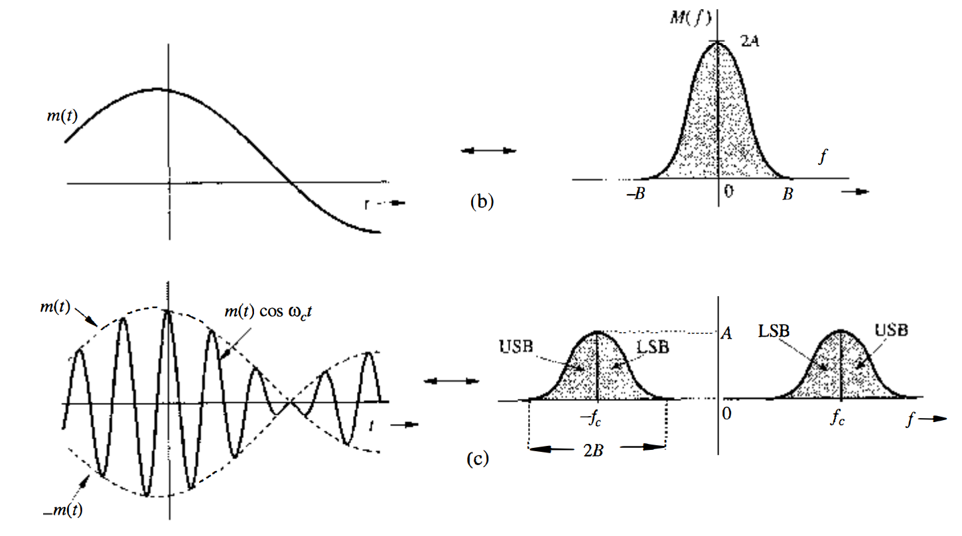
DSB-SC Modulation
$$F\left[m(t)\cos{(2πf_{c}t)}\right]= \frac{1}{2}\left[M\left(f−f_{c}\right)+M(f+f_{c})\right]$$

Slide 7
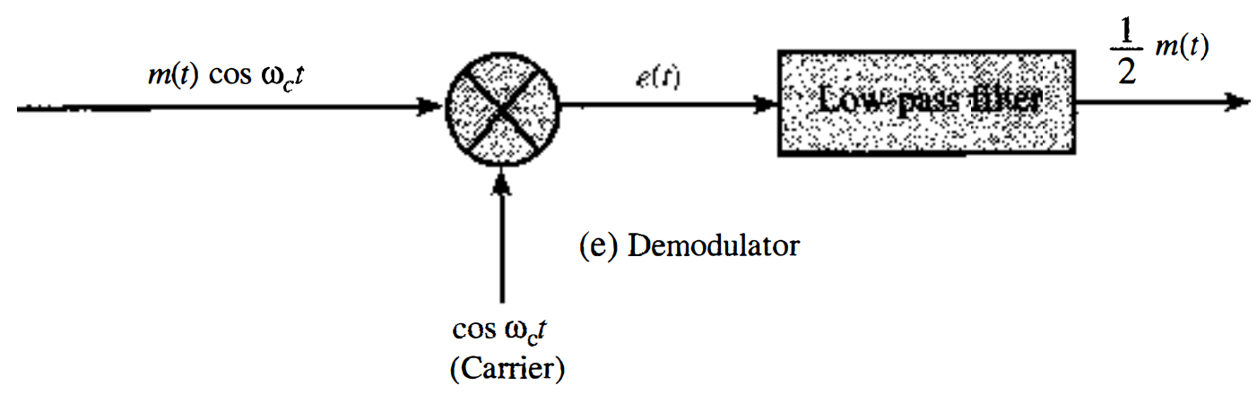

DSB-SC Demodulation
$$F\left[m(t)\cos{2(2πf_{c}t)}\right]=F\left\{\left(\frac{1+\cos{(2π2f_{c}t)}}{2}\right)m(t)\right\}=\frac{1}{2}M\left(f\right)+ \frac{1}{4}\left[M\left(f−{2f}_{c}\right)+M(f+{2f}_{c})\right]$$

Slide 8
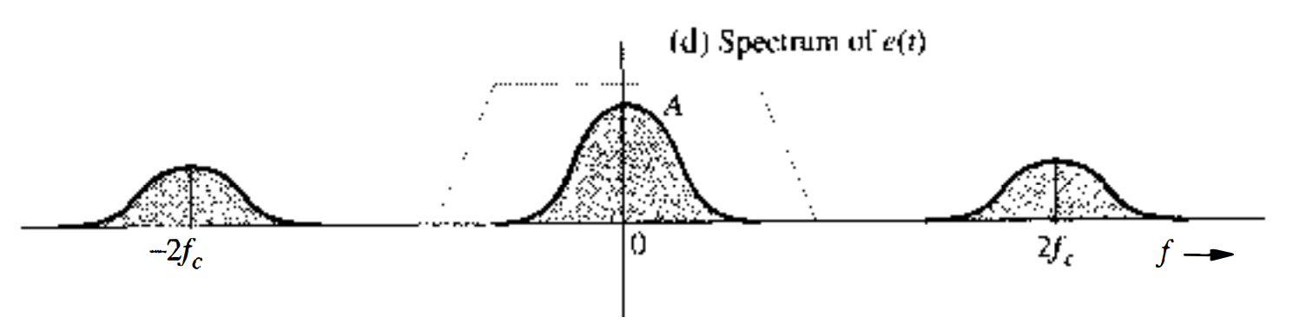

DSB-SC Modulation
$$F\left[m(t)\cos{2(2πf_{c}t)}\right]=F\left\{\left(\frac{1+\cos{(2π2f_{c}t)}}{2}\right)m(t)\right\}=\frac{1}{2}M\left(f\right)+ \frac{1}{4}\left[M\left(f−{2f}_{c}\right)+M(f+{2f}_{c})\right]$$

Slide 9

Angle Modulation
$$s\left(t\right)=A \cos{θ(t)}$$
Angle modulation:
Frequency modulation
Phase modulation

Slide 10
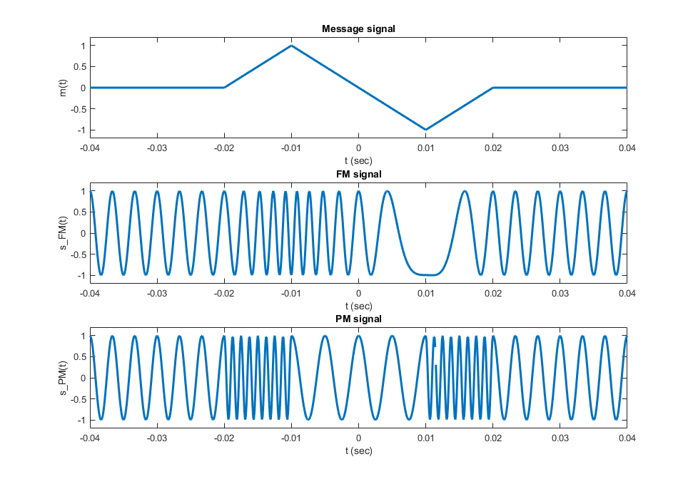

Angle Modulation (Frequency Modulation)
$$s\left(t\right)=A \cos{θ(t)}$$
$w_{i}\left(t\right)=2πf_{c}+k_{f}m(t)$ $∴s_{FM}\left(t\right)=\cos{((2πf_{c}+k_{f}m\left(t\right))t)}$

Slide 11
Angle Modulation (Phase Modulation)
$$s\left(t\right)=A \cos{θ(t)}$$
$θ\left(t\right)=2πf_{c}t+k_{p}m(t)$ $∴s_{PM}\left(t\right)=\cos{(2πf_{c}t+k_{p}m(t))}$

Slide 12
AM vs FM/PM
Amplitude modulation:
Bandwidth is less
More susceptible to noise → noise affects the amplitude
Angle modulation:
Modulated signal requires greater bandwidth than AM
More robust against noise, interference

Slide 13
Summary
Modulation techniques (Analog data → Analog signals):
Different modulation techniques discussed
Amplitude modulation
Frequency modulation
Phase modulation
Comparison of the analog modulation techniques

Slide 14
Extras

Slide 15
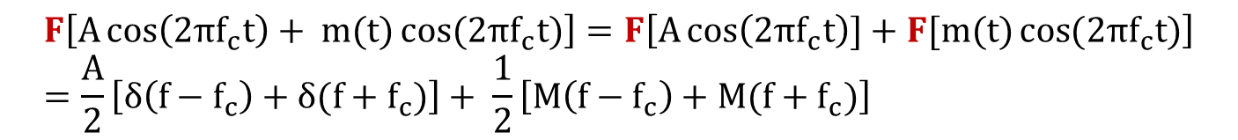
DSB-TC Modulation
The carrier is sent along with the message
Transmitted signal:$A\cos\left(2πf_{c}t\right)+ m(t)\cos{(2πf_{c}t)}$
$$F\left[A\cos\left(2πf_{c}t\right)+ m(t)\cos{(2πf_{c}t)}\right]=F\left[A\cos\left(2πf_{c}t\right)]+F[m(t)\cos{(2πf_{c}t)}\right]=\frac{A}{2}\left[δ\left(f−f_{c}\right)+δ(f+f_{c})\right]+ \frac{1}{2}\left[M\left(f−f_{c}\right)+M(f+f_{c})\right]$$

Slide 16
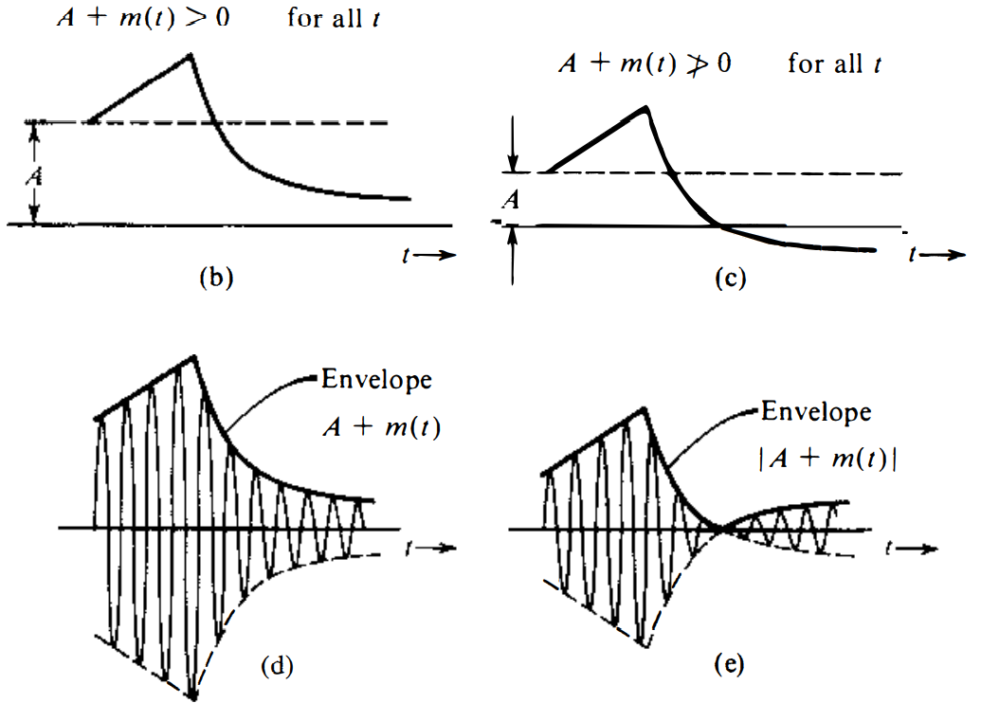
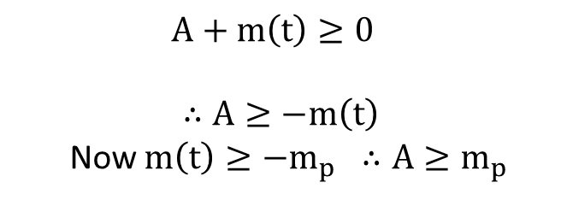

DSB-TC Modulation
$$A+m\left(t\right)≥0$$
$$∴A≥−m\left(t\right)$$
Now $m\left(t\right)≥−m_{p} ∴A≥m_{p}$
$$k_{a}=\frac{m_{p}}{A} ∴0≤k_{a}≤1$$

Slide 17
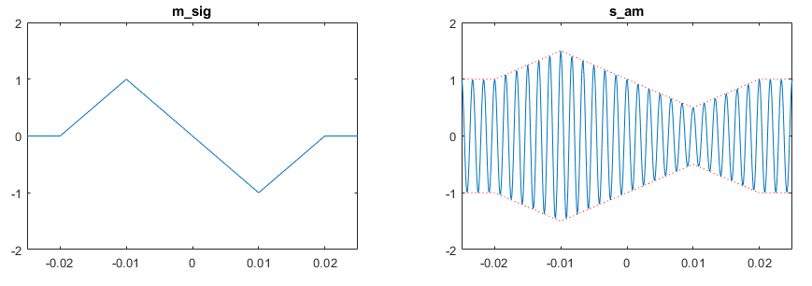
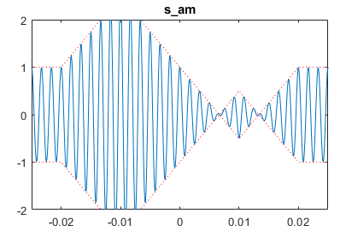
DSB-TC Modulation

Slide 18
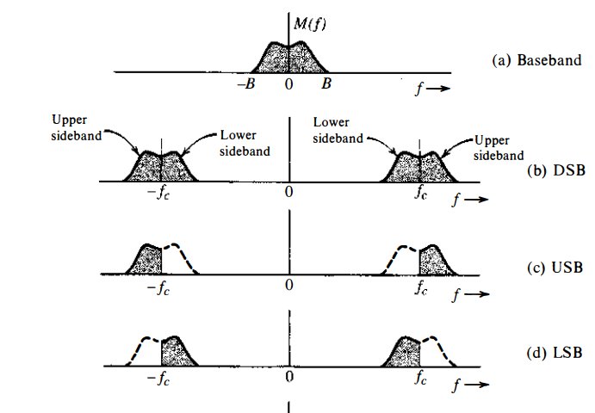
SSB Modulation

Slide 19
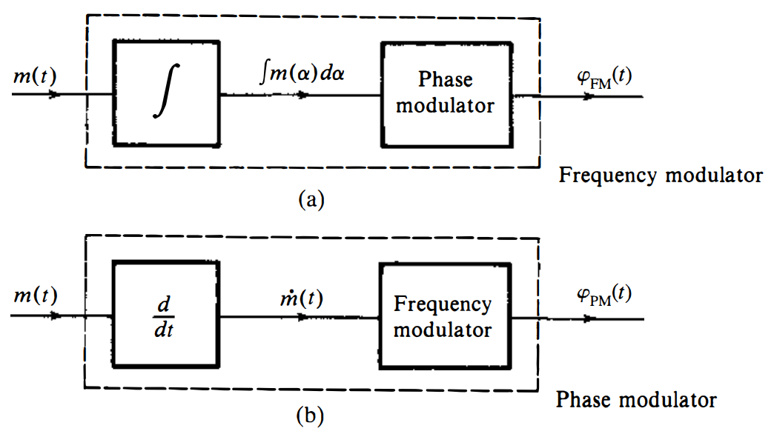

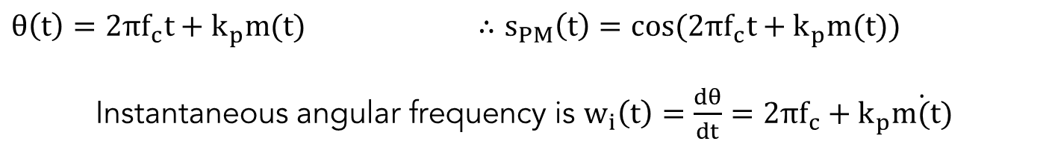
Angle Modulation
$$s\left(t\right)=A \cos{θ(t)}$$
Instantaneous angular frequency is $w_{i}\left(t\right)=\frac{dθ}{dt}$
$w_{i}\left(t\right)=2πf_{c}+k_{f}m(t)$ $∴s_{FM}\left(t\right)=\cos{((2πf_{c}+k_{f}m\left(t\right))t)}$
$θ\left(t\right)=2πf_{c}t+k_{p}m(t)$ $∴s_{PM}\left(t\right)=\cos{(2πf_{c}t+k_{p}m(t))}$
Instantaneous angular frequency is $w_{i}\left(t\right)=\frac{dθ}{dt}=2πf_{c}+k_{p}\dot{m(t)}$

Slide 20
Angle Modulation

Slide 21
Angle Modulation

