Slide 1
Computer Networks I Some Performance Metrics
Amitangshu Pal
Computer Science and Engineering
IIT Kanpur

Slide 2

Throughput
Throughput: Rate (bits/time unit) at which bits are being sent from sender to receiver
Instantaneous: Rate at given point in time
Average: Rate over longer period of time
link capacity
R_{s} bits/sec
link capacity
R_{c} bits/sec
pipe that can carry
fluid at rate
(R_{s} bits/sec)
pipe that can carry
fluid at rate
(R_{c} bits/sec)
server sends bits
(fluid) into pipe
server, with
file of F bits
to send to client

Slide 3
Throughput
R_{s} < R_{c} What is average end-end throughput?
R_{s} bits/sec
R_{c} bits/sec
R_{s} > R_{c} What is average end-end throughput?
R_{s} bits/sec
R_{c} bits/sec
bottleneck link
link on end-end path that constrains end-end throughput

Slide 4
Related Terminologies/Metrics
Datarate/Bitrate: Rate (bits/time unit) at which bits are being sent/received at the physical layer
Throughput: Rate (bits/time unit) at the network layer to measure the end-to-end performance

Slide 5
Related Terminologies/Metrics
Throughput: Rate (bits/time unit) at the network layer to measure the end-to-end performance
A related terminology that used is goodput
Difference between throughput and goodput:
Throughput: Number of bits received per unit time
Goodput: Number of useful bits received per unit time
Suppose we are sending 1 pkts/sec
Throughput: 10000 bps
Goodput: 9000 bps
Header
Data
1000 bits
9000 bits

Slide 6
Packet delay: four sources
Delay/Latency: Time taken by the packet to reach the destination
transmission
A
propagation
B
nodal
processing
queueing
d_{nodal} = d_{proc} + d_{queue} + d_{trans} + d_{prop}
d_{proc}: nodal processing
check bit errors
determine output link
typically < microsecs
d_{queue}: queueing delay
time waiting at output link for transmission
depends on congestion level of router

Slide 7
Packet delay: four sources
Delay/Latency: Time taken by the packet to reach the destination
transmission
A
propagation
B
nodal
processing
queueing
d_{nodal} = d_{proc} + d_{queue} + d_{trans} + d_{prop}
d_{trans}: transmission delay:
L: packet length (bits)
R: link transmission rate (bps)
d_{trans} = L/R
d_{prop}: propagation delay:
d: length of physical link
s: propagation speed (~2x10⁸ m/sec)
d_{prop} = d /s

Slide 8
Packet delay: four sources
d_{proc}
d_{trans}
d_{prop}
d_{proc}
d_{queue}
Cross traffic
d_{trans}

Slide 9
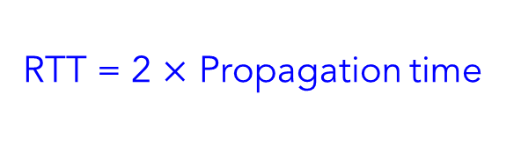
Round Trip Time (RTT)
RTT = 2 $×$ Propagation time
RTT
Client
Server

Slide 10

Transmission and Propagation Delay
Consider a scenario where the distance between the transmitter and receiver is 12000 km, and the signal travels through the transmission link (connecting the transmitter-receiver) is 2$×$10⁸ m/s. Also assume that the transmitter is transmitting a 2 KB of message, and the link transmission rate is 1 Mbps. Find out the transmission and propagation delay.

Slide 11

Transmission and Propagation Delay
Consider a scenario where the distance between the transmitter and receiver is 12000 km, and the signal travels through the transmission link (connecting the transmitter-receiver) is 2$×$10⁸ m/s. Also assume that the transmitter is transmitting a 5 MB of message, and the link transmission rate is 1 Gbps. Find out the transmission and propagation delay.

Slide 12

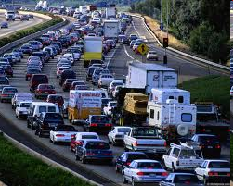
Packet queueing delay
a: average packet arrival rate
L: packet length (bits)
R: link bandwidth (bit transmission rate)
average queueing delay
L
a
.
:
arrival rate of bits
“traffic
intensity”
R
service rate of bits
traffic intensity = La/R
1
La/R ~ 0: avg. queueing delay small
La/R → 1: avg. queueing delay large
La/R > 1: more “work” arriving is more than can be serviced - average delay infinite!
La/R ~ 0
La/R -> 1

Slide 13
How do packet delay and loss occur?
Packets queue in router buffers, waiting for turn for transmission
Queue length grows when arrival rate to link (temporarily) exceeds output link capacity
Packet loss occurs when memory to hold queued packets fills up
buffer
(waiting area)
packet being transmitted
A
B
packet arriving to
full buffer is lost

Slide 14
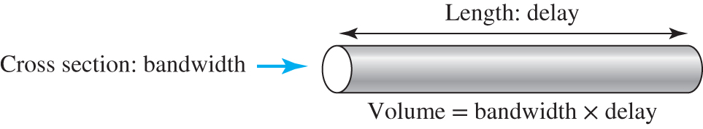
Bandwidth-Delay Product
Bandwidth-delay product:
Think about the link between two points as a pipe
The cross section of the pipe represents the bandwidth
The length of the pipe represents the delay
We can say the volume of the pipe defines the bandwidth-delay product

Slide 15
Bandwidth-Delay Product
Bandwidth-delay product: Number of bits which can be transmitted before an ACK is received from the receiver
The number of bits that can be transmitted before you know that something is wrong
Estimation of number of bits “in transit” through the transmission medium

Slide 16

Bandwidth-Delay Product
Moderate speed satellite network: 512 kbit/s, 900 ms RTT
Residential DSL: 2 Mbit/s, 50 ms RTT
High speed LAN: 100 Gbit/s, 30 $μ$s RTT

Slide 17
Jitter
Jitter is a measure of packet delay variance
Happens when different packets of data face different delays in a network
Important for time-sensitive receiver applications, i.e. audio or video
Example: If the delay of the 1st, 2nd, and 3rd packets are 10ms, 25 ms and 50 ms respectively → real-time application experiences jitter

Slide 18
Jitter
Jitter is negative and causes network congestion and packet loss
Leads to flickering of a display screen
Introduces clicks or other undesired impacts in audio signals

Slide 19
Summary
Useful performance metrics:
Datarate vs Throughput vs Goodput
Delay
Delay-bandwidth product
Jitter

