Slide 1
❞
vodafone
❞
vodafone
Working-Capital Distress
at Vodafone Idea Ltd.
A Longitudinal Analysis of Liquidity, Investment & Financing Decisions | FY21–FY26
CORE ARGUMENT
• Negative working capital persisted through FY21–FY26, driven primarily by the current-liability burden.
• Investment intensity collapsed in FY24 and rebounded after the FY24 equity raise and subsequent restructuring.
• The case links working-capital pressure with investment constraints and financing dependence.
Source: Vodafone Idea Ltd. Annual Reports / Investor Presentations; C-MOTS via Screener; S&P Global. Consolidated financial statements.
1

Slide 2
Why Vodafone Idea?
❞
vodafone
A clear longitudinal case of Working Capital → Investment → Financing → Operating Performance
Key FY21–FY26 movements
Metric | FY21 | FY26 | Change
Revenue | ₹41,952 cr | ₹44,873 cr | +7.0%
EBITDA | ₹16,946 cr | ₹18,859 cr | +11.3%
EBITDA Margin | 40.4% | 42.0% | +1.6 pp
Q4 Exit ARPU | ₹107 | ₹190 | +77.6%
Subscribers | 267.8m | 192.8m | −75.0m
NWC | −₹52,303 cr | −₹17,813 cr | Deficit reduced
KEY TAKEAWAY
Operating profitability and ARPU improved, but Vodafone Idea continued to carry a substantial working-capital deficit.
THE CORE TENSION
Higher monetisation did not remove the balance-sheet and financing constraint.
Source: Final corrected Excel workbook | All figures consolidated unless stated otherwise.
2

Slide 3
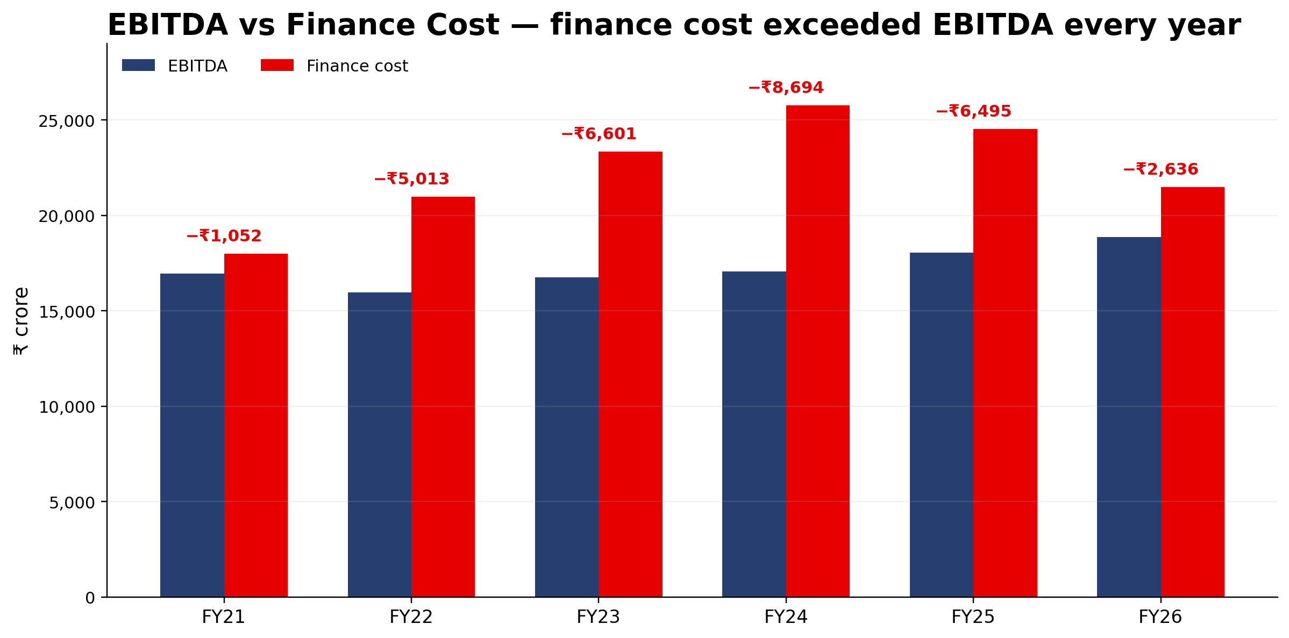
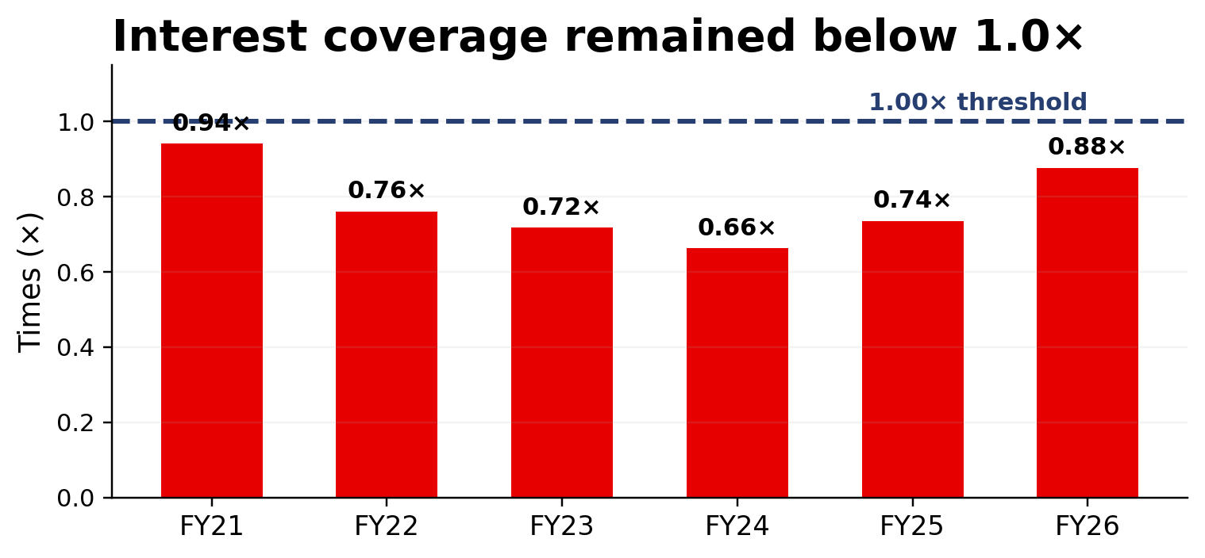
Operating Business vs Financing Burden
❞
vodafone
Operating performance improved, but financing cost remained above EBITDA
EBITDA
₹16,946 cr → ₹18,859 cr
EBITDA MARGIN
40.4% → 42.0%
FY24 GAP
Finance cost exceeded EBITDA by ₹8,694 cr.
Message: operating EBITDA was substantial, but finance cost remained a major constraint on internally available cash.
Source: Final corrected Excel workbook | Interest coverage = EBITDA / finance cost.
3

Slide 4
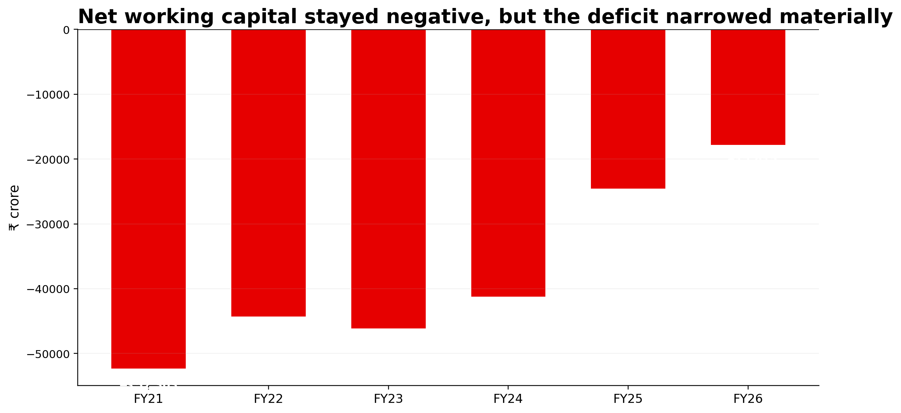
Working-Capital Distress
❞
vodafone
Negative working capital persisted, but the deficit narrowed
FY21
−₹52,303 cr
FY26
−₹17,813 cr
DEFICIT CHANGE
66% narrower over FY21–FY26.
CURRENT RATIO
0.21× → 0.55×
Source: Final corrected Excel workbook | NWC = total current assets less total current liabilities.
4

Slide 5
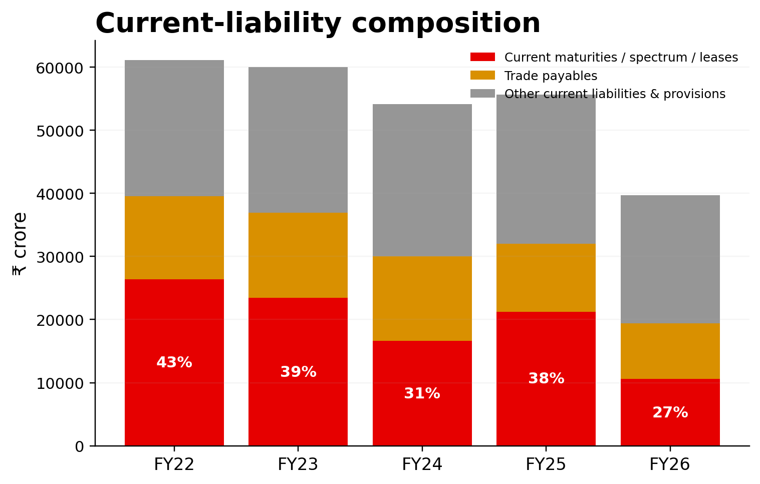
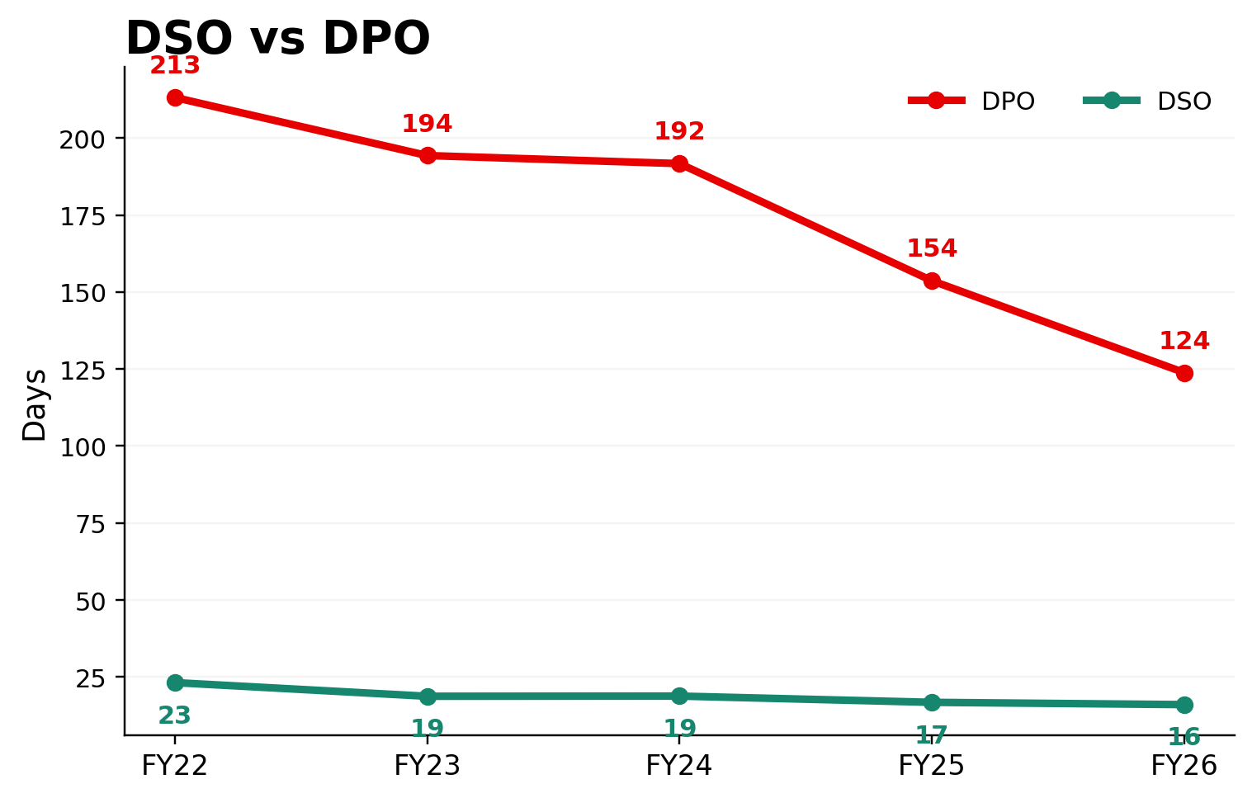
Where Did the Distress Come From?
❞
vodafone
The liability side explains more of the deficit than operating working-capital inefficiency
LIABILITY STRUCTURE
OPERATING INDICATORS
Current maturities peaked at 43% of current liabilities in FY22 (₹26,378 cr) and fell to 27% by FY26 (₹10,559 cr).
DSO improved from 23 to 16 days; DPO fell from 213 to 124 days; inventory never exceeded ₹21 cr.
Source: Final corrected Excel workbook | DSO and DPO are the workbook's stated operating proxies.
5

Slide 6
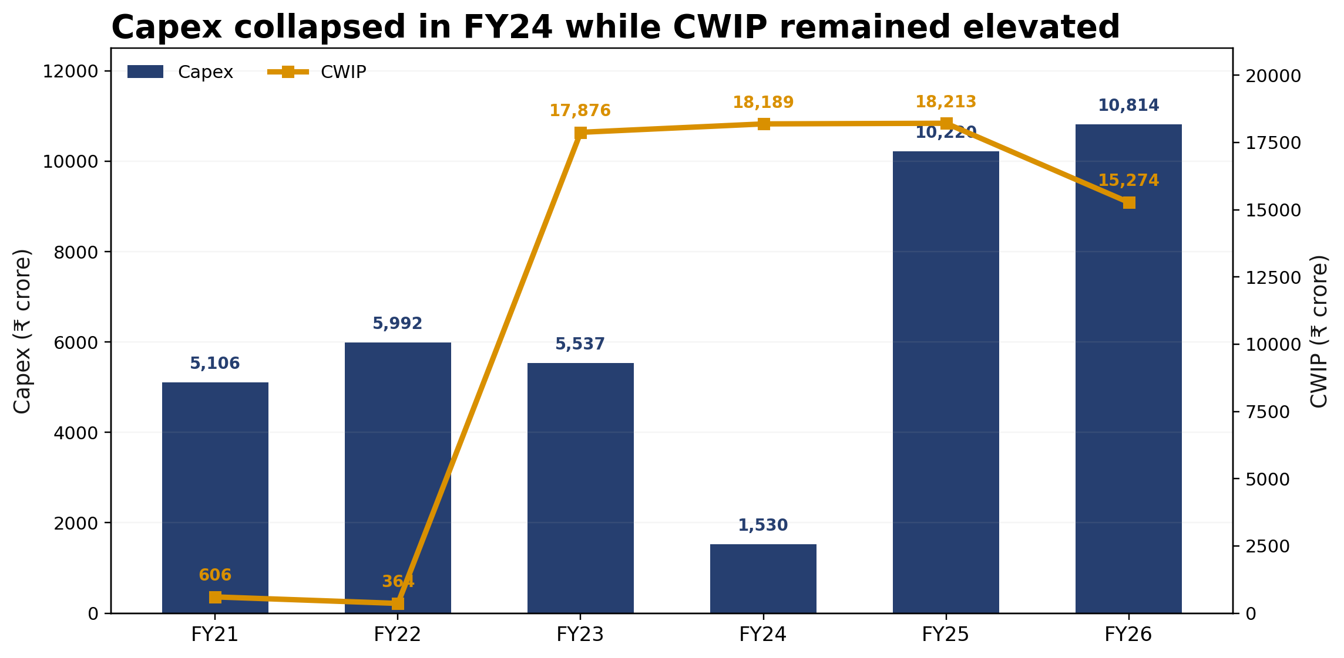
Investment Decisions
❞
vodafone
Investment intensity fell sharply during the liquidity-pressure period
FY24 CAPEX
₹1,530 cr | 3.6% of revenue
FY24 CWIP
₹18,189 cr remained elevated.
FY25–FY26
Capex rebounded to ₹10,220 cr and ₹10,814 cr while CWIP began declining.
Interpretation: the investment pattern moved closely with liquidity availability, consistent with funding constraints limiting the pace of investment in FY24.
Source: Final corrected Excel workbook | Model capex uses cash purchase of PPE/intangibles. Company-disclosed FY26 capex on a narrower definition: ₹8,742 cr.
6

Slide 7
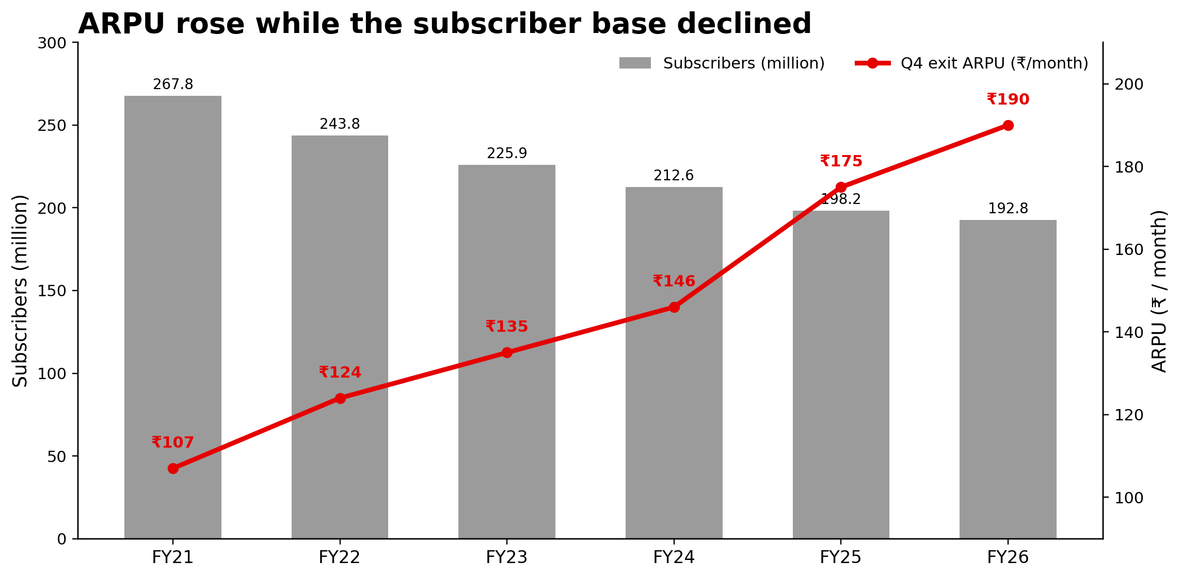
Investment → Business Consequence
❞
vodafone
Investment constraints coincided with a significant subscriber decline
SUBSCRIBERS
267.8m → 192.8m
−75.0m
Q4 EXIT ARPU
₹107 → ₹190
+77.6%
5G / FUNDING SEQUENCE
2022 spectrum acquisition
↓
FY23 CWIP surge
↓
FY24 capex compression
↓
2024 ₹24,000 cr equity raise
↓
2025 commercial 5G launch
↓
FY26 5G expanded to 83 cities
Key takeaway: ARPU improved, but higher monetisation did not fully offset the decline in the subscriber base.
Source: Final corrected Excel workbook and the Investment Timeline sheet | Subscriber and ARPU series are Q4/period-end operating measures.
7

Slide 8
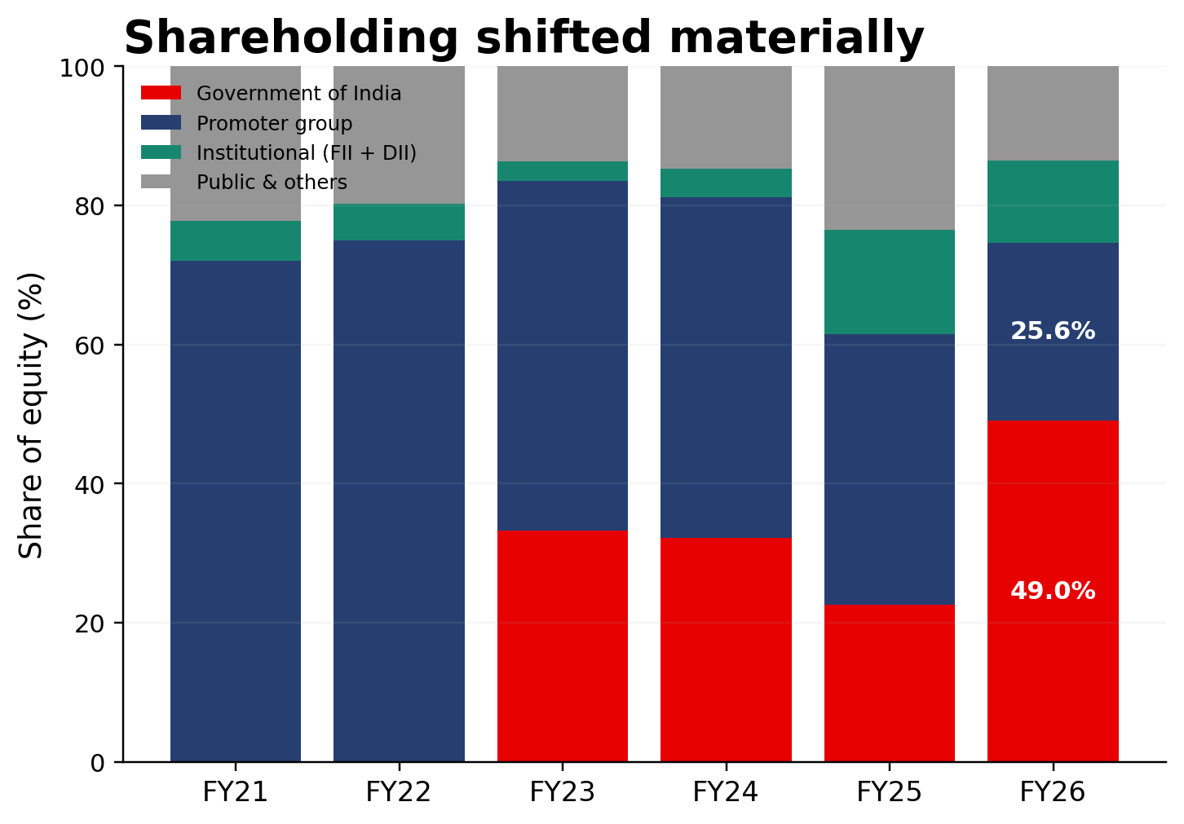
Financing Decisions
❞
vodafone
Financing options became increasingly constrained
FINANCING RESPONSE
• Funded bank debt in the final Excel falls to ₹2,326 cr in FY25 and ₹726 cr in FY26.
• Government conversion of spectrum dues was a major restructuring mechanism; the workbook records ₹36,950 cr agreed for conversion.
• FY24 included an ₹18,000 cr FPO and ₹2,075 cr preferential issue.
• Equity share capital rose from ₹28,735 cr in FY21 to ₹108,343 cr in FY26.
FY26 GOVERNMENT SHARE
FY26 PROMOTER SHARE
49.02%
25.64%
Key takeaway: as conventional debt capacity became constrained, equity and liability restructuring became increasingly important sources of financial support.
Source: Final corrected Excel workbook | Shareholding shown as at 31 March each year.
8

Slide 9
The Inflection Point
❞
vodafone
FY24–FY26: evidence of the Working Capital → Investment linkage
Metric | FY23 | FY24 | FY25 | FY26
NWC | −₹46,122 cr | −₹41,232 cr | −₹24,575 cr | −₹17,813 cr
Liquid Assets | ₹235 cr | ₹169 cr | ₹6,310 cr | ₹3,715 cr
Capex | ₹5,537 cr | ₹1,530 cr | ₹10,220 cr | ₹10,814 cr
Capex / Revenue | 13.1% | 3.6% | 23.5% | 24.1%
FY24
FY25
FY26
Liquidity pressure
→ Capex collapse
Equity raising + improved liquidity
→ Capex rebound
Sustained investment
→ CWIP reduction + 5G expansion
Bottom conclusion: the FY24 → FY25 → FY26 sequence provides the clearest evidence of the WC → Investment linkage in the case.
Source: Final corrected Excel workbook | Liquid assets = cash + short-term investments.
9

Slide 10
Conclusion: A Partial Recovery, Not Full Resolution
❞
vodafone
The balance-sheet pressure narrowed, but material financing constraints remained
WHAT IMPROVED
WHAT REMAINED UNRESOLVED
• NWC deficit narrowed from ₹52,303 cr to ₹17,813 cr.
• EBITDA increased from ₹16,946 cr to ₹18,859 cr.
• EBITDA margin improved to 42.0%.
• ARPU increased to ₹190.
• Capex recovered strongly in FY25–FY26.
• CWIP declined from ₹18,213 cr to ₹15,274 cr.
• Net worth remained negative at −₹35,758 cr in FY26.
• Interest coverage remained below 1× at 0.88×.
• Future spectrum-related obligations remained relevant.
• Financing requirements remained significant.
• Subscriber base remained 75.0m below FY21.
Vodafone Idea's FY25–FY26 improvement shows that liquidity and restructuring can restore investment capacity, but balance-sheet and financing pressures remained material by FY26.
Source: Final corrected Excel workbook | Academic case analysis; not investment advice.
10

