Slide 1
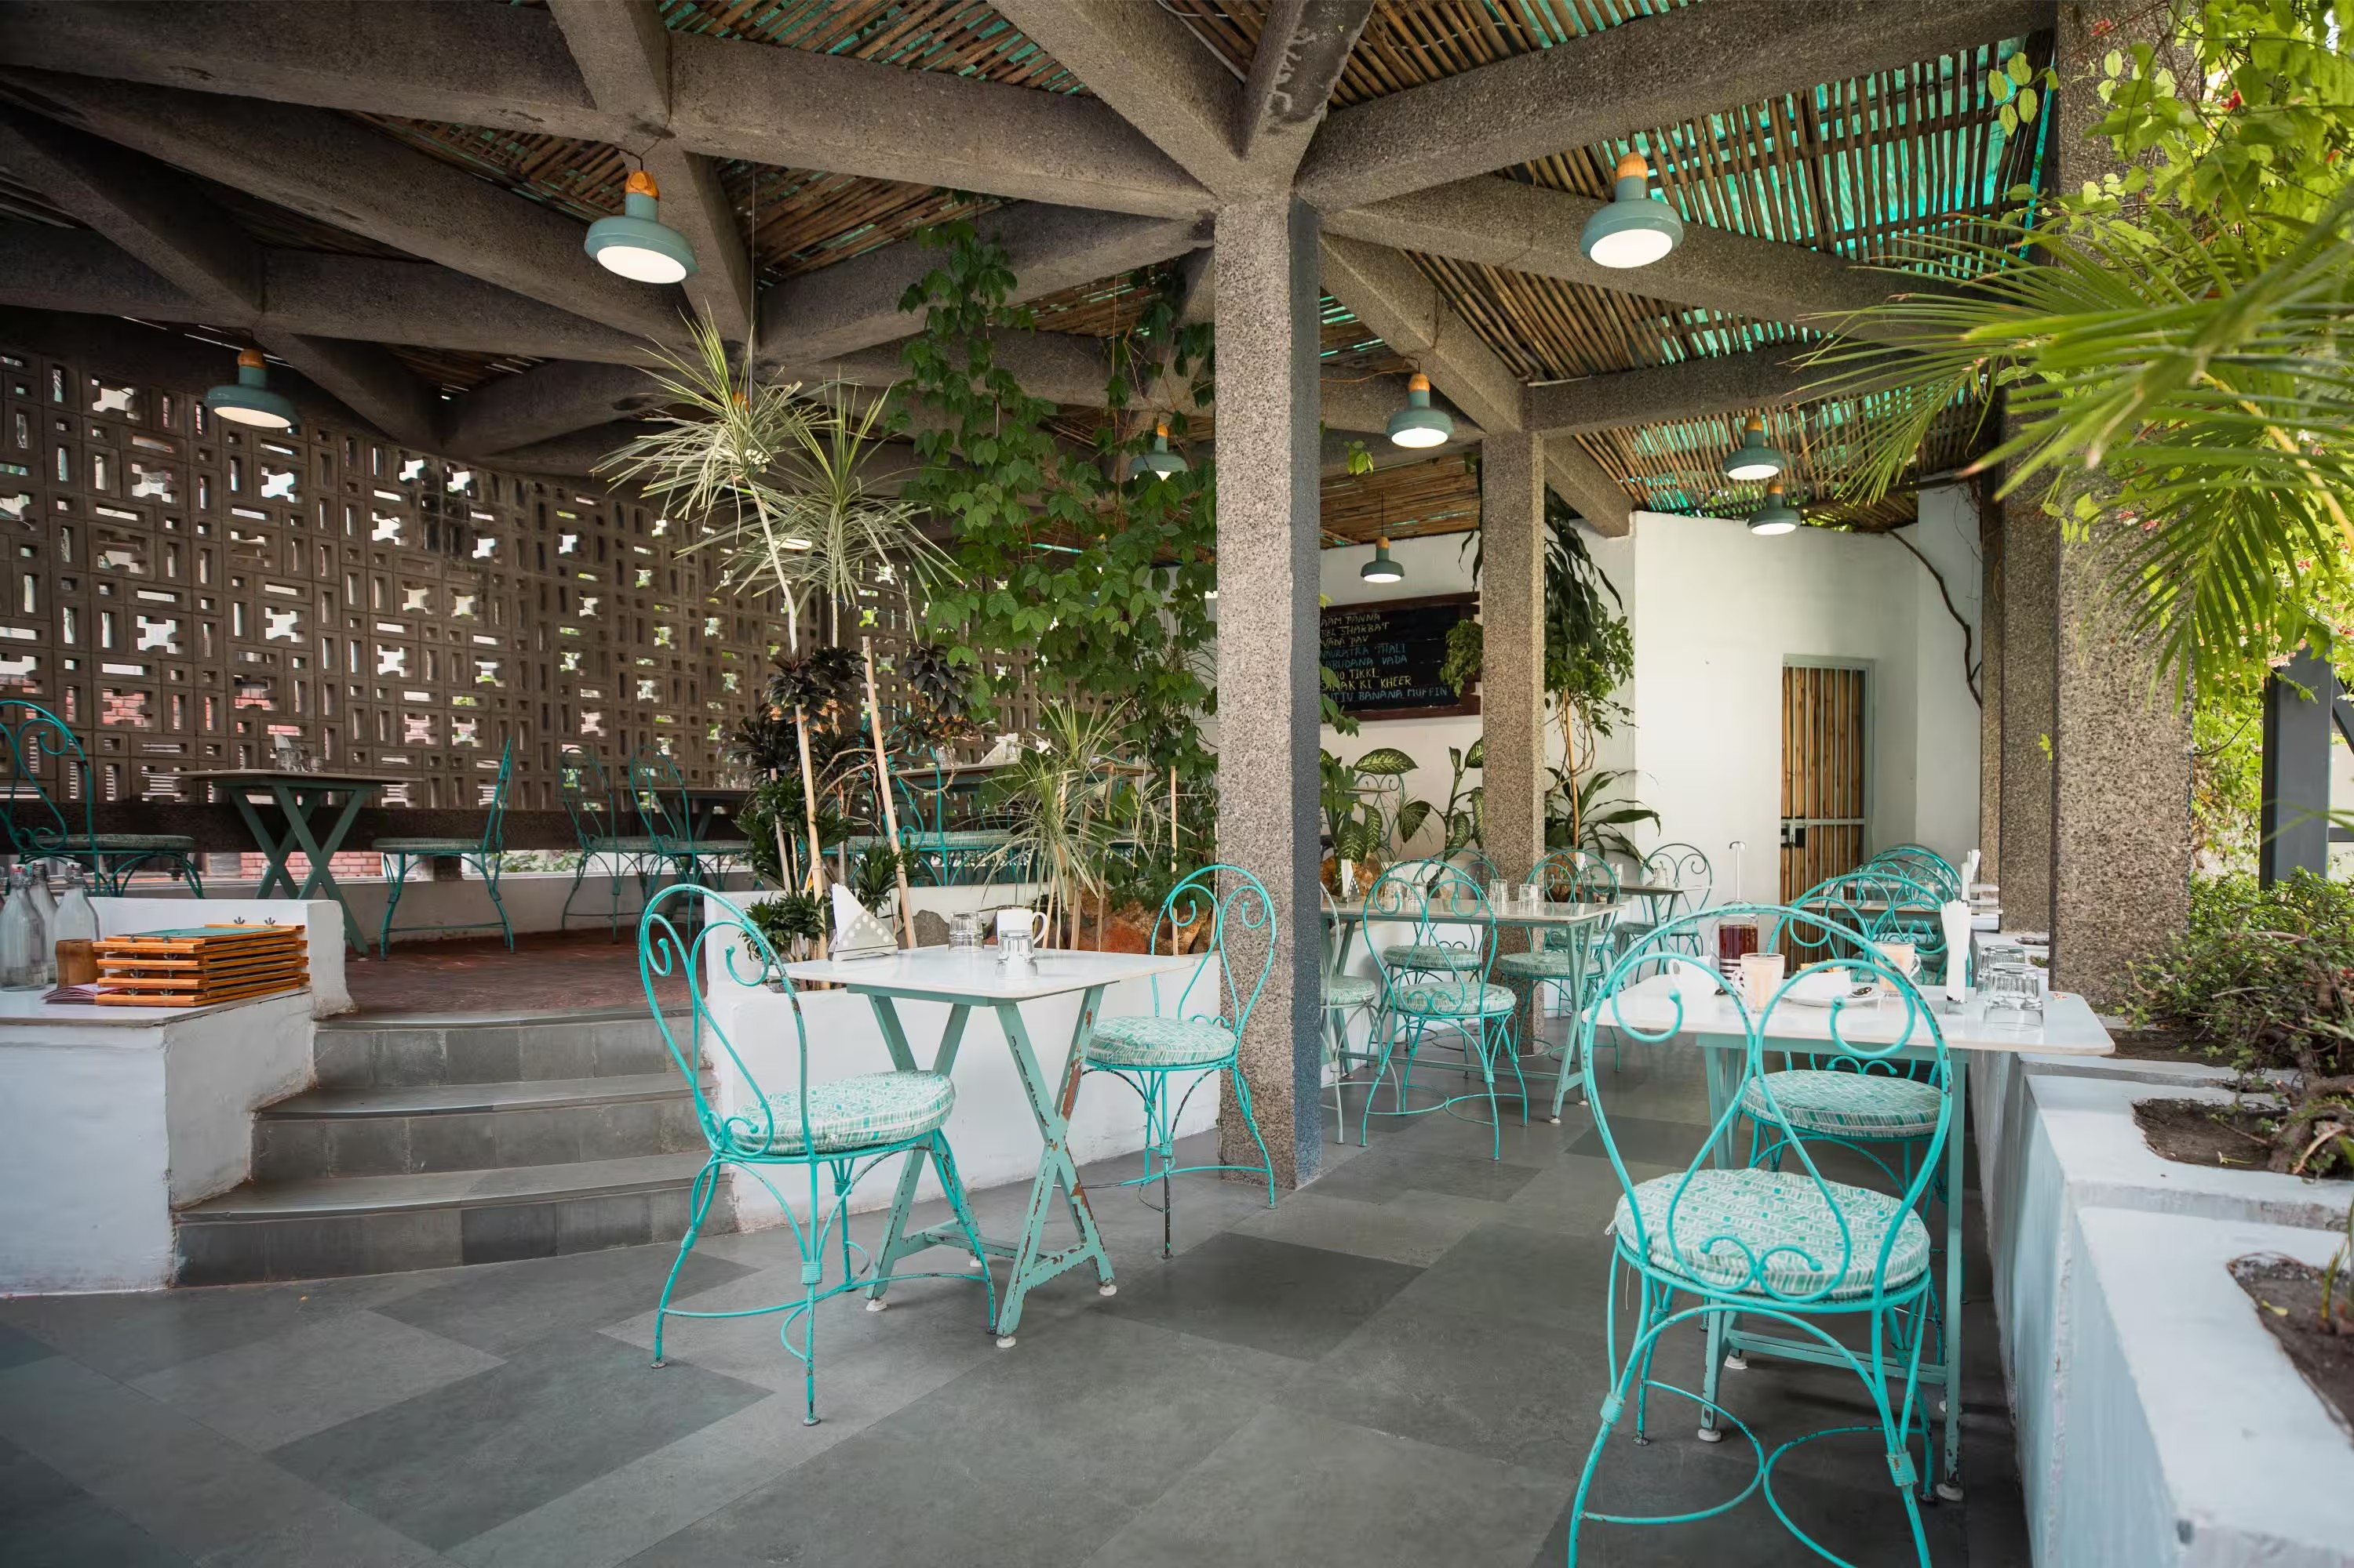
SERVQUAL
Service Quality Study
Measuring the Gap Between Customer Expectations and Perceptions
ORGANIZATION STUDIED
Triveni Terrace Café
205, Tansen Marg, Opp. FICCI Auditorium, Mandi House, New Delhi
Archi Saha • Ujjal Patro • Shanu Kumar • Kaushal Goyal • Subhranil Das • Priya Jhinkwan
Submitted to: Prof. Anirudha Chakrabarty

Slide 2
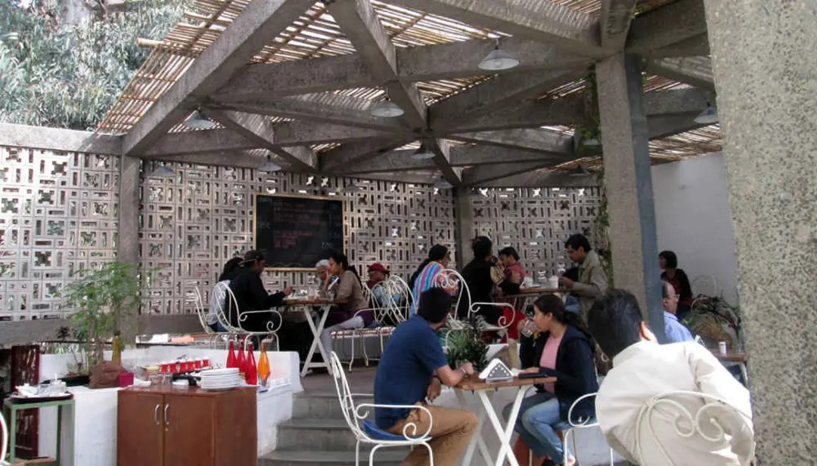


Objective & About the Café
Why This Study
SERVQUAL measures the gap between what customers expect from a service and what they actually perceive they received.
Applied here to Triveni Terrace Café across the 5 standard service-quality dimensions, comparing customer and employee views.
About Triveni Terrace Café
Located at Mandi House, New Delhi — opposite the FICCI Auditorium, in the city's arts & theatre precinct.
Rated 4.4/5 on Google from 6,600+ reviews; known for calm, art-adjacent ambience with outdoor terrace seating.
Mixed customer base: regulars, students, professionals on breaks, and first-time visitors drawn by word of mouth.
Triveni Terrace Café — outdoor pergola seating, Mandi House
02

Slide 3



How We Measured It
Instrument
Customer Sample
Employee Sample
20-statement SERVQUAL questionnaire
4 statements per dimension
7-point Likert scale (1=Strongly Disagree, 7=Strongly Agree)
30 respondents
Mix of first-time, occasional & regular visitors
Balanced gender, ages 19-54
Rated twice: Expectation + Perception
5 respondents
Waitstaff, barista, cashier/billing, floor supervisor
Tenure: 6-30 months
Rated once: self-perception
Gap = Perception − Expectation. Negative = service shortfall. Positive = experience exceeded expectations.
03

Slide 4





The Five SERVQUAL Dimensions
Every statement in the questionnaire maps to one of these — the framework used throughout this study.
Tangibles
Reliability
Responsiveness
Assurance
Empathy
Physical facilities, decor and appearance of staff.
Delivering the promised service accurately and consistently.
Willingness to help and provide prompt service.
Staff knowledge and courtesy that inspire trust.
Caring, individualized attention to each customer.
04

Slide 5
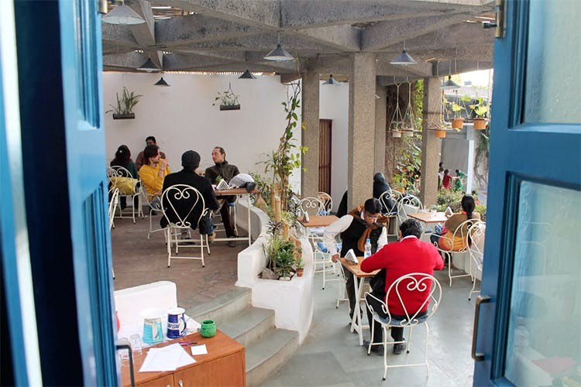
The Setting Was Never in Question
Reviewers consistently single out the pergola, jaali walls and terrace greenery — and the data agrees.
+0.41
TANGIBLES GAP
The only dimension where perception exceeded expectation.
Ambience is a genuine competitive strength — and a differentiator worth protecting as service on other dimensions is improved.
05

Slide 6
Dimension-Wise Gap Summary
Dimension | Customer Expectation | Customer Perception | Gap (P − E) | Employee Self-Perception
Tangibles | 5.94 | 6.35 | +0.41 | 6.30
Reliability | 6.36 | 5.65 | -0.71 | 5.90
Responsiveness | 6.33 | 5.06 | -1.28 | 6.00
Assurance | 6.13 | 5.52 | -0.62 | 6.10
Empathy | 5.85 | 5.08 | -0.77 | 6.05
OVERALL | 6.12 | 5.53 | -0.59 | 6.07
All figures are mean scores on a 1-7 scale (30 customers, 5 employees). Gap = Perception − Expectation.
Key read: Every dimension except Tangibles shows customers receiving less than they expect — and employees rating themselves higher than customers experience them, on every single dimension.
06

Slide 7
Gap by Dimension
Perception minus Expectation, by dimension
Responsiveness is the widest and most urgent gap (-1.28), nearly double the next-largest shortfall.
07

Slide 8
Staff Think They're Doing Better Than Customers Feel
Employee self-perception vs. actual customer perception, by dimension
Insight: The internal-external gap averages +0.54 pts and peaks in Empathy (+0.97) and Responsiveness (+0.94) — staff overestimate their own warmth and speed the most.
08

Slide 9
Service Gap Commentary — At a Glance
Tangibles
+0.41
Decor, greenery and outdoor seating consistently praised by customers.
Reliability
-0.71
Reviews split between 'excellent' and 'average' for the same dishes — kitchen consistency varies.
Responsiveness
-1.28
Staff attentiveness drops noticeably once the cafe gets busy — the top priority to fix.
Assurance
-0.62
Customers feel safe, but courtesy and product knowledge vary from staff member to staff member.
Empathy
-0.77
Service reads as efficient, but not especially warm or personalized.
09

Slide 10

Key Recommendations
PRIORITY FIXES
MAINTAIN & REINFORCE
Responsiveness
Tangibles
Table-side check-in within 5-7 minutes of delivery; add a simple call-for-attention signal at peak hours.
Protect current ambience and decor standards — a genuine, proven differentiator.
Empathy
Reliability
Train staff to recognize and acknowledge repeat customers; encourage brief, genuine conversation.
Introduce a kitchen quality checklist to reduce dish-to-dish inconsistency for high-volume items.
Assurance
Internal Alignment
Standardize a short menu / ingredient / allergen briefing for all customer-facing staff.
Share customer perception data with staff on a regular cadence to close the self-perception gap.
10

Slide 11

The Setting Delivers — The Service Needs to Catch Up
+0.41
-0.59
-1.28
Tangibles
(best dimension)
Overall SERVQUAL
gap score
Responsiveness
(top priority)
Because employees consistently rate their own service delivery more favorably than customers experience it, closing this gap needs better customer-staff feedback loops — not just new procedures.
SERVQUAL Study • Triveni Terrace Café • Group Project

