Slide 1
UNIQLO
LEARNING TEAM 4
INDIA
Andeep
Anshul Mutreja
Strategic
Khushi Verma
Kritika Choubey
Management
Riya Rawat
Mohit Kumar
Analysis
Prof. Indrajit Lahiri
FIIB · Strategic Management
A Comprehensive Business Transformation Study
Fortune Institute of International Business · 2026

Slide 2
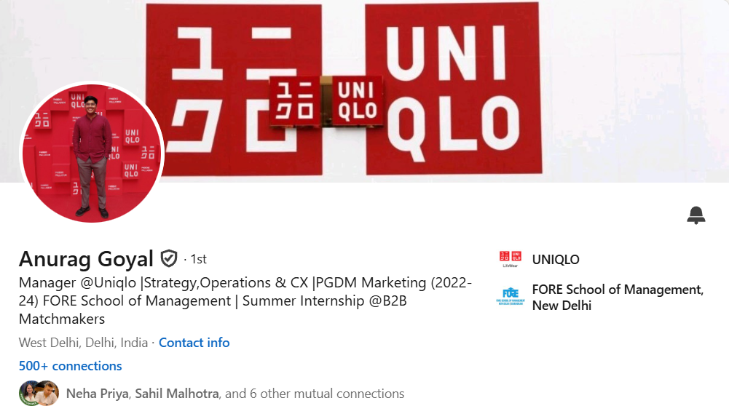
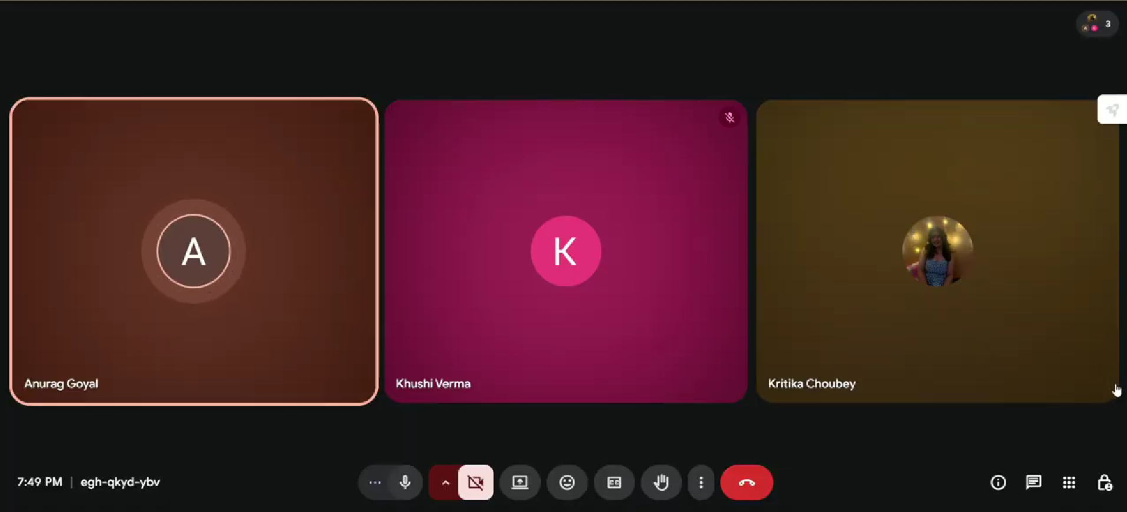
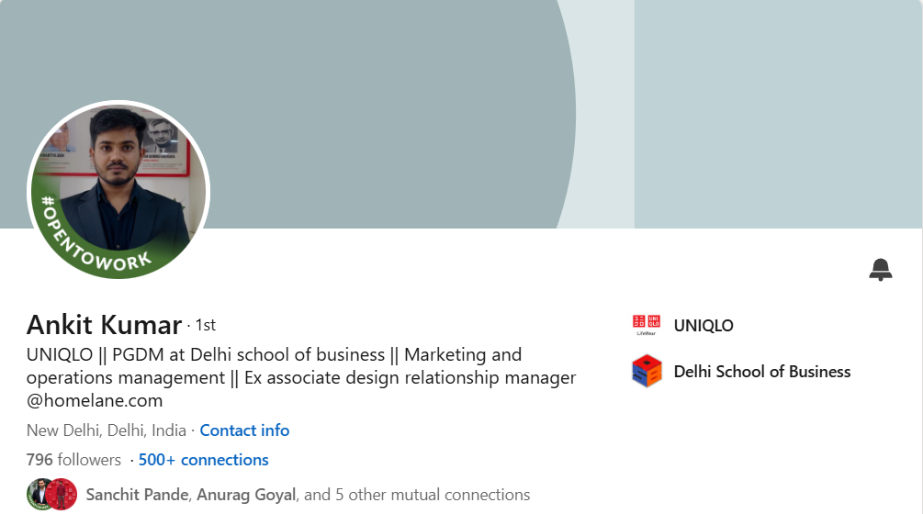
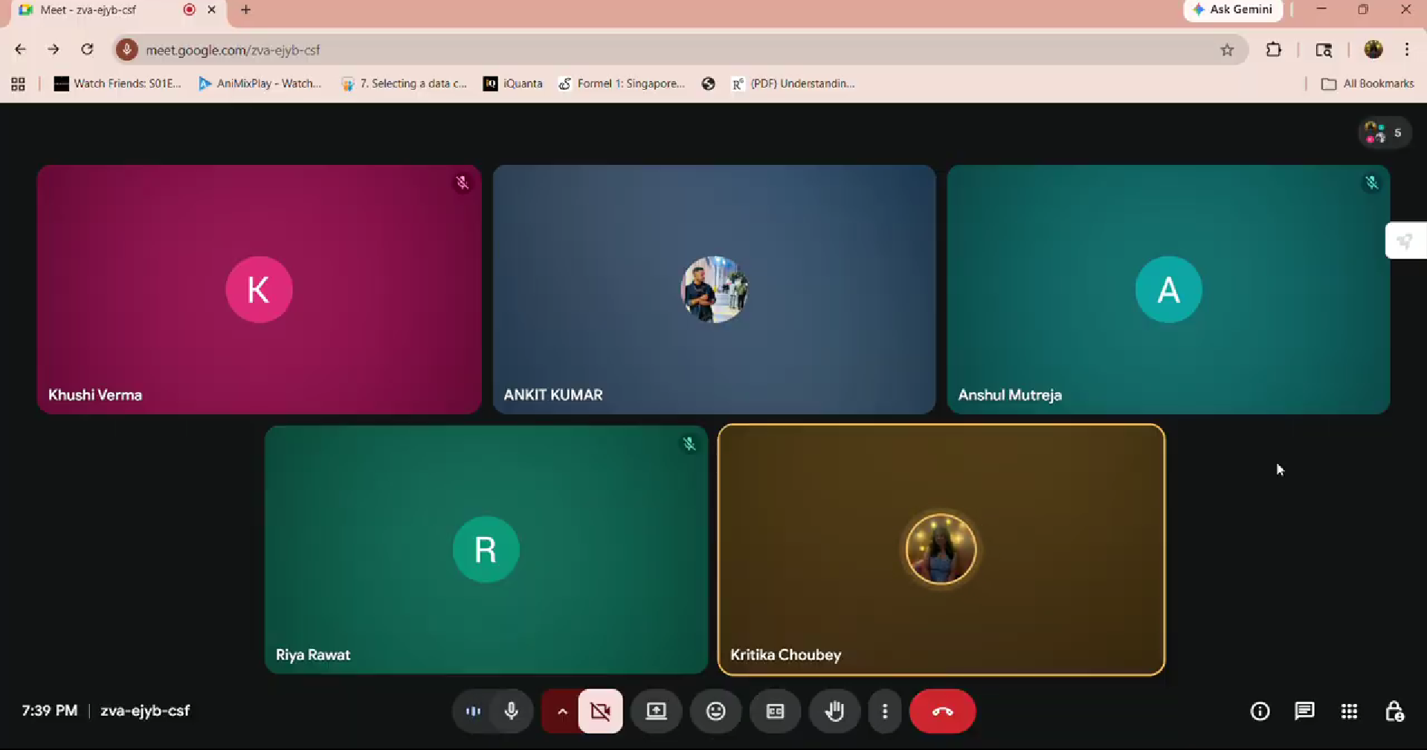
Student Outreach

Slide 3



Executive Summary
Global Giant,
Local Underdog
The Real Gap:
Awareness, Not Quality
Massive Opportunity
Ahead
Uniqlo operates 2,400+ stores globally with 15%+ margins - yet has only ~18 stores in India, mostly in metro cities.
Primary research confirmed that Indian consumers often misclassify Uniqlo as fast fashion. The product is strong; the story isn't being told.
India's fashion market is growing at 12.87% CAGR. Tier 2/3 cities contribute 40% of apparel demand with zero Uniqlo presence.
Core Thesis: Uniqlo India is not a failing brand — it is an underpenetrated one.

Slide 4
2019
~18
ABOUT
UNIQLO
INDIA
Entered India
Stores in India
First store in New Delhi
Concentrated in metros
₹1,000+Cr
2,400+
Owned by Fast Retailing Co. Ltd., Japan
Entered India: October 2019
Philosophy: LifeWear™
FY25 Revenue India
Global Stores
15% post-tax margins
Top global retailer
Brand Pillars: HEATTECH · AIRism · PUFFTECH · LifeWear™

Slide 5
Primary Research · Store Manager Interviews
via LinkedIn & Google Meet
Brand Positioning
Operational Strength
LifeWear philosophy: functional, quality-driven clothing built to last. Deliberately avoids seasonal churn.
Strong inventory discipline, customer-centric service protocols, and Japanese operational standards.
Product Innovation
Awareness Gap
HEATTECH, AIRism, and LifeWear are core pillars and primary drivers of repeat customer retention.
Many customers walk in perceiving Uniqlo as 'just another fast-fashion brand’ - functional USP not understood.
Store Reach Limit
Local Adaptation
Only 18 stores in metros. Tier 2 & 3 cities have virtually zero penetration — significant untapped demand.
Indian consumers have distinct fit, colour, and occasion-wear preferences requiring product localisation.
Key Insight: Uniqlo is not failing - it is underpenetrated. The gap is not capability; it is communication.

Slide 6
SWOT Analysis
STRENGTHS
WEAKNESSES
▸ Strong LifeWear philosophy - functional, timeless clothing
▸ Only ~18 stores - concentrated in metro cities
▸ Patented tech: HEATTECH, AIRism, PUFFTECH
▸ Limited brand awareness outside major urban centers
▸ Disciplined inventory & customer-centric service
▸ Perceived as 'just another fast fashion brand'
▸ Financially healthy - 15% post-tax margins (FY25)
▸ Limited size range & colour options for Indian body types
▸ Global scale with local learning approach
▸ Slow to adopt 'drop culture’ - less exciting for Gen Z
OPPORTUNITIES
THREATS
▸ Fashion retail growing at 12.87% CAGR
▸ H&M and Zara have first-mover advantage in India
▸ Tier 2 & 3 cities contribute ~40% of apparel demand
▸ Strong domestic players (Reliance, Tata, ABFRL)
▸ Rising middle class & working women = premium spending
▸ Price-sensitive consumers may not value premium
▸ Online fashion market projected at USD 35B by 2025
▸ D2C brands capturing young, digital-native shoppers
▸ Sustainability trend aligns with Uniqlo's core values
▸ Reliance on offline stores in fast-growing e-commerce

Slide 7
PESTLE Analysis
P
E
S
Political
Economic
Social
100% FDI allowed · 'Make in India' initiative reduces costs & strengthens supply chain
Fashion retail growing at 12.87% CAGR · Rising incomes · Huge Tier 2/3 potential
Young, aspirational population · Growing demand for western wear · Quality loyalty post-trial
T
L
E
Technological
Legal
Environmental
High digital penetration · Strong e-commerce ecosystem · AI-driven inventory opportunities
GST affects pricing · Labour laws & sourcing compliance · Partnerships crucial for smooth ops
Sustainability trend rising · LifeWear 'buy less, buy better' aligns with conscious consumerism

Slide 8
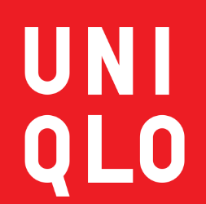
Porter's Five Forces
Competitive Landscape · India
Threat of
New Entrants
Competitive
Rivalry
Buyer Power
MEDIUM
HIGH
HIGH
Capital & supply chain barriers exist; DTC models lower entry bar; SPA model is a moat
Zara, H&M, Reliance, Trent - intense competition, but Uniqlo's LifeWear niche reduces direct rivalry
Price-conscious consumers with vast choice; tech-loyal customers (HEATTECH) show stickiness
UNIQLO
INDIA
Supplier
Power
Threat of
Substitutes
LOW
MEDIUM-HIGH
SPA model gives strong leverage; India being developed as a key sourcing hub
Jockey, Levi's, D2C brands, athleisure trend (5%+ CAGR) - easy to switch before loyalty

Slide 9
VRIO Analysis · Internal Capabilities
Resource / Capability
Valuable
Rare
Inimitable
Competitive Implication
LifeWear Philosophy
✓
✓
~
Sustained Advantage
HEATTECH / AIRism / PUFFTECH
✓
✓
✓
Strong Sustained Advantage
Inventory & Store Ops
✓
–
–
Competitive Parity
Financial Health (15% margin)
✓
–
–
Competitive Parity
Global Brand Reputation
✓
–
–
Parity (Low India Awareness)
Fast Retailing Ecosystem
✓
✓
✓
Sustained Advantage

Slide 10
Strategic Gaps (Strategic Cracks)
Where Uniqlo India must act
01
Geographic Underpenetration
18 stores vs H&M's 60+ · Tier 2/3 cities (40% of apparel sales) have zero Uniqlo presence · Need 50+ stores in 5 years
02
Brand Awareness Gap
Many Indians misclassify Uniqlo as fast fashion · Technology storytelling is under-invested vs competitors
03
Product Localisation Deficit
Festive/ethnic wear is a huge Indian market that is entirely missed · Size ranges not adapted for Indian body types
04
Digital Channel Gap
Only 15% of revenue from e-commerce vs. 30%+ for peers · Self-imposed marketplace exclusivity limits discovery

Slide 11
Growth Strategy · Ansoff Matrix
Diversification
Product Development
(New Product + New Market)
(New Product + Existing Market)
Kidswear / home textiles in new cities - only after stronger brand recall
India-specific fabrics · Ethnic-contemporary fusion · Adapted size ranges
Market Development
Market Penetration
(Existing Product + New Market)
(Existing Product + Existing Market)
Tier 2 cities via e-commerce first · Then physical expansion
Deepen existing cities · Digital education campaigns · Loyalty programmes

Slide 12
Implementation Roadmap
Phase 1
Phase 2
Phase 3
Short-Term · 0–12 Months
Medium-Term · 1–3 Years
Long-Term · 3–5 Years
→ "Wear the Science" pop-up experiences at malls & colleges
→ "Uniqlo Experience Stores" with fabric labs & tech demo zones
→ "India Fit Lab" — R&D for local climate, body types & preferences
→ "LifeWear for India" digital storytelling campaign
→ Omnichannel: click-and-collect + endless aisle + in-store digital
→ Compact cost-efficient stores in Tier 2/3 cities
→ "Uniqlo Community Circles" — app-based engagement
→ "Campus & Corporate Partnerships" for everyday wear essentials
→ Annual "LifeWear India Festival" — fashion + functionality
→ "Try Before You Buy" wardrobe kits for home trials
→ Expand to Pune, Bengaluru, Ahmedabad, Chandigarh
→ Collaborations with Indian designers for limited-edition collections
→ "Uniqlo on Wheels" — mobile vans for Tier 2/3 cities
→ "Everyday Essentials" subscription model for basics & innerwear

Slide 13
Conclusion &
Strategic Recommendations
1
Raise brand awareness through technology education campaigns & community storytelling
4
Strengthen digital & omnichannel presence; partner with Myntra/Amazon for wider reach
2
Expand store footprint to 50+ stores, prioritising Tier 1 & digital-first Tier 2 entry
5
Scale India sourcing from 16% to 30% by FY27 to reduce costs & geopolitical risk
3
Localise products for Indian climate, body types, and festive/occasion-wear needs
Uniqlo India is not a turnaround case — it is a growth opportunity waiting to be fully realised.
Fortune Institute of International Business · Learning Team 4 · Strategic Management · 2026

