Slide 1
LSTM vs Traditional Models for Time-Series Forecasting
Presented by: Varsha Pamisetty

Slide 2

Introduction to Time-Series Forecasting
Time-series data, collected sequentially over time, forms the backbone of crucial predictions across diverse fields.
Time-series data is collected over time, reflecting patterns and trends inherent to various phenomena.
Forecasting predicts future values based on these historical observations.
Applications are ubiquitous: predicting stock market fluctuations, forecasting weather patterns, optimizing retail sales, and managing patient health in healthcare.

Slide 3

Understanding Time-Series Forecasting
Time-series forecasting involves using past data points to predict future values. This complex task is typically broken down by identifying three core components:
Trend
Seasonality
Noise
The long-term increase or decrease in the data.
Repetitive patterns that occur at fixed intervals (e.g., daily, weekly, yearly).
Random variations or irregularities in the data that cannot be explained by trend or seasonality.

Slide 4
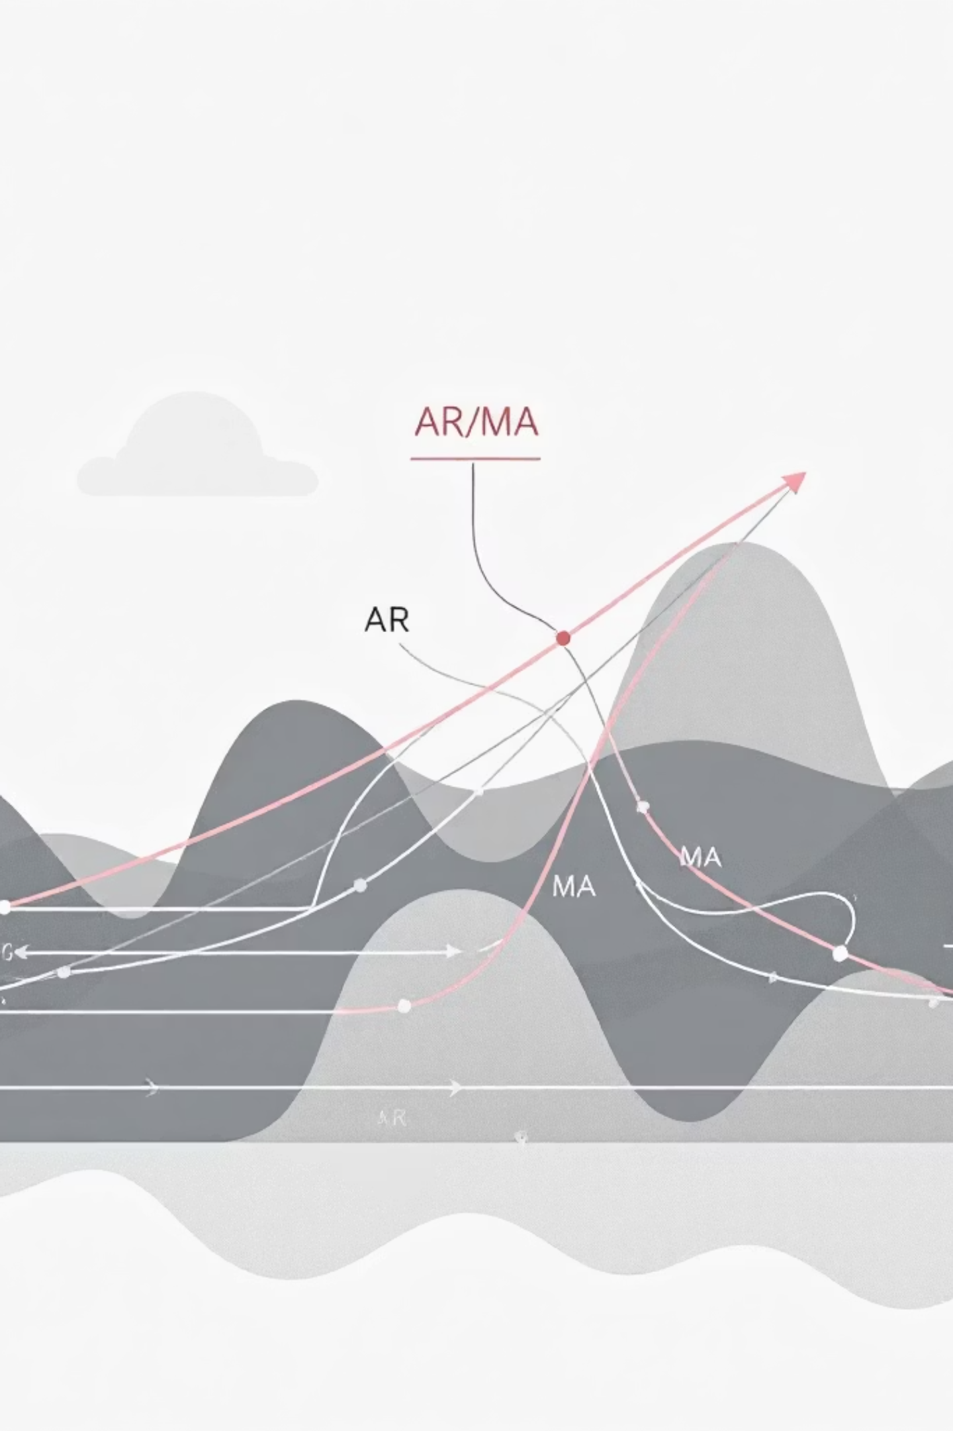
Traditional Time-Series Models: The Foundation
Before the advent of deep learning, several statistical models served as the workhorses for time-series forecasting. These models provide a robust foundation for understanding temporal data.
AR (AutoRegressive)
1
Models where the future value is a linear combination of past values.
MA (Moving Average)
2
Models where the future value is a linear combination of past forecast errors.
ARIMA / SARIMA
3
AutoRegressive Integrated Moving Average (ARIMA) and Seasonal ARIMA (SARIMA) combine AR, MA, and differencing to handle trends and seasonality.
Exponential Smoothing
4
Methods that assign exponentially decreasing weights to observations as they get older.

Slide 5

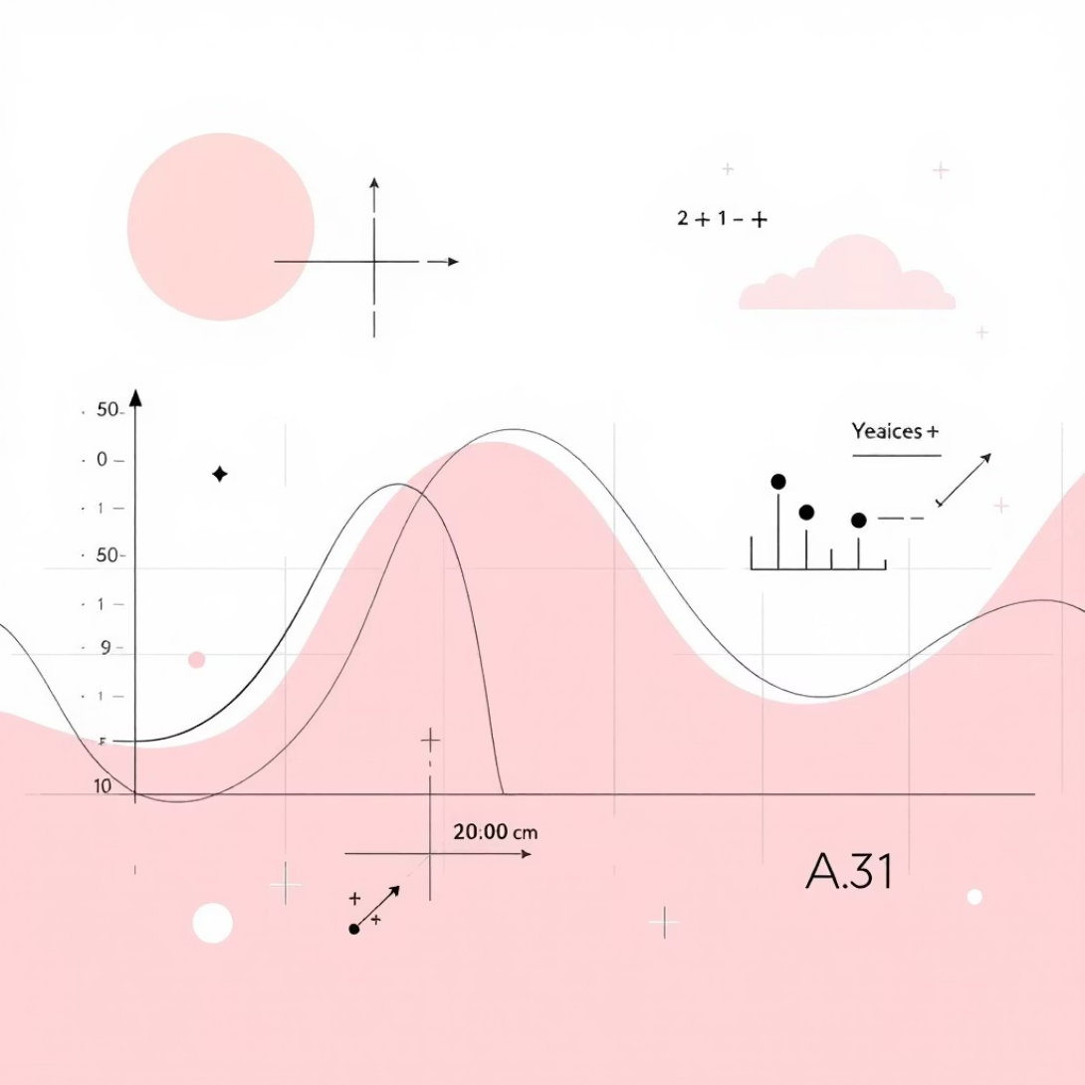
Operating Principles of Traditional Models
Traditional models operate under specific assumptions that simplify the forecasting problem, making them effective in certain scenarios but limited in others.
Assume Linear Relationships
Require Stationary Data
These models primarily capture linear dependencies between past and future data points, struggling with complex, non-linear dynamics.
Many traditional models perform best when the statistical properties of the time series (mean, variance) remain constant over time, often requiring data transformation.
Manual parameter tuning is often necessary, requiring expert knowledge to determine the optimal model orders and settings.

Slide 6


Advantages of Traditional Forecasting Models
Simple and Interpretable
Works with Small Datasets
Their mathematical foundations are straightforward, making results easy to understand and explain.
Effective even with limited historical data, unlike more complex models that require vast amounts of information.
Low Computational Cost
Generally require less computational power and time for training and prediction, making them suitable for resource-constrained environments.

Slide 7

Limitations of Traditional Forecasting Models
While robust in specific contexts, traditional models face significant challenges when confronted with the complexities of real-world time-series data.
Cannot Model Non-Linear Data
Weak Long-Term Dependency Handling
Struggle with intricate, non-linear relationships and sudden shifts often present in complex time-series data.
Ineffective at capturing patterns or dependencies that span over long periods, leading to less accurate long-term forecasts.
This inability to adapt to evolving patterns and extended dependencies highlights the need for more advanced techniques in certain forecasting scenarios.

Slide 8

Introducing LSTM: A Deep Learning Solution
Long Short-Term Memory (LSTM) networks represent a significant leap forward in time-series forecasting, especially for complex and long sequences.
Long Short-Term Memory (LSTM) Network
Type of Recurrent Neural Network
A specialized kind of Recurrent Neural Network (RNN) designed to remember information for extended periods.
LSTMs excel at processing sequences, making them ideal for time-series, speech recognition, and language translation.
Solves Vanishing Gradient Problem
LSTMs overcome a critical limitation of traditional RNNs, allowing them to learn and retain information over very long sequences without forgetting past insights.

Slide 9
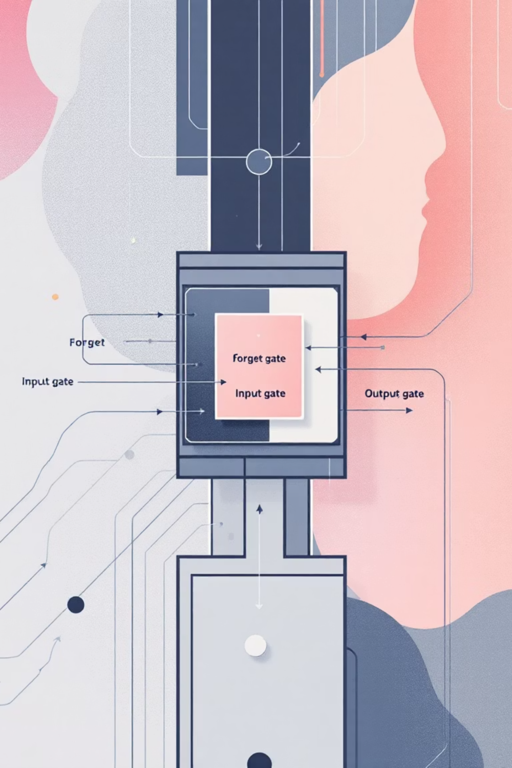



The Internal Mechanism of LSTM
At the core of an LSTM's power are its "gates," which regulate the flow of information, allowing it to selectively remember or forget past data.
Forget Gate
Decides what information to discard from the cell state, preventing information overload.
Input Gate
Determines which new information is relevant to store in the cell state.
Output Gate
Controls what information from the cell state is outputted at a given timestep.

Slide 10
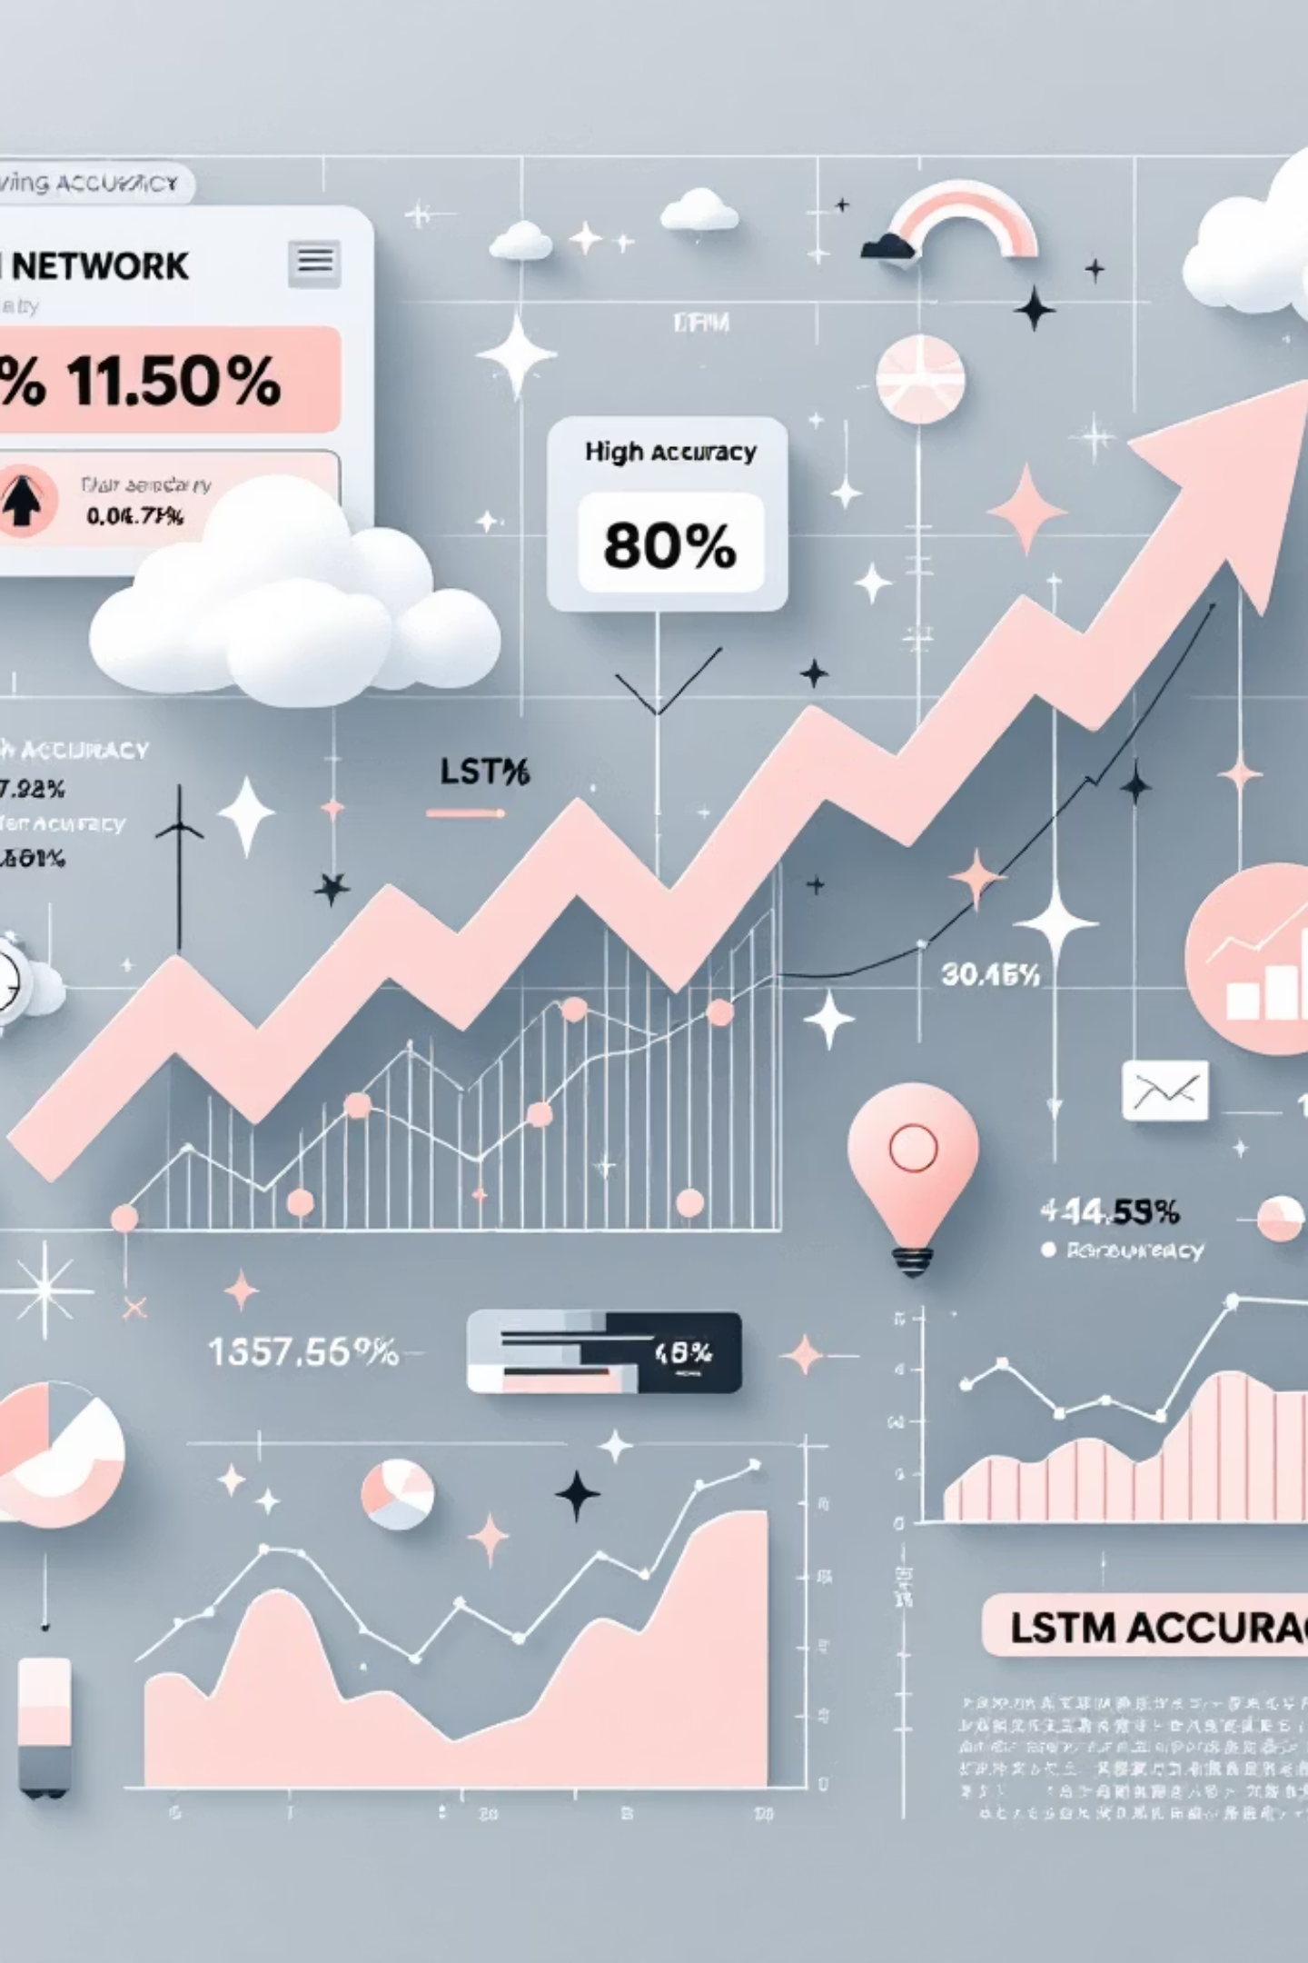
Key Advantages of LSTM Networks
LSTMs offer distinct advantages that make them particularly well-suited for complex time-series forecasting tasks.
Handles Non-Linear Patterns
Unlike traditional models, LSTMs can inherently learn and model complex non-linear relationships within data.
Captures Long-Term Dependencies
Their unique architecture allows them to retain and utilize information from distant past observations, critical for many real-world scenarios.
High Accuracy
Often achieve superior prediction accuracy on complex, real-world time-series datasets due to their ability to learn intricate patterns.

Slide 11
Conclusion: Charting the Future of Time-Series Forecasting
In summary, both traditional models and LSTM networks offer unique strengths for time-series analysis. Choosing the right approach depends on the complexity of your data and your specific interpretability needs.
1
Traditional Models: Simple but Limited
2
LSTMs: Excelling in Complexity
Ideal for straightforward data, offering interpretability, but struggle with complex non-linear patterns and long-term dependencies.
Their advanced architecture effectively handles intricate non-linear relationships and captures long-term dependencies, achieving high accuracy for complex data.
3
Data-Driven Selection
Choose traditional models for simple data and interpretability, and LSTMs for volatile, non-linear, or long-sequence data to unlock deeper insights.

