Slide 1
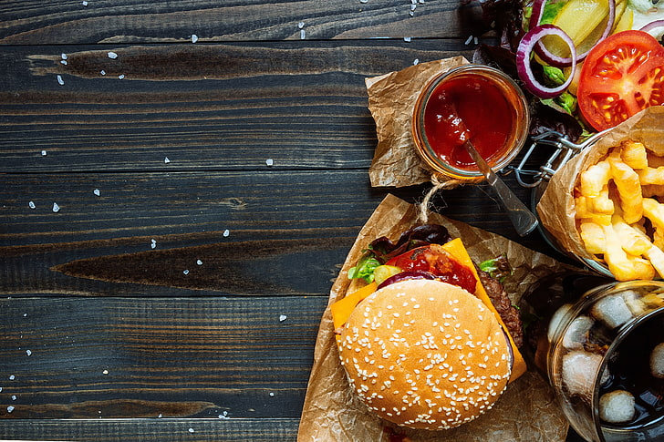
WELCOME

Slide 2
“A Statistical Study on
the Fast – Food Consumption’’
Intern Name: Taware Chaitrali Rajendra
CodeAlpha Internship: Data Analytics
Duration: 20th July – 20th August

Slide 3
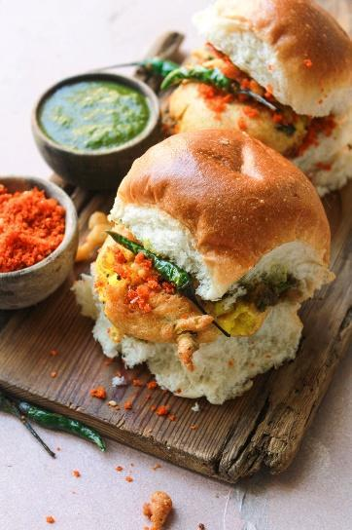
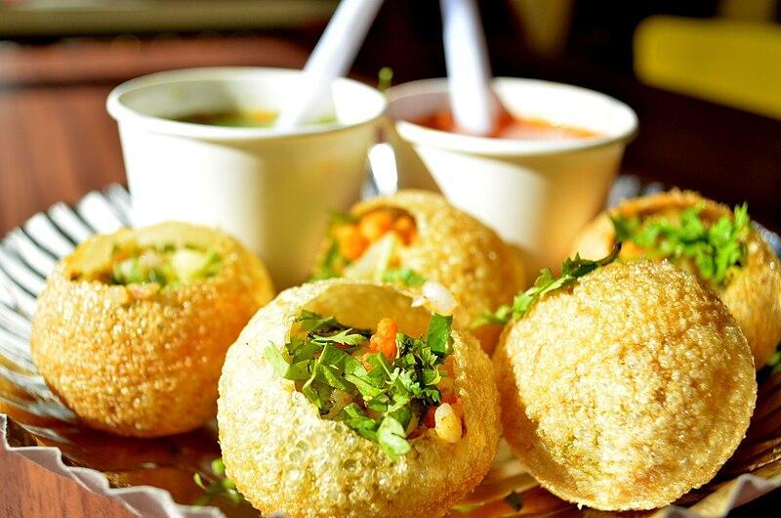
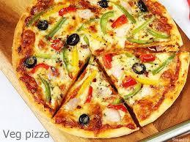
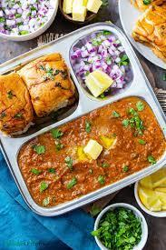
SOME FAST FOODS

Slide 4
FAST FOOD
Smell
Advertisement
Variety
Of
food
Quality
Taste

Slide 5
INTRODUCTION
Fast-food consumption is rising among youth.
This study analyzes consumption patterns and health impact.
Focus: gender differences, mood influence, time of day.

Slide 6
Problem Statement
- Rise in fast-food habits among youth, especially in Baramati
- Need to explore gender-based patterns and lifestyle impact
- Aim: Understand connection between fast food, mood, and health perception

Slide 7
OBJECTIVES
• Analyze fast-food consumption trends
• Identify preferred food types
• Study gender-wise preferences
• Assess health risk awareness
• Apply stats + visuals to present findings

Slide 8
METHODOLOGY
Primary data via structured questionnaire
150 participants (SRSWOR sampling)
Tools: Excel, Word, PowerPoint, R
Focused on youth (18–25 years)

Slide 9
Diagrammatical Representation
Pie Chart
Bar Diagram
Descriptive Statistics
Theory of Attribute
Percentage Bar Diagram
Statistical Tools Used For Analysis

Slide 10
Dataset Overview
• Gender: 60% Female, 40% Male
• Total responses: 150
• Age Group: 18–25 years
• Questionnaire: 14 questions on habits & health

Slide 11
Key Variables
- Gender
- Food type & time of day
- Mood & health impact
- Eating location
- Height & weight (for CV)

Slide 12
Data Visualizations
Pie chart: 89% consume fast food
Bar graph: Food preference by gender
Line/column chart: Time of day preferences
Mood influence on eating pattern

Slide 13
Insights
Mood & convenience drive eating habits
Gender-based preferences: clear divide
Health awareness exists but doesn’t affect choices
Females have more stable physical measures (CV)

Slide 14
CONCLUSIONS
• Fast food linked more to emotions than awareness
• Visual + statistical tools reveal patterns
• Health awareness needs reinforcement
• Need for youth-based wellness interventions

Slide 15
Reference
Fundamental & Mathematical Statistics, By S. C. Gupta and V. K. Kapoor.
Basic Statistics by B. L. Agarwal.

Slide 16


