Slide 1
AGILE METHODOLOGY

Slide 2
AGILE METHODOLOGY
Agile is a software development methodology to build a software incrementally using short iterations of 1 to 4 weeks so that the development is aligned with the changing business needs.
Instead of a single-pass development of 6 to 18 months where all the requirements and risks are predicted upfront, Agile adopts a process of frequent feedback where a workable product is delivered after 1 to 4 week iteration.

Slide 3
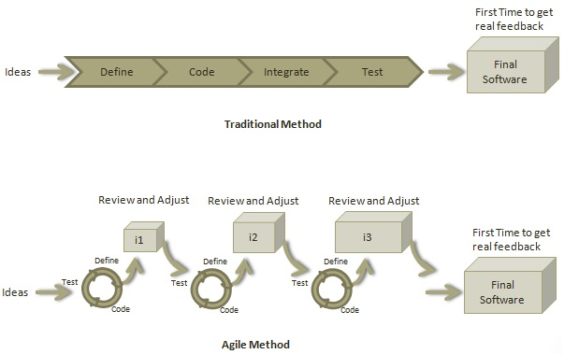

Slide 4
Scrum
SCRUM is an agile development method which concentrates specifically on how to manage tasks within a team-based development environment.
It consists of three roles, and their responsibilities are explained as follows:
Scrum Master
Master is responsible for setting up the team, sprint meeting and removes obstacles to progress
Product owner
The Product Owner creates product backlog, prioritizes the backlog and is responsible for the delivery of the functionality at each iteration
Scrum Team
Team manages its own work and organizes the work to complete the sprint or cycle

Slide 5
Scrum Master
A Scrum Master is a team leader and facilitator who helps the team members to follow agile practices so that they can meet their commitments. The responsibilities of a scrum master are as follows:
To enable close co-operation between all roles and functions.
To remove any blocks.
To shield the team from any disturbances.
To work with the organization to track the progress and processes of the company.
To ensure that Agile Inspect & Adapt processes are leveraged properly which includes
Daily stand-ups,
Planned meetings,
Demo,
Review,
Retrospective Meetings, and
To facilitate team meetings and decision-making process.

Slide 6
USER STORIES
A user story is a tool used in Agile software development to capture a description of a software feature from an end-user perspective. The user story describes the type of user, what they want and why. A user story helps to create a simplified description of a requirement.
As a < type of user >, I want < some goal > so that < some reason >.

Slide 7
SPRINT PLANNING
Sprint planning is a collaborative effort involving a Scrum Master, who facilitates the meeting, a Product Owner, who clarifies the details of the product backlog items and their respective acceptance criteria, and the Entire Agile Team, who define the work and effort necessary to meet their sprint commitment.
Sprint Planning is time-boxed to a maximum of eight hours for a one-month Sprint. For shorter Sprints, the event is usually shorter.

Slide 8
SPRINT RETROSPECTION
Sprint Retrospection is an opportunity for the Scrum Team to inspect itself and create a plan for improvements to be enacted during the next Sprint.
The Sprint Retrospection occurs after the Sprint Review and prior to the next Sprint Planning.
During the Sprint Retrospective, the team discusses:
What went well in the Sprint
What could be improved
What will we commit to improve in the next Sprint

Slide 9
BURNDOWN CHART
A burn down chart is a graphical representation of work left to do versus time
The outstanding work (or backlog) is often on the vertical axis, with time along the horizontal.
It is useful for predicting when all of the work will be completed

Slide 10
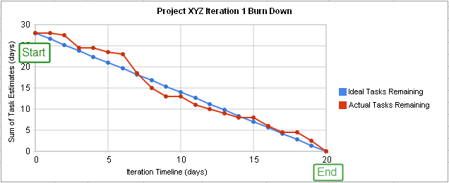
GRAPHICAL VIEW OF BURNDOWN CHART

Slide 11
Poker Planning
What is Planning Poker?
When should we engage in Planning Poker?

Slide 12
DAILY STANDUP
Time Bound
Two Questions that arise in Daily StandUp
What I did yesterday that helped the development team meet the sprint goal?
What will I do today to help the development team meet the sprint goal?
Purpose of Daily StandUp

Slide 13
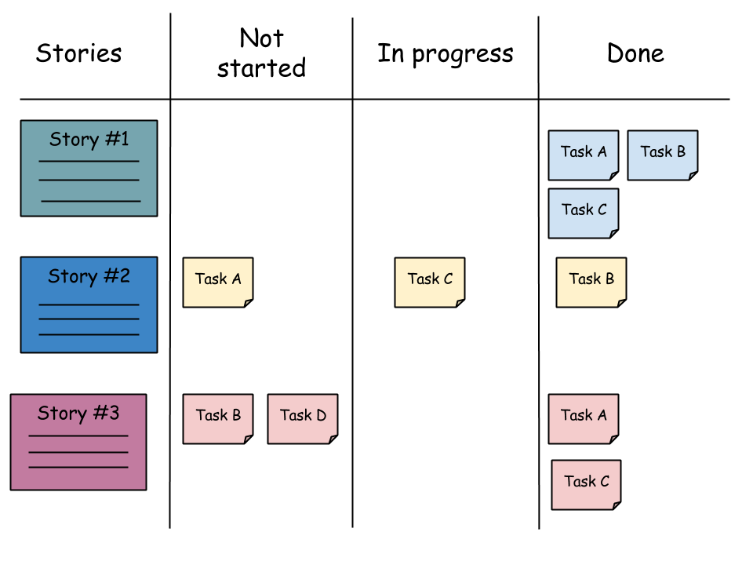
SCRUM BOARD

Slide 14
PRODUCT OWNER
The Scrum product owner is typically a project's key stakeholder.
The product owner responsibilities is to have a vision of what he or she wishes to build, and convey that vision to the scrum team.
The product owner is commonly a lead user of the system or someone from marketing, product management or anyone with a solid understanding of users, the market place, the competition and of future trends for the domain or type of system being developed.

Slide 15
VELOCITY IN AGILE METHODOLOGY
Velocity is a measure of the amount of work a Team can tackle during a single Sprint and is the key metric in Scrum.
Velocity is calculated at the end of the Sprint by totaling the Points for all fully completed User Stories.
The main idea behind velocity is to help teams estimate how much work they can complete in a given time period based on how quickly similar work was previously completed

Slide 16
SPRINT BACKLOG
The sprint backlog is a list of tasks identified by the Scrum team to be completed during the Scrum sprint.
The sprint backlog is commonly maintained as a spreadsheet.
The Sprint Backlog makes visible all the work that the Development Team identifies as necessary to meet the Sprint Goal.
The Sprint Backlog is a plan with enough detail that changes in progress can be understood in the daily scrum. The Development Team modifies the Sprint Backlog throughout the Sprint. Only the Development Team can change its Sprint Backlog during a Sprint.

