Slide 1

MUNICIPAL UTILITY NETWORK
SHRI SHANKARACHARYA ENGINEERING COLLEGE
Department of Computer Science and Engineering
A Project on
By-
Guided By-
WASIF KHAN
ROBIN T
SUDESH KASHYAP
Head of Dept.-
Prof. R.S Panda

Slide 2
MUNICIPAL UTILITY NETWORK

Slide 3
PROBLEM ABSTRACT
Existing System:
Existing system consists of residents approaching the Government Municipal Office for registering their complain.
This was known by the name ‘Prajavani’.
This form of complain is stored by pen and paper format.
Whilst registration, the complain leaflet is queued up in bundles, awaiting further processing.
Since it is fully controlled by humans, it is more prone for delayed action and erroneous conducts.

Slide 4
Solutions for the problems in Existing System:
For solving the problems in above system and providing better facilities District Level Progressing System is proposed with the following features.
Secure registration is provided for the citizens.
Citizen can get more information of his place.
Citizen can post the problem easily and can suggest a possible solution also
Fake complaints can be avoided as the MUN server will forward them to the officers only after verifying them.
Officers can indirectly interact with the people by solving their problems in online via complain status’.

Slide 5
FUNCTIONAL REQUIREMENTS AND USER REQUIREMENTS
Functional Requirements
User ought to be literate.
User ought to have worked with computers in the past.
The Computer must have JAVA installed on it.
HARDWARE REQUIREMENT
Windows XP and above.
RAM and ROM needs to be 512MB and 100GB, respectively.
The system must have a valid internet connection.

Slide 6
SYSTEM ARCHITECTURE
Govt. DB
User
Validation
Authenticated
MUN
DB
MUN
SERVER
Local Head

Slide 7
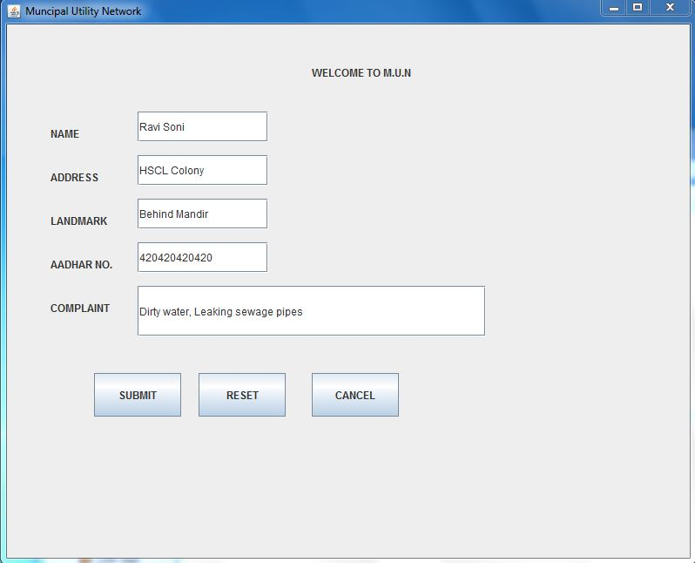
PROJECT SCREEN SHOTS
User can register to the system by filing the appropriate authentication information.

Slide 8
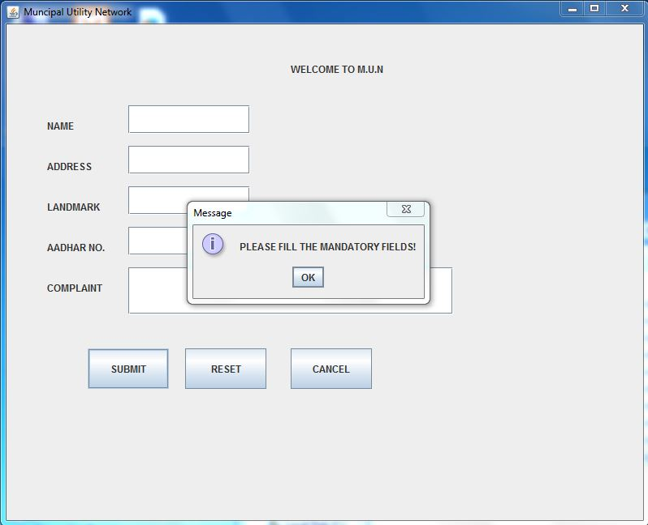
PROJECT SCREEN SHOTS
User can not enter bogus values.

Slide 9
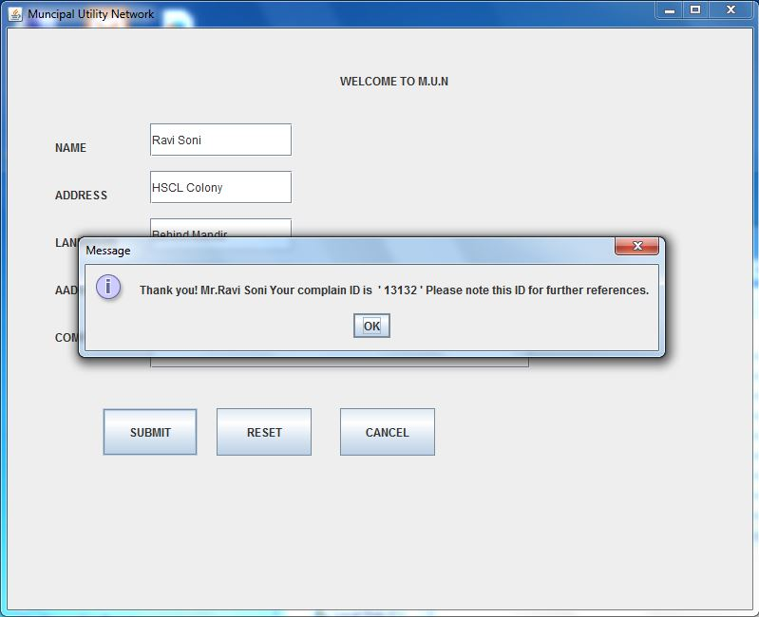
PROJECT SCREEN SHOTS
Ones user registers online, a Complain ID is generated for the user to check status of the afformentioned complain.

Slide 10
TESTING
Verify that user can access to the system module.
Verify that user can view his place details correctly.
Verify that MUN server & operator is able to acknowledge the user who posted the problems.
Verify that government officers and collector can take necessary action regarding to the user’s complain registered to the server.
verify that user is able to utilize all the services provided by the system.
Verify weather query has been delivered to the Govt. officer.

Slide 11
STRENGTHS
WEAKNESS
1. Summation of work done would be fast.
2. Erroneous entries could be evaded.
3. Reception of registered error is almost instantaneous.
4. Complain handling would be transparent.
1. The Server must remain active whilst complain registration.
2. The user must have compatible system and needs to be configured by the official during installation.

Slide 12
THANK YOU!

