Slide 1

Sections 5.1 & 5.2
Queues and Formal Specification

Slide 2
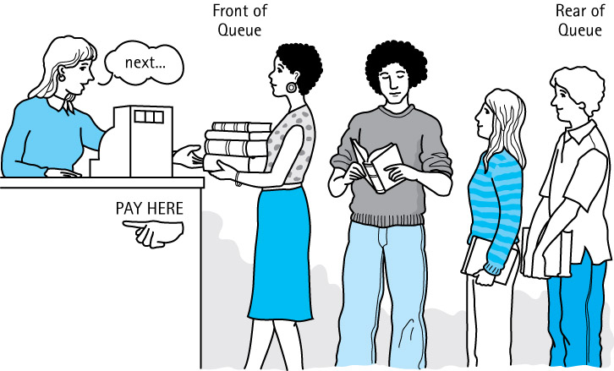
5.1 Queues
Queue A structure in which elements are added to the rear and removed from the front; a “first in, first out” (FIFO) structure

Slide 3
Operations on Queues
Constructor
  new - creates an empty queue
Transformers
  enqueue - adds an element to the rear of a queue
  dequeue - removes and returns the front element of the queue

Slide 4
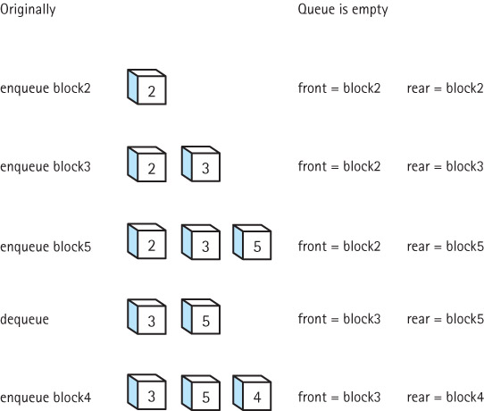
Effects of
Queue
Operations

Slide 5
Using Queues
Operating systems often maintain a queue of processes that are ready to execute or that are waiting for a particular event to occur.
Computer systems must often provide a “holding area” for messages between two processes, two programs, or even two systems. This holding area is usually called a “buffer” and is often implemented as a queue.
Our software queues have counterparts in real world queues. We wait in queues to buy pizza, to enter movie theaters, to drive on a turnpike, and to ride on a roller coaster. Another important application of the queue data structure is to help us simulate and analyze such real world queues

Slide 6
5.2 Formal Specification
(of our Queue ADT)
Recall from Section 5.1 that a queue is a “first-in first-out" structure, with primary operations
  enqueue - adds an element to the rear of a queue
  dequeue - removes and returns the front element of the queue push - adds an element to the top of the stack
In addition we need a constructor that creates an empty queue
Our Queue ADT will be generic, allowing the class of objects held by the queue to be specified upon instantiation of the queue.

Slide 7
Completing the Formal Specification
To complete the formal specification of the Queue ADT we need to
  Identify and address any exceptional situations
  Determine boundedness
  Define the Queue interface or interfaces
We use the same approach we used for Stacks

Slide 8
Exceptional Situations
dequeue – what if the queue is empty?
  throw a QueueUnderflowException
  plus define an isEmpty method for use by the application
enqueue – what if the queue is full?
  throw a QueueOverflowException
  plus define an isFull method for use by the application

Slide 9
Boundedness
We support two versions of the Queue ADT
  a bounded version
  an unbounded version
We define three interfaces
  QueueInterface: features of a queue not affected by boundedness
  BoundedQueueInterface: features specific to a bounded queue
  UnboundedQueueInterface: features specific to an unbounded queue

Slide 10
QueueInterface
//---------------------------------------------------------------------------
// QueueInterface.java by Dale/Joyce/Weems Chapter 5
//
// Interface for a class that implements a queue of Objects.
// A queue is a first-in, first-out structure.
//---------------------------------------------------------------------------
package ch05.queues;
public interface QueueInterface<T>
{
T dequeue() throws QueueUnderflowException;
// Throws QueueUnderflowException if this queue is empty,
// otherwise removes front element from this queue and returns it.
boolean isEmpty();
// Returns true if this queue is empty, otherwise returns false.
}

Slide 11
The Remaining Queue Interfaces
The BoundedQueueInterface
package ch05.queues;
public interface BoundedQueueInterface<T> extends QueueInterface<T>
{
void enqueue(T element) throws QueueOverflowException;
// Throws QueueOverflowException if this queue is full,
// otherwise adds element to the rear of this queue.
boolean isFull();
// Returns true if this queue is full, otherwise returns false.
}
The UnboundedQueueInterface
package ch05.queues;
public interface UnboundedQueueInterface<T> extends QueueInterface<T>
{
void enqueue(T element);
// Adds element to the rear of this queue.
}

Slide 12
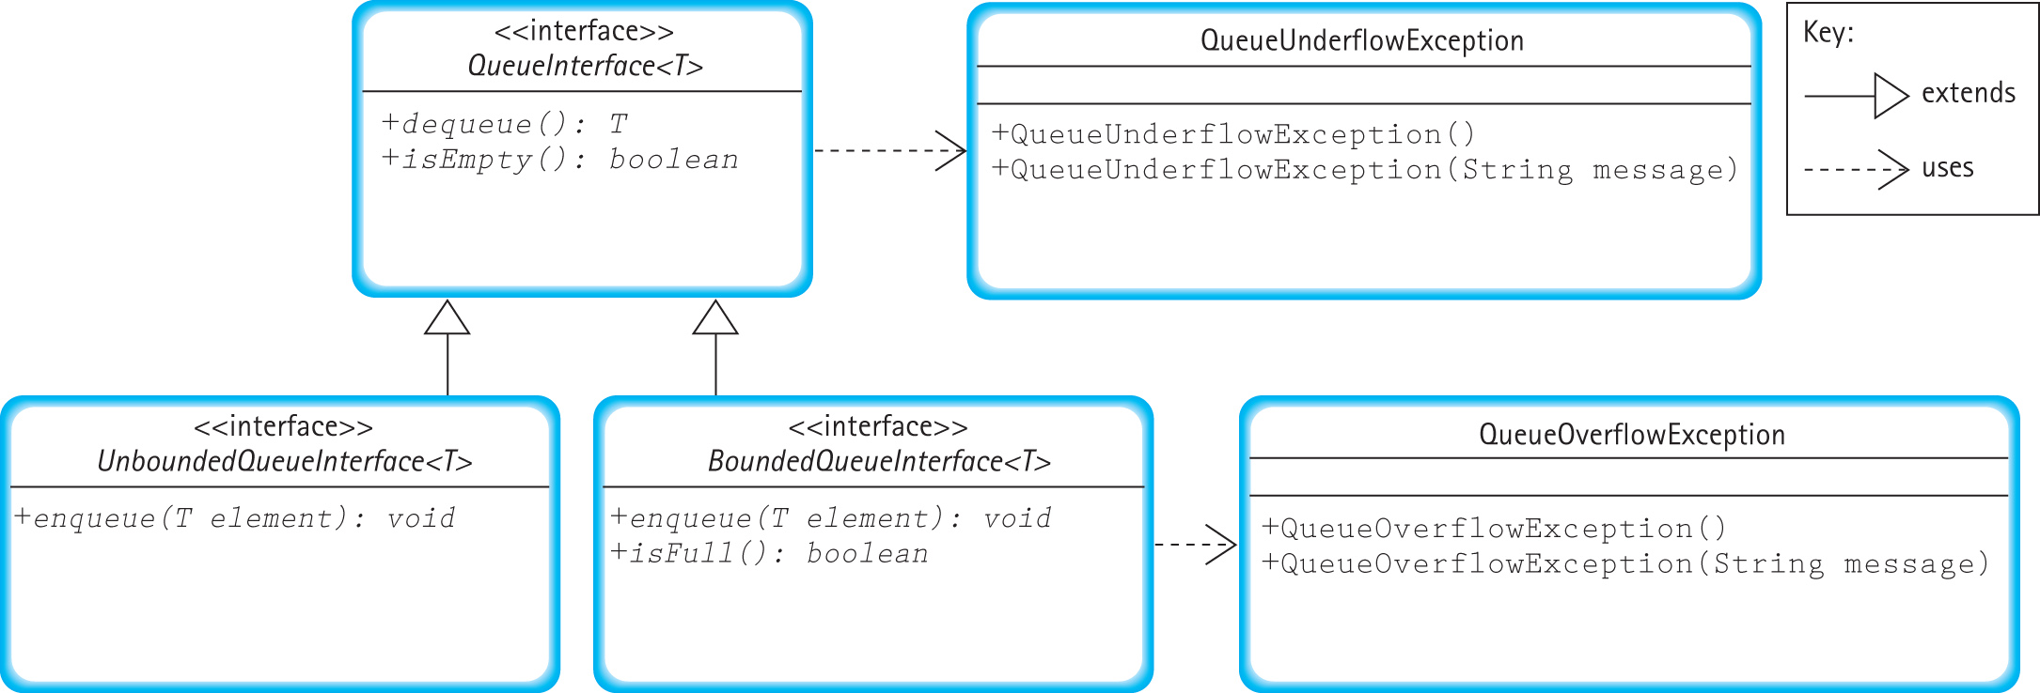
Relationships among Queue Interfaces and Exception Classes

