Slide 1

Section 5.3
Array-Based Implementations

Slide 2
5.3 Array-Based Implementations
In this section we study two array-based implementations of the Queue ADT
  a bounded queue version
  an unbounded queue version
First we establish how we will hold the queue elements in the array

Slide 3



Fixed Front Design
After four calls to enqueue with arguments ‘A’, ‘B’, ‘C’, and ‘D’:
Dequeue the front element:
Move every element in the queue up one slot
The dequeue operation is inefficient, so we do not use this approach

Slide 4
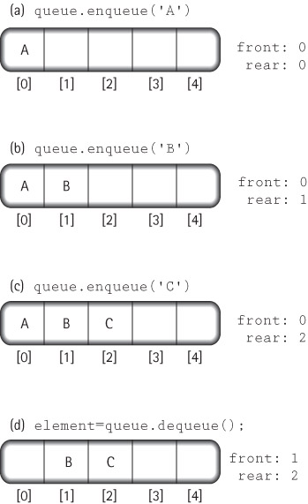
Floating Front Design
We use this
approach

Slide 5
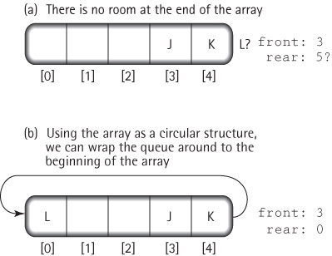
Wrap Around with Floating Front Design

Slide 6
The ArrayBndQueue Class
package ch05.queues;
public class ArrayBndQueue<T> implements BoundedQueueInterface<T>
{
protected final int DEFCAP = 100; // default capacity
protected T[] queue; // array that holds queue elements
protected int numElements = 0; // number of elements in the queue
protected int front = 0; // index of front of queue
protected int rear; // index of rear of queue
public ArrayBndQueue()
{
queue = (T[]) new Object[DEFCAP];
rear = DEFCAP - 1;
}
public ArrayBndQueue(int maxSize)
{
queue = (T[]) new Object[maxSize];
rear = maxSize - 1;
}

Slide 7
The enqueue operation
public void enqueue(T element)
// Throws QueueOverflowException if this queue is full,
// otherwise adds element to the rear of this queue.
{
if (isFull())
throw new QueueOverflowException("Enqueue attempted on a full queue.");
else
{
rear = (rear + 1) % queue.length;
queue[rear] = element;
numElements = numElements + 1;
}
}

Slide 8
The dequeue operation
public T dequeue()
// Throws QueueUnderflowException if this queue is empty,
// otherwise removes front element from this queue and returns it.
{
if (isEmpty())
throw new QueueUnderflowException(“Dequeue attempted on empty queue.”);
else
{
T toReturn = queue[front];
queue[front] = null;
front = (front + 1) % queue.length;
numElements = numElements - 1;
return toReturn;
}
}

Slide 9
Remaining Queue Operations
public boolean isEmpty()
// Returns true if this queue is empty, otherwise returns false
{
return (numElements == 0);
}
public boolean isFull()
// Returns true if this queue is full, otherwise returns false.
{
return (numElements == queue.length);
}

Slide 10
The ArrayUnbndQueue Class
The trick is to create a new, larger array, when needed, and copy the queue into the new array
  Since enlarging the array is conceptually a separate operation from enqueing, we implement it as a separate enlarge method
  This method instantiates an array with a size equal to the current capacity plus the original capacity
We can drop the isFull method from the class, since it is not required by the Unbounded Queue Interface
The dequeue and isEmpty methods are unchanged

Slide 11
The ArrayUnbndQueue Class
package ch05.queues;
public class ArrayUnbndQueue<T> implements UnboundedQueueInterface<T>
{
protected final int DEFCAP = 100; // default capacity
protected T[] queue; // array that holds queue elements
protected int origCap; // original capacity
protected int numElements = 0; // number of elements n the queue
protected int front = 0; // index of front of queue
protected int rear = -1; // index of rear of queue
public ArrayUnbndQueue()
{
queue = (T[]) new Object[DEFCAP];
rear = DEFCAP - 1;
origCap = DEFCAP;
}
public ArrayUnbndQueue(int origCap)
{
queue = (T[]) new Object[origCap];
rear = origCap - 1;
this.origCap = origCap;
}

Slide 12
The enlarge operation
private void enlarge()
// Increments the capacity of the queue by an amount
// equal to the original capacity.
{
// create the larger array
T[] larger = (T[]) new Object[queue.length + origCap];
// copy the contents from the smaller array into the larger array
int currSmaller = front;
for (int currLarger = 0; currLarger < numElements; currLarger++)
{
larger[currLarger] = queue[currSmaller];
currSmaller = (currSmaller + 1) % queue.length;
}
// update instance variables
queue = larger;
front = 0;
rear = numElements - 1;
}

Slide 13
The enqueue operation
public void enqueue(T element)
// Adds element to the rear of this queue.
{
if (numElements == queue.length)
enlarge();
rear = (rear + 1) % queue.length;
queue[rear] = element;
numElements = numElements + 1;
}

