Slide 1
New Features in Dew
Li Zhihui, Wu Wenqi
Intel SSG Cloud Computing
3/15 2015

Slide 2
Outlines
Before
New Features
User Guide
Architecture

Slide 3
Before
The Dew is a light-weight distributed Spark performance analysis framework.
Analyze Spark performance with data flow.
No coupling with Spark application.
No affecting Spark application performance.
No cluster size limitation (powerful scalability)

Slide 4
New Features
Now Dew is a big data application management and analysis system.
Distributed log collection and query
Distributed command execution
Spark performance diagnosis
Spark application management and report
WebCenter: Big Data App Management
Application registration and execute
Application execution result analysis and report
Cluster performance monitor
Dew registered services monitor

Slide 5
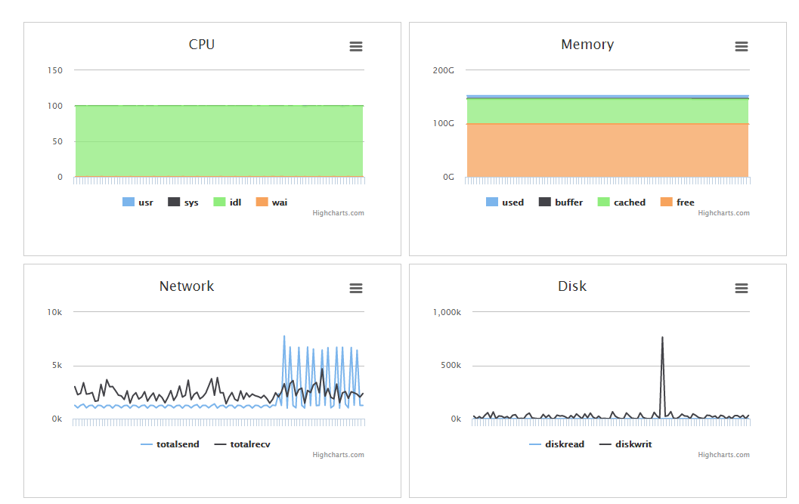
Demo – Cluster Status

Slide 6
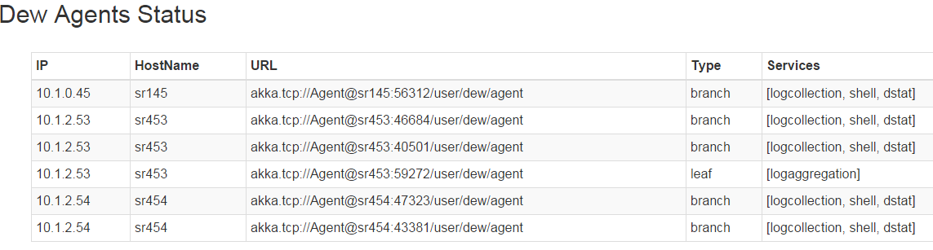
Demo – Agents Status

Slide 7
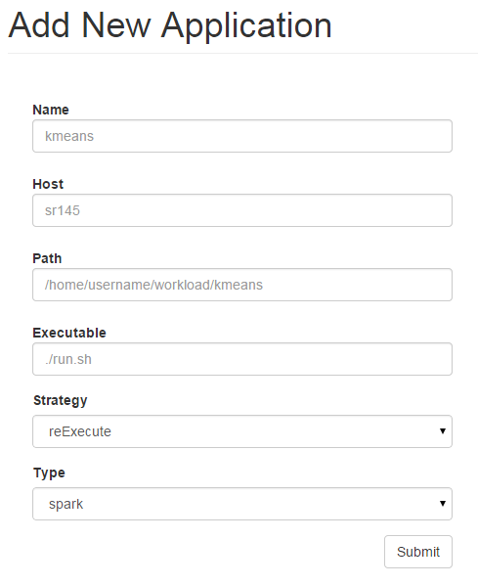
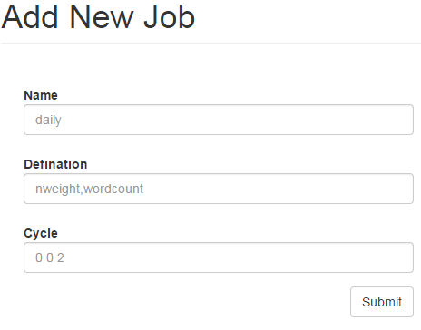
Demo – Application & Job Registration

Slide 8
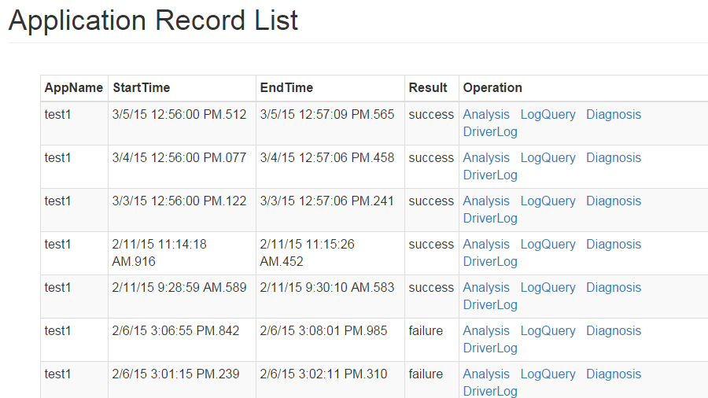
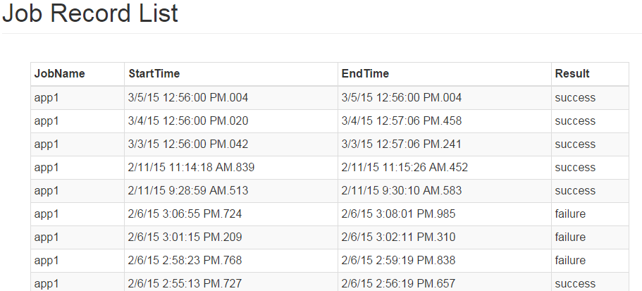
Demo – Execution Result Report

Slide 9
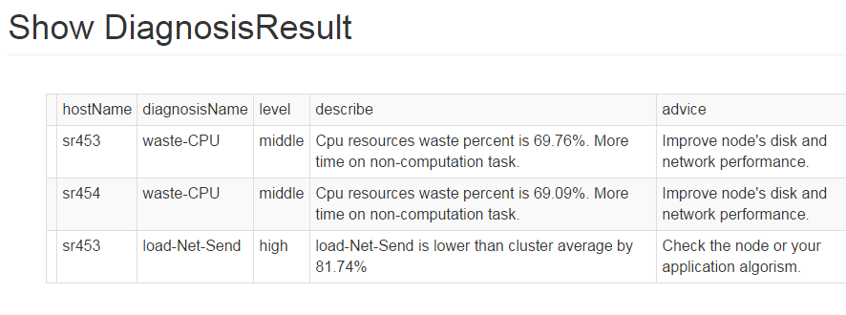
Demo – Diagnosis

Slide 10
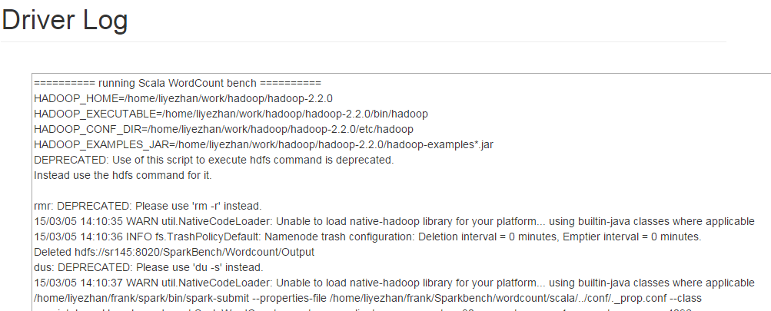
Demo – Driver Log

Slide 11
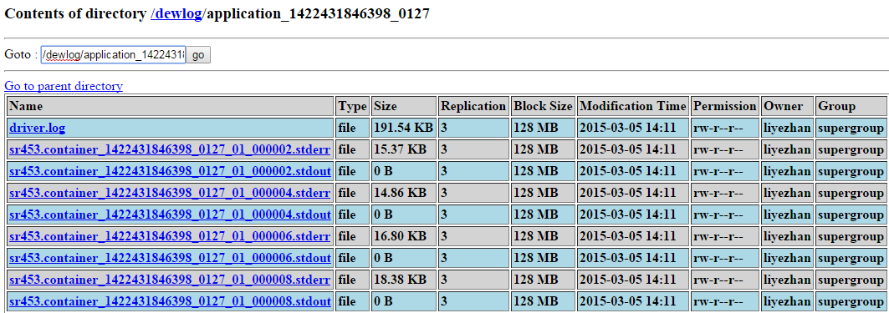
Demo – Log Collection

Slide 12
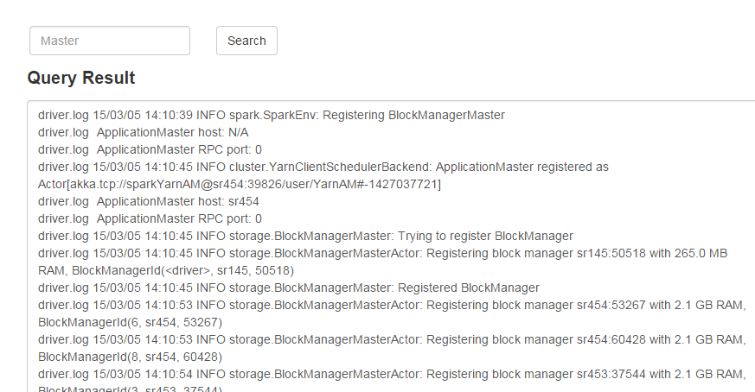
Demo – Log query

Slide 13
Quick Start
Link:https://github.com/Intel-bigdata/Dew
Configuration File
app.sparkpowermeter/conf.properties.template
conf/dew.conf.template
conf/slaves.template
Run Dew
sbin/start-all.sh
Start webcenter
app.webcenter → ./create-db.sh
./start-web.sh
Login
IP:6077 admin:admin

Slide 14
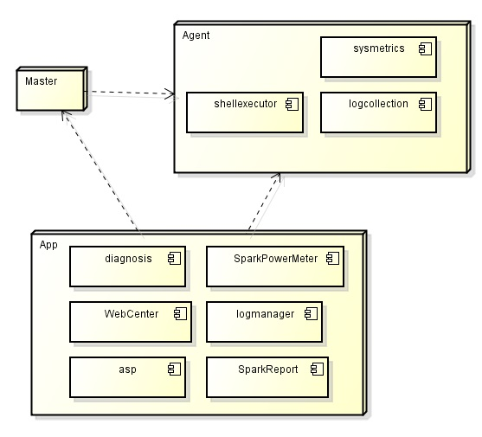
Dew Architecture

Slide 15
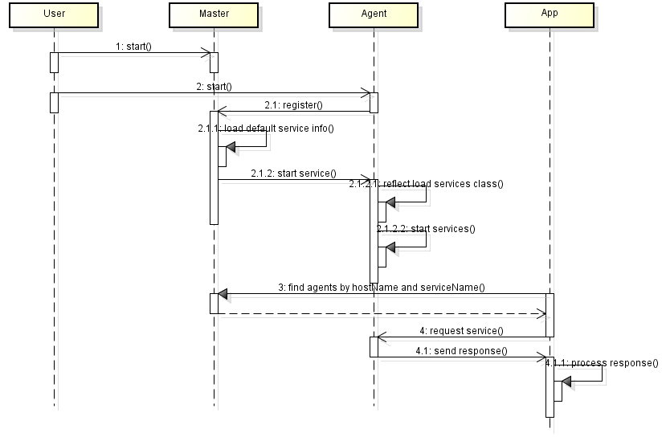
Dew Architecture
Notes:
1.Master, Agent, App is JVM process;
2.There is only one Master in a cluster;
3.There is at least one Agent in every node;
4.There is one or more App in any node;

Slide 16
Advantages
Friendly user interface
Easy to build, easy to use
Do anything with web console
Flexible architecture
Easy to build large scale distributed computation cluster
Easy to implement new distributed service and application
No couple but tightly integrate big data engine(Spark, Hadoop)
With plugin distributed service and application

Slide 17
TODO List
High available when some servers crashed.
System metrics archive to hdfs.
Better user and developer documentation.
Better quality codes.
More dew service and application.

