Slide 1
( Variable Gain Amplifier) KW univ., 정은지 eunjijung1107@gmail.com, 010 8596 9368
Weekly Report

Slide 2
Contents
목차
1. Design and RF test of a prototype traveling wave antenna for helicon current drive in KSTAR
2. Design of multipactor-suppressed high-power VFT for helicon current drive in KSTAR
3. Helicon wave coupling in KSTAR plasmas for off-axis current drive in high electron pressure plasmas
4. RF design of helical long-wire traveling wave antenna for helicon current drive in KSTAR
5. Test and operation of high-power RF system for KSTAR helicon current drive system

Slide 3
Summary
1. Design and RF test of a prototype traveling wave antenna for helicon current drive in KSTAR
Introduction
Non-inductive current drive by fast wave at very high ion cyclotron harmonics, known as ‘helicons’ has the potential for high off-axis current drive efficiency compared with the other known non-inductive current drive techniques. However, non-inductive current drive by helicon wave has not been validated experimentally. To validate its anticipated performance experimentally, an antenna design is one of the most important issues. Low power level helicon wave coupling experiments has been conducted successfully using a mock-up TWA in KSTAR. In the next step, in order to investigate a high power performance, a new prototype TWA based on the mock-up TWA has been designed, fabricated and measured for a medium power (100–300 kW) RF system.
연구 배경
플라즈마 중심(또는 중심 축)에서 벗어난 위치에서, 플라즈마 내부에 전류를 유도하거나 생성하는 과정
필요성: 플라즈마 주변부에서 전류를 구동하면 플라즈마의 안정성이 향상 /
플라즈마 내 전류의 공간 분포(profile)를 최적화하여 핵융합 반응을 효율적으로 유지하는 데 도움
‘helicons’ 가 다른 non-inductive current drive 기술보다 높은 off-axis current drive 효율을 보일 가능성.
실험적으로 증명 되지 않았으며, 안테나 디자인이 성능 실험을 위한 관건 중 하나.
낮은 송신 전력에서의 KSTAR의 mock-up TWA을 사용한 helicon wave 커플링 실험은 수행 성공.
고출력 성능[medium power (100–300 kW) RF system]을 확인하기 위해서 새 prototype TWA을 디자인.
Design and RF test of a prototype traveling wave antenna for helicon current drive in KSTAR.pdf

Slide 4
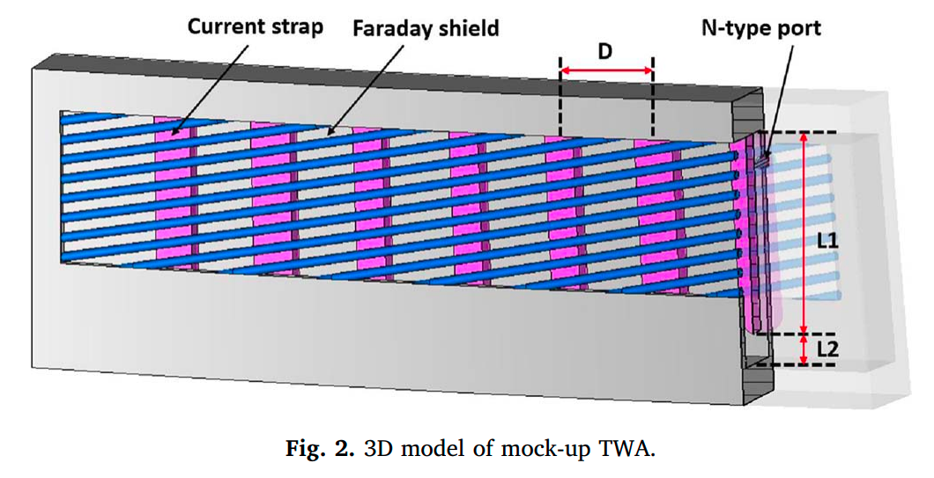

Summary
Mock-up TWA (center freq. 500 MHz)
구조: The mock-up TWA was made of stainless steel and consists of 7 current straps with N-type input and output connectors based on the combline filter design theory.
공식: The feeding structure of the antenna can be simplified to a monopole antenna with capacitance by L2, where the resonant frequency is determined by the combination of L1 and L2. The impedance bandwidth of combline antenna is mainly determined by L1, and the optimum electrical length(θ) of L1 is approximately 53° to achieve the maximum impedance bandwidth
최적화: In order to obtain the maximum impedance bandwidth, the required capacitance was also increased, which causes an increase in the electric field strength at the end of current straps. To reduce electric field strength, the shape of the end of current straps was designed as a round shape.
공식2:

Slide 5
Summary
1. Design and RF test of a prototype traveling wave antenna for helicon current drive in KSTAR
Design of the prototype TWA (center freq. 500 MHz)
문제: The previous experimental results using the mock-up TWA had shown that the parallel refractive index(n||) was distorted when it was operated with too high a coupling around 70–100%.
해결책: Increasing the total number of straps while reducing the coupled energy per unit strap.
한계: The allocated installation area was limited. -> current straps을 충분히 늘릴 수 없음.
타협: The distance between the straps was reduced from 68 mm to 50 mm so that 10 straps can be installed in the same space.
구조: The prototype TWA was made of copper to reduce the Ohmic loss and consists of 10 current straps with 5 inch coaxial feed lines as input and output ports.
기존과 공통점: The dimensions of the current straps are 28 mm, 122 mm, and 14 mm in the toroidal, poloidal, and radial directions respectively.

Slide 6
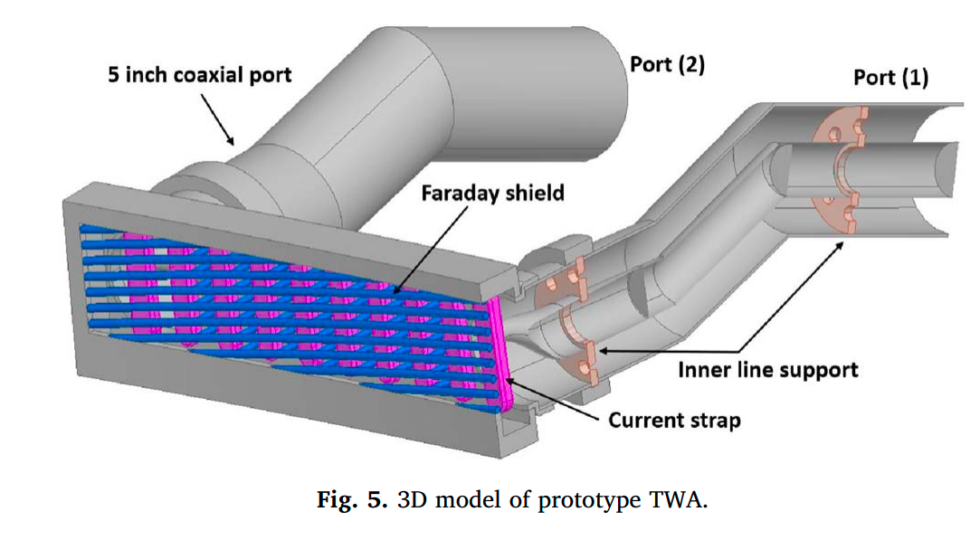
Summary
1. Design and RF test of a prototype traveling wave antenna for helicon current drive in KSTAR
The Faraday shield structure was designed by adding
a support structure between the straps in order to support it more robustly.
Design of the prototype TWA (center freq. 500 MHz)
문제: The previous experimental results using the mock-up TWA had shown that the parallel refractive index was distorted when it was operated with too high a coupling around 70–100%.
해결책: Increasing the total number of straps while reducing the coupled energy per unit strap.
한계: The allocated installation area was limited. -> current straps을 충분히 늘릴 수 없음.
타협: The distance between the straps was reduced from 68 mm to 50 mm so that 10 straps can be installed in the same space.
구조: The prototype TWA was made of copper to reduce the Ohmic loss and consists of 10 current straps with 5 inch coaxial feed lines as input and output ports.
기존과 공통점: The dimensions of the current straps are 28 mm, 122 mm, and 14 mm in the toroidal, poloidal, and radial directions respectively.
In order to deliver more higher power, the N-type feed line was re-designed.

Slide 7
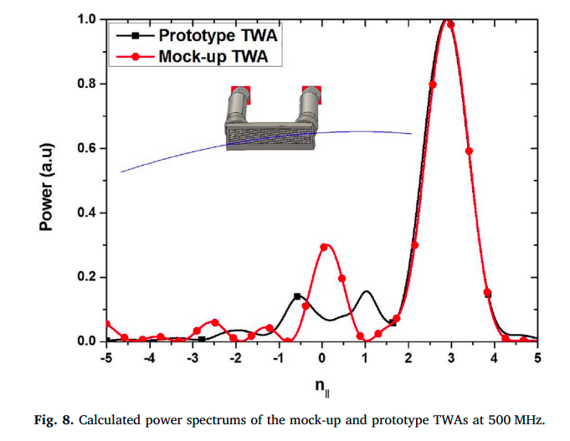

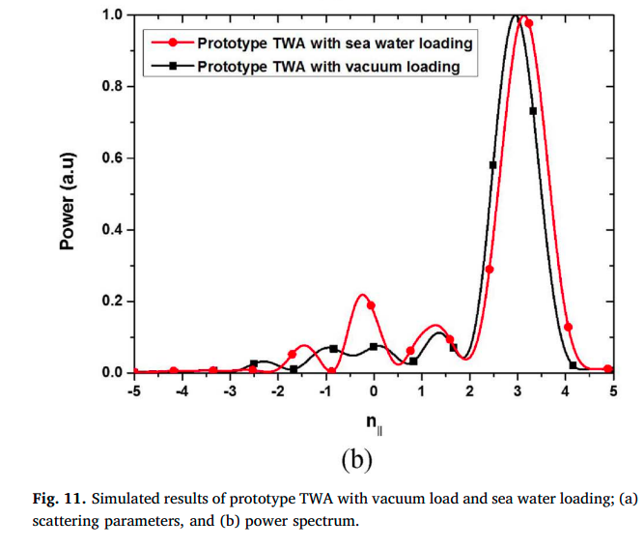
Summary
1. Design and RF test of a prototype traveling wave antenna for helicon current drive in KSTAR
Simulated results of prototype TWA with vacuum loading
When d = 50 mm, Δϕ = 90°, and f = 500 MHz, it was calculated to be n||(parallel refractive index) = 3 and this value was in good agreement with calculated peak spectrum as shown in Fig. 8.
Simulated results of prototype TWA with simplified plasma loading
In order to estimate the performance of the antenna under plasma loading conditions, it was simulated using seawater.
The radial gap between the antenna and sea water was 10 mm.
The peak n|| and resonant frequency were slightly up-shifted compared with vacuum loading case, and S21 was significantly reduced (∼13 dB) while maintaining similar S11 with vacuum loading as shown in Fig. 11.

Slide 8
Summary
2. Design of multipactor-suppressed high-power VFT for helicon current drive in KSTAR
Design of multipactor-suppressed high-power VFT for helicon current drive in KSTAR.pdf

Slide 9
Summary
2. Design of multipactor-suppressed high-power VFT for helicon current drive in KSTAR

Slide 10
Summary
2. Design of multipactor-suppressed high-power VFT for helicon current drive in KSTAR

Slide 11
Summary
3. Helicon wave coupling in KSTAR plasmas for off-axis current drive in high electron pressure plasmas
Helicon wave coupling in KSTAR plasmas for off-axis current drive in high electron pressure plasmas.pdf

Slide 12
Summary
3. Helicon wave coupling in KSTAR plasmas for off-axis current drive in high electron pressure plasmas

Slide 13
Summary
3. Helicon wave coupling in KSTAR plasmas for off-axis current drive in high electron pressure plasmas

Slide 14
Summary
4. RF design of helical long-wire traveling wave antenna for helicon current drive in KSTAR
RF design of helical long-wire traveling wave antenna for helicon current drive in KSTAR.pdf

Slide 15
Summary
4. RF design of helical long-wire traveling wave antenna for helicon current drive in KSTAR
Helical LW-TWA의 개념적 설계
긴 와이어 안테나(LW-TWA)는 통신 시스템에서 수신 안테나로 사용된다.
구조는 충분히 긴 길이(L)로 설계되며, 설계에 따라 반사파를 줄일 수 있다.
병렬 굴절률 (n‖)은 안테나에서 방사된 파의 특성을 결정하며, KSTAR의 헬리콘 파 전류 구동에 최적화된 n‖ = 3을 만족하도록 설계되었다.
기계적 안정성 향상을 위해 구조가 개선되었으며, helical 선을 지지하는 중간 지지대를 추가해 기계적으로 연결하지만 전기적으로는 열린 구조를 유지한다.
패러데이 쉴드가 병렬 전기장을 줄이기 위해 포함되며, 피딩 및 종단 저항 구조도 직렬에서 병렬로 변경되어 저항 값을 감소시켰다.
Helical LW-TWA의 개념적 RF 설계
첫 단계에서 상용 안테나 설계에 이어, 두 번째 단계에서는 3D 구조를 구축하여 RF 특성을 분석했다.
구조는 RF 파워의 자극을 위한 럼프드 포트와 종단 저항기로 구성된다.
n‖ 파워 스펙트럼 분석 결과, n‖ = 3에서 최대값을 보이며 초기 설계와 일치한다.
구조적 강성 증가를 위해 지지 구조가 추가되었으며, 기계적 안정성에도 불구하고 전기적 특성은 안정적으로 유지되었다.
최종 설계 단계에서는 KSTAR의 공간 제약을 고려해 안테나 크기를 조정하고, 패러데이 쉴드를 추가하며, 피딩 및 종단 저항 구조를 병렬로 변경했다.

Slide 16
Summary
4. RF design of helical long-wire traveling wave antenna for helicon current drive in KSTAR
Helical LW-TWA의 RF 설계
KSTAR용 헬리컬 LW-TWA를 설계할 때 설치 환경과 지정된 포트를 고려해야 한다.
RF 구조는 단순화된 모델을 기반으로 하되, 코엑셜 RF 전환 구조로 변환하여 전기장을 줄이고, 안테나 양쪽의 극 한계기와 간섭을 피하도록 설계했다.
플라즈마 모델을 이용한 시뮬레이션 결과, S11이 -21 dB, S21이 -3.9 dB, 전력 결합이 59%로 나타났다. 최대 전기장은 1 MW 입력 시 17 kV/cm로, 이전 설계보다 낮고 균일한 전기장 분포를 유지한다.
안테나-플라즈마 결합 연구는 미래 논문에서 더 정교한 모델링으로 다룰 예정이며, n‖ 스펙트럼 분석에서는 n‖ = 3에서 최대값을 보였다.
반사 전력 비율은 플라즈마 모델의 유전율 변화를 통해 시뮬레이션한 결과, 7% 미만으로 안정적이다.
LW-TWA 제작
주요 구성 요소는 고전도성 산소 무산화 구리(OFHC)로 제작되었으며, 패러데이 쉴드는 플라즈마 부식으로부터 보호하기 위해 50 μm 두께의 텅스텐으로 코팅되었다.
내부 수냉 채널을 포함한 토로이달 지지 구조는 2개의 섹션으로 나뉘며, 연속파(CW) 작동을 위한 냉각 구조는 현재 단계에서 고려되지 않았지만, 향후 성능 향상을 위해 계획 중이다.
조립된 안테나는 나사로 고정할 수 있게 설계되었다.

Slide 17
Summary
4. RF design of helical long-wire traveling wave antenna for helicon current drive in KSTAR

Slide 18
Summary
5. Test and operation of high-power RF system for KSTAR helicon current drive system
Test and operation of high-power RF system for KSTAR helicon current drive system.pdf

Slide 19
Summary
5. Test and operation of high-power RF system for KSTAR helicon current drive system

Slide 20
Summary
5. Test and operation of high-power RF system for KSTAR helicon current drive system

