Slide 1

Surface Transportation Board Update
Transportation Research Forum
Annapolis, MD
Commissioner Francis P. Mulvey
March 22, 2013

Slide 2
STB Basics
Independent economic regulatory agency for the railroad industry
Jurisdiction over
Railroad rate and service disputes
Railroad mergers and acquisitions
Rail line abandonments and construction
Freight/passenger rail relationships
Limited jurisdiction over other modes

Slide 3
U.S. Railroad Regulation
Federal oversight of rail industry split
STB – Economic
FRA – Safety
NTSB – Accident investigation
RRB – Employee issues
Some overlap
E.g., safety-related tariffs with an economic impact

Slide 4
U.S. Railroad Regulation
Regulation by STB preempts most state regulation
Zoning/permitting preempted
Some state police powers preserved
STB regulation replaces antitrust laws in some instances
Railroad mergers subject only to STB review
Price-fixing by railroads subject to antitrust law

Slide 5
U.S. Railroad Regulation
STB regulates common carrier tariffs
Are rates reasonable?
Are practices and tariff provisions reasonable?
STB does not regulate contractual arrangements
Railroads and shippers may ship under contract
Contracts need not conform to all STB rules

Slide 6
Common Carriage/Private Ownership
Railroad network is privately owned
7 major U.S. railroads
Federal/state government support roles
Railroads are common carriers
Must respond to reasonable requests for service
STB resolves disputes

Slide 7
Changes in Regulatory Approach
Railroad industry heavily regulated until Staggers Act of 1980
Staggers required agency to let market determine rail rates whenever possible
Agency can assess reasonableness of rates when effective competition is absent
Entry/Exit Restrictions Eased

Slide 8
Changes in Regulatory Approach
PRIIA gave STB increased passenger rail responsibility
Investigate/adjudicate Amtrak OTP issues
Cost allocation methodology for Amtrak state-supported routes (approved March 2012)
Cost allocation methodology for NE Corridor
Two cases filed under PRIIA to date
Amtrak challenge of OTP issues on certain CN routes (pending)
Cost methodology for state routes (approved March 2012)

Slide 9
STB Board Members
3 Board members
All current members have rail transportation backgrounds
Elliott (D)
United Transportation Union
Begeman (R)
Senate Commerce Committee
Mulvey (D)
House T&I
DOT IG for rail
GAO transp. group

Slide 10
STB STAFF
Professional staff
Lawyers, economists, financial analysts, environmental and operational specialists
Diverse backgrounds
#1 small agency - annual federal
employee survey 4 years in a row

Slide 11
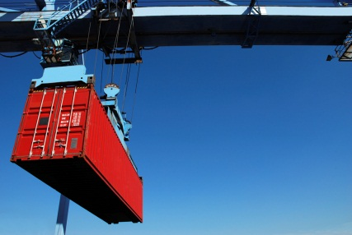

General Rail Industry Trends
Mixed traffic volumes
Rapid intermodal growth
Motor vehicles up
Coal – declining share of
total rail traffic
Petroleum boom
Oil movements via rail triple in
volume
Natural gas growth
Frac sand movements

Slide 12


Agricultural Rail Issues
Largely flat grain rail volumes
New traffic patterns emerging
Energy policy, ethanol
Increased Globalization
Domestic impacts from Russia, South America, Australia
Longer trains, shuttle service, fewer loading points

Slide 13
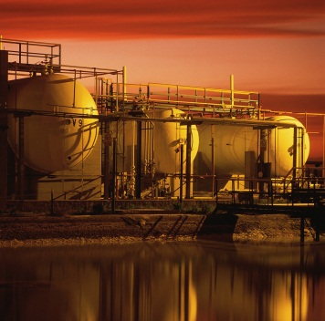
Chemical Rail Issues
Increase in STB cases involving chemical industry
Non-rate cases
PTC cost reporting
TIH liability
3 pending chemical rate cases; 1 recently settled

Slide 14
Rail Rates Issues
Deregulation productivity gains were passed on to shippers via lower rates; studies show this has ended
Not all markets have competitive options
Fewer long-term contracts
Rail is capital intensive industry
Capex $5.8B (2003)
$13B (2013 planned)
New yards, double-tracking, intermodal facilities

Slide 15
Rail Rate Issues
Always a major area of contention
STB mission
Protect captive shippers from monopoly abuses
Permit railroads to earn sufficient revenues
Balance key to STB dispute resolution
Broad review of competition & rate issues underway

Slide 16
Rail Rate Case Changes
Filing fees lowered
Major changes to rate case process in 2007
Improved processes
Reduced costs
Introduction of small/medium rate case procedures
Changes to cost of capital computation

Slide 17
Rail Rates Pending Issues
EP 717 –STB denied petition by railroads to consider indirect competition in rate cases when assessing whether a railroad faces effective competition (March 19, 2012)
EP 715 - Rate Regulation Reforms
Under Board review; expedited schedule
EP 711 – NITL Competitive Switching Proposals
Initial comments/studies filed earlier this month
Reply comments due in May

Slide 18
Rail Rates Pending Cases
DuPont v. NS (chemical)
Total v. CSXT (chemical)
Sunbelt v. NS (chemical)
Intermountain Power Ass’n v. UP (coal)
M&G v CSXT (chemical) recently settled
Western Fuels & AEPCO cases – decided but issues remain (e.g., impact of Berkshire/BNSF transaction, court challenge)

Slide 19
Uniform Railroad Costing System
General purpose costing system critical to regulation
Completed
improved version of online interactive URCS
major staff review of URCS processes
Pending
“Make-whole adjustment” rulemaking
Montana v. BNSF complaint
Carrier reporting changes
Update of URCS software to modern platform

Slide 20
Practices Cases Pending
Various tariff-related issues include:
Fuel surcharges challenge
Coal dust
Tank car routing
Demurrage
Clean cars
Hazmat requirements
Increased informal shipper concerns regarding accessorial charges/costs

Slide 21
STB Informal Dispute Resolution
STB’s Rail Customer and Public Assistance Program (RCPA)
Expert staff, operations knowledge
Available to large & small shippers
Good record on resolving disputes
Less expensive and acrimonious
Pending rulemaking re STB mediation/arbitration process

Slide 22
Congressional Agenda (Senate)
Leadership
Chairman Rockefeller - upcoming retirement
Ranking Member – Senator Thune
Sequester, budget issues
Fiscal cliff deal extended short line tax credit
No recent activity on STB reauthorization bill or railroad antitrust bill
PTC hazmat deadline issues

Slide 23
Congressional Agenda (House)
Leadership
New T&I Chairman Bill Shuster
Ranking Member Rep. Nick Rahall
New Railroad Subcommittee Chairman Rep. Jeff Denham
Ranking Member remains Rep. Corrine Brown
Agency meeting with new committee members

Slide 24
STB Future
Opportunity for Board to address important railroad/shipper issues
Government-wide funding issues
New STB Board member
Holdover year expires end of 2013
White House nomination/Senate confirmation process

Slide 25
Thank you Any Questions?

