Slide 1
Cell Factory Design for Xylitol Production
Group 4 – Midway Presentation
Computer-Aided Cell Factory Design (27410)
Claire J. Moral, Fernando P. Ramirez, Josep S. Olivé, Nikolaus I. Vollmer

Slide 2
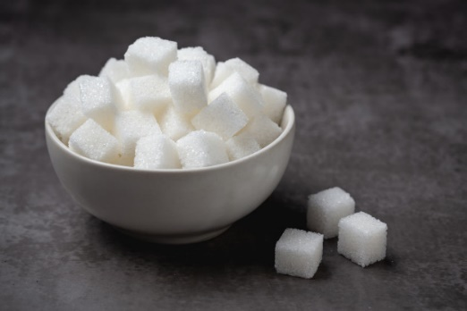
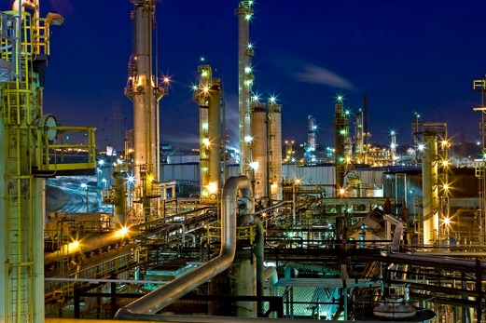
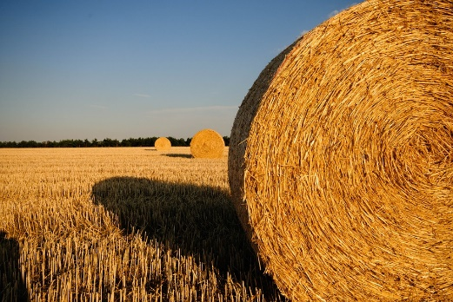
Product of Interest - Xylitol
Xylitol is a pentose sugar alcohol and can be used as platform chemical for bioplastics etc.
Currently high demand in food industries, as it can be used as sugar substitute for diabetic nutrition
Current production process is chemical, based on the catalytic conversion of xylose to xylitol (e.g. process of DuPont)
Feedstock is commonly birch bark or corn stover, containing high amounts of xylose, purification is very expensive, current market price of xylitol around 8-10 $/kg
Possibility to produce it biotechnologically in a biorefinery from the hemicellulose sugars of lignocellulosic biomass, for example wheat stram

Slide 3
Host Cell Factory
Mostly investigated cell factories are Candida sp., Kluyveromyces marxianus, other special yeasts, engineered* Saccharomyces cerevisiae or engineered* Escherichia coli
 | GRAS status | Wild type production | Yield [g/g] | Productivity [g/L*h] | Titer [g/L]
Candida sp. | No | Yes | 0.66 | 0.29 | 41.8
Kl. marxianus | Yes | Yes | 0.50 | 0.17 | 12.3
S. cerevisiae* | Yes | No | 0.87 | 0.32 | 47
E. coli* | No | No | 0.38 | 0.15 | 6.8
Albuquerque et al. Process Biochemistry (2014), Hernández-Pérez et al. Bioresource Technology (2020); Shah et al. Nature (2019)
Use (existing) GEM for S. cerevisiae to predict metabolic/genetic engineering strategies to enhance yield of xylitol
Benchmark with strategies published in literature and compare key performance indicators in order to suggest strategy

Slide 4
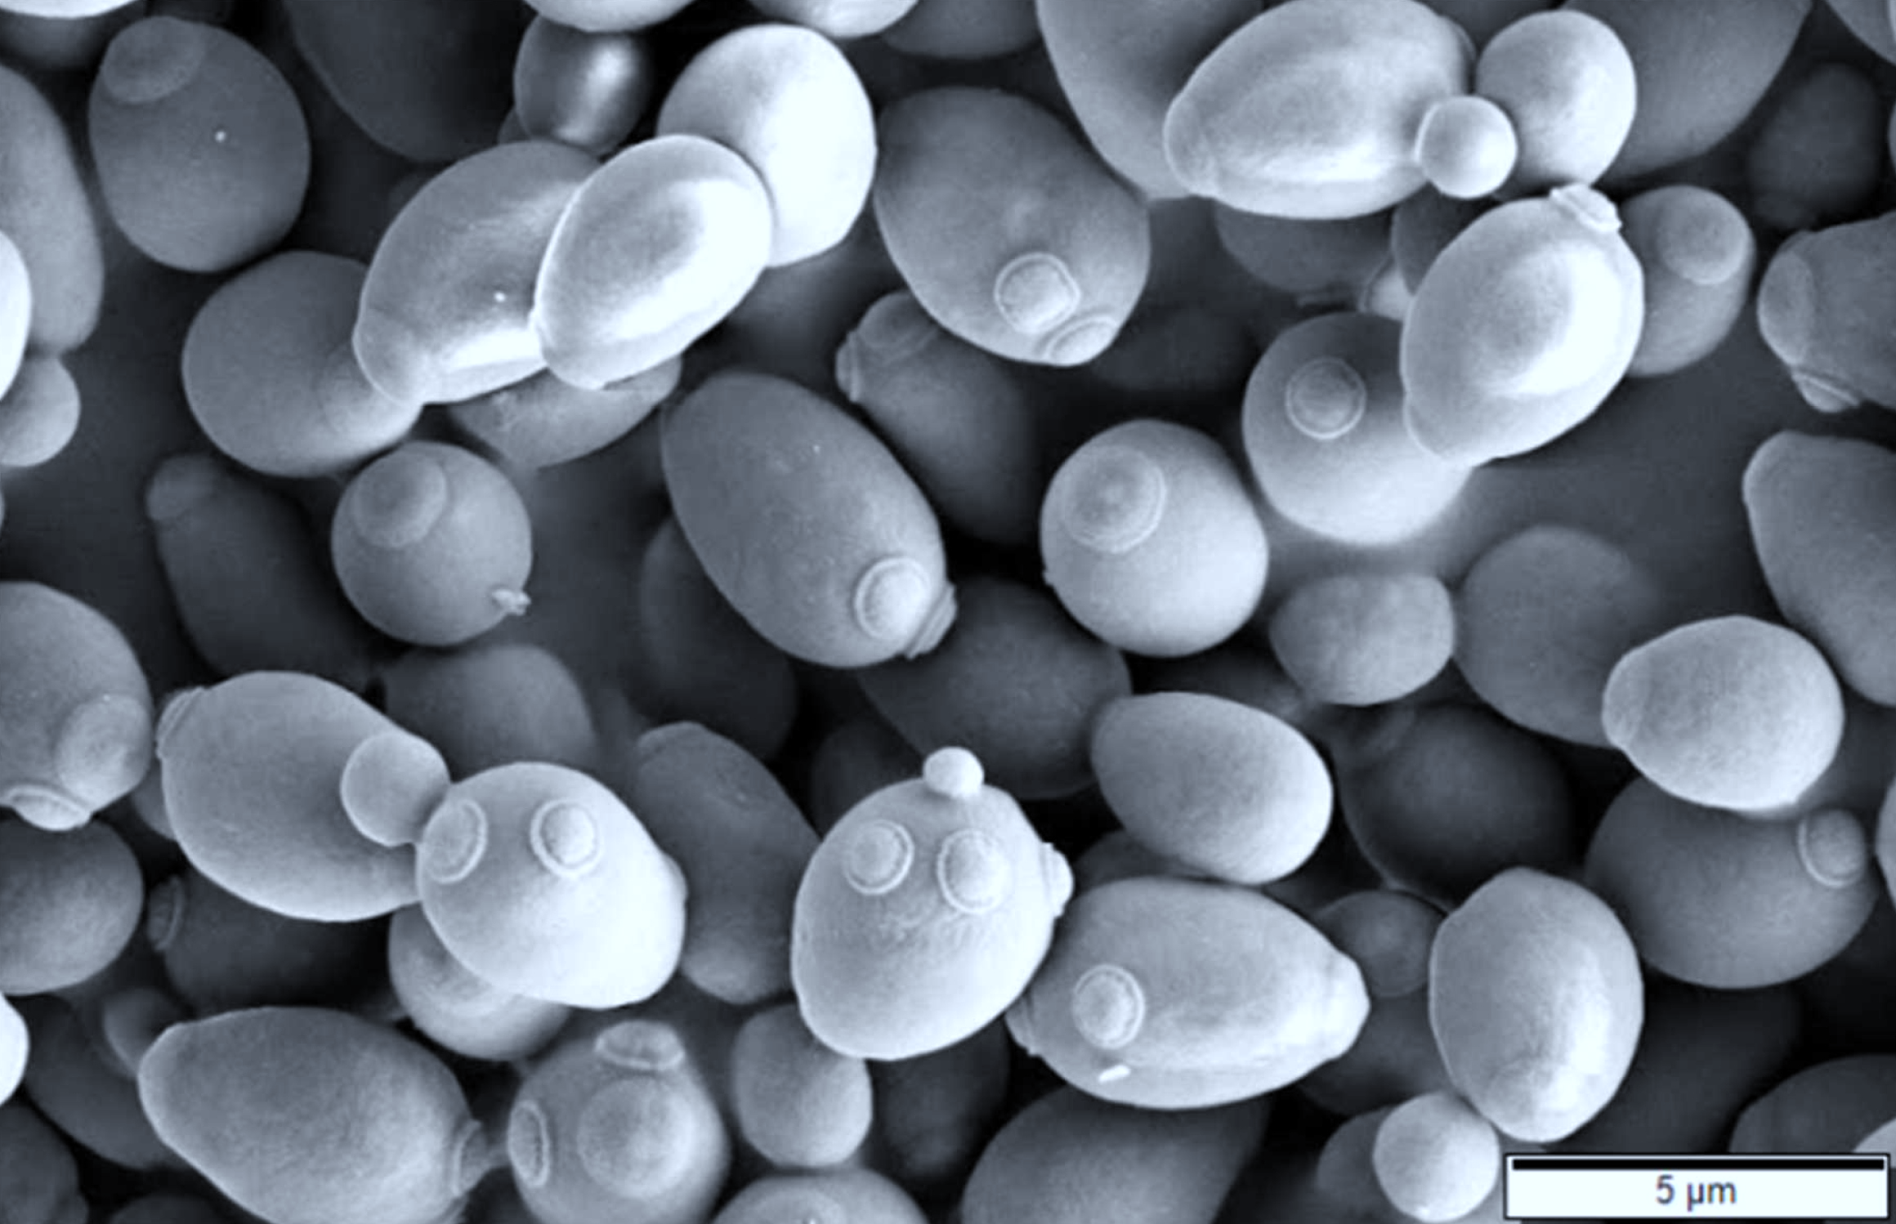
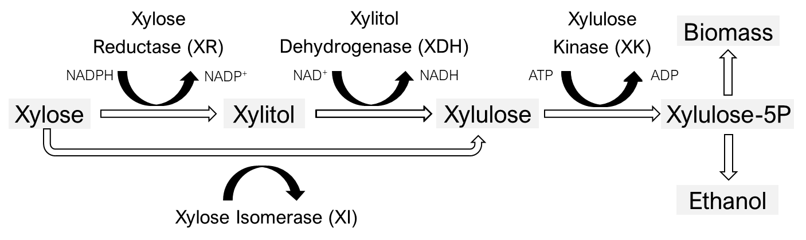
Computer-Aided Cell Factory Design
Benchmark Yeast8 model with MEMOTE as quality check
Assess capability of model with regards to production of desired product in situ
Assess effect of xylose transporter overexpression
Compute knockout strategies (compare to trivial solution: XDH)
Compute effect of overexpression/downregulation (compare: XR/XDH)
Compute co-factor swap targets (compare: XRco/XDHco)
Simulate batch cultivations for all candidates to assess yield, productivity and titer
Compare results
Pentose Assimilation Pathway in Yeasts:
Albuquerque et al. (2014)

