Slide 1
Androstenedione production in yeast

Slide 2


10,000$/kg
17-keto steroids -> Finde nyt target product(?)

Slide 3

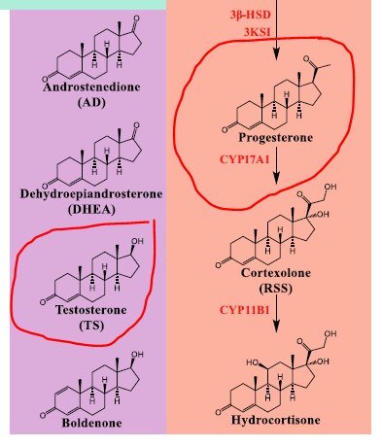
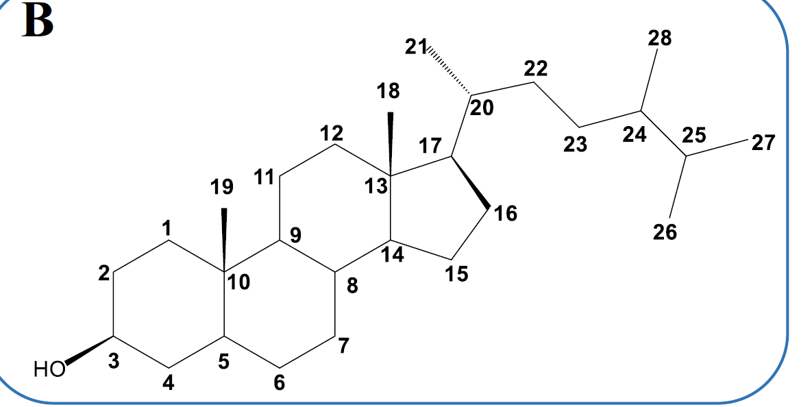

Slide 4
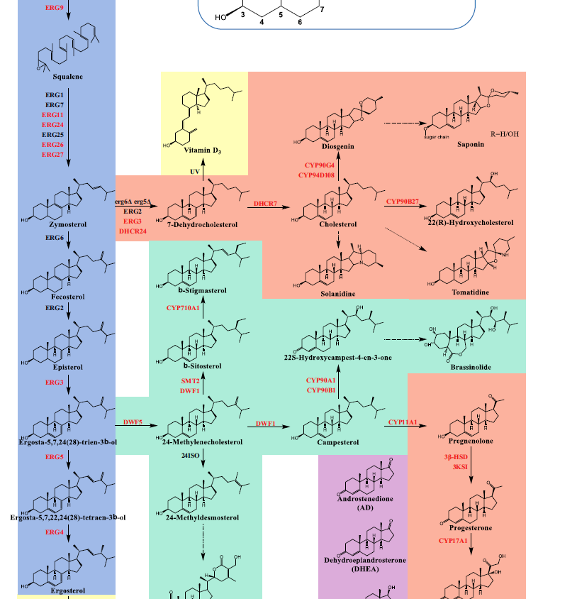
Ergosterol -> Yeast
Cholesterol -> Mammals
Other ones -> Plants

Slide 5
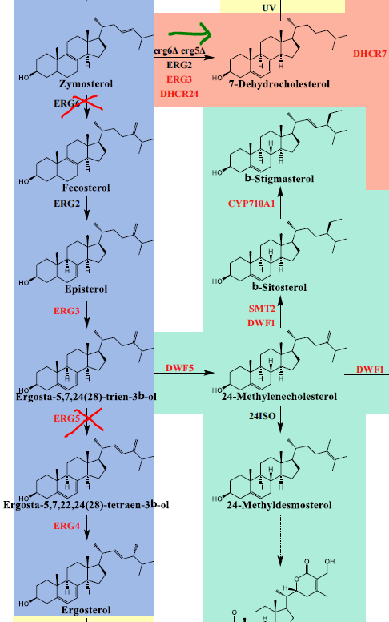
Første step kan fås I Yeast bare ved KO’s

Slide 6
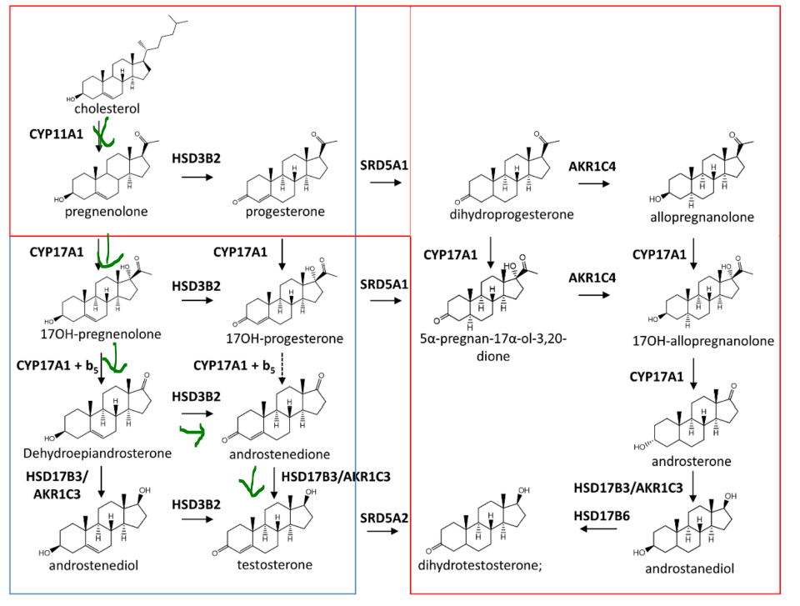

Slide 7
