Slide 1

Building a
REDISTRIBUTABLE
Razor Class Library
Steven Sanderson @StevenSanderson

Slide 2
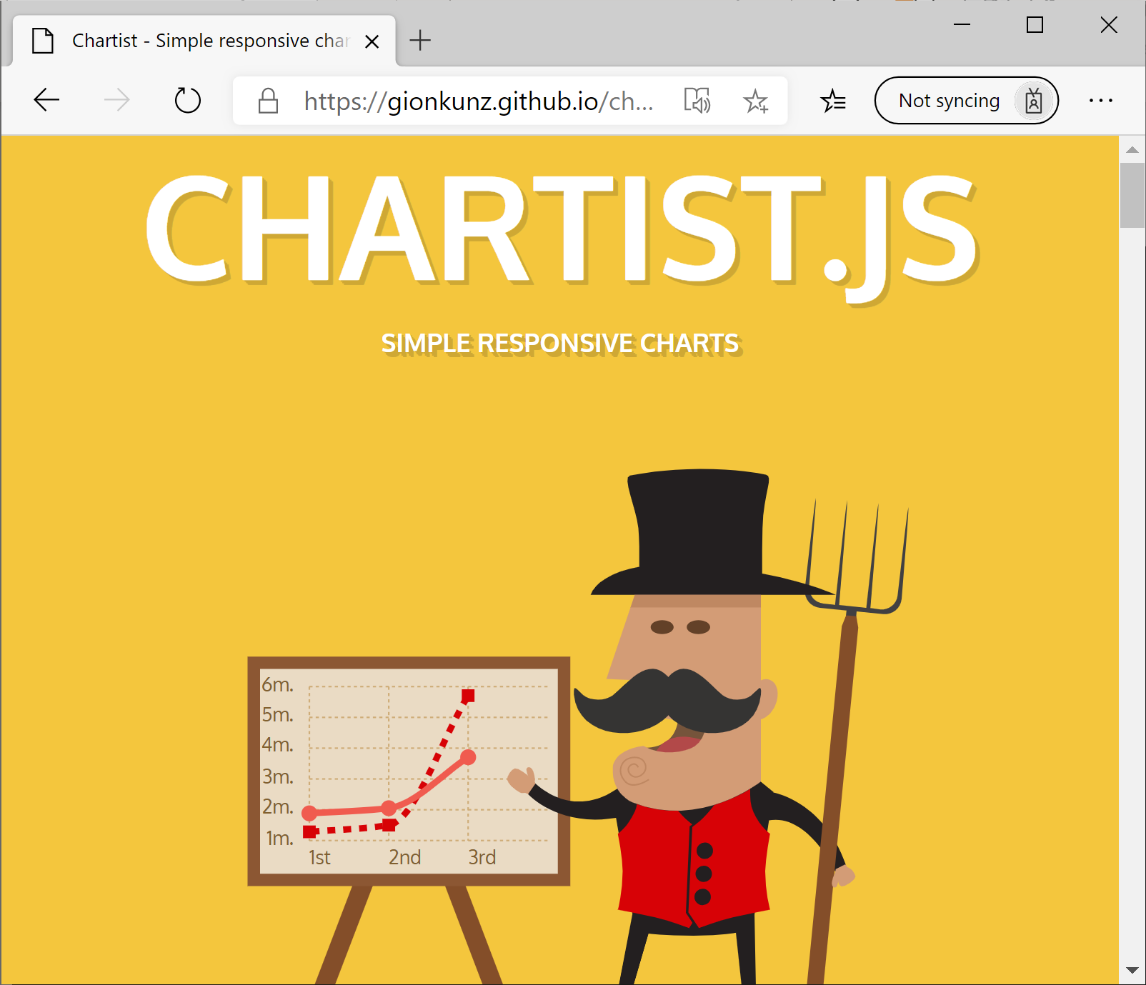
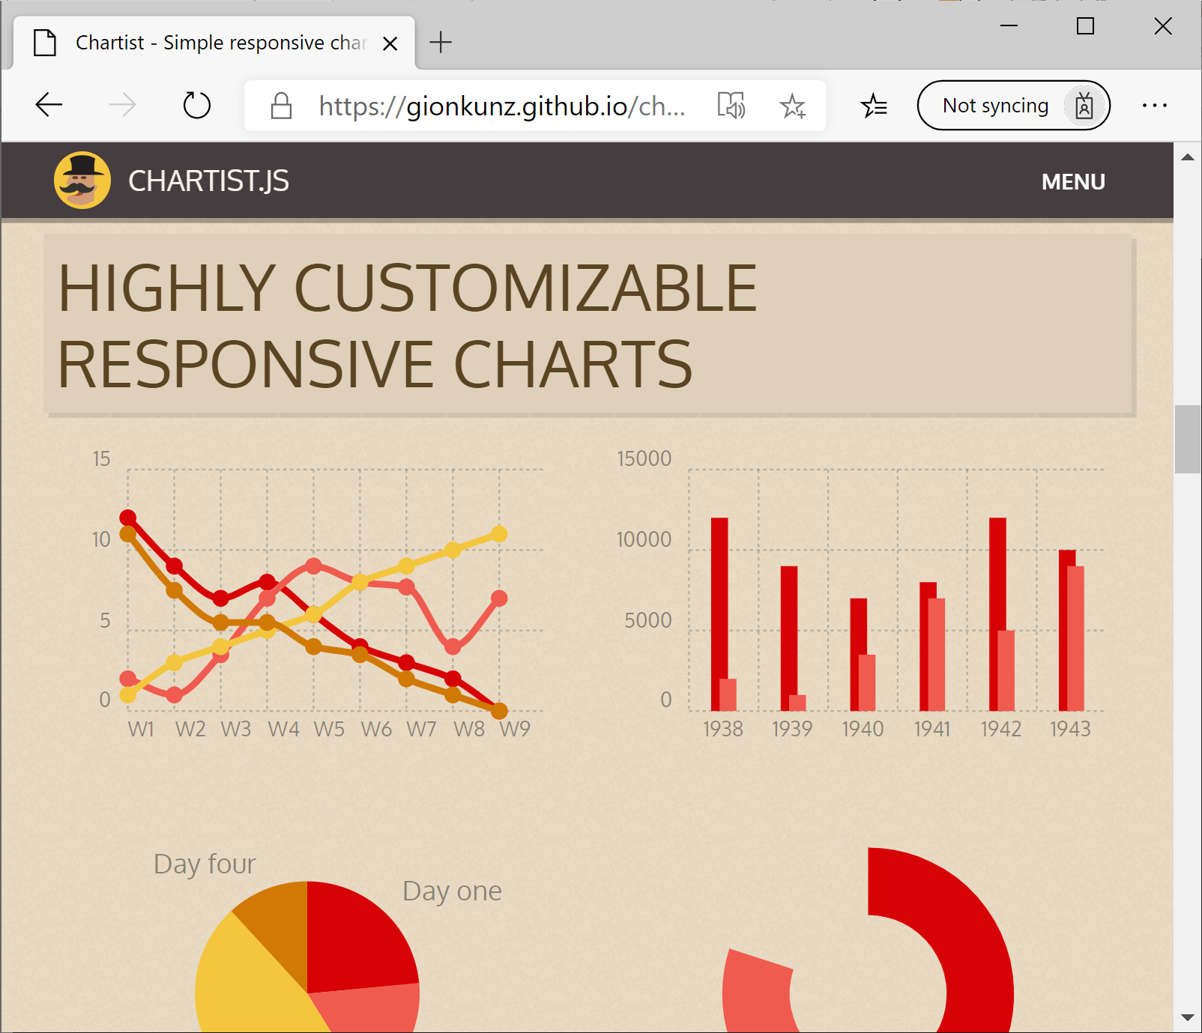

Slide 3
Building a great Razor Class Library
✓
Creating & running an RCL
✓
Adding XML docs
✓
Wrapping 3rd-party JavaScript
✓
Ensuring compatibility: Server, WebAssembly, and Prerendering
✓
Defining an API
✓
Adding a Webpack + TS build
✓
Designing a better API
✓
Continuous integration / Continuous deployment

Slide 4
Building a
REDISTRIBUTABLE
Razor Class Library
CODE & SLIDES
aka.ms/sanderson-rcl
== https://github.com/SteveSandersonMS/presentation-2020-01-NdcBlazorComponentLibraries
Steven Sanderson @StevenSanderson

