Slide 1
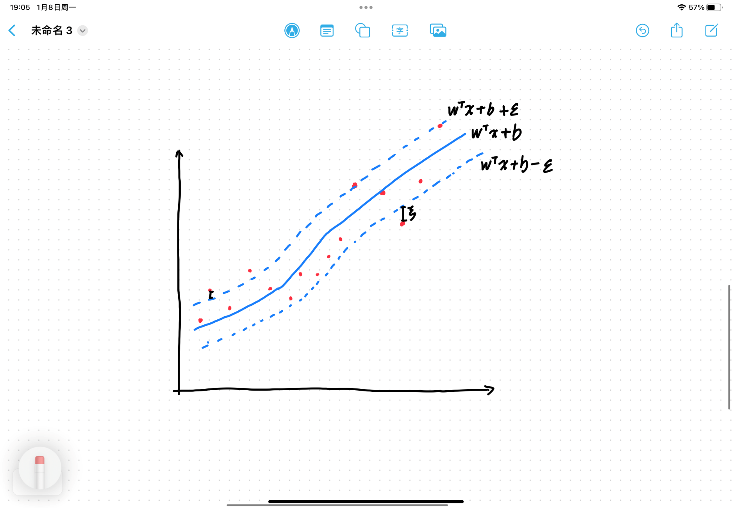
SVR(SVM)
SVM can only predict the trend of the stock (up or down). SVR (support vector regression) is an application of SVM to regression problems which can output the exact price of the stock.
SVR is to find an optimal strip area, let as many points as possible fall within the strip area, and then return to the points outside the region.

Slide 2
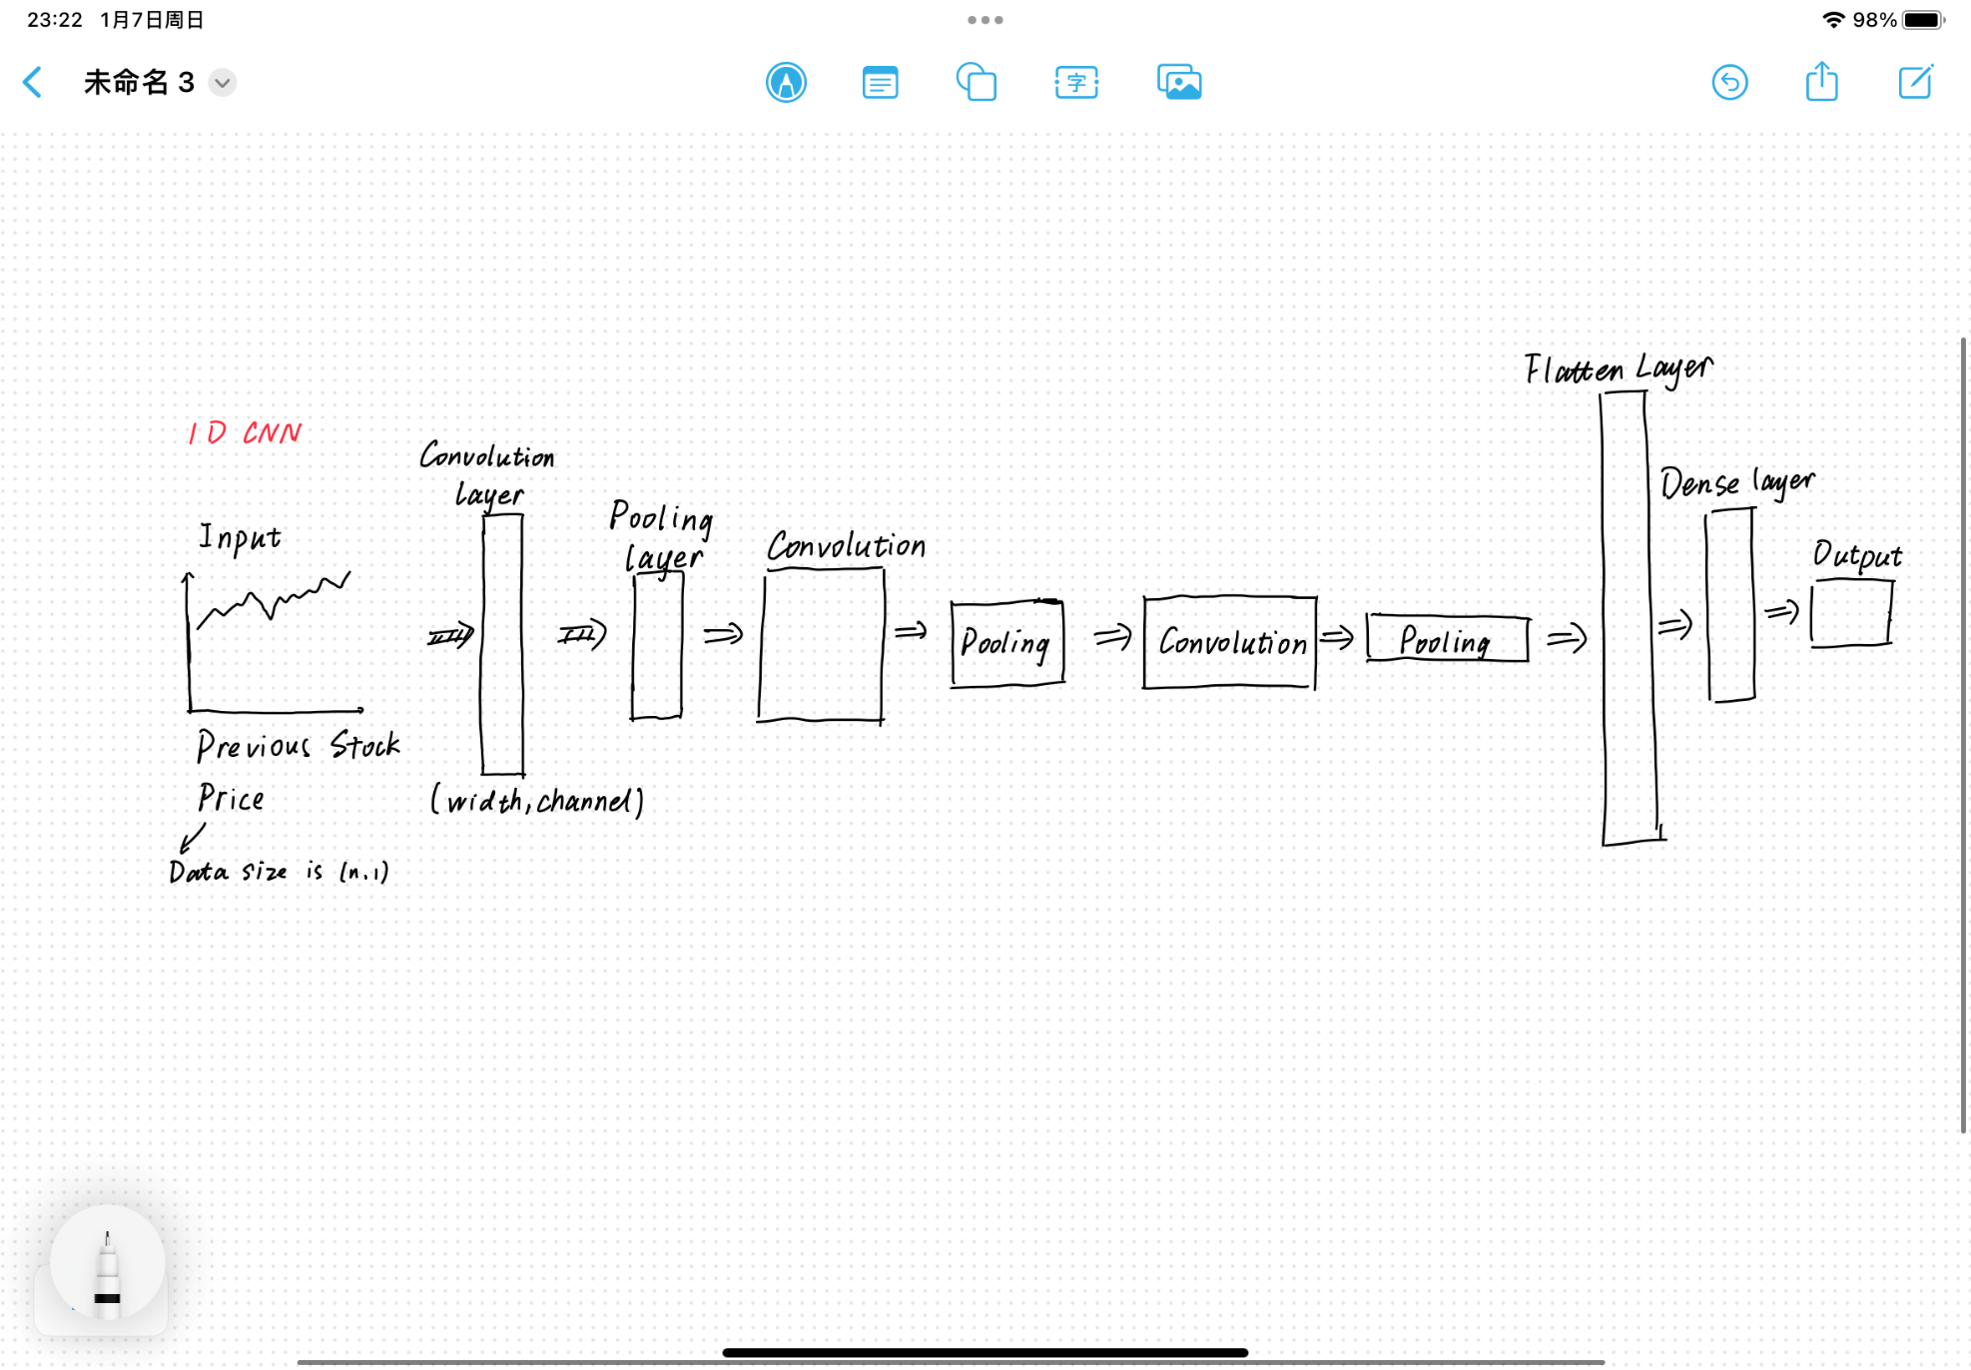
CNN
Unlike image processing, which uses 2D CNN. We use 1D CNN to do regression and predict the price of the stock.

