Slide 1
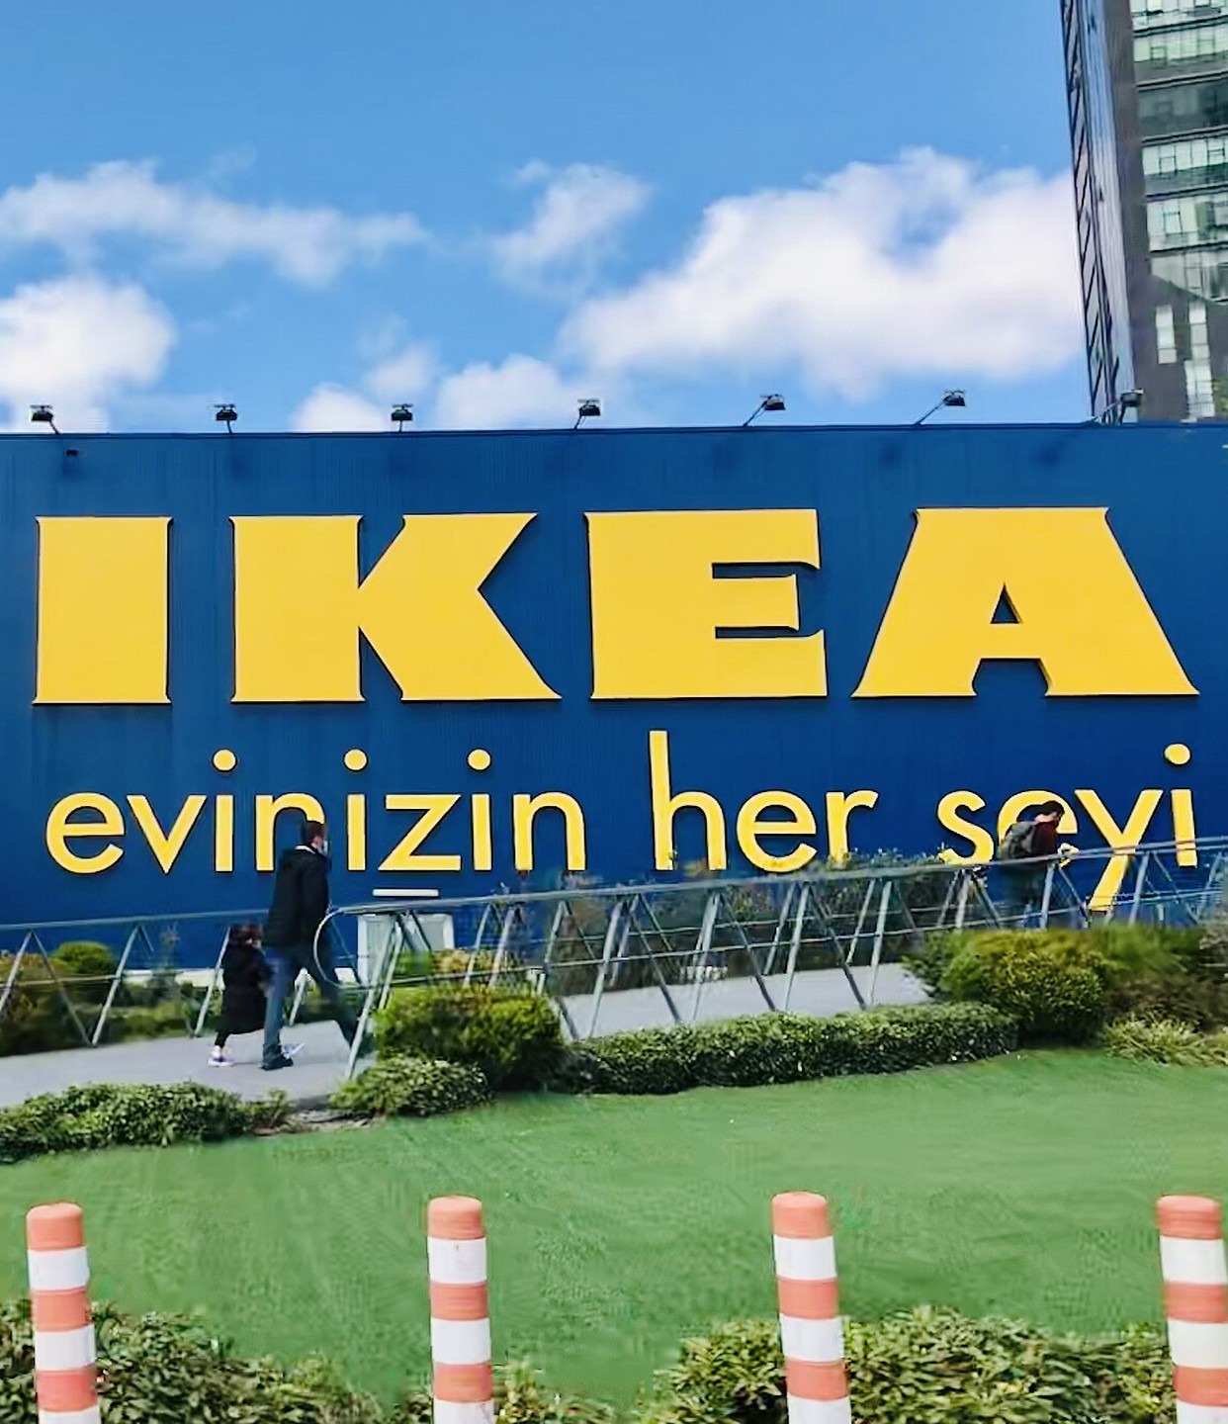
IKEA
SUPPLY CHAIN STRATEGY
IKEA Background & Core Supply Chain (SCM) Model
PART 1
How IKEA delivers extreme cost control and resilience through Design-for-SCM, global sourcing, tiered logistics and pull-based replenishment.
PART 1 | BACKGROUND & SCM MODEL INTRODUCTION
Group 2
Cao Xuming 7157125
Ou Zhipeng 7170878
Lin Xiaoting 7177761
Song Liangyun 7106671
LYU Jiayi 7151391
Hong Zixian 7180835
PART 01
Notes:
Now， I’ll present a strategic SWOT analysis of IKEA’s global supply chain. We will evaluate how IKEA leverages flat-pack design, global flows, and circular models to maintain its competitive edge in a fast-changing market.

Slide 2



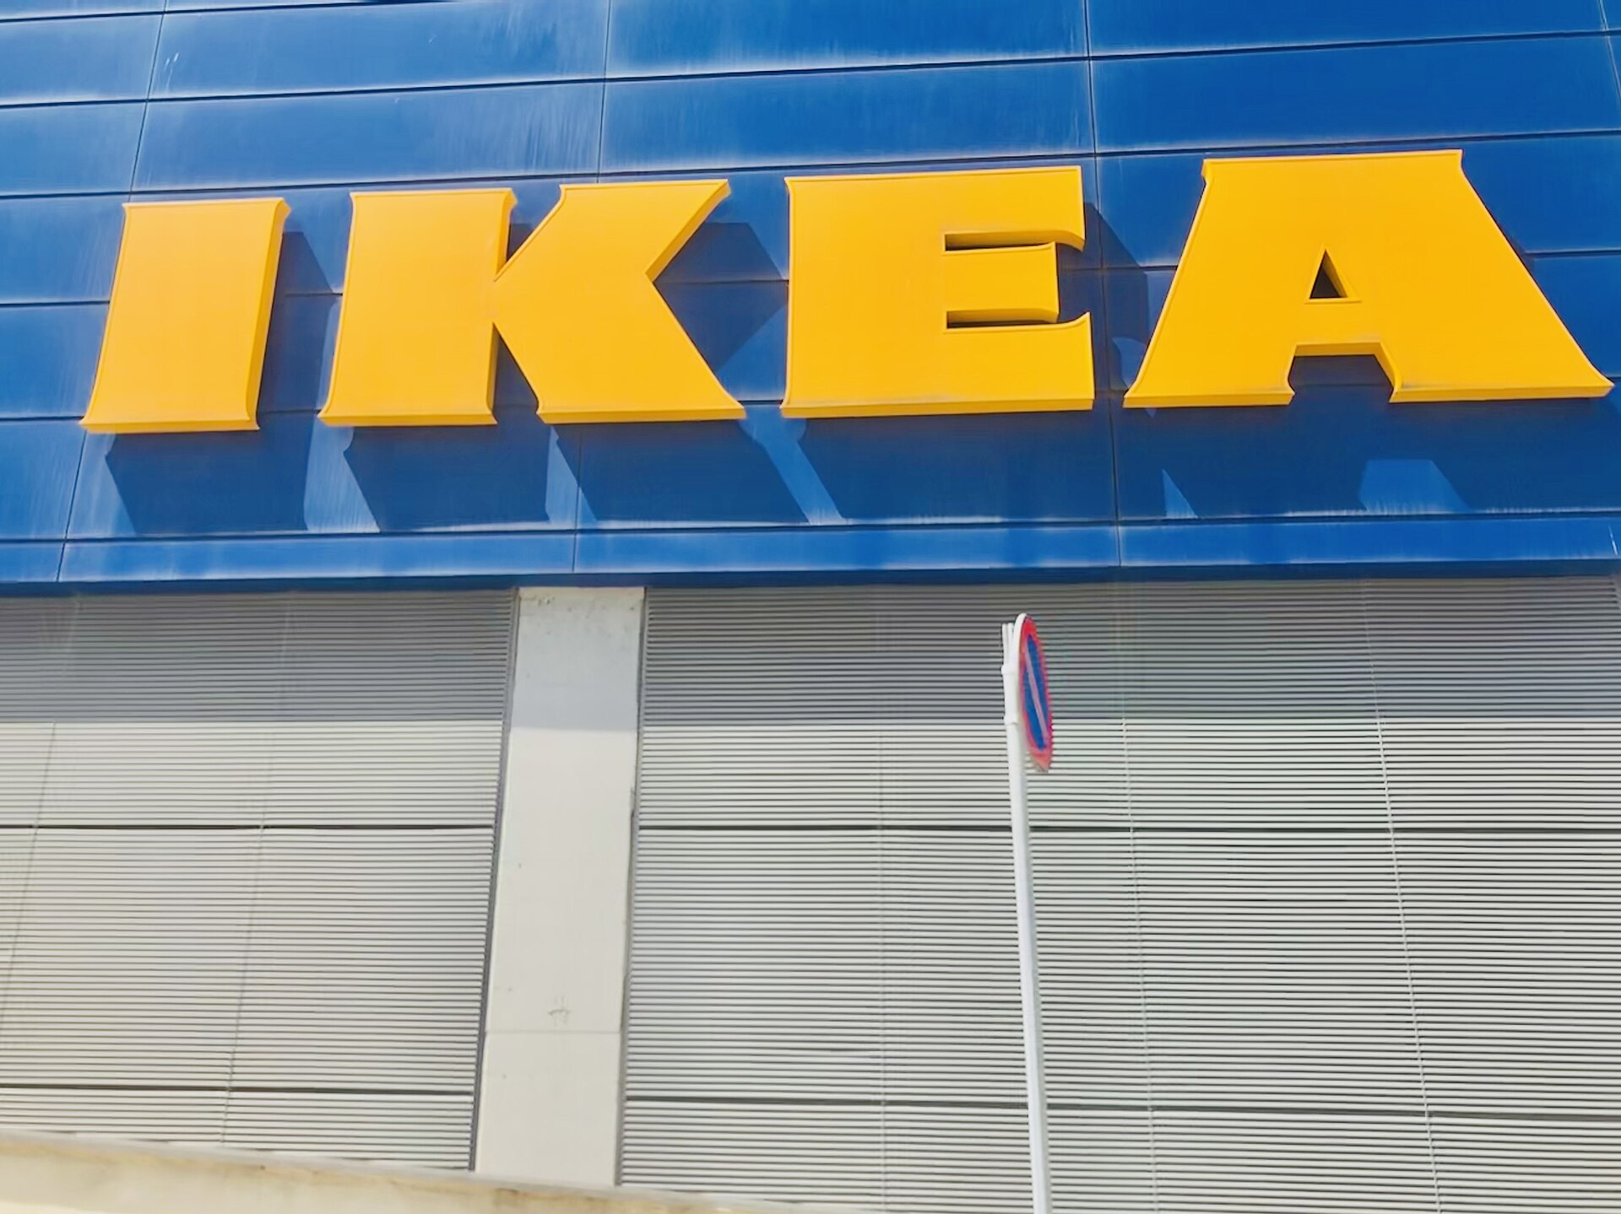
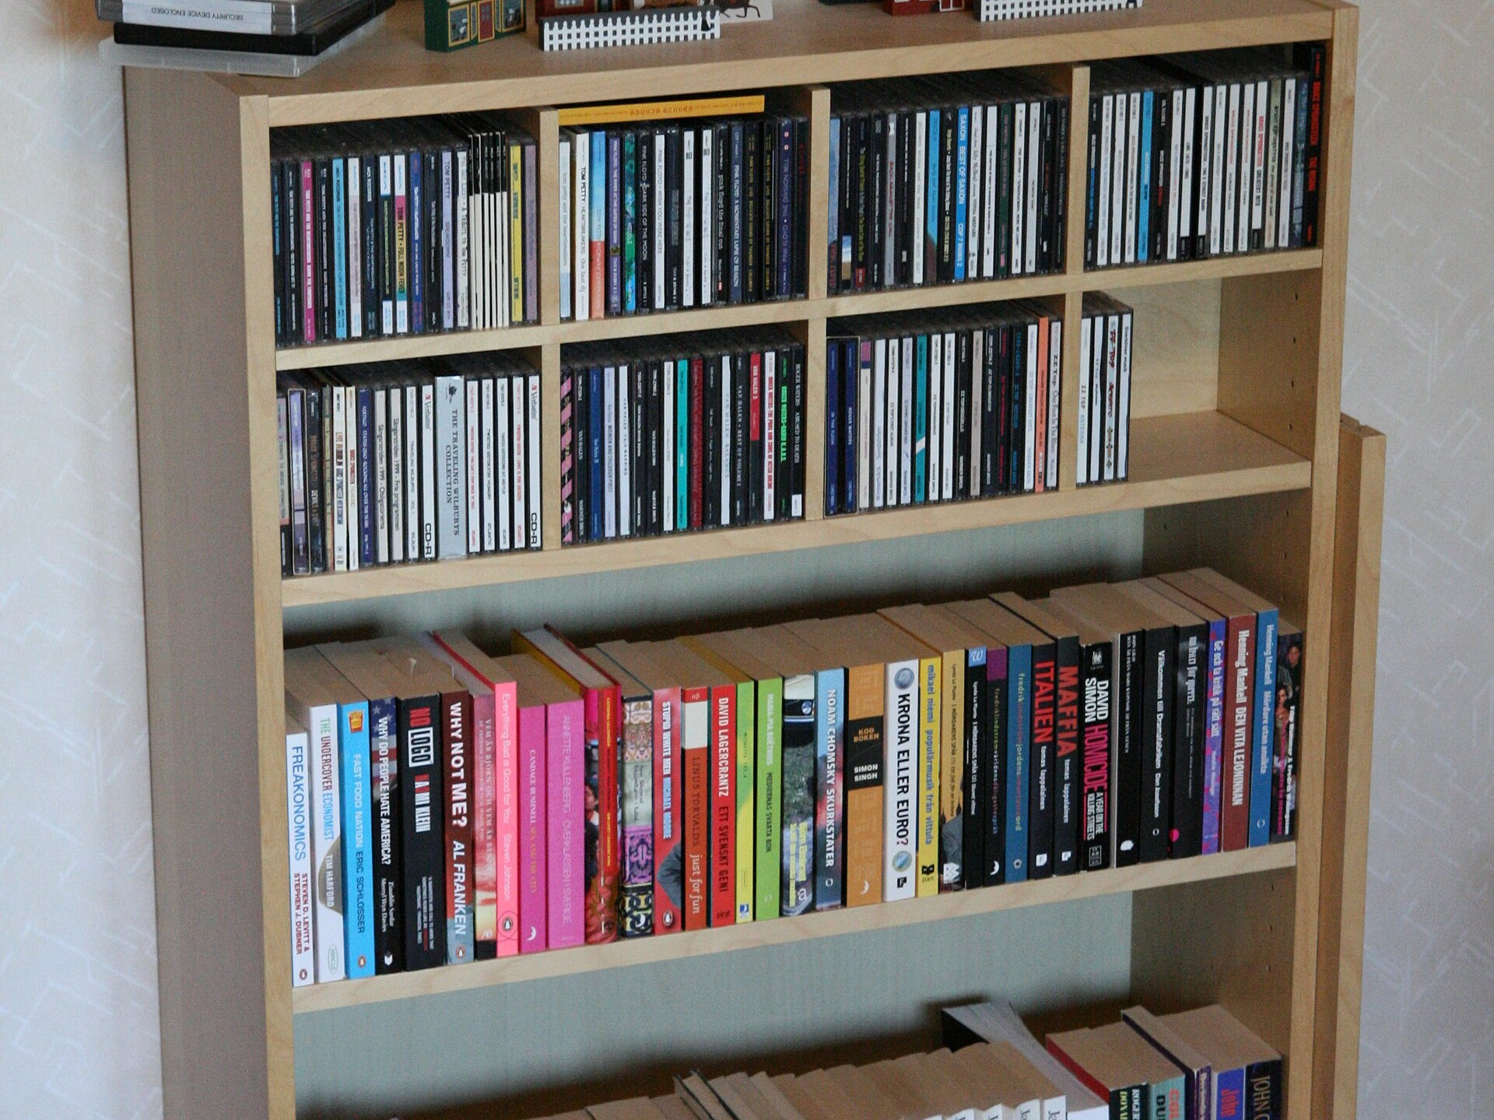
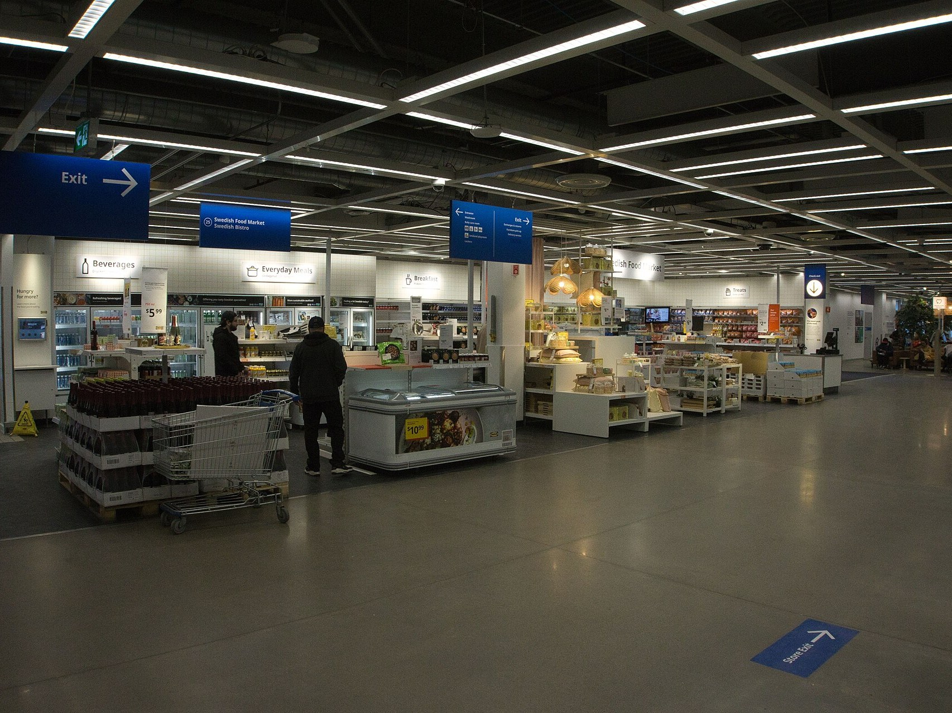
01 / BACKGROUND & BRAND
Background & Brand Overview: Why IKEA?
Born 1943 · Sweden
Democratic Design
SCM as Strategy
Founded 1943 by Ingvar Kamprad — today’s largest furniture retailer.
Form, function, quality, sustainability and low price — all five, in every product.
Bulky goods, huge SKUs and long chains make SCM the core of IKEA’s low-price model.

Slide 3
01 / SOURCING & DESIGN FOR SCM
Global Sourcing & Design for SCM
1,000+ suppliers in 50+ countries · modular design locks in cost advantages
CASE: Poland & IWAY
CASE: LACK & KALLAX
Scale Sourcing & Long-Term Binding
Design for SCM — Common Parts
Poland builds ~20% of IKEA’s wooden furniture — 1,000+ Tier-1 suppliers across 50+ countries.
• Binding: guidance, funding & long-term priority contracts
• IWAY: 100% FSC-certified wood secures ESG compliance
Design and SCM teams co-develop products — modular, standardized structures.
• Shared screws, fittings and molds across LACK & KALLAX
• Fewer raw-material SKUs, lower tooling cost and inventory risk
Core Strategic Takeaway:
Scale procurement + design-embedded efficiency build IKEA’s unreplicable cost moat.
Notes:
At IKEA, design is the supply chain. Take the iconic BILLY bookcase as an example. Its flat-pack design reduces packaging volume to just 20% to 30% of the original size. This reduces truck requirements from 50 down to 10 for every 10,000 units. Cost leadership is built right at the design stage.

Slide 4
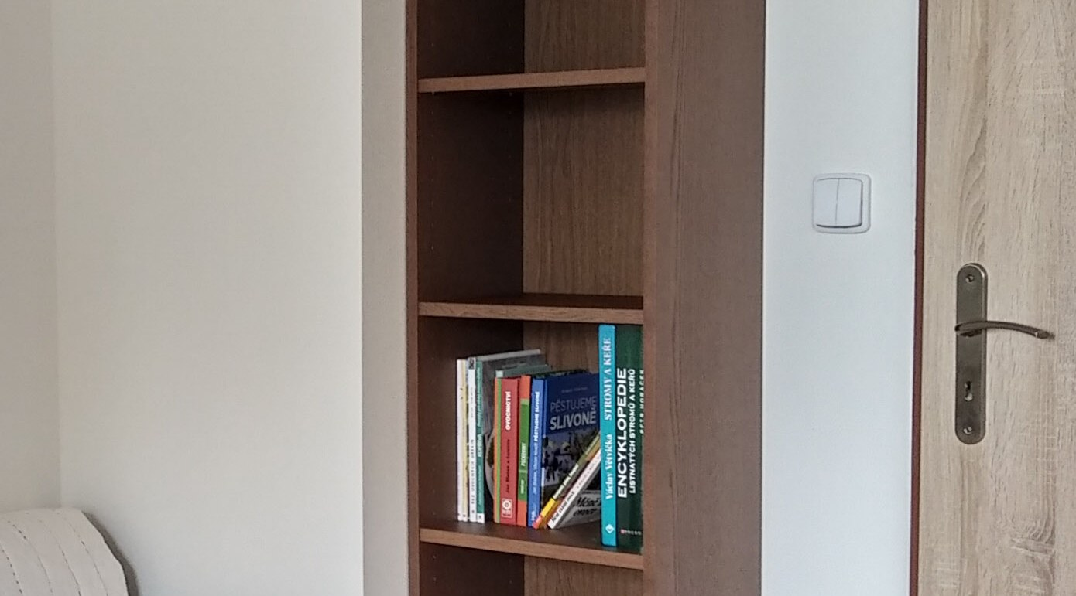
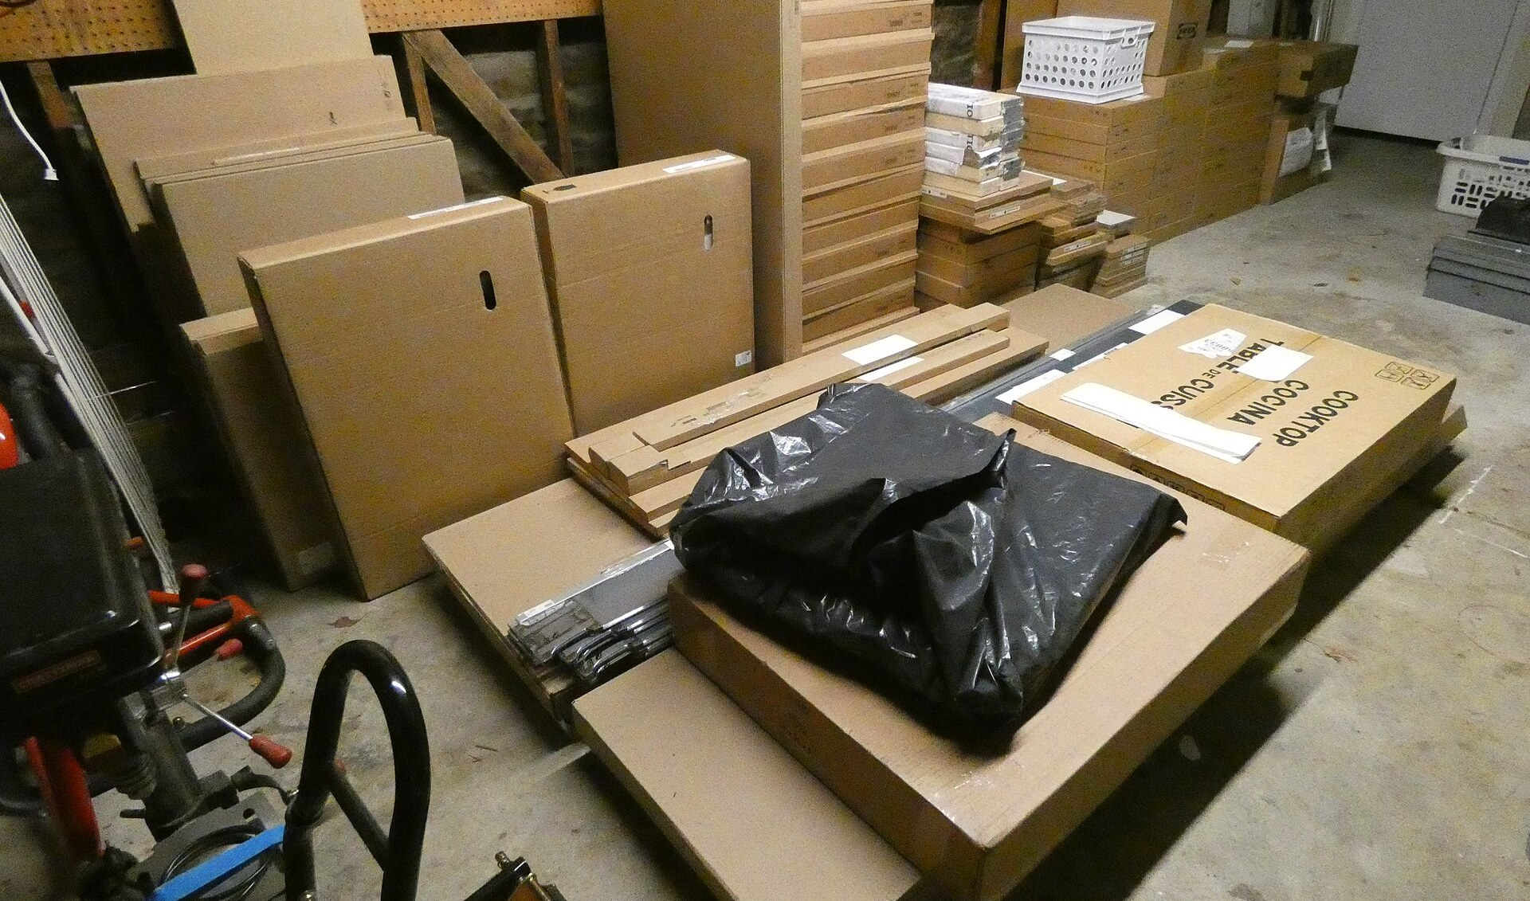
01 / FLAT-PACKING
Flat-packing & the Cost Logic
Design IS the Supply Chain
R&D breaks furniture into standardized modules that stack tightly.
50 → 10
Eliminate “Shipping Air”
Trucks for 10,000 BILLY bookcases: 50 down to 10
No void space — BILLY packs to 20–30% of assembled volume.
Dense Loading, Lower Unit Cost
Dense loading dilutes line-haul and warehousing cost per unit.

Slide 5
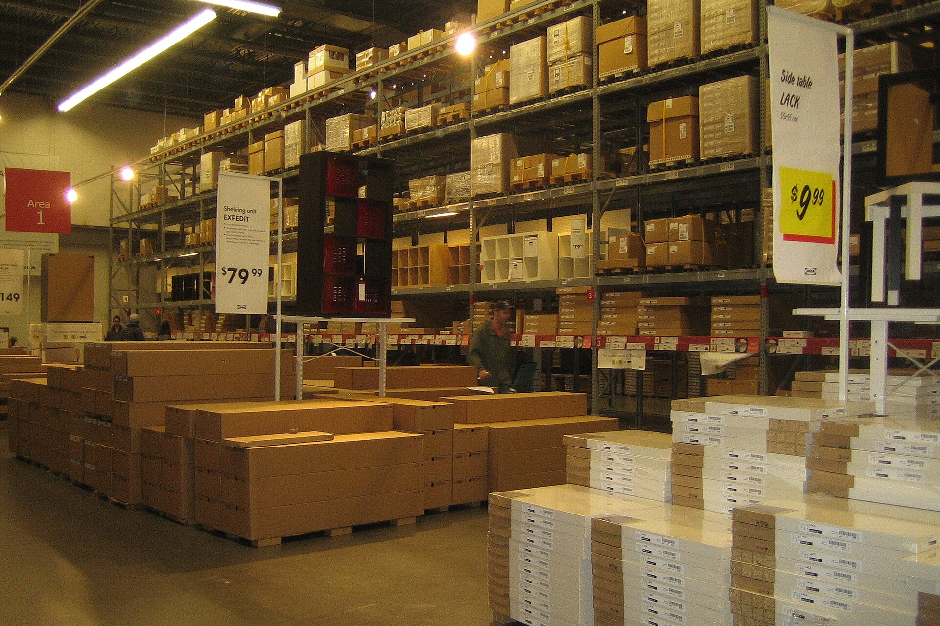

01 / LOGISTICS & FULFILLMENT
Tiered Logistics & Store-Warehouse
Tiered Logistics
Store-Warehouse & DIY
High-flow ships direct to stores/CFCs; low-flow consolidates in CDCs — pull-based Min/Max replenishment.
Showrooms double as micro-warehouses with bulk replenishment; customers pick, pack and carry home.
POS × AI Pull · Min/Max · Damps Bullwhip
Result: Customer Covers Last Mile
Core Strategic Takeaway:
Tiered flows + store-integrated self-service cut logistics cost to the industry minimum.

Slide 6
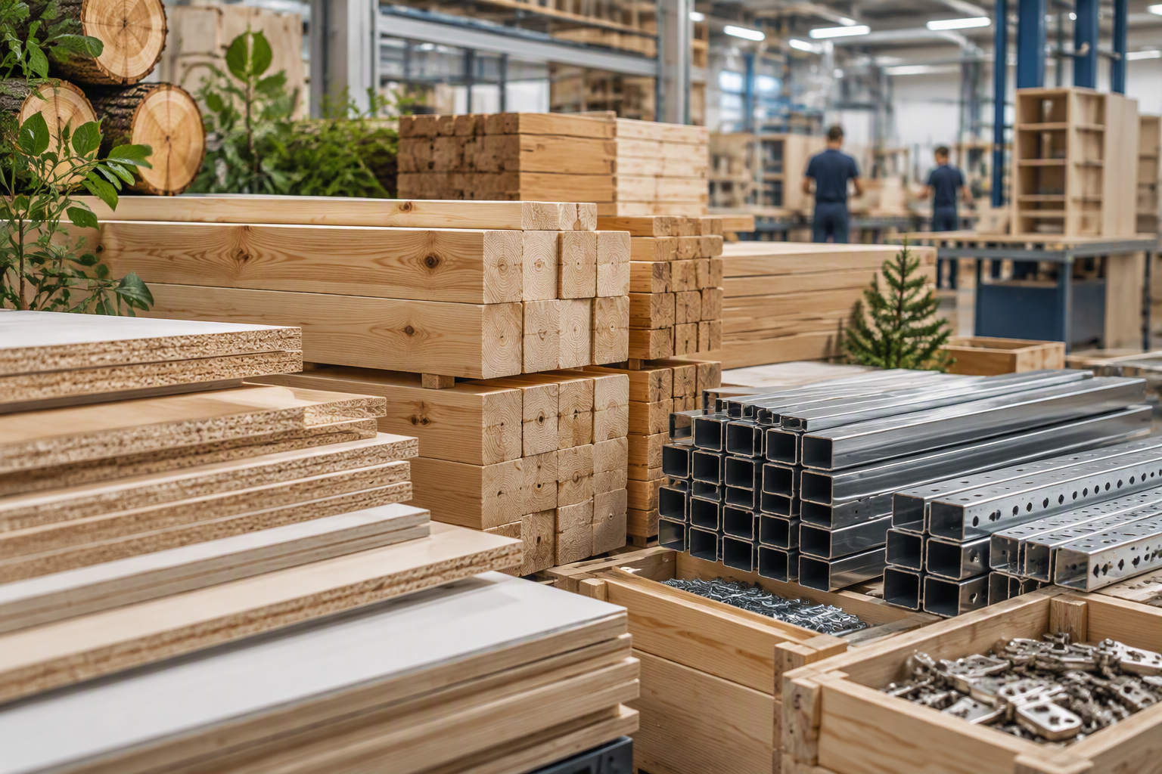
IKEA
SUPPLY CHAIN STRATEGY
PEST Environment & SWOT Strategic Roadmaps
ENGLISH VERSION
Evaluating macro-environmental forces and internal capabilities to architect resilient global fulfillment networks.
STRATEGIC EVALUATION & CASE ANALYSIS
ENGLISH
Notes:
Now， I’ll present a strategic SWOT analysis of IKEA’s global supply chain. We will evaluate how IKEA leverages flat-pack design, global flows, and circular models to maintain its competitive edge in a fast-changing market.

Slide 7
01 / Executive Overview
Macro Environment vs. Internal Capabilities
PEST Macro Pressures
SWOT Strategic Position
Political
Economic
Strengths
Weaknesses
Tariffs & forestry regulation
Freight cost spikes & inflation
Flat-pack design & global scale
Last-mile gap & extended web
Social
Technological
Opportunities
Threats
Circular economy & urban delivery
Automated AS/RS & AI forecasting
Urban MFCs & AI demand sensing
Ocean disruptions & local rivals

Slide 8
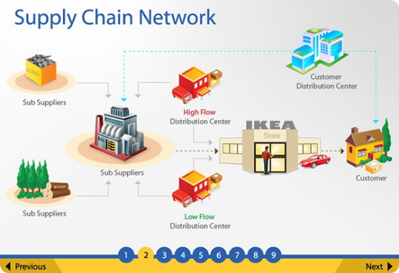
02 / PEST ANALYSIS
STRATEGIC CONTEXT
Aligning SCM Strategy with Macro Drivers
Global Sourcing Alignment
Mitigating global trade disruption through nearshoring and regional supply networks.
Cost Optimization Engine
Flat-pack packaging maximizing container utilization amidst freight price volatility.
Sustainable Transformation
Transitioning toward zero-emission logistics and 100% FSC-certified timber sourcing.

Slide 9
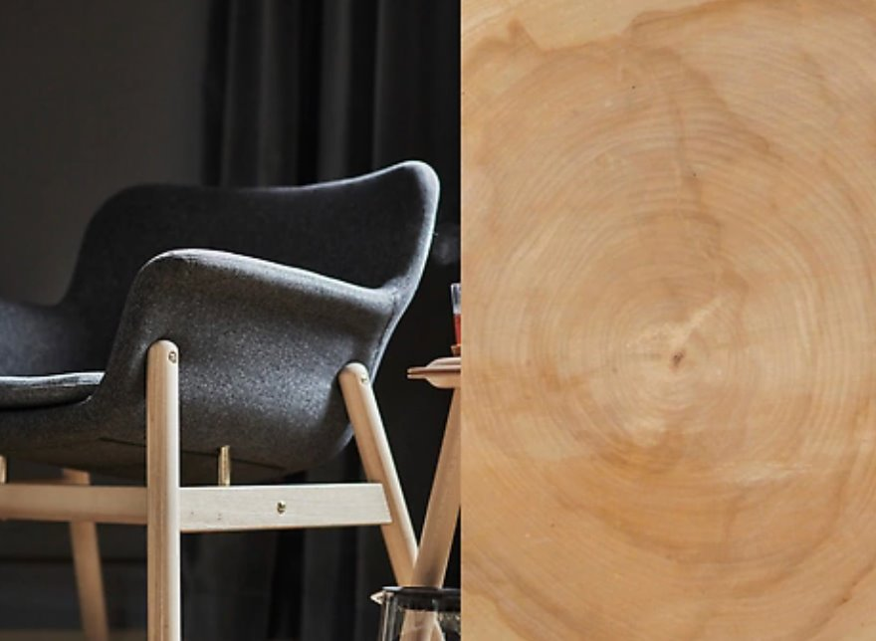

02 / PEST ANALYSIS Factor 01
Political & Legal Drivers
Tariffs & Trade Barriers
Forestry Regulations
Rising geopolitical tensions and shifting import tariffs threaten extended global supply routes.
Strict EU deforestation laws mandate full transparency across global raw material suppliers.
SCM Response: Regionalized Sourcing for Local Markets
SCM Response: Strict IWAY Supplier Compliance Standard

Slide 10
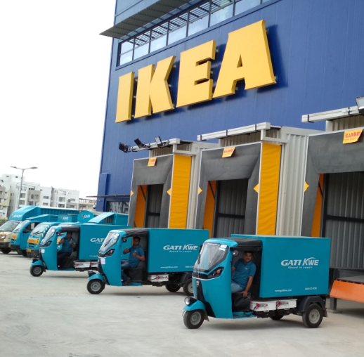
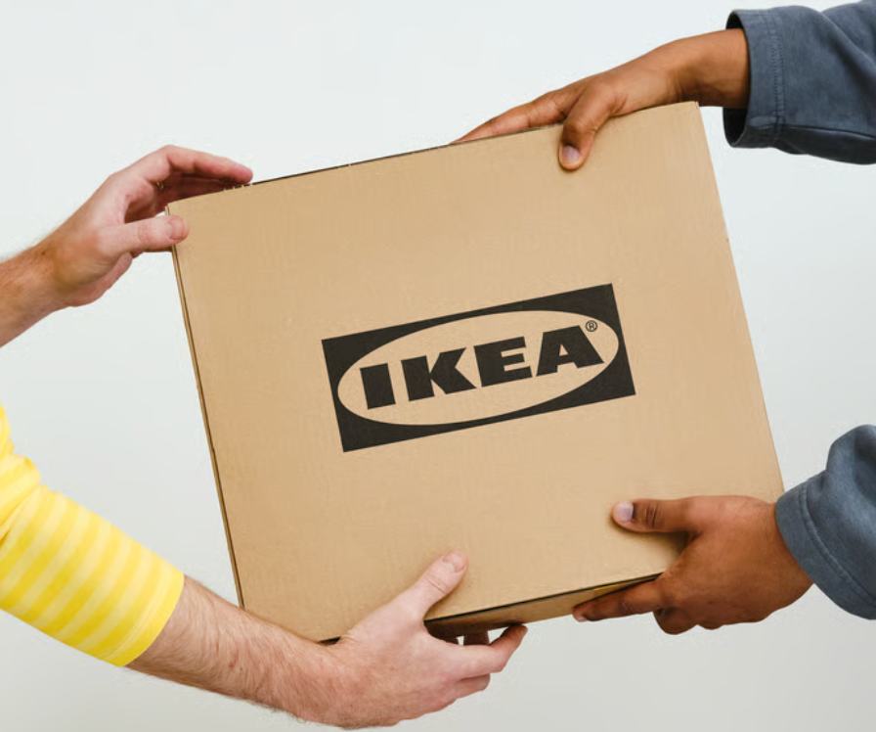
02 / PEST ANALYSIS Factor 02
Economic Impact & Cost Leadership
Container Space Optimization
Eliminates shipping empty air across ocean freight routes.
50%+
High-Volume Scale Purchasing
Reduction in transport volume achieved via flat-pack packaging density.
Locks in low long-term pricing with global supplier hubs.
Customer-Driven Last-Mile
Shifts final delivery and assembly labor to end consumers.

Slide 11
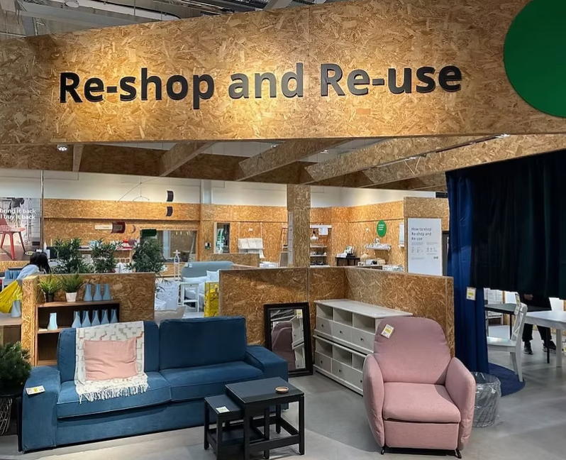
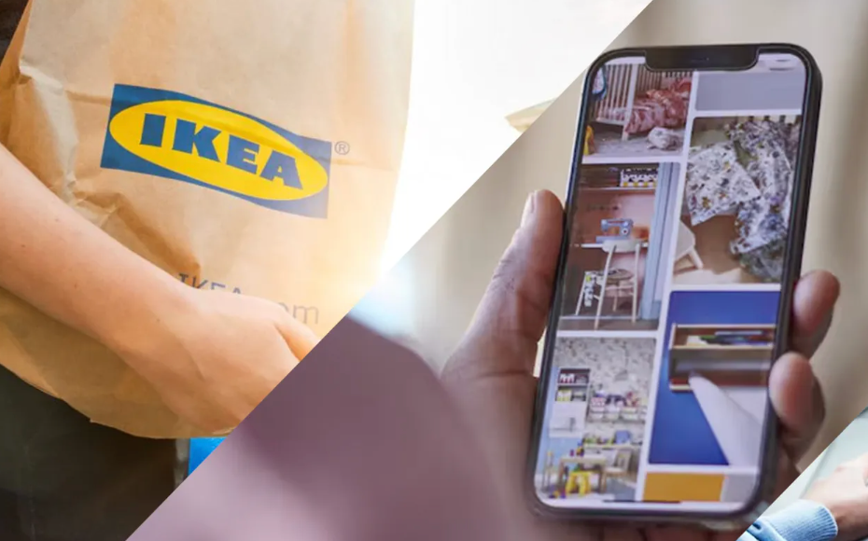
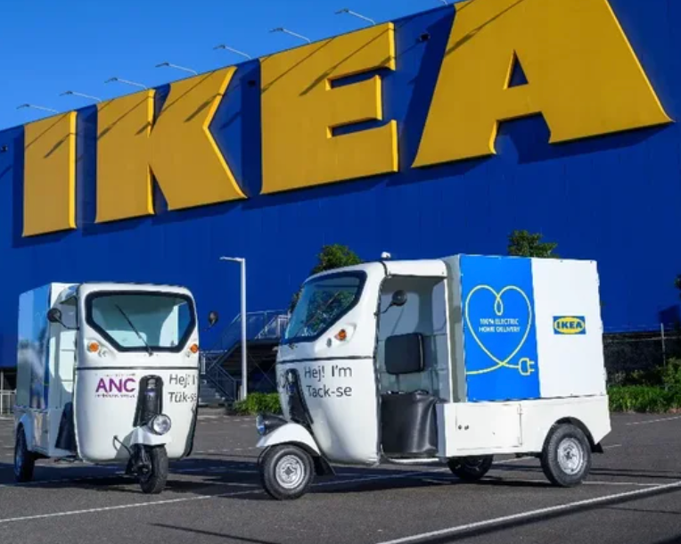
02 / PEST ANALYSIS Factor 03
Social & Sustainability Shift
Circular SCM
Omnichannel Demand
Green Fleet Fleet
Reverse logistics network supporting buy-back and refurbishing.
City-center hubs supporting rapidly growing online fulfillment.
Transitioning last-mile EV deliveries in major urban areas.

Slide 12
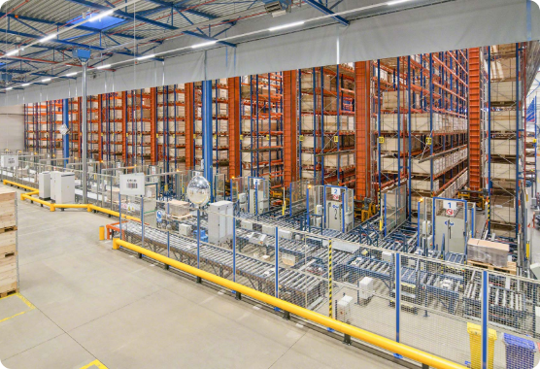
02 / PEST ANALYSIS Factor 04
Technological SCM Innovations
Automated High-Bay Storage (AS/RS)
Maximizing warehouse height density and inventory throughput.
Autonomous Drone Inventory
Automating stock checking during off-peak warehouse hours.
AI Demand Forecasting
Mitigating bullwhip effect via real-time POS data sync.

Slide 13
03 / SWOT OVERVIEW
SWOT MATRIX OVERVIEW
A structured diagnosis of internal capabilities and external conditions
S
W
O
T
STRENGTHS
WEAKNESSES
OPPORTUNITIES
THREATS
Flat-pack design
Global sourcing
Customer Self-Fulfillment
Last-mile gap
Extended Supply Networks
Rigid Push Strategy
MFC
Circular Economy
AI-Driven Sensing
Geopolitical Shipping Disruptions
Raw Material Inflation
Omni-channel Rivals
Notes:
Before diving into details, here is an bird's-eye view of IKEA’s SWOT profile. I will now walk you through these four dimensions one by one, starting with its core Strengths.

Slide 14
03 / SWOT-STRENGTHS IN-DEPTH
Design-Integrated Logistics & Strategic Sourcing
Embedding supply chain efficiency directly into product R&D to build cost moats
CASE: BILLY Bookcase
CASE: Poland Production Hubs
Flat-Pack Architecture
Global Sourcing Scale
Modular disassembly designs reduce packaging volume by 70–80%.
• Logistics Leverage: Trucks required for 10,000 bookcases drop from 50 to 10 vehicles.
• Strategic Rationale: Cost savings are locked in at the design phase rather than post-production.
1,000+ Tier-1 suppliers globally. Poland produces nearly 20% of all IKEA wooden furniture.
• Lock-in Mechanism: Financial backing & long-term exclusive contracts secure capacity.
• Economies of Scale: High-density procurement provides massive bargaining power.
Core Strategic Takeaway:
The triad of "Modular Design + Strategic Sourcing + Customer Self-Fulfillment" eliminates touchpoints and
creates an unreplicable low-cost moat.
Notes:
At IKEA, design is the supply chain. Take the iconic BILLY bookcase as an example. Its flat-pack design reduces packaging volume to just 20% to 30% of the original size. This reduces truck requirements from 50 down to 10 for every 10,000 units. Cost leadership is built right at the design stage.

Slide 15


03 / SWOT-WEAKNESSES IN-DEPTH
Last-Mile Shortfalls & Supply Network Visibility Blindspots
Structural friction in adapting legacy store-fulfillment models to modern e-commerce
E-Commerce Last-Mile Bottlenecks
• Model Mismatch: Suburban stores are designed for full-pallet replenishment and customer self-pickup—not parcel picking.
• Cost Disadvantage: Home delivery for bulky items leads to high logistics costs and slow delivery windows.
• Impact: Erodes customer satisfaction when competing against agile online-first furniture brands.
Extended Supply Visibility & Inelastic Push Model
• Tier-2/3 Blindspots: Extended supplier webs make tracking timber origin and labor practices difficult.
• Push Rigidities: High reliance on long-term demand forecasts creates long replenishment lead times.
• Impact: Regional stockouts and inventory gluts occur simultaneously during demand shifts.
Notes:
On the weakness side, IKEA faces two major challenges. First, its network was built for bulk pallet transport and customer self-pickup, making last-mile home delivery expensive and slow. Second, managing thousands of suppliers across multiple tiers creates compliance blind spots and tracebility risks.

Slide 16
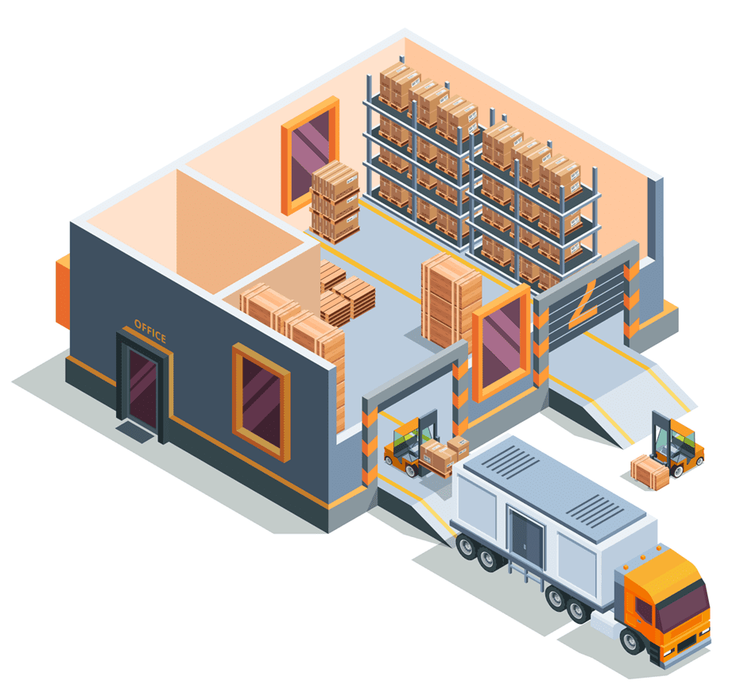

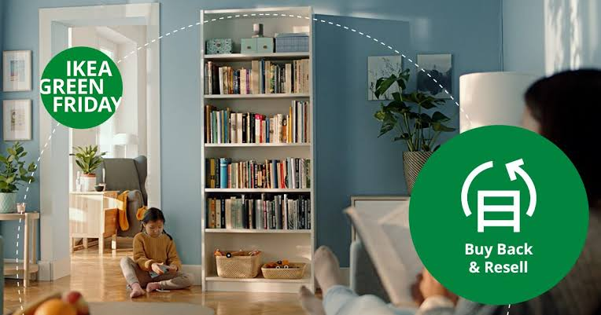
03 / SWOT-OPPORTUNITIES IN-DEPTH
Micro-Fulfillment Networks & Circular Economy Loops
Opening new growth curves by bringing inventory closer to consumers and expanding recycling
Micro-Fulfillment (MFC)
Circular Buy-Back Scheme
Real-Time Demand Sensing
Deploying Planning Studios in city centers paired with urban micro-warehouses to drastically shorten online delivery times.
Expanding "Buy Back & Resell" models to build reverse logistics channels, turning sustainability commitments into new profit centers.
Integrating POS and online search data with AI algorithms to shift from push-based forecasting to Sense-Driven Demand Planning.
Supply Chain Re-engineering:
[Urban Planning Studio] ➔ [Micro-Fulfillment Center (MFC)] ➔ [Direct Delivery] ➔ [Reverse Buy-Back]
Notes:
For opportunities, IKEA is adapting through two key innovations. First, it is launching urban planning studios paired with micro-fulfillment centers, or MFCs, to speed up local delivery. Second, through its 'Buy Back & Resell' program, IKEA converts one-time sales into full lifecycle customer value.

Slide 17


03 / SWOT-THREATS IN-DEPTH
Geopolitical Ocean Disruptions & Inflationary Cost Pressures
Exposing the vulnerabilities of long-distance, cross-border maritime supply chains
CASE: Red Sea Crisis
COST SQUEEZE
Maritime Rerouting & Delay Risks
Commodity Inflation & Local Competition
Geopolitical crises forced container ships to bypass the Suez Canal via the Cape of Good Hope:
• Transit Extensions: Asia-Europe shipping lanes extended by 10–14 days.
• Freight Spikes: Container rates surged, triggering persistent stockouts across European hubs.
• Lesson: Ultra-long ocean supply chains face high vulnerability during Black Swan events.
• Commodity Inflation: Sharp price spikes in timber, metals, and fuel compress IKEA’s low-price margins.
• Near-Store Rivals: Agile local retailers leverage proximity and rapid delivery to capture market share.
Notes:
Turning to external threats, geopolitical shocks remain critical. For instance, the Red Sea crisis forced ships to reroute around the Cape of Good Hope, adding 10 to 14 days to lead times and driving up freight costs. At the same time, volatile wood and metal prices continue to squeeze profit margins.

Slide 18

03 / SWOT-STRATEGIC RECOMMENDATIONS
Strategic Execution Roadmap: From Efficiency to Resilience
Four core strategic pillars derived from the SWOT analysis
01 / Urban Micro-Fulfillment (SO/WO)
Establish city-center MFCs and automated item-picking capabilities to reduce reliance on suburban store self-fulfillment.
02 / AI Demand Sensing (WO)
Unify omni-channel POS data and substitute rigid forecasts with AI real-time demand sensing to optimize regional safety stock.
03 / Nearshoring & Multi-Sourcing (ST/TT)
Expand regional production hubs near consumer markets to hedge against maritime freight disruptions.
04 / Multi-Tier Traceability (WT/ESG)
Implement digital tracking tools down to Tier-2/3 suppliers to eliminate ESG and regulatory compliance gaps.
Notes:
To address these issues, we propose four strategic priorities: first, redesign fulfillment with urban MFCs; second, digitize supply chain decisions with AI demand sensing; third, diversify sourcing and routes to hedge disruption risks; and fourth, scale circular operations to close the supply chain loop.

Slide 19
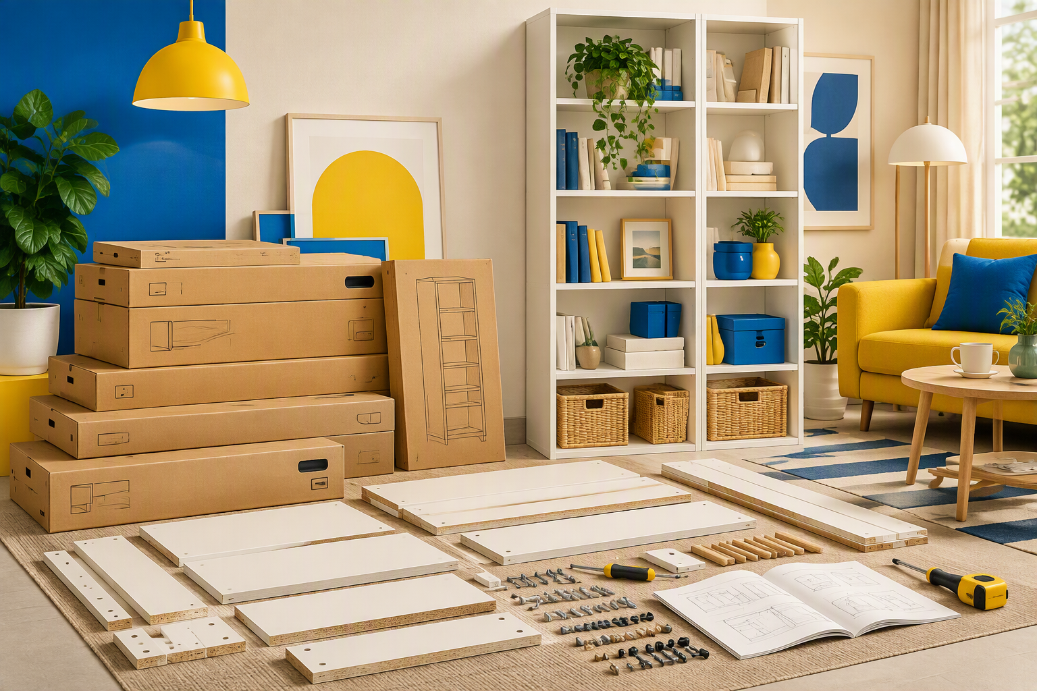
03 / CONCLUSION
Conclusion: The Evolution of IKEA’s Supply Chain
Scale and cost advantages remain key, but agility and transparency will define future leadership
Core Takeaway
IKEA’s enduring success lies in integrating supply chain strategy directly into product design and retail execution. Facing e-commerce shifts, ocean disruptions, and ESG scrutiny, IKEA must retain its low-cost core while accelerating the rollout of "Urban MFCs + Real-Time Demand Sensing + Nearshore Multi-Sourcing"—pivoting from a rigid Push-based model to a resilient Pull-driven ecosystem.
Notes:
In conclusion, IKEA’s foundational low-cost model remains robust, but future growth relies on omnichannel efficiency and resilience. The ultimate goal is to maintain affordability while embedding speed, transparency, and circularity into the network.

Slide 20
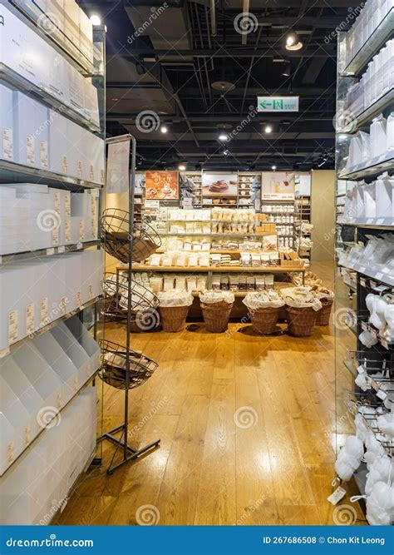
05 /Supply Chain Strategy Comparison
IKEA vs. MUJI: Supply Chain Strategy Comparison
Efficiency vs Flexibility
Dimension | IKEA | MUJI
Competitive Strategy | Cost Leadership | Differentiation
SCM Model | Standardlized Global SCM | Lean SCM
Souring | Global Sourcing | Regional Sourcing
Production | Mass Production | Small-Batch Strategy
Inventory | Push Strategy | Push-Pull Strategy
Goal | Effciency MUJI | Responsiveness
Insight：Both companies compete in the same market, but with fundamentally different supply chain philosophies.

Slide 21
05 /Push vs Pull Strategy Analysis
IKEA – Push Strategy
Forecast Demand → Mass Production → Warehousing → Customers
Advantages
• Lower Cost
• Economies of Scale
• Stable Supply
Disadvantages
• Overstock Risk
• Slow Response to Demand Changes
MUJI – Push-Pull Hybrid
Basic Inventory → Demand Monitoring → Replenishment → Customers
Advantages
• Higher Flexibility
• Faster Response
• Lower Inventory Pressure
Disadvantages
• Higher Operating Cost
• Stock-out Risk
Key Finding: IKEA sacrifices flexibility for efficiency, while MUJI sacrifices efficiency for flexibility.

Slide 22
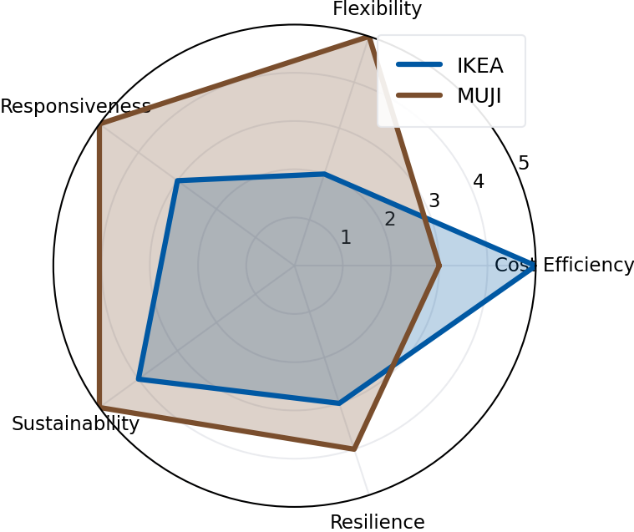
05 / Who performs better?
Executive Summary: IKEA leads in cost efficiency, while MUJI outperforms in flexibility, responsiveness, sustainability, and resilience.
🏆 Winner Scorecard
Cost Efficiency
Flexibility
Responsiveness
Sustainability
Resilience
🟦IKEA
🟫MUJI
🟫MUJI
🟫MUJI
🟫MUJI
Strategic Strengths
IKEA
• Scale
• Efficiency
• Global Sourcing
MUJI
• Flexibility
• Sustainability
• Demand-Driven SCM
Key Takeaway:
Future supply chain success depends on balancing efficiency, flexibility, and sustainability rather than maximizing only one dimension.

Slide 23
05 /Key Findings & Managerial Implications
Finding 1
IKEA's scale creates superior cost efficiency.
• Global sourcing
• Standardized operations
• Economies of scale
Finding 2
MUJI's lean supply chain enables faster market response.
• Demand-driven replenishment
• Higher flexibility
• Better responsiveness
Finding 3
Neither model is perfect.
Future competitiveness requires:
✓ Efficiency
✓ Flexibility
✓ Sustainability
Key Takeaway
The future of supply chain management is not about choosing between efficiency and flexibility, but integrating both capabilities into a resilient and sustainable supply chain.

Slide 24
06 / CHALLENGES IDENTIFICATION
Four Key Supply Chain Challenges
Structural bottlenecks behind the radar gaps in Flexibility, Responsiveness, Resilience and Sustainability
01 / E-Commerce Last-Mile
02 / Long-Haul Maritime Fragility
▸ Model Mismatch: Suburban stores are built for full-pallet replenishment, not single-item parcel picking.
▸ High Delivery Cost: Bulky home delivery drives high cost and slow delivery windows.
▸ Heavy Ocean Reliance: Production concentrates in distant hubs, stretching supply lines.
▸ Disruption Risk: The Red Sea Crisis extended Asia-Europe voyages by 10-14 days.
03 / Upstream Push Rigidities
04 / Tier-2/3 & Inflation
▸ Push-Pull Disconnect: Stores use POS × AI pull, but factories still run on long-term forecasts.
▸ Slow Response: Long lead times raise overstock and stockout risk versus MUJI.
▸ Audit Complexity: Tracking Tier-2/3 timber origin across 1,000+ suppliers is costly.
▸ Margin Squeeze: Rising timber, metal and fuel prices pressure the low-price promise.
CORE TAKEAWAY
Suburban DIY pickup and Push production cannot support omnichannel growth.

Slide 25
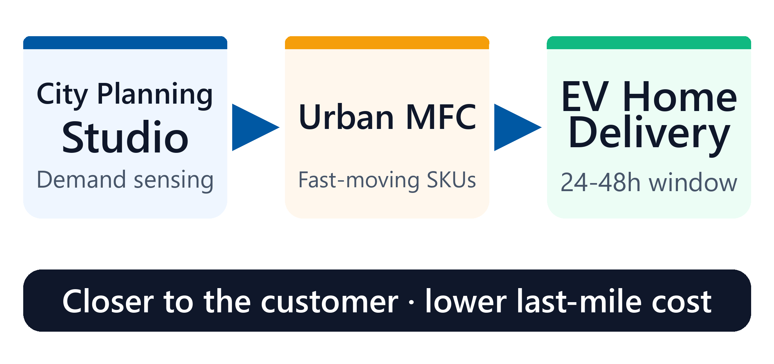
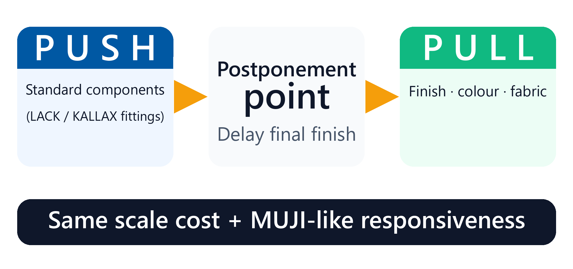
06 / STRATEGIC RECOMMENDATIONS (PART 1)
Upgrading Omnichannel Fulfillment & Supply Flexibility
Addressing last-mile delivery bottlenecks and rigid upstream forecasting
01 / Urban Micro-Fulfillment
02 / Hybrid Push-Pull
[Planning Studio] > [Urban MFC] > [EV Delivery]
▸ Automated Parcel Picking: Deploy urban MFCs to handle fast-moving online orders closer to customers.
▸ Expected Impact: Cuts delivery windows to 24-48 hours and last-mile cost by 15%+.
▸ Upstream Mass Push: Keep scale production for standardized components (LACK / KALLAX fittings).
▸ Downstream Agile Pull: Delay final finishes and fabric covers until real-time POS × AI signals arrive.
▸ Expected Impact: MUJI-like responsiveness without small-batch cost.
CORE TAKEAWAY
Urban micro-warehouses plus modular postponement bridge scale and agility.

Slide 26
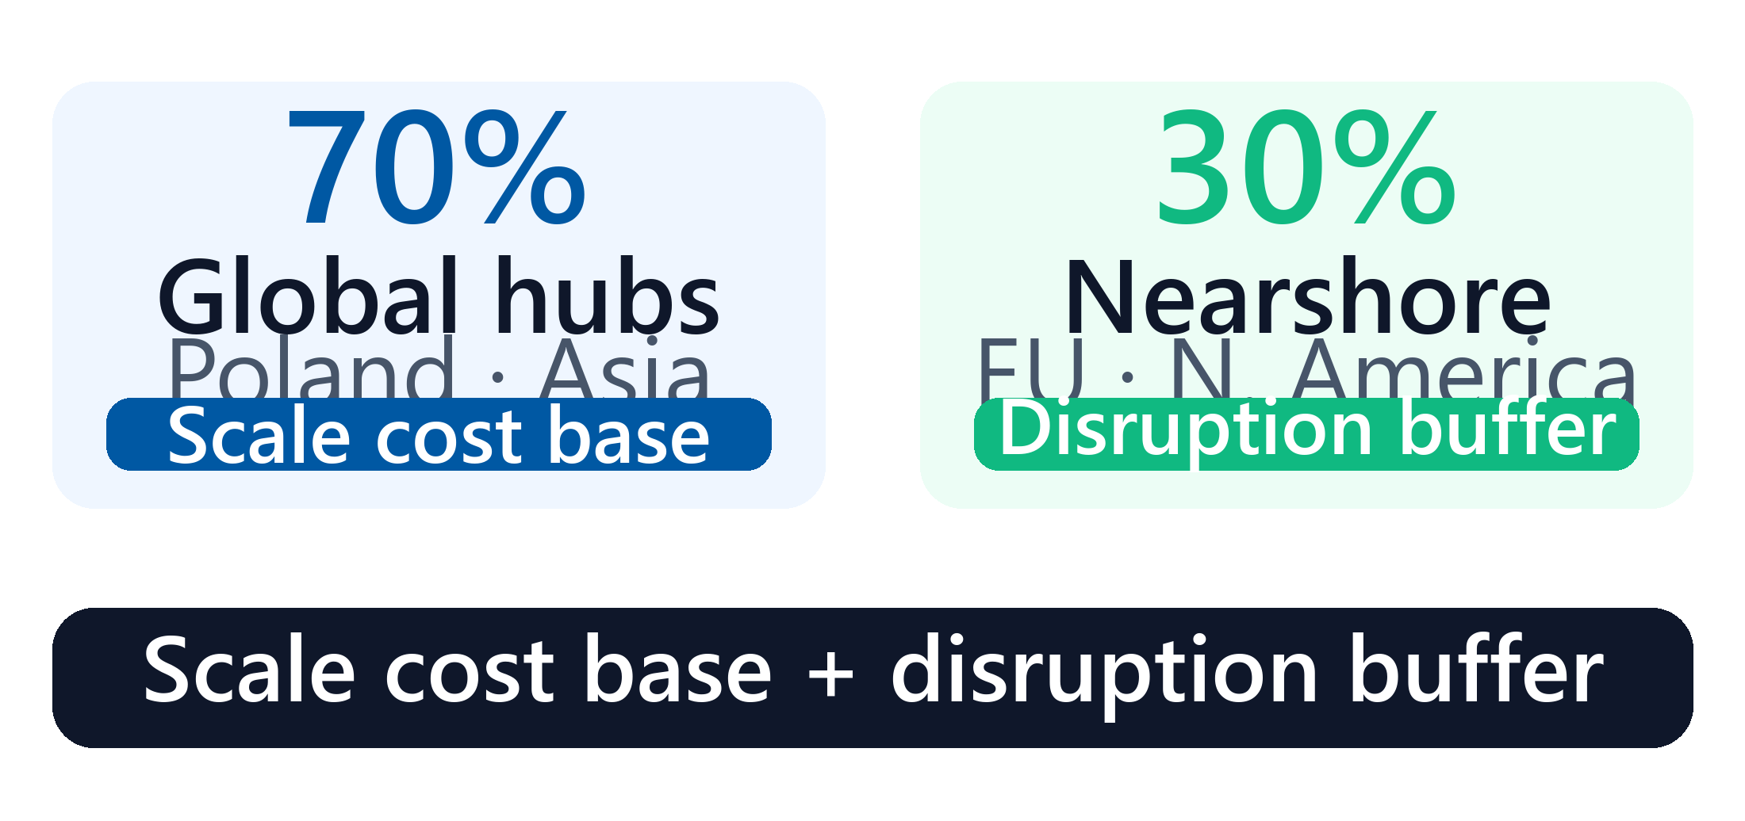
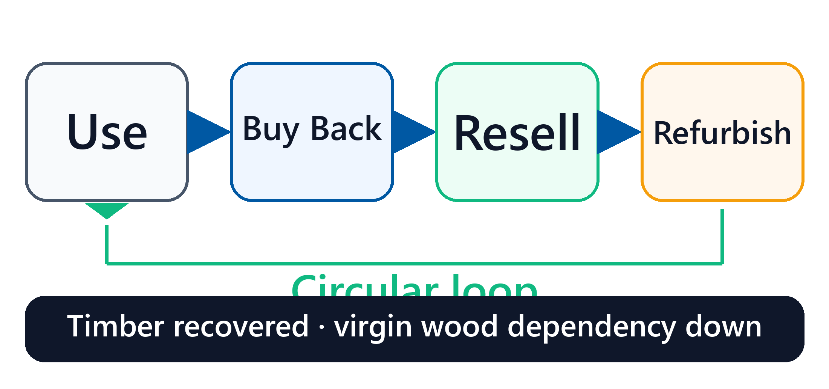
06 / STRATEGIC RECOMMENDATIONS (PART 2)
Building Supply Chain Resilience & Circular Compliance
Hedging against ocean shipping disruptions, raw material inflation, and ESG risks
03 / Dual-Sourcing & Nearshoring
04 / Circular Buy-Back & Tracking
▸ 70% Global Base Hubs: Keep stable products in major hubs (Poland, Asia) to preserve scale cost.
▸ 30% Nearshore Buffer: Expand regional capacity in Europe and North America for seasonal items.
▸ Expected Impact: Cuts lead times by 30% and buffers Red Sea-style crises.
▸ Scale Circular Loops: Expand Buy Back & Resell to recover furniture and reprocess timber.
▸ Tier-2/3 Digital Traceability: Track sub-suppliers to verify 100% FSC compliance under EU rules.
▸ Expected Impact: Hedges raw-material inflation and closes ESG blindspots.
CORE TAKEAWAY
Dual-track sourcing secures continuity; circular recovery turns ESG into a hedge.

Slide 27
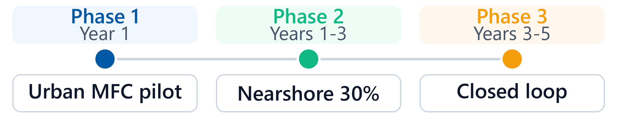
06 / IMPLEMENTATION ROADMAP
Phased Implementation Roadmap & Radar Gap Closure
How the four recommendations close the performance gaps against MUJI
Responsiveness ↑
Flexibility ↑
Resilience ↑
Sustainability ↑
Urban MFCs + EV fleets
Push-Pull postponement
70/30 dual-sourcing
Buy-back + Tier-2/3 tracking
Phase 1 Short-Term
Phase 2 Mid-Term
Phase 3 Long-Term
Quick Wins in Fulfillment
Structural Agility
Closed-Loop Ecosystem
Pilot urban MFCs and EV fleets in major metros; unify store POS and online inventory.
Roll out modular postponement for seasonal lines; build 30% nearshore backup capacity.
Scale buy-back and timber recycling; reach 100% traceability down to Tier-2/3.

Slide 28
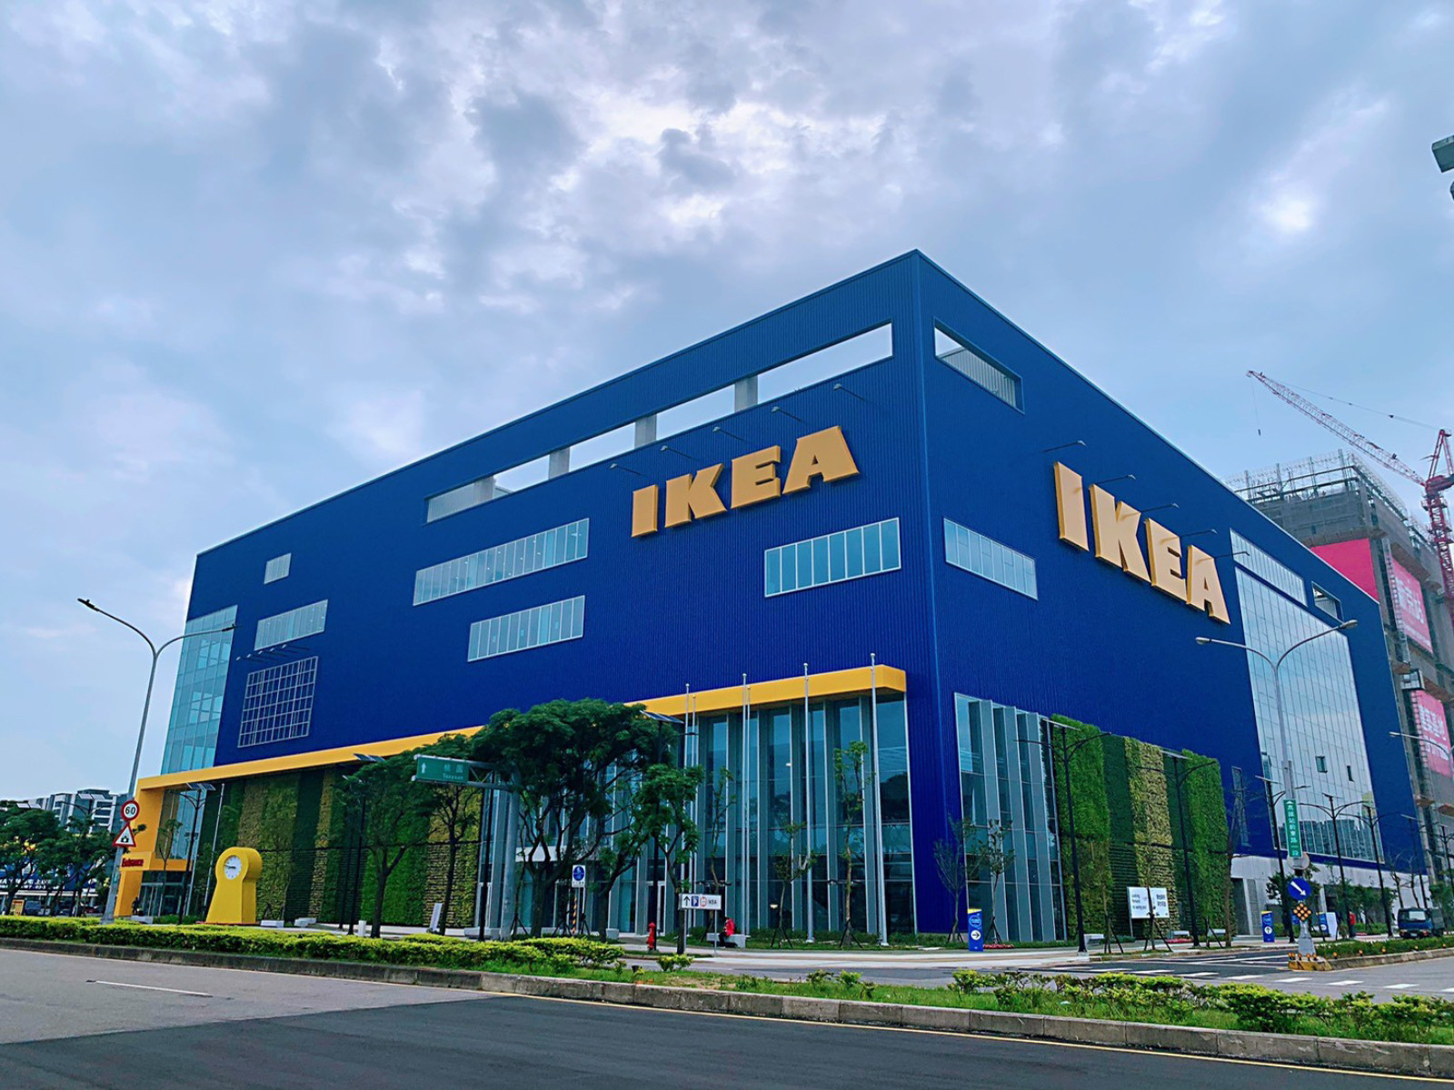
06 / CONCLUSION & SUMMARY
Conclusion: Balancing Efficiency, Agility and Resilience
Key takeaways from IKEA's supply chain model and competitor benchmarking
Core Takeaway
IKEA's enduring success lies in integrating supply chain strategy directly into product design and retail execution. Flat-pack design and global sourcing keep the cost base low, while urban MFCs, postponement and 70/30 dual-sourcing close the gaps in responsiveness, flexibility and resilience.
Facing e-commerce shifts, ocean disruptions and ESG scrutiny, IKEA must retain its low-cost core while moving from a rigid Push model to a resilient, demand-driven ecosystem.

Slide 29
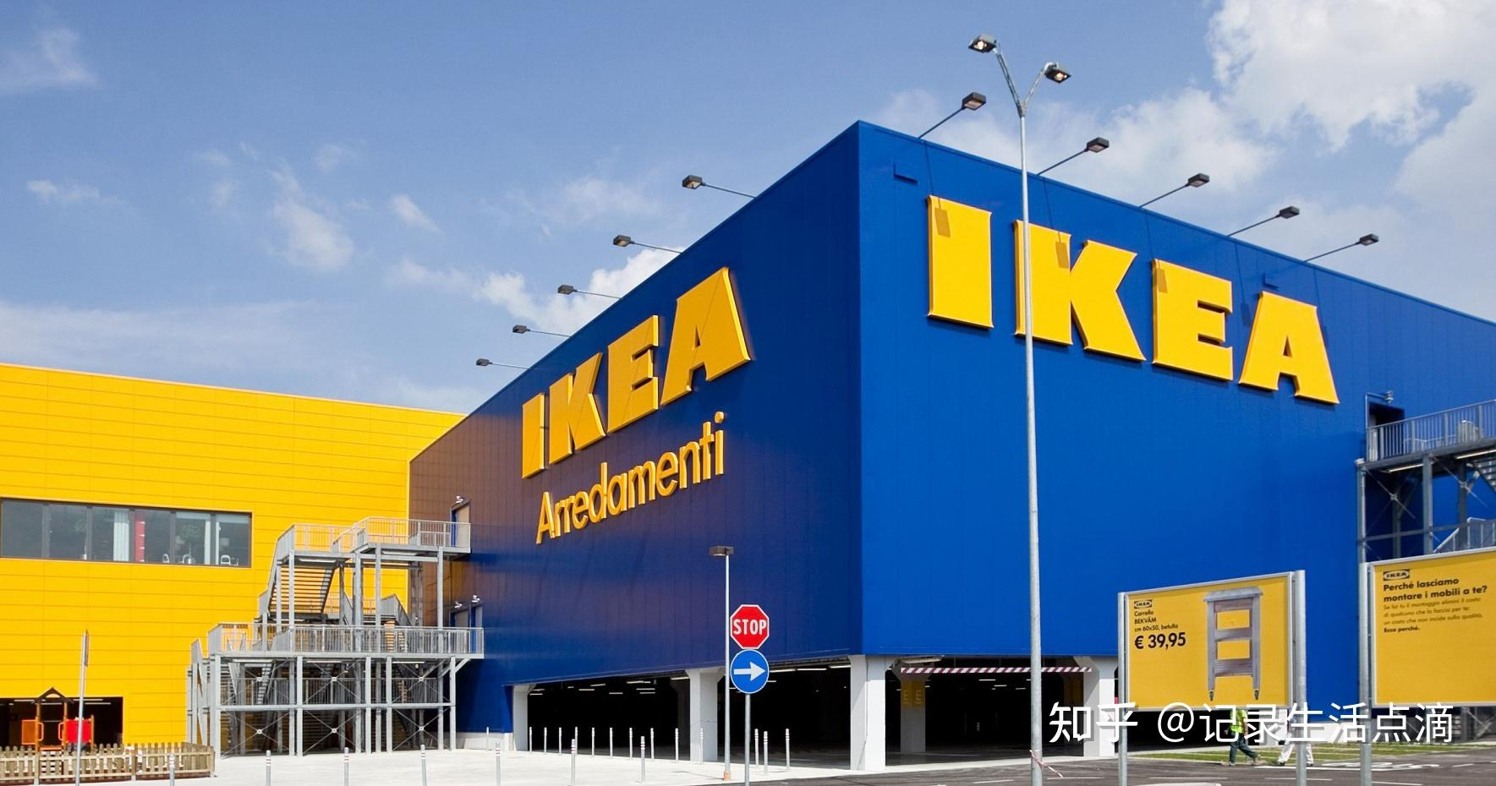
GROUP 2 | IKEA SUPPLY CHAIN STRATEGY ANALYSIS
THANK YOU FOR LISTENING
Cao Xuming (7157125) · Ou Zhipeng (7170878) · Lin Xiaoting (7177761)
Song Liangyun (7106671) · LYU Jiayi (7151391) · Hong Zixian (7180835)
20 October 2026 · Group Presentation

