Slide 2
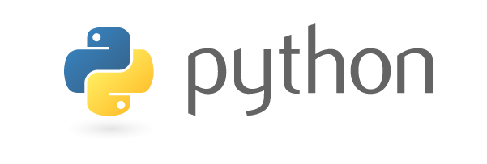
Introduction to Python Programming

Slide 3
Python Overview

Slide 4
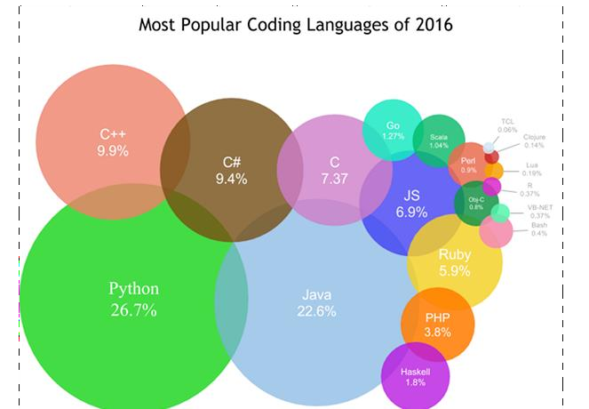
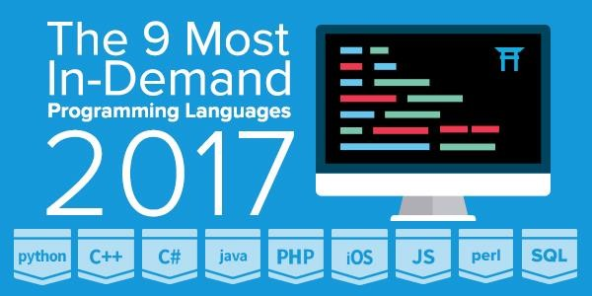
8/22/2017

Slide 5
What is Python?
Python is a high-level programming language which is:
Interpreted: Python is an interpreted language i.e. interpreter executes the code line by line at a time. When you use an interpreted language like Python, there is no separate compilation. .
Interactive: You can use a Python prompt and interact with the interpreter
directly to write your programs.
Object-Oriented: A programming language that can model the real world is said to be object-oriented. It focuses on objects and combines data and function. Python supports both procedure-oriented and object-oriented programming which is one of the key python features.

Slide 6
Python Features
1. Easy to Read
Python code is quite like English. Looking at it, you can tell what the code is supposed to do.
2. High-Level
Python is a high-level language. This means that as programmers, we don’t need to remember the system architecture. Also, we need not manage memory.
3. Cross-platform language
Python can run equally on different platforms such as Windows, Linux, Unix , Macintosh etc. A Python program written on a Windows computer will run on a Linux system and vice versa. Thus, Python is a portable language .
4. Extensible
If needed, you can write some of your Python code in other languages like C++. This makes Python an extensible language, meaning that it can be extended to other languages.

Slide 7
More Features ..
5. Dynamically Typed
Python is dynamically-typed. This means that the type for a value is decided at runtime, not in advance. This is why we don’t need to specify the type of data while declaring it.
6. Free and Open Source
Python is a Open Source Software. In simple terms, you can freely distribute copies of this software, read the software's source code, make changes to it, use pieces of it in new free programs , and that you know you can do these things. Python language is freely available at www.python.org . The source-code is also available. Therefore it is open source.
7. Extensive Libraries
The Python Standard Library is huge indeed. Python library contains built-in modules that provide access to system functionality, as well as modules written in Python that provide standardized solutions for many problems that occur in everyday programming.

Slide 8
Why Python
Easy to read | Python scripts have clear syntax, simple structure and very few protocols to remember before programming.
Easy to Maintain | Python code is easily to write and debug. Python's success is that its source code is fairly easy-to-maintain.
Portable | Python can run on a wide variety of Operating systems and platforms and providing the similar interface on all platforms.
Broad Standard Libraries | Python comes with many prebuilt libraries apx. 21K
High Level programming | Python is intended to make complex programming simpler. Python deals with memory addresses, garbage collection etc internally.
Interactive | Python provide an interactive shell to test the things before implementation. It provide the user the direct interface with Python.
Database Interfaces | Python provides interfaces to all major commercial databases. These interfaces are pretty easy to use.
GUI programming | Python supports GUI applications and has framework for Web. Interface to tkinter, WXPython, DJango in Python make it . _{8/22/2017}

Slide 9
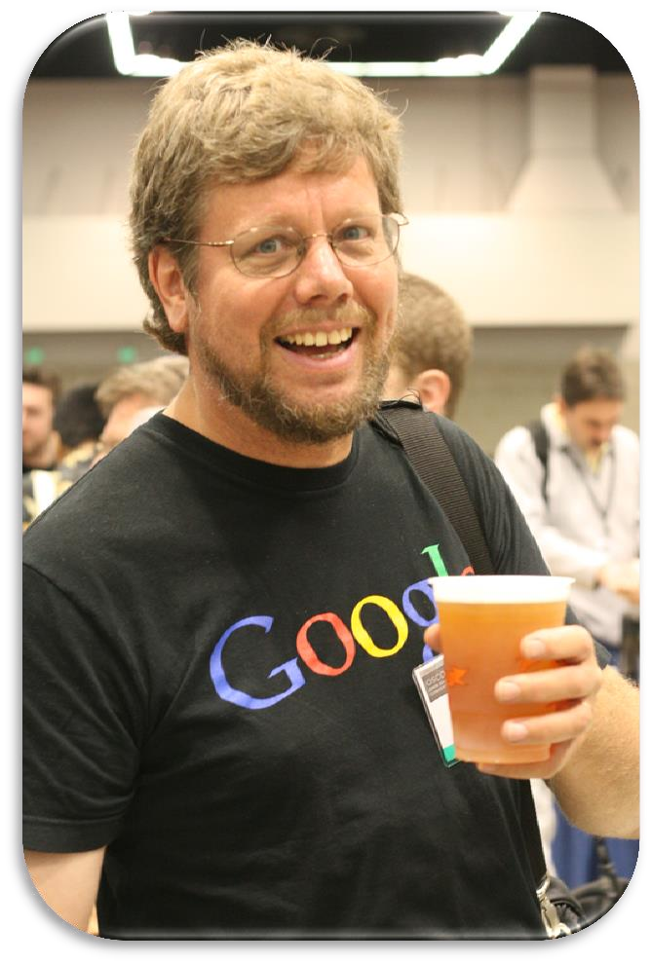
History of Python
Python was created by Guido Van Rossum in the late
1980s.
Rossum published the first version of Python code (0.9.0) in February 1991 at the CWI (Centrum Wiskunde & Informatica) in the Netherlands , Amsterdam.
Rossum chose the name "Python", since he was a big fan of
Monty Python's Flying Circus.
Python is now maintained by a core development team at the institute, although Rossum still holds a vital role in directing its progress.

Slide 10
Python Versions
Release dates for the major and minor versions:
Python 1.0 - January 1994
Python 1.5 - December 31, 1997
Python 1.6 - September 5, 2000
Python 2.0 - October 16, 2000
Python 2.1 - April 17, 2001
Python 2.2 - December 21, 2001
Python 2.3 - July 29, 2003
Python 2.4 - November 30, 2004
Python 2.5 - September 19, 2006
Python 2.6 - October 1, 2008
Python 2.7 - July 3, 2010

Slide 11
Python Versions
Release dates for the major and minor versions:
Python 3.0 - December 3, 2008
Python 3.1 - June 27, 2009
Python 3.2 - February 20, 2011
Python 3.3 - September 29, 2012
Python 3.4 - March 16, 2014
Python 3.5 - September 13, 2015

Slide 12
Installation of Python
To learn this language first ,you have to download the software.
Presently the version in use is Python 3.x
To download the Python go to the site http://www.python.org/downloads and click on the suitable icon.

Slide 13
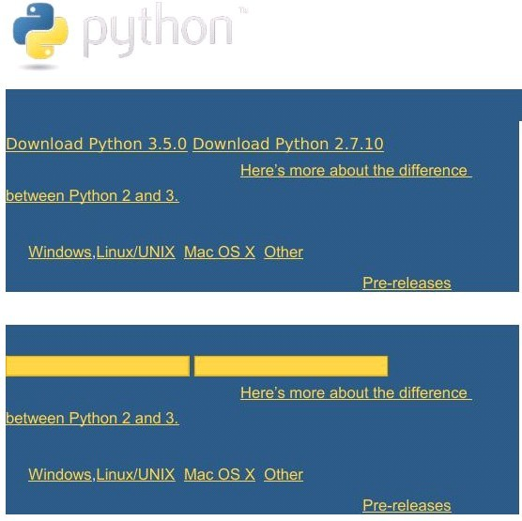
The website appears as shown below.

Slide 14
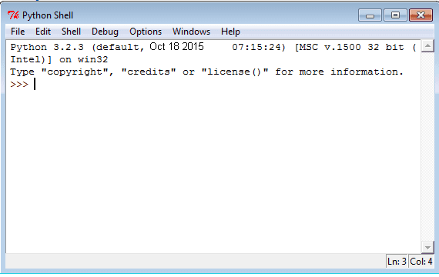
This Python shell allows us to use Python in interactive mode.
The shell waits for a command from the user ,executes it and returns the result.

Slide 15
IDLE
IDLE is a graphical user interface for doing Python development, and is a standard and free part of the Python system.
It is usually referred to as an Integrated Development Environment (IDE).
One can write the Python code using the IDLE which is like an editor.This comes along with Python .

Slide 16
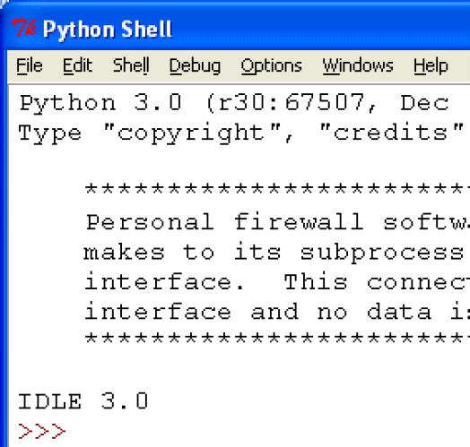
The Screenshot for IDLE will be as shown below. The >>> is the prompt, telling you Idle is waiting for you to type something.

Slide 17
Python Basic Syntax

Slide 18
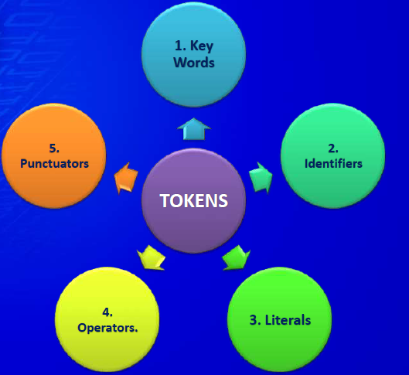
Tokens
The smallest individual unit in a program is known as a token. There are five types of tokens allowed in Python.

Slide 19
Python Character Set
Letters: A - Z, a - z
Digits : 0 - 9
Special Symbols: space + - * / ** \ ( ) [ ] // = != == <> . ‘ “ ‘’’ , ; : % ! & # <= >= @ >>> << >> _
Whitespaces : Blank space, tab, carriage return, newline, form-feed
Other Characters: Python can process all ASCII and uni-code chars

Slide 20
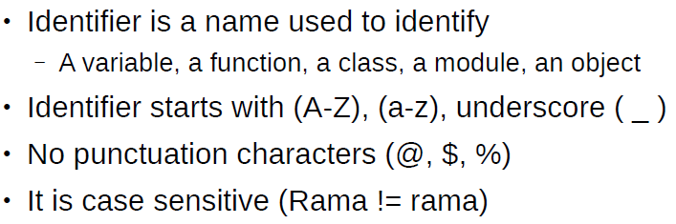
Python Identifiers

Slide 21
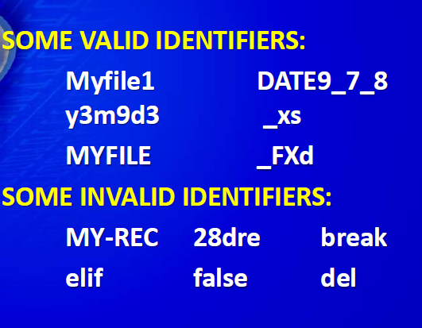
Examples

Slide 22
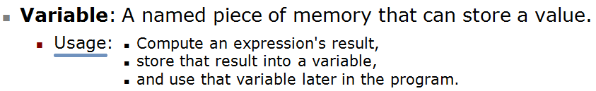
Variables
Python has no command for declaring a variable
Must start with a letter or underscore _
Must consist of letters, numbers, and underscores
Case Sensitive
Good: spam eggs spam23 _speed
Bad: 23spam #sign var.12
Different: spam Spam SPAM

Slide 23
Rules for Naming Variables
Variables names must start with a letter or an underscore
x = 5 # valid
_y = 3 # valid
9x = 10 # starts with numeral
SyntaxError: invalid syntax
$y = False # starts with symbol
=> SyntaxError: invalid syntax
2. The remainder of your variable name may consist of letters, numbers and underscores.
has_0_in_it = "Still Valid"
3. Names are case sensitive.
x = 9
y = X*5
=> NameError: name 'X‘ is not defined

Slide 24
Knowing the Data Type of Variable
a = 2
print(type(a))
# Output: <type 'int'>
name = 'John Doe'
print(type(name))
# Output: <type 'str'>
q = True
print(type(q))
# Output: <type 'bool'>

Slide 25
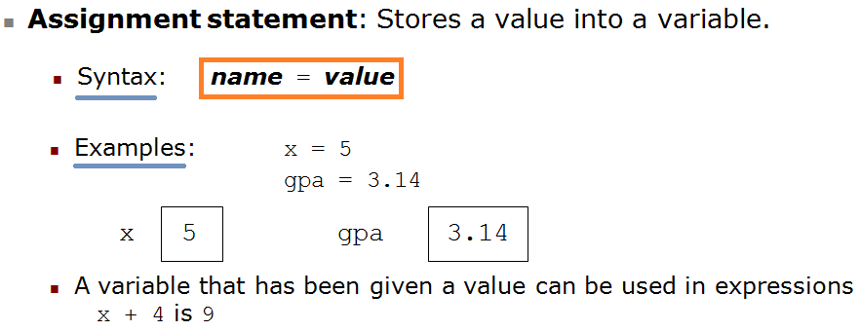
Assignment Statements

Slide 26

A single value can be assigned to several variables simultaneously
a = b = c = 1
print(a, b, c)
# Output: 1 1 1

Slide 27

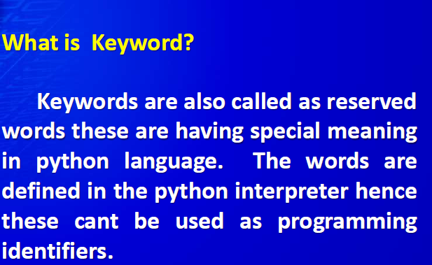

Slide 28
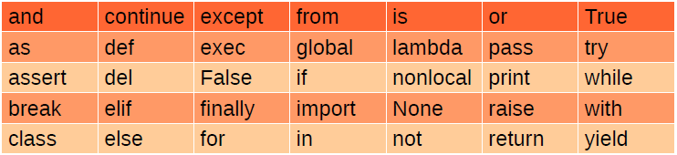
Python keywords
>>>import keyword
>>>print(keyword.kwlist)

Slide 29

Correct indentation :
Following block generates error :
if 5 > 2: print("Five is greater than two!")
o/p :
File "demo_indentation_test.py", line 2 print("Five is greater than two!") ^ IndentationError: expected an indented block

Slide 30
Spaces vs. Tabs
Always use 4 spaces for indentation.
Python 3 disallows mixing the use of tabs and spaces for indentation.
Python 2 allows mixing tabs and spaces in indentation.

Slide 31
Escape Characters

Slide 32
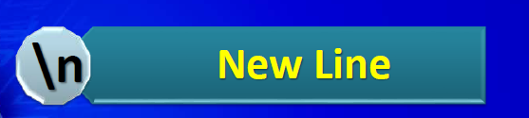
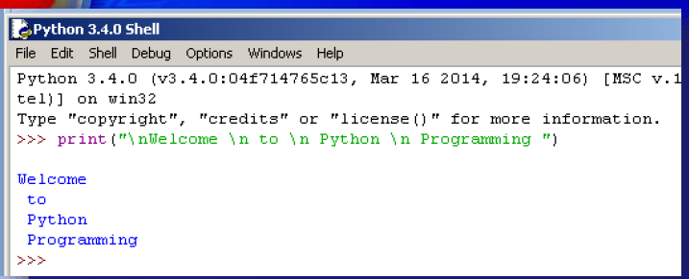

Slide 33
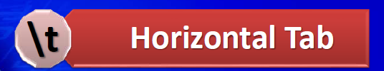
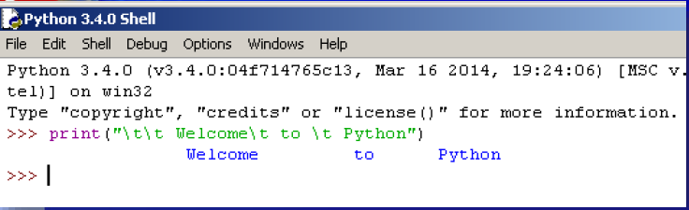

Slide 34

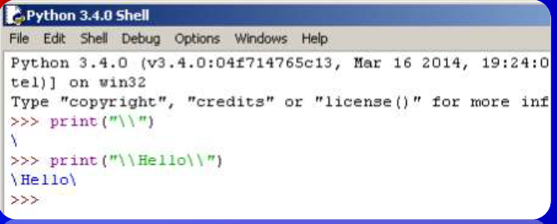

Slide 35
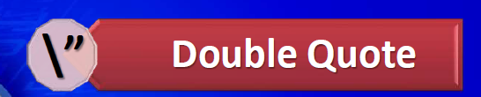
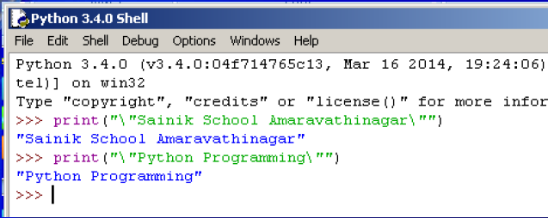
Q. Display Good Morning “Ramesh”

Slide 36

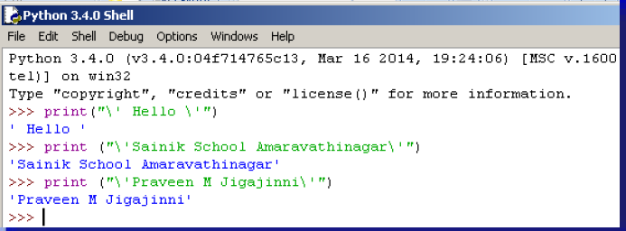
Q. Display It’s ok.

Slide 37

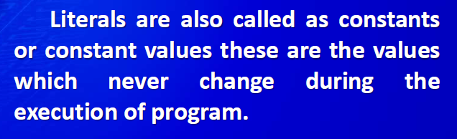

Slide 38
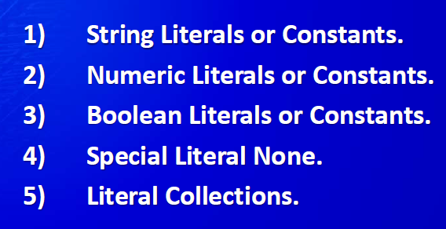

Slide 39
String: sequence of characters that is used as data
String literal: string that appears in actual code of a program
Must be enclosed in single (‘) or double (“) quote marks
String literal can be enclosed in triple quotes (''' or """)
Enclosed string can contain both single and double quotes and can have multiple lines

Slide 40
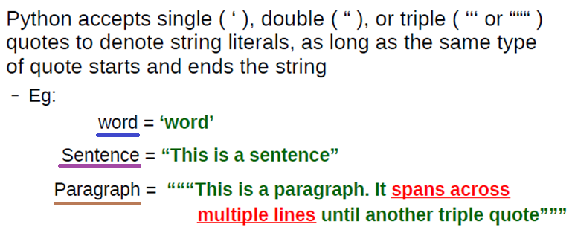

Slide 41

Numerical Literals have following types:
Integers : Whole Numbers
Examples: 23,100
2. Float : Real Numbers
Examples: 10.5,34.90
3. Complex : Complex Numbers
Examples: 10j , 5+2j

Slide 42

A Boolean Literal in python is used to represent the Boolean values(True of False).
Example:
X= True
print(x)
True
a= False
print(a)
False
The None literal is used to indicate absence of value.
Example: x=None
print(x)
None

Slide 43
Basic Operators
Types of Operator
Python language supports the following types of operators-
Arithmetic Operators
Comparison (Relational) Operators
Assignment Operators
Logical Operators
Bitwise Operators
Membership Operators
Identity Operators

Slide 44
OPERATORS
Arithmetic
Operator | Example | Result
+ | a + b | 18
- | a - b | 8
* | a * b | 65
/ | a / b | 2.6
% | a % b | 3
** | a ** b | 371293
// (Floor operator) | a // b | 2
The results are a = 13
b = 5
obtained for the values of:

Slide 45
OPERATORS
Assignment
Operators
=
+=
/=
%=
**=
//=
Example-1:
a = b = 1
Example-2:
a=2
a**=3 🡪 a= a**3
Output = 8
Example-3:
x=5
x//=2
Output = 2
Python does not have ++ AND -- operators

Slide 46
OPERATORS
Unary Minus
Example-1:
n = 10
print(-n)
Example-2:
num = -10 num = -num print(num)

Slide 47
OPERATORS
Relational
Operator | Example | Result
> | a > b | False
>= | a >= b | False
< | a < b | True
<= | a <= b | True
== | a == b | False
!= | a != b | True
The results are a = 1
b = 2
obtained for the values of:

Slide 48
OPERATORS
Relational: Chaining
Example-1:
x = 15
print(10< x < 20)
Example-2:
print(1 < 2 < 3 < 4)

Slide 49
OPERATORS
Logical
a = 1, b = 2,
Operator | Example | Result
and | a and b | 2
or | a or b | 1
not | not a | False

Slide 50
OPERATORS
Boolean
a = True, b = False
Operator | Example | Result
and | a and b | False
or | a or b | True
not | not a | False
Example-1:
print(a and b) print(a or b) print(not a)

Slide 51
OPERATORS
Bitwise
a = 10(0000 1010), b = 11(0000 1011)
Operator | Example | Result
~(NOT) | ~a | 1111 0101(-11)
&(AND) | a & b | 0000 1010(10)
|(OR) | a | b | 0000 1011(11)
^(XOR) | a ^ b | 0000 0001(1)
<<(Left Shift) | a << 2 | 0010 1000(40)
>>(Right Shift) | a >> 2 | 0000 0010(2)

Slide 52
OPERATORS
Membership
Operator | Description
in | Returns | True, | if | an | item | is | found in | the | specified sequence
not in | Returns | True, | if | an | item | is | not found | in | the specified sequence
Example-1:
x =“ Silicon”
print(“li” in x)
Example-2:
x =“ Silicon”
print(“p” not in x)

Slide 53
OPERATORS
Identity
Use to comapre the memory locations of two objects id(): Is used to get the memory location ID
λ
λ
Operator | Description
is | Returns | True, | if | ID | of | two | objects | are | same
is not | Returns | True, | if | ID | of | two | objects | are | not | same
Example-1:
a = 25
b = 25
c=45
print(a is b)
Print(a is not c)

Slide 54
y
λ
5000
Example :
x = 200 y = 500 z = x print(z is x) 🡪 True
Print(x is not y) 🡪 True
x
2000
z
a = 25
a = 65
Garbage
a
25
a
65

Slide 55
OPERATORS
Precedence
Operator | Name
** | Exponentiation
*, /, //, % | Multiplication, division, floor division, remainder
+, - | Addition, Subraction
<<, >> | Bitwise Left, Right shift
& | Bitwise AND
^ | Bitwise XOR
| | Bitwise OR
All operators follow, Left – Right associativity, except ** which follows Right - Left

Slide 56
Algebraic Expression:
100 + 200 / 10 - 3 * 10 🡪90

