Slide 1
Analyzing consumer shopping behavior from a large multi-category online store
DATA 228 – Project Presentation
Professor: Andrew H. Bond
San Jose State University
Saniya Lande, Shilpa Shivarudraiah, Neetu Rasinger Babu, Iqra Bismi
(Project Group- Data Artists)

Slide 2

Introduction & Background
The advent of technology and the internet has led to an increasing demand for E-commerce industries.
People of all ages prefer online shopping and increase in trend of online shopping was highly noticeable during the pandemic and post pandemic
The tremendous growth in online shopping has created a need for the business to understand how the customer perceives online shopping and purchases to improve their over all business performance.
Large-scale data analytics in e-commerce is still in its nascent stage and there is plenty to learn about it in all facets.
Analyzing such data which records the online shopper user activity is knows as consumer shopping behavior analysis.
DATA228 Project Presentation
Consumer Shopping behavior analysis

Slide 3


Goals & Objectives
To do an in-depth analysis of the ecommerce dataset to gain insights on customer behavior and activity which can help business make strategic decisions.
To understand big data analytics and how the evolving technologies help deal with such huge volume of data and leverage it to extract meaningful insights.
DATA228 Project Presentation
Consumer Shopping behavior analysis

Slide 4
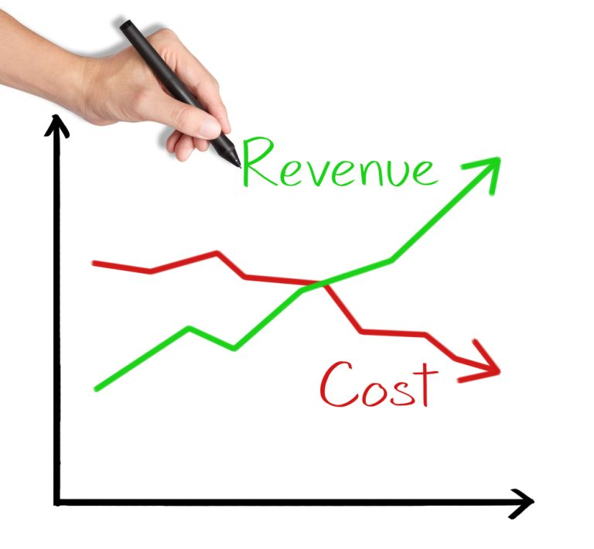


Project application & Impact
The consumer shopping behavior analysis is the process of discovering, interpreting, and communicating data patterns and insights related to E-commerce online business.
It helps in measuring the user behavior, market and performance trends, and ROI. This analysis can be used by the business to show ROI for the campaigns and make better decisions to reduce costs, increase sales, and make business improvements accordingly.
DATA228 Project Presentation
Consumer Shopping behavior analysis

Slide 5

Data Description
Data Source: Kaggle
Dataset from a multicategory e-commerce online store
Data Size: 15GB
Data period: October-November 2019
Dataset comprises of attributes such as product ID, product category, product sub-category, price, user details, user session details, brand, event_type, etc describing the user shopping activity.
Link: https://www.kaggle.com/datasets/mkechinov/ecommerce-behavior-data-from-multi-category-store
DATA228 Project Presentation
Consumer Shopping behavior analysis

Slide 6
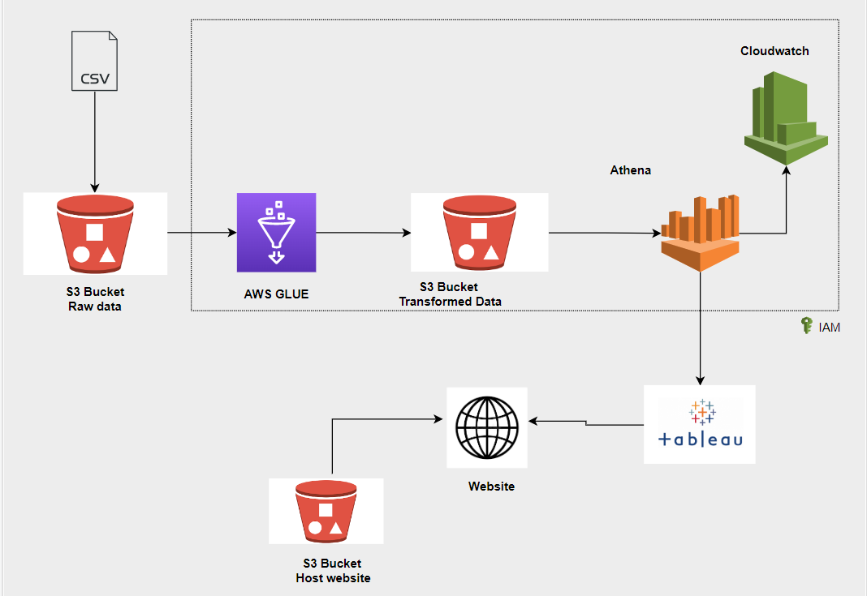
System Design/ ELT Architecture
DATA228 Project Presentation
Consumer Shopping behavior analysis

Slide 7
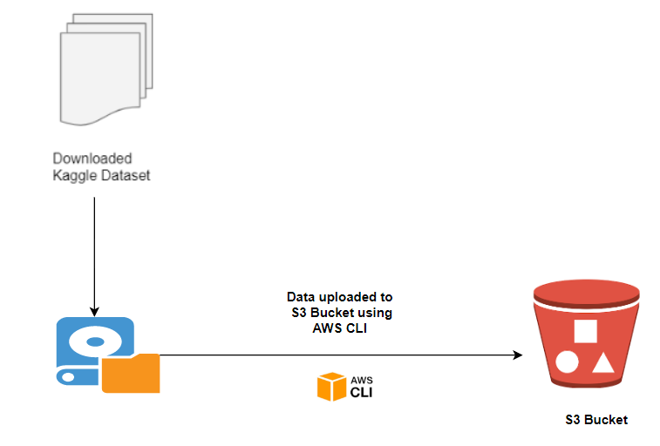
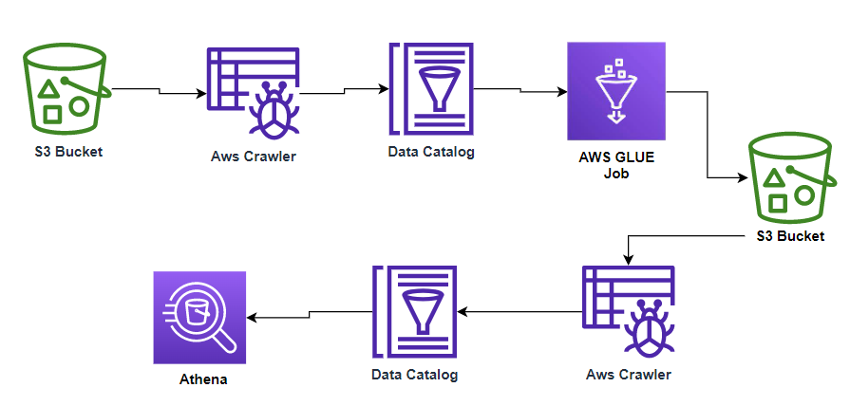
Data Loading And Transformation
Loading Data Into S3
Data Transformation
DATA228 Project Presentation
Consumer Shopping behavior analysis

Slide 8
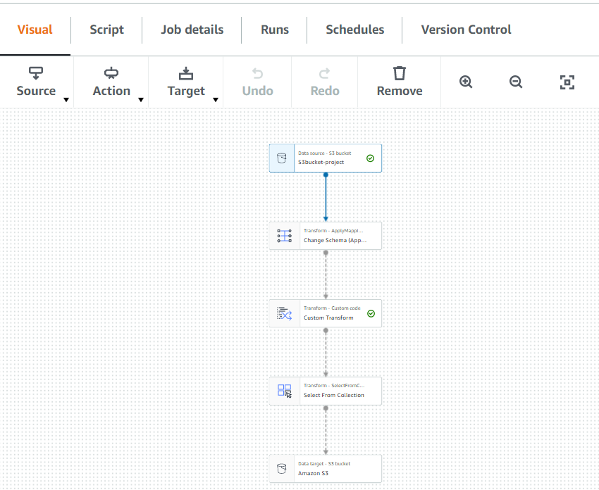
ETL – Glue Job
The columns are modified with relevant datatypes.
The column category_code is split into three columns.
DATA228 Project Presentation
Consumer Shopping behavior analysis

Slide 9
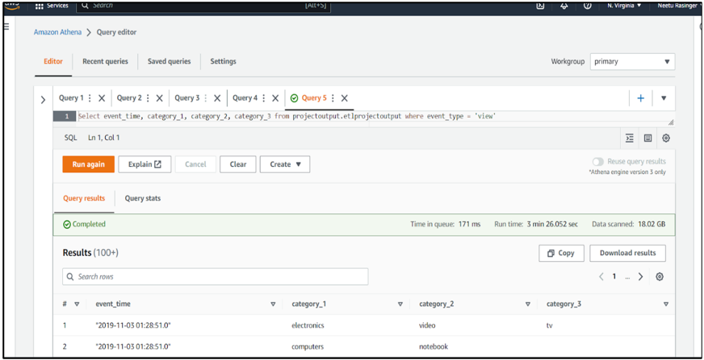
Data Analysis
Athena is serverless.
In Athena the data in S3 bucket is analyzed using SQL.
Querying Data in Athena
DATA228 Project Presentation
Consumer Shopping behavior analysis

Slide 10
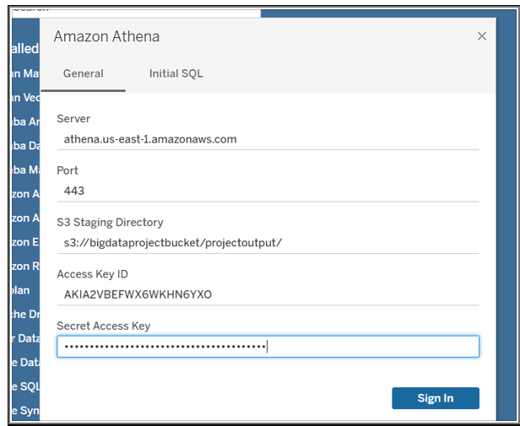
Connection To Tableau
Tableau desktop is used to create connections with Athena for creating dashboards.
Connecting Tableau to Athena
DATA228 Project Presentation
Consumer Shopping behavior analysis

Slide 11
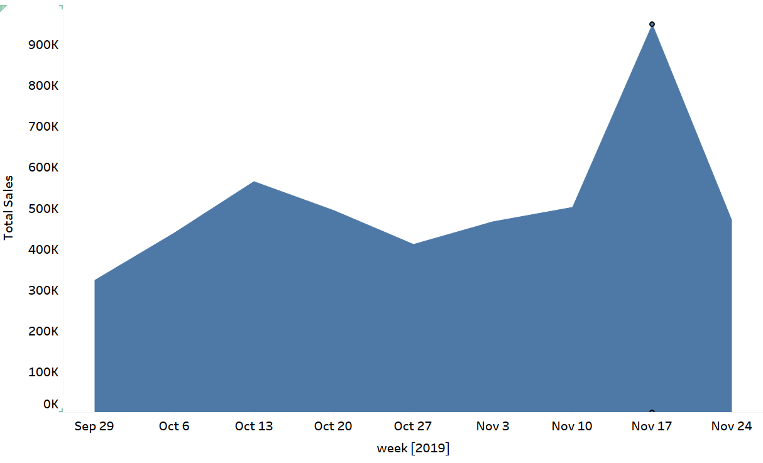
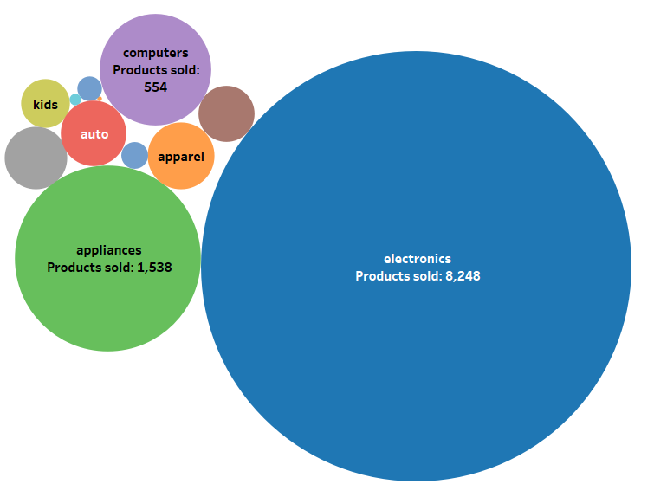
Data Visualizations
Total Sales per week
Top Sold Product Category
DATA228 Project Presentation
Consumer Shopping behavior analysis

Slide 12
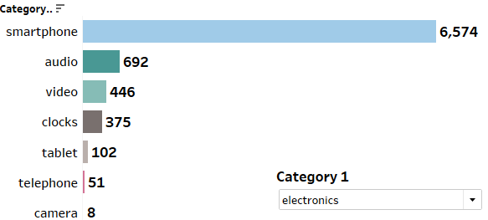
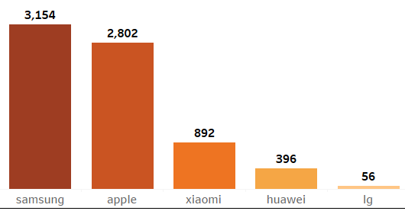
Data Visualizations
Top Sold Product Sub-category for Electronics
Popular Brand
DATA228 Project Presentation
Consumer Shopping behavior analysis

Slide 13
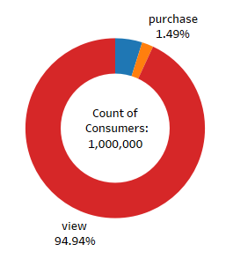
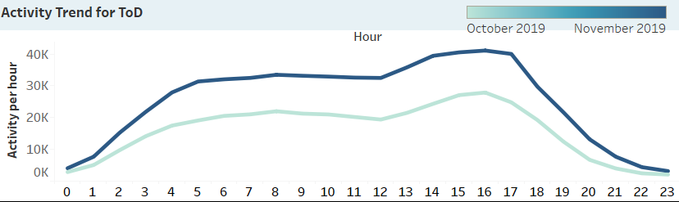
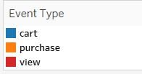
Data Visualizations
Distribution for each event
Activity Trend throughout the day
DATA228 Project Presentation
Consumer Shopping behavior analysis

Slide 14
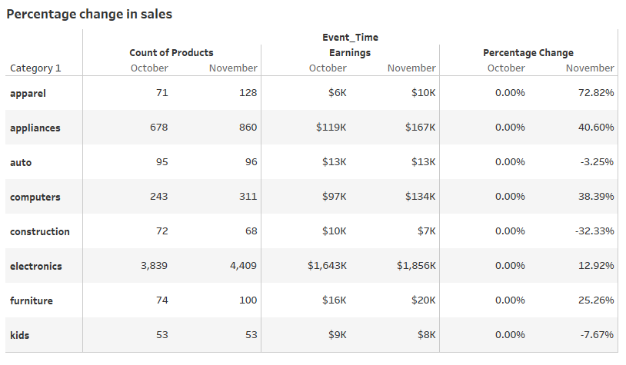
Data Visualizations
Month-Over-Month Growth %
DATA228 Project Presentation
Consumer Shopping behavior analysis

Slide 15
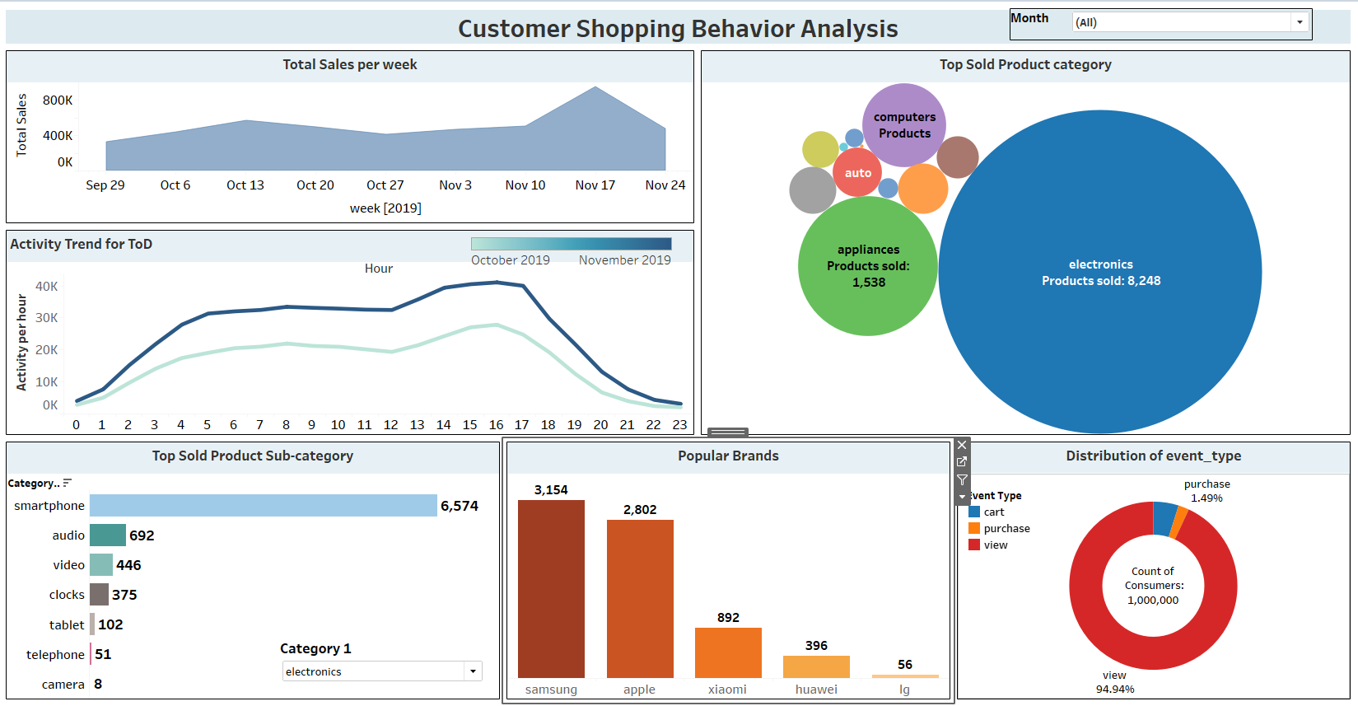
Dashboard
DATA228 Project Presentation
Consumer Shopping behavior analysis

Slide 16
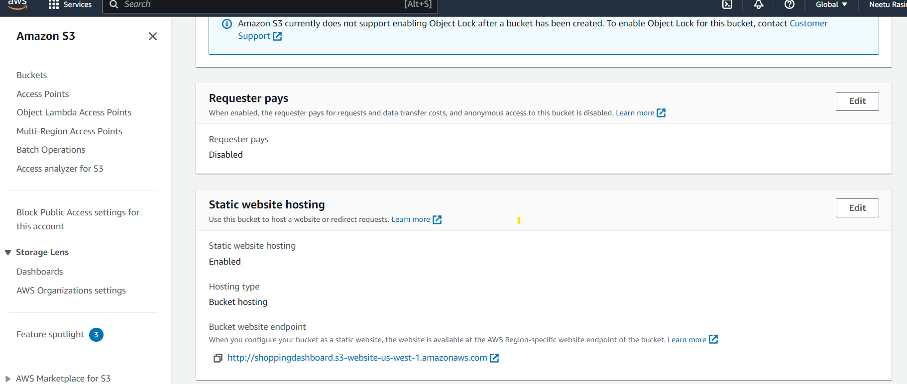
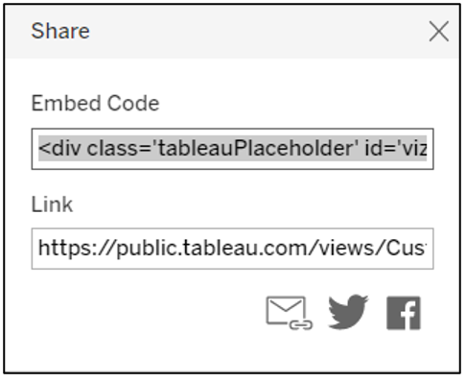
Web Integration
Embedded Code In Tableau
Static website link: https://shoppingdashboard.s3.us-west-1.amazonaws.com/index.html
DATA228 Project Presentation
Consumer Shopping behavior analysis

Slide 17

Conclusion
Analyzed the most active hour and day for online shopping
Observed the most purchased product category and sub-category by most users
Observed the most popular brands for each product category.
Consumer experience can be improved by ensuring that there is no server crash during the most active period.
Offering discounts on products during weekdays can attract more users for shopping through the week further contributing to increase in sales.
DATA228 Project Presentation
Consumer Shopping behavior analysis

Slide 18

Future Work
Analyze Consumer shopping behavior for a couple of years. (High Volume data)
Use machine learning algorithms for predicting the demands for products based on the consumer shopping behavior for inventory planning.
Build recommendation systems to recommend the products to the users based on their past purchases and predicting their future purchases.
DATA228 Project Presentation
Consumer Shopping behavior analysis

Slide 19
Image References
https://www.analyticsvidhya.com/blog/2015/06/start-journey-kaggle/
https://www.softcrylic.com/unleash-the-power-of-data-analytics-in-aws/
https://jgmediallc.com/2018/11/24/e-commerce-is-the-solution-for-rowan-county-nc/
http://revenueconsultant.com/2016/12/12/8-incredible-tips-to-increase-sales-performance/
https://sigma.software/about/media/top-5-major-challenges-big-data-analytics-and-ways-tackle-them
https://www.analyticsvidhya.com/blog/2015/06/start-journey-kaggle/
https://www.google.com/search?q=data+loading+from+aws+cli+unto+S3+bucket&tbm=isch&ved=2ahUKEwiZxee3bj7AhUSgI4IHTR0DiMQ2cCegQIABAA&oq=data+loading+from+aws+cli+unto+S3+bucket&gs_lcp=CgNpbWcQAzoECCMQJzoFCAAQgAQ6BAgAEB46BggAEAgQHjoHCAAQgAQQGFDrFFi6gAFglYcBaABwAHgAgAFSiAGYFJIBAjM3mAEAoAEBqgELZ3dzLXdpei1pbWfAAQE&sclient=img&ei=8h14Y5mEMJKAuvQPtOi5mAI&bih=714&biw=1536&rlz=1C1CHBF_enUS912US912&hl=en#imgrc=J36yJMLwnqnIAM
https://www.google.com/search?q=aws+cli+images&rlz=1C1CHBF_enUS912US912&sxsrf=ALiCzsbMXliCPLTN_ePDeor14XpdR6eidw:1668816454519&source=lnms&tbm=isch&sa=X&ved=2ahUKEwjt493f-bj7AhUeMDQIHYd5DAsQ_AUoAXoECAEQAw&biw=1536&bih=714&dpr=1.25#imgrc=7u79qN_DnoFTBM
https://www.google.com/search?q=aws+glue+etl+job+icon&tbm=isch&ved=2ahUKEwjm9qb_h7n7AhVbiI4IHRPDC0kQ2cCegQIABAA&oq=aws+glue+etl+icon&gs_lcp=CgNpbWcQARgBMgUIABCABDIGCAAQBxAeOgQIABBDOgYIABAIEB5QuApYnBdgrChoAHAAeACAAWCIAcAFkgECMTCYAQCgAQGqAQtnd3Mtd2l6LWltZ8ABAQ&sclient=img&ei=Ni14YaDMtuQuvQPk4avyAQ&bih=714&biw=1519&rlz=1C1CHBF_enUS912US912&hl=en#imgrc=FiZ-Tg2N9vWSEM
draw.io
https://www.shutterstock.com/search/conclusions-icons
https://www.shutterstock.com/search/future-work-icons
DATA228 Project Presentation
Consumer Shopping behavior analysis

Slide 20

Thank you
Comparative Performance Analysis - Cassandra Vs MongoDB

