Slide 1

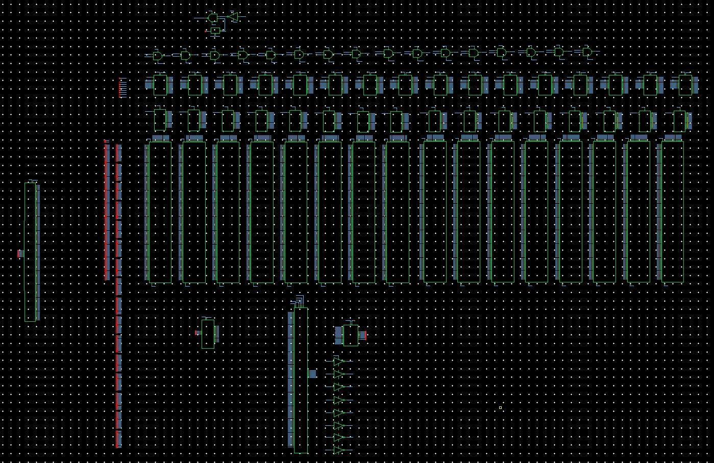
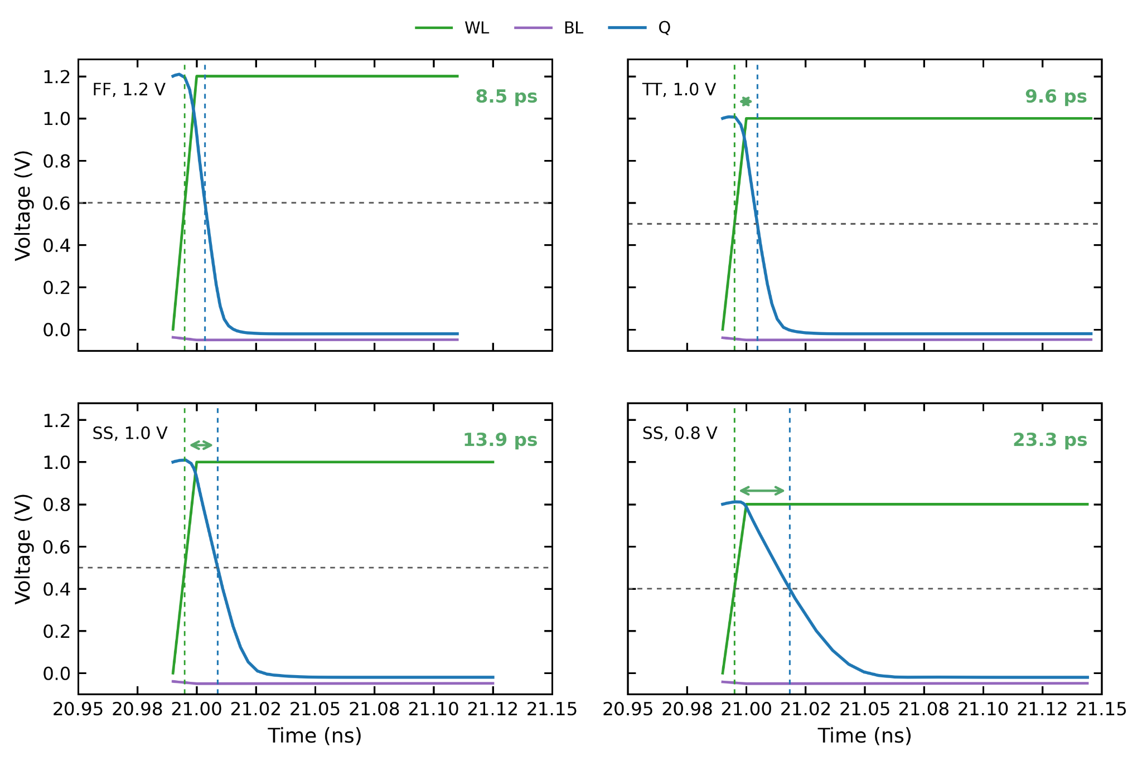
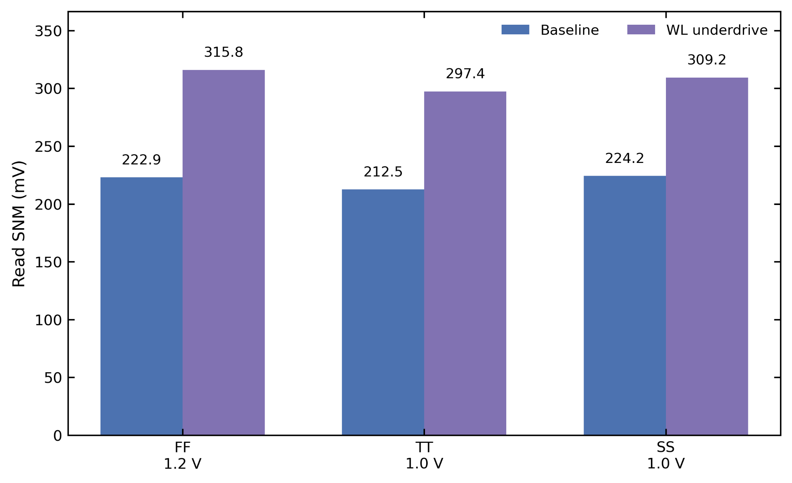
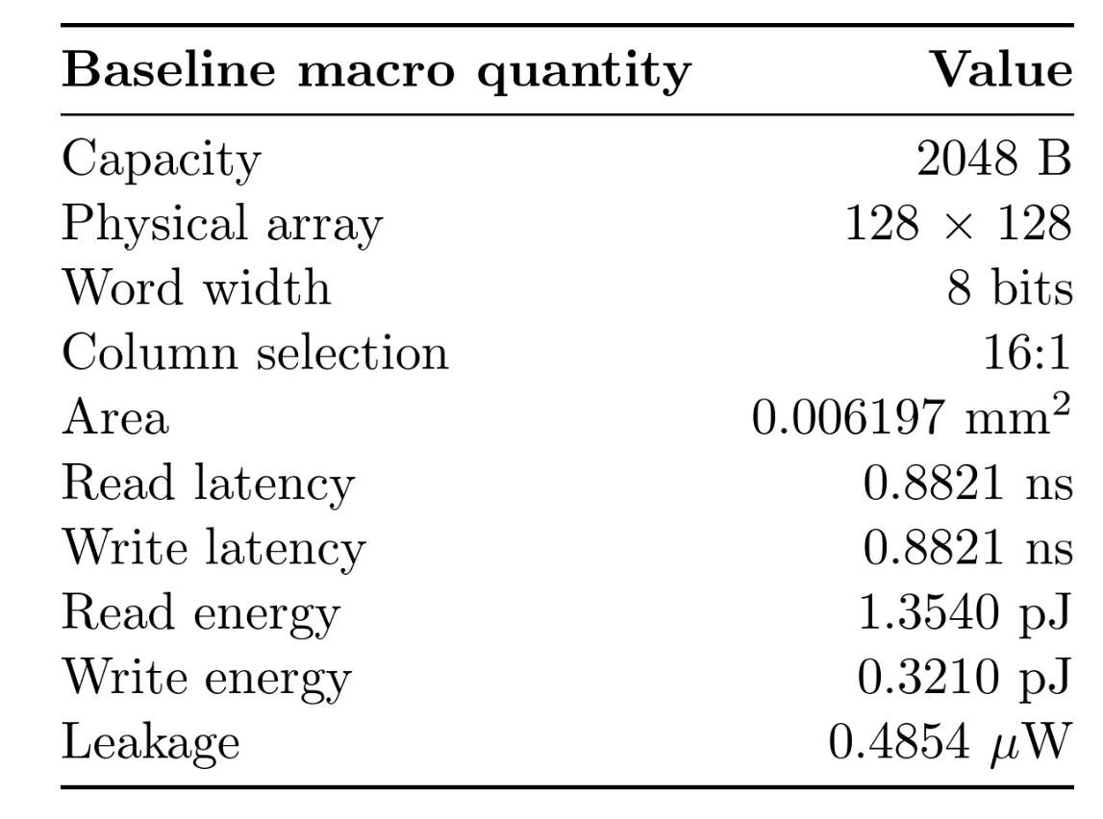
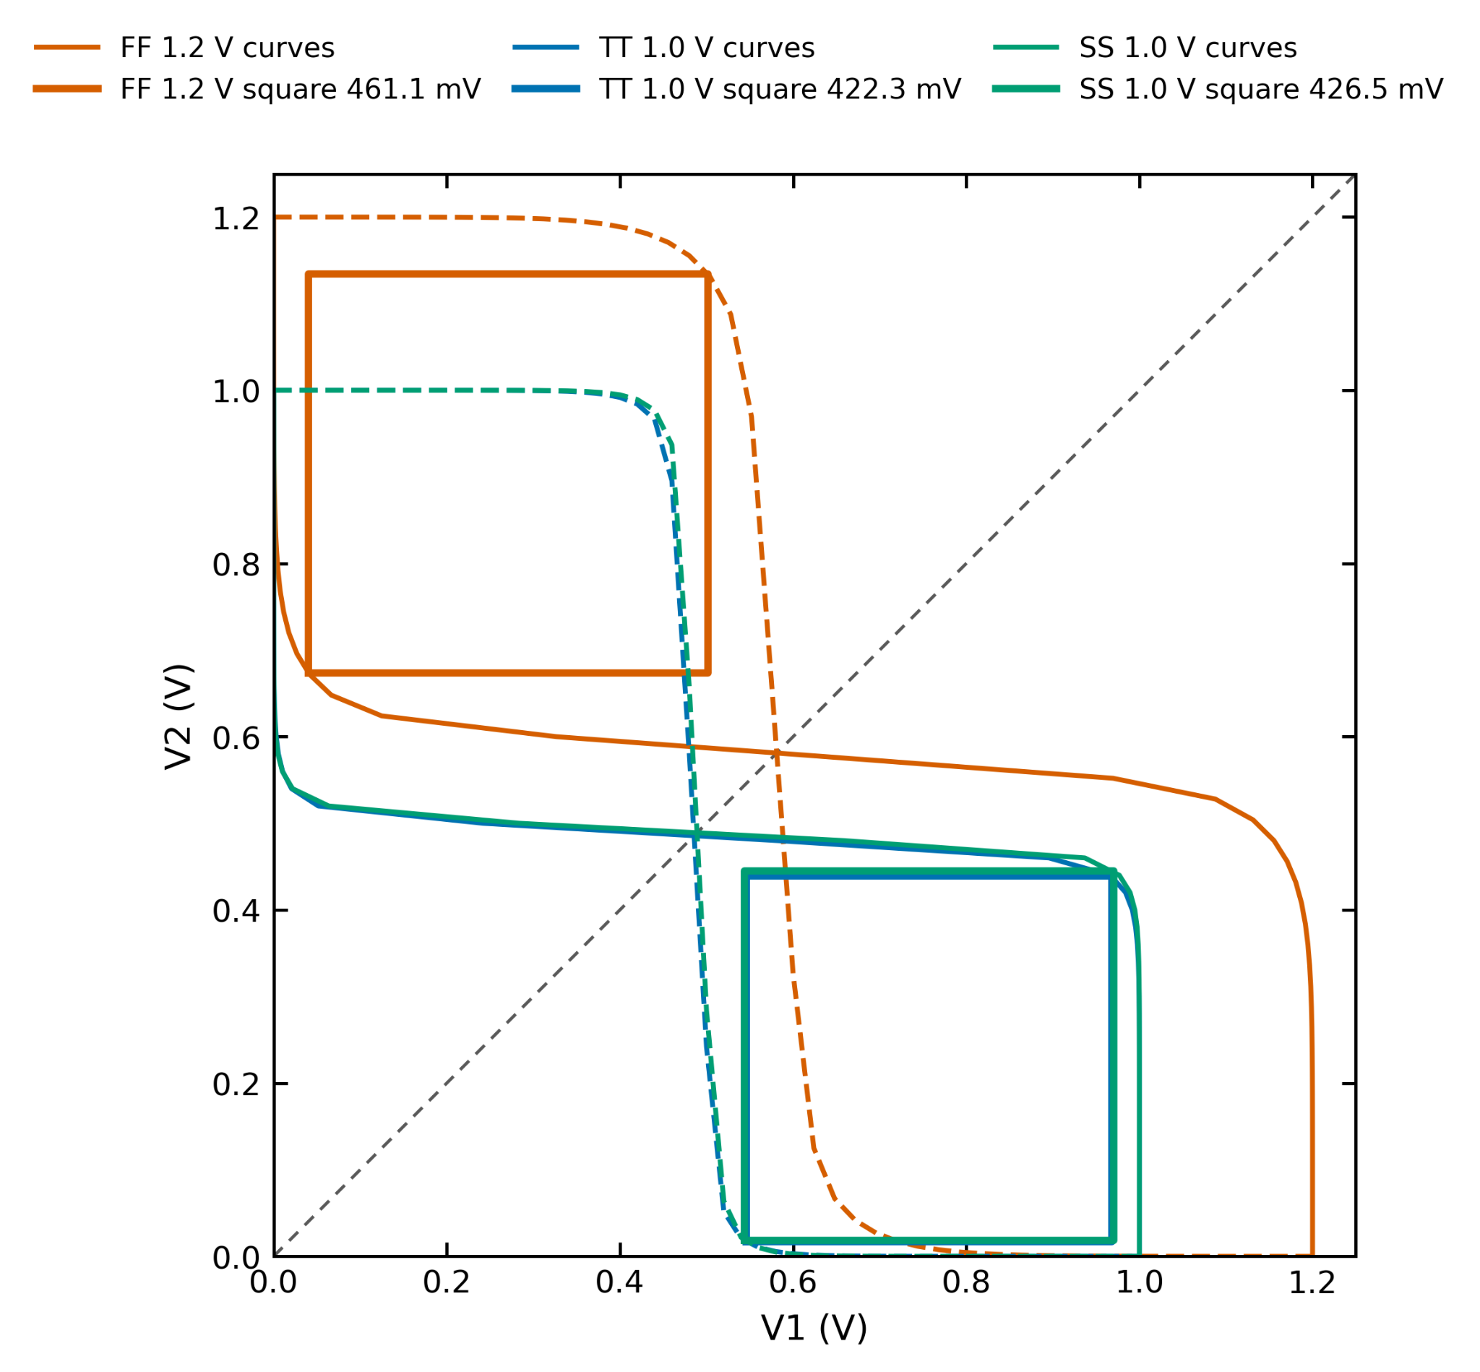
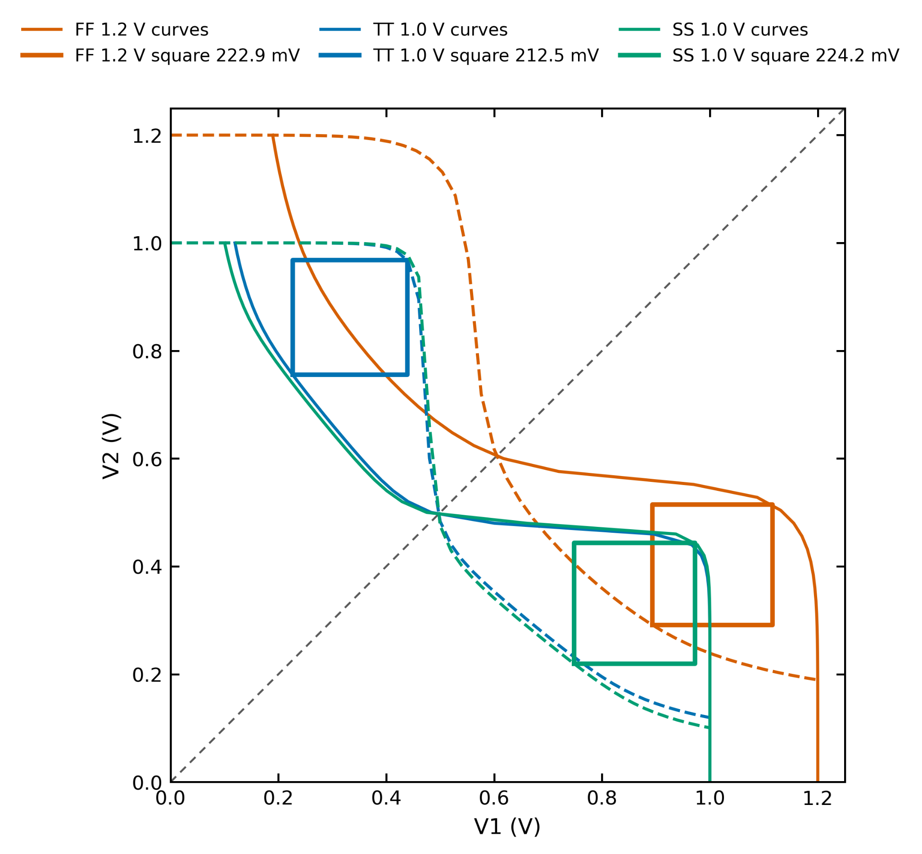
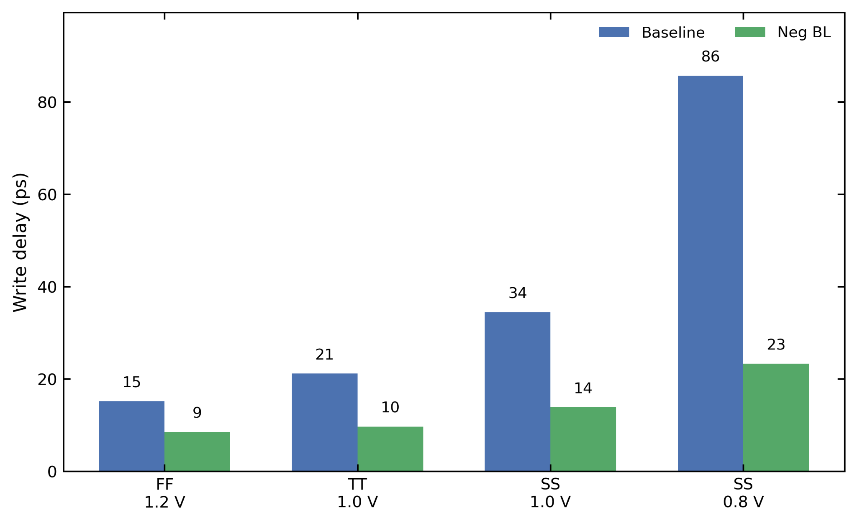
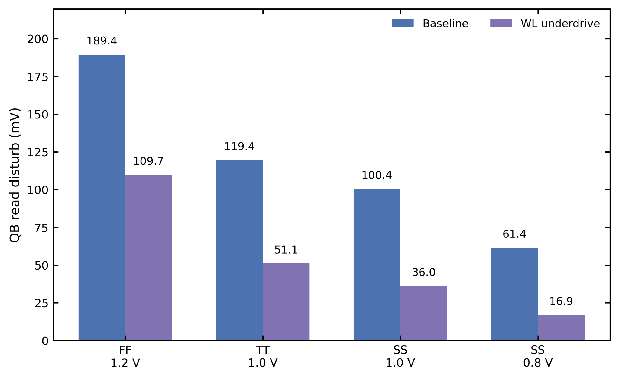
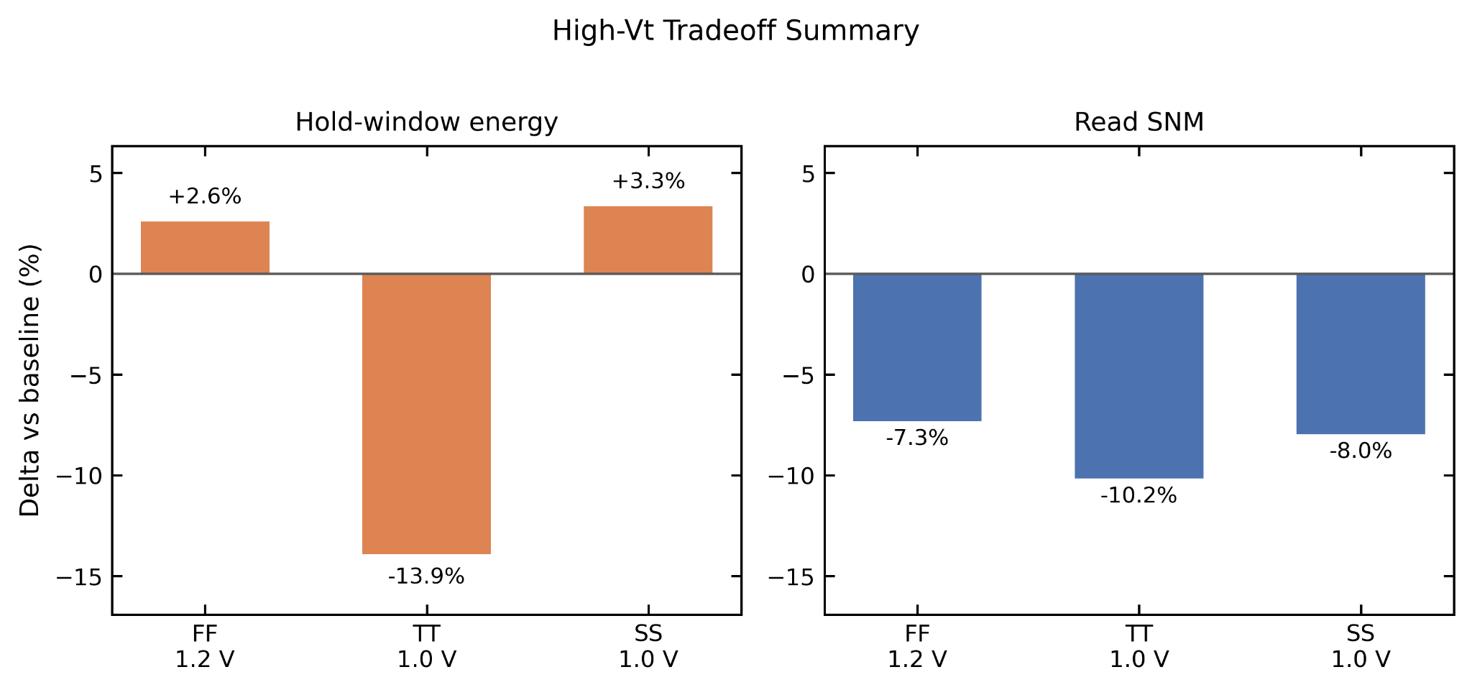
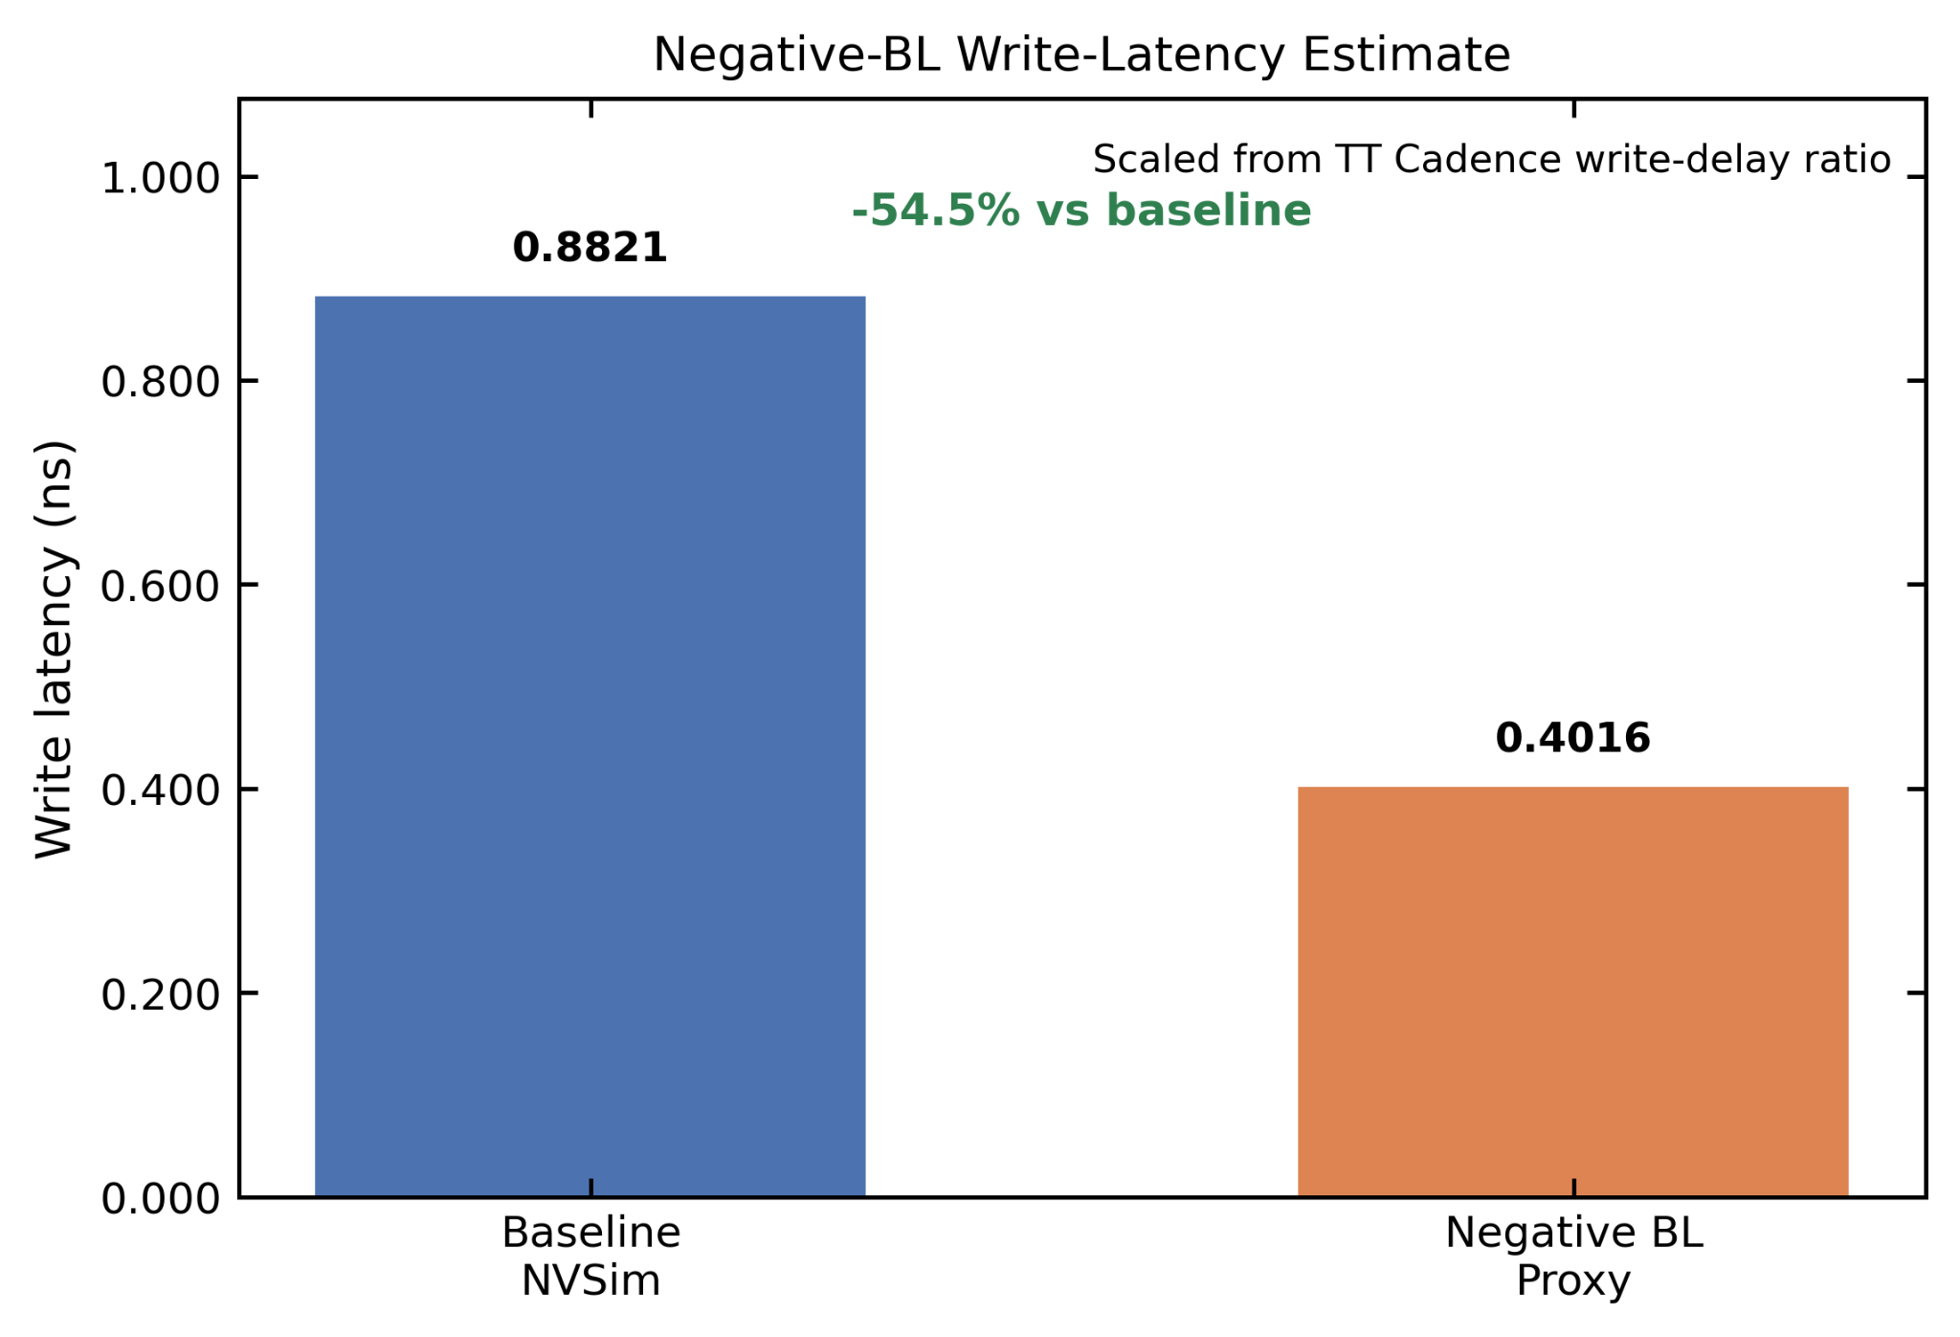
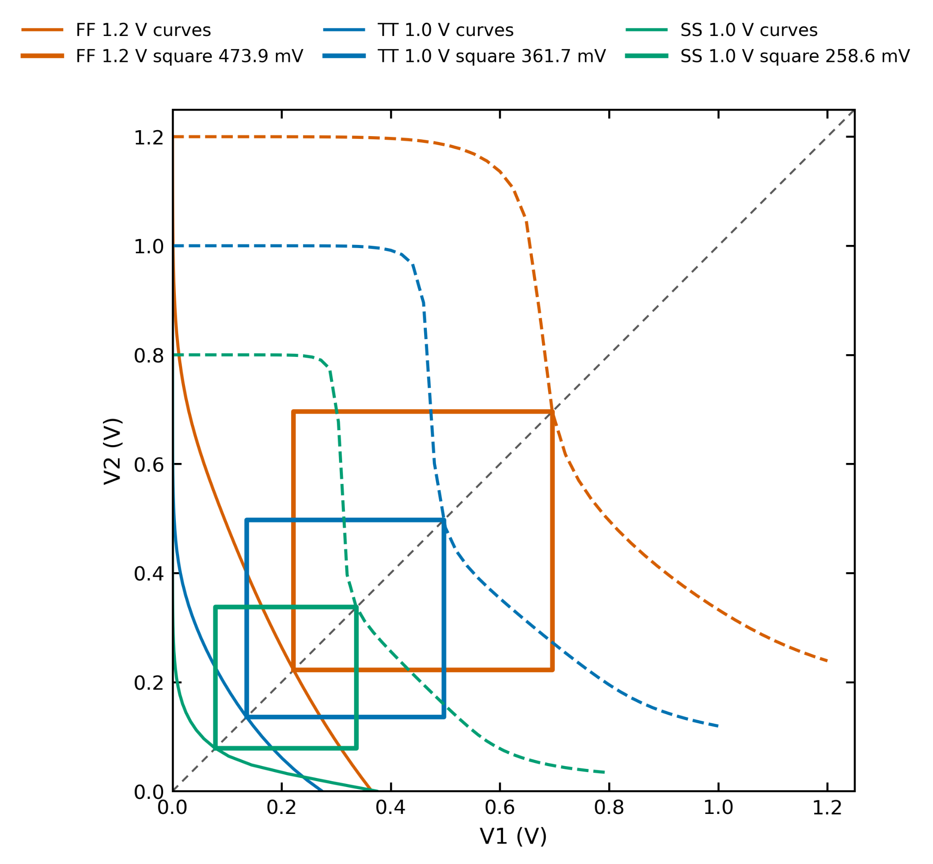
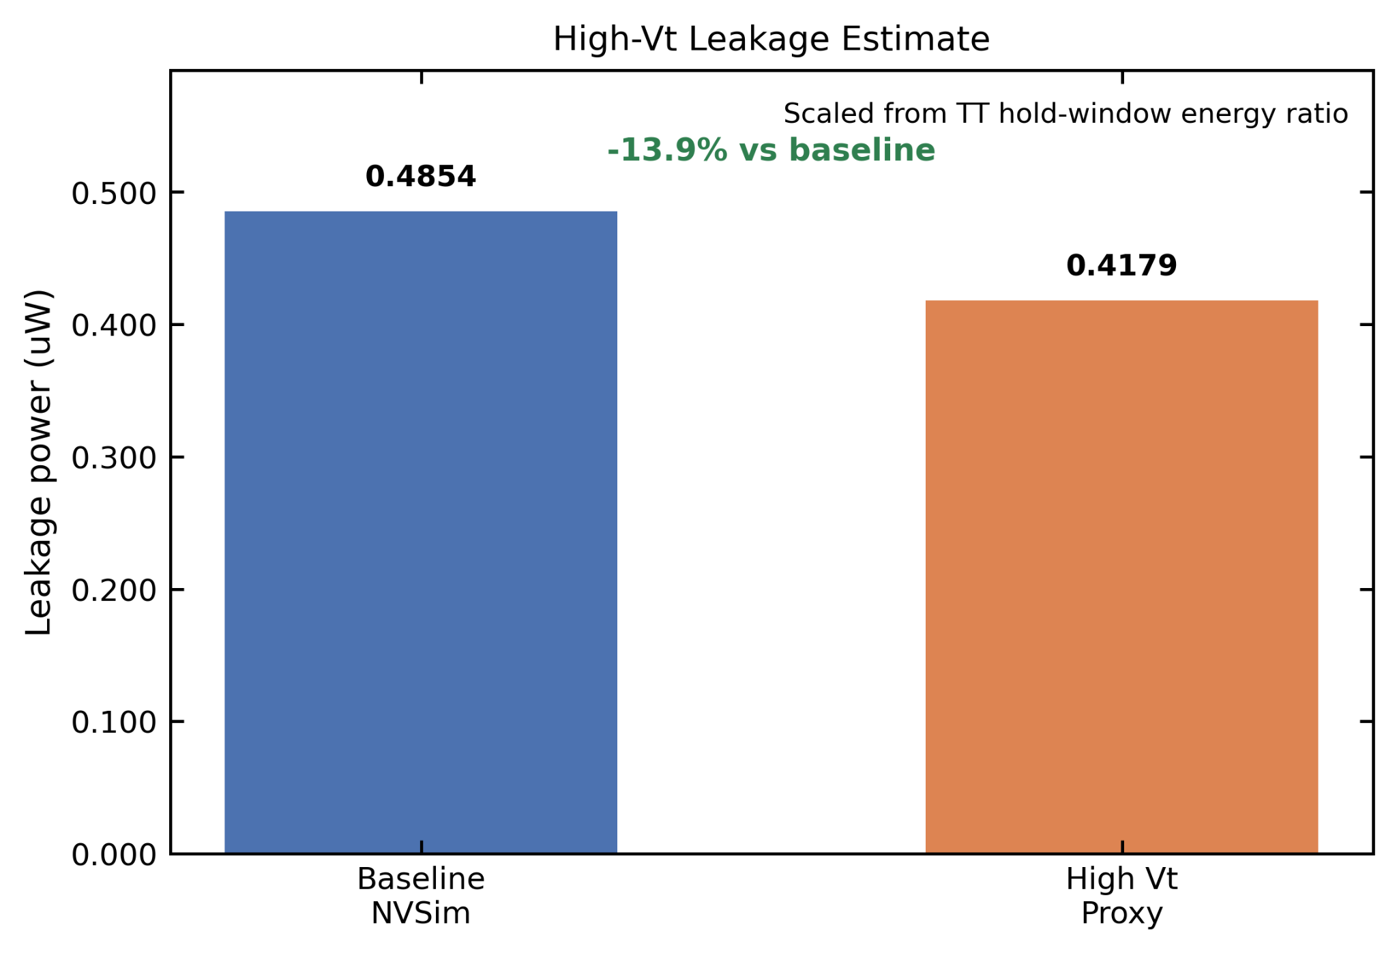
PVT-Aware Evaluation of 6T SRAM Stability, Writability, and Design Tradeoffs
Krishna Karthikeya Chemudupati||✝, Taarana Jammula||, Adithya Selvakumar||✝
Department of Electrical and Systems Engineering||, Department of Physics and Astronomy✝
Abstract
Cell Level Optimizations
Array-Level Macro Results
We evaluate a 6T SRAM bitcell across FF/TT/SS corners (1.2/1.0/1.0 V) and SS 0.8 V, bridging to a 128×128, 8-bit, 16:1 NVSim macro. At TT, high-Vt cuts hold-window energy by 13.9% (-10.2% read SNM), negative bitline reduces write delay by 54.5%, and wordline underdrive improves read SNM by 39.9% with 57.3% lower read disturb. All macro results are labeled by source.
Three optimizations are evaluated against the baseline cell, each targeting a different worst-case metric identified above. High-Vt access transistors target hold-window leakage energy; negative-bitline write assist targets write delay at the slow corner; and wordline-underdrive read assist targets the binding read SNM and transient read disturb. Each optimization improves its target metric at the cost of another, and the tradeoffs are characterized across the PVT corners.
Bitcell results bridge to a 128×128, 8-bit, 16:1
NVSim macro. High-Vt leakage and negative-BL write latency are adjusted as derived proxies from TT Cadence results; all other values remain at NVSim baseline. WL underdrive is treated as a cell-level improvement only. Each value is labeled as NVSim estimate or Cadence simulation.
Negative Bitline Write-Assist
Driving the bitline below ground during the write strengthens the access transistor's pull-down ability and accelerates the storage-node flip. The benefit grows monotonically as the corner slows.
Wordline Underdrive Read-Assist
Underdriving the wordline during a read keeps the access transistors weaker than the cross-coupled pull-down devices, which raises read SNM and suppresses dynamic disturbance of the storage node.
Baseline Bitcell Stability
2 KB (128x128) SRAM array with periphery successfully verified in Cadence Virtuoso (45nm) with baseline and optimized bit cells
The 6T bitcell is sized at TT (1.0 V, 27°C) and characterized across FF/TT/SS corners. SNM is extracted as the largest inscribed square in the butterfly curve; WNM uses the diagonal-corner convention. Hold SNM (422-461 mV) is comfortable across all corners. Read SNM (212-224 mV) sets the reliability floor. WNM degrades from 474 mV (FF) to 259 mV (SS), making the slow corner the binding writability constraint.
Per-corner negative- bitline write-delay waveforms zoomed around the assisted write transition.
Per-corner read SNM for the baseline cell versus the wordline underdrive assist.
Per-corner negative-bitline write-delay waveforms zoomed around the assisted write transition.
Per-corner pulse-window transient read-disturb metric for the baseline cell versus the wordline und- erdrive assist.
(Left) Hold-SNM butterfly overlays across corners. The cell holds robustly at all three corners (422–461 mV), confirming stable data retention without assist. The larger FF envelope partly reflects its higher 1.2 V supply.
(Right) Read-SNM butterfly overlays across corners. Read SNM is the smallest of the three margins (212–224 mV) and sets the read-side reliability floor. The compressed eyes relative to hold reflect the access transistor pulling on the storage node during a read.
Baseline NVSim macro summary at the locked 128×128, 8-bit, 16:1 organization. All rows are direct NVSim estimates. Row decode dominates both read and write latency at 61% of the total 0.8821 ns access time.
High-Vt Pull-Up Transistors
Raising the pull-up transistor threshold voltage is expected to cut subthreshold leakage through the PMOS load during the hold window, but weakens the pull-up path and reduces read SNM because the inverter trip point shifts and the storage node is held less stiffly against the access transistor during read.
High-Vt reduces TT hold-window energy by 13.9% but degrades read SNM by 10.2%. FF/SS show slight energy regressions, likely because gate leakage dominates over subthreshold leakage at those corners.
Negative-BL macro write latency as a derived proxy: baseline NVSim write latency (0.8821 ns) scaled by the TT Cadence write-delay ratio gives 0.4016 ns (-54.5%).
Write-noise-margin butterfly overlays across corners. WNM degrades monotonically from FF (474 mV) to TT (362 mV) to SS (259 mV), identifying the slow corner as the binding writability constraint and motivating the negative-bitline write assist.
High-Vt macro leakage as a derived proxy: baseline NVSim leakage (0.4854 µW) scaled by the TT hold-window energy ratio gives 0.4179 µW (-13.9%).
We would like to acknowledge the following individuals and organizations:
Professor Robert M. Radway and TA Kefei Bao for their guidance

