Slide 1
T-Level OSP Introduction
Occupational Specialism

Slide 2
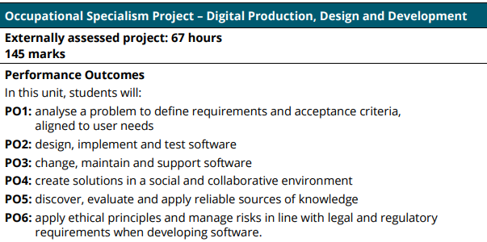

Slide 3
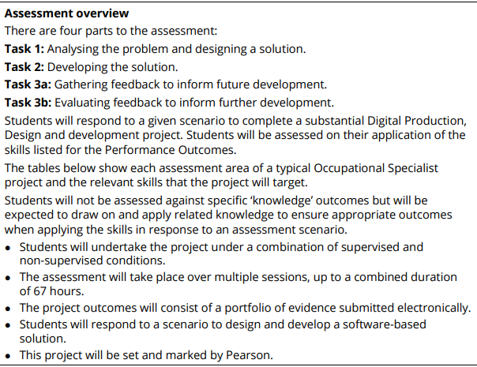

Slide 4
