Slide 1
SideMenu
第11组

Slide 2
CONTENTS
01
Logic View
02
Development View
03
Evolution Perspective
04
Technical Debt

Slide 3
PART ONE
Logic View

Slide 4
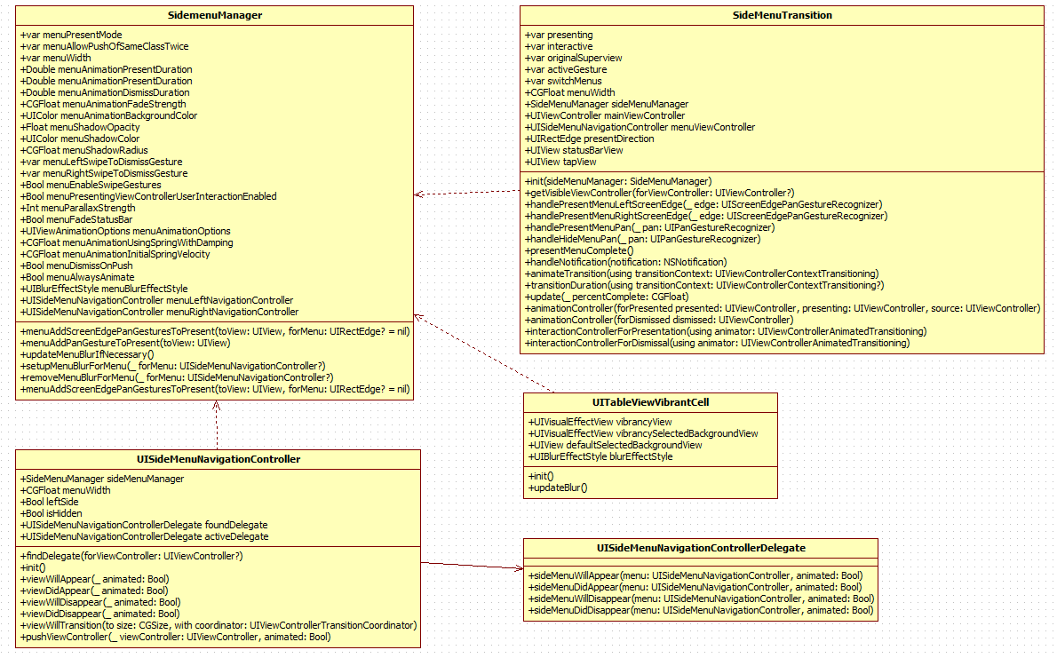
01 Logic View

Slide 5
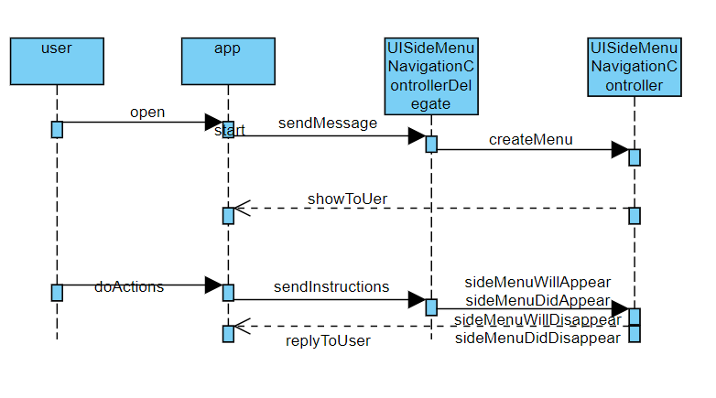


01 Logic View

Slide 6
01 TITLE
the sequence diagram shows how this sidemenu works with the app. The user open the app while UISideMenuNavigationController create the menu, and there are several kinds of action, for example, slide in, slide out, dissolve, slide in+out which will be caught by UISideMenuNavigationControllerDelegate and finish the move. When the user press a button, the ControllerDelegate would receive the notification and make the corresponding response. For example, if the user slide in a menu then the function sideMenuWillAppear which will be followed by a appearance of a new menu and before that a hint: "SideMenu Appearing! (animated: (animated))" will be showed somewhere. It works like that. And if setting the sideMenuDelegate property on UISideMenuNavigationController is optional. If your view controller adheres to the protocol then the methods will be called automatically.

Slide 7
PART TWO
Development View

Slide 8
02 Development View
Design Discipline
Sidemenu is an open-source Swift library. It is so small but useful when you need a sidemenu in your IOS project. It can be use without complex codes, which makes it easier to use, and you don’t need to study it for a long time. In addition, as it is an open-source library, we can change the effects easily.

Slide 9
02 Development View
Design Discipline
Composition
Sidemenu is a small library that the key codes is the swift files in Pld/Classes. That makes it easy to read, and you can even change it by yourself just by reading a few codes, and it is important that it will not cause the errors in your project.

Slide 10
02 Development View
Design Discipline
Stability
You can follow the README.md to install and use by code-less storyboard or customize in SideMenuManager, UISideMenuNavigationController and UISideMenuNavigationControllerDelegate. If you follow the guide, it will not cause any instability.

Slide 11
02 Development View
Design Discipline
Interoperability
Anyone can install easily just to use cocoapods and carthage, and any IOS projects can use them by following the README.md, because of that it is just a small tool and it is flexible, so the interoperability is obvious.

Slide 12
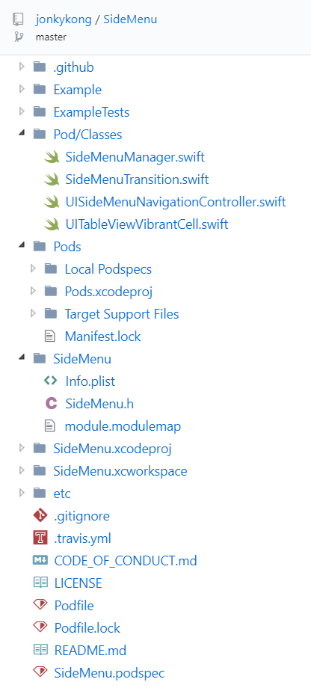
02 Development View
Source Code Structure
Functionality
Main functions are designed in the Pod/classes and where you can change the effects is in the folder.
In SideMenuManager, you can customize the effects. Just type SideMenuManager.default.menu... and code completion will show you everything you can customize (for Objective-C, use SideMenuManager.defaultManager.menu...). Defaults values are shown below for reference.
In UISideMenuNavigationController, it supports the following customizations and properties: SideMenuManager instance associated with this menu. Width of the menu when presented on screen, showing the existing view controller in the remaining space. Whether the menu appears on the right or left side of the screen. Right is the default. Indicates if the menu is anywhere in the view hierarchy.
In UISideMenuNavigationControllerDelegate, To receive notifications when a menu is displayed from a view controller, have it adhere to the UISideMenuNavigationControllerDelegate protocol.
Example and ExampleTest folders are designed to show the sample effects.
Pods are something get from CocoaPods.
ect are the pictures to show the library.

Slide 13
02 Development View
Design Patterns
This section discusses some of the design patterns used in SideMenu.
·Singleton Pattern
The singleton pattern that you can use the SideMenu, and only one object. So that makes it easier to use the SideMenu.
·Least Knowledge Principle(Law Of Demeter)
That means the SideMenu object just affect itself, like the activity to show, the effects, ect. And you can change it needless to consider about others.
·Extensibility
The SideMenu is easily to change, you can customize it by modifying the classes like UISideMenuNavigationController, SideMenuManager, UISideMenuNavigation-ControllerDelegate, etc.

Slide 14
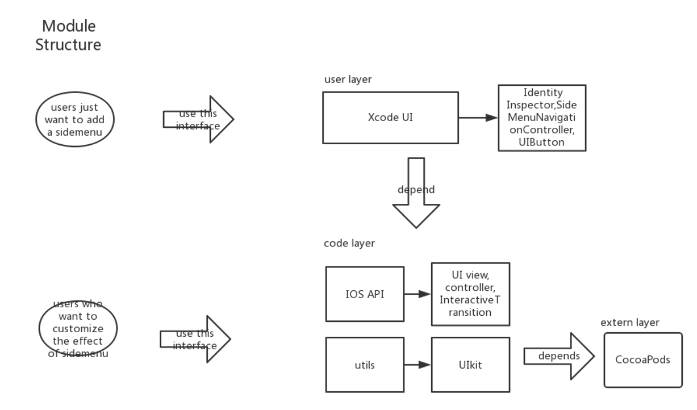
02 Development View
Module Structure

Slide 15
PART THREE
Evolution Perspective

Slide 16
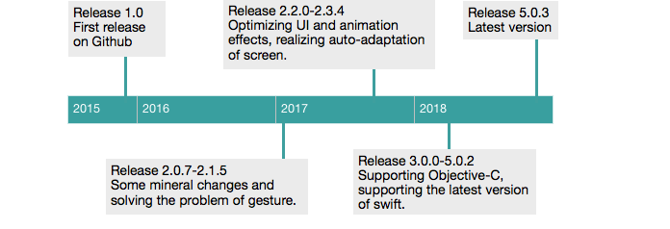
03 Evolution Perspective
Thought out the years, SlideMenu has evolved a lot. At this moment SlideMenu has 28 releases, which started with release 2.0.7 in December 2015 and the latest release 5.0.3 in November 2018. However the real first a few release can't be found on the Github repository anymore. This is probably because it was an alpha version and can not be put into use well. In order to understand the changes in the various releases, the release notes have been analyzed. These were found on the SlideMenu release page on Github.

Slide 17
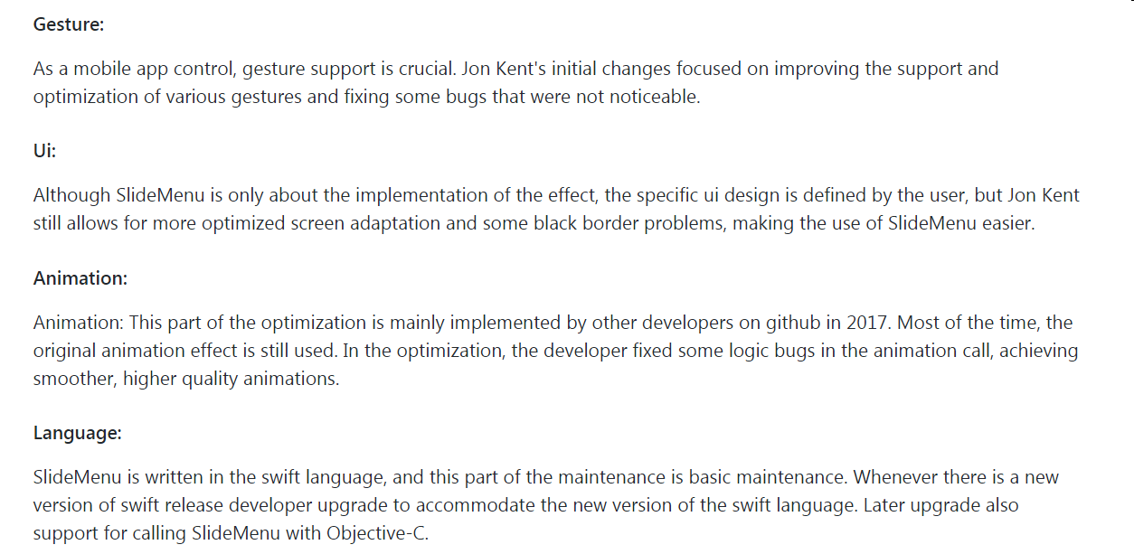
03 Evolution Perspective

Slide 18
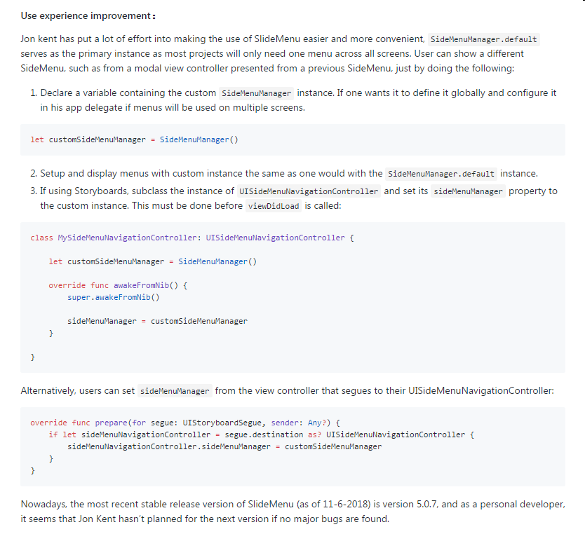
03 Evolution Perspective
User
Experience
Improvement

Slide 19
PART FOUR
Technical Debt

Slide 20

04 Technical Debt
To analyse the code quality，we choose Codacy to be tools.
Codacy contains almost all the features you need. Such as free installation, support for multiple languages, only focus on new issues in the submitted version, enterprise-level security, notifications when new issues are discovered, security and performance checks, configuration files for all projects, cloud or presets Version, code coverage,

Slide 21
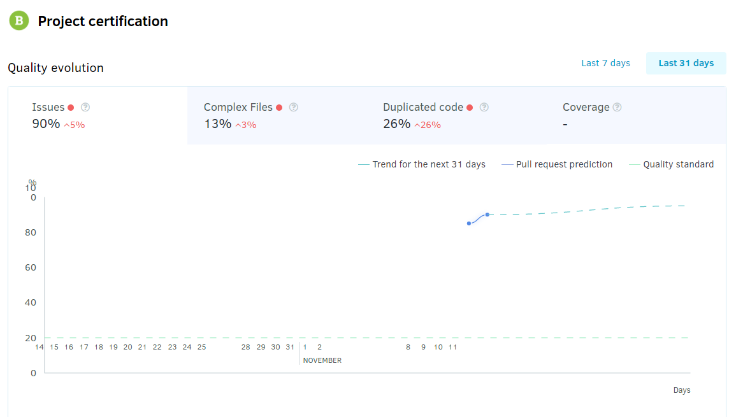
04 Technical Debt

Slide 22
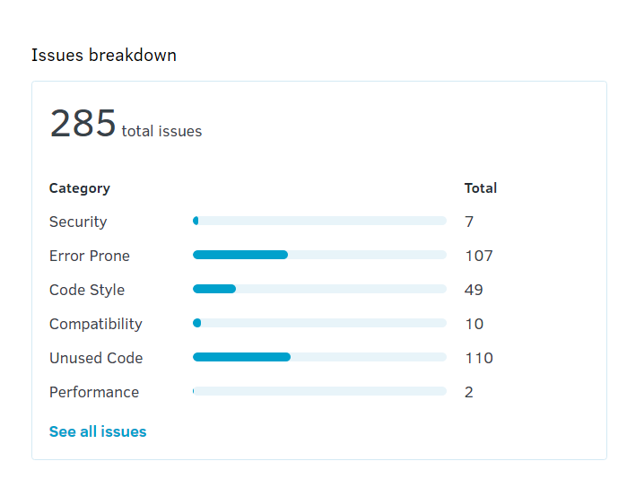
04 Technical Debt

Slide 23
04 Technical Debt
Security
As the Internet penetrates into all walks of life, more and more application systems, websites, etc. are connected and accessed by humans through the Internet. How to ensure that the system and website will not cause security problems such as system crash and data leakage due to malicious attacks by hackers. The most fundamental means to solve this problem is to return to the code. Only the code written is safe and impeccable. Without any logic loopholes, all security issues can be eliminated. SideMenu's security catagory only gets 7. After all, SideMenu is only a framework. It does nothing with users's data or privacy. SideMenu also needs not to connect database. So in some way, security is not significant for SideMenu.

Slide 24
04 Technical Debt
Error Prone
Using Error Prone to augment the compiler’s type analysis, you can catch more mistakes before they cost you time, or end up as bugs in production. Most of the issues have use error prone to avoid later error in usage. This guarantee less error to take place when user import SideMenu in their own project. This helps the project be stable.
Notes:
24

Slide 25
04 Technical Debt
Code Style
Although the code style is not as easy to fry as a technical circle, it is not as easy to stand as a programming language or editor, but there are always people who have a unified style to improve work efficiency. If code styles are different, it is not conducive to collaborative programming, the code is also chaotic. As for similar code style, this produce a certain constraint. Functional importance, code style and post-maintenance are also important. As we know, SideMenu can be seen as a private project, It is nearly implemented by one person. SideMenu's code style is not diverse.
Notes:
25

Slide 26
04 Technical Debt
Compatibility
Compatibility refers to the degree of coordination between hardware, software, or a combination of hardware and software. Since SideMenu is implemented in Swift. So unluckily, SideMenu is not for Antroid users. As for IOS user, this is a good choice. But at first, the iOS need to be X or above. You use Xcode to be the compiler and the version should be above 9. When all the requirements are satisfied, you can easily import SideMenu in your project. Obviously, SideMenu just as the figure shown, has good compatibility for IOS user who needs SideMenu.
Notes:
26

Slide 27
04 Technical Debt
Unused Code
Unused Code, we can regard as dead code. At first, when the result gives out, it shows like the SideMenu has lots of unused code. But when I click "show details", I found that Codacy think 'import' and dependency as unused code. Maybe that is the shortcome of the tools I use. Review the details except code mentioned above , unused code reduced 70%. In code quality, SideMeNu doen't have many unused code. In this aspect, its code quality is good.
Performance
There are only 2 issues about performance. In my opinion, SideMenu is a private project, so it There will be no special personnel to maintain and update it, and as a sidebar menu, there will be no relevant security detection or protection. Compared to other industrial projects, the sidebar menu is very simple, its role is only limited to the sliding in and out of the scene, so it is not significant in terms of performance. But through the examples provided by the author, I have to admit that SideMenu is very convenient
Notes:
27

Slide 28
THANK YOU

