Slide 1
EXCEL
Barukam Vamshi Krishna Yadav

Slide 2
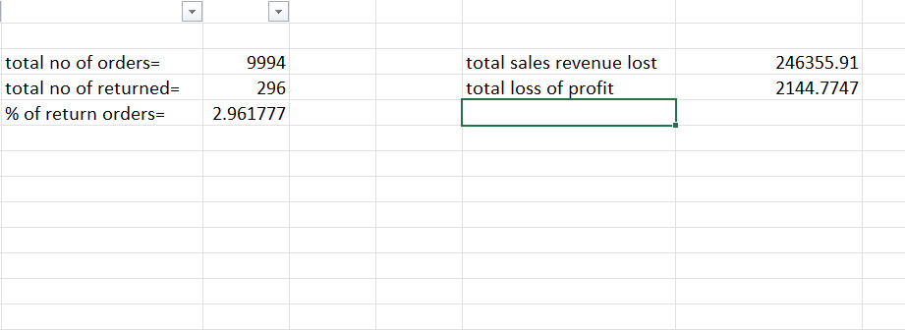
Question 1
Insight:bcoz of returning the superstore lost less revenue only
Inference:the returning of products makes us know customer review and its not so big issue for profits
Formula:=sumif(range,cretiera,sum range)

Slide 3
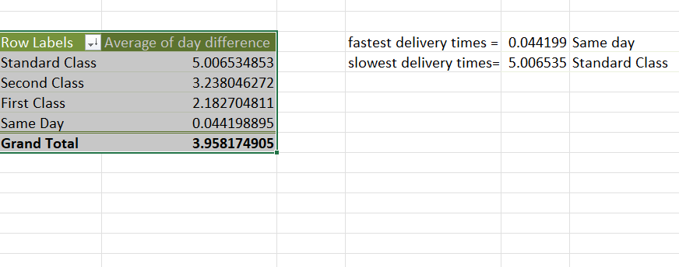
Question 2
Insight:the same day delivery is happening on same day and it’s the fastest delivery and standard class takes longer time than any delivery mode.
Inference:same day delivery is helping customers get products within a day
Formula:

Slide 4
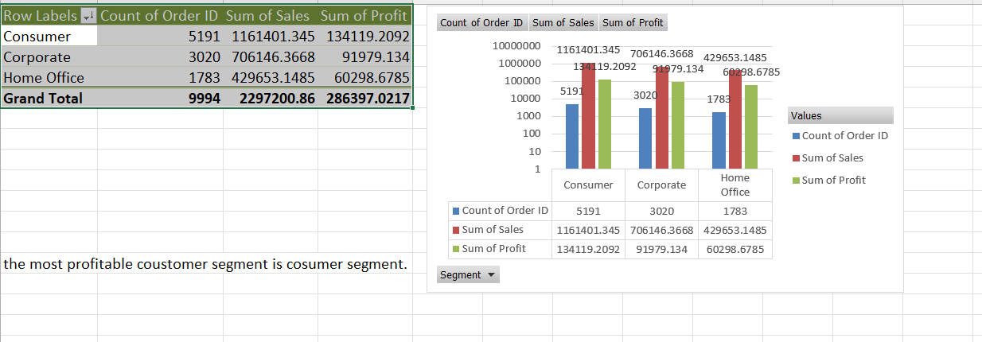
Question 3
Insight:the sum of sales and count of order r more for consumer segment
Inference:the most profitable coustomer segment is cosumer segment.
Formula:

Slide 5
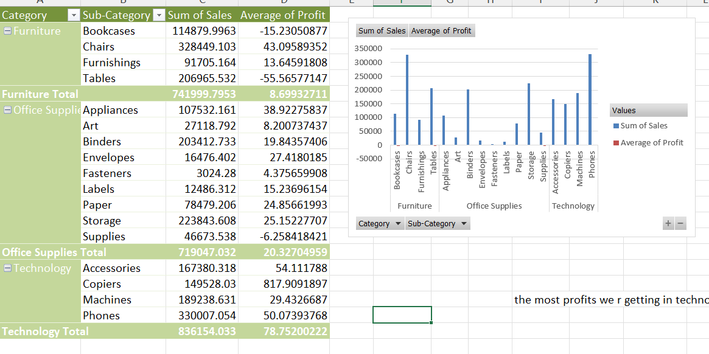
Question 4
Insight:the most profits we r getting in technology category in that Copiers sub category is performing best.
Inference:the technology category is most prfitable
Formula:

Slide 6
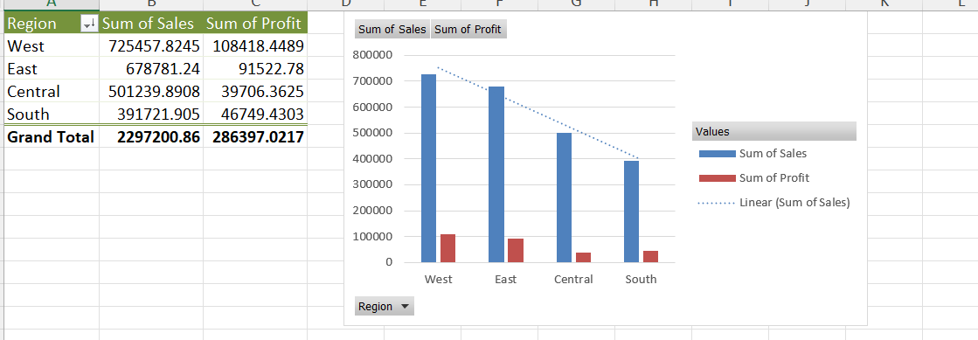
Question 5
Insight:
The South region, despite having the lowest sales among the regions, shows a relatively higher profitability compared to the Central region
The West region has the highest sales and profitability, indicating a strong market presence and effective profit management strategies in that region.
Formula:

Slide 7
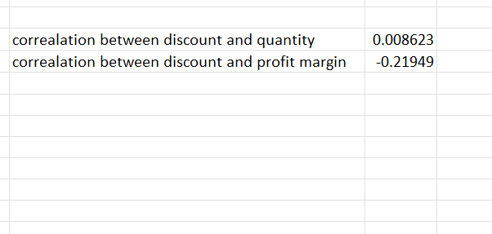
Question 6
Insight:correlation coefficient of 0.00862297 suggests a very weak positive linear relationship between discount and quantity so discount is not affecting the sales of products
A correlation coefficient of -0.219487456 suggests a weak negative linear relationship between discount and profit margin but Since the coefficient is negative, it indicates that as one discount increases, the profit margin tends to decrease
Formula:
Inference:

Slide 8
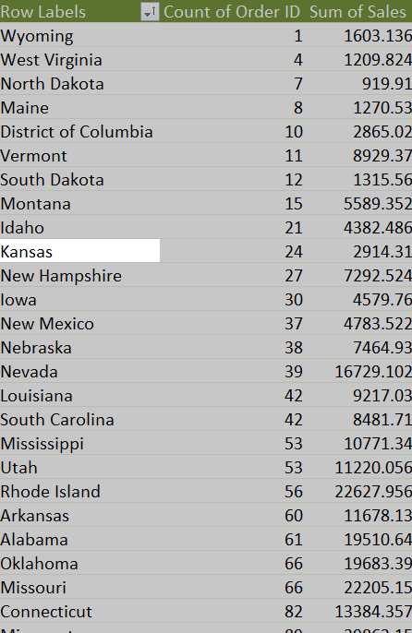
Question 7
Insight: where there is less sales there will be bigger market to discover and understand so we can start better plans to sell the products in those area
Inference:
Formula:

Slide 9
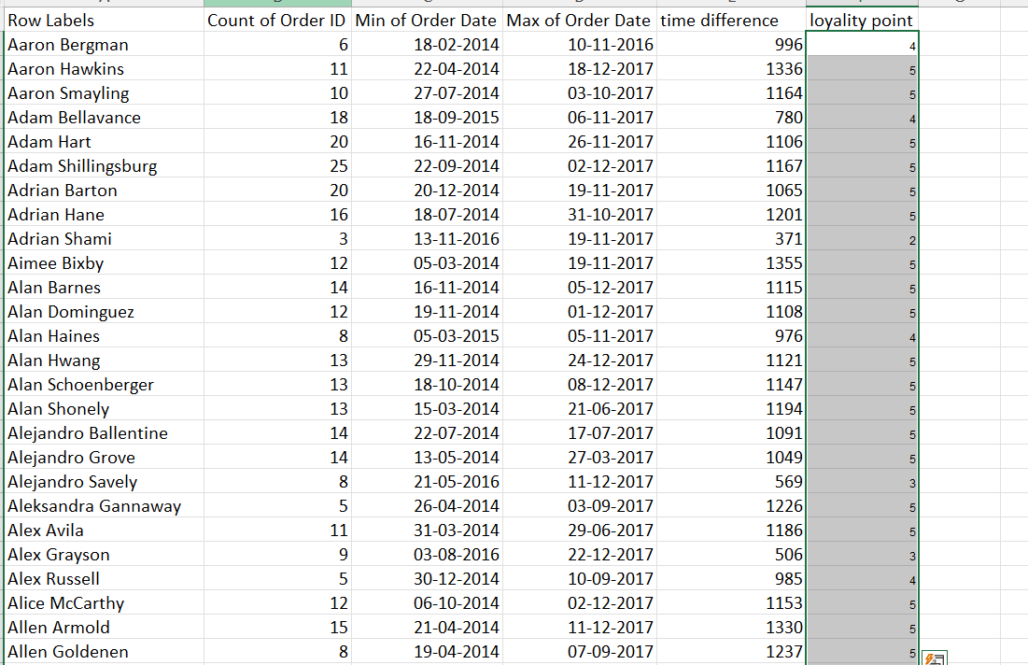
Question 8
Insight:by this we r knowing customer loyalty and we can know customer problems and understand and solve there issues and give more better deals
Inference:
Formula:

Slide 10
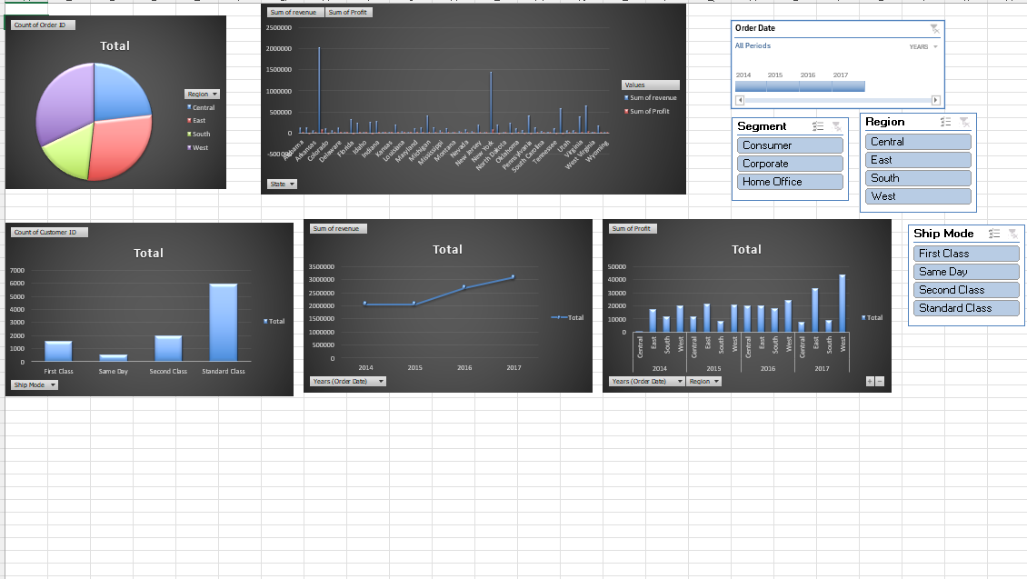
Question 9

Slide 11
Question 10
Insight:
Here we can see year region wise no of orders
And we can understand by customers r preferring which kind of delivery by this we can help them in increasing the help in deliveries
As for state we can we sales and profits by this data we can know where we need to deleop campaign programs to incresee sales
Year wise revenue generation we can see and understand our store revenue development
And at last we can see the region wise profits in each year.
And added some sliciers for as segment and year to understand stastics.
Formula:

