Slide 1
Online voting System
Developed using Java Swing and OOP Concepts
Presented by: Group 18

Slide 2
Introduction
Objective: To design an online voting system.
Technologies Used: Java, Swing, OOP`s

Slide 3
OOP Concepts Applied
Encapsulation: Grouping related data and functions in classes (e.g., VotingFrame, AdminDashboard).
Abstraction: Hiding internal details and exposing only necessary functionalities (e.g., VotingFrame handles voting logic).
Classes and Objects: Defining classes (e.g., VotingFrame, LoginFrame) and creating objects to interact with them.
Inheritance: VotingFrame, AdminDashboard, and LoginFrame inherit from JFrame.
Polymorphism: Event handling methods (ActionListener) have different implementations depending on the class.

Slide 4
GUI Components
JFrame: Main window container (e.g., VotingFrame, AdminDashboard, LoginFrame).
JButton: Button component (e.g., btnA, btnB, logoutBtn).
JLabel: Text label component (e.g., voteLabel, resultALabel, resultBLabel).
JTextField: Text input field (e.g., usernameField).
JPasswordField: Password input field (e.g., passwordField).
JOptionPane: Popup message/dialog (e.g., for voting confirmation or invalid credentials).

Slide 5
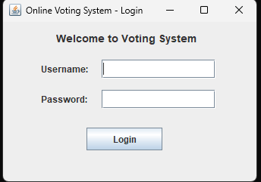
Application Workflow
Login: User logs in (Admin or Voter).
Voter: Selects a candidate and submits a vote.
Admin: Views and manages vote counts.
Logout: User logs out and returns to the login screen.

Slide 6
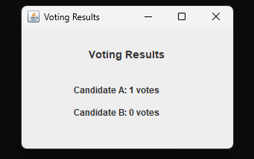
Sample Output
Voting: Click on "Candidate A" or "Candidate B" to vote.
Result: "Candidate A: 1 vote, Candidate B: 0 votes."

Slide 7
Enhancements & Future Work
User Authentication: Implement more secure login methods (e.g., password hashing).
Real-Time Updates: Show live vote updates without refreshing.
Multiple Candidates: Allow multiple voters to vote.
Admin Features: Add voting analytics and reports.
Mobile Support: Make the UI responsive for mobile devices.

Slide 8
Conclusion
Simple and functional voting system.
Users can vote, view results, and log out.
Admin can manage vote counts and reset votes.
Future improvements include security, real-time updates, and mobile support.

