Slide 1
Development of TTS
Group 48
Pre By: Chen Jian

Slide 2
TABLE OF CONTENTS
01
02
03
04
Why we need TTS?
Classical Models
Common applications
Several iconic developments
Applications
Difficulties and Prospects
Applications in different fields
Analysis and Prospect

Slide 3
01
Why we need TTS?

Slide 4
Common TTS applications
Reading texts
Voice assistant
Bilingual translation
Virtual singer

Slide 5
Common Problems
The transitions between sentences are relatively vague
Poor granularity and audio quality
Lack of a unified model
Solely supports a single language

Slide 6
02
Classical Model and Development

Slide 7
Evolution Process
Concatenative synthesis
Parametric synthesis
WaveRnn
simplifying assumption
autoregressive model
optimize
up-to-date
Wavenet
non-regressive

Slide 8
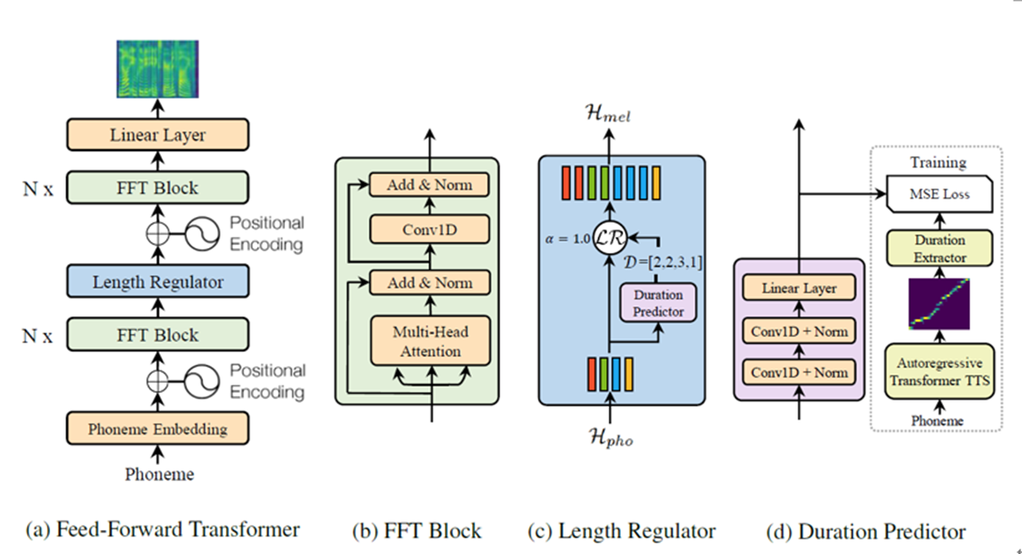
FastSpeech

Slide 9
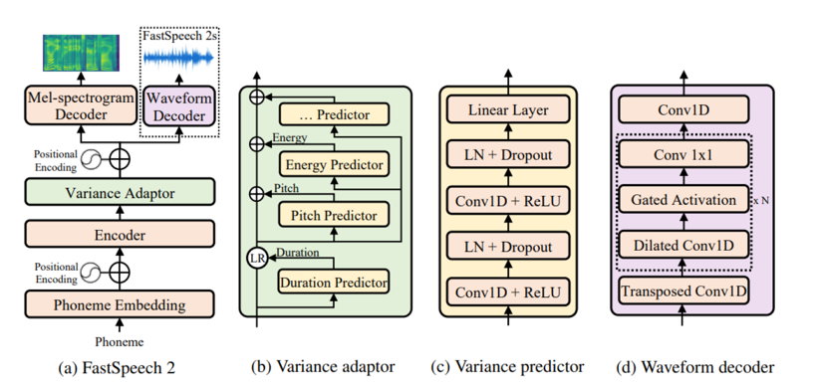
FastSpeech 2

Slide 10
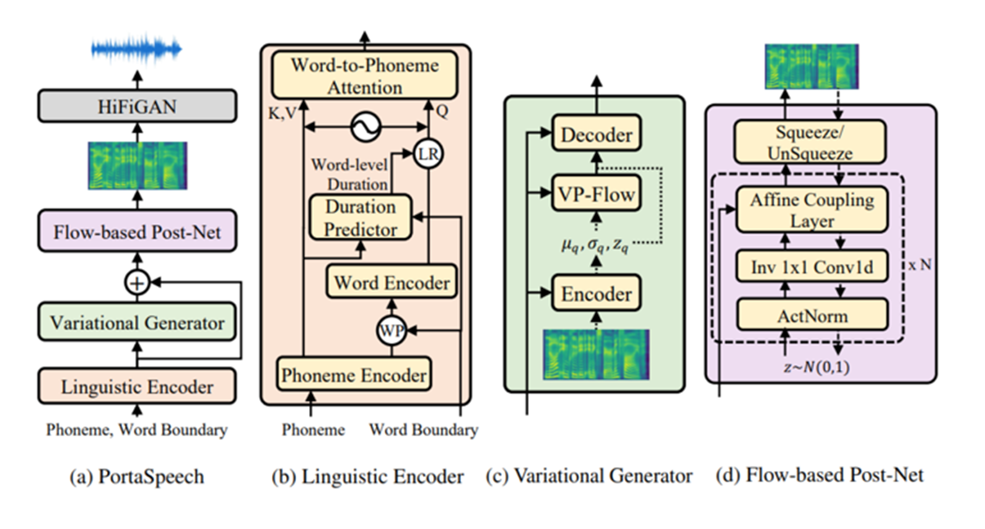
PortaSpeech

Slide 11
03
Application

Slide 12
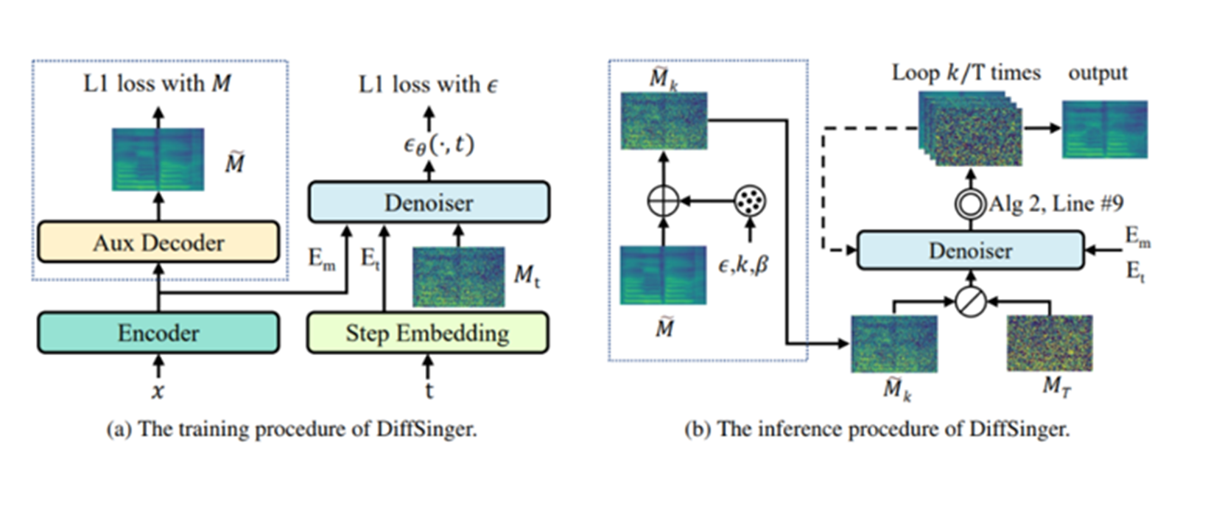
Applications in other fields Diffspeech vocoder

Slide 13
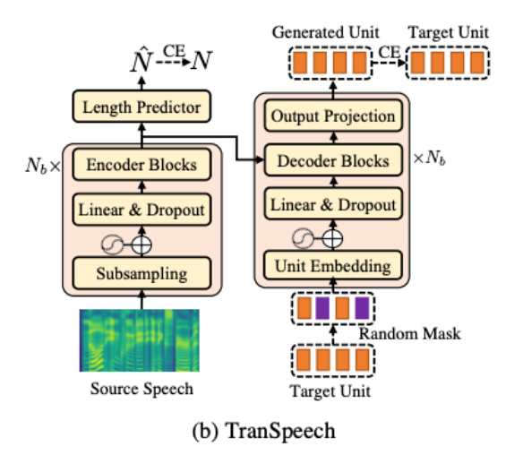
Applications in other fields bilingual translation

Slide 14
04
Difficulties and Future Prospects

Slide 15
Various applications such as speech and singing are independently studied.
The input is relatively complex, such as singing synthesis, which often requires inputting each pitch, duration, pause, etc., which clearly poses difficulties for its promotion

Slide 16
Future Prospects
25%
15%
Simple Entry
Unified multitasking audio synthesis model
Personalized services
60%

Slide 17
Thanks
Thank you for listening.

