Slide 1
Logic and Computer Design Fundamentals
Digital Systems and Information
Mingmin Zhang
zhangmm95@zju.edu.cn
QQ群:
821490389

Slide 2
Topics
Signal
Digital System
Digital Computer
Computer Structure
Number Systems and Coding

Slide 3
Signal
For digital systems, the variable takes on discrete values.
Binary values are the most popular representations in digital systems. Binary values are represented by:
  Digits: 0 and 1
  Symbols
    False (F) and True (T)
    Low (L) and High (H)
    On and Off.
Binary values are represented by values or ranges physical values, such as two level voltages

Slide 4
Signal Examples Over Time
Time
Continuous in value & time
Analog
Digital
Discrete in value & continuous in time
Asynchronous
Synchronous
Discrete in value & time

Slide 5
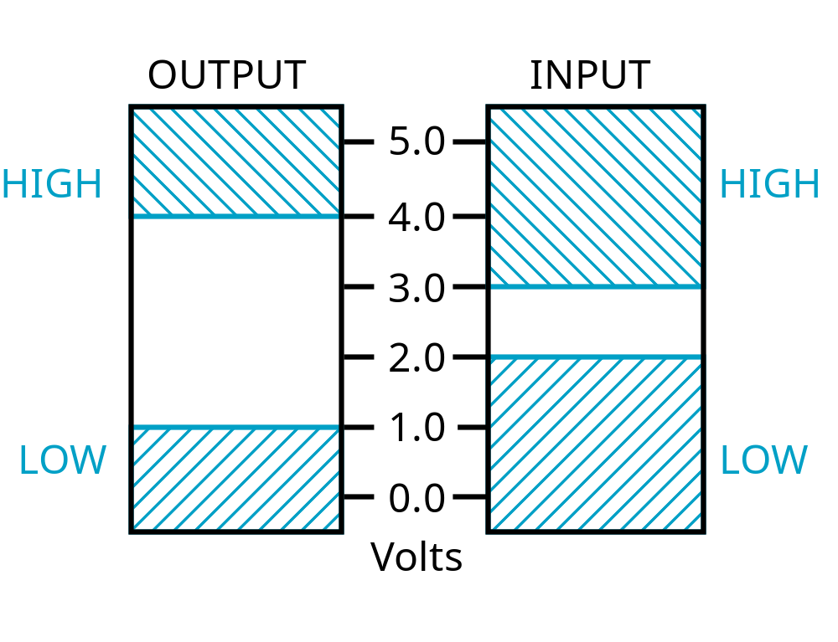
Signal Example – Physical Quantity: Voltage
The range of voltage values ​​is used to represent two different discrete values.
Why not decimal？
Threshold Region
Figure 1-1: An Example of Voltage Ranges for Binary Signals

Slide 6
Binary Values: Other Physical Quantities
Other physical quantities that can be used to represent 0 and 1
  CPU Voltage
  Disk Magnetic Field Direction
  CD Surface Pits/Light
  DRAM Electrical Charge

Slide 7
Digital System
Digital System takes a set of discrete information inputs and discrete internal system state information and generates a set of discrete information outputs.
Discrete
Information
Discrete
Processing
Discrete
Inputs
System
Outputs
System State

Slide 8
Typical Digital System
Combinational Logic System
  No state present
  Output Function: Output = Function(Input)
Sequential Logic System
  State present
  State updated at discrete times
    Synchronous Sequential System
  State updated at any time
    Asynchronous Sequential System
  State Equation: State = Function (State, Input)
  Output Function: Output = Function (State , Input)
  or Function (State)

Slide 9
Digital System Example
A Digital Counter (e.g., odometer):
Count Up
0
0
1
3
5
6
4
Reset
Inputs:
Count Up, Reset
Outputs:
Visual Display
State:
"Value" of stored digits
Synchronous or Asynchronous?

Slide 10
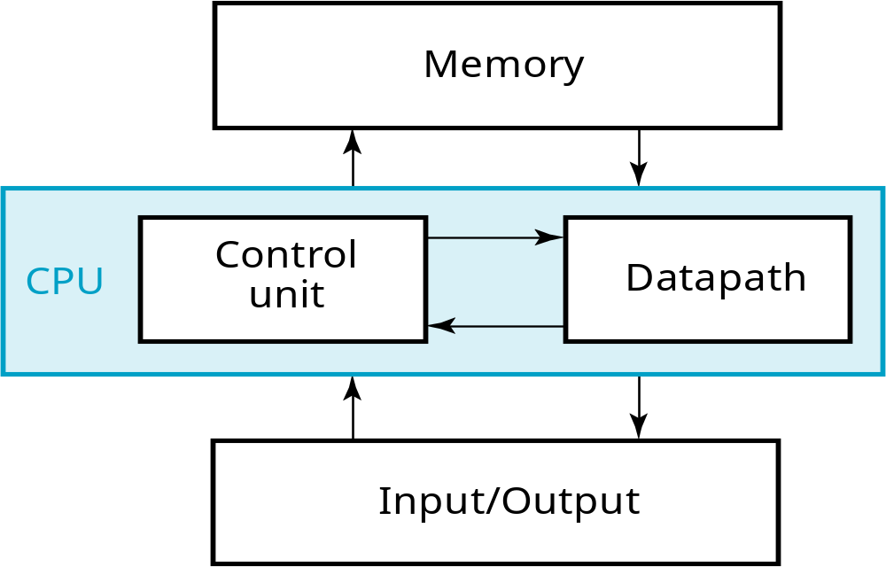
A Digital Computer Example
A general-purpose system used to process the discrete values
Inputs: Keyboard, mouse, modem, microphone
Outputs: CRT, LCD, modem, speakers
Figure 1-2: Block Diagram of Digital Computer
Synchronous or Asynchronous?
Notes:
Answer: Part of specification for a PC is in MHz. What does that imply? A clock which defines the discrete times for update of state for a synchronous system. Not all of the computer may be synchronous, however.

Slide 11
Computer Architecture
1. Memory
  Stores programs as well as input, output and intermediate data.
    internal storage
    external storage
    Cache (include internal and external)
2. Data path ( bus )
  The paths (connection) between processor, memory and I/O
    Processor Bus (inside CPU)
    I/O Bus

Slide 12
Computer Architecture
3. Control Unit
  Supervises the flow of information between the various program.
4. CPU(Central Processing Unit)
  Consist of datapath and control unit. Modern CPU consists of 4 parts: CPU, FPU, MMU and internal cache.
    MMU(Memory Management Unit): the memory space that appears to be available to CPU is much, much larger than the actual size of the RAM
5. Input / Output Device
  Devices used to interact with data process system
    Input device: keyboard, CRT, Scanners
    Output device: CRT, printer, audio

Slide 13
Digital Computer
Features: flexibility and versatility
  A general-purpose system used to process the discrete values
Information Representation in Computer
  Binary number system: 0 and 1
  Groups of bits can be used to represent the computer instructions and executed data.

Slide 14
Number System and Coding
Number system is employed in everyday arithmetic to represent numbers by string of digits.
1. Radix(Base)
Radix – collection of numeral symbols used to represent numbers in number system
Radix number – size of the collection
Example: Suppose radix is R,
0, 1, 2……, R-1 are the R basic numeral symbols

Slide 15
2. Weight
digit weight: the counting unit value of basic digital symbols in different position. ie, weight W
Example: the weight of 3 in 2336 in decimal number system is 10².
Example: the weight of the highest digit in 8421 code is 8.

Slide 16
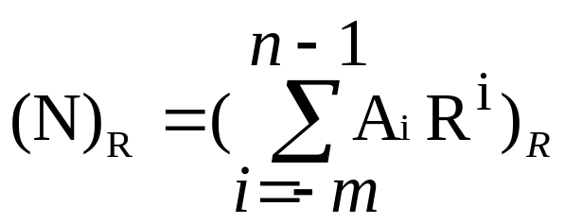
3. Representation of a number in radix R
(digits of a number N are listed From left to right, length n+m)
String of Digits 0≤A_{i}<R
(N)_{Ｒ}＝(A_{n－1}A _{n－2}A _{n－3}…A ₁A ₀ • A₋₁A _{-２}A…A _{–m+1}A _{-m})_{R}
MSB
radix point
LSB
Power Series
Notes:
MSB：Most Significant Bit 最高有效位
LSB：Least Significant Bit 最低有效位

Slide 17
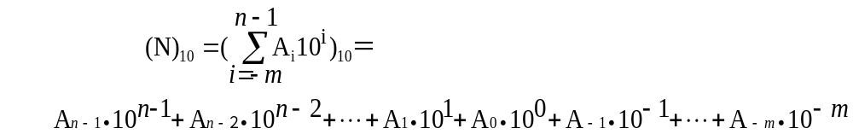
Example of Decimal Number Representation
Radix: R=10
Basic symbols: 0,1,2,3…9
Power series: W_{i}＝10^{i}
Representation:
Example: (123.45)₁₀=1∙10²+2∙10¹+3∙10⁰+4∙10⁻¹+5∙10⁻²

Slide 18
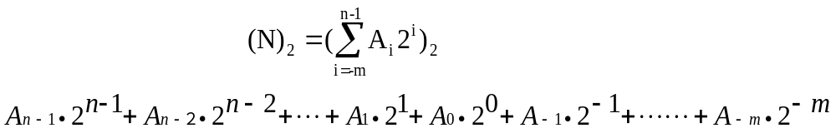
Example of Binary Number Representation
1. Representation of binary number
Radix: R=2
Basic symbols : 0，1
Power series: W_{i}＝2^{i}
Representation:
Example: (1011.101)₂=1∙2³+0∙2²+1∙2¹+1∙2⁰+1∙2⁻¹+0∙2⁻²+1∙2⁻³

Slide 19

2. Operation Rules
Addition: ０＋０＝０、０＋１＝１、
１＋０＝１、１＋１＝１０
Multiplication :
０＊０＝０、０＊１＝０、
１＊０＝０、１＊１＝１
3. Representation in Physical
Convenient – record by transistor or magnetic medium
Trouble – Writing, Memory – Use hexadecimal in short
Digital value 1/0 can be represented by voltage level high/low
1
1
1
0
0
0
0
4. Boolean algebra can be applied

Slide 20
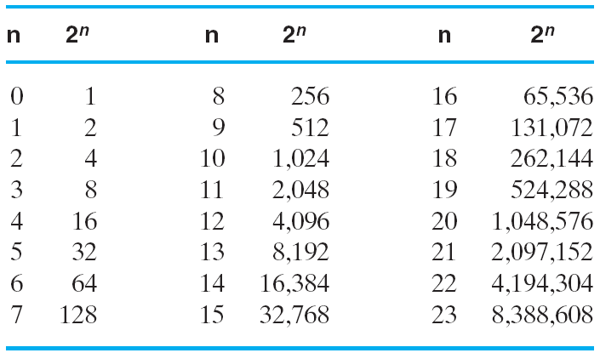
Useful for Base Conversion
Table1-1 Power of 2

Slide 21
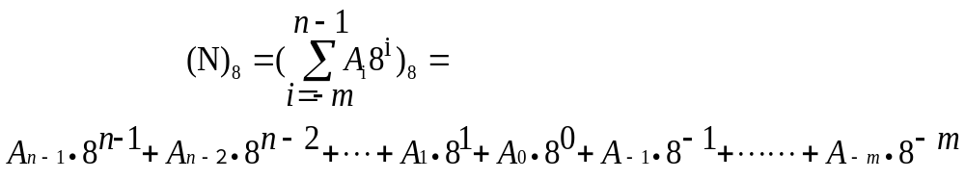
Example of Octal Number Representation
Radix: R=8
Basic Symbol: 0、1、2、…、7
Power series: W_{i}＝8^{i}
Representation:
Example: (567.125)8

Slide 22
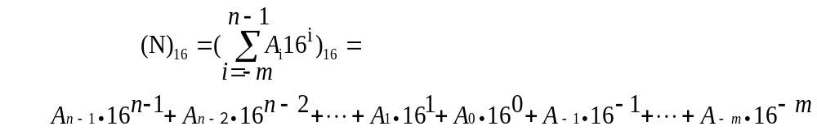
Example of Hexadecimal Number Representation
Radix: R=16
Basic Symbols: 0、1、2…、9、A、B、C、D、E、F
Power series: W_{i}＝16^{i}
Representation:
Example: (5AF.9B)16

Slide 23
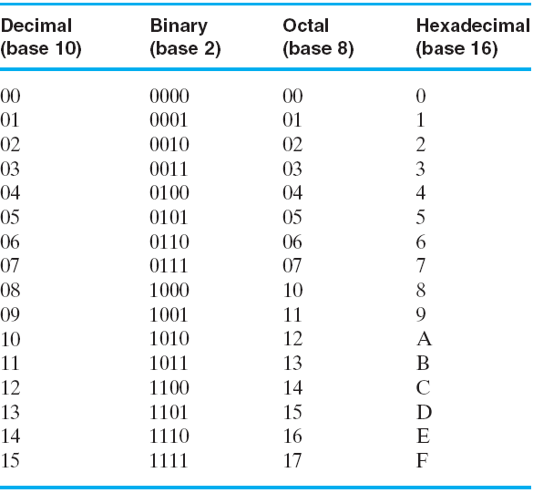
Useful for Base Conversion
Table 1-2: Number with Different Bases

Slide 24
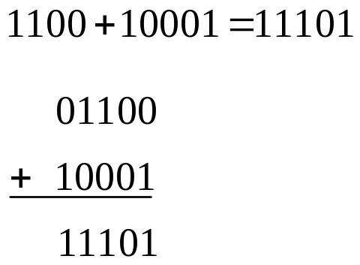
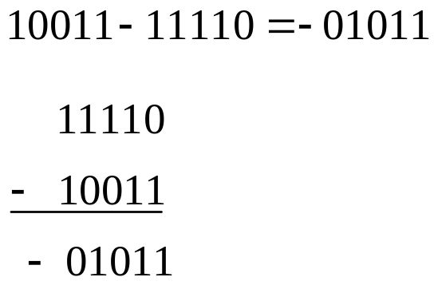
Arithmetic Operations
1. Addition and subtraction operations
Example 1:
Example 2:
(When minuend is smaller than subtrahend, swap minuend with subtrahend, and add Negative sign to the new result )

Slide 25
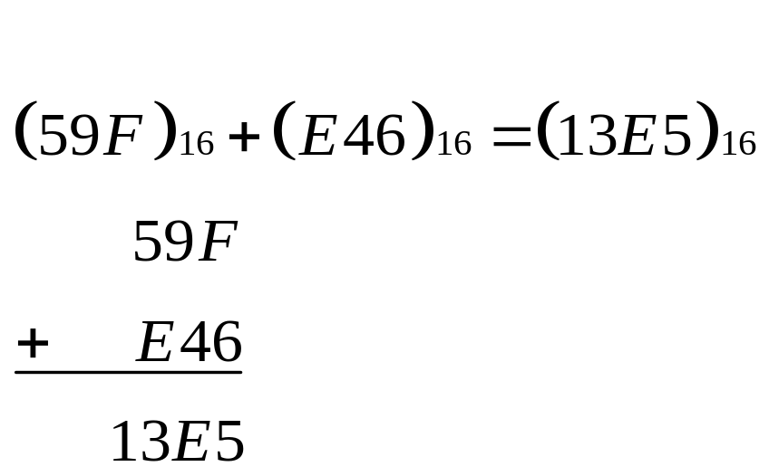
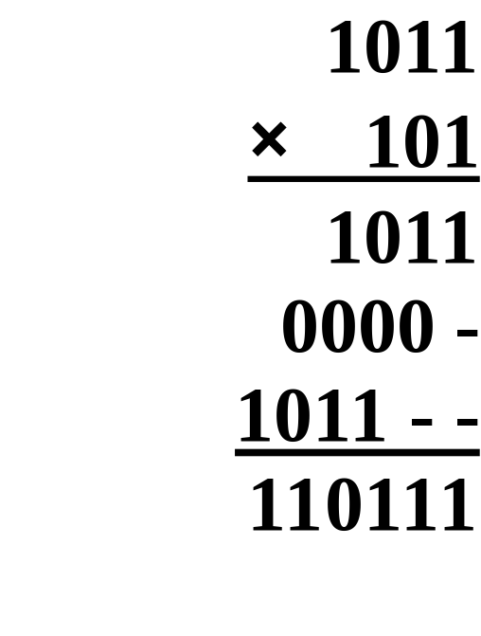
Arithmetic Operation
Example 3:
2. Multiplication
Example 1:

Slide 26
Converting among Binary,
Octal, Hexadecimal
and Decimal Numbers

Slide 27
Conversion Details
To Convert the Integral Part
  Repeatedly divide the number by the new radix and save the remainders. The digits for the new radix are the remainders in reverse order of their computation. If the new radix is > 10, then convert all remainders > 10 to digits A, B, …
To Convert the Fractional Part
  Repeatedly multiply the fraction by the new radix and save the integer digits that result. The digits for the new radix are the integer digits in order of their computation. If the new radix is > 10, then convert all integers > 10 to digits A, B, …
Chapter 1 <number>

Slide 28
1. Binary and Octal Conversion
Principle:
2³ = 8, thus 3 binary digits and 1 octal digit can represent exactly the same value
Example:
(67.731) ₈ ＝（110 111 .111 011 001)₂
(312.64)₈＝(011 001 010 . 110 1)₂
(11 111 101 . 010 011 11)₂＝(375.236)₈
(10 110.11)₂＝(26.6)₈

Slide 29
2. Binary and Hexadecimal Conversion
Principle:
2⁴ = 16, thus 4 binary digits and 1 Hexadecimal digit can represent exactly the same value
Example: (3AB4.1) ₁₆ ＝（0011 1010 1011 0100 .0001)₂
(21A.5)₁₆＝(0010 0001 1010 . 0101)₂
(1001101.01101)₂= ( 0100 1101. 0110 1000 )₂=(4D.68)₁₆
(111 1101 . 0100 1111)₂＝(7D.4F)₁₆
(110 0101.101)₂＝(65.A)₁₆

Slide 30
3. Binary and Decimal Conversion
1. Binary to Decimal
Principle: Power Series
Method: sum the digits times their respective powers
Example:
(110 0101.101)₂ ＝1*2⁶+1*2⁵+0*2⁴+0*2³+
+1*2²+0*2¹+1*2⁰+1*2⁻¹+0*2⁻²+1*2⁻³
＝(101.625)₁₀

Slide 31
1. Decimal to Binary
Principle:
Integral Part - Repeatedly divide the
number by the new radix and save the remainders.
Fractional Part - Repeatedly multiply the fraction by the
new radix and save the integer digits that result.
Example: (725.678)＝(10 1101 0101.1010 1101 1001)₂
＝(2D5.AD9)₁₆

Slide 32
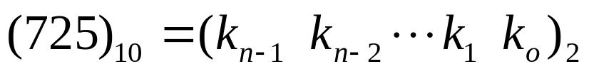
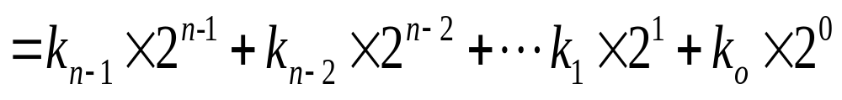
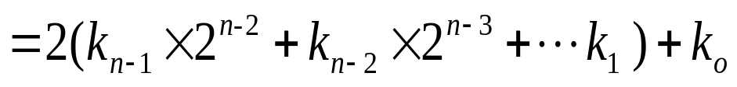
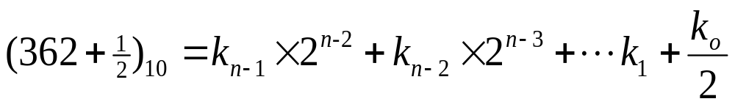
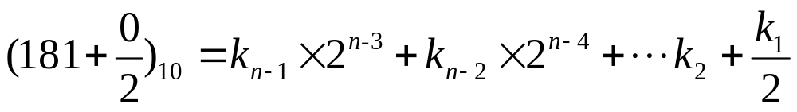
1. Integral Part
Example: Convert (725)₁₀ to Binary
1
0
…
(725)₁₀ = (10 1101 0101)₂

Slide 33
2 7 2 5
(725)₁₀ = (10 1101 0101)₂
2 3 6 2…………1
2 1 8 1…………0
2 9 0…………1
2 4 5…………0
2 2 2…………1
2 1 1…………0
2 5…………1
2 2…………1
2 1…………0
2 0…………1

Slide 34
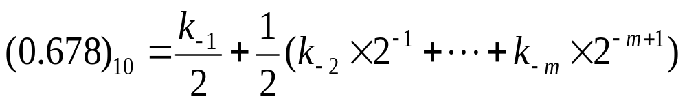
2.Fractional Part
1
Example: Convert (0.678)₁₀ to Binary
1
0
…
(0.678)₁₀ = (0.1010 1101 1001)₂
Note that: repeated multiplications in the fractional part may never end!

Slide 35
Repeatedly multiply the fraction by 2
(0.678)₁₀ = (0.1010 1101 1001)₂
2× 0.678………… = 1.356
3.3
2× 0.356………… = 0.712
Digits in binary correspond to 1 digit in decimal
2× 0.712………… = 1.424
2× 0.424………… =0.848
2× 0.848………… =1.696
2× 0.696………… =1.392
2× 0.392………… =0.784
2× 0.784………… =1.568
2× 0.568………… =1.136
2× 0.136………… =0.272
2× 0.272………… =0.544
2× 0.544………… =1.088

Slide 36
Codes
Coding Factors:
Data types - decimals, integers, real numbers, complex numbers, symbols
Value range - indicates the size of the number
Numerical accuracy - the accuracy of the number value
Hardware cost – data storage and process
Convenient representation
- both actual value and process value are needed
Coding Types:
Fixed-point format – simple with small range
Floating-point format – complex with wide range
Encoding format - For symbolic processing
Details about encoding of signed numbers in binary will be introduced in chapter 5

Slide 37
1. Real value: using ‘+’ and ‘-’ to represent positive and negative, can’t be used in machine
2. Machine value: encode the value together with signed symbols, can be used in machine
3. The sign bit is usually the most significant bit and it can’t be omitted. 0 for positive number and 1 for negative
Example: +1011→
0 1 0 1 1
-1011→
1 1 0 1 1

Slide 38
Binary Coding for Decimal
Binary Coded Decimal (BCD), use several (4) binary digits to represent one decimal digit.

Slide 39
1. Weighted Code
1. 8421 code (BCD code)
This code is the simplest, most intuitive binary code for decimal digits and uses the same powers of 2 as a binary number, but only encodes the first ten values from 0 to 9. The last 6 values are considered to be illegal.
8421 code is a weighted code, the weight from the most significant bit to least significant is 8, 4, 2, 1.
8421 code: 0111 = 0×8+1×4+1×2+1×1=7
Example: If N = (93)₁₀, then N = (1001 0011)_{8421BCD}

Slide 40
8421 BCD Code
BCD Addition
Example:
Note that: the decimal carry and the correct BCD sum digit are forced by adding 6 in binary.
8
1000
+5
+0101
13
1101
+0110
Carry = 1
0011
0001 | 0011

Slide 41
8421 BCD Code
BCD Addition
Example:
2905_{BCD} ＋ 1897_{BCD} = 4802_{BCD}
1 1 1
0
0001 1000 1001 0111
+ 0010 1001 0000 0101
0100 10010 1010 1100
+ 0000 + 0110 + 0110 + 0110
0100 1000 0000 0010
Notes:
超过1001了，都要加110

Slide 42
5421 BCD code
5421 code in short. The digit bit B₃ is set to 0 for number 0~4, 1 for number 5~9.
5421 code is weighted code, and its weight from the most significant bit to least significant is 5, 4, 2, 1.
Example:
  if N = (93)₁₀, then
  N=(1100 0011)_{5421BCD}

Slide 43
2421 BCD code
2421 code in short. It encodes the first 8 values of (B₃B₂B₁B₀) from 0 to 7 as binary code, 1110 for 8 and 1111 for 9 in decimal number system.
2421 code is weighted code, and its weight from the most significant bit to least significant is 2, 4, 2, 1.
Example:
  if N = (93)₁₀, then
  N=(1111 0011)_{2421BCD}

Slide 44
2. Nonweighted code
Excess 3 Code
In excess 3 code, numbers are represented as binary digits, and each digit is represented by four bits as the BCD code plus 3. Excess 3 code is a nonweighted code.
When do addition for each digit, we need to subtract binary 0011 (decimal 3) if the resulting is less than decimal 10, otherwise add binary 0011.

Slide 45
Example: 0100+0110=0111
1000+1001= 1 0 1 0 0
0 1 0 0
＋) 0 1 1 0
1 0 0 0
＋) 1 0 0 1
1 0 1 0
1 0 0 0 1
－)
0 0 1 1
+)
0 0 1 1
0 1 1 1
1 0 1 0 0
Notes:
不够-3，进位+3

Slide 46
Reliable code
Codes that can reduce error, detect error and correct error are called reliable code.

Slide 47
1. Gray Code
Also known as cyclic permutation code, is a binary numeral system where two successive values differ in only one bit.
Gray code are widely used in counters, to prevent multiple counts or less counts.
Decimal | 8,4,2,1 | Gray
0 | 0000 | 0000
1 | 0001 | 0001
2 | 0010 | 0011
3 | 0011 | 0010
4 | 0100 | 0110
5 | 0101 | 0111
6 | 0110 | 0101
7 | 0111 | 0100
8 | 1000 | 1100
9 | 1001 | 1000
Notes:
顺着转：8:1100， 9:1000（原0位）
逆着转：8:1100， 9:1101（原7位）

Slide 48
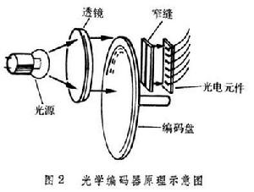
1. 格雷码
111
000
100
000
B
0
B
1
110
001
101
001
B
2
G
2
G
1
010
111
G
0
101
011
100
011
110
010
(a) Binary Code for Positions 0 through 7
(b) Gray Code for Positions 0 through 7
Optical Shaft Angle Encoder
Notes:
Why gray codes: a change of more than one bit when counting up or down can cause serious problems.

Slide 49
2. Parity Code
Consist of the original data bits and a parity bit. The Parity bit indicates whether the number of bits in the data bits with the value 1 is even or odd.

Slide 50
2. Parity Code
Original data even parity odd parity
1000001 01000001 11000001
1010100 11010100 01010100
An extra bit appended onto the code word to make the number of 1’s odd or even. Parity can detect all single-bit errors and some multiple-bit errors.
Example: 1 0 0 1 1 0 1 0→ 1 0 0 1 1 0 0 1

Slide 51
Several Codes for Numbers 0 ~ 9
Decimal | 8421 | 5421 | 2421 | Excess 3 Code | Gray Code1
0 | 0000 | 0000 | 0000 | 0011 | 0000
1 | 0001 | 0001 | 0001 | 0100 | 0001
2 | 0010 | 0010 | 0010 | 0101 | 0011
3 | 0011 | 0011 | 0011 | 0110 | 0010
4 | 0100 | 0100 | 0100 | 0111 | 0110
5 | 0101 | 1000 | 0101 | 1000 | 0111
6 | 0110 | 1001 | 0110 | 1001 | 0101
7 | 0111 | 1010 | 0111 | 1010 | 0100
8 | 1000 | 1011 | 1110 | 1011 | 1100
9 | 1001 | 1100 | 1111 | 1100 | 1000
Notes:
也可以：0000， 0001， 0011， 0010， 0110， 1110， 1010， 1011， 1001， 1000
二进制反射格雷码

Slide 52
Alphanumeric Codes
Applications require the handling of data consisting not only numbers but also letters, symbols and other media.
But computer can only handle binary data, thus encoded these symbols to binary code.

Slide 53
Bits ASCII Code
American Standard Code for Information Interchange. It uses 7-bits to represent:
94 Graphic printing characters.
  10 digits: 30 ~ 39
  26 uppercase letter 41 ~ 59
  26 lowercase letter 61 ~ 79
  32 special printable characters
34 Non-printing characters
  For format (e.g. BS = Backspace, CR = carriage return)
  For text (e.g. STX and ETX )
  For communication (e.g. ACK)
Chapter 1 <number>
Notes:
ASCII: American Standard Code for Information Interchange

Slide 54
7 BIT ASCII CODE TABLE
b6b5b4 B3b2b1b0 | 000 | 001 | 010 | 011 | 100 | 101 | 110 | 111
0000 | NUL | DLE | SP | 0 | @ | P | ， | p
0001 | SOM | DC | ! | 1 | A | Q | a | q
0010 | STX | DC | “ | 2 | B | R | b | r
0011 | ETX | DC | # | 3 | C | S | c | s
0100 | EOT | DC | $ | 4 | D | T | d | t
0101 | ENQ | NAA | % | 5 | E | U | e | u
0110 | ACA | SYN | & | 6 | F | V | f | v
0111 | BEL | ETB | ， | 7 | G | W | g | w
1000 | BS | CAN | ( | 8 | H | X | h | x
1001 | HT | EM | ) | 9 | I | Y | i | y
1010 | LF | SUB | * | : | J | Z | j | z
1011 | VT | ESC | + | ; | A | [ | k
1100 | FF | FS | ， | < | L | \ | l | |
1101 | CR | GS | － | = | M | ] | m
1110 | SO | RS | ． | > | N |  | n | ~
1111 | SI | US | / | ? | O | ← | o | DEL

Slide 55
2. UNICODE
UNICODE extends ASCII to 16 bits (65,536) universal characters codes
  For encoding characters in world languages
  Available in many modern applications
  2 byte (16-bit) code words
  See Reading Supplement – Unicode on the Companion Website http://www.prenhall.com/mano

Slide 56
Assignment
Problem Assignment:
1-3, 1-9, 1-12(a), 1-13, 1-16, 1-18, 1-19, 1-28

Slide 57
Thank You !

