Slide 1
Logic and Computer Design Fundamentals
Chapter 3 – Arithmetic Functions and Circuits
College of Computer Science and Technology, Zhejiang University

Slide 2
Overview
Iterative combinational circuits
Binary adders
  Half and full adders
  Ripple carry and carry lookahead adders
Binary subtraction
Binary adder-subtractors
  Signed binary numbers
  Signed binary addition and subtraction
  Overflow
*Binary Multiplication
Other Arithmetic Functions
Chapter 5 <number>

Slide 3
4.1 Iterative Combinational Circuits
Arithmetic functions
  Operate on binary vectors
  Use the same subfunction in each bit position
Can design functional block for subfunction and repeat to obtain functional block for overall function
Cell - subfunction block
Iterative array - a array of interconnected cells
An iterative array can be in a single dimension (1D) or multiple dimensions
Chapter 5 <number>

Slide 4
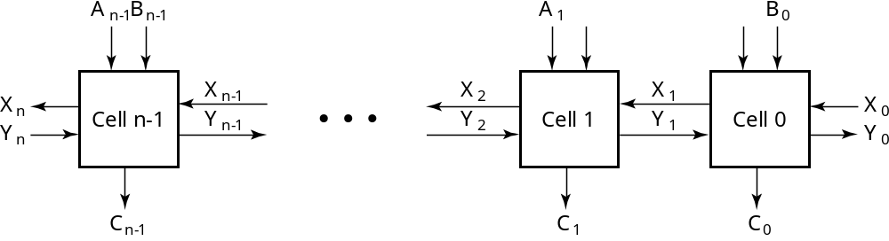
Block Diagram of a 1D Iterative Array
Example: n = 32
  Number of inputs = ? 66
  Truth table rows = ? 2⁶⁶
  Equations with up to ? Input 66 variables
  Equations with huge number of terms
  Design impractical!
Iterative array takes advantage of the regularity to make design feasible
Chapter 5 <number>
Notes:
64个操作数，一个下进位，一个操作符

Slide 5
Functional Blocks: Addition
Binary addition used frequently
Addition Development:
  Half-Adder (HA), a 2-input bit-wise addition functional block,
  Full-Adder (FA), a 3-input bit-wise addition functional block,
  Ripple Carry Adder, an iterative array to perform binary addition, and
  Carry-Look-Ahead Adder (CLA), a hierarchical structure to improve performance.
Chapter 5 <number>

Slide 6
Functional Block: Half-Adder
A 2-input, 1-bit width binary adder that performs the following computations:
A half adder adds two bits to produce a two-bit sum
The sum is expressed as a sum bit , S and a carry bit, C
The half adder can be specified as a truth table for S and C ⇒
X
0
0
1
1
+ Y
+ 0
+ 1
+ 0
+ 1
C S
0 0
0 1
0 1
1 0
X
Y
C
S
0
0
0
0
0
1
0
1
1
0
0
1
1
1
1
0
Chapter 5 <number>

Slide 7
Logic Simplification: Half-Adder
The K-Map for S, C is:
This is a pretty trivial map!
By inspection:
and
These equations lead to several implementations.
S
Y
C
Y
1
0
1
0
1
X
1
X
1
S
=
X
Y
+
X
Y
=
X
⊕
Y
2
3
2
3
S
=
(
X
+
Y
)
(
X
+
Y
)
C
=
X
Y
C
=
(
(
X
Y
)
)
Chapter 5 <number>

Slide 8
Five Implementations: Half-Adder
We can derive following sets of equations for a half-adder:
(a), (b), and (e) are SOP, POS, and XOR implementations for S.
In (c), the C function is used as a term in the AND-NOR implementation of S, and in (d), the function is used in a POS term for S.
(
a
)
S
=
X
Y
+
X
Y
(
d
)
S
=
(
X
+
Y
)
C
C
=
X
Y
C
=
(
X
+
Y
)
(
b
)
S
=
(
X
+
Y
)
(
X
+
Y
)
(
e
)
S
=
X
⊕
Y
C
=
X
Y
C
=
X
Y
(
c
)
S
=
(
C
+
X
Y
)
C
=
X
Y
C
Chapter 5 <number>

Slide 9
Implementations: Half-Adder
The most common half adder implementation is: (e)
A NAND only implementation is:
X
S
Y
S
=
X
⊕
Y
C
=
X
Y
C
C
X
S
=
(
X
+
Y
)
C
C
=
(
)
S
(
X
Y
)
Y
Chapter 5 <number>

Slide 10
Functional Block: Full-Adder
A full adder is similar to a half adder, but includes a carry-in bit from lower stages. Like the half-adder, it computes a sum bit, S and a carry bit, C.
  For a carry-in (Z) of 0, it is the same as the half-adder:
  For a carry- in
  (Z) of 1:
Z
0
0
0
0
X
0
0
1
1
+ Y
+ 0
+ 1
+ 0
+ 1
C S
0
0
0 1
0 1
1 0
Z
1
1
1
1
X
0
0
1
1
+ Y
+ 0
+ 1
+ 0
+ 1
C S
0 1
1 0
1 0
1
1
Chapter 5 <number>

Slide 11
Logic Optimization: Full-Adder
Full-Adder Truth Table:
Full-Adder K-Map:
X
Y
Z
C
S
0
0
0
0
0
0
0
1
0
1
0
1
0
0
1
0
1
1
1
0
1
0
0
0
1
1
0
1
1
0
1
1
0
1
0
1
1
1
1
1
S
Y
C
Y
1
1
1
0
1
3
2
0
1
3
2
X
1
1
X
1
1
1
4
5
7
6
4
5
7
6
Z
Z
Chapter 5 <number>

Slide 12
Equations: Full-Adder
From the K-Map, we get:
The S function is the three-bit XOR function (Odd Function):
The Carry bit C is 1 if both X and Y are 1 (the sum is 2), or if the sum is 1 and a carry-in (Z) occurs. Thus C can be re-written as:
The term X·Y is carry generate.
The term X⊕Y is carry propagate.
S
=
X
Y
Z
+
X
Y
Z
+
X
Y
Z
+
X
Y
Z
C
=
X
Y
+
X
Z
+
Y
Z
S
=
X
⊕
Y
⊕
Z
C
=
X
Y
+
(
X
+
Y
)
Z
Chapter 5 <number>

Slide 13
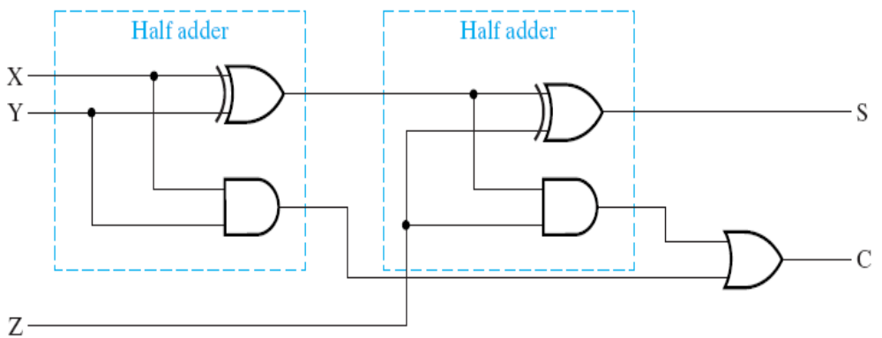
Implementation: Full Adder
Ai
Bi
Logic Diagram of Full Adder
A_{i}, B_{i}, C_{i} and C_{i+1} in the left circuit equals
to X, Y, Z and C in the right circuit
G_{i} is called generate function
P_{i} is called propagate function
Note: S_{i} is the XOR result of variable A_{i}, B_{i} and C_{i} . And carry function C_{i+1} can be expressed as bellow:
C_{i+1} = G_{i} + P_{i} · C_{i}
Gi
Pi
Ci
Ci+1
Si
Chapter 5 <number>

Slide 14
Ripple-Carry Binary Adders
To add multiple operands, we “bundle” logical signals together into vectors and use functional blocks that operate on the vectors
Example: 4-bit ripple carry
adder: Adds input vectors A(3:0) and B(3:0) to get
a sum vector S(3:0)
Note: carry out of cell i
becomes carry in of cell
i + 1
Subscript
Description
Name
3 2 1 0
Carry In
0 1 1 0
Ci
Augend
1 0 1 1
Ai
Addend
0 0 1 1
Bi
Sum
1 1 1 0
Si
Carry out
0 0 1 1
Ci+1
Chapter 5 <number>

Slide 15
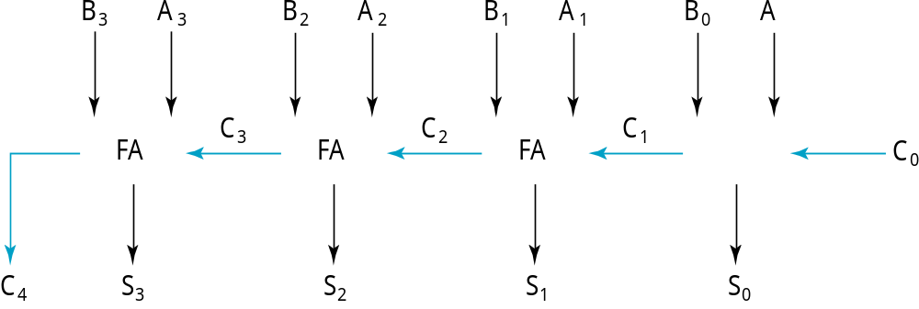
4-bit Ripple-Carry Binary Adder
A four-bit Ripple Carry Adder made from four 1-bit Full Adders:
Chapter 5 <number>

Slide 16
Carry Propagation & Delay
One problem with the addition of binary numbers is the length of time to propagate the ripple carry from the least significant bit to the most significant bit.
The gate-level propagation path for a 4-bit ripple carry adder of the last example:
Note: The "long path" is from A₀ or B₀ though the circuit to S₃ (3 + (4-1)*2 + 3 = 12 gate delay).
A3
A2
A1
A0
B3
B2
B1
B0
C3
C2
C1
C0
C4
S3
S2
S1
S0
Chapter 5 <number>
Notes:
1位三个门延迟

Slide 17
Carry Lookahead Adder
For a given i-bit binary adder,
  If A_{i} = B_{i} = “1” and whatever C_{i} is, we have carry out as 1,
  that is C_{i+1} = 1
  If the output of half adder is 1 and we have carry in as 1, we have carry out as 1.
  that is C_{i+1} = 1
This two condition of setting carry out as 1 is called generate (G_{i}) and propagate (P_{i}).
Ai
Bi
Gi
Pi
Ci
Ci+1
Si
Chapter 5 <number>

Slide 18
Carry Lookahead Adder (Cont.)
In Ripple-Carry Binary Adders:
  G_{i}, P_{i}, and S_{i} are generated by devices itself
  C_{i+1} is generated by itself while it also depend on C_{i}
In Carry Lookahead Adder, to reduce the delay of long carry path, C_{i+1} is generated directly by input signals.
Adder defined by P_{i} and G_{i} is as follows:
P
=
A
⊕
B
G
=
A
B
i
i
i
i
i
i
S
=
P
⊕
C
C
=
G
+
P
C
i
i
i
i
+
1
i
i
i
Chapter 5 <number>

Slide 19
Carry Lookahead Development
C_{i+1} can be removed from the cells and used to derive a set of carry equations spanning multiple cells.
Beginning at the cell 0 with carry in C₀:
C1 = G0 + P0 C0
C2 = G1 + P1 C1 = G1 + P1(G0 + P0 C0)
= G1 + P1G0 + P1P0 C0
C3 = G2 + P2 C2 = G2 + P2(G1 + P1G0 + P1P0 C0)
= G2 + P2G1 + P2P1G0 + P2P1P0 C0
C4 = G3 + P3 C3
= G3 + P3G2 + P3P2G1+ P3P2P1G0 + P3P2P1P0 C0
Chapter 5 <number>

Slide 20
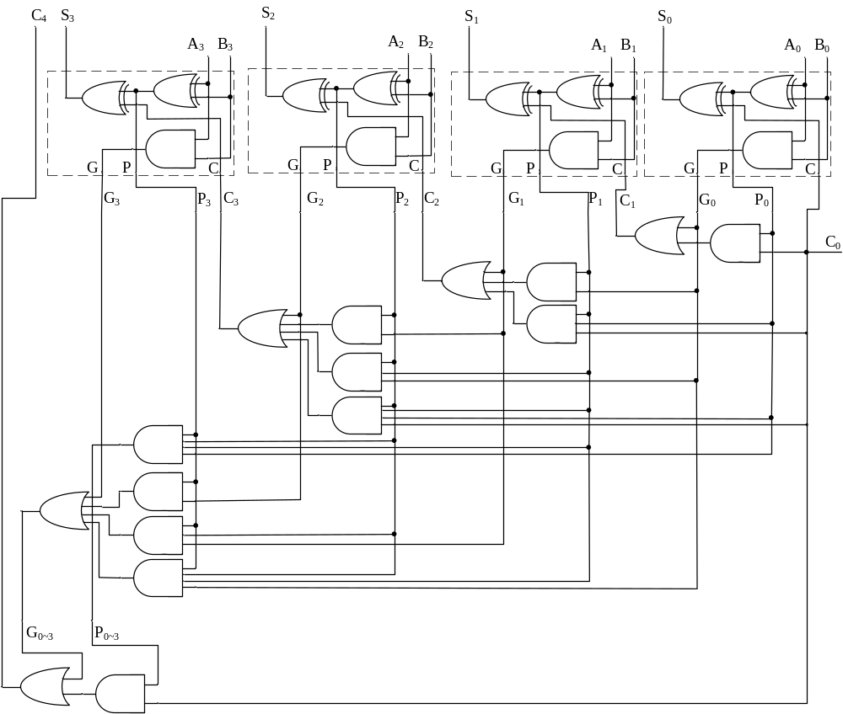
Carry Look-ahead Adder
Chapter 5 <number>

Slide 21
Group Carry Lookahead Logic
Figure 5-6 in the text shows the implementation of these equations for four bits. This could be extended to more than four bits; in practice, due to limited gate fan-in, such extension is not feasible.
C₄= G₃ + P₃G₂ + P₃P₂G₁+ P₃P₂P₁G₀ + P₃P₂P₁P₀ C₀
Instead, the concept is extended another level by considering group generate (G₀₋₃) and group propagate (P₀₋₃) functions:
Using these two equations:
Thus, it is possible to have four 4-bit adders use one of the same carry lookahead circuit to speed up 16-bit addition
G
=
G
+
P
G
+
P
P
G
+
P
P
P
P
G
0
∼
3
3
3
2
3
2
1
3
2
1
0
0
P
=
P
P
P
P
0
∼
3
3
2
1
0
C
=
G
+
P
C
4
0
∼
3
0
∼
3
0
Chapter 5 <number>

Slide 22
Group Carry Lookahead Logic (Cont.)
C₄ = G₃ + P₃G₂ + P₃P₂G₁ + P₃P₂P₁G₀ + P₃P₂P₁P₀C₀= G_{0~3}+ P_{0~3}C₀
C₈ = G₇ + P₇G₆ + P₇P₆G₅ + P₇P₆P₅G₄ + P₇P₆P₅P₄C₄= G_{4~7}+ P_{4~7}C₄
C₁₂ =G₁₁+P₁₁G₁₀+P₁₁P₁₀G₉+P₁₁P₁₀P₉G₈+ P₁₁P₁₀P₉P₈C₈= G_{8~11}+ P_{8~11}C₈
C₁₆=G₁₅+P₁₅G₁₄+P₁₅P₁₄G₁₃+P₁₅P₁₄P₁₃G₁₂+P₁₅P₁₄P₁₃P₁₂C₁₂= G_{12~15}+ P_{12~15}C₁₂
Chapter 5 <number>

Slide 23
Carry Lookahead Example
Specifications:
  16-bit CLA
  Delays:
    NOT = 1
    XOR = Isolated AND = 3
    AND-OR = 2
Longest Delays:
  Ripple carry adder* = 3 + 15 ⋅ 2 + 3 = 36
  CLA = 3 + 3 ⋅ 2 + 3 = 12
3
3
CLA
CLA
CLA
CLA
2
2
CLA
2
Chapter 5 <number>
Notes:
Ripple carry adder见P16
CLA把15个中间步骤并成了3个

Slide 24
4.2 Binary subtraction
Unsigned Subtraction
Binary adder-subtractors
  Signed binary numbers
  Signed binary addition and subtraction
  Overflow
Chapter 5 <number>

Slide 25
Unsigned Subtraction
Algorithm:
  Subtract the subtrahend N from the minuend M
  If no end borrow occurs, then M ≥ N, and the result is a non-negative number and correct.
  If an end borrow occurs, the N > M and the difference M − N + 2^{n} is subtracted from 2^{n}, and a minus sign is appended to the result.
Examples:
0 1
1001 0100
− 0111 − 0111
0010 1101
10000
− 1101
(−) 0011
Chapter 5 <number>

Slide 26
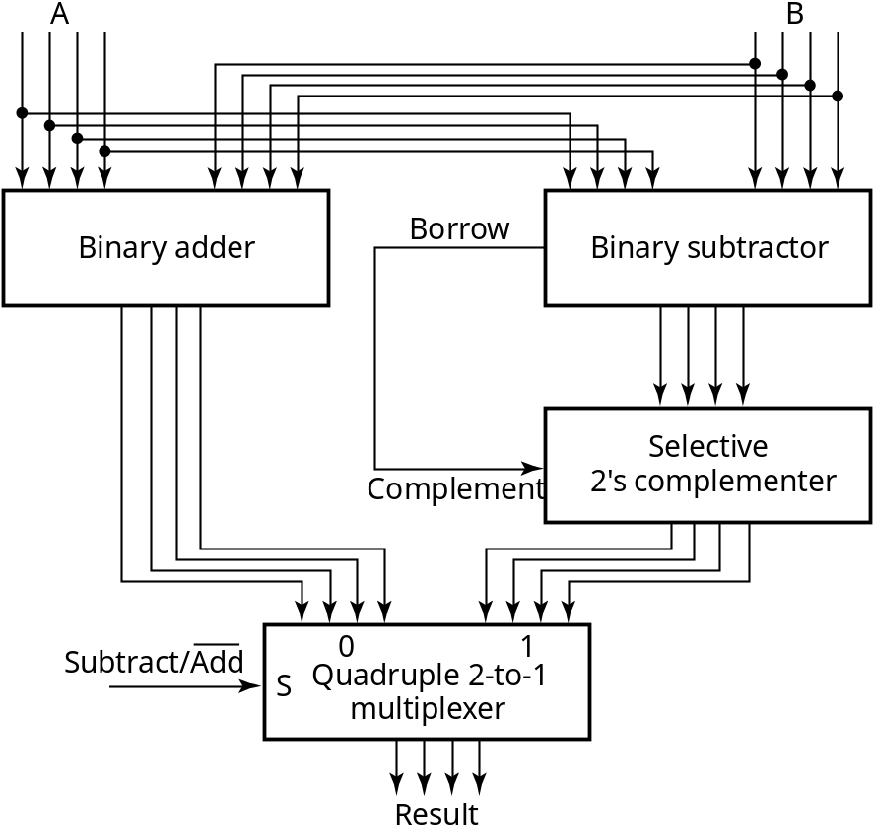
Unsigned Subtraction (continued)
The subtraction, 2^{n} − N, is taking the 2’s complement of N
To do both unsigned addition and unsigned subtraction requires:
Quite complex!
Goal: Shared simpler
logic for both addition
and subtraction
Introduce complements
as an approach
Chapter 5 <number>

Slide 27
Signed Binary Numbers
True value and machine number
  True value: use “+” and “-” to represent the sign of binary numbers. True value can’t be used in computers.
  Machine number: Use one bit to represent a sign (+ and -) and the other bit to represent the value,. Widely used in computer. Also known as machine code.
Chapter 5 <number>

Slide 28
Signed Binary Numbers
The leftmost bit represents the sign in machine number
Binary Code Machine number
sign number value
Example: +1011 →
0 1 0 1 1
sign number value
-1011 →
1 1 0 1 1
Chapter 5 <number>

Slide 29
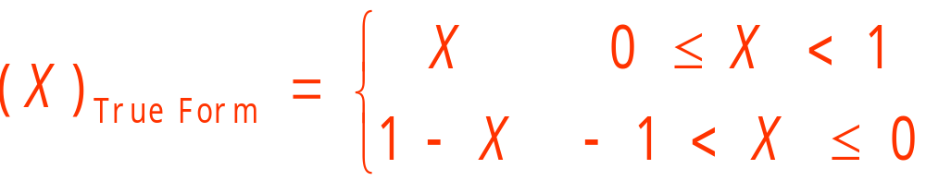
1. True Form
Allocate one sign bit to represent the sign: set that bit (often the most significant bit) to 0 for a positive number, and set to 1 for a negative number. The remaining bits in the number indicate the magnitude
(1) Definition of Fraction in true form:
Example: X1=+0.1101 (X1)True Form =0.1101
X2=-0.1101 (X2) True Form=1.1101
Chapter 5 <number>

Slide 30
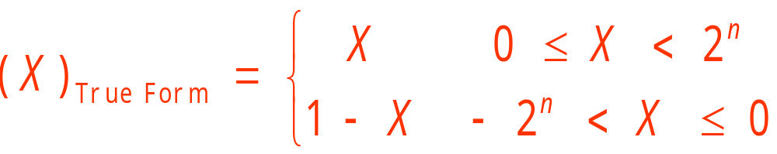
(2) Definition of Integer in true form:
Example:
Positive N1 = +10011 [N1] True Form= 0 10011
Negative N2 = – 01010 [N2] True Form= 1 01010
(3) Two representatives for 0 in true form:
[ +0]True Form= 00…0 [– 0]True Form= 1 0…0
Example:
(N)2=+10111.101 (N) True Form=010111.101
(N)2= –11001.011 (N) True Form=111001.011
Chapter 5 <number>

Slide 31
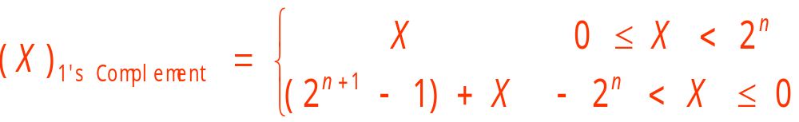
2. 1’s Complement
Positive numbers are the same simple, binary system used by two's complement and sign-magnitude. Negative values are the bit complement of the corresponding positive value.
（1）Definition of integer in 1’s Complement:
Example:
N1 = +10011 [ N1]1’s Complement= 0 10011
N2 = – 01010 [N2] 1’s Complement= 1000000 – 1 + (-01010)
= 11 1111 - 01010 = 1 10101
Chapter 5 <number>

Slide 32
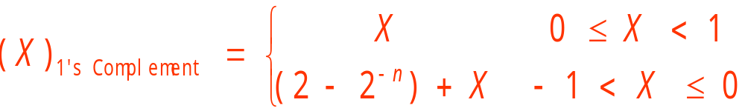
（1）Definition of fraction in 1’s Complement:
Example:N1 = +0.10011 [ N1]1’s Complement= 0 .10011
N2 = – 0.1010 [N2] 1’s Complement= 1.1111+(-0.1010)
=1.1111- 0.1010 = 1 .0101
（3）0 in 1’s Complement ：
[ +0]1’s Complement = 00…0
[– 0] 1’s Complement = 1 1…1
Chapter 5 <number>

Slide 33
1’s Complement Examples
N1 = +1100.11 [ N1]反= 0 1100.11
N2 = – 101.101 [N2]反= 1010.010
Example: What is 1’s complement of (30.25)10
Solution: (30.25)10= +(11110.01)2
[30.25] 1’s complement =011110.01
Example: What is 1’s complement of -120.625
Solution: (-120.625)10= -(1111000.101)2
[-120.625] 1’s complement =1 0000111.010
Chapter 5 <number>

Slide 34
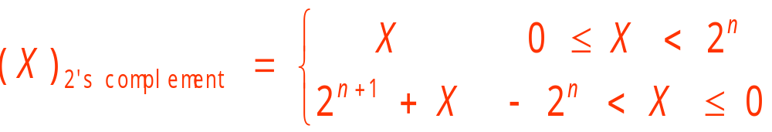
3 . Two’s Complement
For positive numbers, 1’s complement and the true form are the same. For negative numbers, the sign bit is 1 and other bits are value of 1’s complement plus 1.
(1) Definition of integer in 2’s complement:
Example:N1 = +10011 [N1]2’s Complement= 010011
N2 = – 01010 [N2] 2’s Complement= 2⁶-01010
= 1 10110
= 110101+1 = [N2] 1’s Complement+1
Chapter 5 <number>

Slide 35
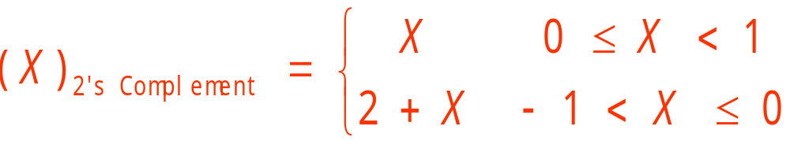
(2) Definition of fraction in 2’s complement:
Example: N1 = +0.10011 [N1] 2’s Complement = 0.10011
N2 = – 0.1010 [N2] 2’s Complement = 2-0.1010
= 1 .0110
=[N2] 1’s Complement +“1”
Chapter 5 <number>

Slide 36
(1) Definition of 0 in 2’s complement:
Only one representation in 2’s complement for 0:
[+0] 2’s Complement =[+0]true form= 0 0
[-0] 2’s Complement =[-0]1’s Complement+1= 1 1…1+1
= 1 0 0…0 = 0 0
abandoned
Chapter 5 <number>

Slide 37
(4) Number with integer part and fraction part still have its 2’ complement, which is composed of its 2’complement for integer and its 2’s complement for fraction.
Example: What is 2’s complement of -120.625
Solution: (-120.625)10= -(1111000.101)2
[-120.625] 2’s Complement =1 0001000.011
N1 = +1100.11 N2 = –101.101
[ N1] 1’s Complement = 0 1100.11 [N2] 1’s Complement = 1011.011
Chapter 5 <number>

Slide 38
4. Signed Binary Addition and Subtraction
(1) Operation in true form
Sign bit operates separately, defined by the result of operation. Assume A,B are the absolute values:
(+A) + (+B) = (+A) - (-B)
(-A) + (-B) = (-A) - (+B)
Addition of numbers with same sign bit or Subtraction of numbers with different sign bit: Add the absolute values and set the sign bit with sign of augend(Minuend).
(+A) - (+B) = (+A) + (-B)
(-A) - (-B) = (-A) + (+B)
Subtraction of numbers with different sign bit or Addition of numbers with same sign bit: Subtract the absolute values and set the sign bit with sign of number whose absolute is larger.
Chapter 5 <number>

Slide 39
Example: N1 = -0011，N2 = 1011；
What is (N1 +N2) and (N1 - N2)
Solution: [ N1 ]true form＝10011, [ N2 ]true form＝01011
✶ [ N1 +N2]true form: Subtraction of absolute values
1 0 1 1
－) 0 0 1 1
1 0 0 0
Set sign bit the sign of N2: [ N1 +N2]true form＝01000
True value: N1 +N2＝+1000
Chapter 5 <number>

Slide 40
✴ [ N1 －N2]true form, Addition of absolute values
0 0 1 1
＋) 1 0 1 1
1 1 1 0
Set the sign bit the sign of N1:
[ N1 －N2]true form=11110
True value: N1 －N2= -1110
Chapter 5 <number>

Slide 41
(2) Addition and Subtraction with 1’s Complement (Result in 1’s Complement)
Sign bit is used in the operation
[ N1 +N2]1’s Complement＝ [ N1] 1’s Complement+ [ N2] 1’s Complement
[ N1 -N2] 1’s Complement＝ [ N1] 1’s Complement+ [- N2] 1’s Complement
Add the carry of sign bits to the least significant bit, and the obtained sign bit is the sign bit of result
If operations of two numbers with same sign output a number whose sign bit is different from the original, an overflow happens in the operation
Chapter 5 <number>

Slide 42
Example: N1 = -0011，N2 = 1011, What is the 1’s complement of (N1 +N2) and (N1 -N2)
Solutions: [ N1 ]1’s Complement ＝1 1100, [ N2 ]1’s Complement＝0 1011,
[-N2 ]1’s Complement＝1 0100
[ N1 +N2]1’s Complement=1 1100+ 0 1011= 01000
1 1 1 0 0
＋) 0 1 0 1 1
1 0 0 1 1 1
＋)
1
0 1 0 0 0
True Value: N1 +N2=1000
Chapter 5 <number>
Notes:
不管正负做加法，最后再加个1

Slide 43
[ N1 －N2]1’s Complement＝ 11100+10100
1 1 1 0 0
＋) 1 0 1 0 0
1 1 0 0 0 0
＋)
1
1 0 0 0 1
True Value: N1 -N2= -1110
Chapter 5 <number>
Notes:
不管正负做加法，最后再加个1

Slide 44
(3) Addition and Subtraction with 2’s Complement (Result in 2’s Complement)
Sign bit is used in the operation
[ N1 +N2]2’s Complement ＝ [ N1] 2’s Complement + [ N2] 2’s Complement
[N1 －N2] 2’s Complement＝ [ N1] 2’s Complement + [－ N2] 2’s Complement
Chapter 5 <number>

Slide 45
Example: N1 = -0011，N2 = 1011，What is 2’s Complement of (N1 +N2) and (N1 - N2 )
Solution: [ N1 ]2’s Complement ＝11101,
[ N2 ] 2’s Complement ＝01011, [- N2 ] 2’s Complement ＝10101
[ N1 +N2] 2’s Complement =11101+01011= 01000
1 1 1 0 1
＋) 0 1 0 1 1
Abandon
1 0 1 0 0 0
True Value: N1 +N2= +1000
Chapter 5 <number>
Notes:
不管正负做加法

Slide 46
[ N1 －N2] 2’s Complement =1 1101+1 0101
1 1 1 0 1
＋) 1 0 1 0 1
Abandon
1 1 0 0 1 0
True Value: N1 - N2= -1110
Chapter 5 <number>

Slide 47
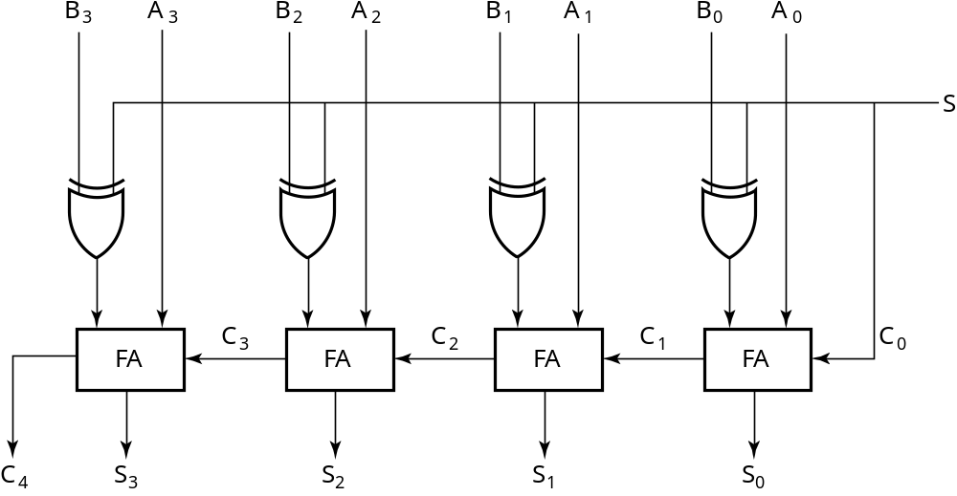
2’s Complement Adder/Subtractor
Subtraction can be done by addition of the 2's Complement.
1. Complement each bit (1's Complement.)
2. Add 1 to the result.
The circuit shown computes A + B and A – B:
For S = 1, subtract,
the 2’s complement
of B is formed by using
XORs to form the 1’s
comp and adding the 1
applied to C₀.
For S = 0, add, B is
passed through
unchanged
Chapter 5 <number>

Slide 48
Implementing Arithmetic Logic Unit (ALU)
- performs integer arithmetic and logical operations
idea: Use adders and control some of the inputs
    A block of logic that selects four choices for the B input to the adder
Implementation
Change generate function Gi and propagate function Pi
Chapter 5 <number>

Slide 49
ALU Example: G_{i}=X_{i}+Y_{i}+C_{in}
C
in
Assume: Y_{i}=B_{i}S₀+B_{i}S₁
n
A
X
n
n-bit
n
B
parallel
G
=
X
+
Y
+
C
in
n
adder
B input
Y
S
logic
0
S
1
C
out

Slide 50
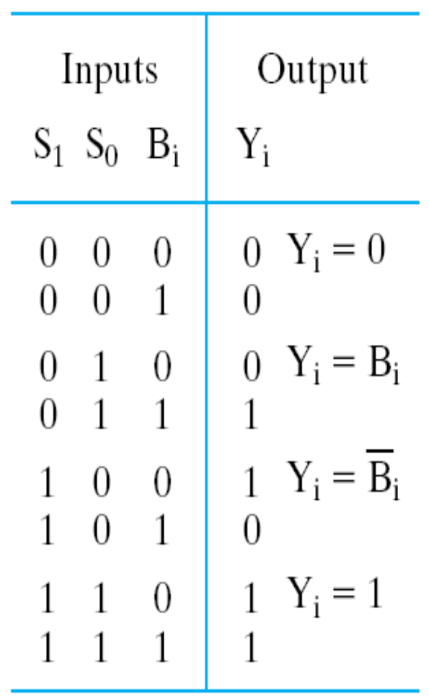
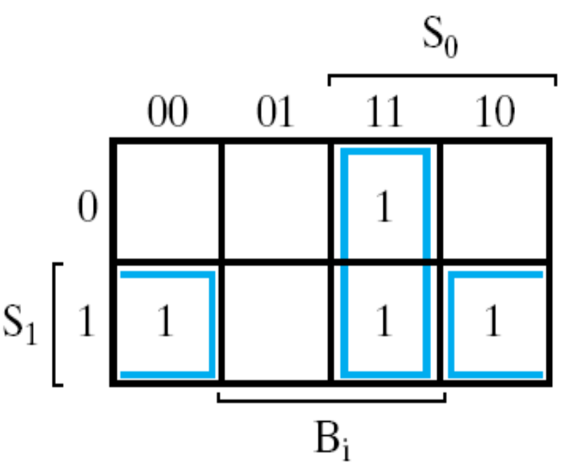

Arithmetic Circuit Design
1. Multiplexing
2. Redesign the input of B
Chapter 5 <number>

Slide 51
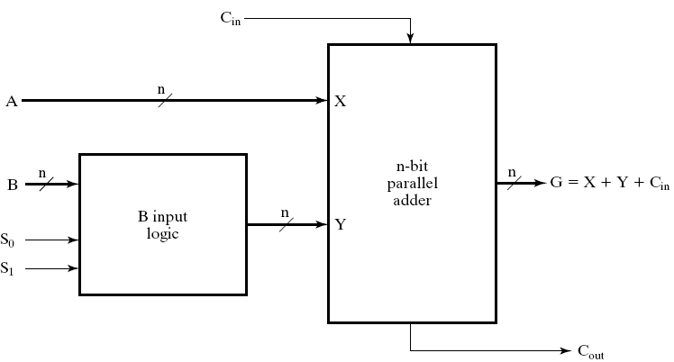
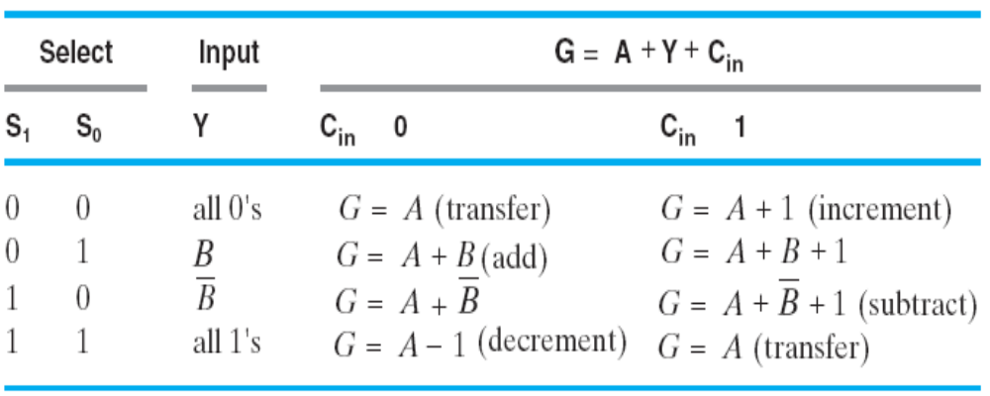
ALU Example:
G_{i}=X_{i}+Y_{i}+C_{in}
Chapter 5 <number>

Slide 52
Assignment
Reading: pp. 150-167, 447-450
Problems:
  3-50; 3-51; 3-59;
Chapter 5 <number>

