Slide 1
Logic and Computer Design Fundamentals
Programmable Implementation Technologies
College of Computer Science and Technology, Zhejiang University

Slide 2
Overview
Why programmable logic?
Programmable logic technologies
Programmable Configurations
Programmable Logic Functions Implementation

Slide 3
Why Programmable Logic?
Facts:
  It is most economical to produce an IC in large volumes
  Many designs required only small volumes of ICs
Need an IC that can:
  Be produced in large volumes
  Handle many designs required in small volumes
A programmable logic part can be:
  made in large volumes
  programmed to implement large numbers of different low-volume designs
Notes:
IC: Integrated Circuit (Chips) 集成电路/芯片

Slide 4
Programmable Logic - Additional Advantages
Many programmable logic devices are field- programmable, i. e., can be programmed outside of the manufacturing environment
Most programmable logic devices are erasable and reprogrammable.
  Allows “updating” a device or correction of errors
  Allows reuse the device for a different design - the ultimate in re-usability!
  Ideal for course laboratories
Programmable logic devices can be used to prototype design that will be implemented for sale in regular ICs.
  Complete Intel Pentium designs were actually prototype with specialized systems based on large numbers of VLSI programmable devices!

Slide 5
Programming Technologies
  Control connections
    Mask programming
    Fuse
    Antifuse
    Single-bit storage element
  Build lookup tables
    Storage elements (as in a memory)
  Control transistor switching
    Stored charge on a floating transistor gate
      Erasable
      Electrically erasable
      Flash (as in Flash Memory)
    Storage elements (as in a memory)

Slide 6
Technology Characteristics
Permanent - Cannot be erased and reprogrammed
    Mask programming
    Fuse
    Antifuse
Reprogrammable
  Volatile - Programming lost if chip power lost
    Single-bit storage element
  Non-Volatile
    Erasable
    Electrically erasable
    Flash (as in Flash Memory)

Slide 7
Programmable Configurations
Read Only Memory (ROM) - a fixed array of AND gates and a programmable array of OR gates
Programmable Array Logic (PAL)® - a programmable array of AND gates feeding a fixed array of OR gates.
Programmable Logic Array (PLA) - a programmable array of AND gates feeding a programmable array of OR gates.
Complex Programmable Logic Device (CPLD) /Field- Programmable Gate Array (FPGA) - complex enough to be called “architectures” - See VLSI Programmable Logic Devices reading supplement

Slide 8
ROM, PAL and PLA Configurations
Fixed
Programmable
Programmable
Inputs
AND array
Connections
OR array
Outputs
(decoder)
(a) Programmable read-only memory (PROM)
Inputs
Programmable
Programmable
Fixed
Connections
AND array
OR array
Outputs
(b) Programmable array logic (PAL) device
Programmable
Programmable
Programmable
Programmable
Inputs
Connections
AND array
Connections
OR array
Outputs
(c) Programmable logic array (PLA) device

Slide 9
Read Only Memory
Read Only Memories (ROM) or Programmable Read Only Memories (PROM) have:
  N input lines,
  M output lines, and
  2^{N} decoded minterms.
Fixed AND array with 2^{N} outputs implementing all N-literal minterms.
Programmable OR Array with M outputs lines to form up to M sum of minterm expressions.
A program for a ROM or PROM is simply a multiple-output truth table
  If a 1 entry, a connection is made to the corresponding minterm for the corresponding output
  If a 0, no connection is made
Can be viewed as a memory with the inputs as addresses of data (output values), hence ROM or PROM names!

Slide 10
Read Only Memory Example
Example: A 8 X 4 ROM (N = 3 input lines, M= 4 output lines)
The fixed "AND" array is a
“decoder” with 3 inputs and 8
outputs implementing minterms.
The programmable "OR“
array uses a single line to
represent all inputs to an
OR gate. An “X” in the
array corresponds to attaching the
minterm to the OR
Read Example: For input (A₂,A₁,A₀)
= 001, output is (F₃,F₂,F₁,F₀ ) = 0011.
What are functions F₃, F₂ , F₁ and F₀ in terms of (A₂, A₁, A₀)?
D7
X
X
X
D6
D5
X
X
D4
X
A
A2
D3
X
B
D2
X
X
A1
D1
C
A0
D0
X
F3
F2
F1
F0
Notes:
F3 = D7 + D5 + D2 = A2 A0 + A2’ A1 A0’
F2 = D7 + D0 = A2 A1 A0 + A2’ A1’ A0’
F1 = D4 + D1 = A1 A1’ A0’ + A2’ A1’ A0
F0 = D7 + D5 + D1 = A2 A0 + A1’ A0

Slide 11
Programmable Array Logic (PAL)
The PAL is the opposite of the ROM, having a programmable set of ANDs combined with fixed ORs.
Disadvantage
  ROM guaranteed to implement any M functions of N
  inputs. PAL may have too few inputs to the OR gates.
Advantages
  For given internal complexity, a PAL can have larger N and M
  Some PALs have outputs that can be complemented, adding POS functions
  No multilevel circuit implementations in ROM (without external connections from output to input). PAL has
  outputs from OR terms as internal inputs to all AND
  terms, making implementation of multi-level circuits easier.

Slide 12
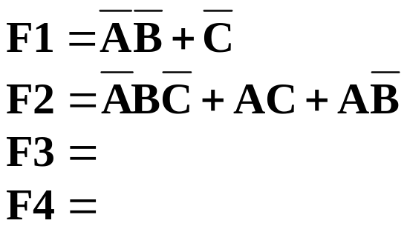
Programmable Array Logic Example
AND gates inputs
4-input, 4-output PAL with fixed, 3-input OR terms
What are the equations for F1 through F4?
0
1
2
3
4
5
6
7
8
9
Product
1
X
term
2
X
X
F
1
3
I
1
=
A
4
X
X
X
5
X
X
F
2
6
X
X
I
2
=
B
7
X
X
8
X
X
F
3
9
X
I
3
=
C
10
X
X
11
X
X
F
4
12
X
I
4
=
D
0
1
2
3
4
5
6
7
8
9

Slide 13
Programmable Logic Array (PLA)
Compared to a ROM and a PAL, a PLA is the most flexible having a programmable set of ANDs combined with a programmable set of ORs.
Advantages
  A PLA can have large N and M permitting implementation of equations that are impractical for a ROM (because of the number of inputs, N, required)
  A PLA has all of its product terms connectable to all outputs, overcoming the problem of the limited inputs to the PAL Ors
  Some PLAs have outputs that can be complemented, adding POS functions
Disadvantage
  Often, the product term count limits the application of a PLA. Two-level multiple-output optimization reduces the number of product terms in an implementation, helping to fit it into a PLA.

Slide 14
Programmable Logic Array Example
A
What are the equations for F₁ and F₂?
Could the PLA implement the
functions without the XOR gates?
B
C
X
X
1
X
X
A B
X
X
2
X
B C
X
Fuse intact
A C
Fuse blown
X
X
3
X
X
X
4
X
A B
C
C
B
B
A
A
X
0
3-input, 2-output PLA with 4 product terms
X
1
F
1
F
2

Slide 15
Combinational Function Implementation
Implementation techniques:
  Decoders and OR gates
  Multiplexers (and inverter)
  ROMs
  PLAs
  PALs
  Lookup Tables
Can be referred to as structured implementation methods since a specific underlying structure is assumed in each case
Chapter 4 <number>

Slide 16
Decoder and OR Gates
Any combinational circuit with n inputs and m outputs can be implemented with:
  an n-to-2^{n}-line decoder, and
  m OR gates (one for each output)
Approach 1:
  Find the truth table for the functions
  Make a connection to the corresponding OR from the corresponding decoder output wherever a 1 appears in the truth table
Approach 2:
  Find all the minterms in the Boolean function
  Map the minterms with OR gates.
Chapter 4 <number>

Slide 17
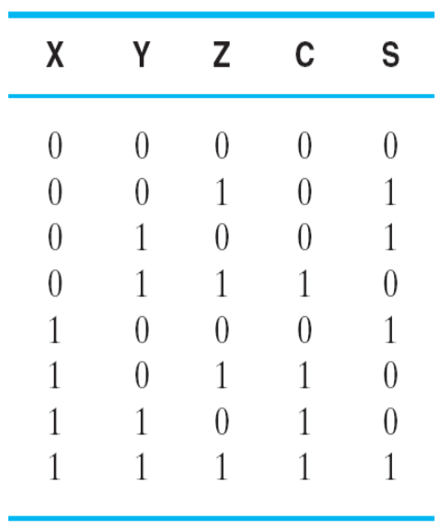
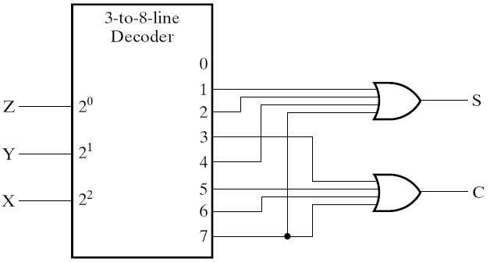
Decoder and OR Gates Example
Implement one bit binary adder
  Truth table
  Sum of minterms expressions
S（X，Y，Z）
=Σm（1，2，4，7）
C（X，Y，Z）
=Σm（3，5，6，7）
  Logic Circuit:
Chapter 4 <number>

Slide 18
Decoder and OR Gates Example
Implement the following set of odd parity functions of (A₇, A₆, A₅, A₃)
P₁ = A₇ A₅ A₃
P₂ = A₇ A₆ A₃
P₄ = A₇ A₆ A₅
Sum of
minterms expressions
P₁ = Σ_{m}(1,2,5,6,8,11,12,15)
P₂ = Σ_{m}(1,3,4,6,8,10,13,15)
P₄ = Σ_{m}(2,3,4,5,8,9,14,15)
Draw circuit
Is this a good idea?
+
+
A₇
A₆
A₅
A₃
P₁
0
1
2
3
4
5
6
7
8
9
10
11
12
13
14
15
+
+
+
+
P₂
P₄
Chapter 4 <number>
Notes:
No. The complexity is high. Much better to implement the functions with XOR gates.
Also, the sharing of logic can cause 2 bits in error, which for this application
(a Hamming encoder) is not detectable! Note that XOR gates should not be shared in the implementation as well.

Slide 19
Multiplexer Approach
Implement m functions of n variables with:
  Sum-of-minterms expressions
  An m-wide 2^{n}-to-1-line multiplexer
Design:
  Find the truth table for the functions.
  In the order they appear in the truth table:
    Apply the function input variables to the multiplexer inputs S_{n − 1}, … , S₀
    Label the outputs of the multiplexer with the output variables
  Value-fix the information inputs to the multiplexer using the values from the truth table (for don’t cares, apply either 0 or 1)
Chapter 4 <number>

Slide 20
One Bit Binary Adder By Multiplexer
Implementing a 1-bit Binary Adder with a Dual 8-to-1-Line Multiplexer
  Truth table
  Circuit: (图3-29）
Chapter 4 <number>

Slide 21
Not Enough Control Pole for Multiplexer
Implement a multiplexer of n+1 variables and m functions with the following devices:
  M-bit width 2^{n} -to-1 Multiplexer
  One invertor
Design:
  Derive the truth table
  Using X+X law, the truth table is separated into two parts based on the first n variable
  Use the variable as another input for the multiplexer, now the input combination is (0, 1, X, X)
Chapter 4 <number>

Slide 22
Multiplexer Implementation - Minterms > Selection Inputs
Implementing a 1-bit Binary Adder with a Dual 8-to-1-Line Multiplexer
  Truth table:
  Circuit: （图3-30）
Chapter 4 <number>

Slide 23
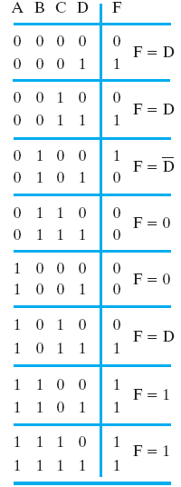
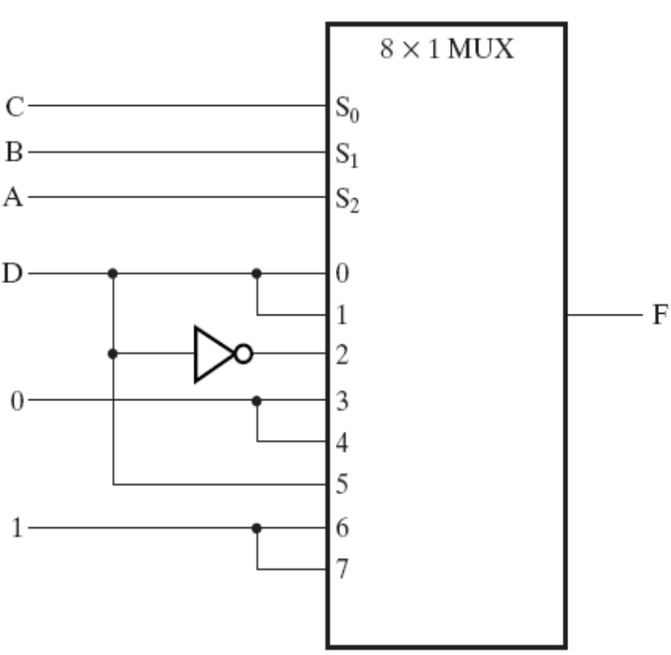
Example: 4-Variable Function
Implement the function with an 8×1 MUX:
F(A,B,C,D)
= Σ_{m}(1,3,4,11,12,13,14,15)
Chapter 4 <number>

Slide 24
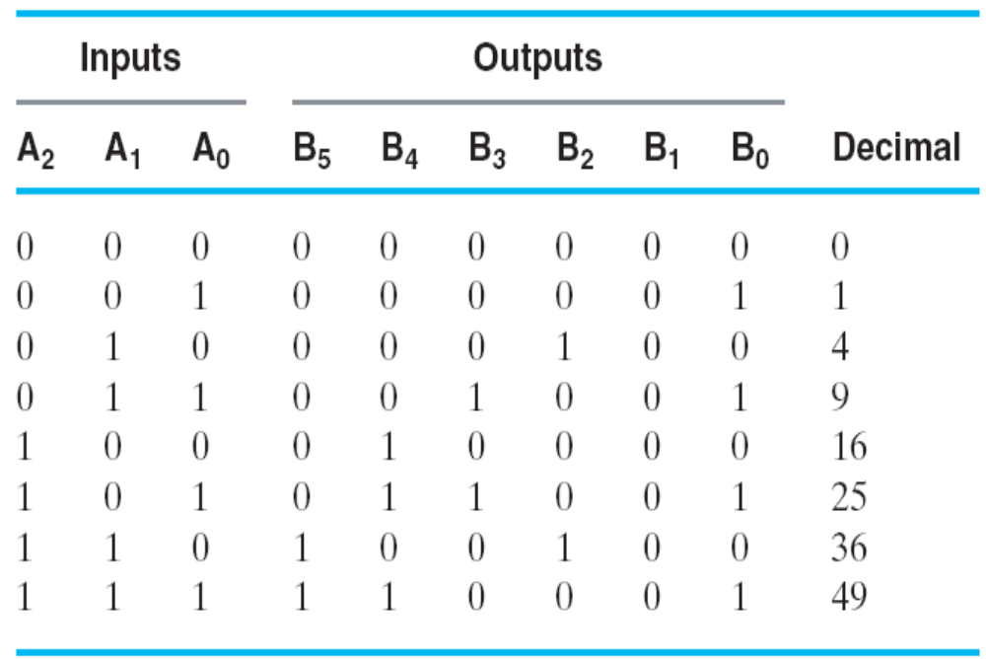
ROM Example: Square of 3-bit input number
Functions are implemented by storing the truth table
Other representations such as equations more convenient
Generation of programming information from equations usually done by software
_{B0 = A0}
_{B1 = 0}
_{8×4bit} _{ROM can be selected}
Chapter 4 <number>

Slide 25
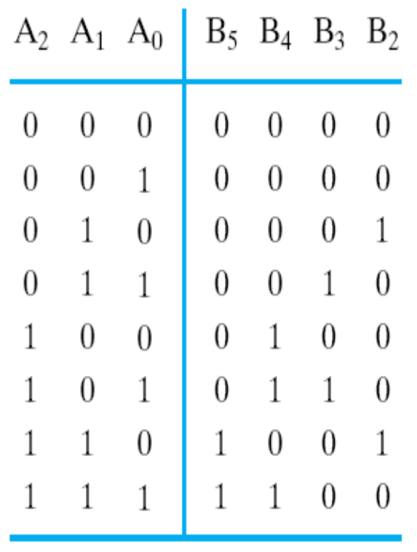
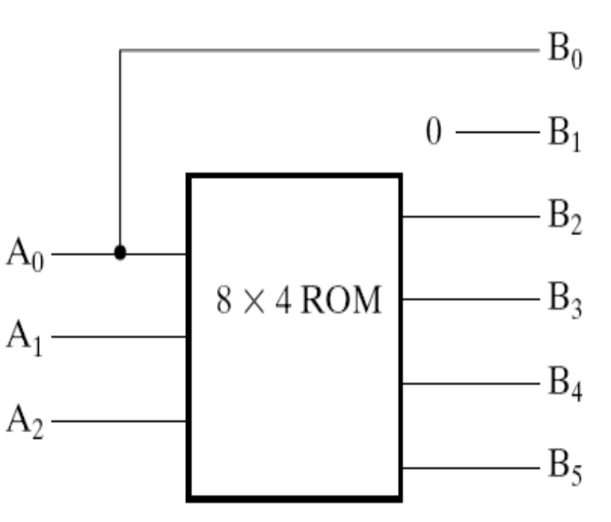
Square of 3-bit input number
ROM Truth Table
8 × 4 ROM are selected
The equations input the address of ROM, and ROM ouput the square of input
How to choose ROM?
Chapter 4 <number>

Slide 26
Example: Gray to Binary Code
Design a circuit to
convert a 3-bit Gray
code to a binary code
The formulation gives
the truth table on the
right
It is obvious from this
table that X = C and the
Y and Z are more complex
Gray
Binary
A B C
x y z
0
0
0
0
0
0
1 0
0
0
0 1
1
1 0
0 1 0
0 1 0
0 1
1
0 1
1
1 0
0
1
1
1
1 0 1
1 0 1
1
1 0
0
0 1
1
1
1
Chapter 3 <number>

Slide 27
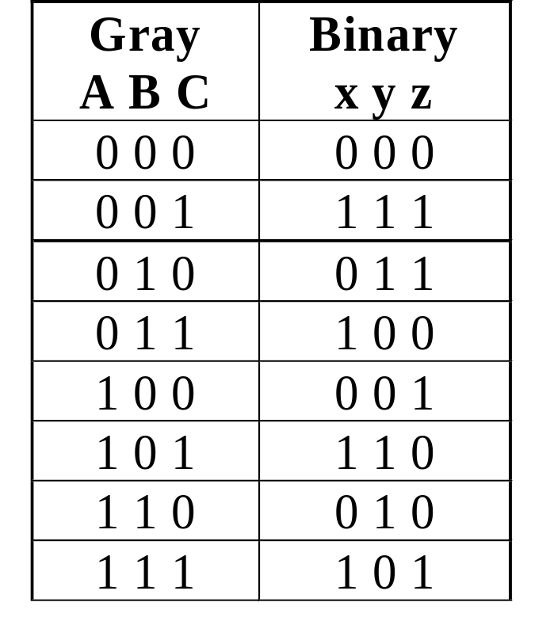
Gray to Binary (continued)
Rearrange the table so
that the input combinations
are in counting order
Functions y and z can
be implemented using
a dual 8-to-1-line
multiplexer by:
  connecting A, B, and C to the multiplexer select inputs
  placing y and z on the two multiplexer outputs
  connecting their respective truth table values to the inputs
Chapter 3 <number>

Slide 28
Gray to Binary (continued)
Note that the multiplexer with fixed inputs is identical to a ROM with 3-bit addresses and 2-bit data!
0
D00
0
D10
1
D01
1
D11
1
D02
1
D12
0
D03
0
D13
0
D04
1
D14
1
Out
Y
0
Out
Z
D05
D15
1
D06
0
D16
0
D07
1
D17
A
S2
A
S2
8-to-1
8-to-1
B
S1
B
S1
MUX
S0
MUX
C
S0
C
Chapter 3 <number>

Slide 29
Combinational Logic Implementation
- Multiplexer Approach 2
Implement any m functions of n + 1 variables by using:
  An m-wide 2^{n}-to-1-line multiplexer
  A single inverter
Design:
  Find the truth table for the functions.
  Based on the values of the first n variables, separate the truth table rows into pairs
  For each pair and output, define a rudimentary function of the final variable (0, 1, X, )
  Using the first n variables as the index, value-fix the information inputs to the multiplexer with the corresponding rudimentary functions
  Use the inverter to generate the rudimentary function
X
Chapter 3 <number>

Slide 30
Example: Gray to Binary Code
Design a circuit to
convert a 3-bit Gray
code to a binary code
The formulation gives
the truth table on the
right
It is obvious from this
table that X = C and the
Y and Z are more complex
Gray
Binary
A B C
x y z
0
0
0
0
0
0
1 0
0
0
0 1
1
1 0
0 1 0
0 1 0
0 1
1
0 1
1
1 0
0
1
1
1
1 0 1
1 0 1
1
1 0
0
0 1
1
1
1
Chapter 3 <number>

Slide 31
Gray to Binary (continued)
Rearrange the table so that the input combinations are in counting order, pair rows, and find rudimentary functions
Gray A B C | Binary x y z | Rudimentary Functions of C for y | Rudimentary Functions of C for z
0 0 0 | 0 0 0
0 0 1 | 1 1 1
0 1 0 | 0 1 1
0 1 1 | 1 0 0
1 0 0 | 0 0 1
1 0 1 | 1 1 0
1 1 0 | 0 1 0
1 1 1 | 1 0 1
F = C
F = C
F = C
F = C
F = C
F = C
F = C
F = C
Chapter 3 <number>

Slide 32
Gray to Binary (continued)
Assign the variables and functions to the multiplexer inputs:
Note that this approach (Approach 2) reduces the cost by almost half compared to Approach 1.
This result is no longer ROM-like
Extending, a function of more than n variables is decomposed into several sub-functions defined on a subset of the variables. The multiplexer then selects among these sub-functions.
C
D00
C
D10
C
D01
C
D11
C
C
C
D02
Out
Y
C
D12
Out
Z
C
D03
C
D13
A
S1
4-to-1
A
S1
4-to-1
B
S0
MUX
B
S0
MUX
Chapter 3 <number>

Slide 33
Lookup Tables
Lookup tables are used for implementing logic in Field-Programmable Gate Arrays (FPGAs) and Complex Logic Devices (CPLDs)
Lookup tables are typically small, often with four inputs, one output, and 16 entries
Since lookup tables store truth tables, it is possible to implement any 4-input function
Thus, the design problem is how to optimally decompose a set of given functions into a set of 4-input two- level functions.
We will illustrate this by a manual attempt
Chapter 4 <number>

Slide 34
Lookup Table Example
Equations to be implemented:
F1(A,B,C,D,E,F,G,H,I)=ABCDE+FGHIDE
F2(A,B,C,D,E,F,G,H,I)=ABCEF+FGHI
Compute the number of LUT：Factoring k
  Number of inputs = 9 k=[9/4]=3 need 3 LUT
Divide these 2 functions into function group with 4 variables, each group contains 3 functions
  Need at most 6 LUT
  If common LUT exists, the number of LUT can be reduced by 2
F₁=(ABC)DE+(FGHI)DE
F₁(D,E,X₁,X₂)=X₁DE+X₂DE
X₁(A,B,C)=ABC
X₂(F,G,H,I)=FGHI
F₂=(ABC)EF+FGHI
F₂(E,F,X₁,X₂)=X₁EF+X₂
Chapter 4 <number>

Slide 35
Programmable Logic Array
The set of functions to be implemented must fit the available number of product terms
The number of literals per term is less important in fitting
The best approach to fitting is multiple-output, two-level optimization (which has not been discussed)
Since output inversion is available, terms can implement by either a function or its complement
For small circuits, K-maps can be used to visualize product term sharing and use of complements
For larger circuits, software is used to do the optimization including use of complemented functions
Chapter 4 <number>

Slide 36
Programmable Logic Array Example
lists the product term numbers
Specifies the required paths between inputs and AND gates
Specifies the paths between the AND and OR gates
For each output variable, we may have a T or C for controlling the output exclusive-OR gate
Build the programming table
Chapter 4 <number>
Notes:
F2=(AC+BC)’ = (A+B)’+C’=A’B’+C’

Slide 37
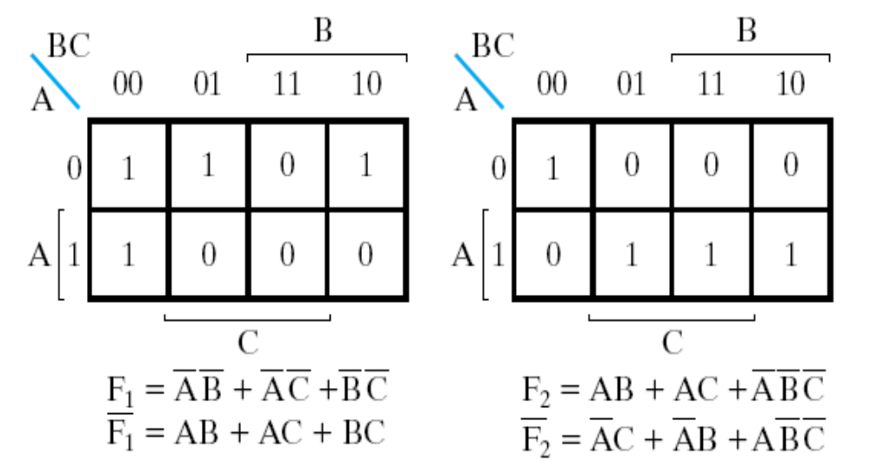
PLA Design Example
Implement functions:
F1(A,B,C)
=Σm(0,1,2,4)
F2(A,B,C)
=Σm(0,5,6,7)
K-map
specification
How can this
be implemented
with the least product terms?
Complete the
programming table
Chapter 4 <number>

Slide 38
PLA Example
A
B
C
X
X
1
X
X
X
X
2
X
X
X
Fuse intact
＋
Fuse blown
X
X
3
X
X
X
X
4
X
C
C
B
B
A
A
X
0
X
1
F
1
F
2
Chapter 4 <number>

Slide 39
Programmable Array Logic
Different from ROM and PLA, there is no sharing of AND gates
Design requires fitting functions within the limited number of ANDs per OR gate
Single function optimization is the first step to fitting
If the number of product terms in a function is greater than the number of ANDs per OR gate, then factoring is necessary
Chapter 4 <number>

Slide 40
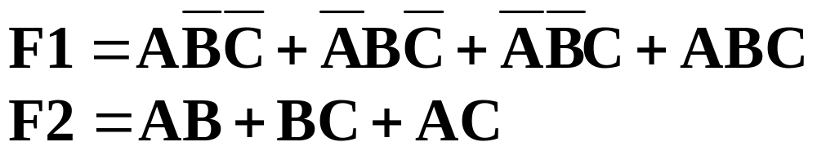

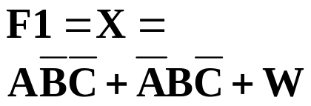
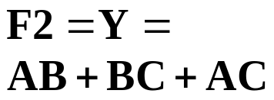
PAL Example
Equations:
F1 must be
factored
Factor out
last two
terms as W
AND
Inputs
Pr
od
uc
t
term
A B C D
W
Outputs
1
0
0
1
—
—
2
1
1
1
—
—
3
—
—
—
—
—
4
1
0
0
—
—
5
0
1
0
—
—
6
—
—
—
—
1
7
1
1
—
—
—
8
—
1
1
—
—
9
1
—
1
—
—
10
—
—
—
—
—
11
—
—
—
—
—
12
—
—
—
—
—
Chapter 4 <number>

Slide 41
PAL Example
AND gates inputs
Product
A
A
B
B
C
C
D
D
W
W
term
1
X
X
X
2
X
X
X
W
3
X
A
4
X
X
X
All fuses intact
(always
=
0)
5
X
X
X
F1
6
X
B
7
X
X
8
X
X
F2
9
X
X
C
10
11
12
D
X
Fuse intact
1
Fuse blown
Chapter 4 <number>
A
A
B
B
C
C
D
D
W
W

Slide 42

Assignment
Reading: pp. 319--329
Problem Assignment:
5-4 5-12

