Slide 1
Logic and Computer Design Fundamentals
Chapter 3 Combinational Logic Design
College of Computer Science and Technology, Zhejiang University

Slide 2
Overview
  Design Concepts and Automation
    Fundamental concepts of design and computer-aided design techniques
  Design Space
    Technology parameters for gates, positive and negative logic and design tradeoffs
  Design Procedure
    The major design steps: specification, formulation, optimization, technology mapping, and verification
  Technology Mapping
    From AND, OR, and NOT to other gate types
  Verification
    Does the designed circuit meet the specifications?

Slide 3
3.1 Design Concepts and Automation
Logic Circuits
Combinational Logic Circuit
Two Types:
Sequential Logic Circuit
Definition of Combinational Circuit
A combinational circuit consists of logic gates whose output at any time are determined by logic operations on the input values.

Slide 4
Combinational Logic Circuit
A combinational logic circuit has:
  A set of n Boolean inputs,
  A set of m Boolean outputs, and
  m Boolean functions, each mapping the 2^{n} input combinations to an output such that the current output depends only on the current input values
A block diagram:
x₁
Combinational Logic Circuit
F₁
x₂
F₂
…
n Boolean Inputs
…
…
m Boolean Outputs
x_{n}
F_{m}
F_{i}=f_{i}(x₁，x₂，…x_{n})， i=1，2，…，m
(Without any memory devices, feedback loops, one-way transmission of input signal)

Slide 5
Hierarchical Design
To control the complexity of the function mapping from inputs to outputs:
  Decompose the function into smaller pieces called blocks
  Decompose each block’s function into smaller blocks, repeating as necessary until all blocks are small enough
  Any block that cannot be further decomposed is called a primitive block
  The collection of all blocks including the decomposed ones is a hierarchy
Example: 9-input parity generator (see next slide)
  Top Level: 9 inputs, one output
  2nd Level: Four integrated 3-input odd function blocks
  3rd Level: 3-input odd function circuit as interconnected exclusive-OR blocks
  Primitives: exclusive-OR block as 4 interconnected four NAND gates
  Design requires 4 X 2 X 4 = 32 2-input NAND gates

Slide 6
Hierarchy for 9-Input Parity Checker Example
X
0
X
1
X
2
9-Input
X
3
odd
X
4
Z
O
X
5
function
X
X
6
0
A
0
3-Input
X
7
A
odd
X
8
X
1
1
function
B
O
(a) Symbol for Circuit
X
2
A
2
X
3
A
0
3-Input
A
0
3-Input
X
4
A
1
odd
B
O
A
1
odd
B
O
Z
O
X
A
function
A
function
5
2
2
X
6
A
0
3-Input
X
7
A
1
odd
B
O
X
A
function
8
2
(b) Circuit as interconnected 3-input odd
function blocks
A
0
A
1
B
O
A
2
(c) 3-input odd function circuit as
interconnected exclusive-OR
blocks
(d) Exclusive-OR block as interconnected
NANDs

Slide 7
Method of Describing Logic Events
S₃ | S₂ | S₁ | F
0 | 0 | 0 | 0
0 | 0 | 1 | 1
0 | 1 | 0 | 1
0 | 1 | 1 | 0
1 | 0 | 0 | 1
1 | 0 | 1 | 0
1 | 1 | 0 | 0
1 | 1 | 1 | 1
S₂ S₁
Truth Table
Boolean Function
Karnaugh Maps
Timing Diagram
Logic Circuit
S₃
00 01 11 10
01
1
1
1
1
S₁
a
F
t_{pd}
S₂
+
d
e
S₃
g
1
2
F

Slide 8
Reusable Function Blocks and CAD
Whenever possible, we try to decompose a complex design into common, reusable function blocks
These blocks are
  verified and well-documented
  placed in libraries for future use
Representatives of Computer-Aided Design Tools:
  Schematic Capture
  Logic Simulators
  Tools for Timing Verification
  Hardware Description Languages
    Verilog and VHDL
  Logic Synthesizers
  Integrated Circuit Layout

Slide 9
Top-Down versus Bottom-Up
A top-down design proceeds from an abstract, high-level specification to a more and more detailed design by decomposition and successive refinement
A bottom-up design starts with detailed primitive blocks and combines them into larger and more complex functional blocks
Designs usually proceed from both directions simultaneously
  Top-down design answers: What are we building?
  Bottom-up design answers: How do we build it?
Top-down controls complexity while bottom-up focuses on the details

Slide 10


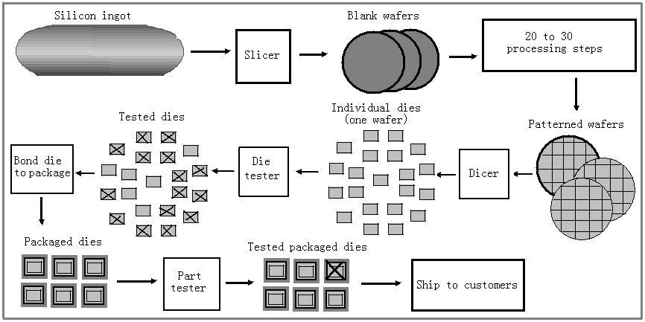
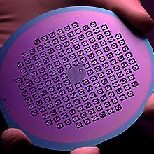
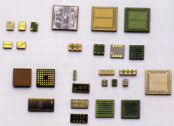
3.2 The Design Space
Gate Properties
Digital Circuit Integrated Circuit Semiconductor

Slide 11
Integrated Circuits
Integrated circuit (informally, a “chip”) is a semiconductor crystal (most often silicon) containing the electronic components for the digital gates and storage elements which are interconnected on the chip.
Terminology - Levels of chip integration
  SSI (small-scale integrated) - fewer than 10 gates
  MSI (medium-scale integrated) - 10 to 100 gates
  LSI (large-scale integrated) - 100 to 1000s of gates
  VLSI (very large-scale integrated) - s to 100s of millions of gates

Slide 12
Technology Parameters
Specific gate implementation technologies are characterized by the following parameters:
  Fan-in – the number of inputs available on a gate
  Fan-out – the number of standard loads driven by a gate output
  Noise Margin – the maximum external noise voltage imposed on a normal input value that will not cause an undesirable change in the circuit output
  Cost for a gate - a measure of the contribution of the gate to the cost of the integrated circuit
  Propagation Delay – The time required for a change in the value of a signal to propagate from an input to an output
  Power Dissipation – the power drawn from the power supply and consumed by the gate

Slide 13
Propagation Delay
Propagation delay is the time for a change on an input of a gate to propagate to the output.
Delay is usually measured at the midpoint between the H and L output voltage levels.
High-to-low (t_{PHL}) and low-to-high (t_{PLH}) output signal changes may have different propagation delays.
High-to-low (HL) and low-to-high (LH) transitions are defined with respect to the output, not the input.
An HL input transition causes:
  an LH output transition if the gate inverts and
  an HL output transition if the gate does not invert.

Slide 14
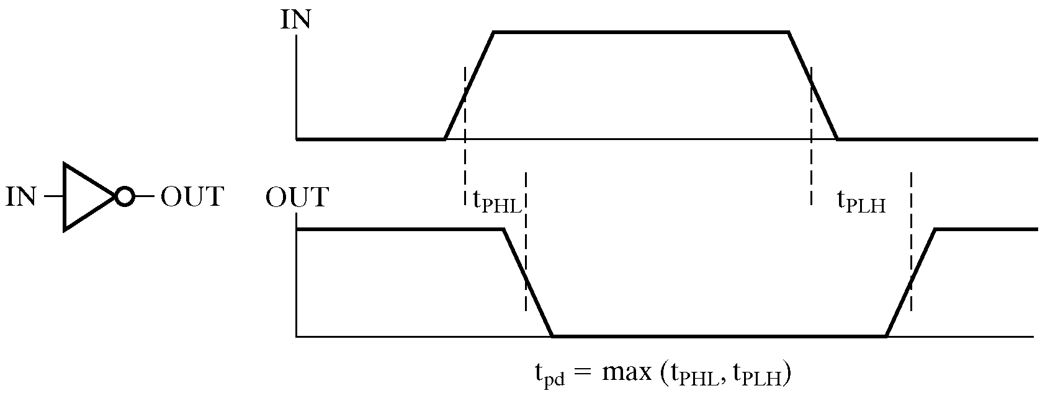
Propagation Delay (continued)
Propagation delays measured at the midpoint between the L and H values

Slide 15
Propagation Delay Example
Find the t_{PHL}, t_{PLH} and t_{pd} for the given signals
IN (volts)
OUT (volts)
t (ns)
1.0 ns per division

Slide 16
Delay Models
Transmission delay - a change of the output in response to a change on the inputs occurred after a fixed specified delay
Inertial delay - similar to transport delay, except that if input changes cause the output to changes twice in an interval less than the rejection time, then the first of the output changes does not occur. This models typical electronic circuit behavior, namely, rejects narrow “pulses” on the outputs

Slide 17
Delay Model Example
A
B
A B:
No Delay
(ND)
a
b
c
d
e
Transport
Delay (TD)
Inertial
Delay (ID)
0
2
4
6
8
10
12
14
16
Time (ns)
Propagation Delay = 2.0 ns Rejection Time = 1.0 ns

Slide 18
Fan-out
Fan-out can be defined in terms of a standard load
  Example: 1 standard load equals the load contributed by the input of 1 inverter.
  Transition time -the time required for the gate output to change from H to L, t_{HL}, or from L to H, t_{LH}
  The maximum fan-out that can be driven by a gate is the number of standard loads the gate can drive without exceeding its specified maximum transition time

Slide 19
Fan-out and Delay
The fan-out loading of a gate’s output affects the gate’s propagation delay
Example:
  One equation for t_{pd} for a NAND gate with 4 inputs is:
    t_{pd} = 0.07 + 0.021 SL ns
  SL is the number of standard loads the gate is driving, i. e., its fan-out in standard loads
  For SL = 4.5, t_{pd} = 0.1645 ns

Slide 20
Gate Cost
In an integrated circuit:
  The cost of a gate is proportional to the chip area occupied by the gate
  The gate area is roughly proportional to the number and size of the transistors and the amount of wiring connecting them
  Ignoring the wiring area, the gate area is roughly proportional to the gate input count
  So gate input count is a rough measure of gate cost
If the actual chip layout area occupied by the gate is known, it is a far more accurate measure

Slide 21
Design Trade-Offs
Cost - performance tradeoffs
Gate-Level Example:
  NAND gate G with 20 standard loads on its output has a delay of 0.45 ns and has a normalized cost of 2.0
  A buffer H has a normalized cost of 1.5. The NAND gate driving the buffer with 20 standard loads gives a total delay of 0.33 ns
  In which of the following cases should the buffer be added?
    The cost of this portion of the circuit cannot be more than 2.5
    The delay of this portion of the circuit cannot be more than 0.40 ns √
    The delay of this portion of the circuit must be less than 0.30 ns and the cost less than 3.0
Tradeoffs can also be accomplished much higher in the design hierarchy
Constraints on cost and performance have a major role in making tradeoffs

Slide 22
Positive and Negative Logic
The same physical gate has different logical meanings depending on the interpretation of the signal levels.
Positive Logic
  HIGH (more positive) signal levels represent Logic 1
  LOW (less positive) signal levels represent Logic 0
Negative Logic
  LOW (more negative) signal levels represent Logic 1
  HIGH (less negative) signal levels represent Logic 0
A gate that implements a Positive Logic AND function will implement a Negative Logic OR function, and vice-versa.

Slide 23
Positive and Negative Logic (continued)
Given this signal level table:
What logic function is implemented?
Input
Output
X Y
L
L
L
L H
H
H L
H
H
H
H
Positive
(H = 1)
Negative
(H = 0)
Logic
(L = 0)
Logic
(L = 1)
0 0
0
1 1
1
0 1
1
1 0
0
1 0
1
0 1
0
1 1
1
0 0
0

Slide 24
Positive and Negative Logic (continued)
Rearranging the negative logic terms to the standard function table order:
Positive
(H = 1)
Negative
(H = 0)
Logic
(L = 0)
Logic
(L = 1)
0 0
0
0 0
0
0 1
1
0 1
0
1 0
1
1 0
0
1 1
1
1 1
1
F=A+B
F=AB

Slide 25
Logic Symbol Conventions
Use of polarity indicator to represent use of negative logic convention on gate inputs or outputs
X
Y
Z
X
CKT
Z
L
L
L
Y
L
H
H
Logic Circuit
H
L
H
H
H
H
X
X
Z
Z
Y
Y
Positive Logic
Negative Logic

Slide 26
3.3 Analysis of Logic Circuits
Write the Boolean function for the circuit
  begin with the input signal
  Define the relationship of each gate
  optimization
Derive a truth table
  Define the relationships between the inputs and outputs,
Functional Analysis
  Define the function of each signal and the whole circuit
  Draw the timing diagram of the circuit
Verification
  Verify the correctness of the final design

Slide 27
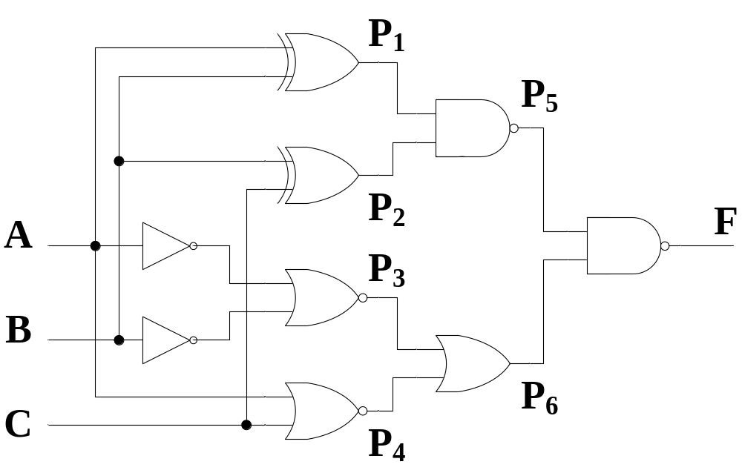
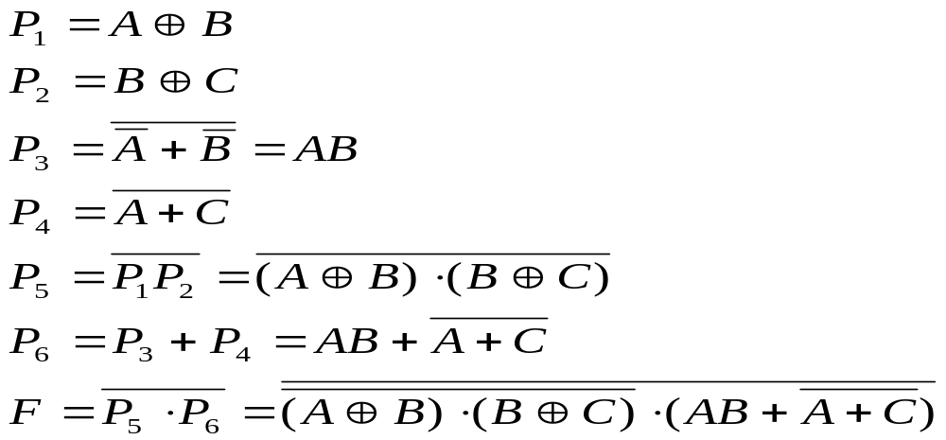
Analyze the Function of the Logic Circuit
Logic Circuits
List the Boolean functions for all signals

Slide 28
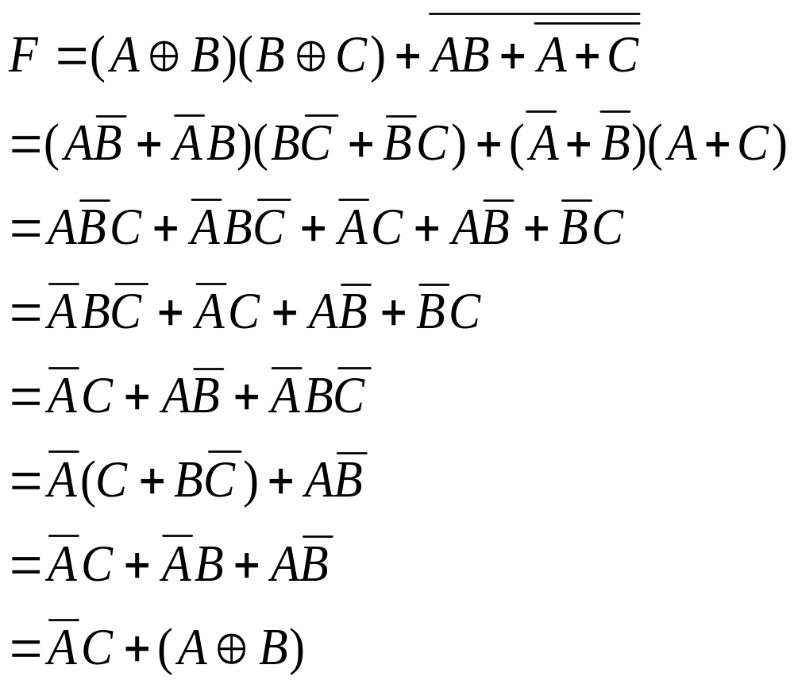
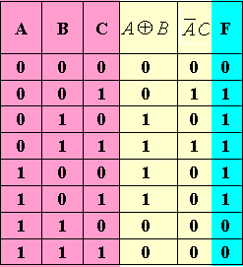
Boolean Function Simplification
Derive the truth table

Slide 29
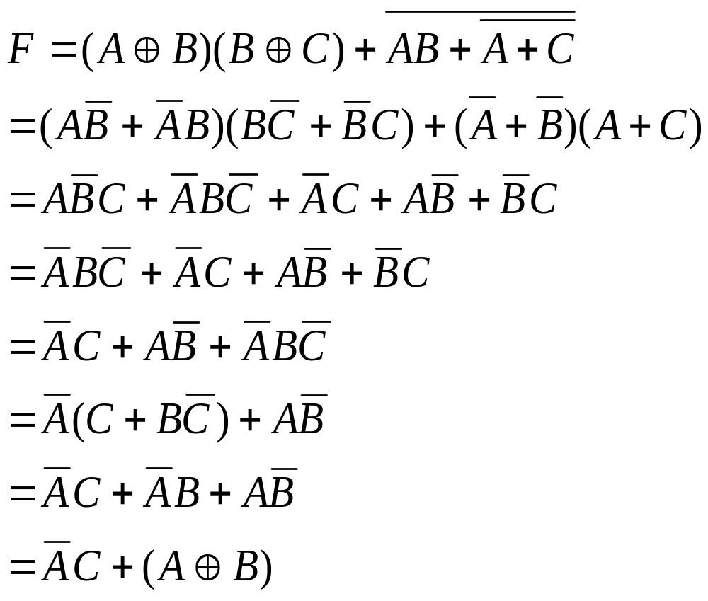
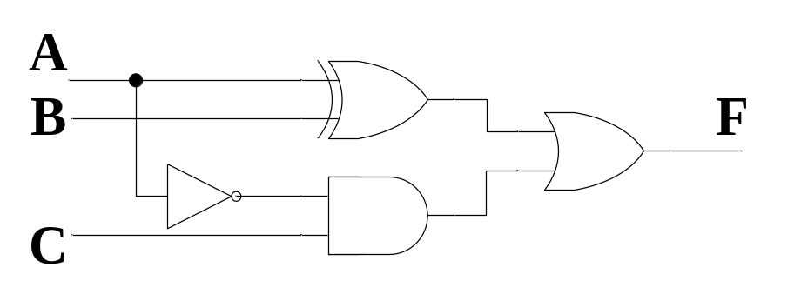
Boolean Function Simplification
Derive the truth table
From the truth table, we can see that F=1 if A≠B or A<C.
The original design is not
the best. Use the following
circuits instead.

Slide 30
Design Procedure
Specification
  Write a specification for the circuit if one is not already available (text, HDL)
Formulation
  Derive a truth table or initial Boolean equations that define the required relationships between the inputs and outputs, if not in the specification
Optimization
  Apply 2-level and multiple-level optimization
  Draw a logic diagram or provide a netlist for the resulting circuit using ANDs, ORs, and inverters

Slide 31
Design Procedure
Technology Mapping
  Map the logic diagram or netlist to the implementation technology selected
Verification
  Verify the correctness of the final design

Slide 32
Optimum function
Logic Circuit
Optimization
Problem
Truth Table
Transferred function
Logic Circuit
Transmission

Slide 33
Design Example 1
Example: The only light in the room is controlled by three switches, and each switch can control the light separately. Please design the logic circuit for the light and switches with least gates.
Solutions: 1. Specification
Analysis result:
input signal: switches S₁,S₂,S₃
output signal: light F
“1” for switch closed and “0” for opened
“1” for light on and “0” for light off
Truth table
S₃ | S₂ | S₁ | F
0 | 0 | 0 | 0
0 | 0 | 1 | 1
0 | 1 | 0 | 1
0 | 1 | 1 | 0
1 | 0 | 0 | 1
1 | 0 | 1 | 0
1 | 1 | 0 | 0
1 | 1 | 1 | 1
2. Formulation

Slide 34
S₃ | S₂ | S₁ | F
0 | 0 | 0 | 0
0 | 0 | 1 | 1
0 | 1 | 0 | 1
0 | 1 | 1 | 0
1 | 0 | 0 | 1
1 | 0 | 1 | 0
1 | 1 | 0 | 0
1 | 1 | 1 | 1
3. Optimization
S₂ S₁
S₃
00 01 11 10
01
1
1
1
1
Already optimized
真值表：

Slide 35
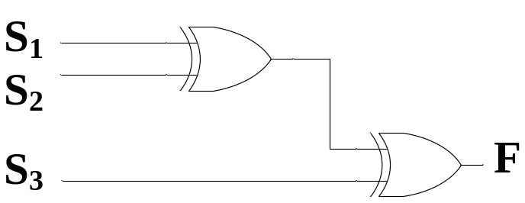
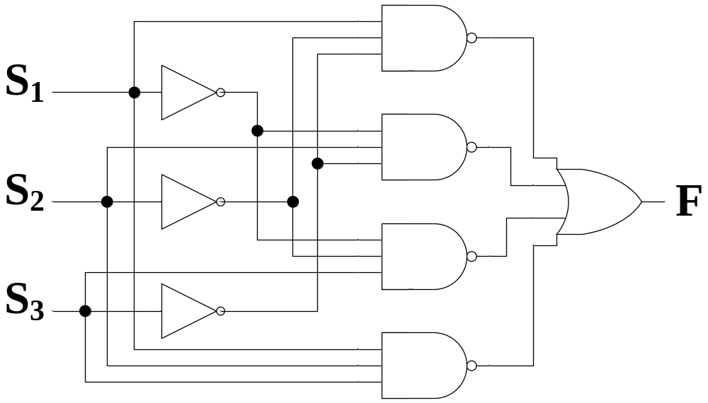
4. Technology Mapping
Least use of gates?

Slide 36
Verilog Programming
module lamp_control(s1,s2,s3,F );
input s1,s2,s3;
output F;
wire s1,s2,s3,F;
assign F= (~s3&~s2&s1) | (~s3&s2&~s1) | (s3&~s2&~s1) | (s3&s2&s1) ;
endmodule
Notes:
input, output默认为wire

Slide 37
Design Example 2
Specification
  BCD to Excess-3 code converter (p75)
  Transforms BCD code for the decimal digits to Excess-3 code for the decimal digits
  BCD code words for digits 0 through 9: 4-bit patterns 0000 to 1001, respectively
  Excess-3 code words for digits 0 through 9: 4-bit patterns consisting of 3 (binary 0011) added to each BCD code word
  Implementation:
    multiple-level circuit
    NAND gates (including inverters)

Slide 38
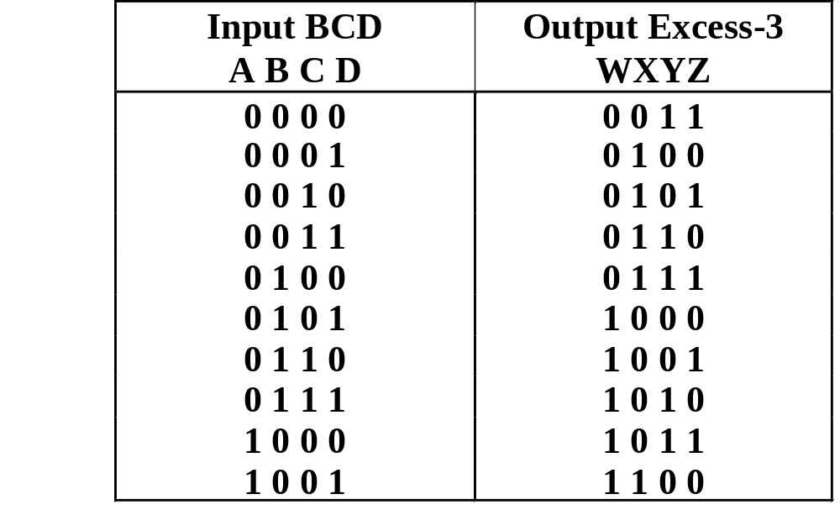
Design Example 2 (continued)
Formulation
  Conversion of 4-bit codes can be most easily formulated by a truth table
  Variables
  - BCD:
  A,B,C,D
  Variables
  - Excess-3
  W,X,Y,Z
  Don’t Cares
  - BCD 1010
  to 1111

Slide 39
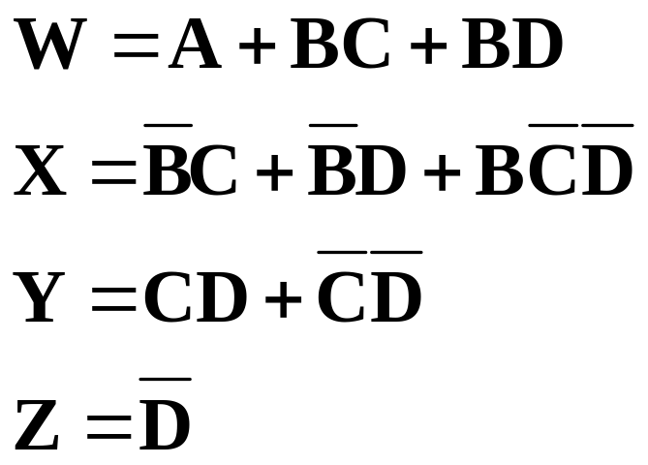
Design Example 2 (continued)
Optimization
  2-level using
  K-maps
z
C
y
C
1
1
1
1
0
1
3
2
0
1
3
2
1
1
1
1
4
5
7
6
B
4
5
7
6
B
X
X
X
X
X
X
X
X
A
12
13
15
14
A
12
13
15
14
1
X
X
1
X
X
8
9
11
10
8
9
11
10
D
D
x
C
w
C
1
1
1
0
1
3
2
0
1
3
2
1
1
1
1
4
5
7
6
B
4
5
7
6
B
X
X
X
X
X
X
X
X
A
12
13
15
14
A
12
13
15
14
1
X
X
1
1
X
X
8
9
11
10
8
9
11
10
D
D

Slide 40
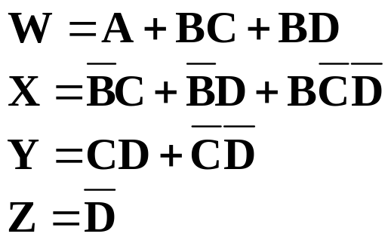
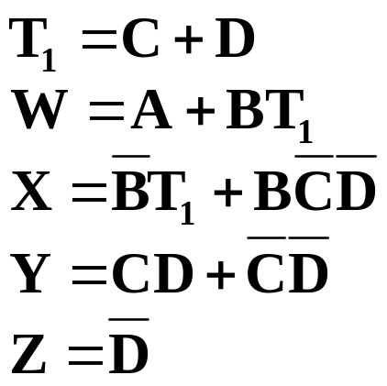
Design Example 2 (continued)
Optimization (continued)
  Multiple-level using transformations
  Perform extraction, finding factor: T₁ = C + D
G = 7 + 10+ 6 + 0 = 23
G = 2+4+7+6+0=19

Slide 41
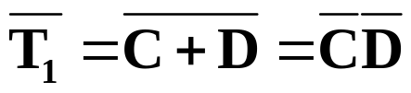
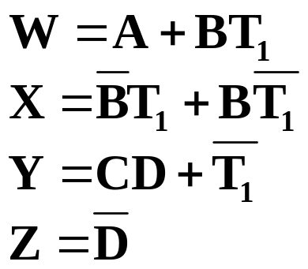
Design Example 2 (continued)
Optimization (continued)
  Multiple-level using transformations
  An additional extraction not shown in the text since it uses a Boolean transformation:
G = 2+4+7+6+0=19
G = 2 +1 + 4 + 6 + 4 + 0 = 17!

Slide 42
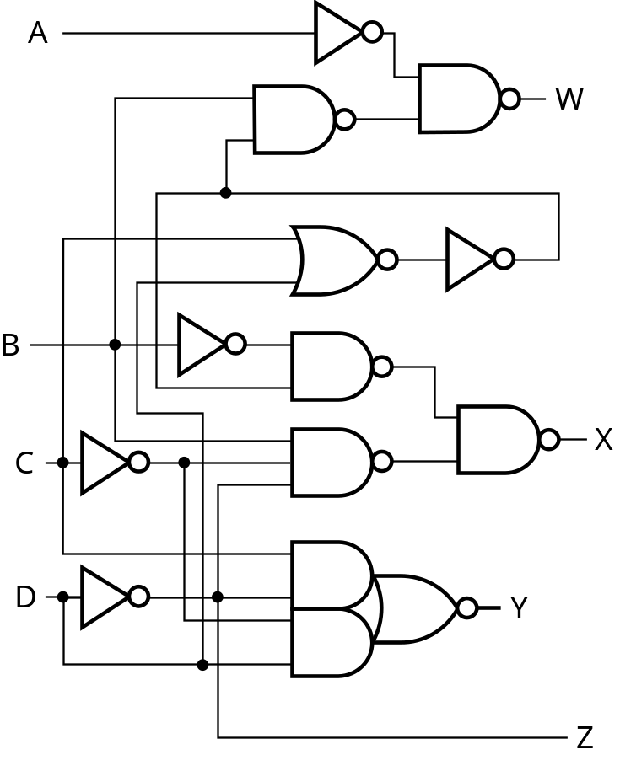
Design Example 2 (continued)
Technology Mapping
  Mapping with a library containing inverters and 2-input NAND, 3-input NAND, 2-input NOR, and 2-2 AOI gates
A
W
B
X
C
Y
D
Z

Slide 43
Verilog Programming
module BCD_ Excess_3( A,B,C,D,W,X,Y,Z );
input A,B,C,D;
output W,X,Y,Z;
wire A,B,C,D , W,X,Y,Z,T1;
assign T1 = C|D;
assign W = A|B&C|B&D ;
assign X = ~B&T1|B&~T1;
assign Y = C&D|~T1;
assign Z= ~D ;
endmodule

Slide 44
3.4 Technology Mapping
Chip design styles
Cells and cell libraries
Mapping Techniques
  NAND gates
  NOR gates
  Multiple gate types

Slide 45
Chip Design Styles
Full customized - the entire design of the chip down to the details of the layout is finished
  Expensive
  Justifiable only for dense, fast chips with high sales volume
Standard cell - blocks have been designed ahead of time or as part of previous designs
  Intermediate cost
  Less density and speed compared to full customized
Gate array - regular patterns of gate transistors that can be used in many designs built into chip - only the interconnections between gates are specific to a design
  Lowest cost
  Less density compared to full customized and standard cell
Notes:
门阵列：PAL，GAL，PLA

Slide 46
Cell Libraries
Cell - a pre-designed primitive block
Cell library - a collection of cells available for design using a particular implementation technology
Cell characterization - a detailed specification of a cell for use by a designer - often based on actual cell design and fabrication and measured values
Cells are used for gate array, standard cell, and in some cases, full custom chip design

Slide 47
Typical Cell Characterization Components
Schematic or logic diagram
Area of cell
  Often normalized to the area of a common, small cell such as an inverter
Input loading (in standard loads) presented to outputs driving each of the inputs
Delays from each input to each output
One or more cell templates for technology mapping
One or more hardware description language models
If automatic layout is to be used:
  Physical layout of the cell circuit
  A floorplan layout providing the location of inputs, outputs, power and ground connections on the cell

Slide 48
Example Cell Library
Typical
Typical
Input-to-
Basic
Cell
Cell
Normalized
Input
Output
Function
Name
Schematic
Area
Load
Delay
Templates
Inverter
1.00
1.00
0.04
＋
0.012
*
SL
2NAND
1.25
1.00
0.05
＋
0.014
*
SL
2NOR
1.25
1.00
0.06
＋
0.018
*
SL
2-2 AOI
2.25
0.95
0.07
＋
0.019
*
SL

Slide 49
Mapping to NAND gates
Assumptions:
  Gate loading and delay are ignored
  Cell library contains an inverter and n-input NAND gates, n = 2, 3, …
  An AND, OR, inverter schematic for the circuit is available
The mapping is accomplished by:
  Replacing AND and OR symbols,
  Pushing inverters through circuit fan-out points, and
  Canceling inverter pairs

Slide 50
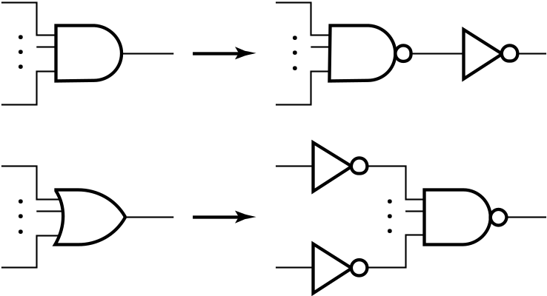
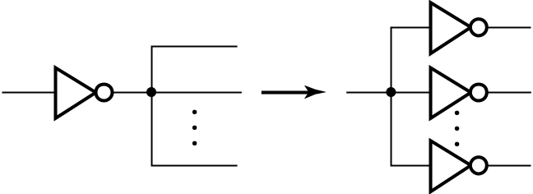

NAND Mapping Algorithm
Replace ANDs and ORs:
Repeat the following steps until there is at most one inverter between :
  A circuit input or driving NAND gate output, and
  The attached NAND gate inputs.

Slide 51
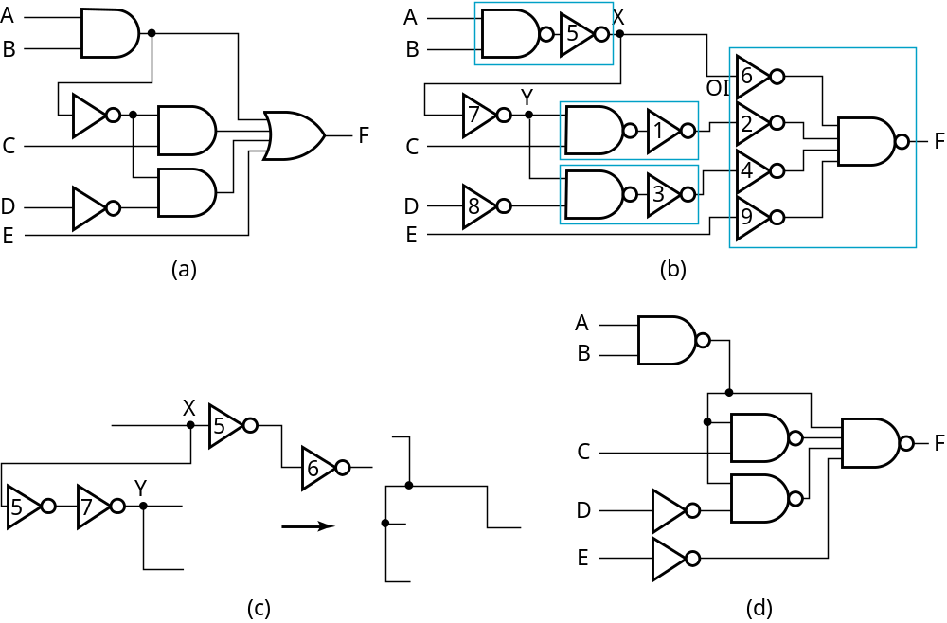
NAND Mapping Example

Slide 52
Mapping to NOR gates
Assumptions:
  Gate loading and delay are ignored
  Cell library contains an inverter and n-input NOR gates, n = 2, 3, …
  An AND, OR, inverter schematic for the circuit is available
The mapping is accomplished by:
  Replacing AND and OR symbols,
  Pushing inverters through circuit fan-out points, and
  Canceling inverter pairs

Slide 53
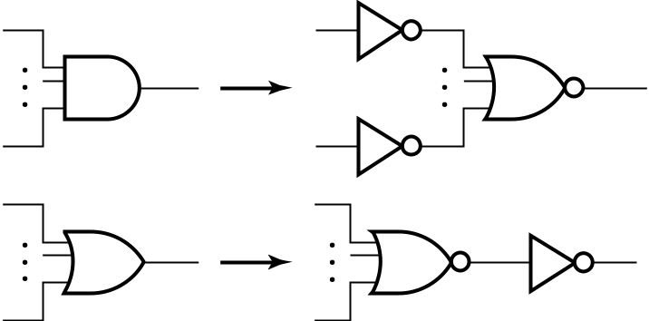
NOR Mapping Algorithm
Replace ANDs and ORs:
Repeat the following pair of actions until there is at most one inverter between :
  A circuit input or driving NOR gate output, and
  The attached NOR gate inputs.

Slide 54
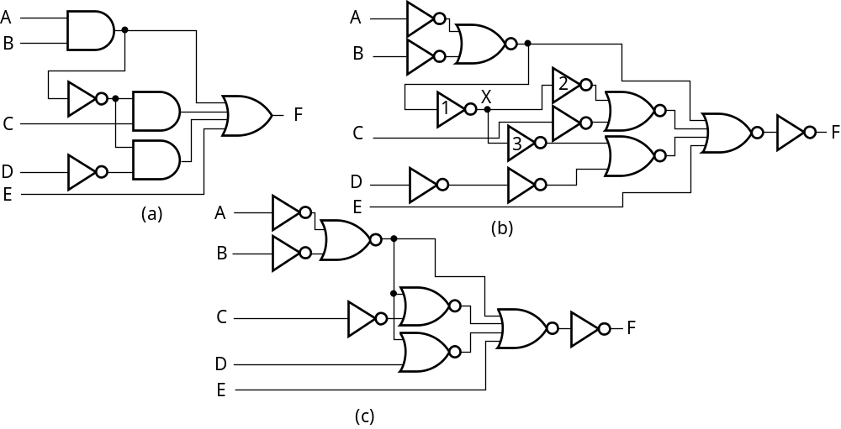
NOR Mapping Example

Slide 55
Mapping Multiple Gate Types
Algorithm is available in the Advanced Technology Mapping reading supplement
Cell library contains more than one “type” of gates
Concept Set 1
  Steps
    Replace all AND and OR gates with optimum equivalent circuits consisting only of 2-input NAND gates and inverters.
    Place two inverters in series on each line in the circuit containing NO inverters
  Justification
    Breaks up the circuit into small standardize pieces to allow maximum flexibility in the mapping process
    For the equivalent circuits, could use any simple gate set that can implement AND, OR and NOT and all of the cells in the cell library

Slide 56
Mapping Multiple Gate Types
Concept Set 2
  Fan-out free subcircuit - a circuit in which a single output cell drives only one other cell
  Steps
    Use an algorithm that guarantees an optimum solution for “fan-out free” subcircuits by replacing interconnected inverters and 2-input NAND gates with cells from the library
    Perform inverter “canceling” and “pushing” as for the NAND and NOR
  Justification
    Steps given optimize the total cost of the cells used within “fan-out free” subcircuits of the circuit
Final result: An optimum mapping solution within the “fan-out free subcircuits”

Slide 57
Example: Mapping Multiple Cell Types
Uses same example circuit as NAND mapping and NOR mapping
Cell library: 2-input and 3-input NAND gates, 2-input NOR gate, and inverter
Circuits on next slide
  (a) Optimized multiple-level circuit
  (b) Circuit with AND and OR gates replaced with circuits of 2-input NAND gates and inverters (Outlines show 2-input NANDs and inverter sets mapped to library cells in next step)
  (c) Mapped circuit with inverter pairs cancelled
  (d) Circuit with remaining inverters minimized

Slide 58
Example: Mapping Multiple Gate Types
A
A
B
B
C
F
C
F
D
D
E
E
(a)
(b)
A
B
A
B
C
F
C
F
D
D
E
E
(c)
(d)

Slide 59
3.5 Verification
Verification - show that whether the final designed circuit implements the original specification
Simple specifications are:
  truth table
  Boolean equations
  HDL code
If the above result from formulation are not the original specification, it is critical that the formulation process be flawless for the verification to be valid!

Slide 60
Basic Verification Methods
Manual Logic Analysis
  Find the truth table or Boolean equations for the final circuit
  Compare the final circuit truth table with the specified truth table, or
  Show that the Boolean equations for the final circuit are equal to the specified Boolean equations
Simulation
  Simulate the final circuit (or its netlist, possibly written as an HDL) and the specified truth table, equations, or HDL description using test input values that fully validate correctness.
  The obvious test for a combinational circuit is application of all possible “care” input combinations from the specification

Slide 61
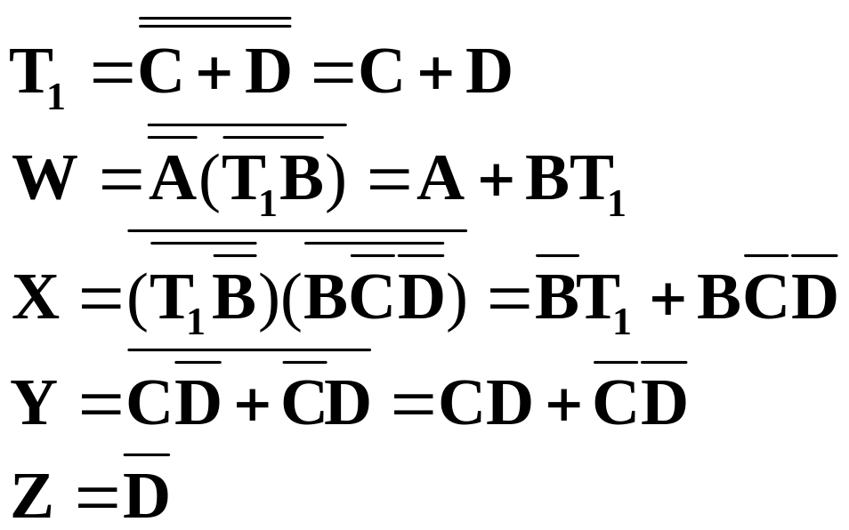
Verification Example: Manual Analysis
BCD-to-Excess 3 Code Converter
  Find the SOP Boolean equations from the final circuit.
  Find the truth table from these equations
  Compare to the formulation truth table
Finding the Boolean Equations:

Slide 62
Verification Example: Manual Analysis
Find the circuit truth table from the equations and compare to specification truth table:
Input BCD
Output Excess
-
3
Input BCD
Output Excess
-
3
A B C D
WXYZ
A B C D
WXYZ
0 0 0 0
0 0 1 1
0 0 0 0
0 0 1 1
0 0 0 1
0 1 0 0
0 0 0 1
0 1 0 0
0 0 1 0
0 1 0 1
0 0 1 0
0 1 0 1
0 0 1 1
0 1 1 0
0 0 1 1
0 1 1 0
0 1 0 0
0 1 1 1
0 1 0 0
0 1 1 1
0 1 0 1
1 0 0 0
0 1 0 1
1 0 0 0
0 1 1 0
1 0 0 1
0 1 1 0
1 0 0 1
0 1 1 1
1 0 1 0
0 1 1 1
1 0 1 0
1 0 0 0
1 0 1 1
1 0 0 0
1 0 1 1
1 0 0 1
1 1 0 0
1 0 0 1
1 1 0 0
The tables match!
Notes:
Since the outputs are not specified for the don’t cares, no analysis for correctness is needed.

Slide 63
Verification Example: Simulation
Simulation procedure:
  Use a schematic editor or text editor to enter a gate level representation of the final circuit
  Use a waveform editor or text editor to enter a test consisting of a sequence of input combinations to be applied to the circuit
    This test should guarantee the correctness of the circuit if the simulated responses to it are correct
    Short of applying all possible “care” input combinations, generation of such a test can be difficult

Slide 64
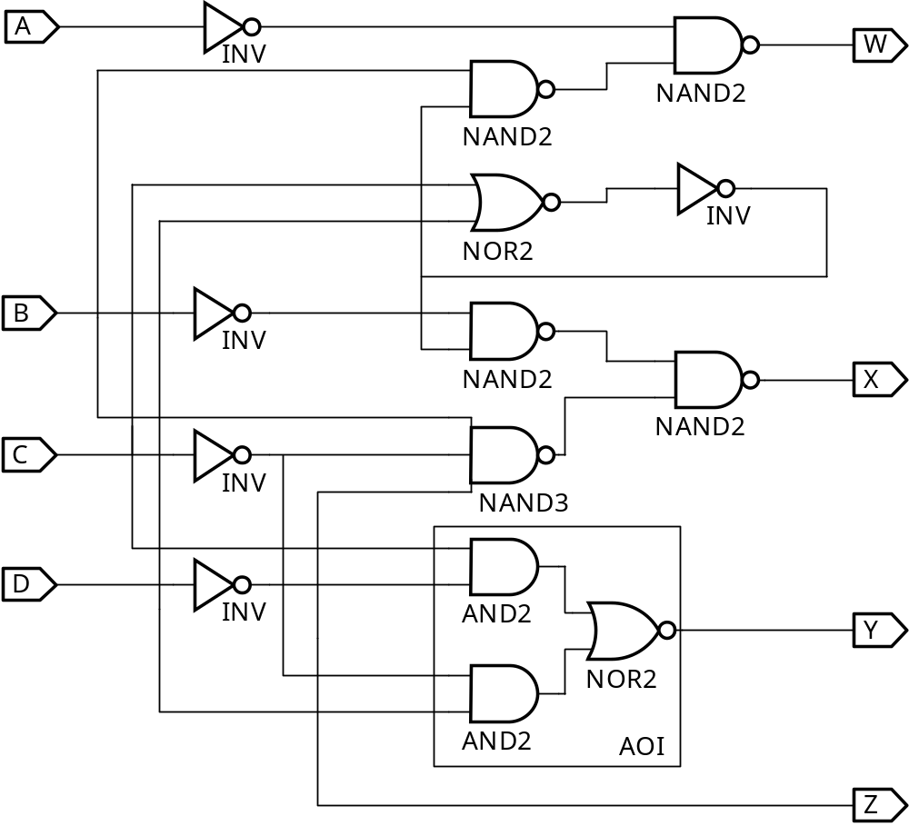
Verification Example: Simulation
Enter BCD-to-Excess-3 Code Converter Circuit Schematic
AOI symbol
not available

Slide 65
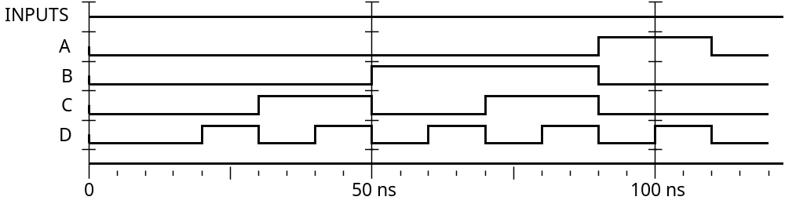
Verification Example: Simulation
Enter waveform that applies all possible input combinations:
Are all BCD input combinations present? (Low is a 0 and high is a one)
Notes:
Yes, 0000 through 1001 are present.

Slide 66
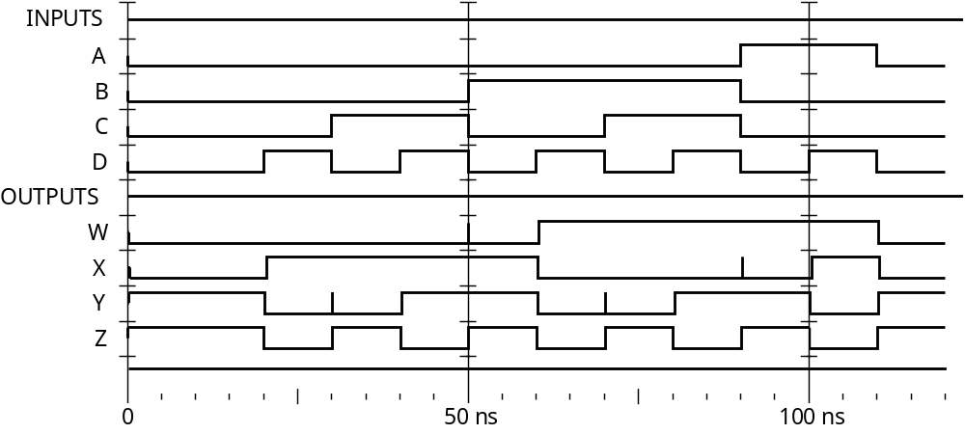
Verification Example: Simulation
Run the simulation of the circuit for 120 ns
Do the simulation output combinations match the original truth table?
Notes:
Yes, the output combinations 0011 through 1100 occur in response to 0000 through 1001, respectively.

Slide 67
Assignment
Reading: pp. 97-107，302-306
Problem Assignment:
3-7；3-8；3-11；3-13；3-14；3-16；5-3

