Slide 1
Logic and Computer Design Fundamentals
Chapter 3 Combinational
Logic Design II
College of Computer Science and Technology, Zhejiang University

Slide 2
Overview
Functions and functional blocks
Rudimentary logic functions
Decoding
Encoding
Selecting
Chapter 4 <number>

Slide 3
Functions and Functional Blocks
The functions considered are those found to be very useful in design
Corresponding to each of the functions is a combinational circuit implementation called a functional block.
In the past, many functional blocks were implemented as SSI, MSI, and LSI circuits.
Today, they are often simply parts within a VLSI circuits.
Chapter 4 <number>

Slide 4
Rudimentary Logic Functions
Four elementary combinational logic functions
  Value-Fixing: F = 0 or F = 1 , no Boolean operator
  Transferring: F = X , no Boolean operator
  Inverting: F = X , involves one logic gate
  Enabling: F = X·EN or F = X + EN , involves one or two logic gates
  The first three are functions of a single variable X
Table 4-1
Functions of one variable
V
CC
or V
DD
1
F
=
1
F
=
1
X
F
=
X
X
F
=0
F
=X
F
=
X
F=1
(c)
0
0
0
1
1
0
F
=
0
F
=
0
X
F
=
X
1
0
1
0
1
(a)
(b)
(d)
Chapter 4 <number>

Slide 5
Multiple-bit Rudimentary Functions
Multi-bit Examples:
A wide line is used to represent
a bus which is a vector signal
In (b) of the example, F = (F₃, F₂, F₁, F₀) is a bus.
The bus can be split into individual bits as shown in (b)
Sets of bits can be split from the bus as shown in (c)
for bits 2 and 1 of F.
The sets of bits need not be continuous as shown in (d) for bits 3, 1, and 0 of F.
A
F
A
3
3
2
1
F
1
2
4
4
2:1
F(2:1)
2
F
0
F
0
F
1
1
A
0
(c)
F
0
A
(a)
(b)
3
4
3,1:0
F(3), F(1:0)
F
(d)
Chapter 4 <number>

Slide 6
Enabling Function
Enabling permits an input signal to pass through to an output
Disabling blocks an input signal from passing through to an output, replacing it with a fixed value
The value on the output when it is disable can be Hi-Z (as for three-state buffers and transmission gates), 0 , or 1
When disabled, 0 output
When disabled, 1 output
See Enabling App in text
X
F
EN
(a)
X
F
EN
(b)
Chapter 4 <number>

Slide 7
Decoder
Decoding - the conversion of an n-bit input code to an m-bit output code with n ≤ m ≤ 2^{n} such that each valid code word produces a unique output code
Circuits that perform decoding are called decoders
Variable Decoder
Display Decoder
Types
Chapter 4 <number>

Slide 8
Decoder
？
What’s the bit length of data?
Controller
0
1
2
3
4
5
6
7
Chapter 4 <number>

Slide 9
Decoder
A | B | C | Y0 | Y1 | Y2 | Y3 | Y4 | Y5 | Y6 | Y7
0 | 0 | 0 | 1 | 0 | 0 | 0 | 0 | 0 | 0 | 0
0 | 0 | 1 | 0 | 1 | 0 | 0 | 0 | 0 | 0 | 0
0 | 1 | 0 | 0 | 0 | 1 | 0 | 0 | 0 | 0 | 0
0 | 1 | 1 | 0 | 0 | 0 | 1 | 0 | 0 | 0 | 0
1 | 0 | 0 | 0 | 0 | 0 | 0 | 1 | 0 | 0 | 0
1 | 0 | 1 | 0 | 0 | 0 | 0 | 0 | 1 | 0 | 0
1 | 1 | 0 | 0 | 0 | 0 | 0 | 0 | 0 | 1 | 0
1 | 1 | 1 | 0 | 0 | 0 | 0 | 0 | 0 | 0 | 1
Chapter 4 <number>

Slide 10
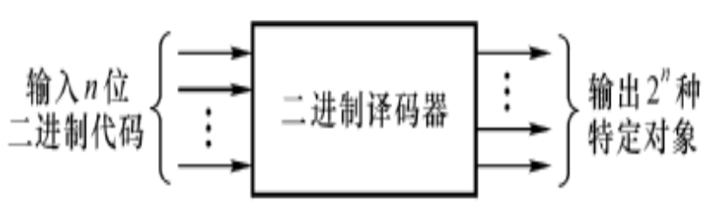
Decoder
Decoding - the conversion of an n-bit input code to an m-bit output code with n ≤ m ≤ 2^{n} such that each valid code word produces a unique output code
Decoders:
decoder with 2 input and 4 output, 74LS139 (2-to-4-Line Decoder)
decoder with 3 input and 8 output, 74LS138 (3-to-8-Line Decoder)
decoder with 4 input and 16 output, MC14514(4-to-16-Line Decoder)
Chapter 4 <number>

Slide 11
Decoder Examples
1-to-2-Line Decoder
2-to-4-Line Decoder
A
D
0
D
1
D
0
=
A
0
1
0
1
0
1
A
D
=
A
1
(a)
(b)
A
0
A
1
A
1
A
0
D
0
D
1
D
2
D
3
D
0
=
A
1
A
0
0
0
1
0
0
0
0
1
0
1
0
0
D
1
=
A
1
A
0
1
0
0
0
1
0
1
1
0
0
0
1
D
=
A
A
2
1
0
(a)
Note that the 2-4-line
made up of 2 1-to-2-
line decoders and 4 AND gates.
D
3
=
A
1
A
0
(b)
Chapter 4 <number>

Slide 12
Decoder Expansion
Decoder with n input can have 2^{n} output. When n is large, the circuit is very complex.
General procedure:
  Let k = n.
  If k is even, divide k by 2 obtain k/2. Use 2^{k} AND gates driven by two decoders of output size 2^{k/2}. If k is odd, obtain (k+1)/2 and (k-1)/2. Use 2^{k} AND gates driven by a decoder of output size 2 ^{(k+1)/2} and a decoder of output size 2 ^{(k-1)/2} .
  For each decoder resulting from step 2, repeat step 2 with k equal to the values obtained in step 2 until k = 1. For k = 1, use a 1-to-2 decoder.
Still valid when output ≠ 2^{n}
Chapter 4 <number>

Slide 13
Example: 3-to-8-Line Decoder
3-to-8-Line Decoder
  Construct directly, drive 8 3-input ANDs
  Hierarchically, divide the input signals equally
    2-to-4-Line decoder
    1-to-2-Line decoder
2-to-4-Line Decoder
  drive 4 2-input ANDs
  divide the input signals equally
    1-to-2-Line decoder
Chapter 4 <number>

Slide 14
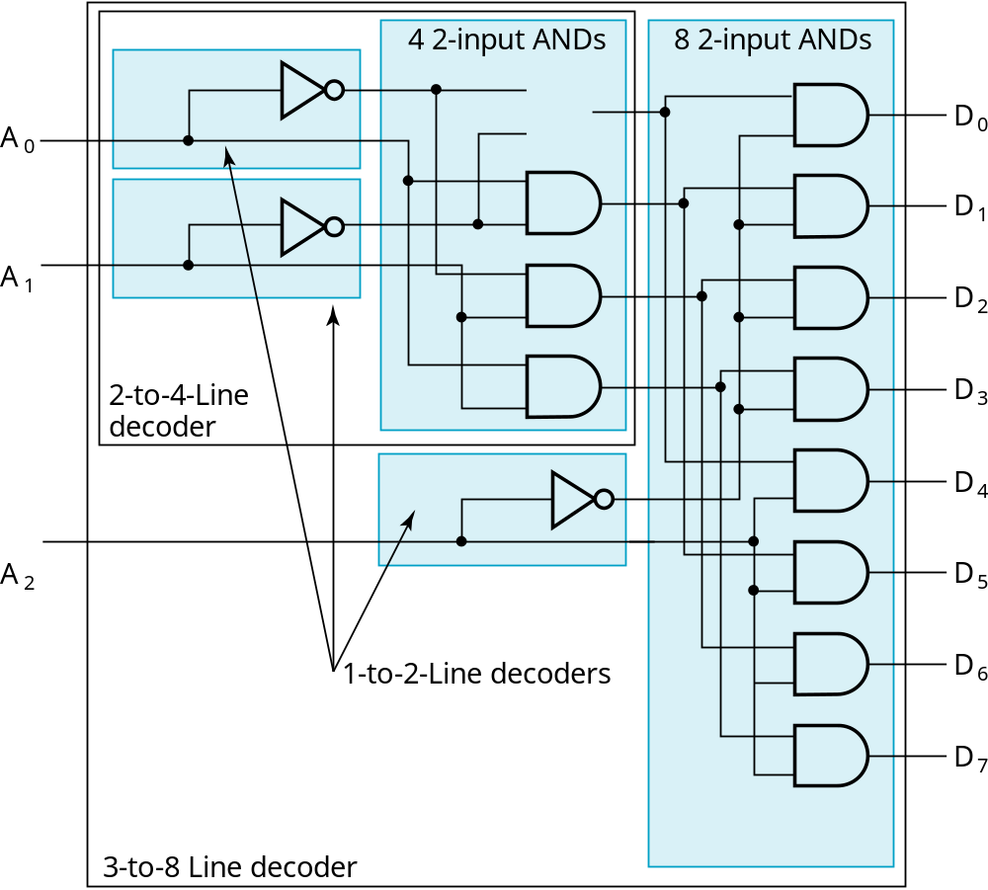
Circuit of 3-to-8-Line Decoder
Result
Chapter 4 <number>

Slide 15
Example: 7-to-128-Line Decoder
7-to-128-Line Decoder
  128 7-input ANDs are needed if constructed directly
  Hierarchically , level 1:
    4-to-16-Line Decoder
    3-to-8-Line Decoder
  4-to-16-Line decoder
    16 2-input ANDs
    Level 2:
      2 2-to-4-Line Decoder
  Constructed by the known 3-to-8-Line Decoders and 2-to-4-Line Decoders
Chapter 4 <number>

Slide 16
Decoder with Enable
In general, attach m-enabling circuits to the outputs
See truth table below for function
  Note use of X’s to denote both 0 and 1
  Combination containing two X’s represent four binary combinations
Alternatively, can be viewed as distributing value of signal EN to 1 of 4 outputs
In this case, called a
demultiplexer
EN
A
1
A
0
D
0
EN
A
1
A
0
D
0
D
1
D
2
D
3
D
1
0
X
X
0
0
0
0
1
0
0
1
0
0
0
D
2
1
0
1
0
1
0
0
1
1
0
0
0
1
0
D
1
1
1
0
0
0
1
3
(a)
(b)
Chapter 4 <number>

Slide 17
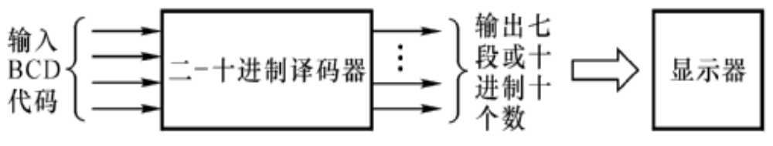
Code Translation Decoder
Translate data from one code system to another.
  Common Decoders:
  Binary-coded → Decimal
    Binary code to decimal (8421 code) or decimal decoder (BCD decoder)
    Excess 3 Code to decimal code decoder
Chapter 4 <number>

Slide 18
BCD-to-Decimal Decoders
BCD-to-Decimal Decoders is a decoder whose input is 4-bit BCD code and output is decimal code.
Decimal Code
8-4-2-1 Code
0
0
0
0
0
1
0
0
0
1
2
0
0
1
0
3
0
0
1
1
4
0
1
0
0
5
0
1
0
1
6
0
1
1
0
7
0
1
1
1
8
1
0
0
0
9
1
0
0
1
Chapter 4 <number>

Slide 19
Two strategies to deal with the 6 unused combinations
makes two BCD-to-Decimal Decoders
Incompletely Decoded BCD-to-Decimal Decoder:
  Only use 10 combinations
Completely Decoded BCD-to-Decimal Decoder:
  All 16 combinations are used
Chapter 4 <number>

Slide 20
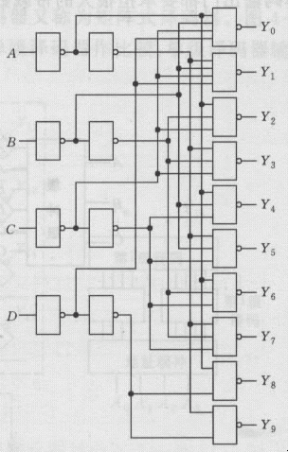
Incompletely Decoded BCD-to-Decimal Decoder
Truth table Circuit
A
B
C
D
Y0
Y1
Y2
Y3
Y4
Y5
Y6
Y7
Y8
Y9
0
0
0
0
0
0
1
1
1
1
1
1
1
1
1
1
1
0
0
0
1
0
1
1
1
1
1
1
1
1
2
0
1
0
0
1
1
0
1
1
1
1
1
1
1
3
1
1
0
0
1
1
1
0
1
1
1
1
1
1
4
0
0
1
0
1
1
1
1
0
1
1
1
1
1
5
1
0
1
0
1
1
1
1
1
0
1
1
1
1
6
0
1
1
0
1
1
1
1
1
1
0
1
1
1
7
1
1
1
0
1
1
1
1
1
1
1
0
1
1
8
0
0
0
1
1
1
1
1
1
1
1
1
0
1
9
1
0
0
1
1
1
1
1
1
1
1
1
1
0
Chapter 4 <number>

Slide 21
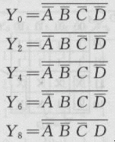
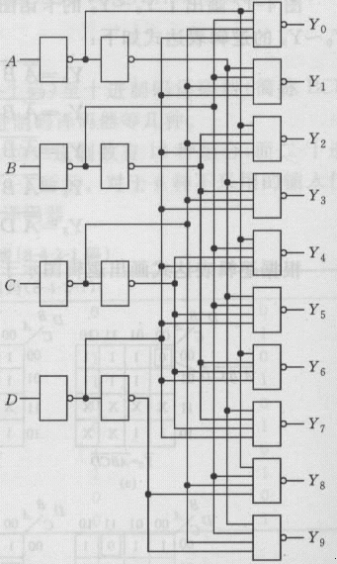
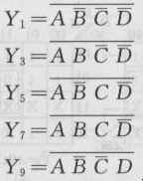
Completely Decoded BCD-to-Decimal Decoder
A
B
C
D
Y0
Y1
Y2
Y3
Y4
Y5
Y6
Y7
Y8
Y9
0
0
0
0
0
0
1
1
1
1
1
1
1
1
1
1
1
0
0
0
1
0
1
1
1
1
1
1
1
1
2
0
1
0
0
1
1
0
1
1
1
1
1
1
1
3
1
1
0
0
1
1
1
0
1
1
1
1
1
1
4
0
0
1
0
1
1
1
1
0
1
1
1
1
1
5
1
0
1
0
1
1
1
1
1
0
1
1
1
1
6
0
1
1
0
1
1
1
1
1
1
0
1
1
1
7
1
1
1
0
1
1
1
1
1
1
1
0
1
1
8
0
0
0
1
1
1
1
1
1
1
1
1
0
1
9
1
0
0
1
1
1
1
1
1
1
1
1
1
0
0
1
0
1
1
1
1
1
1
1
1
1
1
1
Nouse
1
1
0
1
1
1
1
1
1
1
1
1
1
1
0
0
1
1
1
1
1
1
1
1
1
1
1
1
1
0
1
1
1
1
1
1
1
1
1
1
1
1
0
1
1
1
1
1
1
1
1
1
1
1
1
1
1
1
1
1
1
1
1
1
1
1
1
1
1
1
No Enablings in both types of BCD-to-Decimal decoders
Chapter 4 <number>

Slide 22
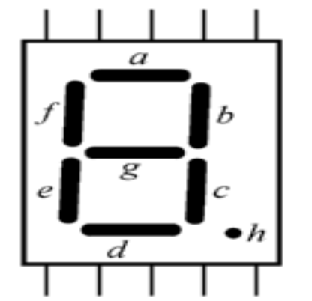
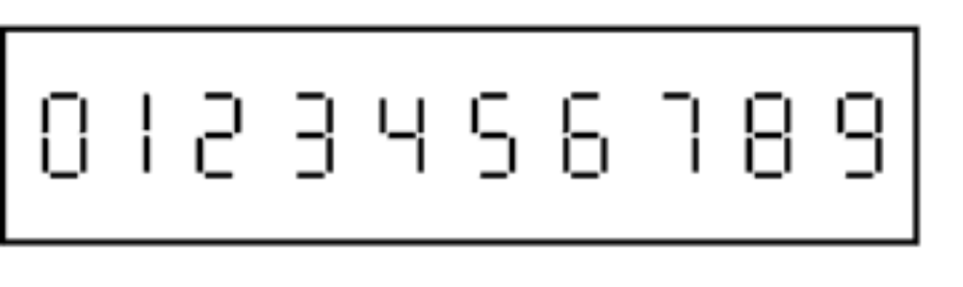
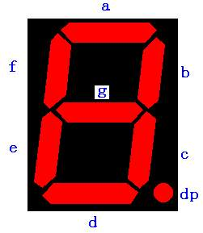
Display Decoder
Some calculators and devices require to show the numbers. Display decoders deal with binary or BCD inputs and output the display signal to drive the display devices
Common Electrode
d
c
b
a
The widely used 7-segment display
e
f
g
h
Common Electrode
Digital Tube types: Common Cathode and Common Anode
Chapter 4 <number>

Slide 23
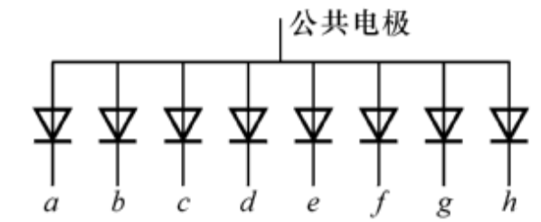
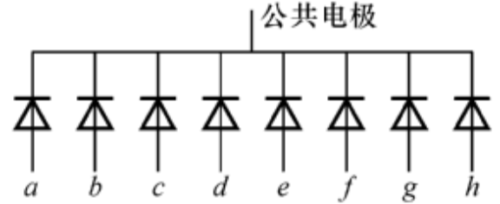
LED Display
VCC=5V
Common electrode
d
c
b
a
a
R
Common Anode
“0”
GND
e
f
g
h
a
Common electrode
Common Cathode
R
“1”
Chapter 4 <number>

Slide 24
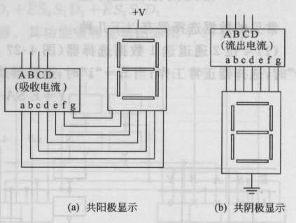
The Common Anode Display (CAD)
  All the anode connections of the LED's are joined together to logic "1" and the individual segments are illuminated by connecting the individual Cathode terminals to a "LOW", logic "0" signal.
  a~g = 0 on, a~g = 1 off (Active Low)
The Common Cathode Display (CCD)
  All the cathode connections of the LED's are joined together to logic "0" or ground.
  The individual segments are illuminated by application of a "HIGH", logic "1" signal to the individual Anode terminals.
  a~g = 1 on, a~g = 0 off (Active High)
Chapter 4 <number>

Slide 25
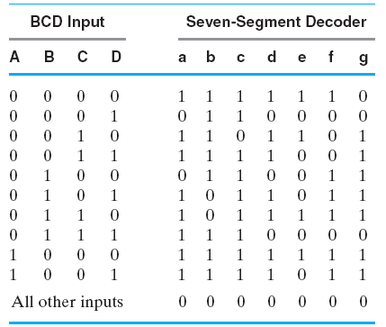
BCD-to-Seven Segment Decoder
Truth Table for BCD-to-Seven-Segment Decoder
Chapter 4 <number>

Slide 26
Encoder
Encoding - the opposite of decoding - the conversion of an m-bit input code to a n-bit output code with n ≤ m ≤ 2^{n} such that each valid code word produces a unique output code
Circuits that perform encoding are called encoders
Types:
  Instruction Encoder
  Binary-to-Decimal Encoder
  Priority Encoder (widely used in computer priority interrupt system and keyboard coding system)
  cypher Encoder
a1
Encoder
F1
a2
F2
… …
… …
am
Fn
n ≤ m ≤ 2^{n}
Chapter 4 <number>

Slide 27
Encoder
？
What’s the bit width of data?
Monitor
0
1
2
3
4
5
6
7
Workpiece
Workpiece
Chapter 4 <number>

Slide 28
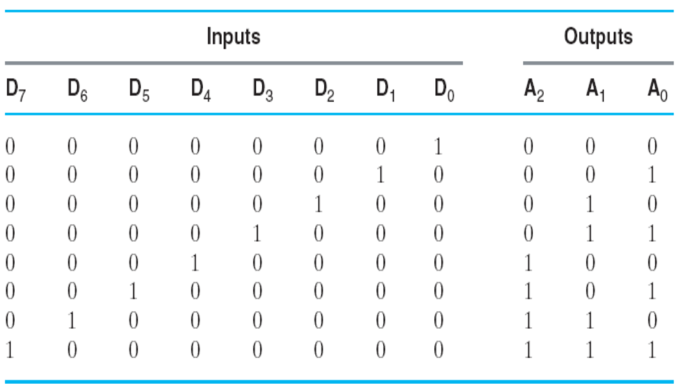
Encoder Example
A Octal-to-BCD encoder
  Inputs: 8 bits corresponding to octal digits 0 through 7, (D₀, …, D₇)
  Outputs: 3 bits with BCD codes
  Function: If input bit D_{i} is a 1, then the output (A₂, A₁, A₀) is the BCD code for i,
Chapter 4 <number>

Slide 29
Encoder Example (continued)
The truth table could be formed, but alternatively, the equations for each of the four outputs can be obtained directly.
BCD Equations:
  A₂ = D₄ + D₅ + D₆ + D₇
  A₁ = D₂ + D₃ + D₆ + D₇
  A₀ = D₁ + D₃ + D₅ + D₇
Chapter 4 <number>

Slide 30
Priority Encoder
The above encoder does not work when the input signal contains multiple “1”s.
One encoder that can accept all possible combinations of input values and produce a meaningful result is a priority encoder.
Among the 1s that appear, it selects the most significant input position (or the least significant input position) containing a 1 and responds with the corresponding binary code for that position.
Chapter 4 <number>

Slide 31
Priority Encoder Example
Priority encoder with 5 inputs (D₄, D₃, D₂, D₁, D₀) - highest priority to most significant 1 present - Code outputs A2, A1, A0 and V where V indicates at least one 1 present.
Xs in input part of table represent 0 or 1; thus table entries correspond to product terms instead of minterms. The column on the left shows that all 32 minterms are present in the product terms in the table
No. of Min-terms/Row | Inputs |  |  |  |  | Outputs
 | D4 | D3 | D2 | D1 | D0 | A2 | A1 | A0 | V
1 | 0 | 0 | 0 | 0 | 0 | X | X | X | 0
1 | 0 | 0 | 0 | 0 | 1 | 0 | 0 | 0 | 1
2 | 0 | 0 | 0 | 1 | X | 0 | 0 | 1 | 1
4 | 0 | 0 | 1 | X | X | 0 | 1 | 0 | 1
8 | 0 | 1 | X | X | X | 0 | 1 | 1 | 1
16 | 1 | X | X | X | X | 1 | 0 | 0 | 1
Chapter 4 <number>
Notes:
Go over table explaining how entries were obtained, particularly those containing Xs

Slide 32
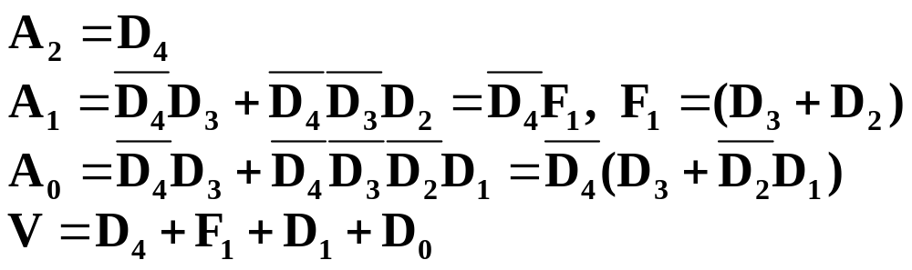
Priority Encoder Example (continued)
Could use a K-map to get equations, but can be read directly from table and manually optimized if careful:
Chapter 4 <number>

Slide 33
Selecting
Selecting of data or information is a critical function in digital systems and computers
Circuits that perform selecting have:
  A set of information
  inputs from which the
  selection is made
  A single output
  A set of control lines
  for making the selection
Logic circuits that perform selecting are called multiplexers
Selecting can also be done by three-state logic or transmission gates
Circuit
DBUS
Y
CBUS
Chapter 4 <number>

Slide 34
Multiplexers
A multiplexer selects information from an input line and directs the information to an output line
A typical multiplexer has n control inputs (S_{n − 1}, … S₀) called selection inputs, 2^{n} information inputs (I₂n ₋ ₁, … I₀), and one output Y
A multiplexer can be designed to have m information inputs with m < 2^{n} as well as n selection inputs
Chapter 4 <number>

Slide 35
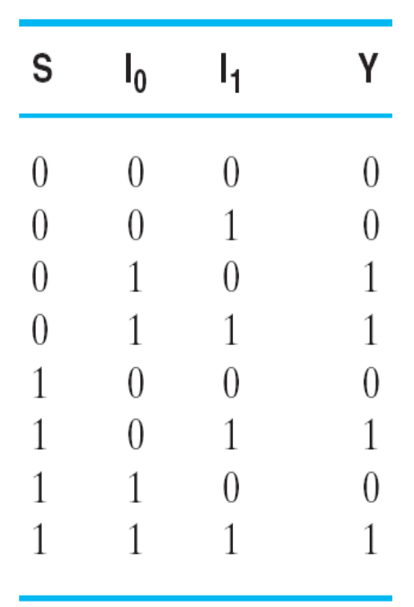
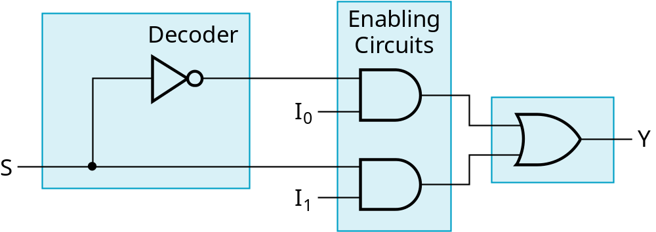
2-to-1-Line Multiplexer
Since 2 = 2¹, n = 1
The single selection variable S has two values:
  S = 0 selects input I₀
  S = 1 selects input I₁
The equation:
Y = I₀ + SI₁
The circuit:
S
Chapter 4 <number>

Slide 36
2-to-1-Line Multiplexer (continued)
Note the regions of the multiplexer circuit shown:
  1-to-2-line Decoder
  2 Enabling circuits
  2-input OR gate
To obtain a basis for multiplexer expansion, we combine the Enabling circuits and OR gate into a 2 × 2 AND-OR circuit:
  1-to-2-line decoder
  2 ⋅ 2 AND-OR
In general, for an 2^{n}-to-1-line multiplexer:
  n-to-2^{n}-line decoder
  2^{n} ⋅ 2 AND-OR
Chapter 4 <number>

Slide 37
Example: 4-to-1-line Multiplexer
2-to-2²-line decoder
2² ⋅ 2 AND-OR
S
Decoder
1
S
4
×
2 AND-OR
0
I
0
I
1
Y
I
2
I
3
Chapter 4 <number>

Slide 38
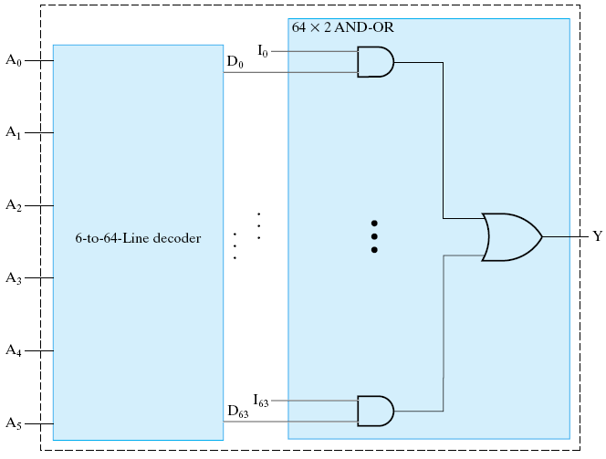
Example: 64-to-1-line Multiplexer
6-to-2⁶-line decoder
2⁶ ⋅ 2 AND-OR
Chapter 4 <number>

Slide 39
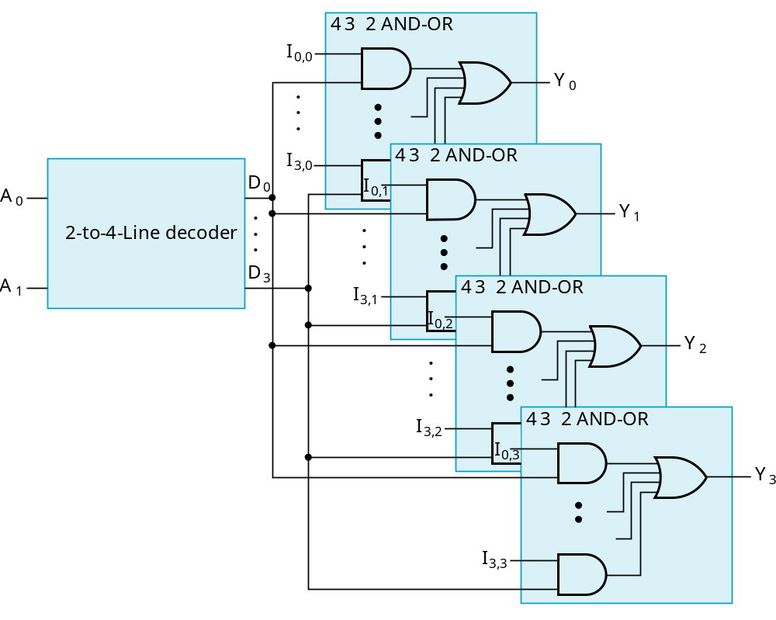
Multiplexer Width Expansion
Select “vectors of bits” instead of “bit”
Use multiple copies of 2^{n} ⋅ 2 AND-OR in parallel
Example:
4-to-1-line
quad multi-
plexer
Chapter 4 <number>

Slide 40
Other Selection Implementations
Three-state logic in place of AND-OR
Gate input cost = 18
S
1
S
0
I
0
I
1
Y
I
2
I
3
Chapter 4 <number>

Slide 41
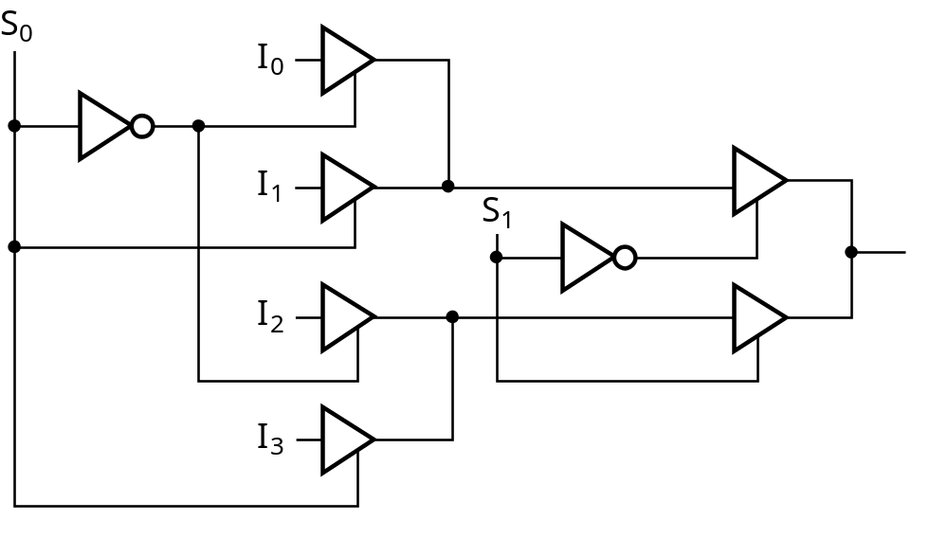
Other Selection Implementations
Distributing the decoding across the three-state drivers
Gate input cost = 14
GN of AND-OR gate implementation:22
GN of implementation with AND-OR gate replaced by three-state drivers: 18
Chapter 4 <number>

Slide 42
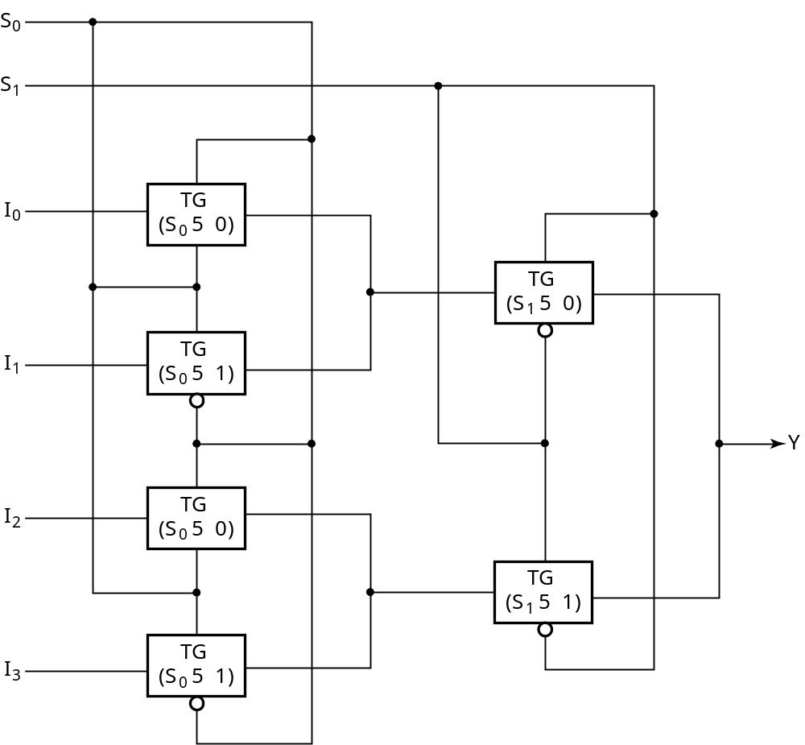
Other Selection Implementations
Transmission Gate Multiplexer
Gate input
cost = 8
compared
to 14 for
3-state logic
and 18 or 22
for gate logic
＝
＝
＝
＝
＝
＝
Chapter 4 <number>
Notes:
Transmission gate的cost

Slide 43

Assignment
_{Reading: pp. 107--139}
_{Problem Assignment:}
3-27; 3-28; 3-29; 3-37; 3-44; 3-47

