Slide 1
Lecture 15 Review
Peng Liu
liupeng@zju.edu.cn

Slide 2
Topics
Hardware-software interface
  Machine language and assembly language programming
Compiler optimizations and performance
Processor design
  Pipelined processor design
Memory hierarchy design
  Caches
I/O devices and systems
Virtual memory & operating systems support
Multiprocessors

Slide 3
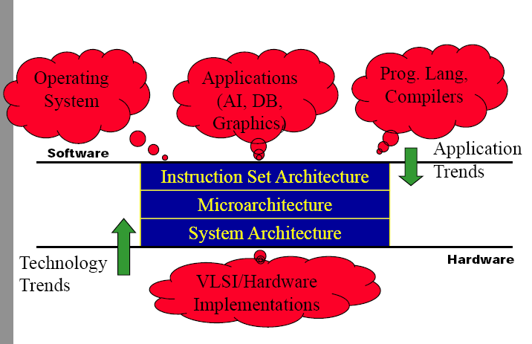
What is Computer Architecture?

Slide 4
5 components of any Computer
Computer
Keyboard,
Mouse
Processor
Memory
(where
programs,
data
live when
running)
Devices
Disk
(where
programs,
data
live when
not running)
Control
(“brain”)
Input
Datapath
(“brawn”)
Output
Display,
Printer

Slide 5
Salient Features of MIPS I
32-bit fixed format inst (3 formats)
32 32-bit GPR (R0 contains zero) and 32 FP registers (and HI LO)
  partitioned by software convention
3-address, reg-reg arithmetic instr.
Single address mode for load/store: base+displacement
  no indirection, scaled
16-bit immediate plus LUI
Simple branch conditions
  compare against zero or two registers for =,≠
  no integer condition codes
Delayed branch
  execute instruction after a branch (or jump) even if the
  branch is taken
  (Compiler can fill a delayed branch with useful work about
  50% of the time)

Slide 6
Computer Performance Metrics
Response Time (latency)
  How long does it take for my job to run?
  How long does it take to execute a job?
  How long must I wait for the database query?
Throughput
  How many jobs can the machine run at once?
  What is the average execution rate?
  How many queries per minute?
If we upgrade a machine with a new processor what to we increase?
If we add a new machine to the lab what do we increase?

Slide 7
Performance = Execution Time
Elapsed Time
  Counts everything (disk and memory accesses, I/O, etc.)
  A useful number, but often not good for comparison purposes
    E.g., OS & multiprogramming time make it difficult to compare CPUs
CPU time (CPU = Central Processing Unit = processor)
  Doesn’t count I/O or time spent running other programs
  Can be broken up into system time, and user time
Our focus: user CPU time
  Time spent executing the lines of code that are “in” our program
  Includes arithmetic, memory, and control instructions, …

Slide 8
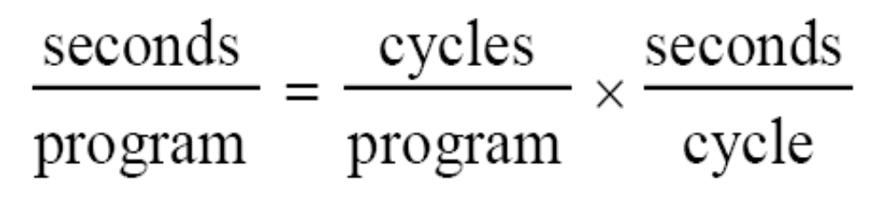
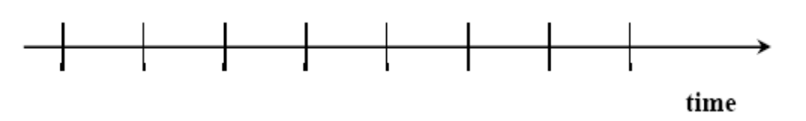
Clock Cycles
Instead of reporting execution time in seconds, we often use cycles
Clock “ticks” indicate when to start activities
Cycle time = time between ticks = seconds per cycle
Clock rate (frequency) = cycles per second (1Hz. = 1cycle/sec)
  A 2Ghz clock has a 500 picoseconds (ps) cycle time.

Slide 9
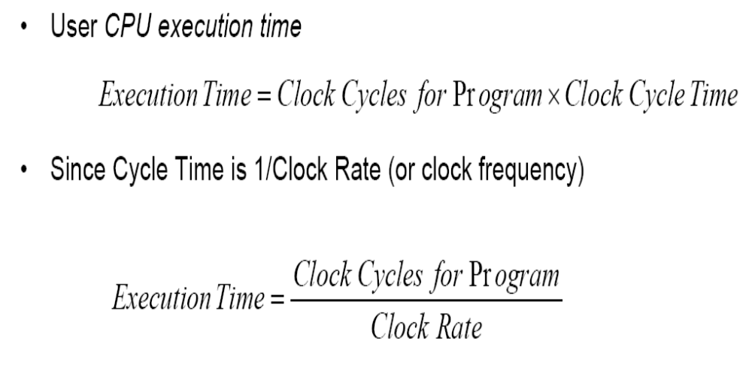
Performance and Execution Time
The program should be something real people care about
  Desktop: MS office, edit, compile
  Server: web, e-commerce, database
  Scientific: physics, weather forecasting

Slide 10
Measuring Clock Cycles
Clock cycles/program is not an intuitive or easily determined value, so
  Clock Cycles = Instructions x Clock Cycles Per Instruction
Cycles Per Instruction (CPI) used often
CPI is an average since the number of cycles per instruction varies from instruction to instruction
  Average depends on instruction mix, latency of each inst. Type etc.
CPIs can be used to compare two implementations of the same ISA, but is not useful alone for comparing different ISAs
  An X86 add is different from a MIPS add

Slide 11
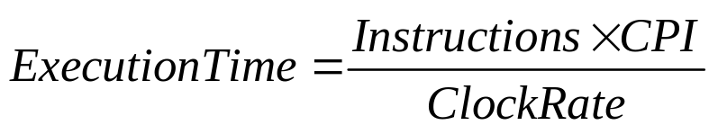
Using CPI
Drawing on the previous equation:
To improve performance (i.e. reduce execution time)
  Increase clock rate (decrease clock cycle time) OR
  Decrease CPI OR
  Reduce the number of instructions
Designers balance cycle time against the number of cycles required
  Improving one factor may make the other one worse

Slide 12
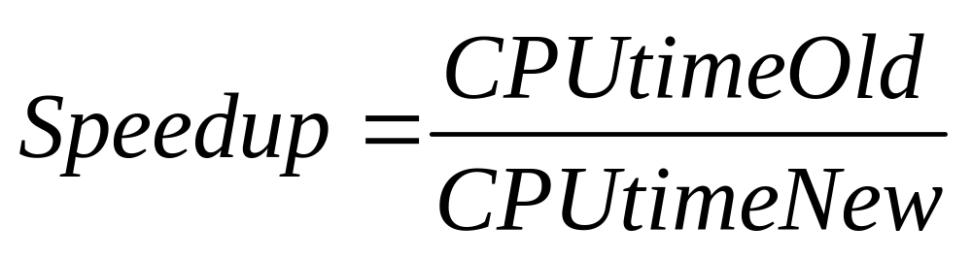
Speedup
Speedup allows us to compare different CPUs or optimizations
Example
  Original CPU takes 2sec to run a program
  New CPU takes 1.5sec to run a program
  Speedup = 1.333 or speedup or 33%

Slide 13
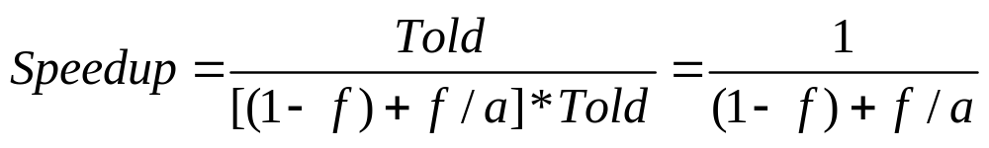
Amdahl’s Law
Page 505
If an optimization improves a fraction f of execution time by a factor of a
This formula is known as Amdahl’s Law
Lessons from
  If f->100%, then speedup = a
  If a->∞, the speedup = 1/(1-f)
Summary
  Make the common case fast
  Watch out for the non-optimized component

Slide 14
SW and ISA

Slide 15
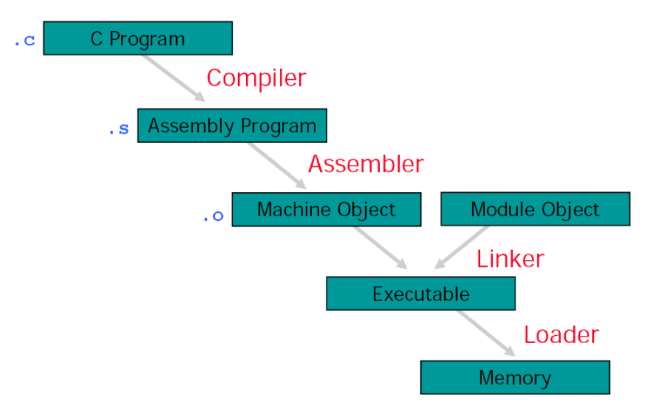
Translation Hierarchy
High-level->Assembly->Machine

Slide 16
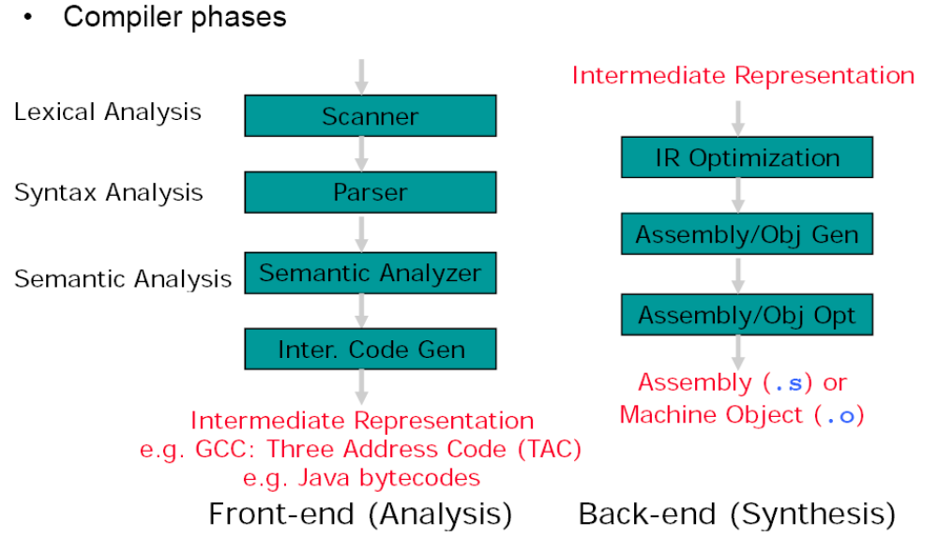
Compiler
Converts high-level language to machine code

Slide 17
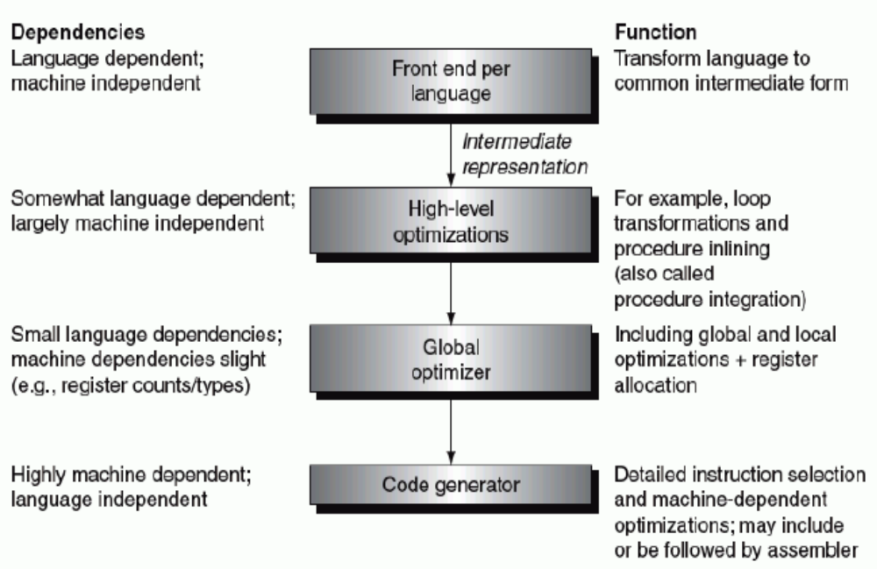
The Structure of a Modern Optimizing Compiler

Slide 18
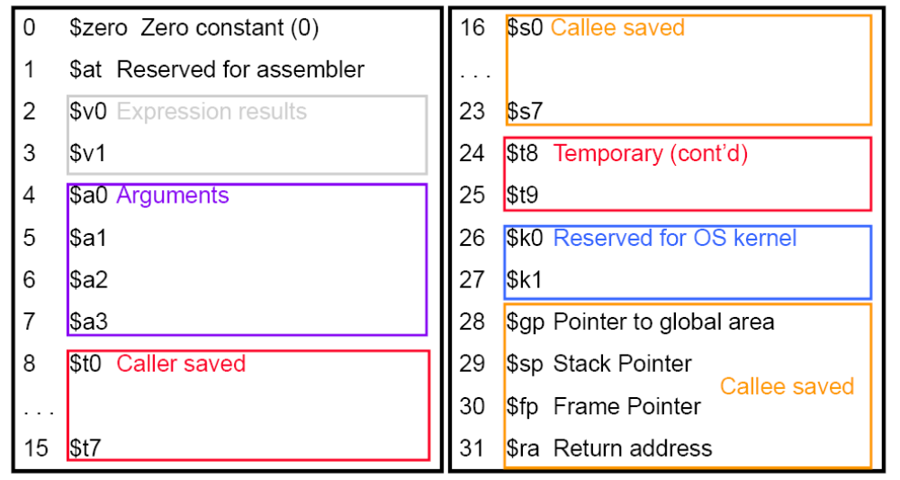
Register Assignments
Calling Convention

Slide 19
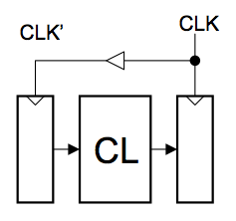
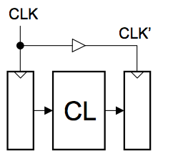
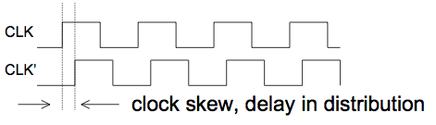
Clock skew also eats into “time budget”
CLKd
CLKd
As T →0, which circuit fails first?
CLKd

Slide 20
Memories In Our Design
They will be combinational
  Otherwise we can’t complete an instruction in one cycle!
Interface is simple:
  Inputs:
    Address
    DataIn
    WriteEn (WriteEn must be a pulse)
  Outputs:
    Dataout
Register file:
  It has three address, two for reads, and one for write
  It is called a 3-port, since it can perform 3 accesses per cycle
Data Memory
32
Addr
32
Dout
Din
32
WE

Slide 21
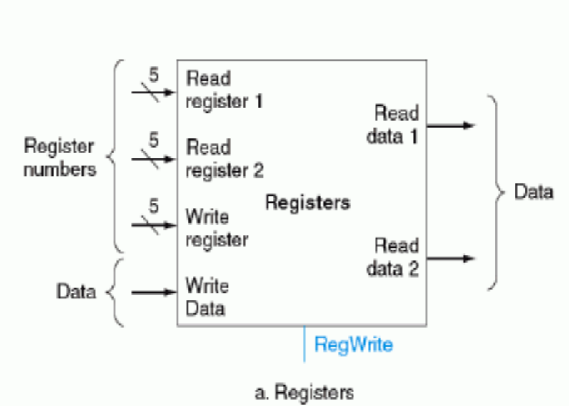
Register File Schematic Symbol
Why do we need WE?
If we had a MIPS register file w/o WE, how could we work around it?
RegFile
5
rs1
32
5
rd1
rs2
5
ws
32
rd2
wd
32
WE

Slide 22
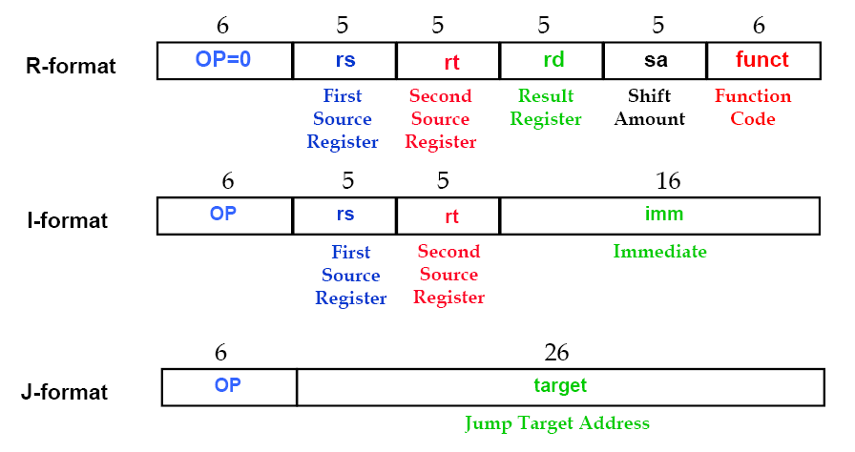
MIPS ISA Format

Slide 23
Processor

Slide 24
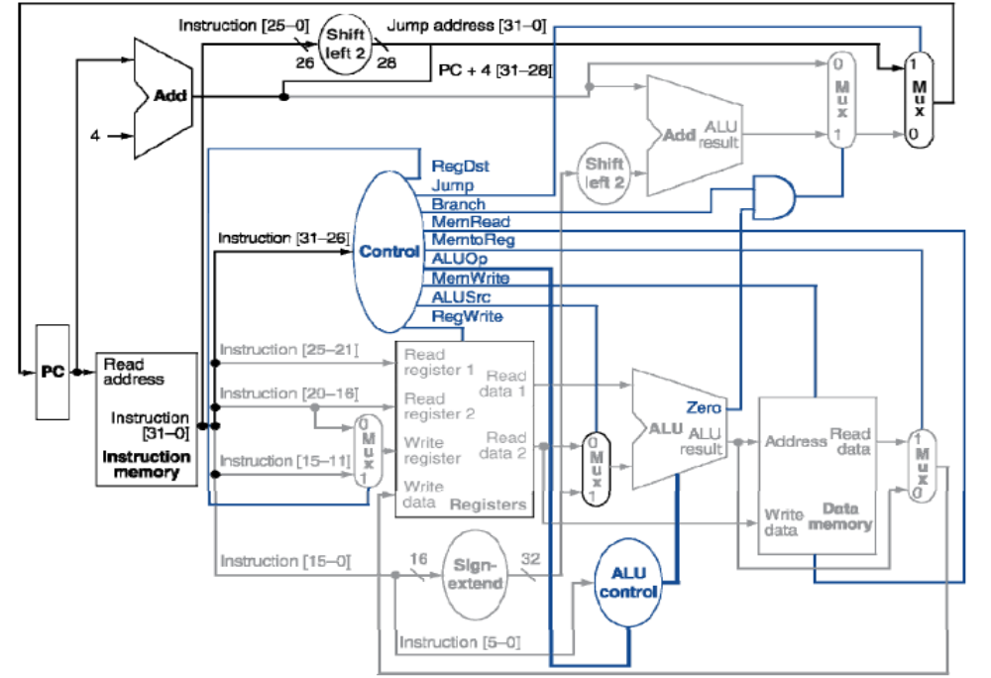
Single Cycle Processor

Slide 25
Single Cycle, Multiple Cycle, vs. Pipeline
Single Cycle Implementation:
Cycle 1
Cycle 2
Clk
Load
Store
Waste
Multiple Cycle Implementation:
Cycle 1
Cycle 2
Cycle 3
Cycle 4
Cycle 5
Cycle 6
Cycle 7
Cycle 8
Cycle 9
Cycle 10
Clk
lw
sw
R-type
IFetch
Dec
Exec
Mem
WB
IFetch
Dec
Exec
Mem
IFetch
Pipeline Implementation:
“wasted” cycles
lw
IFetch
Dec
Exec
Mem
WB
sw
IFetch
Dec
Exec
Mem
WB
R-type
IFetch
Dec
Exec
Mem
WB
Notes:
Here are the timing diagrams showing the differences between the single cycle, multiple cycle, and pipeline implementations.
For example, in the pipeline implementation, we can finish executing the Load, Store, and R-type instruction sequence in seven cycles.

Slide 26
5-Stage Pipelined Execution
0x4
Add
we
rs1
rs2
rd1
PC
addr
IR
ws
we
rdata
wd
rd2
ALU
addr
GPRs
rdata
Inst.
Memory
Data
Memory
Imm
Ext
wdata
Write
-Back (WB)
I-Fetch (IF)
Decode, Reg. Fetch (ID)
Execute (EX)
Memory (MA)
time t0 t1 t2 t3 t4 t5 t6 t7 . . . .
instruction1 IF₁ ID₁ EX₁ MA₁ WB₁
instruction2 IF₂ ID₂ EX₂ MA₂ WB₂
instruction3 IF₃ ID₃ EX₃ MA₃ WB₃
instruction4 IF₄ ID₄ EX₄ MA₄ WB₄
instruction5 IF₅ ID₅ EX₅ MA₅ WB₅
Notes:
CS252 S05

Slide 27
Pipelined Processor
Go back and examine your data path and control diagram
Associate resources with states
  Be sure there are no structural hazards: one use / clock cycle
Add pipeline registers between stages to balance clock cycle
  Amdahl’s Law suggests splitting longest stage
Resolve all data and control dependencies
  If backwards in time in pipeline drawing to registers
  => data hazard: forward or stall to resolve them
  If backwards in time in pipeline drawing to PC
  => control hazard: we’ll see next time
5 stage pipeline with reads early in same stage, writes later in same stage, avoids WAR/WAW hazards
Assert control in appropriate stage
Develop test instruction sequences likely to uncover pipeline bugs (If you don’t test it, it won’t work )

Slide 28
Cache

Slide 29
Cache Terminology
Block – Minimum unit of information transfer between levels of the hierarchy
  Block addressing varies by technology at each level
  Blocks are moved one level at a time
Hit – Data appears in a block in lower numbered level
Hit rate – Percent of accesses found
Hit time – Time to access at lower nuumbered level
  Hit time = Cache access time + Time to determine hit/miss
Miss – Data was not in lower numbered level and had to be fetched from a higher numbered level
Miss rate – Percent of misses (1 – Hit rate)
Miss penalty – Overhead in getting data from a higher numbered level
  Miss penalty = higher level access time + Time to deliver to lower level + Cache replacement/forward to processor time
  Miss penalty is usually much larger than the hit time

Slide 30
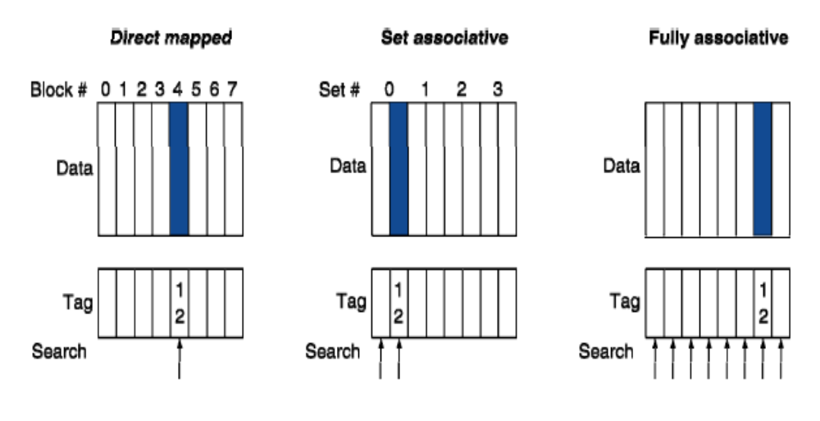
Associative Cache Example

Slide 31
A Typical Memory Hierarchy
Split instruction & data primary caches
(on-chip SRAM)
Multiple interleaved memory banks
(off-chip DRAM)
L1 Instruction Cache
Unified L2 Cache
Memory
CPU
Memory
L1 Data Cache
Memory
RF
Memory
Multiported register file (part of CPU)
Large unified secondary cache (on-chip SRAM)
Notes:
Implementation close to the CPU looks like a Harvard machine.

Slide 32
Direct-Mapped Cache
Tag
Index
Block
Offset
t
k
b
V
Tag
Data Block
2^{k}
lines
t
=
HIT
Data Word or Byte

Slide 33
2-Way Set-Associative Cache
Tag
Index
Block
Offset
b
t
k
V
Tag
Data Block
V
Tag
Data Block
t
=
=
Data
Word
or Byte
HIT
Notes:
Compare latency to direct mapped case?

Slide 34
Fully Associative Cache
V
Tag
Data Block
t
=
Tag
t
=
HIT
Block
Offset
Data
Word
or Byte
=
b

Slide 35
Causes for Cache Misses
Compulsory: first-reference to a block a.k.a. cold
start misses
- misses that would occur even with infinite cache
Capacity: cache is too small to hold all data needed by the program
- misses that would occur even under perfect
replacement policy
Conflict: misses that occur because of collisions
due to block-placement strategy
    misses that would not occur with full associativity
Coherence

Slide 36
Virtual Memory

Slide 37
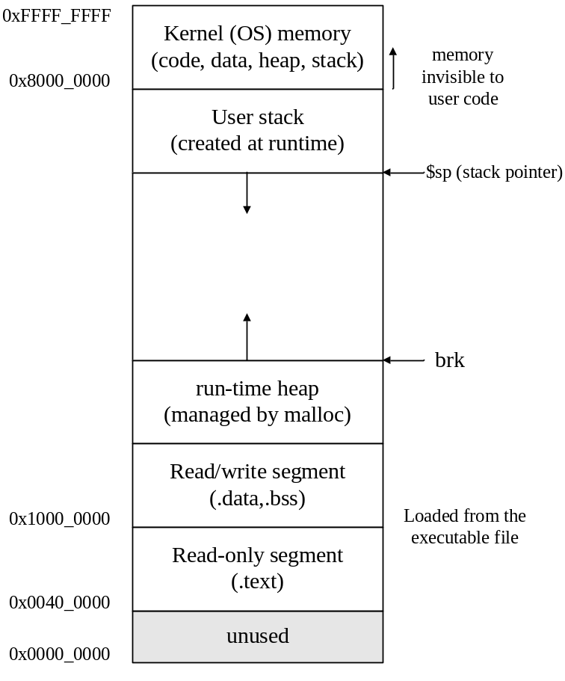
Motivation #1: Large Address Space for Each Executing Program
Each program thinks it has a ~232 byte address space of its own
  May not use it all though
Available main memory may be much smaller

Slide 38
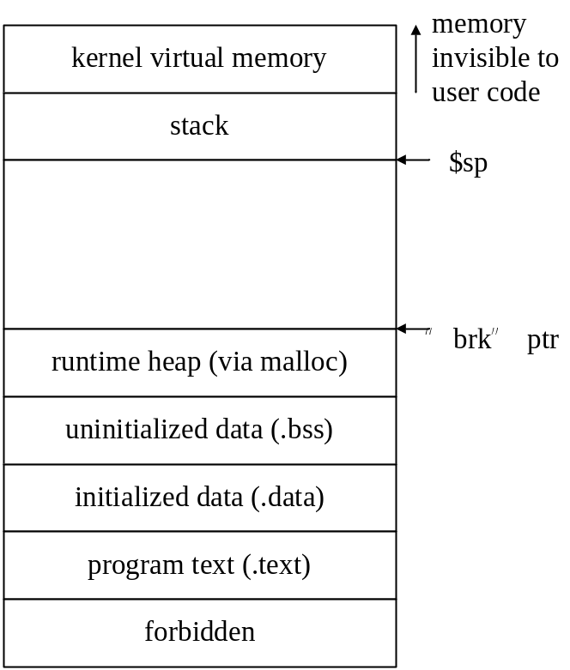
Motivation #2: Memory Management for Multiple Programs
At an point in time, a computer may be running multiple programs
  E.g., Firefox + Thunderbird
Questions:
  How do we share memory between multiple programs?
  How do we avoid address conflicts?
  How do we protect programs
    Isolations and selective sharing

Slide 39
Virtual Memory in a Nutshell
Use hard disk (or Flash) as a large storage for data of all programs
  Main memory (DRAM) is a cache for the disk
  Managed jointly by hardware and the operating system (OS)
Each running program has its own virtual address space
  Address space as shown in previous figure
  Protected from other programs
Frequently-used portions of virtual address space copied to DRAM
  DRAM = physical address space
  Hardware + OS translate virtual addresses (VA) used by program to physical addresses (PA) used by the hardware
  Translation enables relocation (DRAM disk) & protection

Slide 40
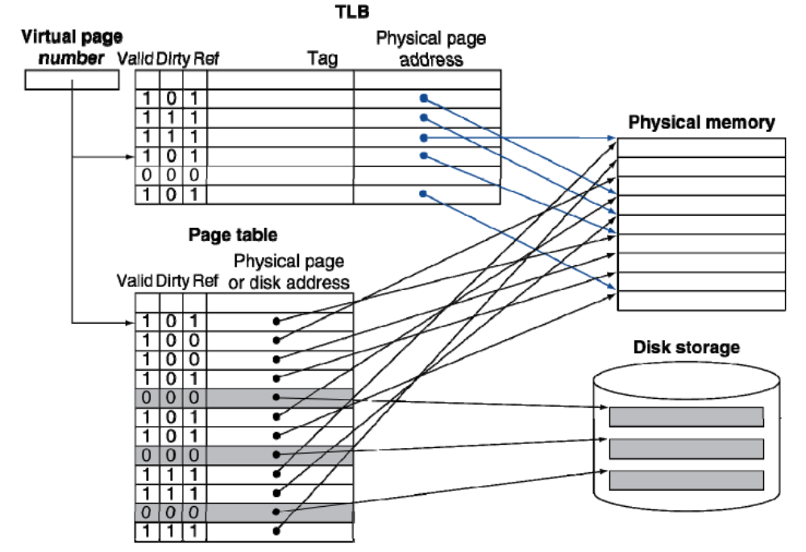
Fast Translation Using a TLB

Slide 41
Address Translation: putting it all together
Virtual Address
hardware
hardware or software
software
TLB
Lookup
miss
hit
Page Table
Walk
Protection
Check
the page is
∉ memory ∈ memory
denied
permitted
Page Fault
(OS loads page)
Update TLB
Protection
Fault
Physical
Address
(to cache)
Where?
SEGFAULT
Notes:
CS252 S05
Need to restart instruction.
Soft and hard page faults.

Slide 42
Get involved in research
Undergrad research experience is the most important part of application to top grad schools, and fun too.
Thanks for taking the class!

