Slide 1
  Parallel Algorithms

Slide 2
Parallel Algorithms
Parallelism
☞ Machine parallelism
  Processor parallelism
  Pipelining
  Very-Long Instruction Word (VLIW)
☞ Parallel algorithms
To describe a parallel algorithm
☞ Parallel Random Access Machine (PRAM)
☞ Work-Depth (WD)

Slide 3
Parallel Algorithms
Parallel Random Access Machine (PRAM)
P₁
P₂
……
P_{n}
Unit time access
(read/write/
computation)
Shared memory
P_{i}
processor i: c := a + b
a
c
b
P₁
P₂
……
P_{n}
B(1)
B(2)
B(n)
for P_{i} , 1 ≤ i ≤ n pardo
A( i ) := B( i )
A(1)
A(2)
A(n)

Slide 4
Parallel Algorithms
To resolve access conflicts
☞ Exclusive-Read Exclusive-Write (EREW)
☞ Concurrent-Read Exclusive-Write (CREW)
☞ Concurrent-Read Concurrent-Write (CRCW)
  Arbitrary rule
  Priority rule (P with the smallest number)
  Common rule (if all the processors are trying to write the same value)

Slide 5
Parallel Algorithms
〖Example〗 The summation problem.
Input: A(1), A(2), …, A(n)
Output: A(1) + A(2) + … +A(n)
B(3,1)
1~8
B(2,1)
1~4
B(2,2)
5~8
B(1,1)
1~2
B(1,2)
3~4
B(1,3)
5~6
B(1,4)
7~8
A(1)
A(2)
A(3)
A(4)
A(5)
A(6)
A(7)
A(8)
B(0,1)
B(0,2)
B(0,3)
B(0,4)
B(0,5)
B(0,6)
B(0,7)
B(0,8)
B(h, i) = B(h-1, 2i-1) + B(h-1, 2i)

Slide 6

Parallel Algorithms
PRAM model
for P_{i} , 1 ≤ i ≤ n pardo
B(0, i) := A( i )
for h = 1 to log n do
if i ≤ n/2^{h}
B(h, i) := B(h-1, 2i-1) + B(h-1, 2i)
else stay idle
for i = 1: output B(log n, 1); for i > 1: stay idle
Time
 Does not reveal how the algorithm will run on PRAMs with different number of processors
 Fully specifying the allocation of instructions to processors requires a level of detail which might be unnecessary
t
……
3
2
p
1
Number of operations

Slide 7
Parallel Algorithms
Work-Depth (WD) Presentation
for P_{i} , 1 ≤ i ≤ n pardo
B(0, i) := A( i )
for h = 1 to log n
for P_{i}, 1 ≤ i ≤ n/2^{h} pardo
B(h, i) := B(h-1, 2i-1) + B(h-1, 2i)
for i = 1 pardo
output B(log n, 1)
Time
Time
General
WD mode
t
t
……
……
3
3
2
2
1
1
Number of operations
Number of operations

Slide 8
Parallel Algorithms
Measuring the performance
Work load – total number of operations: W(n)
Worst-case running time: T(n)
  W(n) operations and T(n) time
  P(n) = W(n)/T(n) processors and T(n) time (on a PRAM)
  W(n)/p time using any number of p ≤ W(n)/T(n) processors (on a PRAM)
  W(n)/p + T(n) time using any number of p processors (on a PRAM)
All asymptotically equivalent

Slide 9

Parallel Algorithms
for P_{i} , 1 ≤ i ≤ n pardo
B(0, i) := A( i )
for h = 1 to log n
for P_{i}, 1 ≤ i ≤ n/2^{h} pardo
B(h, i) := B(h-1, 2i-1) + B(h-1, 2i)
for i = 1 pardo
output B(log n, 1)
T(n) =
log n + 2
W(n) =
where 2^{k} = n
= 2n
【WD-presentation Sufficiency Theorem】An algorithm in the WD mode can be implemented by any P(n) processors within
O(W(n)/P(n) + T(n)) time, using the same concurrent-write convention as in the WD presentation.

Slide 10
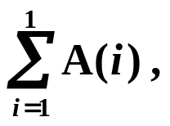

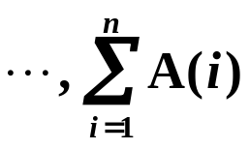
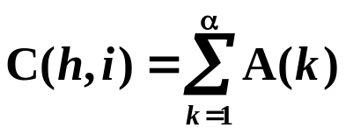
Parallel Algorithms
〖Example〗 Prefix-Sums.
Input: A(1), A(2), …, A(n)
Output:
 Technique: Balanced Binary Trees
16
B(3,1)
16
C(3,1)
B
where (0, α) is the rightmost descendant leaf of node (h, i).
7
16
B(2,1)
7
C(2,1)
B(2,2)
9
C(2,2)
C(1,2)
C(1,3)
C(1,4)
2
7
5
8
1
B(1,1)
B(1,2)
B(1,3)
15
B(1,4)
16
if ( i==1 )
C(h, i) := B(h, i)
if ( i%2 == 0 )
C(h, i) := C(h+1, i/2)
C
1
1
2
3
6
2
0
1
B(0,1)
B(0,2)
B(0,3)
B(0,4)
B(0,5)
B(0,6)
B(0,7)
B(0,8)
if (i%2 == 1 && i != 1) C(h, i) := C(h+1, (i-1)/2) + B(h, i)

Slide 11
Parallel Algorithms
for P_{i} , 1 ≤ i ≤ n pardo
B(0, i) := A(i)
for h = 1 to log n
for i , 1 ≤ i ≤ n/2^{h} pardo
B(h, i) := B(h - 1, 2i - 1) + B(h - 1, 2i)
for h = log n to 0
for i even, 1 ≤ i ≤ n/2^{h} pardo
C(h, i) := C(h + 1, i/2)
for i = 1 pardo
C(h, 1) := B(h, 1)
for i odd, 3 ≤ i ≤ n/2^{h} pardo
C(h, i) := C(h + 1, (i - 1)/2) + B(h, i)
for P_{i} , 1 ≤ i ≤ n pardo
Output C(0, i)
T(n) =
O( log n )
W(n) =
O( n )
 The operations are charged to nodes of the balanced binary tree

Slide 12
Parallel Algorithms
〖Example〗 Merging – merge two non-decreasing arrays A(1), A(2), …, A(n) and B(1), B(2), …, B(m) into another non-decreasing array C(1), C(2), …, C(n+m)
 Technique: Partitioning
  To simplify, assume:
  the elements of A and B are pairwise distinct
  n = m
  both log n and n/log n are integers
☞ Partitioning Paradigm
partitioning - partition the input into a large number, say p, of independent small jobs, so that the size of the largest small job is roughly n/p
actual work - do the small jobs concurrently, using a separate (possibly serial) algorithm for each

Slide 13
Parallel Algorithms
Merging Ranking
RANK( j, A) = i, if A(i) < B(j) < A(i + 1), for 1 ≤ i < n
RANK( j, A) = 0, if B(j) < A(1)
RANK( j, A) = n, if B(j) > A(n)
The ranking problem, denoted RANK(A,B) is to compute:
RANK( i, B) for every 1 ≤ i ≤ n, and
RANK( i, A) for every 1 ≤ i ≤ n
Claim: Given a solution to the ranking problem, the merging problem can be solved in O(1) time and O(n+m) work.
for P_{i} , 1 ≤ i ≤ n pardo
C(i + RANK(i, B)) := A(i)
for P_{i} , 1 ≤ i ≤ n pardo
C(i + RANK(i, A)) := B(i)

Slide 14
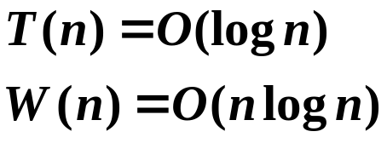

Parallel Algorithms
i
1
2
3
4
5
6
7
8
A
11
12
15
17
RANK( i, B)
0
0
2
3
B
13
14
16
18
RANK( i, A)
2
2
3
4
C
11
12
13
14
15
16
17
18
☞ Binary Search
☞ Serial Ranking
for P_{i} , 1 ≤ i ≤ n pardo
RANK(i, B) := BS(A(i), B)
RANK(i, A) := BS(B(i), A)
i = j = 0;
while ( i ≤ n || j ≤ m ) {
if ( A(i+1) < B(j+1) )
RANK(++i, B) = j;
else RANK(++j, A) = i;
}
Notes:
注意：串行算法中默认增加了A(n+1)和B(m+1)，它们比原始的最大元要大。
比较：串行减少了W，但增大了T

Slide 15

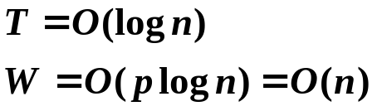
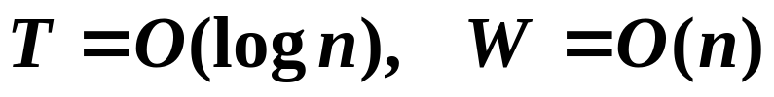
Parallel Algorithms
Parallel Ranking
Assume that n = m ; and that A(n+1) and B(n+1) are each larger than both A(n) and B(n).
Stage 1: Partitioning
A_Select( i ) = A( 1+(i-1)logn ) for 1 ≤ i ≤ p
B_Select( i ) = B( 1+(i-1)logn ) for 1 ≤ i ≤ p
Compute RANK for each selected element
A
4
6
8
9
16
17
18
19
20
21
23
25
27
29
31
32
B
1
2
3
5
7
10
11
12
13
14
15
22
24
26
28
30
Stage 2: Actual Ranking
At most 2p smaller sized (O(logn)) problems.

Slide 16



Parallel Algorithms
〖Example〗 Maximum Finding.
Replace “+” by “max” in the summation algorithm
Compare all pairs
for P_{i} , 1 ≤ i ≤ n pardo
B(i) := 0
for i and j, 1 ≤ i, j ≤ n pardo
if ( (A(i) < A(j)) || ((A(i) = A(j)) && (i < j)) )
B(i) = 1
else B(j) = 1
for P_{i} , 1 ≤ i ≤ n pardo
if B(i) == 0
A(i) is a maximum in A
Discussion 21:
How to resolve access
conflicts?

Slide 17
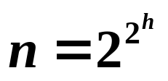

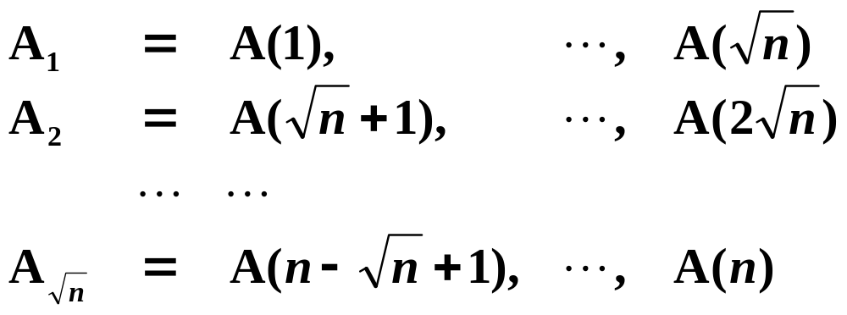


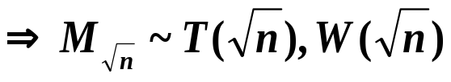

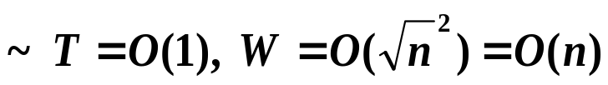
Parallel Algorithms
A Doubly-logarithmic Paradigm
Assume that h = log log n is an integer ( ).
Partition by :

Slide 18
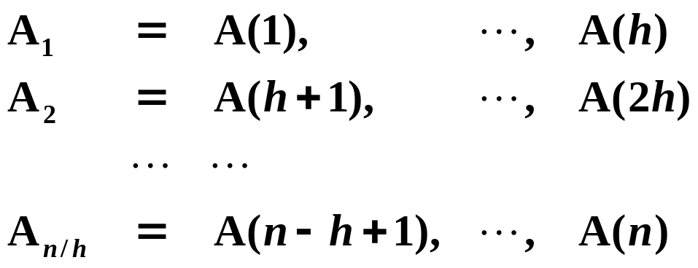



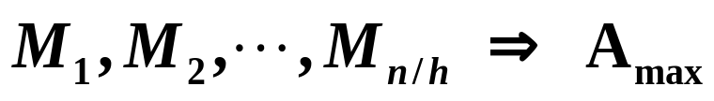
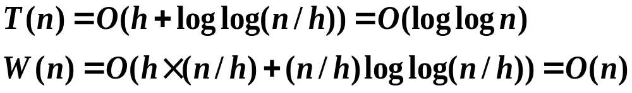
Parallel Algorithms
A Doubly-logarithmic Paradigm
Partition by h = log log n :

Slide 19

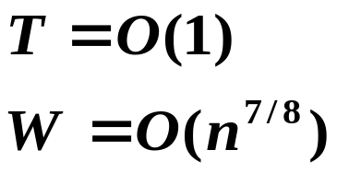
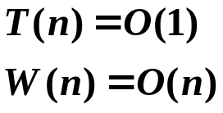

Parallel Algorithms
Random Sampling
with very high probability, on an Arbitrary CRCW PRAM
A: n elements
random
B: n^{7/8} elements of A
n^{1/8}
n^{1/8}
n^{1/8}
n^{3/4}
? blocks
B: n^{3/4} M⁽¹⁾ elements of A
n^{1/4}
n^{1/4}
n^{1/2}
? blocks

Slide 20
Parallel Algorithms
Random Sampling
while (there is an element larger than M) {
for (each element larger than M)
Throw it into a random place in a new B(n^{7/8});
Compute a new M;
}
【Theorem】The algorithm finds the maximum among n elements. With very high probability it runs in O(1) time and O(n) work. The probability of not finishing within this time and work complexity is O(1/n^{c}) for some positive constant c.

Slide 21

Parallel Algorithms
Research Project 8
MapReduce (26)
MapReduce is a programming model and an associated implementation for processing and generating large data sets with a parallel, distributed algorithm on a cluster. A MapReduce program is composed of a Map( ) procedure and a Reduce( ) procedure.
In this project, you are supposed to briefly introduce the framework of MapReduce, and implement a MapReduce program to count the appearance of each word in a set of documents.
Detailed requirements can be downloaded from
https://pintia.cn/

Slide 22
Reference:
Thinking in Parallel：Some Basic Data-Parallel Algorithms and Techniques; Uzi Vishkin. Class notes, 2010

