Slide 1
External Sorting

Slide 2
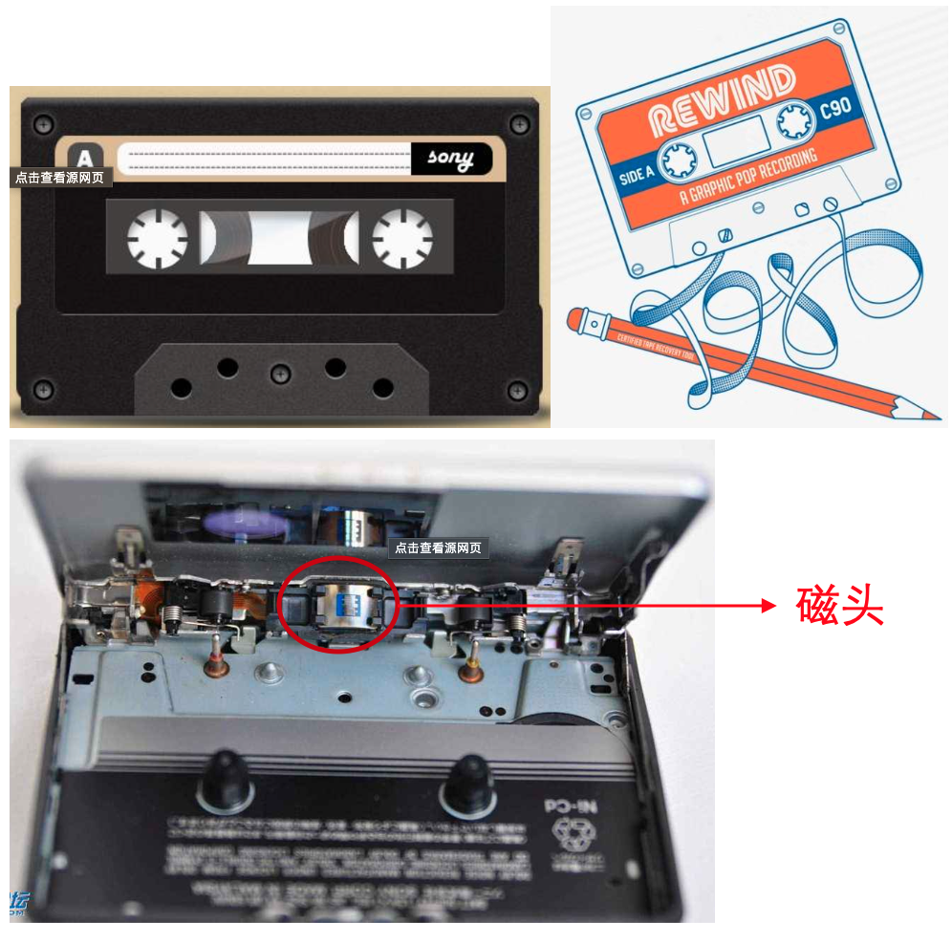


External Sorting
Why can’t we simply do quicksort on a disk?
To get a[i] on
☞ internal memory – O(1)
☞ hard disk
find the track;
find the sector;
find a[i] and transmit.
device-dependent
Tool : Mergesort
To simplify –
☞ Store data on tapes (can only be accessed sequentially)
☞ Can use at least 3 tape drives

Slide 3

External Sorting
〖Example〗 Suppose that the internal memory can handle M = 3 records at a time.
T₁
81
94
11
96
12
35
17
99
28
58
41
75
15
Internal memory
11
12
81
35
94
96
Run
T₂
11
81
94
17
28
99
15
Number of passes = 1+3
T₃
12
35
96
41
58
75
T₁
11
12
35
81
94
96
15
T₄
17
28
41
58
75
99
T₂
11
12
17
28
35
41
58
75
81
94
96
99
T₃
15
Notes:
Question: Given 10,000,000 records of 128 bytes each, and the size of the internal memory is 4MB. How many passes we have to do?
Answer: 1+ log(320 runs) = 1 + 9

Slide 4

External Sorting
What are the concerns?
• Seek time
— O( number of passes )
• Time to read or write one block of records
• Time to internally sort M records
• Time to merge N records from input buffers to the output buffer
 Computer can carry out I\O and CPU processing in parallel
Targets:
Reduction of the number of passes
Run merging
Buffer handling for parallel operation
Run generation

Slide 5

External Sorting
How to reduce the number of passes?
Use a k-way merge!
T₁
81
94
11
96
12
35
17
99
28
58
41
75
15
T₂
11
81
94
41
58
75
11
12
17
28
35
81
94
96
T₃
99
12
35
96
15
T₄
12
17
81
81
81
99
99
99
17
81
35
35
99
96
17
28
99
96
T₁
11
12
17
28
35
81
94
96
99
T₅
15
41
58
75
Number of passes =
T₆
 Require 2k tapes!
Notes:
Question: 320 runs with 10 tapes?
Answer: 1 + 4 passes

Slide 6
External Sorting
Can we use 3 tapes for a 2-way merge?
T₁
34 runs
T₂
17 runs
1 + 6 passes + 5 copies
T₃
17 runs
T₁
17 runs
☹
9 runs
T₂
8 runs
 A smarter way – split unevenly
T₁
34 runs
13 runs
3 runs
1 run
5 runs
1 run
T₂
21 runs
5 runs
1 run
8 runs
2 runs
1 + 7 passes
T₃
13 runs
8 runs
2 runs
1 run
3 runs

Slide 7

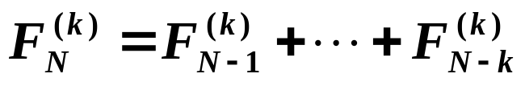
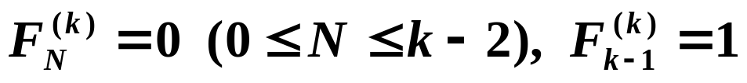

External Sorting
Discussion 20:
What will happen if 22 runs are placed on T₂, with
12 on T₃ ?
Claim: If the number of runs is a Fibonacci number F_{N}, then the best way to distribute them is to split them into F_{N–1} and F_{N–2} .
Claim: For a k-way merge,
where
Polyphase Merge
k + 1 tapes only
What if the initial
number of runs is NOT
a Fibonacci number?
Notes:
For a k-way merge, please refer to the paper for details…

Slide 8
External Sorting
How to handle the buffers for parallel operation?
〖Example〗 Sort a file containing 3250 records, using a computer with an internal memory capable of sorting at most 750 records. The input file has a block length of 250 records.
T₁
Internal memory
input buffers
output buffer
☹
T₂
T₁
T₃
Runs

Slide 9
External Sorting
2-way merge
input buffers
output buffer
In general, for a k-way merge we need 2k input buffers and 2 output buffers for parallel operations.
k
# of input buffers
buffer size
seek time
block size on disk
Beyond a certain k value, the I\O time would actually increase despite the decrease in the number of passes being made. The optimal value for k clearly depends on disk parameters and the amount of internal memory available for buffers.

Slide 10
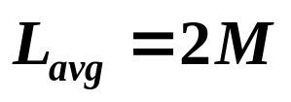
External Sorting
Can we generate a longer run?
81
94
11
96
12
35
17
99
28
58
41
75
15
11
81
94
96
17
12
17
28
35
41
58
75
99
15
Replacement selection
94
94
96
35
35
35
35
99
99
99
99
99
81
96
12
12
12
17
99
35
58
58
75
15
15
15
11
81
94
96
12
17
28
35
41
58
75
99
15
 Powerful when input is often nearly sorted for external sorting.
Notes:
Question: What if we swap 35 with 99?
Answer: 99 will belong to the 1st run.

Slide 11
External Sorting
How to minimize the merge time?
〖Example〗 Suppose we have 4 runs of length 2, 4, 5, and 15, respectively. How can we arrange the merging to obtain minimum merge times?
26
Huffman Tree!
11
15
6
5
2
4
Total merge time = O ( the weighted external path length )
Notes:
外部路径长度:从根到达各个叶节点的路径长度之和
内部路径长度:从根到达各个分支节点的路径长度之和

Slide 12
Reference:
Data Structure and Algorithm Analysis in C (2nd Edition)：Ch.6，p.222-227；M.A.Weiss著、陈越改编，人民邮件出版社，2005
The Fibonacci Numbers and Polyphase Sorting; W. C. LYNCH, Case Institute of Technology, Cleveland, Ohio

