Slide 1
Example 1

Slide 2
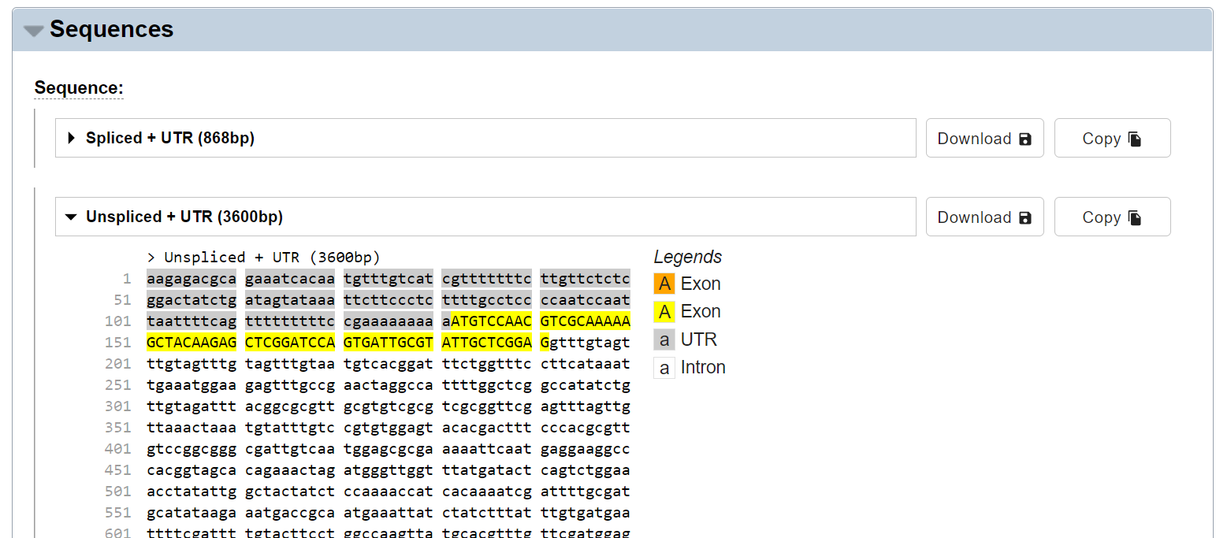
https://wormbase.org/species/c_elegans/transcript/Y40B10A.2a.1#06--10
unspliced+UTRTranscriptSequence_Y40B10A.2a.1.fasta

Slide 3
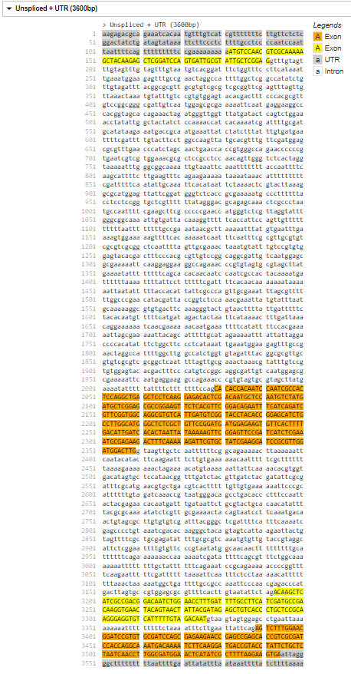
Python HW2: Given unspliced+UTRTranscriptSequence_Y40B10A.2a.1.fasta Generate the following table
1
191
2029
2359
3193
3326
3389
3600
Name | Start | End | Length
5’UTR | 1 | 131 | 131
CDS | - | - | -
3’UTR | 3545 | 3600 | 56
Exon1 | 1 | 191 | 191
Intron1 | 192 | 2028 | 1837
Exon2 | 2029 | 2359 | 331
Intron2 | 2360 | 3192 | 833
Exon3 | 3193 | 3326 | 134
Intron3 | 3327 | 3388 | 62
Exon4 | 3389 | 3600 | 212

Slide 4
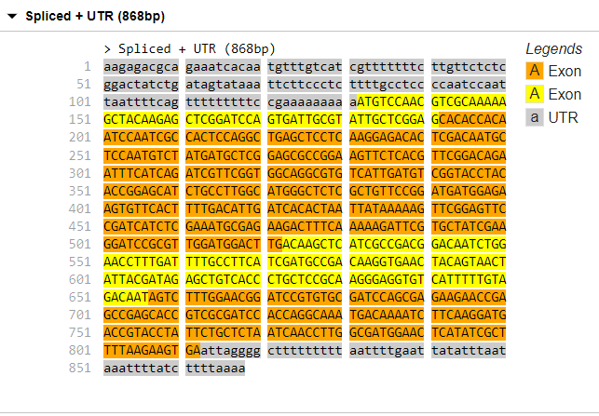
Python HW3: Given unspliced+UTRTranscriptSequence_Y40B10A.2a.1.fasta Generate the following table and spliced mRNA sequence
1
191
192
522
523
656
657
868
1
131
132
812
813
Name | Start | End | Length
5’UTR | 1 | 131 | 131
CDS | 132 | 812 | 681
3‘UTR | 813 | 868 | 56
Exon1 | 1 | 191 | 191
Exon2 | 192 | 522 | 331
Exon3 | 523 | 656 | 134
Exon4 | 657 | 868 | 212
868

Slide 5
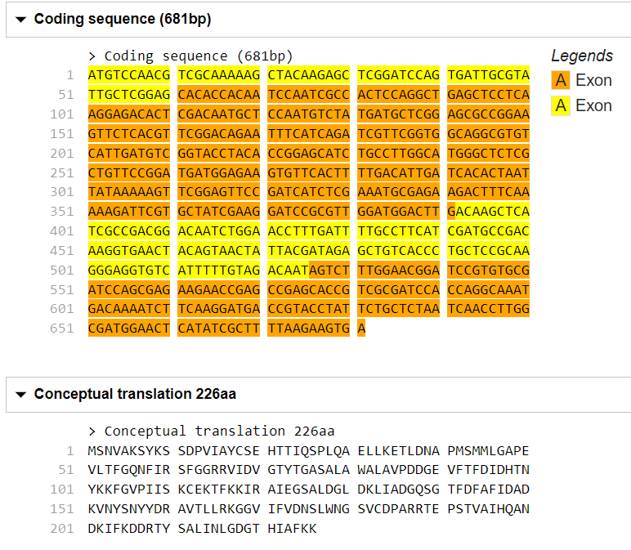
CDS length 681: protein seq length 681/3-1=226
最後一個是Stop Codon, 沒code for amino acid
Python HW4: Given unspliced+UTRTranscriptSequence_Y40B10A.2a.1.fasta Generate the CDS and amino acid sequence

Slide 6
Example 2

Slide 7
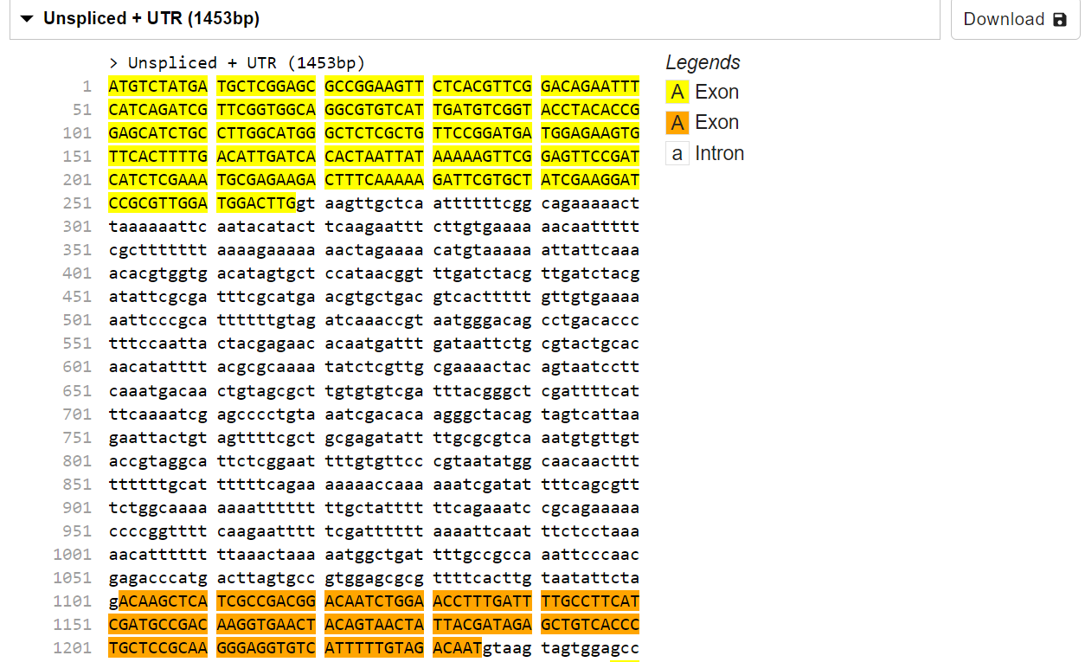
https://wormbase.org/species/c_elegans/transcript/Y40B10A.2b.1#06--10
unspliced+UTRTranscriptSequence_Y40B10A.2b.1.fasta

Slide 8
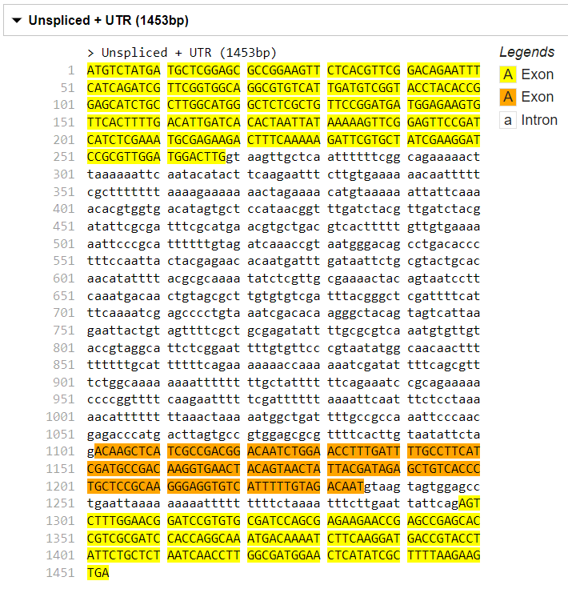
Python HW2: Given unspliced+UTRTranscriptSequence_Y40B10A.2b.1.fasta Generate the following table
1
268
1102
1235
1298
1453
Name | Start | End | Length
5’UTR | - | - | -
CDS | - | - | -
3’UTR | - | - | -
Exon1 | 1 | 268 | 268
Intron1 | 269 | 1101 | 833
Exon2 | 1102 | 1235 | 134
Intron2 | 1236 | 1297 | 62
Exon3 | 1298 | 1453 | 156

Slide 9
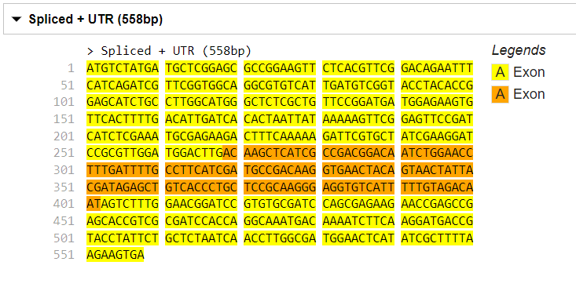
Python HW3: Given unspliced+UTRTranscriptSequence_Y40B10A.2b.1.fasta Generate the following table and spliced mRNA sequence
1
268
269
402
403
558
558
1
Name | Start | End | Length
5’UTR | - | - | -
CDS | 1 | 558 | 558
3‘UTR | - | - | -
Exon1 | 1 | 268 | 268
Exon2 | 269 | 402 | 134
Exon3 | 403 | 558 | 156

Slide 10
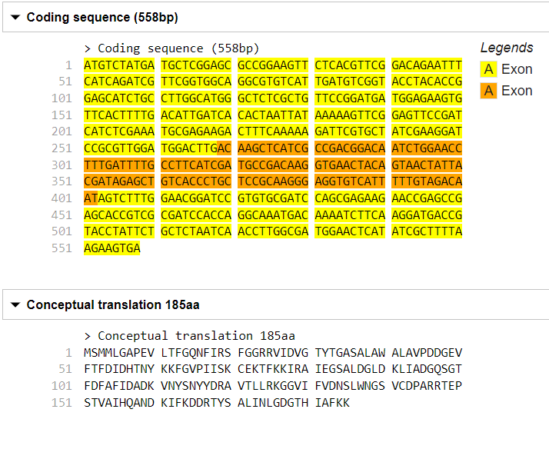
CDS length 681: protein seq length 558/3-1=185
https://wormbase.org/species/c_elegans/cds/Y40B10A.2b#06--10
最後一個是Stop Codon, 沒code for amino acid
Python HW4: Given unspliced+UTRTranscriptSequence_Y40B10A.2b.1.fasta Generate the CDS and amino acid sequence

