Slide 1
2022年暑期新生訓練成果project
能呈現線蟲mRNA structure之網頁分析平台

Slide 2
先用比喻的方式解講此project
想做一個電機系實驗室成員查詢系統, 讓使用者用advisor name or lab member names來查詢 (e.g. 吳謂勝, 鍾其融,…)
查詢後先跑出實驗室簡介頁(列出advisor and all the lab member names)
點某個lab member name (e.g. 鍾其融)會另開新頁呈現此lab member的相關資訊 (見下頁投影片)
Advisor | Lab member
吳謂勝 | 鍾其融
吳謂勝 | 王依婷
吳謂勝 | 黃奕淳

Slide 3

鍾其融
碩二
指導教授: 吳謂勝
興趣: 攀岩
此頁要呈現的資料
有些是後端從資料庫內的資料表調取後送往網頁前端顯示
有些是後端要臨場用網路爬蟲去爬資料回來, 臨場做大數據分析後將結果送往網頁前端顯示

Slide 4
比喻 vs. 真實
老師名字(吳謂勝) | 基因Sequence Name (2L52.1)
老師身份證字號(P121xxx) | 基因 WormBase ID (WBGene00007063)
實驗室學生身分證字號(F232xxx, L221xxx) | Transcript WormBase ID (2L52.1a.1, 2L52.1b.1)

Slide 5
Python HW1: 整理每個基因有多少種Transcripts (每個教授的實驗室有多少學生)
https://downloads.wormbase.org/releases/current-production-release/species/c_elegans/PRJNA13758/
下載transcript檔案
c_elegans.PRJNA13758.WS284.mRNA_transcripts.fa.gz
檔案內容
>2L52.1a.1 (學生ID) gene=WBGene00007063 (老師ID)
AAATTTTTCTCAACTTGTCATGTCAATGGTAAGAAATGTATCAAATCAGAGCGAAAAATT……………
>2L52.1b.1 gene=WBGene00007063
ATGTCAGATAATGAAGAAGTATATGTGAACTTCCGTGGAATGAACTGTATCTCAACAGGA…………..

Slide 6
進行整理
總共有多少基因? 總共有多少transcripts?
根據# of transcripts由大到小排序
Gene WormBase ID | # of transcripts | Transcript WormBase IDs
WBGene00007063 | 2 | 2L52.1a.1|2L52.1a.1
WBGene00006962 | 3 | C18A11.5a|C18A11.5b.1|C18A11.5c.1

Slide 7
生物背景
DNA
https://www.youtube.com/watch?v=C1CRrtkWwu0
RNA
https://www.youtube.com/watch?v=Y4p6jhFaru4
Transcription (DNA to mRNA)
https://www.youtube.com/watch?v=_Zyb8bpGMR0&t=4s
DNA→mRNA→Protein
https://www.youtube.com/watch?v=gG7uCskUOrA&t=8s

Slide 8
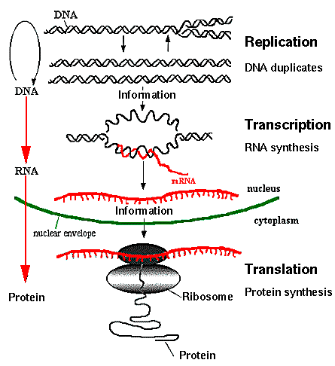
Central Dogma of Molecular Biology
from http;//www.accessexcellence.org/AB/GG/central.html

Slide 9
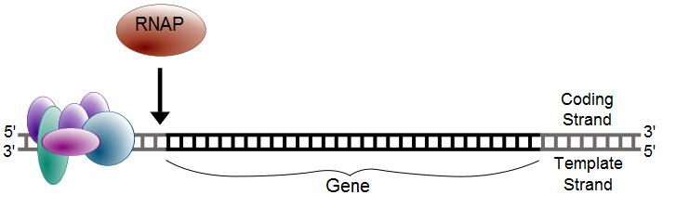
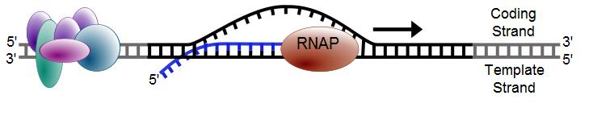
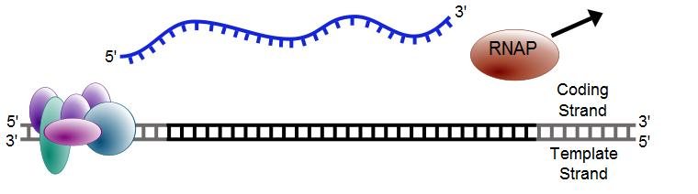
Transcription
from Wiki

Slide 10
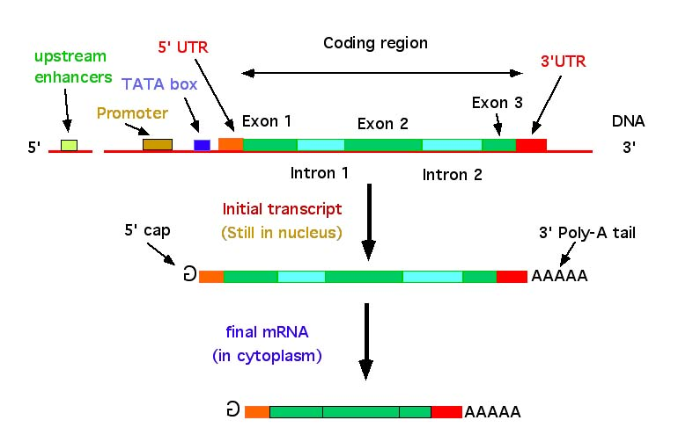
DNA → RNA
from http://nitro.biosci.arizona.edu/courses/EEB600A-2003/lectures/lecture24/lecture24.html

Slide 11
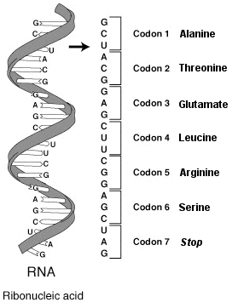
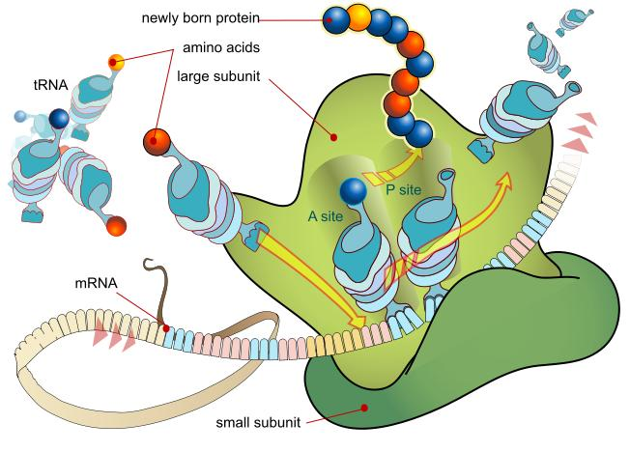
Translation
from Wiki

Slide 12
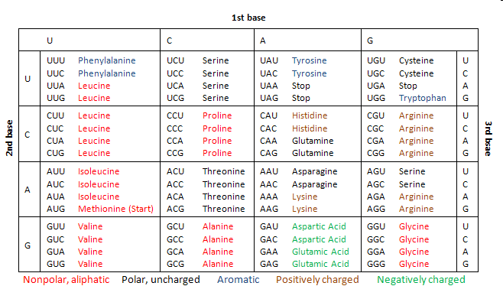
Codon table
from Wiki

Slide 13
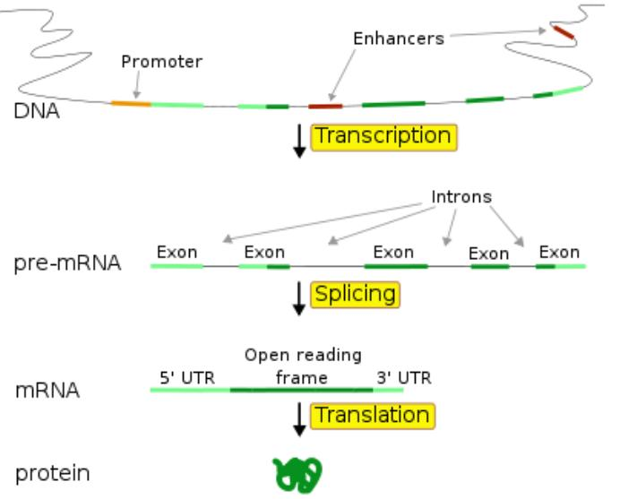
5’utr有可能橫跨Exon1 and Exon2嗎??

Slide 14
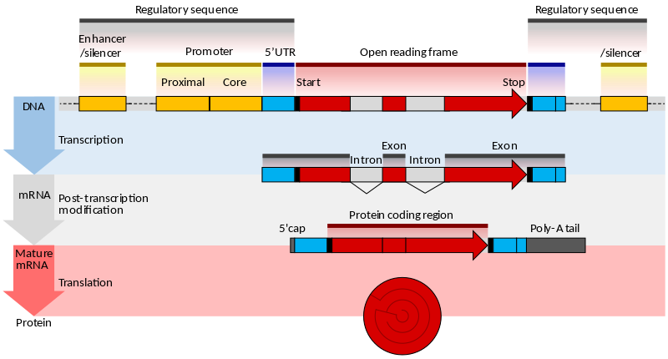
https://en.wikipedia.org/wiki/Gene_structure
3’UTR
5’UTR
CDS
3’UTR

Slide 15
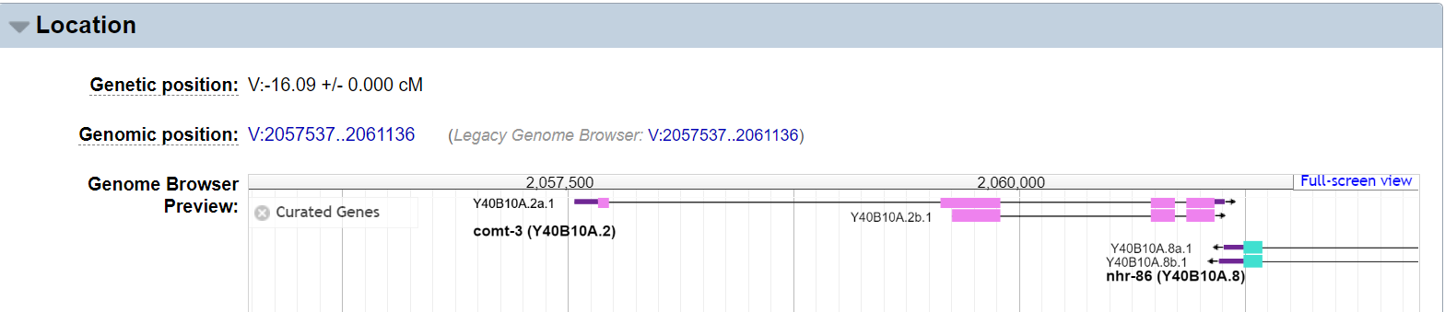
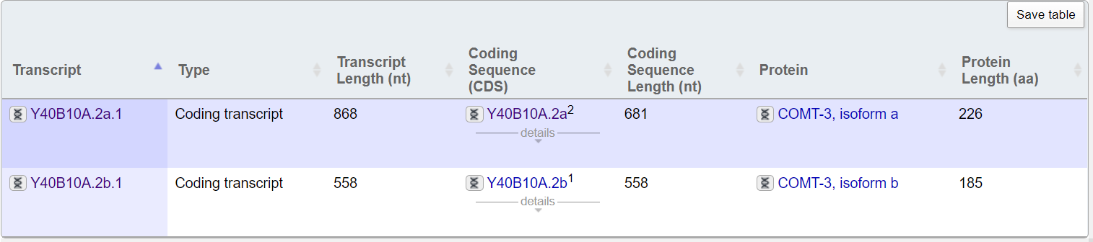
Wormbase: Gene comt-3
https://wormbase.org/species/c_elegans/gene/WBGene00021487#0-9f-10
粉紅色方塊是組成CDS的exon
Y40B10A.2b.1沒有UTR

Slide 16
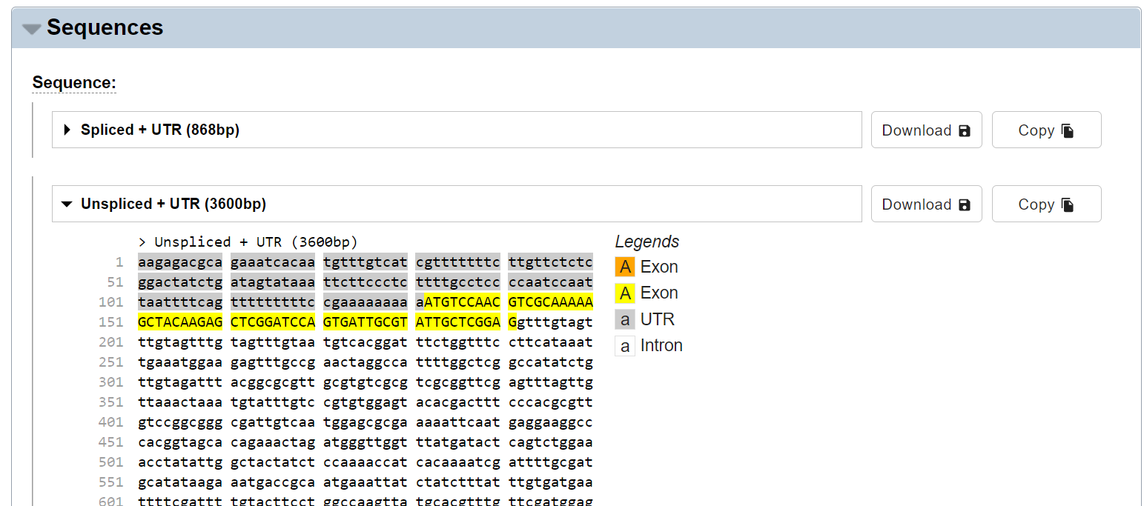
https://wormbase.org/species/c_elegans/transcript/Y40B10A.2a.1#06--10
unspliced+UTRTranscriptSequence_Y40B10A.2a.1.fasta

Slide 17
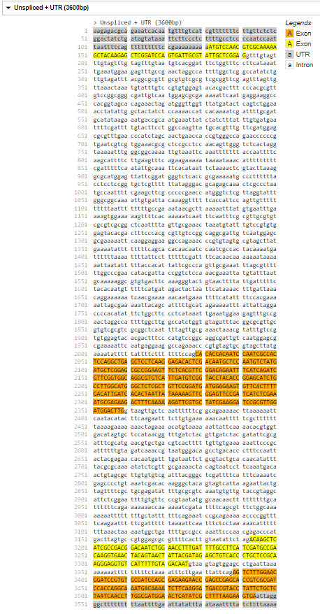
Python HW2: Given unspliced+UTRTranscriptSequence_Y40B10A.2a.1.fasta Generate the following table
1
191
2029
2359
3193
3326
3389
3600
Name | Start | End | Length
5’UTR | 1 | 131 | 131
CDS | - | - | -
3’UTR | 3545 | 3600 | 56
Exon1 | 1 | 191 | 191
Intron1 | 192 | 2028 | 1837
Exon2 | 2029 | 2359 | 331
Intron2 | 2360 | 3192 | 833
Exon3 | 3193 | 3326 | 134
Intron3 | 3327 | 3388 | 62
Exon4 | 3389 | 3600 | 212

Slide 18
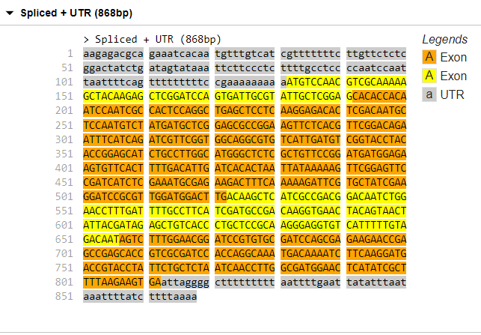
Python HW3: Given unspliced+UTRTranscriptSequence_Y40B10A.2a.1.fasta Generate the following table and spliced mRNA sequence
1
191
192
522
523
656
657
868
1
131
132
812
813
5’UTR | 1 | 131 | 131
CDS | 132 | 812 | 681
3‘UTR | 813 | 868 | 56
Exon1 | 1 | 191 | 191
Exon2 | 192 | 522 | 331
Exon3 | 523 | 656 | 134
Exon4 | 657 | 868 | 212
868

Slide 19
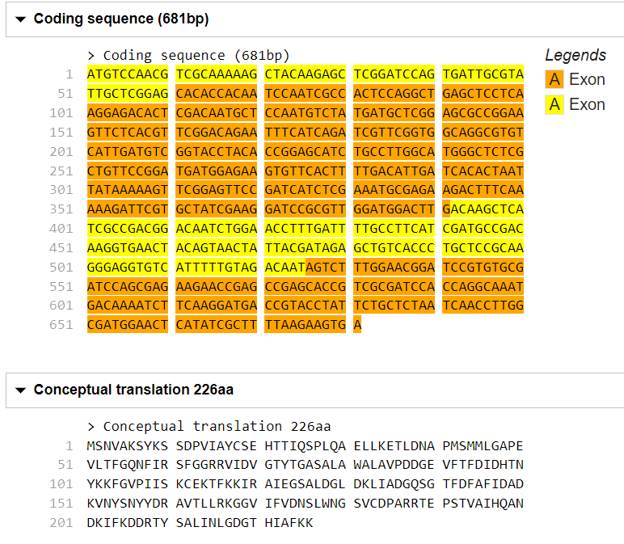
CDS length 681: protein seq length 681/3-1=226
最後一個是Stop Codon, 沒code for amino acid
Python HW4: Given unspliced+UTRTranscriptSequence_Y40B10A.2a.1.fasta Generate the CDS and amino acid sequence

Slide 20
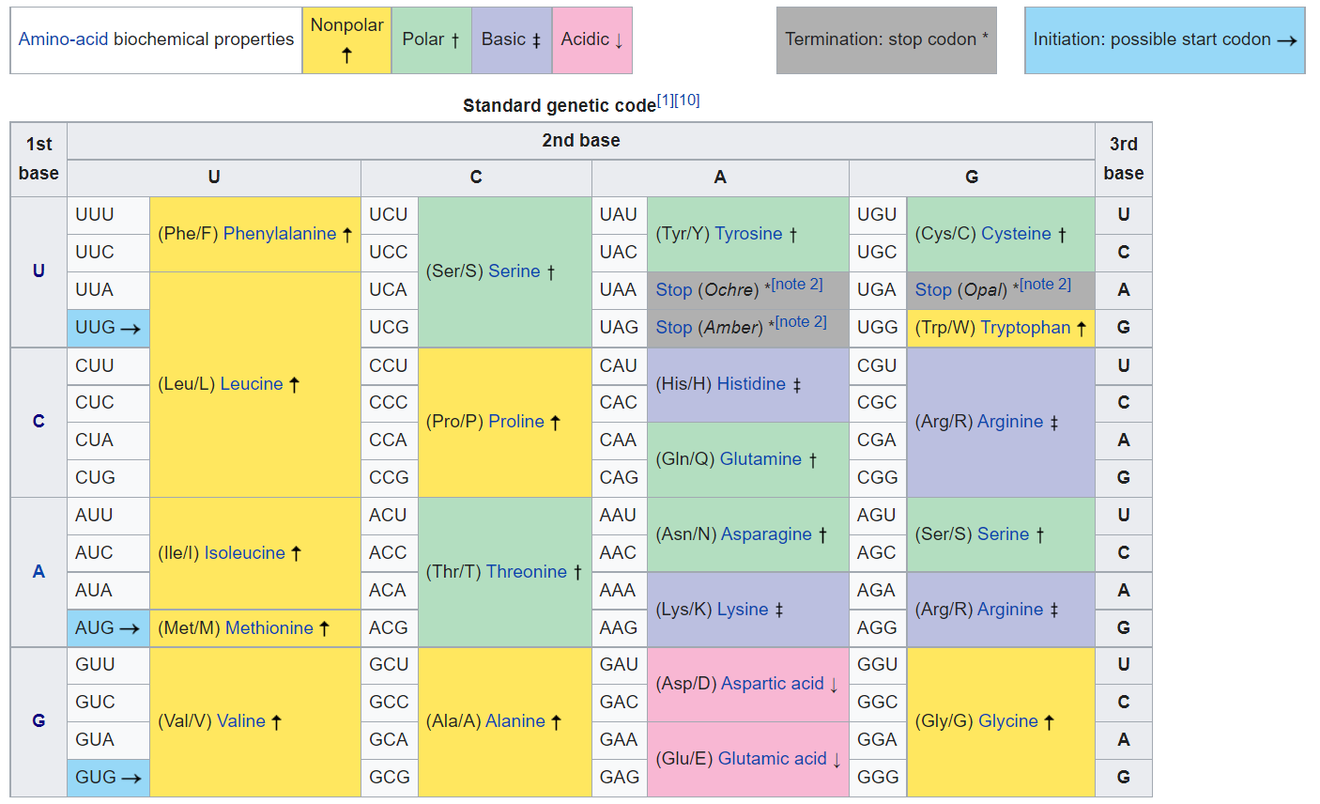

Slide 21
能呈現線蟲mRNA structure之網頁分析平台
Input page: 輸入Gene WormBase ID or Transcript WormBase ID
Output page: 輸出此家族所有成員資訊
點擊Y40B10A.2a.1
Gene WormBase ID | # of transcripts | Transcript WormBase IDs
WBGene00021487 | 2 | Y40B10A.2a.1|Y40B10A.2b.1

Slide 22
點擊Y40B10A.2a.1
用網路爬蟲到
https://wormbase.org/species/c_elegans/transcript/Y40B10A.2a.1#06--10
爬回unspliced+UTRTranscriptSequence_Y40B10A.2a.1.fasta
後端跑HW2, HW3, HW4程式, 將結果送到網頁前端顯示

Slide 23
HW2: Given unspliced+UTRTranscriptSequence_Y40B10A.2a.1.fasta Generate the following table
1
191
2029
2359
3193
3326
3389
3600
Name | Start | End | Length
5’UTR | 1 | 131 | 131
CDS | - | - | -
3’UTR | 3545 | 3600 | 56
Exon1 | 1 | 191 | 191
Intron1 | 192 | 2028 | 1837
Exon2 | 2029 | 2359 | 331
Intron2 | 2360 | 3192 | 833
Exon3 | 3193 | 3326 | 134
Intron3 | 3327 | 3388 | 62
Exon4 | 3389 | 3600 | 212

Slide 24
HW3: Given unspliced+UTRTranscriptSequence_Y40B10A.2a.1.fasta Generate the following table and spliced mRNA sequence
1
191
192
522
523
656
657
868
1
131
132
812
813
5’UTR | 1 | 131 | 131
CDS | 132 | 812 | 681
3‘UTR | 813 | 868 | 56
Exon1 | 1 | 191 | 191
Exon2 | 192 | 522 | 331
Exon3 | 523 | 656 | 134
Exon4 | 657 | 868 | 212
868

Slide 25
CDS length 681: protein seq length 681/3-1=226
最後一個是Stop Codon, 沒code for amino acid
HW4: Given unspliced+UTRTranscriptSequence_Y40B10A.2a.1.fasta Generate the CDS and amino acid sequence

