Slide 1
2022年暑期新生訓練成果project
能呈現線蟲mRNA structure之網頁分析平台

Slide 2
先用比喻的方式解講此project
想做一個電機系實驗室成員查詢系統, 讓使用者用advisor name or lab member names來查詢 (e.g. 吳謂勝, 鍾其融,…)
查詢後先跑出實驗室簡介頁(列出advisor and all the lab member names)
點某個lab member name (e.g. 鍾其融)會另開新頁呈現此lab member的相關資訊 (見下頁投影片)
Advisor | Lab member
吳謂勝 | 鍾其融
吳謂勝 | 王依婷
吳謂勝 | 黃奕淳

Slide 3

鍾其融
碩二
指導教授: 吳謂勝
興趣: 攀岩
此頁要呈現的資料
有些是後端從資料庫內的資料表調取後送往網頁前端顯示
有些是後端要臨場用網路爬蟲去爬資料回來, 臨場做大數據分析後將結果送往網頁前端顯示

Slide 4
比喻 vs. 真實
老師名字(吳謂勝) | 基因Sequence Name (2L52.1)
老師身份證字號(P121xxx) | 基因 WormBase ID (WBGene00007063)
實驗室學生身分證字號(F232xxx, L221xxx) | Transcript WormBase ID (2L52.1a.1, 2L52.1b.1)

Slide 5
Python HW1: 整理每個基因有多少種Transcripts (每個教授的實驗室有多少學生)
https://downloads.wormbase.org/releases/current-production-release/species/c_elegans/PRJNA13758/
下載transcript檔案
ripc_elegans.PRJNA13758.WS284.mRNA_transcts.fa.gz
檔案內容
>2L52.1a.1 (學生ID) gene=WBGene00007063 (老師ID)
AAATTTTTCTCAACTTGTCATGTCAATGGTAAGAAATGTATCAAATCAGAGCGAAAAATT……………
>2L52.1b.1 gene=WBGene00007063
ATGTCAGATAATGAAGAAGTATATGTGAACTTCCGTGGAATGAACTGTATCTCAACAGGA…………..

Slide 6
進行整理
總共有多少基因? 總共有多少transcripts?
31989 個mRNA transcripts，分屬 19981 個基因
根據# of transcripts由大到小排序
Gene WormBase ID | # of transcripts | Transcript WormBase IDs
WBGene00007063 | 2 | 2L52.1a.1|2L52.1b.1
WBGene00006962 | 3 | C18A11.5a|C18A11.5b.1|C18A11.5c.1

Slide 7
生物背景
DNA
https://www.youtube.com/watch?v=C1CRrtkWwu0
RNA
https://www.youtube.com/watch?v=Y4p6jhFaru4
Transcription (DNA to mRNA)
https://www.youtube.com/watch?v=_Zyb8bpGMR0&t=4s
DNA→mRNA→Protein
https://www.youtube.com/watch?v=gG7uCskUOrA&t=8s

Slide 8
Organism (生物)
An organism is any living thing (such as animal, plant, fungus, or micro-organism) that is capable of response to stimuli, reproduction, growth, development, and maintenance of homeostasis as a stable whole.
Unicellular organism (e.g. yeast)
Multicellular organism (e.g. human 10¹⁴ cells ): composed of many billions of cells grouped into specialized tissues and organs

Slide 9
Cell: The Unit of Life
Reproduction by cell division
Metabolism, including taking in raw materials, building cell components, converting energy, molecules and releasing by-products
Response to external and internal stimuli such as changes in temperature, pH or levels of nutrients
Growth, development, and maintenance of homeostasis,…

Slide 10
Model Organism
A model organism is a species that is extensively studied to understand particular biological phenomena, with the expectation that discoveries made in the organism model will provide insight into the workings of other organisms. In particular, model organisms are widely used to explore potential causes and treatments for human disease when human experimentation would be unfeasible or unethical.
This strategy is made possible by the common descent of all living organisms, and the conservation of metabolic and developmental pathways and genetic material over the course of evolution.
When researchers look for an organism to use in their studies, they look for several traits. Among these are size, generation time, accessibility, manipulation, genetics, conservation of mechanisms, and potential economic benefit.

Slide 11
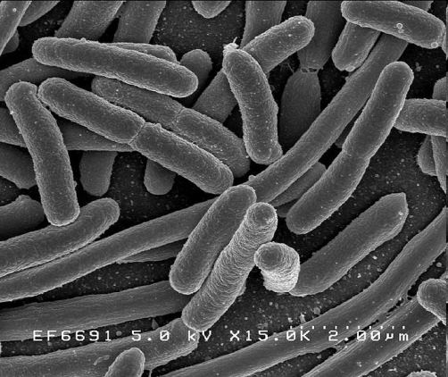
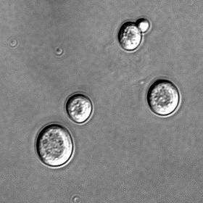
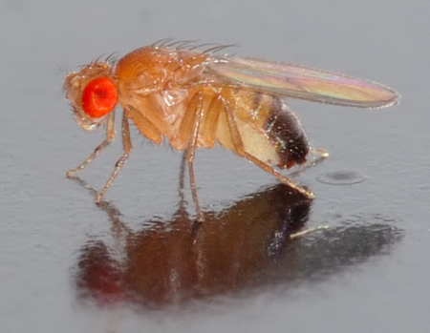
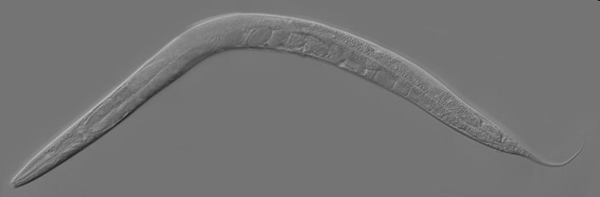
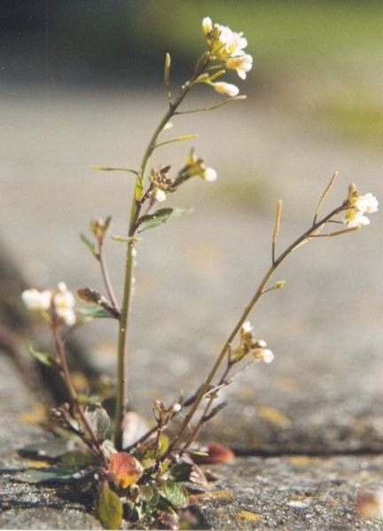
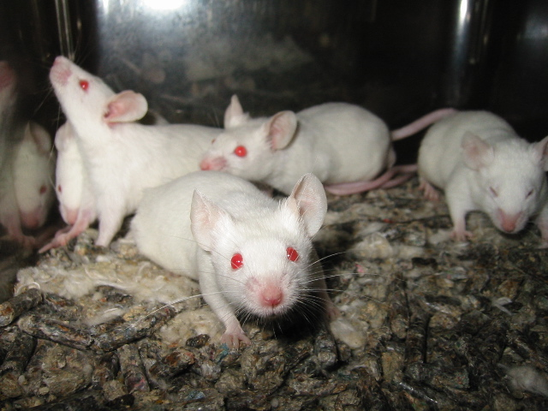
Prokaryote
Escherichia coli 大腸桿菌
Eukaryote, unicellular
Saccharomyces cerevisiae 酵母菌
Eukaryote, multicellular
Drosophila melanogaster 果蠅
Caenorhabditis elegans 線蟲
Arabidopsis thaliana 阿拉伯芥
Vertebrate, multicellular
Mus musculus 老鼠
Homo sapiens 人類
from Wiki

Slide 12
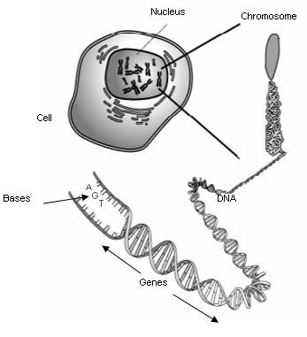
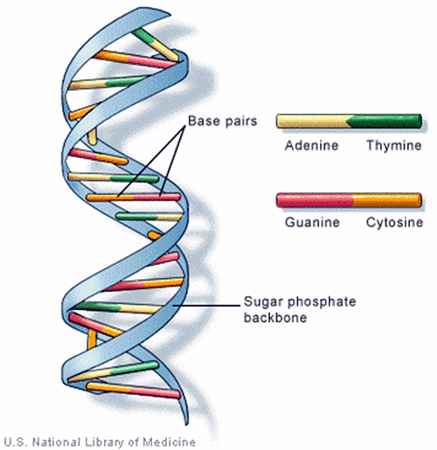
Cell: The Unit of Life
from Wiki
Human (2003) | Yeast (1996)
46 chromosomes | 16 chromosomes
3 x 10⁹ DNA bps | 1.2 x 10⁷ DNA bps
~ 25,000 genes | ~ 6,000 genes

Slide 13
Cell: The Unit of Life
Reproduction by cell division
Metabolism, including taking in raw materials, building cell components, converting energy, molecules and releasing by-products
Response to external and internal stimuli such as changes in temperature, pH or levels of nutrients
Growth, development, and maintenance of homeostasis,…
from Wiki
Human (2003) | Yeast (1996)
46 chromosomes | 16 chromosomes
3 x 10⁹ DNA bps | 1.2 x 10⁷ DNA bps
~ 25000 genes | ~ 6000 genes

Slide 14
Protein: The Machinery of Life
Proteins are essential parts of organisms and participate in every process within cells.
Metabolism (enzyme), immune response (antibody), cell growth (hormone), cell cycle, cell signaling, DNA replication, DNA repair,…

Slide 15
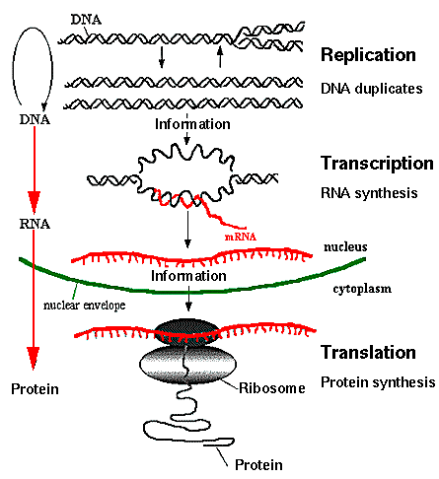
Central Dogma of Molecular Biology
from http;//www.accessexcellence.org/AB/GG/central.html

Slide 16
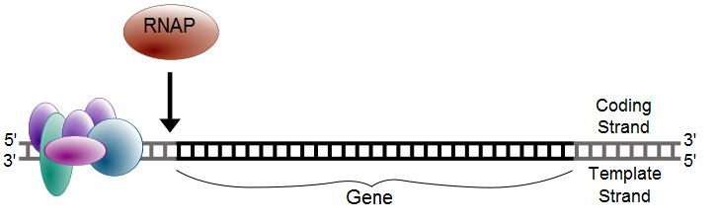
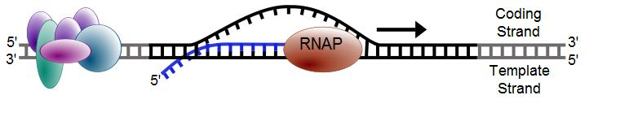
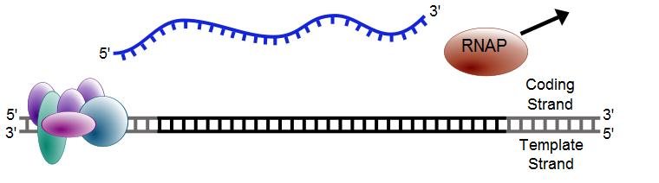
Transcription
from Wiki

Slide 17
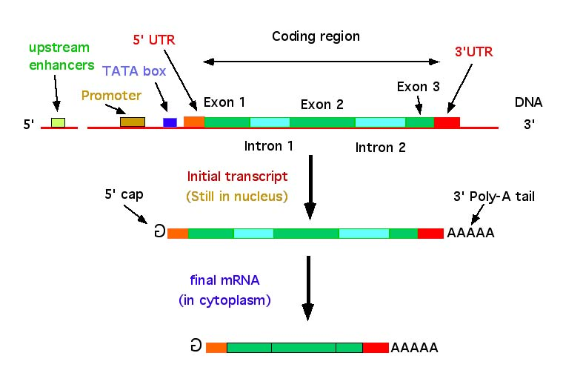
DNA → RNA
from http://nitro.biosci.arizona.edu/courses/EEB600A-2003/lectures/lecture24/lecture24.html

Slide 18
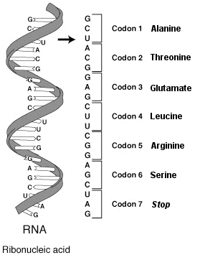
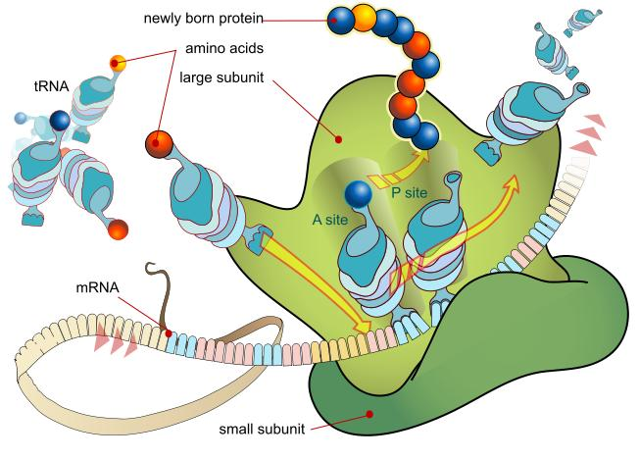
Translation
from Wiki

Slide 19
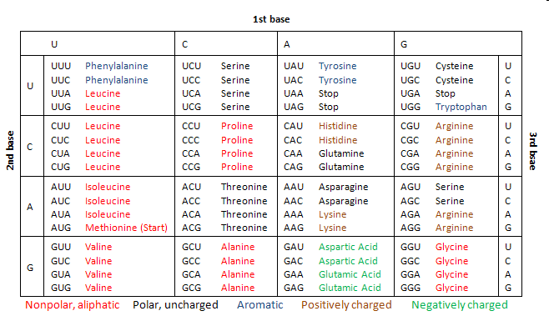
Codon table
from Wiki

Slide 20
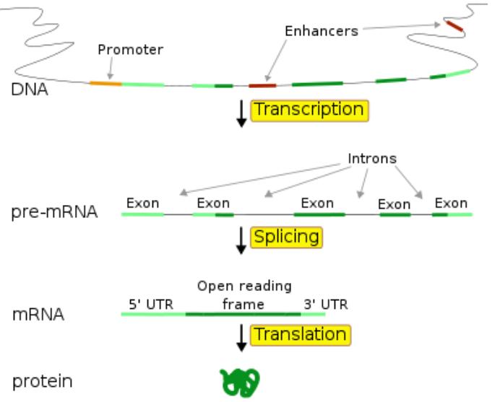
5’utr有可能橫跨Exon1 and Exon2嗎??

Slide 21
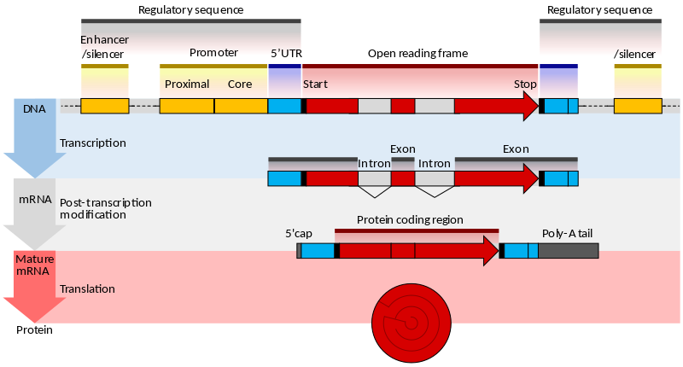
https://en.wikipedia.org/wiki/Gene_structure
3’UTR
5’UTR
CDS
3’UTR

Slide 22
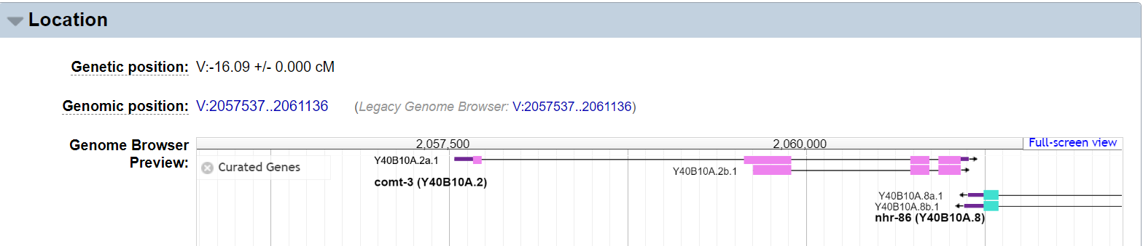
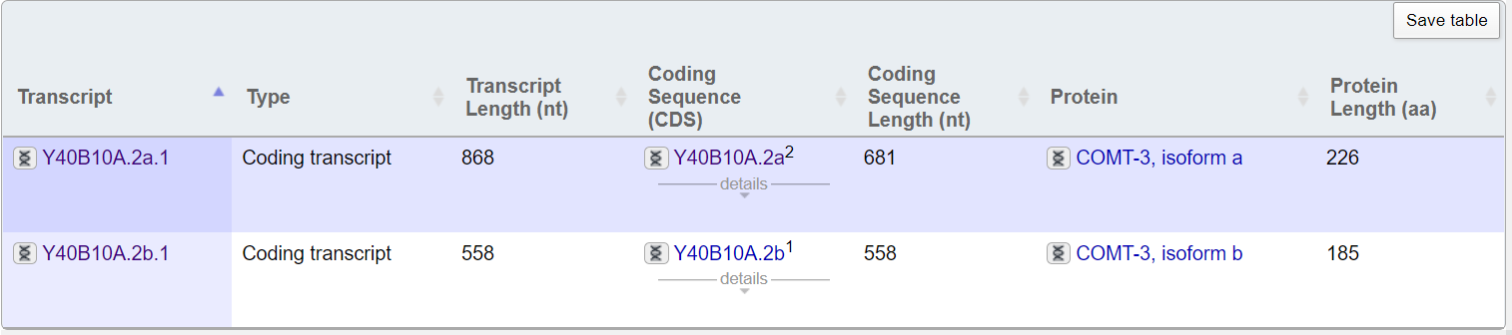
Wormbase: Gene comt-3
https://wormbase.org/species/c_elegans/gene/WBGene00021487#0-9f-10
粉紅色方塊是組成CDS的exon
Y40B10A.2b.1沒有UTR

Slide 23
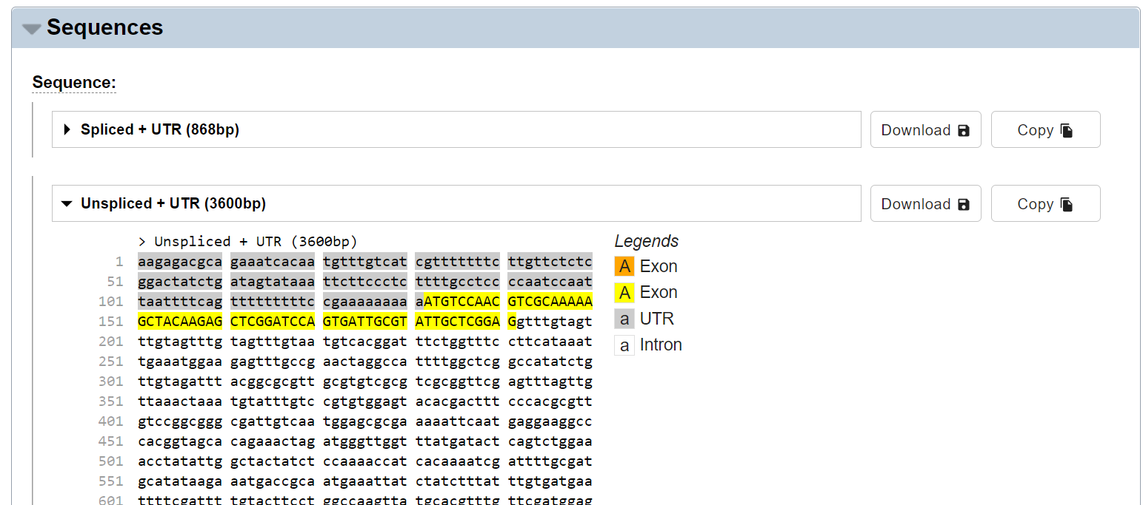
https://wormbase.org/species/c_elegans/transcript/Y40B10A.2a.1#06--10
unspliced+UTRTranscriptSequence_Y40B10A.2a.1.fasta

Slide 24
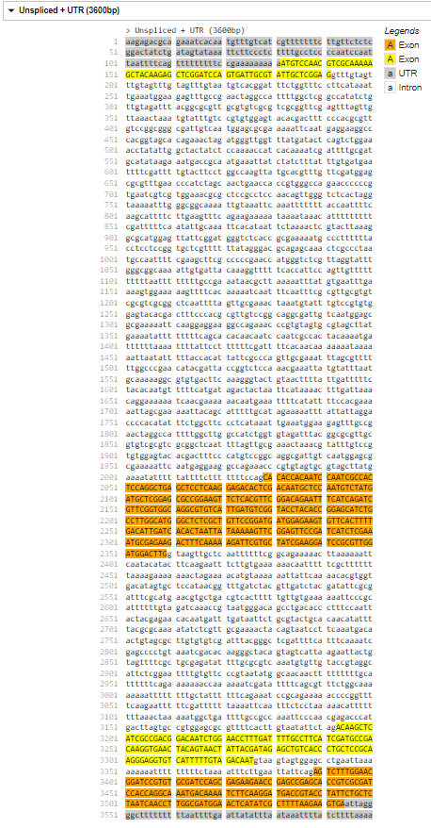
Python HW2: Given unspliced+UTRTranscriptSequence_Y40B10A.2a.1.fasta Generate the following table
1
191
2029
2359
3193
3326
3389
3600
Name | Start | End | Length
5’UTR | 1 | 131 | 131
CDS | - | - | -
3’UTR | 3545 | 3600 | 56
Exon1 | 1 | 191 | 191
Intron1 | 192 | 2028 | 1837
Exon2 | 2029 | 2359 | 331
Intron2 | 2360 | 3192 | 833
Exon3 | 3193 | 3326 | 134
Intron3 | 3327 | 3388 | 62
Exon4 | 3389 | 3600 | 212

Slide 25
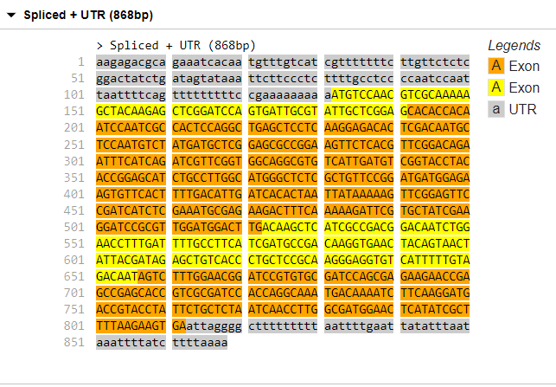
Python HW3: Given unspliced+UTRTranscriptSequence_Y40B10A.2a.1.fasta Generate the following table and spliced mRNA sequence
1
191
192
522
523
656
657
868
1
131
132
812
813
5’UTR | 1 | 131 | 131
CDS | 132 | 812 | 681
3‘UTR | 813 | 868 | 56
Exon1 | 1 | 191 | 191
Exon2 | 192 | 522 | 331
Exon3 | 523 | 656 | 134
Exon4 | 657 | 868 | 212
868

Slide 26
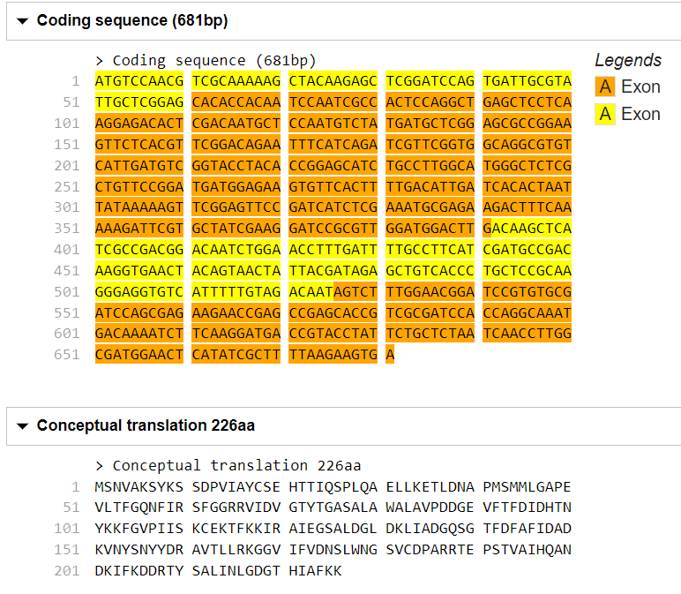
CDS length 681: protein seq length 681/3-1=226
最後一個是Stop Codon, 沒code for amino acid
Python HW4: Given unspliced+UTRTranscriptSequence_Y40B10A.2a.1.fasta Generate the CDS and amino acid sequence

Slide 27
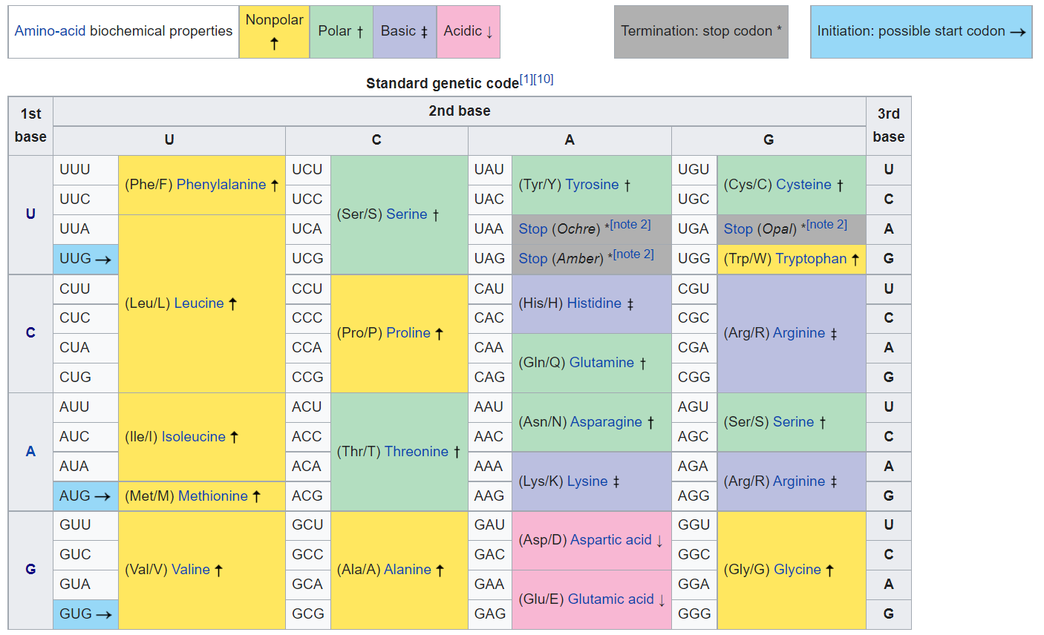

Slide 28
能呈現線蟲mRNA structure之網頁分析平台
Input page: 輸入Gene WormBase ID or Transcript WormBase ID
Output page: 輸出此家族所有成員資訊
點擊Y40B10A.2a.1
Gene WormBase ID | # of transcripts | Transcript WormBase IDs
WBGene00021487 | 2 | Y40B10A.2a.1|Y40B10A.2b.1

Slide 29
點擊Y40B10A.2a.1
用網路爬蟲到
https://wormbase.org/species/c_elegans/transcript/Y40B10A.2a.1#06--10
爬回unspliced+UTRTranscriptSequence_Y40B10A.2a.1.fasta
後端跑HW2, HW3, HW4程式, 將結果送到網頁前端顯示

Slide 30
HW2: Given unspliced+UTRTranscriptSequence_Y40B10A.2a.1.fasta Generate the following table
1
191
2029
2359
3193
3326
3389
3600
Name | Start | End | Length
5’UTR | 1 | 131 | 131
CDS | - | - | -
3’UTR | 3545 | 3600 | 56
Exon1 | 1 | 191 | 191
Intron1 | 192 | 2028 | 1837
Exon2 | 2029 | 2359 | 331
Intron2 | 2360 | 3192 | 833
Exon3 | 3193 | 3326 | 134
Intron3 | 3327 | 3388 | 62
Exon4 | 3389 | 3600 | 212

Slide 31
HW3: Given unspliced+UTRTranscriptSequence_Y40B10A.2a.1.fasta Generate the following table and spliced mRNA sequence
1
191
192
522
523
656
657
868
1
131
132
812
813
5’UTR | 1 | 131 | 131
CDS | 132 | 812 | 681
3‘UTR | 813 | 868 | 56
Exon1 | 1 | 191 | 191
Exon2 | 192 | 522 | 331
Exon3 | 523 | 656 | 134
Exon4 | 657 | 868 | 212
868

Slide 32
CDS length 681: protein seq length 681/3-1=226
最後一個是Stop Codon, 沒code for amino acid
HW4: Given unspliced+UTRTranscriptSequence_Y40B10A.2a.1.fasta Generate the CDS and amino acid sequence

