Slide 1
Engineering
Computation
Lecture 3

Slide 2
Roots of Equations
    Objective:
    Solve for x, given that f(x) = 0
    -or-
    Equivalently, solve for x such that
    g(x) = h(x) ==> f(x) = g(x) – h(x) = 0

Slide 3
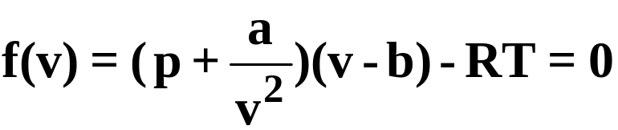
Roots of Equations
Chemical Engineering (C&C 8.1, p. 187):
van der Waals equation; v = V/n (= volume/# moles)
Find the molal volume v such that
p = pressure,
T = temperature,
R = universal gas constant,
a & b = empirical constants

Slide 4
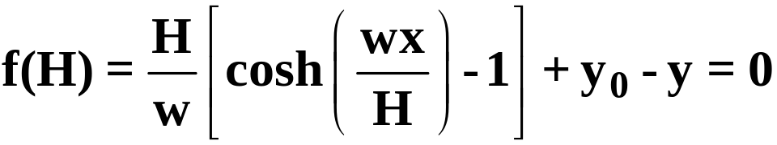
Roots of Equations
Civil Engineering (C&C Prob. 8.17, p. 205):
    Find the horizontal component of tension, H, in a cable that passes through (0,y₀) and (x,y)
w = weight per unit length of cable

Slide 5
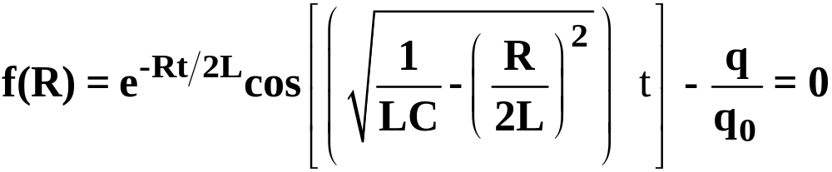
Roots of Equations
Electrical Engineering (C&C 8.3, p. 194):
  Find the resistance, R, of a circuit such that the charge reaches q at specified time t
L = inductance,
C = capacitance,
q₀ = initial charge

Slide 6
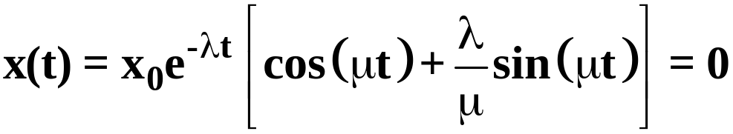
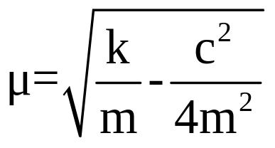
Roots of Equations
Mechanical Engineering (C&C 8.4, p. 196):
  Find the value of stiffness k of a vibrating mechanical system such that the displacement x(t) becomes zero at t= 0.5 s. The initial displacement is x₀ and the initial velocity is zero. The mass m and damping c are known, and λ = c/(2m).
in which

Slide 7
Roots of Equations
Determine real roots of :
  Algebraic equations (including polynomials)
  Transcendental equations such as f(x) = sin(x) + e^{-x}
  Combinations thereof

Slide 8
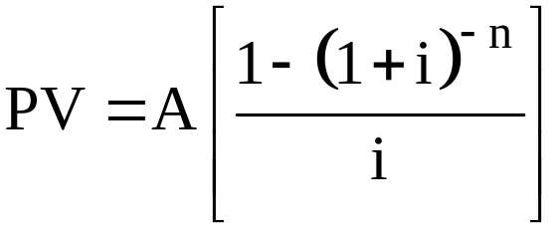
Roots of Equations
Engineering Economics Example:
  A municipal bond has an annual payout of $1,000 for 20 years. It costs $7,500 to purchase now. What is the implicit interest rate, i ?
  Solution: Present-value, PV, is:
  in which:
  PV = present value or purchase price = $7,500
  A = annual payment = $1,000/yr
  n = number of years = 20 yrs
  i = interest rate = ? (as a fraction, e.g., 0.05 = 5%)

Slide 9
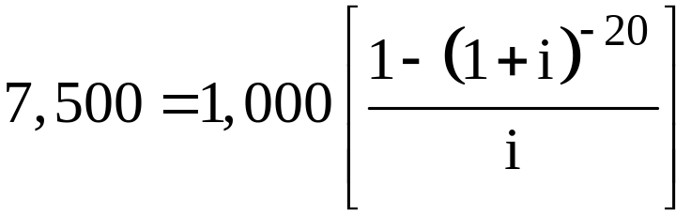
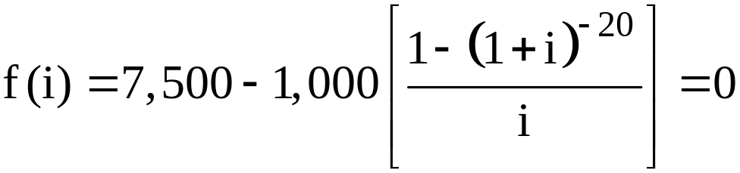
Roots of Equations
Engineering Economics Example (cont.):
  We need to solve the equation for i:
  Equivalently, find the root of:

Slide 10
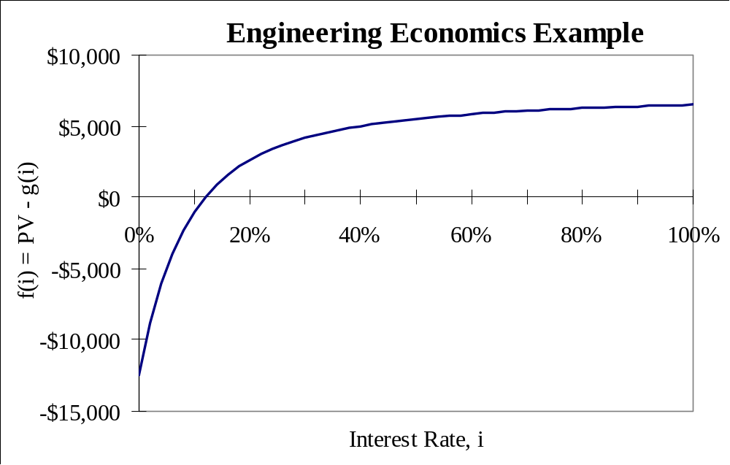
Roots of Equations
Excel

Slide 11

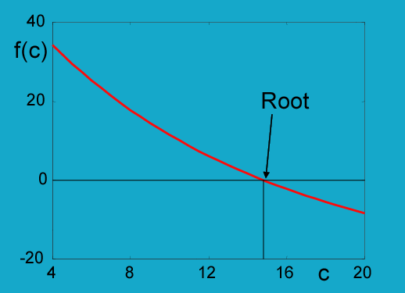
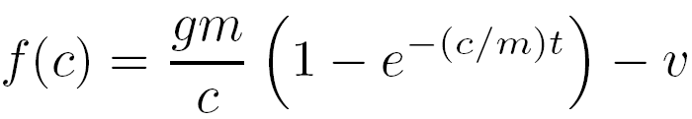

Roots of Equations
Graphical methods:
  Determine the friction coefficient c necessary for a parachutist of mass 68.1 kg to have a speed of 40 m/seg at 10 seconds.
  Reorganizing.

Slide 12
Roots of Equations
  Two Fundamental Approaches
    1. Bracketing or Closed Methods
    - Bisection Method
    - False-position Method (Regula falsi).
    2. Open Methods
    - Newton-Raphson Method
    - Secant Method
    - Fixed point Methods

Slide 13
Bracketing Methods
f(x)
In Figure a) we have the case of f(x_{l}) and f(x_{u}) with the same sign, and there is no root in the interval (x_{l},x_{u}).
a)
x
f(x)
In Figure b) we have the case of f(x_{l}) and f(x_{u}) With different sign, and there is a root in the interval (x_{l},x_{u}).
b)
x
f(x)
In Figure c) we have the case of f(x_{l}) and f(x_{u}) with the same sign, and there are two roots.
x
c)
f(x)
In Figure d) we have the case of f(x_{l}) and f(x_{u}) with different sign, and there is an odd number of roots.
x_{l}
x
d)
x_{u}

Slide 14
Bracketing Methods
Though the cases above are generally valid, there are cases in which they do not hold.
f(x)
In Figure a) we have the case of f(x_{l}) and f(x_{u}) with different sign, but there is a double root.
a)
x
f(x)
In Figure b) We have the case of f(x_{l}) and f(x_{u}) With different sign, but there are two discontinuities.
x
b)
f(x)
In Figure c) we have the case of f(x_{l}) and f(x_{u}) with the same sign, but there is a multiple root.
x_{l}
x
c)
x_{u}

Slide 15
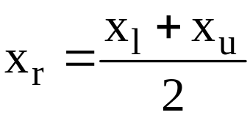
Bracketing Methods (Bisection method)
Bisection Method
f(x)
f(x)
f(x_{u})
f(x_{u})
f(x_{r})
(x₁)
f(x₁) f(x_{r}) > 0
(x₁)
(x_{u})
x
x_{r} => x₁
(x_{r})
(x_{u})
x
f(x_{r})
f(x₁)
f(x₁)

Slide 16
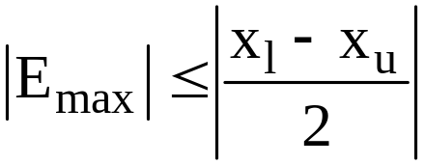
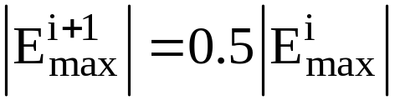
Bracketing Methods (Bisection method)
Bisection Method
Advantages:
  1. Simple
  2. Estimate of maximum error:
  3. Convergence guaranteed
Disadvantages:
  1. Slow
  2. Requires two good initial estimates which define an interval around root:
    use graph of function,
    incremental search, or
    trial & error

Slide 17
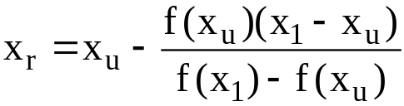
Bracketing Methods (False-position Method)
False-position Method
f(x)
f(x)
f(x_{u})
(x_{r})
f(x_{u})
f(x₁) f(x_{r}) > 0
(x₁)
x₁ = x_{r}
(x₁)
(x_{u})
x
(x_{u})
f(x_{r})
f(x₁)
f(x₁)
f(x_{r})

Slide 18
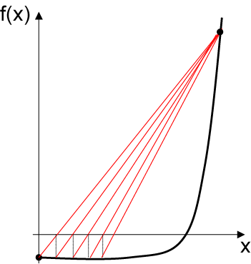
Bracketing Methods (False-position Method)
There are some cases in which the false position method is very slow, and the bisection method gives a faster solution.

Slide 19
Bracketing Methods (False-position Method)
Summary of False-Position Method:
Advantages:
  1. Simple
2. Brackets the Root
Disadvantages:
  1. Can be VERY slow
  2. Like Bisection, need an initial interval around the root.

Slide 20
Open Methods
Roots of Equations - Open Methods
Characteristics:
    1. Initial estimates need not bracket the root
    2. Generally converge faster
    3. NOT guaranteed to converge
Open Methods Considered:
- Fixed-point Methods
- Newton-Raphson Iteration
- Secant Method

Slide 21
Roots of Equations
  Two Fundamental Approaches
    1. Bracketing or Closed Methods
    - Bisection Method
    - False-position Method
    2. Open Methods
    - One Point Iteration
    - Newton-Raphson Iteration
    - Secant Method

Slide 22
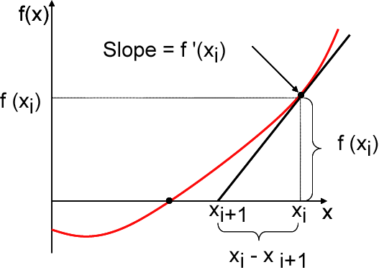
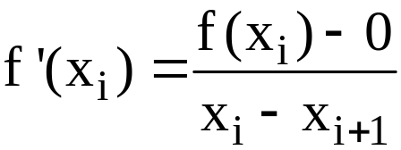
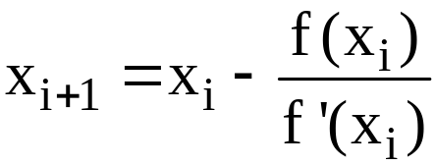
Open Methods (Newton-Raphson Method)
Newton-Raphson Method:
Geometrical Derivation:
Slope of tangent at x_{i} is
Solve for x_{i+1}:
[Note that this is the same form as the generalized one-point iteration, x_{i+1} = g(x_{i})]

Slide 23
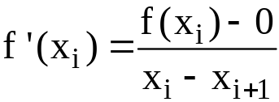

Open Methods (Newton-Raphson Method)
Newton-Raphson Method
f(x)
Tangent w/slope=f '(x_{i} )
f(x)
f(x_{i})
f(x_{i+1})
f(x_{i})
f(x_{i+1})
x_{i+1}
x_{i}
x
(x_{i})
x
x_{i+1}
x_{i} = x_{i+1}

Slide 24
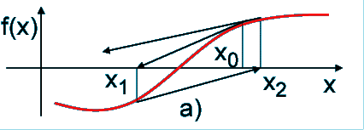
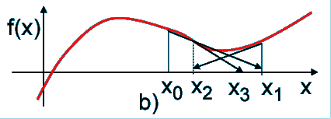
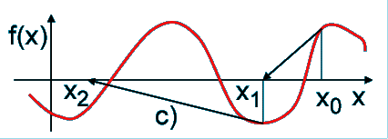
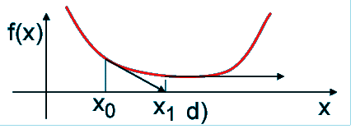
Open Methods
a) Inflection point in the neighboor of a root.
b) Oscilation in the neighboor of a maximum or minimum.
c) Jumps in functions with several roots.
d) Existence of a null derivative.

Slide 25

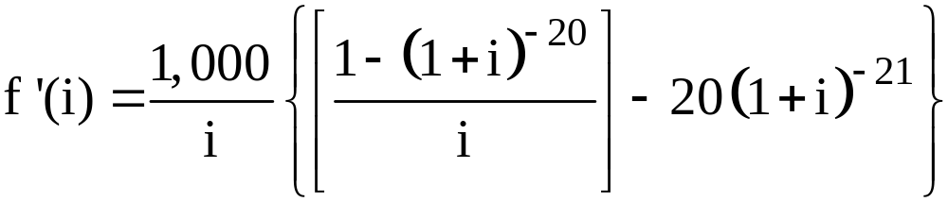
Open Methods (Newton-Raphson Method)
Bond Example:
  To apply Newton-Raphson method to:
  We need the derivative of the function:

Slide 26
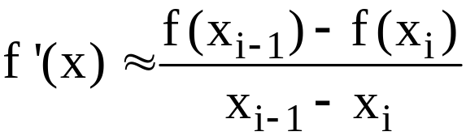

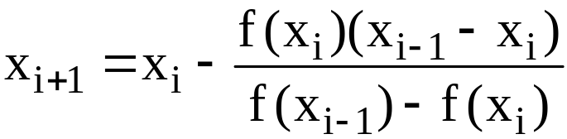
Open Methods (Secant Method)
Secant Method
Approx. f '(x) with backward FDD:
Substitute this into the N-R equation:
to obtain the iterative expression:

Slide 27
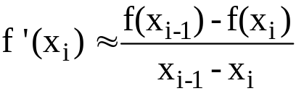
Open Methods (Secant Method)
Secant Method
f(x)
f(x)
f(x_{i-1})
f(x_{i})
f(x_{i})
f(x_{i-1})
x_{i+1}
x_{i}
x_{i-1}
x
x_{i+1}
x_{i}
x_{i-1}
x
x_{i} = x_{i+1}

