Slide 1
Multimedia Protocols

Slide 2
Difference with classic applications
Highly delay-sensitive
Packets are useless if they arrive too late
Loss-tolerant (for the most part)
Packet loss can be concealed

Slide 3
Categories of Internet audio/video
Streaming Stored Audio and Video
On-demand requests for compressed and stored audio/video files
Streaming Live Audio and Video
Broadcasting of radio or TV programs over the Internet
Real-Time Interactive Audio and Video
Internet telephony or Internet teleconferencing
Others

Slide 4
Streaming Stored Audio and Video
The multimedia content has been prerecorded and stored on a server
User may pause, rewind, forward, etc…
The time between the initial request and display start can be 1 to 10 seconds
Constraint: after display start, the playout must be continuous

Slide 5
Streaming Live Audio and Video
Similar to traditional broadcast TV/radio, but delivery on the Internet
Non-interactive just view/listen
Can not pause or rewind
Often combined with multicast
The time between the initial request and display start can be up to 10 seconds
Constraint: like stored streaming, after display start, the playout must be continuous

Slide 6
Real-Time Interactive Audio and Video
Phone conversation/Video conferencing
Constraint: delay between initial request and display start must be small
Video: <150 ms acceptable
Audio: <150 ms not perceived, <400 ms acceptable
Constraint: after display start, the playout must be continuous

Slide 7
Others
Multimedia sharing applications
Download-and-then-play applications
Distance learning applications
Coordinate video, audio and data
Typically distributed on CDs

Slide 8
Challenges
TCP/UDP/IP suite provides best-effort, no guarantees on expectation or variance of packet delay
Performance deteriorates if links are congested
Most router implementations use only First-Come-First-Serve (FCFS) packet processing and transmission scheduling

Slide 9
Other Issues
Limited bandwidth
Solution: Compression
Packet Jitter
Solution: Fixed/adaptive playout delay for Audio (example: phone over IP)
Packet loss
Solution: FEC, Interleaving

Slide 10
Packet Loss
Packet never arrives or arrives later than its scheduled playout time.
Since retransmission is inappropriate for Real Time applications, Forward Error Correction or Interleaving are used to reduce loss impact.
Forward Error Correction
Send redundant encoded chunk every n chunks (XOR original n chunks)
If 1 packet in this group is lost, it can be reconstructed
If >1 packets lost, it cannot be recovered
Disadvantages
The smaller the group size, the larger the overhead
Playout delay increases

Slide 11
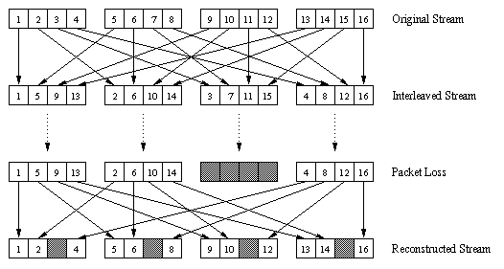
Packet Loss
Interleaving
Divide 20 msec of audio data into smaller units of 5 msec each and interleave
Upon loss, have a set of partially filled chunks

Slide 12
Recovering from packet loss Receiver-based Repair
The simplest form: Packet repetition
Replaces lost packets with copies of the packets that arrived immediately before the loss
A more computationally intensive form: Interpolation
Uses Audio before and after the loss to interpolate a suitable packet to cover the loss

Slide 13
Streaming Stored Audio / Video
User’s perspective:
Quick start without waiting for full download.
Coming continuously without interruption.
VCR operation (pause, resume, fast forward, rewind, etc.)
Multimedia Streaming: Clients request audio/video files from servers and pipeline reception over the network and display
Streaming Server
Client/Receiver
Storage Device
Video
Decoder
Audio
Decoder
Multimedia Streaming Protocols
Raw
Video
Compressed
Video
Multimedia Streaming Protocols
Raw
Audio
Compressed
Audio
Transport
Protocols
Transport
Protocols
Internet

Slide 14
Streaming Stored Audio / Video
First Approach: Using a Web Server
Second Approach: Using a Web Server with Metafile
Third Approach: Using a Media Server
Fourth Approach: Using a Media Server and RTSP

Slide 15
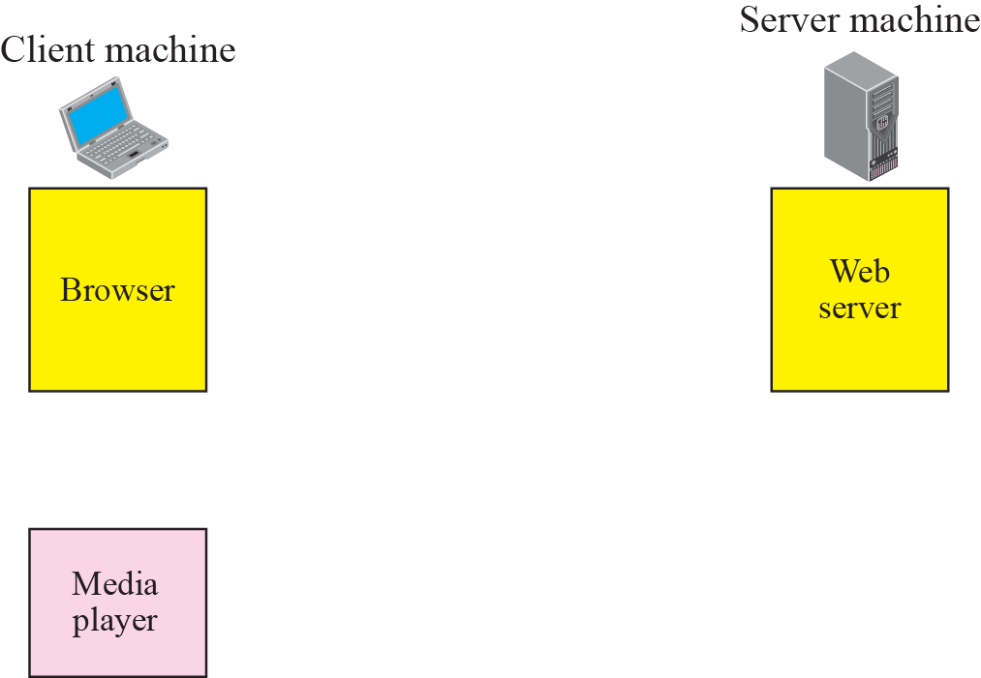
Using a web server
Audio: in files sent as HTTP objects
Video (interleaved audio and images in one file, or two separate files and client synchronizes the display) sent as HTTP object(s)

Slide 16
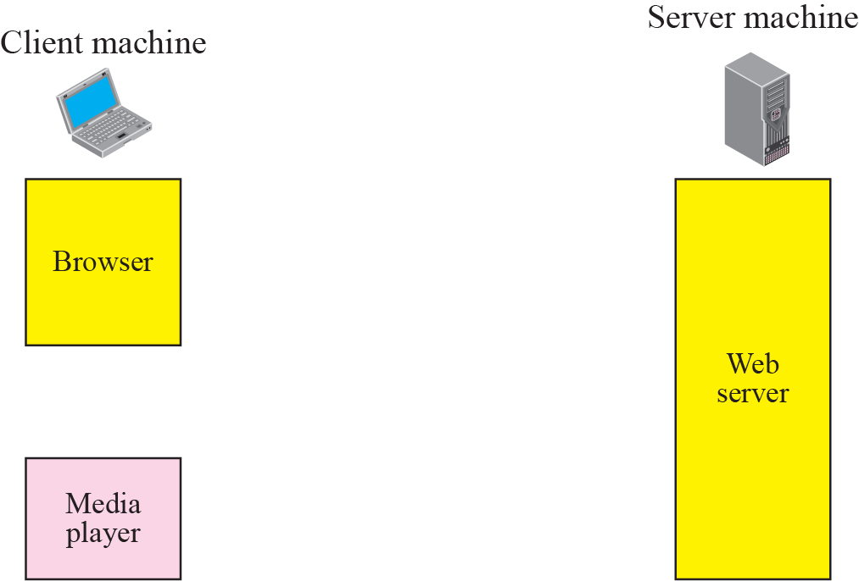
Using a Web Server with Metafile
Web browser requests and receives a Meta File (a file describing the object) instead of receiving the file itself;
Browser launches the appropriate Player and passes it the Meta File;
Player sets up a TCP connection with a streaming server and downloads the file

Slide 17
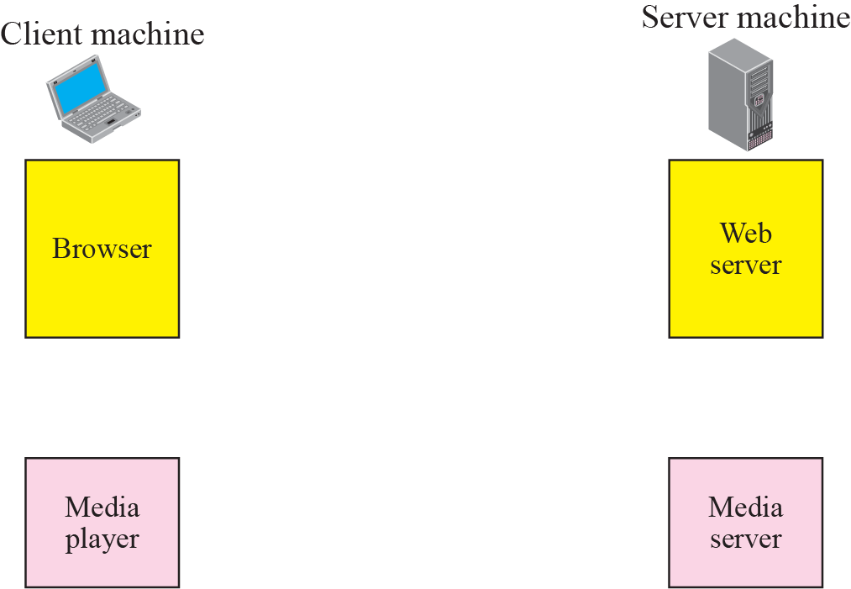
Using a Media Server

Slide 18
Streaming Live Audio Video
Similar to streaming stored audio/video.
However, in the first application, the communication is unicast and on-demand. In the second, the communication is multicast and live.

Slide 19
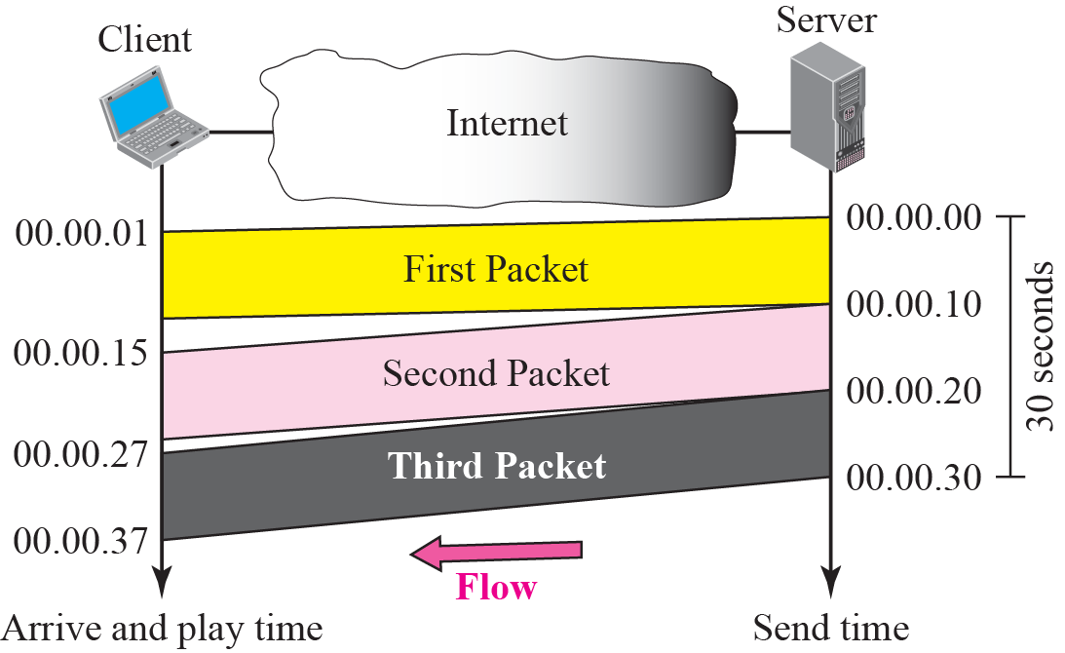
Real-time Audio Video
Effect of Jitter
Jitter is introduced in real-time data by the delay between packets

Slide 20
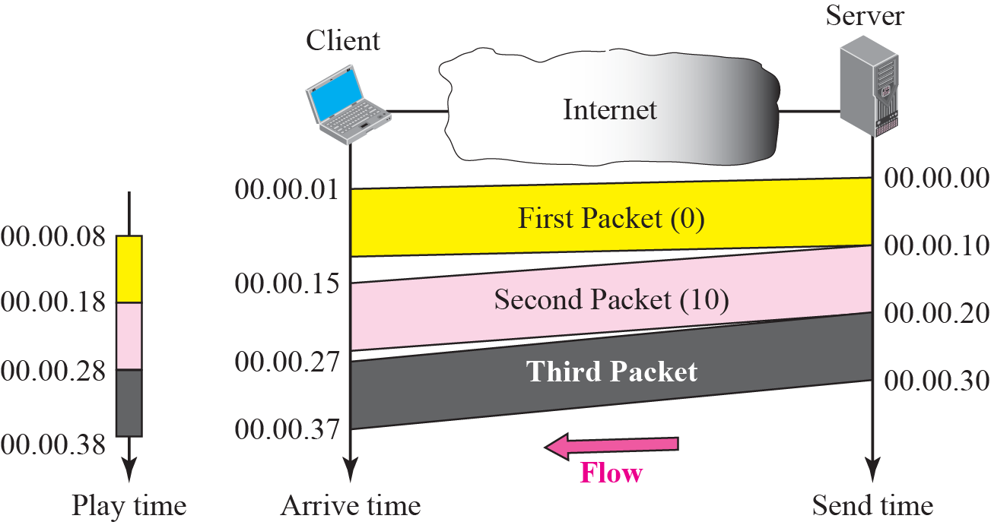
Real-time Audio Video
To prevent jitter, we can timestamp the packets and separate the arrival time from the playback time.

Slide 21
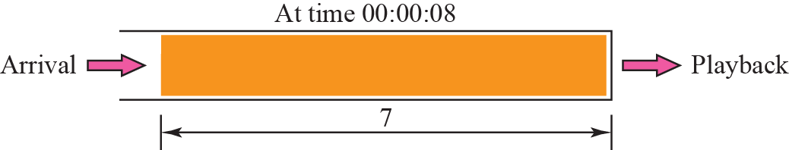
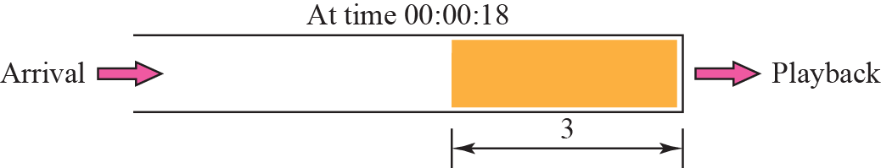
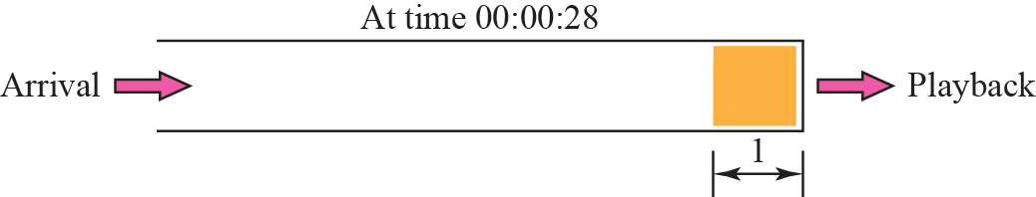
Playback buffer
Real-time traffic requires
Playback buffer
A sequence number to track packet loss
Support for multicasting

Slide 22
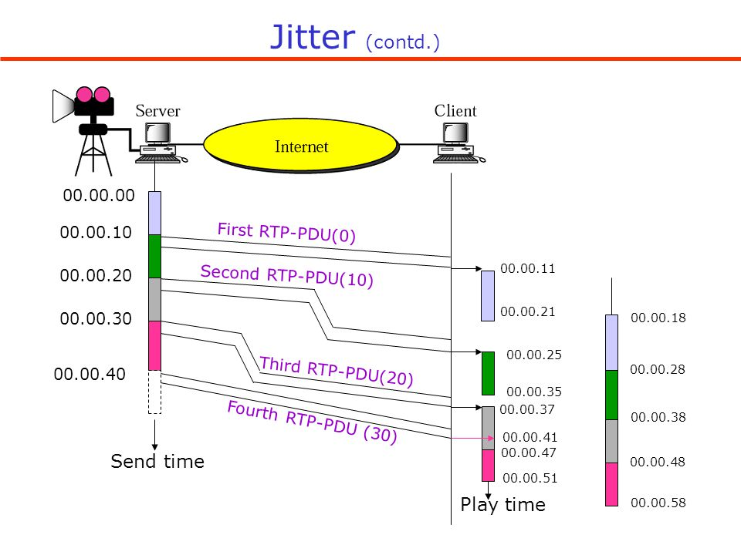

Slide 23
Other services
Translation
changing the encoding of a payload to a lower quality to match the bandwidth of the receiving network.
Mixing
combining several streams of traffic from different sources into one stream.
Such as audio and video

Slide 24
TCP is not suitable interactive streaming media traffic for its
error control mechanism.
No support for timestamping.
No multicasting.
UDP does not have
sequence numbers.
No timestamping.
No support for mixing
New protocols are needed

Slide 25
Popular protocols for serving media
Network transmission control
RTP – Realtime Transmission Protocol
RTCP – Realtime Transmission Control Protocol
Session control
Real-Time Streaming Protocol (RTSP)
Session Description Protocol (SDP) – textual representation of session
VOIP – SIP – Session Initiation Protocol
Signaling for IP Telephony
SAP – Session announcement protocol for multicast sessions

Slide 26
Protocol stack for media streaming
Data Plane
Control Plane
Compressed
Video/Audio
RTP Layer
RTCP Layer
RTSP Layer
UDP
TCP
IPv4, IPv6
Internet
Multimedia Streaming Protocols

Slide 27
Real Time Protocol (RTP)
RTP logically extends UDP
sits between UDP and application
end-to-end transport functions suitable for real-time audio/video applications over multicast and unicast network services
implemented as an application library
RTP uses a temporary even-numbered UDP port
What does it do?
Framing
Multiplexing
Synchronization
Feedback (RTCP)

Slide 28
Real-time Protocol - RTP
RTP is a data transfer protocol and RTCP is a control protocol.
RTP provides services for
Payload type identification: Identify which kind of information is being transmitted, RTP provides 128 possible different types of encoding; eg MPEG2 video, etc.
Sequencing: Reassemble the stream and detect packet loss.
Timestamping: Assure synchronization. Also used for jitter calculation
Source identification: Provide a means for the receiver to distinguish different sources.
RTP does not provide
Quality of service
Reliability in packet delivery
Security

Slide 29

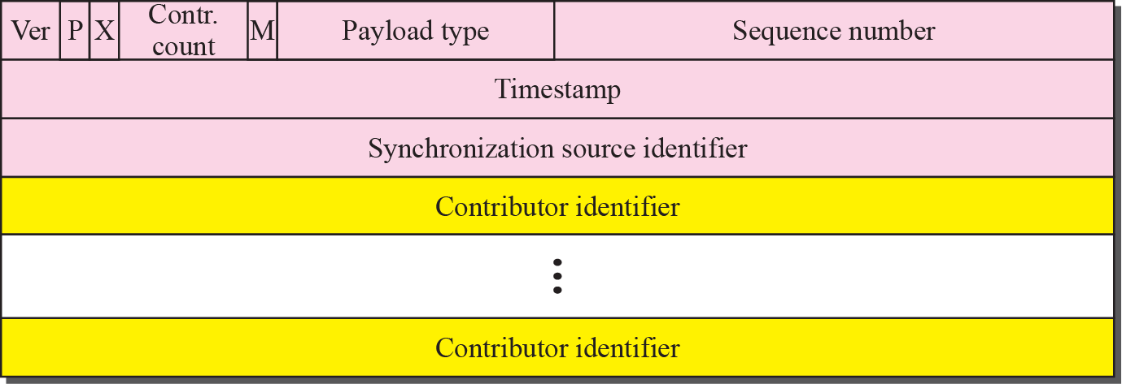
Payload Type: 7 bits, providing 128 possible different types of encoding; eg PCM, MPEG2 video, etc.
Sequence Number: 16 bits; used to detect packet loss
Timestamp: 32 bytes; gives the sampling instant of the first audio/video byte in the packet; used to remove jitter introduced by the network
Synchronization Source identifier (SSRC): 32 bits; an id for the source of a stream; assigned randomly by the source

Slide 30
Timestamp vs. Sequence No
Timestamps relate packets to real time
Timestamp value sampled from a media specific clock
Sequence number relates packets to other packets
Example of silent audio –
Consider audio data type
What is sent during silence?
Not sending anything
Why might this cause problems?
Other side needs to distinguish between loss and silence
Receiver uses timestamps and sequence no. to figure out what happened

Slide 31
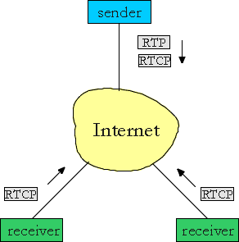
RTP Control Protocol (RTCP)
Used in conjunction with RTP to exchange control information and reports between the sender and the receiver.
Control connection is held over a different channel than the RTP.
Uses an odd-numbered UDP port number that follows the port number selected for RTP.
Reports can be Receiver reception, Sender, and Source description.
Reports contain statistics such as the number of packets sent, number of packets lost, inter-arrival jitter
Multiple RTCP packets can be concatenated by translators/mixers

Slide 32
RTP Control Protocol (RTCP)
RTCP provides
QoS Feedback: In form of sender reports/receiver reports. Senders adjust transmission rate based on reports.
Participant Identification: Human-friendly source identification.
Control Packets Scaling: Typically, limit the RTCP bandwidth to 5% of the session bandwidth, divided between the sender reports (25%) and the receivers reports (75%)
Minimal Session Control Information: Advanced control functions must be implemented in a higher level protocol.
Types of RTCP packets:
Sender report packet,
Receiver report packet,
Source Description RTCP Packet,
Goodbye RTCP Packet and
Application Specific RTCP packets.
RTCP itself does not provide any flow encryption or authentication. SRTCP protocol can be used for that purpose.

Slide 33
Five RTCP packets
SR sender reports
tx and rx statistics from active senders
RR receiver reports
rx statistics from other participants, or from
active senders
SDES source description, e.g. name (including CNAME), email-address, telephone number and address of the owner or controller of the source
BYE explicit leave
APP application specific extensions

Slide 34
RTCP packets
RR packet includes
SSRC of source - identify the source to which this RR block pertains
fraction lost since previous RR (SR) sent (=int(256*lost/expected))
Cumulative # of packets lost -- long term loss
highest seq # received -- compare losses
interarrival jitter smoothed interpacket distortion
LSR time when last SR heard (timestamp from the last sender report received)
DLSR delay since last SR (delay since last sender report received)
SR packet includes
SSRC of sender - identify source of data
NTP timestamp when report was sent
RTP timestamp corresponding RTP time
packet count - total number sent
octet count - total number sent
followed by zero or more receiver report…
example:
RTCP packet
SR
sender
report
receiver
report
receiver
report
SSRC
SSRC
SSRC
source 2
source 3

Slide 35
Calculation of Round-trip delay
D = A-LSR-DLSR

Slide 36
Real Time Streaming Protocol (RTSP)
Supports VCR-like control operations
User controls operations like rewind, fast forward, pause, resume, etc…
Out-of-band protocol (uses two connections, one for control messages (Port 554) and one for media stream)
RFC 2326 permits use of either TCP or UDP for the control messages connection, sometimes called the RTSP Channel
Meta file is communicated to web browser which then launches the Player
Player sets up an RTSP connection for control messages in addition to the connection for the streaming media
Retrieves requested media.
Adds media to an existing session.

Slide 37
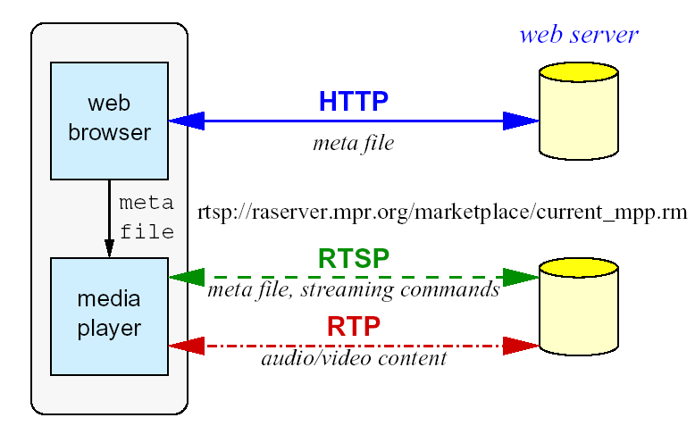
It uses RTP as the underlying data delivery protocol
RTSP is a two-way protocol (in contrast RTP is a one-way protocol) used to send live or stored streams from the server to the client

Slide 38
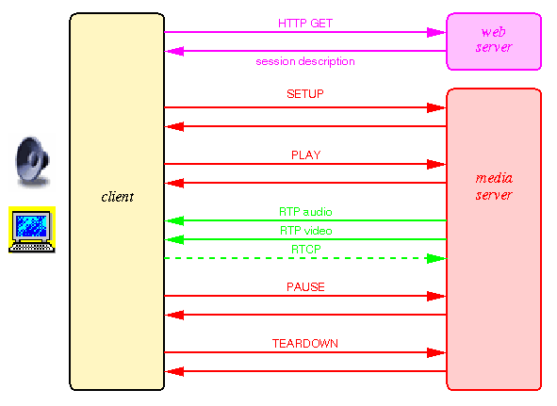

Slide 39
RTSP Protocol design
text-based protocol
transport protocol independent
chooses the optimum delivery channel to the client. For instance, if UDP cannot be used (some corporate firewalls will not pass UDP), the streaming server has to offer a choice of delivery protocols – multicast UDP or TCP to suit different clients.
supports any session description (sdp, xml, etc.)
similar design as HTTP with some differences
e.g. both the client and the server can issue requests during interaction
server maintains a « session state » (HTTP is a stateless protocol)
data carried out-of-band
works either with unicast or multicast

Slide 40
RTSP Methods
Major methods
SETUP: server allocates resources for a stream and starts an RTSP session
PLAY: starts data tx on a stream
PAUSE: temporarily halts a stream
TEARDOWN: free resources of the stream, no RTSP session on server any more
Additional methods
OPTIONS: get available methods
ANNOUNCE: change description of media object
DESCRIBE: get low level description of media object
RECORD: server starts recording a stream
REDIRECT: redirect client to new server
SET_PARAMETER: device or encoding control

Slide 41
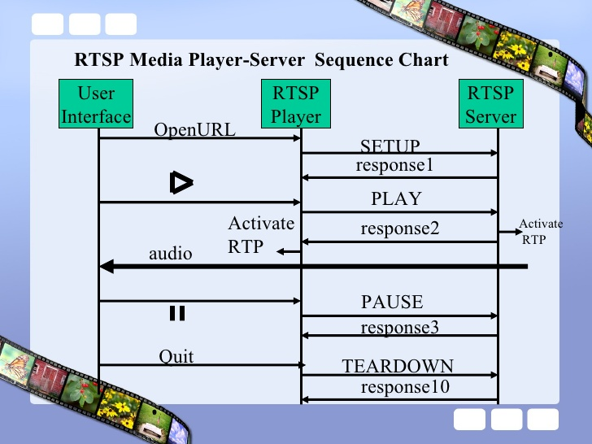
RTSP Media Server Sequence Diagram

Slide 42
Session Description Protocol (SDP)
Text format for describing multimedia sessions
Not really a protocol (similar to markup language like HTML)
Can be carried in any protocol, e.g., RTSP or SIP
Describes unicast and multicast sessions
There are five terms related to multimedia session description:
Conference: set of two or more communicating users along with the software they are using.
Session : multimedia sender and receiver and the flowing stream of data.
Session Announcement: a mechanism by which a session description is conveyed to users in a proactive fashion
Session Advertisement : same as session announcement
Session Description : A well defined format for conveying sufficient information to discover and participate in a multimedia session.

Slide 43
Voice over IP (VoIP)
Internet telephony - Requirements
ability of one party to signal to other party to initiate a new call
association between a number of participants
name translations and user location
mapping between names of different levels of abstraction
E.g. email address to IP address of host
feature negotiation
group of end systems must agree on what media to exchange and their respective parameters
E.g. different encodings, rates
call Participant Management
invite participants to existing call, transfer call and hold other users
Feature change
adjust composition of media sessions during the course of call
add or reduce functionality
impose or remove constraints due to addition or removal of participants

Slide 44
Two signaling protocols:
SIP (IETF Standard) - Simple, cheap. Limited, but popular
H.323 (ITU Standard) - set of protocols

Slide 45
SIP (Session Initiation Protocol)
Goal: inviting new participants to call
Client-Server protocol at the application layer
SIP requests can traverse many proxy servers
Server may act as redirect server
Proxies or redirect servers cannot accept/reject requests, only user agent server can
Requests/Responses are textual

Slide 46
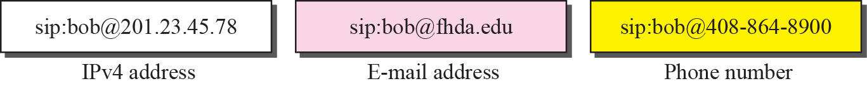
SIP (Session Initiation Protocol)
Calls have unique call ID (carried in Call-ID header field of SIP message)
created by the caller and used by all participants
SIP chooses email-like identifier
user@domain
user@host
user@IPaddress
phone-number@gateway

Slide 47
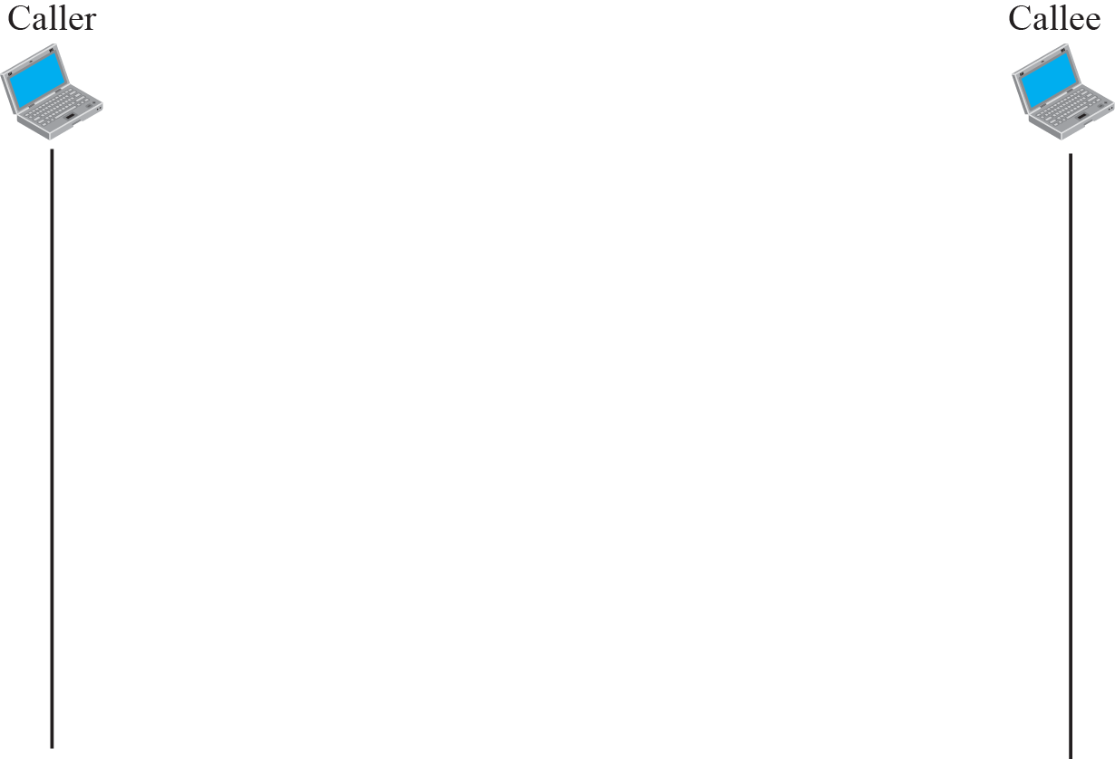
A Simple Session of SIP

Slide 48
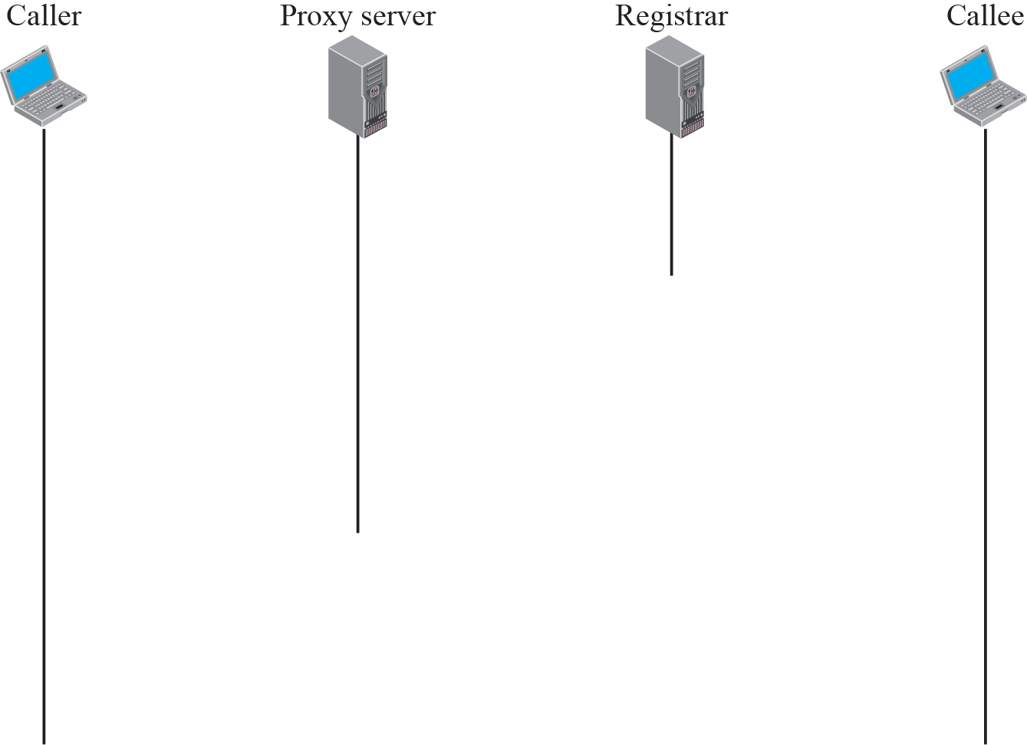
Tracking the callee

Slide 49
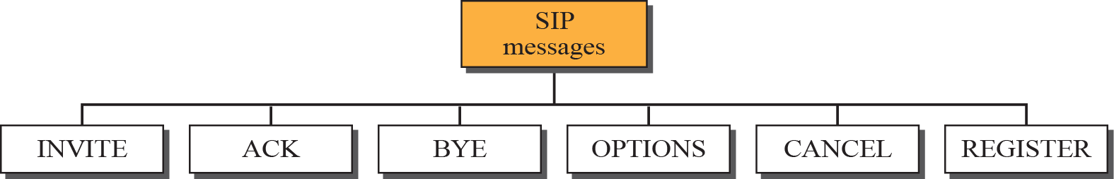
INVITE—Indicates a user is being invited to participate in a call session.
ACK—Confirms that the user has received a final response to an INVITE request.
BYE—Terminates a call and can be sent by either the caller or the callee.
CANCEL—Cancels any pending searches but does not terminate a call that has already been accepted.
OPTIONS—Queries the capabilities of servers.
REGISTER—Registers the address listed in the To header field with a SIP server.

Slide 50
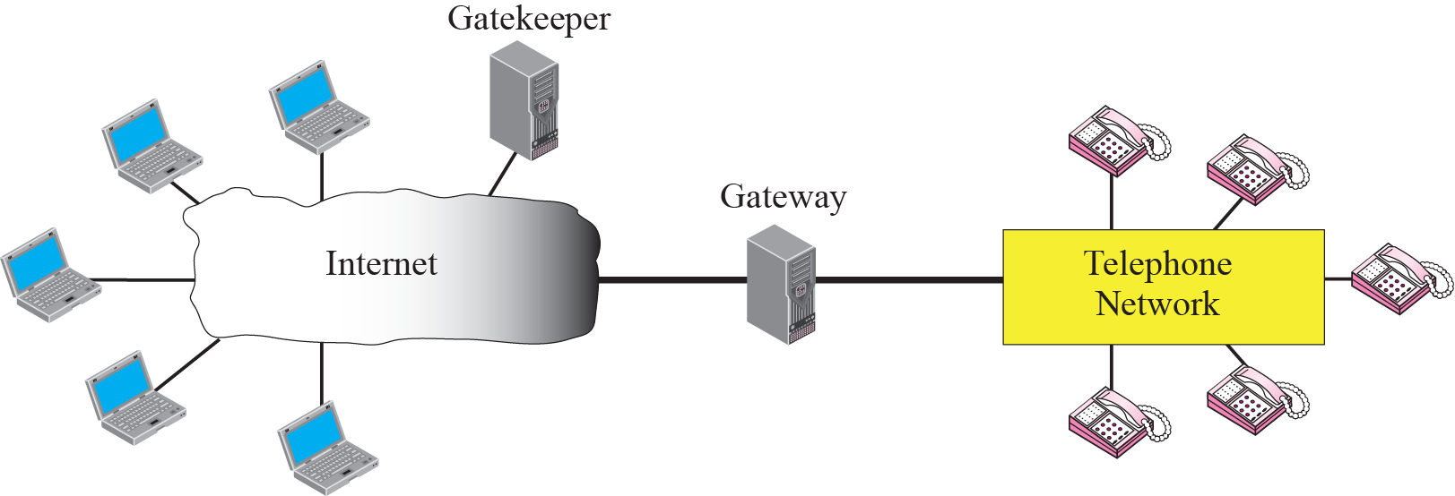
H.323 Architecture

Slide 51
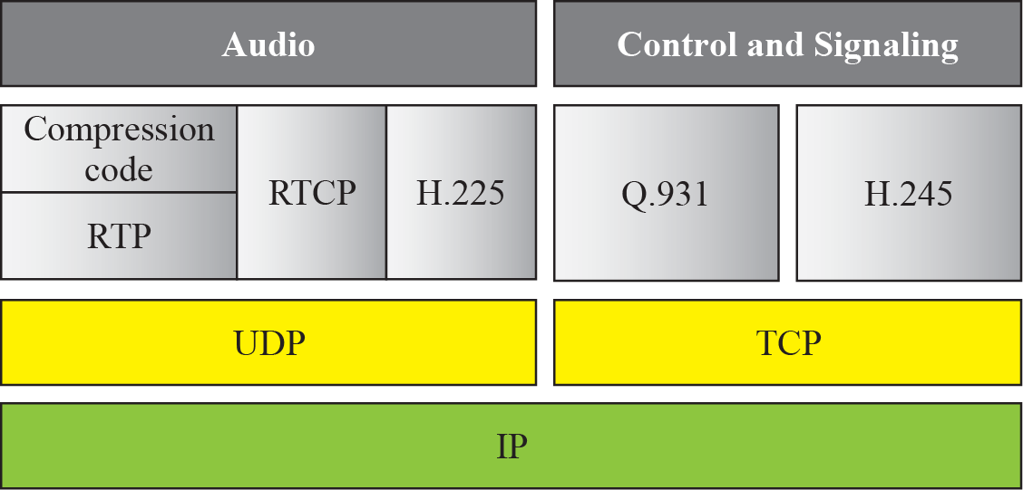
H.323 Protocol Stack

Slide 52
H.323 uses a logical channel on the LAN
RAS (Registration, admission and status) – H.225
Gatekeeper Discovery
Endpoint registration
Call management
Admission procedures
and several more

Slide 53
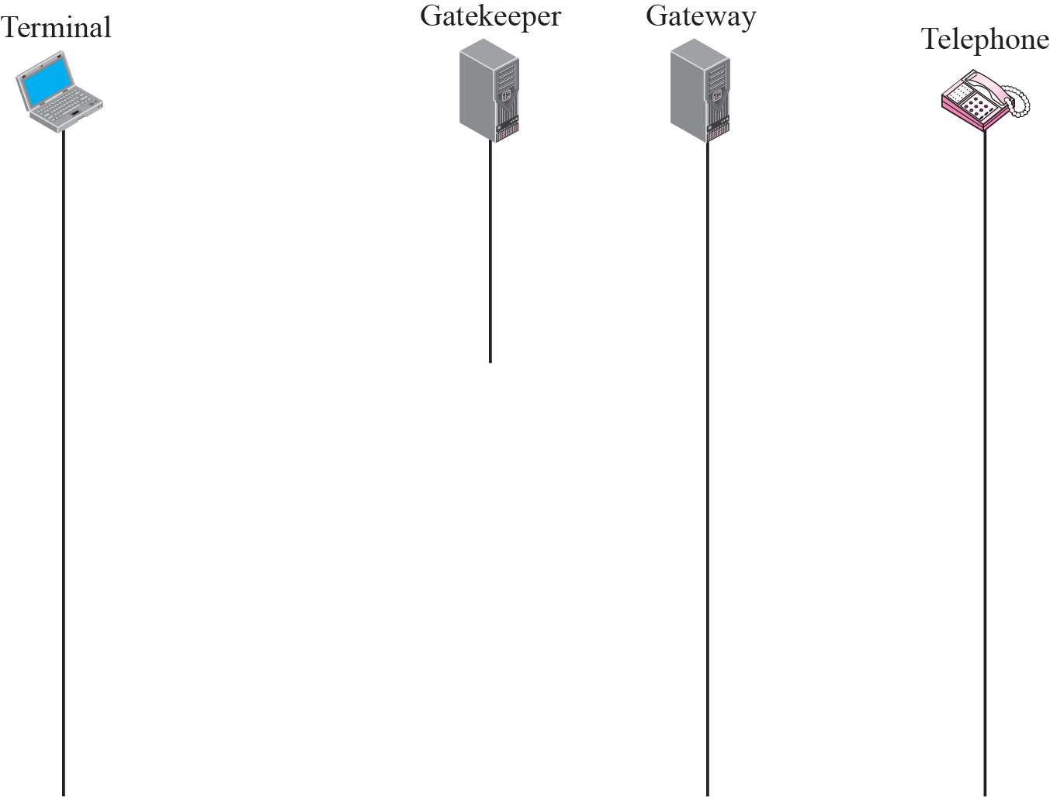


Slide 54
The terminal sends a broadcast message to gatekeeper. The gatekeeper responds with its IP address
The terminal and gatekeeper communicate, using H.225 to negotiate bandwidth.
The terminal, the gatekeeper, gateway and the telephone communicate using Q.931 to set up a connection.
The terminal, the gatekeeper, gateway and the telephone communicate using H.245 to negotiate the compression method.
The terminal, gateway and the telephone exchange audio using RTP under the control of RTCP.
The terminal, the gatekeeper, gateway and the telephone communicate using Q.931 to terminate a connection.

