Slide 1
Pattern Recognition:
Clustering
For BCSE Final Year
Jadavpur University

Slide 2
Pattern Classification by Distance Functions
The method of pattern classification by distance functions can be expected to yield practical and satisfactory results only when the pattern classes tend to have clustering properties

Slide 3
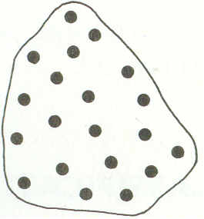
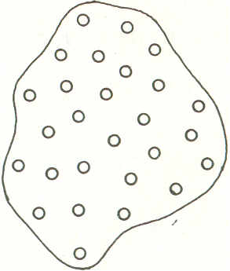
Contd..
x
Figure 1. Patterns classifiable by
proximity concept

Slide 4
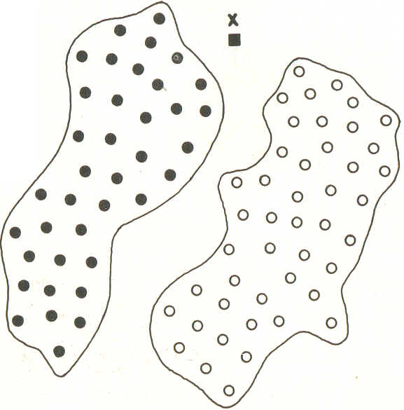
Contd..
Figure 2. Patterns not easily classifiable
by proximity concept

Slide 5
Contd..
Unlike Fig. 2, in Fig. 1, the patterns of each class tend to cluster tightly about a typical or representative pattern for the class. This occurs in case where pattern variability and other corruptive influences are well behaved.
A typical example is the problem of reading bank checks by machine.

Slide 6
Contd..
Here the proximity of an unknown pattern to the patterns of a class will serve as a measure for its classification, so the method is called minimum-distance pattern classification. And the system which does this is called minimum-distance classifiers.
x

Slide 7
Single Prototypes
In this case, the patterns of each class tend to cluster tightly about a typical or representative pattern for that class. Under these conditions, minimum-distance classifiers can constitute a very effective approach to the classification problem.

Slide 8
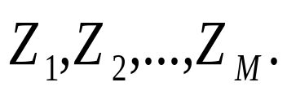
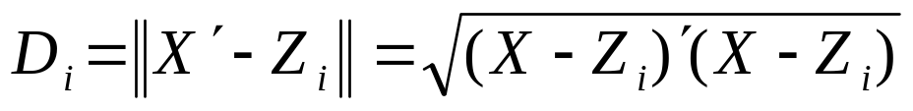
Contd..
Consider M pattern classes and assume that these classes are representable by prototype patterns
The Euclidean distance between an arbitrary pattern vector x and the ith prototype is given by,
………………….(1)

Slide 9
Contd..
A minimum-distance classifier computes the distance from a pattern x of unknown classification to the prototype of each class, and assigns the pattern to the class to which it is closest.

Slide 10
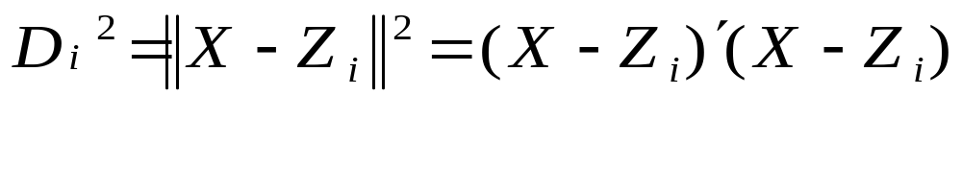
Contd..
In other words, x is assigned to class ω_{ι} if D_{i} < D_{j} for all i≠j. Ties are resolved arbitrarily.
Equation (1) may be expressed as

Slide 11
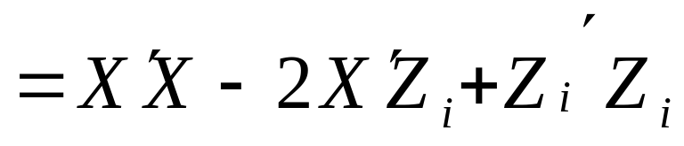
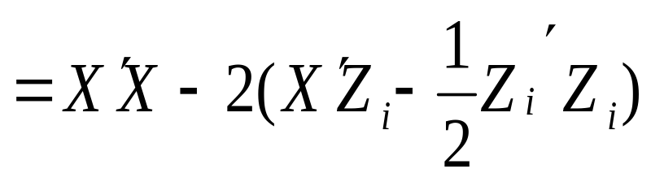
Contd..

Slide 12
Contd..
Choosing the minimum D_{i}² is equivalent to choosing the minimum D_{i} since all distances are positive, since the term X^{t}X is independent of i, choosing the minimum D_{t}² is equivalent to choosing the maximum (X^{t}Z_{i} – 1/2xZ_{i}^{t}Z_{i}) Consequently, we may define the decision functions..

Slide 13
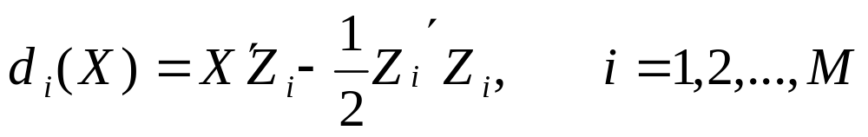
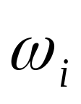
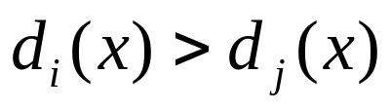
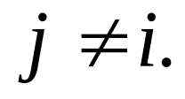
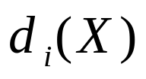
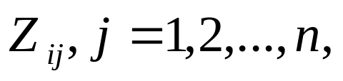
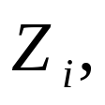
Contd..
……….(2)
where x is assigned to class
, if
for all
Observe that is a linear decision function; that is, if are the components of and we let..

Slide 14
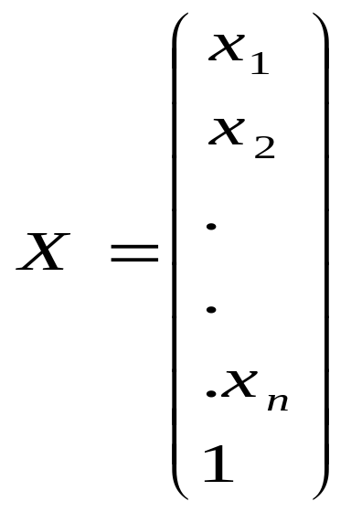
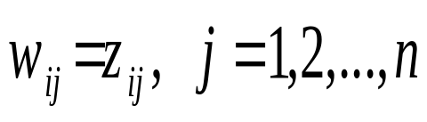
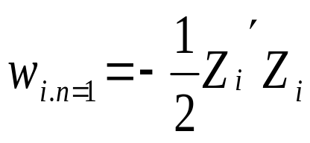
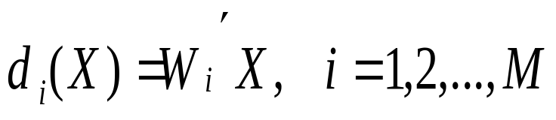
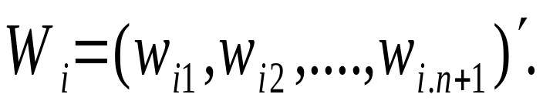
Contd..
and
then we may express Eq. (2) in the familiar
linear form
where

Slide 15
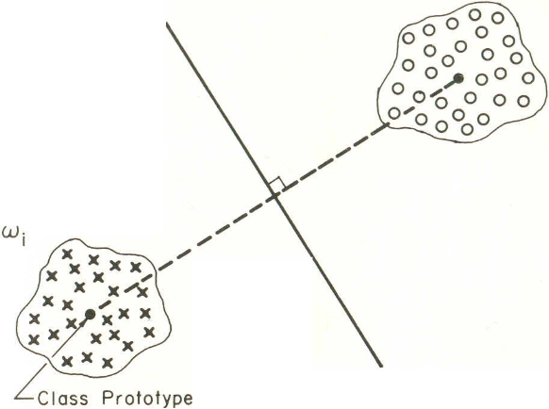
Contd..
The decision boundary of a two-class example in which each class is characterized by a single prototype is shown below.
Figure 3. Decision boundary of two classes
characterized by single prototype

Slide 16
Contd..
It can be shown that the linear decision surface separating every pair of prototype points z_{i} and z_{j} is the hyperplane which is the perpendicular bisector of the line segment joining the two points. Thus the minimum-distance-classifiers are a special case of linear classifiers.

Slide 17


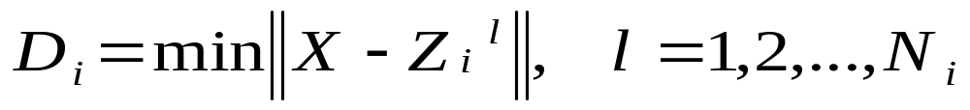
Multiprototypes
Here each class is characterized by several prototypes, that is, each pattern of class ω_{i} tends to cluster about one of the prototypes
where is the number of prototypes in the i_{th} pattern class.
Let the distance function between an arbitrary pattern x and class ω_{i} be denoted by

Slide 18
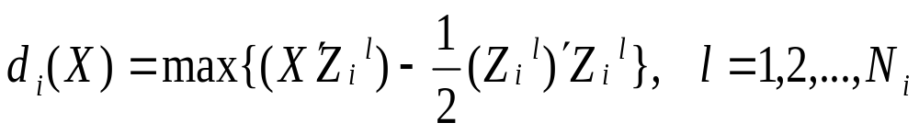
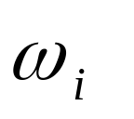


Contd..
Following the development for single prototype, the decision functions
where, as before, x is placed in class
,if
for all
The decision boundaries for a two-class case
in which each class contains two prototypes
are shown in the next slide.

Slide 19
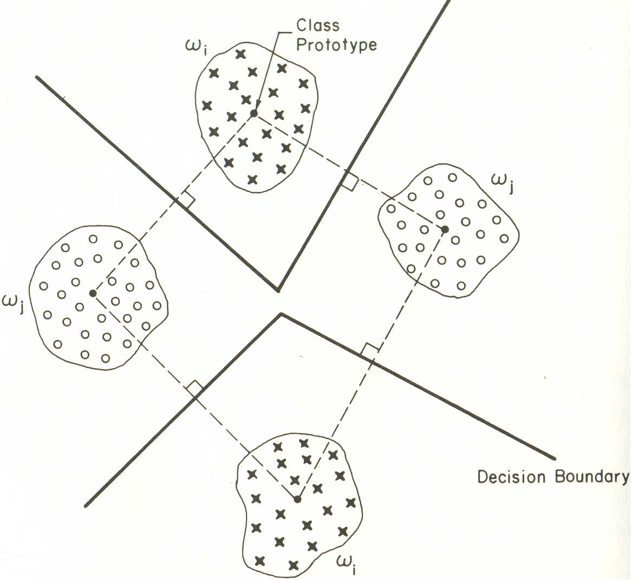
Contd..
Figure 2. Piecewise-linear decision boundaries
for two classes, each of which is characterized
by two prototypes

Slide 20
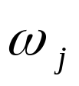
Contd..
Note that the boundaries between classes
and are piecewise linear. Since we could have defined this as a single-prototype, four-class problem, the sections of the boundaries are the perpendicular bisectors of the lines joining the prototypes of different classes.

Slide 21
Contd..
Although general iterative algorithms exist which can be used in the calculation of linear decision function parameters, unfortunately, no truly general algorithm is yet known for the piecewise-linear classifier decision function.

Slide 22
Cluster Seeking
It is evident that the ability to determine characteristic prototypes or cluster centers in a given set of data plays a central role in the design of pattern classifiers based on the minimum­-distance concept. So we need to study various cluster-seeking methods.

Slide 23
Contd..
Note that the performance of a given algorithm is not only dependent on the type of data being analyzed, but is also strongly influenced by the chosen measure of pattern similarity

Slide 24
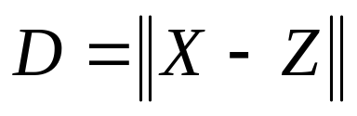
Measures of Similarity
To define a data cluster, it is necessary to first define a measure of similarity which will establish a rule for assigning patterns to the domain of a particular cluster center. Earlier we considered the Euclidean distance between two patterns x and z:
as a measure of their similarity----the smaller
the distance, the greater the similarity.

Slide 25
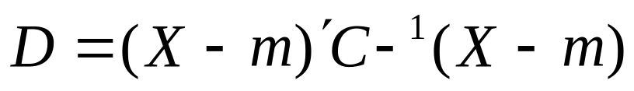
Contd..
There are, however, other meaningful distance measures which are sometimes useful. For example, the Mahalanobis distance from x to m.
………………(1)

Slide 26
Contd..
It is a useful measure of similarity when statistical properties are being ex­plicitly considered. Here C is the covariance matrix of a pattern population, m is the mean vector, and x represents a variable pattern.

Slide 27
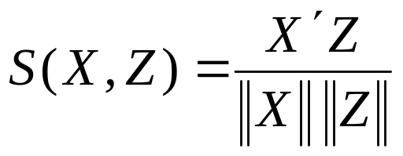
Contd..
Measures of similarity need not be restricted to distance measures. For example, the non-metric similarity function:
………………….(2)
which is the cosine of the angle between
the vectors x and z, is maximum when
x and z are oriented in the same direction
with respect to the origin.

Slide 28
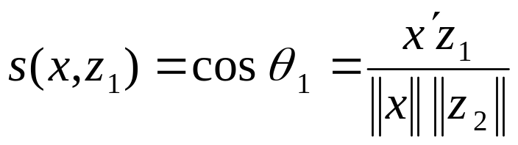
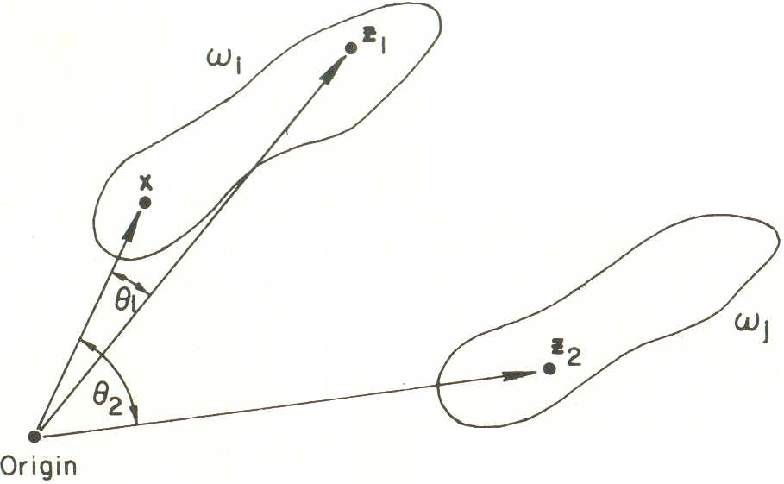
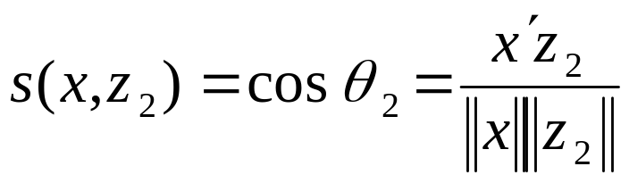
Contd..
This measure of similarity is useful when cluster regions tend to develop along principal axes, as shown below.
Figure 4. Illustration of a similarity measure

Slide 29
Contd..
Here the use of this similarity measure is governed by certain qualifications, such as sufficient separation of cluster regions with respect to each other as well as with respect to the coordinate system origin.

Slide 30
Contd..
When the patterns under consideration are binary valued with 0, 1 elements, the similarity function of Eq. (2) may be given an interesting non­-geometrical interpretation.

Slide 31
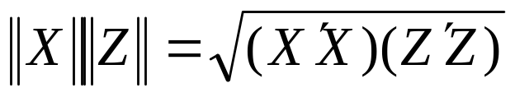
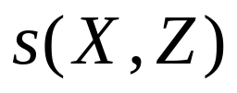
Contd..
We say that a binary pattern x possesses the i_{th} attribute if x Then the term X^{t}Z in Eq. (2) is simply the number of attributes shared by x and z, while is the geometric mean of the number of attributes possessed by x and the number possessed by z. In this case the similarity function is, therefore, seen to be a measure of common attributes possessed by the binary vectors x and z.

Slide 32
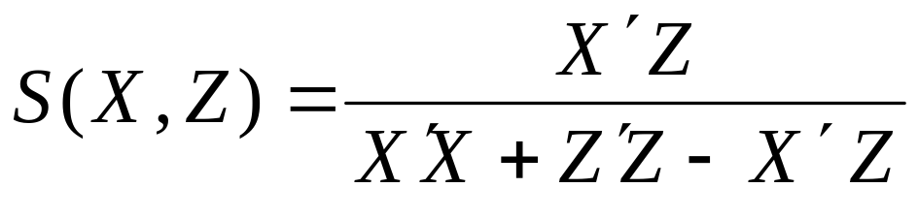
Contd..
A binary variation of Eq. (2) which has been widely used in informa­tion retrieval, nosology (classification of diseases), and taxonomy (classifica­tion of plants and animals) is the so-called Tanimoto measure, which is given by

Slide 33
Clustering Criteria
After a measure of pattern similarity has been adopted, we are still faced with the problem of specifying a procedure for partitioning the given data into cluster domains.

Slide 34
Contd..
The clustering criterion used may represent a heuristic scheme, or it may be based on the minimization (or maximization) of a certain performance index. The heuristic approach is guided by intuition and experience.

Slide 35
Contd..
The Euclidean distance is generally used as measure of proximity. A suitable threshold is also necessary in order to define degrees of acceptable similarity in the cluster-seeking process.

Slide 36
Contd..
The performance-index (sometimes called objective function) approach is guided by the development of a proce­dure which will minimize or maximize the chosen performance index. One of the most often used indices is the sum of the squared errors index, given by..

Slide 37
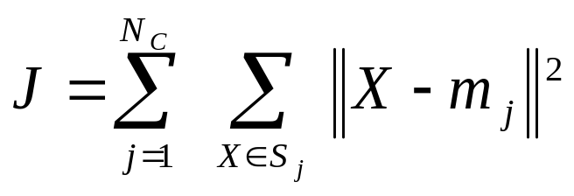
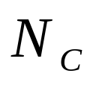
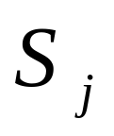
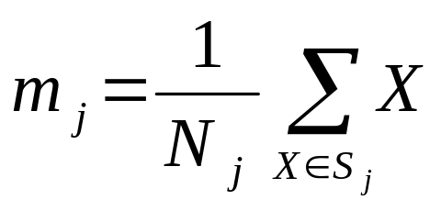

Contd..
where is the number of clusters, is the set of samples belonging to the jth cluster, and
is the sample mean vector of set

Slide 38
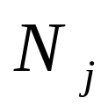

Contd..
represents the number of samples in S_{j.} The index represents the overall sum of the squared errors between the samples of a cluster domain and their corresponding mean. The K-means clustering algorithm is based on this performance index.
.

Slide 39
Contd..
Other common performance indices are :
the average squared dis­tances between samples in a cluster domain
the average squared distances between samples in different cluster domains
indices based on the scatter matrix concept,
minimum and maximum-variance indices
a score of other performance measures which have been used throughout the years.

Slide 40
Contd..
It is not uncommon to find a cluster-seeking algorithm that represents a combination of the heuristic and performance index approaches. The Isodata clustering algorithm is such a combination.

Slide 41

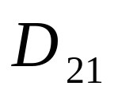
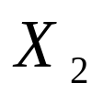
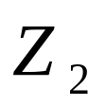
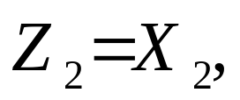


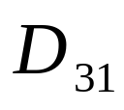
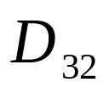


A Simple Cluster-Seeking Algorithm
Suppose that we have a set of N sample patterns Let the first cluster center Z₁=X₁(or any other pattern) and select an arbitrary nonnegative threshold T.
Next, we compute the distance from to
If this distance exceeds T, a new cluster center, is started. Otherwise, we assign
to the domain of cluster center .Suppose that so that is established. In the next step, the distances and from to and are computed.
.

Slide 42

Contd..
If both and are greater than T, a new cluster center, is created. Otherwise, we assign to the domain of the cluster center to which it is closest. This process is repeated for all patterns.

Slide 43
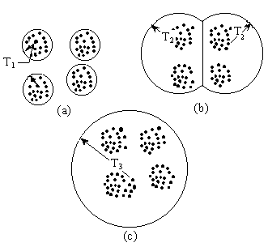
Contd..
Figure 5. Effect of threshold in clustering

Slide 44
Contd..
The results of the foregoing procedure
depend on
the first cluster center chosen,
the order in which the patterns are considered,
the value of T, and,
the geometrical properties of the data.

Slide 45
Contd..
Some intuitive idea for choosing a suitable
value of T may be based on
MST of data points
Intra-cluster distance
Inter-cluster distance
The closest and farthest points in cluster from the cluster center and
the variance of these cluster domains

Slide 46
Contd..
This procedure may be expected to yield useful results in situations where the data exhibit characteristic "pockets" which are reasonably well separated with respect to the chosen values of the threshold.

Slide 47
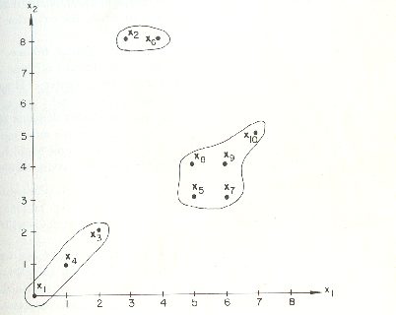
Maximin-Distance Algorithm
The maximum-distance algorithm is another simple heuristic procedure based on the Euclidean distance concept. Consider the ten two-dimensional samples shown in the Figure below.

Slide 48
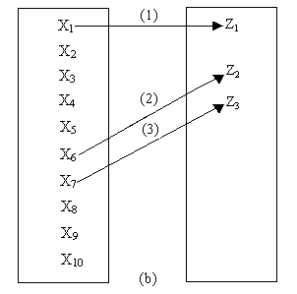
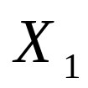

Contd..
The table is initially empty. Then, in the first step,
we arbitrarily let
become the first cluster
center, designated by
.

Slide 49


Contd..
Next, we determine the farthest sample from , which in this case is , and call it cluster center
In the third step we compute the distance from each remaining sample to and . For every pair of these computa­tions we save the minimum distance. Then, we select the maximum of these minimum distances. If this distance is an appreciable fraction (say, at least half or more), of the distance between cluster centers and we call the corresponding sample cluster center. Otherwise the algorithm is terminated.
,

Slide 50





K-means Algorithm
Clustering is an unsupervised technique used in discovering inherent structure present in the set of patterns. In fact, clustering techniques aim to extract the groups present in a given data set and each such group is termed as a cluster.
Let the set of patterns be
where is the pattern vector, is the total number of patterns and is the dimensionality of the feature space.

Slide 51








Contd..
Let the number of clusters be If the clusters are represented by then we assume
.
P1.
for
P2.
for
and
P3.
where
represents null set.

Slide 52
Contd..
Clustering techniques may broadly be divided into two categories: Hierarchical and non-hierarchical. The non-hierarchical or partitional clustering problem deals with obtaining an optimal partition of into subsets such that some clustering criterion is satisfied.

Slide 53
Contd..
Among the partitional clustering techniques, the -Means algorithm has been one of the most widely used algorithms. Here the value of K needs to be known a priori. The principle used for clustering by K-means algorithm is to minimize the sum of intraclass distances to get the optimal clusters. Mathematically this principle has been stated below.

Slide 54






Contd..
Let
be a set of
clusters of
2.Let
for
where
.
represents the number of points in

Slide 55


Contd..
3.Let
is referred as the objective
function of the clustering
4. Minimize
over all such
where
satisfy P1, P2 and P3 stated earlier.

Slide 56




Contd..
All possible clusterings of are to be considered to get the optimal So obtaining the exact solution of the problem is theoretically possible, yet not feasible in practice due to limitations of computer storage and time. One requires the evaluation of
partitions if exhaustive enumeration is used to solve the problem, where

Slide 57

This clearly indicates that exhaustive enumeration cannot lead to the required solution for most practical problems in reasonable computation time. For example, for the crude-oil data, the exact solution requires the examination of
partitions.

Slide 58
Contd..
Thus, approximate heuristic techniques seeking a compromise or looking for an acceptable solution have usually been adopted. One such method is the Forgy's K-means algorithm.

Slide 59




Algorithm K-means
Step 1 : Select an initial cluster configuration.
Repeat
Step 2 : Calculate cluster centers
of the existing groups.
Step 3 : Redistribute patterns among clusters utilizing the minimum squared Euclidean distance classifier concept :
if
Until (there is no change in cluster centers)
End

Slide 60
Contd..
The behavior of the K-means algorithm is influenced by
the number of cluster centers specified,
the choice of initial cluster centers,
the order in which the samples are taken, and,
the geometrical properties of the data.

Slide 61
Contd..
Although no general proof of convergence exists for this algorithm, it can be expected to yield acceptable results when the data exhibit char­acteristic pockets which are relatively far from each other.

Slide 62



Isodata Algorithm
The Isodata (Iterative Self-Organizing Data Analysis) is similar in principle to the K-means procedure in the sense that cluster centers are iteratively determined sample means. Unlike the latter algorithm, however, Isodata represents a fairly comprehensive set of additional heuristic procedures which have been incorporated into an interactive scheme.
Before executing the algorithm it is necessary to specify a set of initial cluster centers
For a set of N samples, Isodata consists of the following steps..

Slide 63






Contd..
Step 1. Specify the following process parameters:
= number of cluster centers desired;
= a parameter against which the number of samples in a cluster domain is compared;
= standard deviation parameter;
= lumping parameter;
= maximum number of pairs of cluster centers which can be lumped;
= number of iterations allowed.

Slide 64




Contd..
Step 2. Distribute the N samples among the present cluster centers, using the relation
for all x in the sample set. In this notation,
represents the subset of samples assigned to cluster center
Step 3. Discard sample subsets with fewer than members; that is, if for any discard and reduce by 1.

Slide 65





Contd..
Step 4. Update each cluster center by
setting it equal to the sample mean of its corresponding set ; that is,
where is the number of samples in
Step 5. Compute the average distance of samples in cluster domain from their corresponding cluster center, using the relation

Slide 66

Contd..
Step 6. Compute the overall average distance of the samples from their respective cluster centers, using the relation

Slide 67



Contd..
Step 7.
(a) If this is the last iteration, set and go to Step 11.
(b) If go to Step 8.
(c) If this is an even-numbered iteration, or if go to Step 11; otherwise, continue

Slide 68








Contd..
Step 8. Find the standard deviation vector
for each sample subset, using the relation
where n is the sample dimensionality, is the ith component of the kth sample in is the ith component of and is the number of samples in Each component of represents the standard deviation of the samples in along a principal coordinate axis.

Slide 69







Contd..
Step 9. Find the maximum component of each
and denote it by .
Step 10. If for any we have and
(a) and or
(b)
.

Slide 70










Contd..
then split into two new cluster centers and , delete and increase by 1.
Cluster center is formed by adding a given quantity to the component of which corresponds to the maximum component of
is formed by subtracting from the same component of . One way of specifying is to let it be equal to some fraction of that is,
,
where

Slide 71
Contd..
The basic requirement in choosing y_{j} is that it be sufficient to provide a detectable difference in the distance from an arbitrary sample to the two new cluster centers, but not so large as to change the overall cluster domain arrangement appreciably.
If splitting took place in this step, go to Step 2; otherwise continue.

Slide 72

Contd..
Step 11. Compute the pairwise distances
between all cluster centers :

Slide 73


Contd..
Step 12. Compare the distances against the parameter . Arrange the L smallest distances which are less than in ascending order:
where and L is the maximum number of pairs of cluster centers which can be lumped together. The lumping process is discussed in the next step.

Slide 74





Contd..
Step 13. With each distance there is associated a pair of cluster centers and Starting with the smallest of these distances, perform a pairwise lumping operation according to the following rule :
For if neither nor has been used in lumping in this iteration, merge these two cluster centers using the following relation:
Delete and and reduce by 1.

Slide 75
Contd..
It is noted that only pairwise lumping is allowed and that a lumped cluster center is obtained by weighting each old cluster center by the number of samples in its domain. Experimental evidence indicates that more complex lumping can produce unsatisfactory results. The above procedure makes the lumped cluster centers representative of the true average point of the combined subsets. It is also important to note that, since a cluster center can be lumped only once, this step will not always result in L lumped centers.

Slide 76
Contd..
Step 14. If this is the last iteration, the algorithm terminates. Otherwise go to Step 1 if any of the process parameters requires changing at the user's discretion, or go to Step 2 if the parameters are to remain the same for the next iteration. An iteration is counted every time the procedure returns to Step 1 or 2.

Slide 77



Example
Example: Let the patterns be {(0,0), (1,1), (2,2), (4,3), (4,4), (5,3), (5,4), (6,5)}
In this case and . Suppose that we initially let and specify the following parameters:
Step 1.

Slide 78



Contd..
If no a priori information on the data being analyzed is available, these parameters are arbitrarily chosen and then adjusted during successive itera­tions through the algorithm.
Step 2. Since there is only one cluster center,
and
Step 3. Since
no subsets are discarded.

Slide 79



Contd..
Step 4. Update the cluster centers
Step 5. Compute

Slide 80





Contd..
Step 6. Compute in this case
,
:
Step 7. Since this is not the last iteration and
Go to step 8.
Step 8. Find the standard deviation vector for

Slide 81







Contd..
Step 9. The maximum component of is 1.99 ; hence,
Step 10. Since and we split into two new clusters. Following the procedure described in Step 10, suppose that we let Then,

Slide 82





Contd..
For convenience these two cluster centers are renamed and respectively. Also, is increased by 1. Go to Step 2.
Step 2. The sample sets are now
and
Step 3. Since both and are greater than , no subsets are discarded.

Slide 83



Contd..
Step 4. Update the cluster centers :
Step 5. Compute

Slide 84

Contd..
Step 6. Compute :
Step 7. Since this is an even-numbered
iteration, condition (c) of Step 7 is satisfied.
Therefore, go to Step 11.

Slide 85




Contd..
Step 11. Compute the pairwise distances:
Step 12. Compare to In this case,
Step 13. From the results of Step 12, we see that no lumping of cluster centers can take place.
Step 14. Since this is not the last iteration, we are faced with the decision of whether or not to make an alteration in the parameters. Since, in this simple example,

Slide 86
Contd..
we have obtained the desired number of clusters,
their separation is greater than the average spread indicated by the standard deviations, and
each cluster subset contains a significant percentage of the total number of samples, we arrive at the conclusion that the cluster centers are representative of the data. Therefore, we return to Step 2.

Slide 87



Contd..
Steps 2-6 : yield the same results as in the previous iteration
Step 7. None of the conditions in this step is satisfied. Therefore, we proceed to Step 8.
Step 8. Compute the standard deviation of sets
and

Slide 88



Contd..
Step 9. In this case and
Step 10. The conditions for splitting are not satisfied. Therefore, we proceed to Step 11.
Step 11. We obtain the same result as in the previous iteration:
Step 12. We obtain the same result as in the
Previous iteration.

Slide 89

Contd..
Step 13. We obtain the same result as in the previous iteration.
Step 14. Nothing new has been added in this iteration, except the com­putation of the standard deviation vectors. Therefore, we return to Step 2.
Steps 2—6. yield the same results as in the previous iteration.
Step 7. Since this is the last iteration, we set and go to Step ll.

Slide 90
Contd..
Step 11. as before.
Step 12. We obtain the same result as in the previous iteration.
Step 13. From the results of Step 12, we see that no lumping can take place.
Step 14. Since this is the last iteration, the algorithm is terminated

Slide 91
Contd..
It should be clear, even from the above simple example, that the applica­tion of Isodata to a set of moderately complex data requires, in general, extensive experimentation before one can arrive at meaningful conclusions. However, by properly organizing the information obtained in each iteration, it is possible to gain considerable insight into the structure of the data.

Slide 92
Evaluation of Clustering Results
The principal difficulty in evaluating the results of clustering algorithms is inability to visualize the geometrical properties of a high-dimensional space.
Several interpretation techniques exist which allow at least partial insight into the geometrical properties of the resulting cluster domains.

Slide 93
Contd..
A very useful interpretation tool is the distance between cluster centers This information is best presented in the form of a table.

Slide 94









Contd..
Cluster Center
Table 1. Distance Table for Interpreting
Clustering Results

Slide 95
Contd..
Cluster center is far removed from the other cluster centers. If it is known that this cluster center is associated with numerous samples, we would accept it as a valid description of the data, otherwise we might dismiss this cluster center as representative of noise samples.

Slide 96
Contd..
If two cluster centers are relatively close, and one of the centers is associated with a much larger number of samples, it is often possible to merge the two cluster domains. The variances of a cluster domain about its mean can be used to infer the relative distribution of the samples in the domain.

Slide 97










Contd..
Cluster Domains | Variances
S₄
Table 2. Variance Table for Interpreting Clustering Results

Slide 98
Contd..
It is assumed that each variance component is along the direction of one of the coordinate axes.
Note :
Since domain S₁ has very similar variances, it can be expected to be roughly spherical in nature.
Cluster domain S₅ on the other hand, is significantly elongated about the third coordinate axis. A similar analysis can be carried out for the other domains.

Slide 99
Contd..
This information, coupled with the distance table and sample numbers, can be of significant value in interpreting clustering results.

Slide 100
Graph-Theoretic Approach
Till now, the clusters are determined in such a way that the intraset distance among each cluster is kept to a minimum, and the interset distances between two clusters are made as large as possible.

Slide 101
Contd..
An alternative approach to cluster seeking is to make use of some basic notion in graph theory. In this approach, a pattern graph is first constructed from the given sample patterns, which form the nodes of the graph. A node j is connected to a node k by an edge, if the patterns corresponding to these two nodes are similar or are related.

Slide 102



Pattern and pattern are said to be similar if the similarity measure is greater than a pre-specified threshold T. The similarity measure may be used to generate a similarity matrix S, whose elements are 0 or 1. The similarity matrix provides a systematic way to construct the pattern graph. Since cliques of a pattern graph form the clusters of the patterns, cluster seeking can be accomplished by detecting the cliques of the pattern graph.

Slide 103
Contd..
Several clique detection algorithms and programs have been introduced in the literature. Several such methods exist that utilize the MST of the data points to get the clustering.

Slide 104
Thank You

